Slide 1
Capstone Project Loan Default Report
Rufen Yang
2023.05.01

Slide 2
Agenda
Intrduction
EDA
Data enginnering
Model & Results
Future work

Slide 3
Introduction
we aim to understand the borrower’s profile, and build a model to predict whether a given loan would be charged off to make the investors make decisions and minimize the future loan defaults
Outcome:
Accuracy +30%
Saving per year $500+M

Slide 4
Loan Dataset describe
1827125 records
145 columns
133526 charged-off loans, 7.3% of the total
58 Attributs with missing rate > 50%
31 Attributes would have been available to investors before making decisions
17 Attibutes with no records

Slide 5
EDA Insight

Slide 6
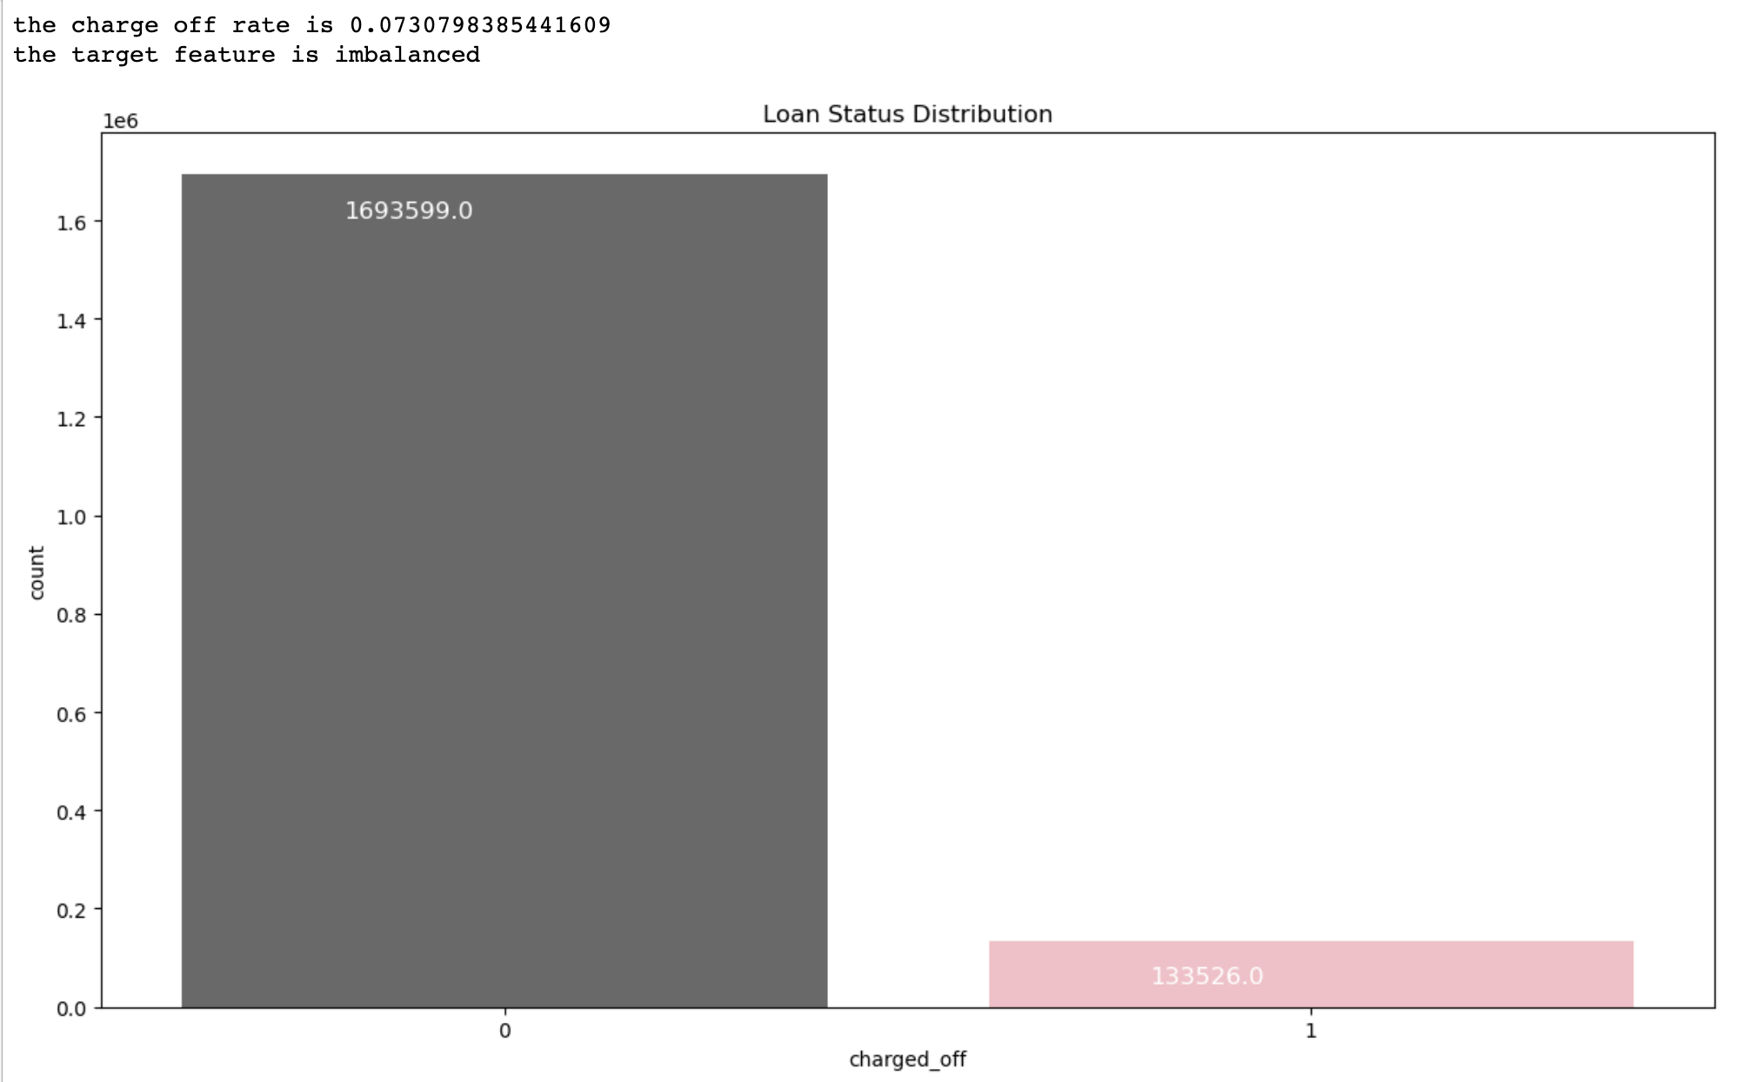

Slide 7
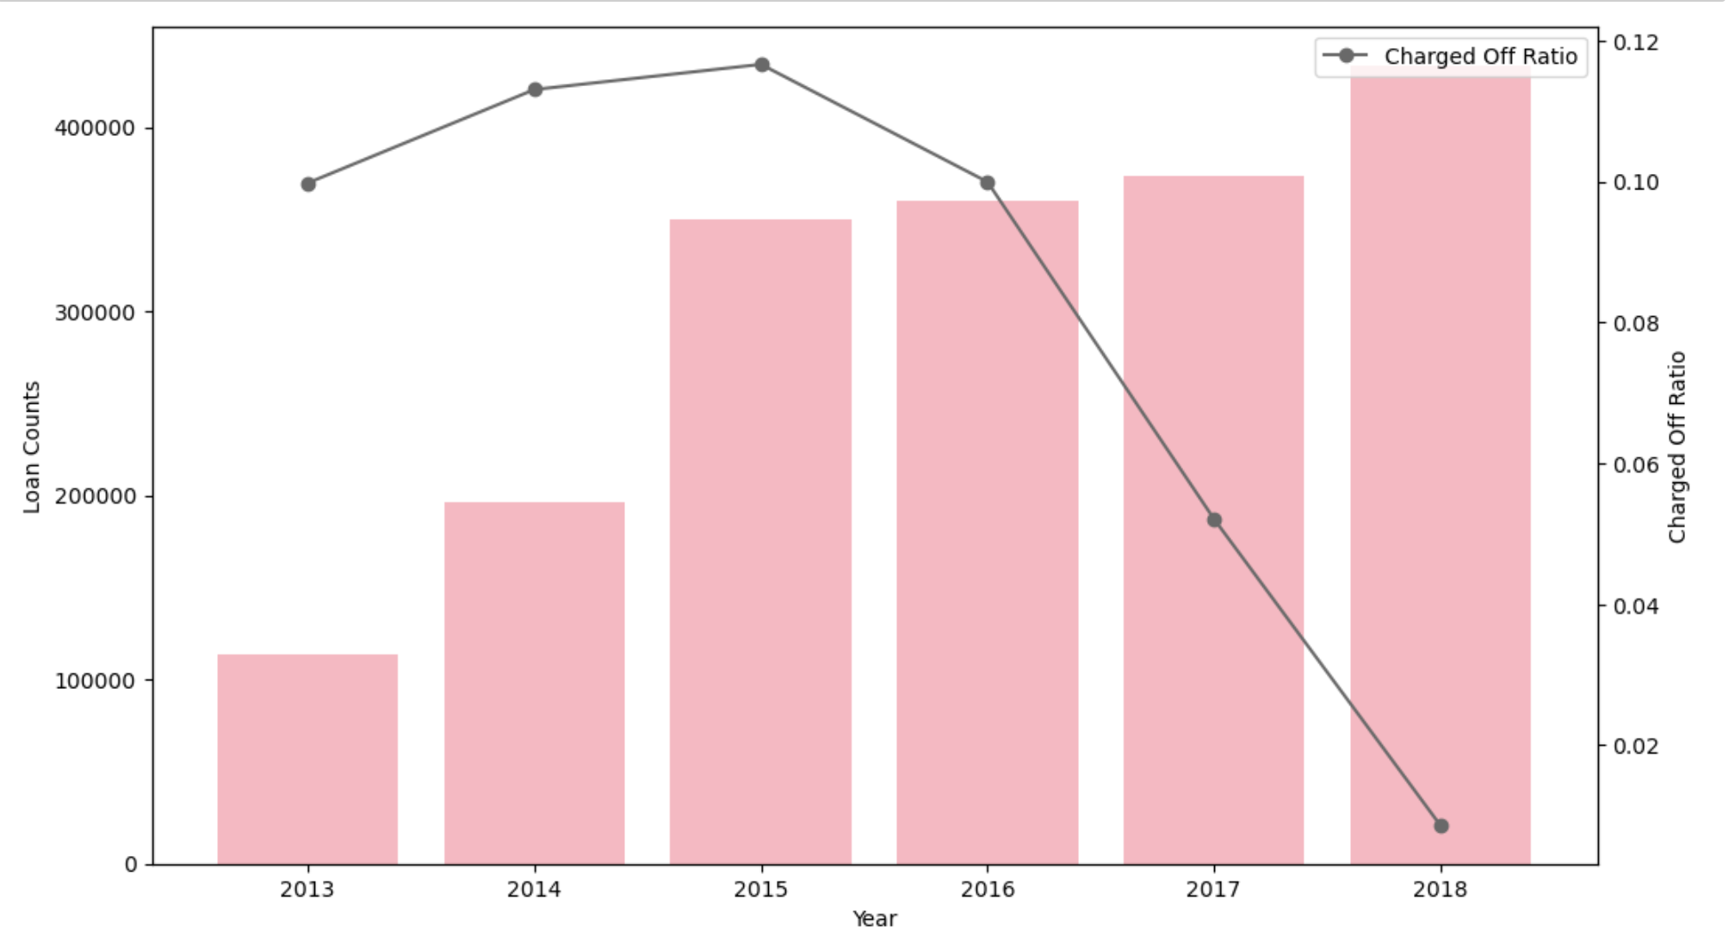

Slide 8
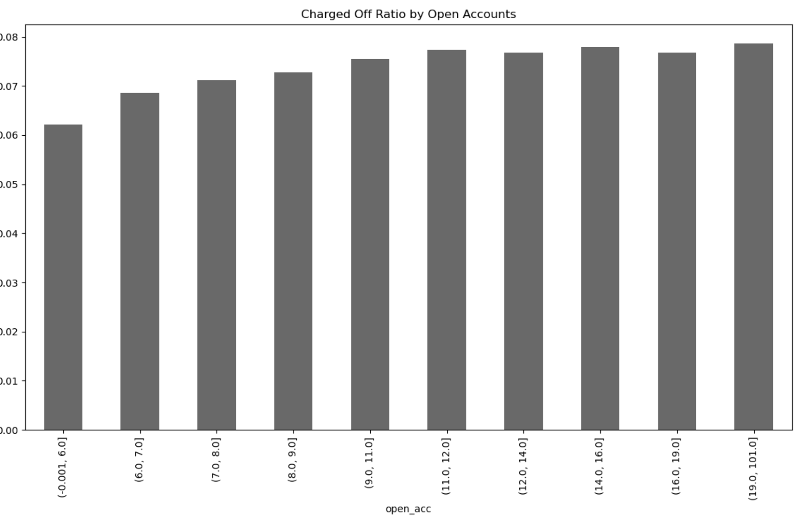

Slide 9
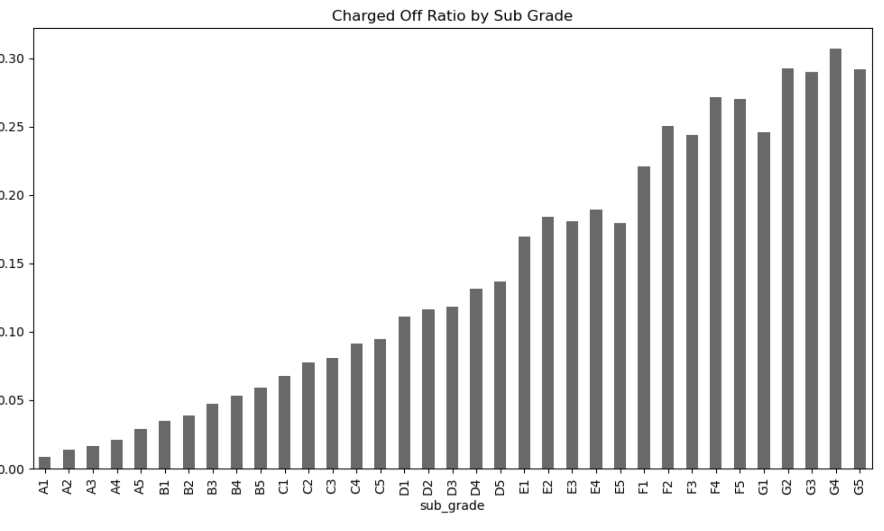

Slide 10
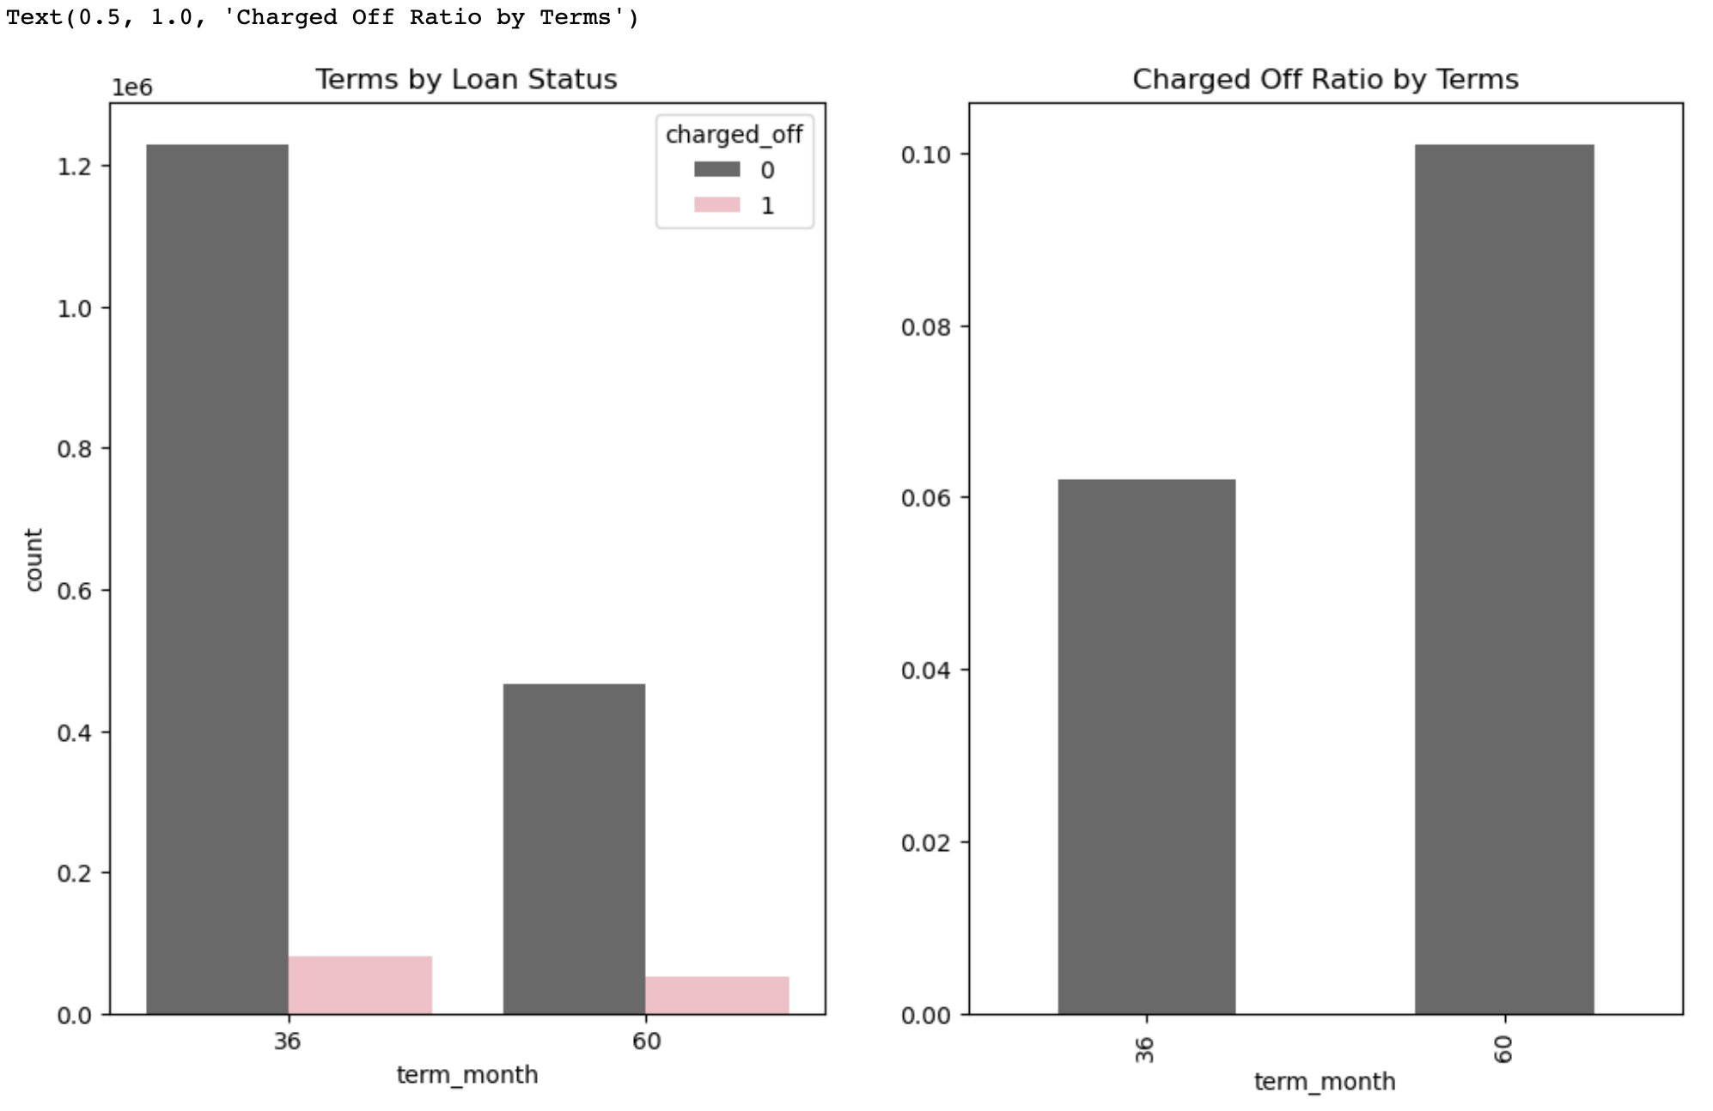

Slide 11
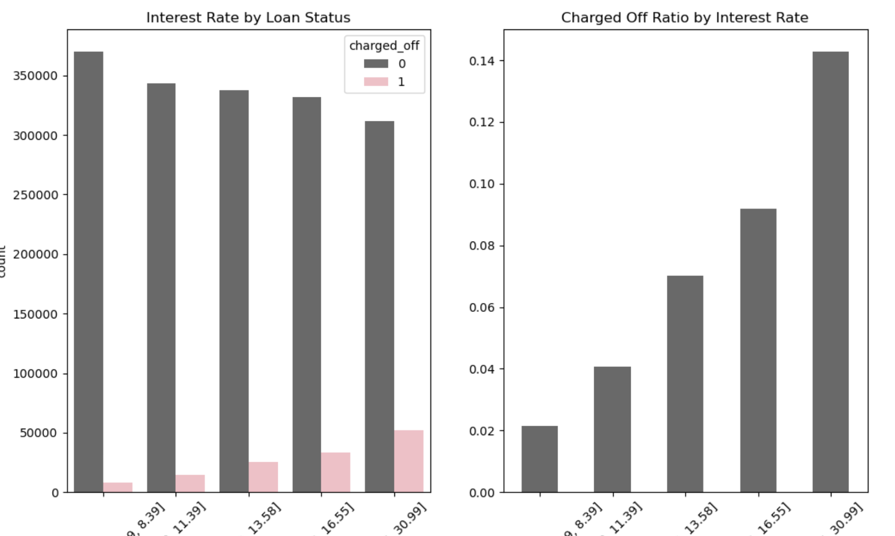

Slide 12
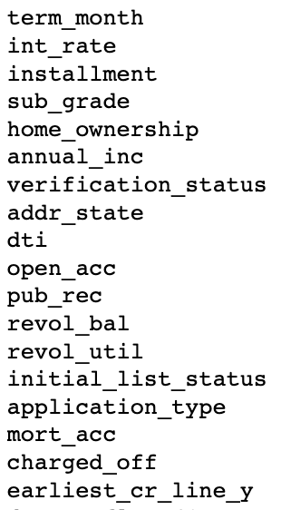
Data Engineering
Data cleaning
Dimension reduction
Correlation analysis
Data featuring

Slide 13
1. Train/Validation Set Split: stratified, 70%/30% 2. Doan Sampling: both classes have 131,828 observations 3.Model Selection: 4 predictive models
Model name | ROC score | Accuracy
Logistic Regression | 0.65 | 0.61
Decision Tree | 0.73 | 0.67
Radom Forest | 0.73 | 0.68
XG Boost | 0.76 | 0.69

Slide 14
Hyper-parameter Tuning
Randomized Search cv based on XGBoost(method)
Pros: Faster than Grid Search, especially when dealing with large dataset
Cons: may not guarantee to find the optimal combination of hyperparameters
Parameters (picture)

Slide 15
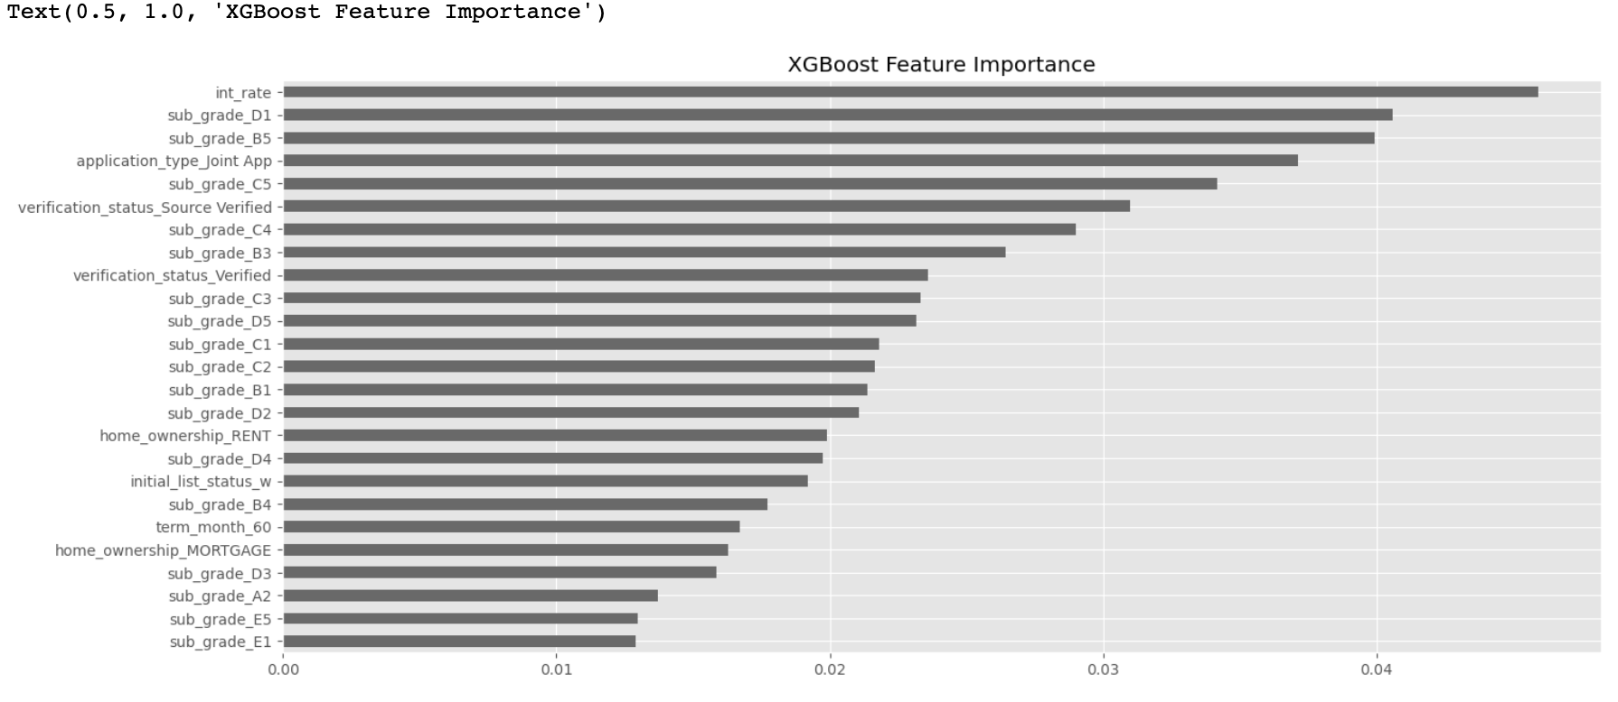

Slide 16
Future work
Check for overfitting
Search deeper in the macroeconomics index of different years
Complete the analysis only based on fully paid loans and charged off loans to see if there’s any improvement
Choose a high threshold close to 1 to elevate the precision by sacrificing the recall and use this model as a preventive tool for the investors to avid risky loans

