Slide 1

Advanced Methods in Text Analytics
Large Language Models
Licensed under Creative Commons Attribution 4.0 International

Slide 2
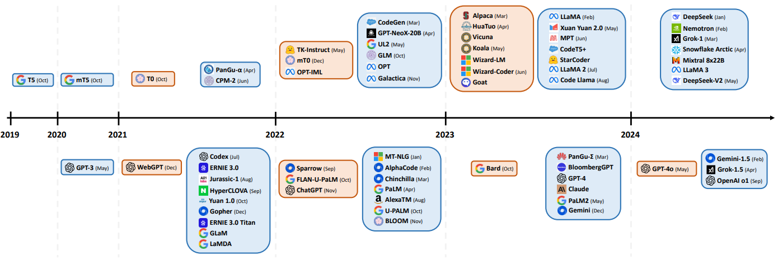
Large Language Models (1)
LLMs: Large Language Models (vast majority are causal LMs, i.e. CLMs)
Active/trendy research topic, many open questions/challenges
Above line: open source; orange cards: instruction tuned
Image source

Slide 3
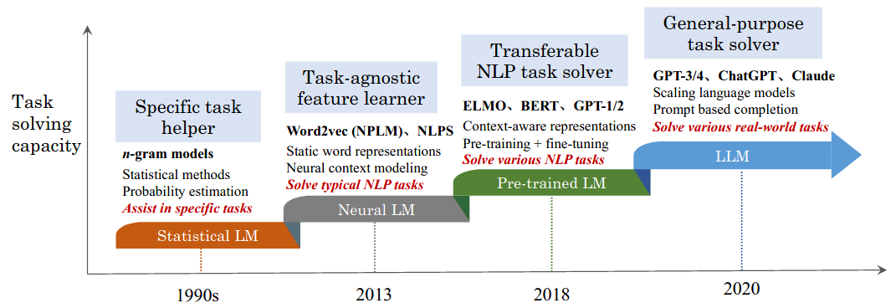
Large Language Models (2)
LLMs distinguished by:
(i) size --> (ii) what they can do --> (iii) how they are used
The way we use LMs has changed over time, rough history:
Statistical LMs: count-based, e.g. n-gram models
Neural LMs: FNNs/RNNs, task-specific downstream data and architectures
Pre-trained LMs: transfer learning, task-specific data, general architecture
Large LMs: as PLMs but sometimes no task-specific data required
Image source

Slide 4
Large Language Models (3)
What can LLMs do? (1) In-context learning abilities
Zero shot, or few shot tasks via in-context learning
Other “emergent abilities”, mostly related to text generation
What can LLMs do? (2) Solve new tasks by following instructions
New = not trained or tuned for it, task = "summarize", "write a poem", etc.
E.g. "summarize the following article into a single sentence"
New tuning methods developed for this
Still, essentially pre-trained LMs (can do transfer learning, PEFT, etc.)
LLMs also come with new challenges:
Expensive to train, bias and fairness, data privacy, hallucinations
In this lecture, we focus on key methods/models
Not a laundry list! (New models regularly, many won't stand test of time)
For comprehensive overview of methods, see this survey and this survey
Industry: get LLMs to perform better, apply them to real-world, sell them
Academia: study LLMs, understand LLMs

Slide 5
Outline
Large Language Models
In-Context Learning
Model Overview
LLM Tuning
Instruction Tuning
Model Alignment

Slide 6
Large Language Models
In-Context Learning

Slide 7
Emergent Abilities
“An ability is emergent if it is not present in smaller models but is present in larger models.” Wei et al. 2022
1. In-context learning (ICL) (this section)
Provide model with instruction/examples, then model performs task
Brown et al. 2020 found that larger models much better at this
2. Instruction following (next section)
Model is tuned on multiple tasks via natural language instructions
Then model performs well on new unseen tasks described similarly
Thoppilan et al. (2022) observed this for their model with 68B parameters, but not for the one with 8B parameters
Such "abilities" are task dependent
They work well on some tasks, not so much on others
Prompting generally brittle, performance dependent on chosen prompts
Note: term "ability" is vague, we care about what these mean concretely
I.e. we focus on solving NLP (i.e. text-based) tasks, not human-like abilities

Slide 8
Few-Shot Tasks (1)
Background: concept of few-shot, one-shot, zero-shot common in ML
E.g. in computer vision, robotics, recommender systems, etc.
n-shot: n number of training examples
Usually, n is a very small number; few = 5, 10, 20, etc.; one = 1; zero = none
Deep learning models notoriously data-hungry, n-shot can be challenging
But humans known to do n-shot quite well
Zero-shot task: "Identify the word"
rnmtrfraeso =>
One-shot task: "Identify the word"
eanlingr => learning
rnmtrfraeso =>
Few-shot task: "Identify the word"
eanlingr => learning
rcnpisgose => processing
rnmtrfraeso =>

Slide 9
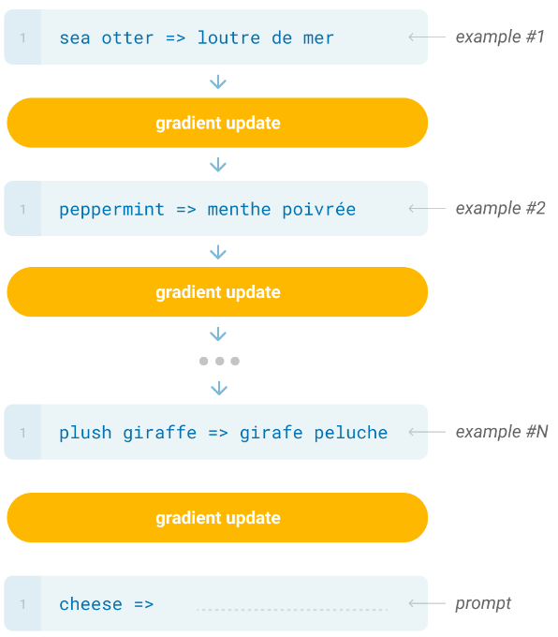
Few-Shot Tasks (2)
Good few-shot performance can potentially be very useful!
Getting lots of data for training/tuning is often costly, may be impossible
Learning from few examples may be key for human-level intelligence
In NLP, good few-shot performance achieved with transfer learning
Typically fine-tuning on few shots
E.g. given pre-trained LM PLM_{θ}
parameterized by θ, N task-specific
examples (x_{i},y_{i}) and loss function L:
Update θ given L(PLM_{θ}(x₁), y₁)
Update θ given L(PLM_{θ}(x₂), y₂)
…
Update θ given L(PLM_{θ}(x_{N}), y_{N})
Main point: we update parameters
Catastrophic forgetting may occur

Slide 10
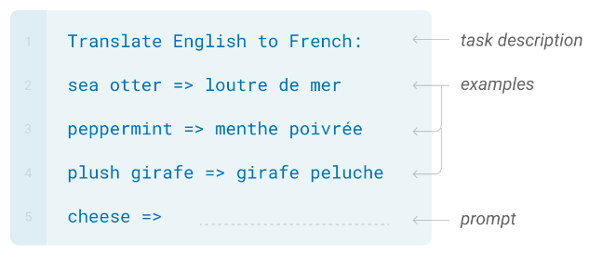
In-Context Learning (1)
In-context learning: given (i) instruction of task and/or (ii) examples of task (often called demonstrations), language model performs the task
Important: no weight updates!
Not learning in the traditional sense
Note ICL also based on transfer learning
The model in question is a pre-trained language model (typically a CLM)
Example, few-shot setting (most common ICL setting):
Image source

Slide 11
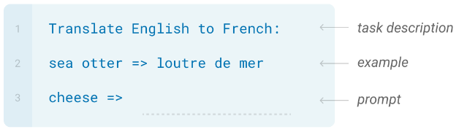
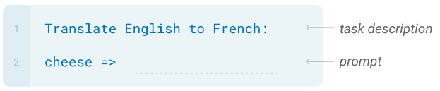
In-Context Learning (2)
Can also be used in one-shot setting:
And zero-shot setting:
Image source
Image source

Slide 12
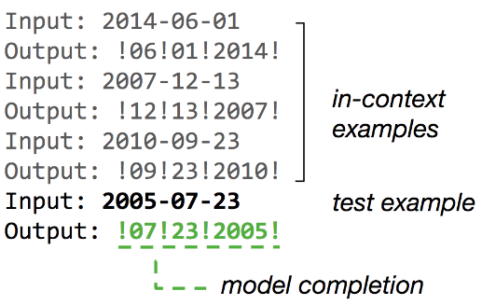
In-Context Learning (3)
Can also be done without task instructions, just examples:
CLM naturally completes given prompt
Does this really work?
Yes! First work to document this well was GPT-3 (Brown et al. 2020)
Image source

Slide 13
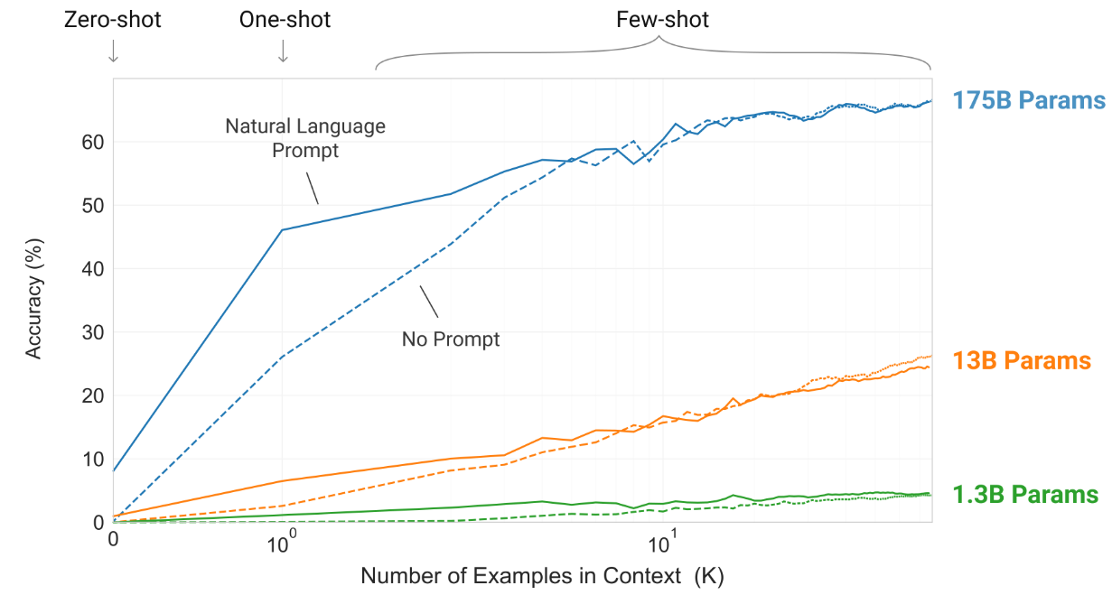
In-Context Learning (4)
Brown et al. (2020) observed (using between 10 and 100 examples):
Larger model -> better at ICL, largest models competitive with fine-tuning
Largest model made good use of task instruction in zero/one shot setting
Later studies found ICL to be comparable to fine-tuning
Important question: why does this work?

Slide 14
Why does ICL Work? (1)
ICL ability reported by GPT-3 authors has since been observed multiple times on multiple models
Generally observed only after models reach certain size
But other factors do matter, e.g. data quality, model architecture
Through the years, smaller models get better at this
E.g. Llama3-8B (2024) comparable to/better than Llama2-70B (2023)
Why does ICL work?
There are no weight updates!
Models not (directly) trained on these tasks, e.g. sentiment analysis
Open research question, two main directions
1. There is indeed some form of learning happening in the forward pass
E.g. ICL seen from a Bayesian inference perspective
Or ICL from a gradient-descent perspective
2. Models don't learn the new tasks, exploit patterns seen during pre-training
E.g. correct labels not needed, just label distribution/space (Min et al. 2022)

Slide 15
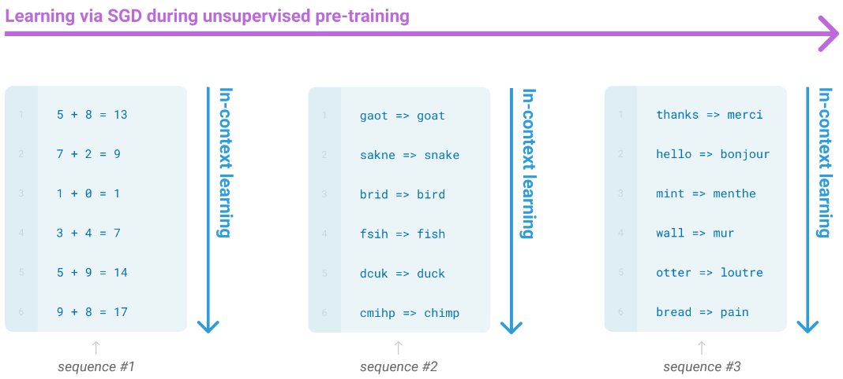
Why does ICL Work? (2)
Authors of GPT-3 suggested models learn "skills" during pre-training
Then use these "pattern recognition abilities" to perform new tasks
They highlight that training examples may contain many such "subtasks"

Slide 16
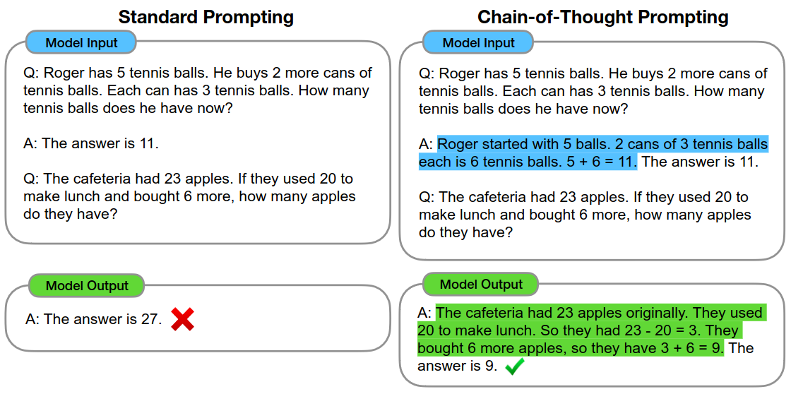
Prompting (1)
Also observed multiple times: ICL performance highly sensitive to prompt given to model (e.g. see Chen et al. 2023, Lu et al. 2023)
E.g. order of examples is relevant, distribution of labels is relevant, etc.
Thus, prompting: finding right prompt for model to perform well on task
Important example of impact of prompting: chain-of-thought
Examples of thinking in steps helps e.g. math problems (Wei et al. 2022)

Slide 17
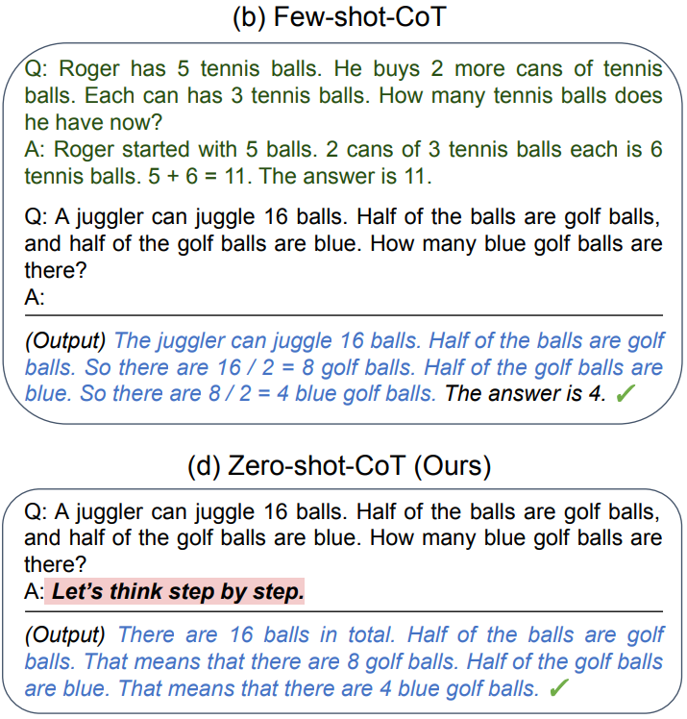
Prompting (2)
Kojima et al. 2022 extended the idea of chain-of-thought by simply prompting models to "think step by step"
They tested their approach with
GPT-3 and in a zero-shot setting,
i.e. no demonstrations as in the
top picture
This small addition to the prompt
significantly improved zero-shot
performance
Interpretation:
It seems by having models also
predict text that explains
reasoning increases probability
of tokens in correct answer
Next: overview of some LLMs

Slide 18
Large Language Models
Model Overview

Slide 19
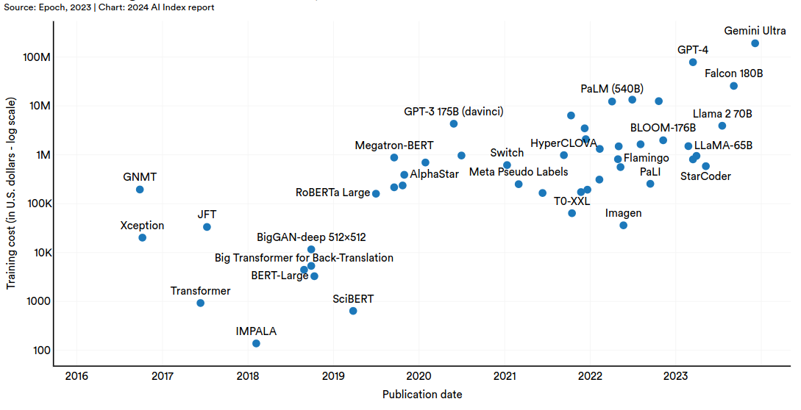
LLMs are Expensive (1)
Training LLMs has become prohibitively expensive
Example: LLaMa-2 70B (2023) trained on 2 trillion tokens (~10TB of open data), 6K GPUs, 12 days, 2M USD (source: Intro to LLMs by A. Karpathy)
Some estimates go beyond 100M USD (source: Stanford's AI Index Report 2024)

Slide 20
LLMs are Expensive (2)
Once pre-trained, fine-tuning is cheaper (computationally)
Computationally much more feasible, e.g. with PEFT, quantization
But getting data can be challenging
Data quality matters more than quantity at this stage
Data more reflective of relevant downstream tasks, e.g. chatbots
Also, fine-tuning is iterative process
Observe problems, create data for adjusting, fine-tune, repeat
I.e. costs can be continuous
More in next section
Let’s have a look at some models
But first, a quick overview of architectures and training objectives

Slide 21
Architectures
All architectures are transformer-based
Causal LM, decoder-only (most common by far)
Decoder autoregressively predicts new tokens conditioned only on output of decoder
E.g. GPT series (closed source, OpenAI), LlaMA series (open source, MetaAI)
Encoder/decoder (less adopted in recent years)
Encoder produces sequence of contextualized tokens
Decoder autoregressively predicts new tokens conditioned on output of decoder and encoder
Cross-attention: attends to output tokens from encoder
Example model: T5, UL2
Other less common architectures (for LLMs) exist
Encoder-only
Non-causal decoder only (bidirectional attention across past tokens)

Slide 22
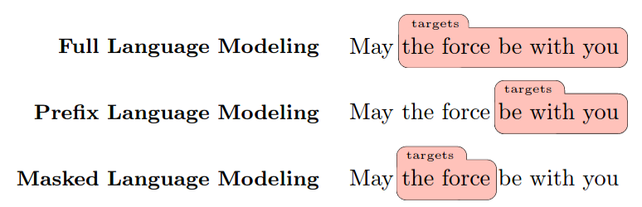
Training Objectives
(Full) Autoregressive/Causal language modeling (CLM)
Most common approach, highly adopted since GPT-2 (2019)
Causal masking on (self-)attention scores (KQ) matrix
Masked language modeling: fill-in-the-blank task (less adopted)
Prefix language modeling (less adopted)
Prefix: fixed subsequence of first n tokens
Task: predict tokens after prefix
Difference with CLMs: attention bidirectional over prefix token
Image source

Slide 23
The GPT Series (1)
Proprietary models! Closed source, not all information is available
We’ve already discussed the GPT architecture in a previous lecture
Causal language modeling, decoder-only
In terms of number of parameters
GPT-1: 117M
GPT-2: 1.5B
GPT-3: 175B
In terms of decoder layers
GPT-1: 12 layers of size 768
GPT-2: 48 layers of size 1600
GPT-3: 96 layers of size 12228
GPT-2 vs GPT-1
Small changes in architecture (discussed in Transfer Learning lecture)
Performed well on zero-shot tasks, but performance below fine-tuning

Slide 24
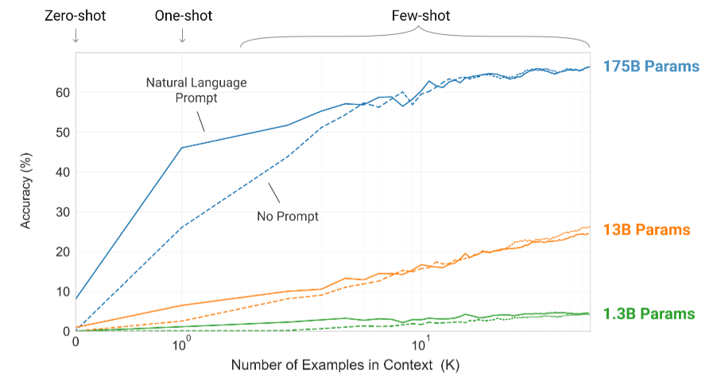
The GPT Series (2)
GPT-3 vs GPT-2
Leap in few-shot performance via in-context learning (ICL)
Inspired to continue scaling up models
Image source

Slide 25
The GPT Series (3)
Codex
GPT-3 fine-tuned on large corpus of GitHub code
Able to solve coding problems, improved performance on math problems
GPT-3.5 models
GPT-3-based models with stronger abilities
Abilities -> not benchmarked tasks, evaluated by humans
How did they get better? Model alignment (more in next section)
ChatGPT: fine-tuned for dialogue (ability: communicate with humans)
GPT-4
Superior performance on human-generated tests compared to ChatGPT
Still many challenges
Mainly, hallucinations: false information presented as fact
Perhaps a reminder: these are still language models
LLMs can predict facts sometimes, i.e. may be used as unreliable databases
But no internal "stop-and-think" mechanism (on-going research, e.g. here, here)

Slide 26
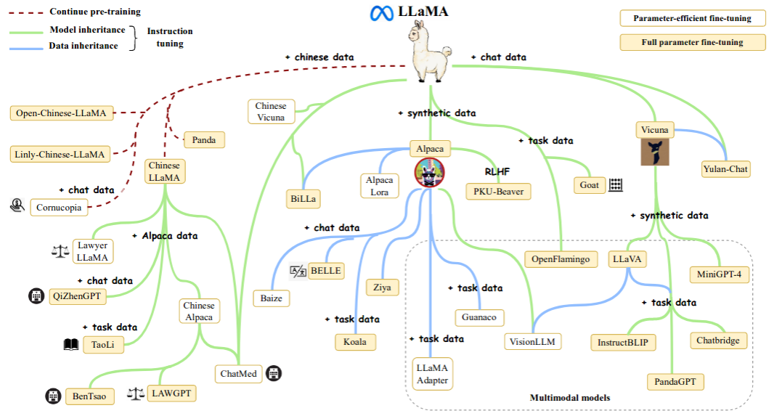
The LLaMA Series (1)
Highly valuable contribution! "LlaMA is the new BERT"
Being open source, it sparked large number of research/applications
Image source

Slide 27
The LLaMA Series (2)
Important open source LLM developed by META AI
LLaMA-1 (2023)
Decoder-only causal LM
Several sizes: 7B to 65B parameters
Largest model has 80 layers of size 8192
Trained only on publicly available data
Competitive with best LLMs
All weights (checkpoints), code made available
LLaMA-2 (2023)
Focused on fine-tuning for dialogue applications
Same architecture as LLaMA-1, but larger model at 70B parameters
Trained on 40% more data than LLaMA-1
Released all pre-trained and fine-tuned models

Slide 28
The LLaMA Series (3)
LlaMA-3 (2024)
Improved quality and size of training data (15T vs 1.8T for Llama-2)
Sizes from 8B to 405B parameters (the largest model is dense, more soon)
Hidden representations size ranges from 4096 to 8192
Number of attention heads ranges from 32 to 128
Vocabulary size: 128.000
Llama-4 (2025)
Sizes from 109B to 2T parameters
But all models now sparse, i.e. relying on mixture-of-experts (more soon)
Technical report withdrawn from arxiv due to controversies about report
Interesting "mid-season" release: Llama-3.2 (2024)
Small 1B and 3B models achieved via model distillation
In the following, we briefly discuss some common LLM components:
PreNorm vs PostNorm models, RMSNorm, SwiGLU
Model distillation, Mixture-of-Experts (MoE)

Slide 29
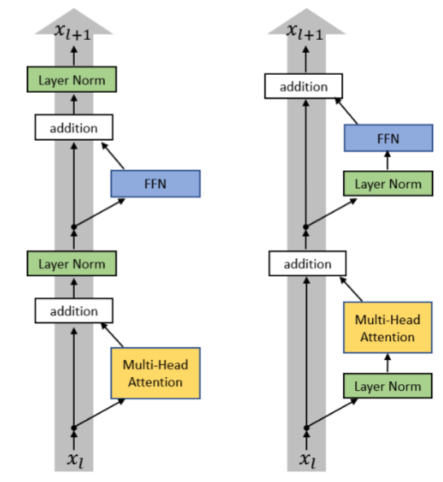
PreNorm vs PostNorm
Following prior work, Xiong et al. (2020) argued that using LayerNorm differently addresses gradient-based issues during training
They proposed to move the
LayerNorm component from after
each self-attention and MLP layer
(image on left) to inside (and
before) each self-attention and
MLP layer (image on right)
This variant is commonly used by
some LLMs, e.g the Llama family
But Llama models do not use
LayerNorm
They use a variant: RMSNorm

Slide 30
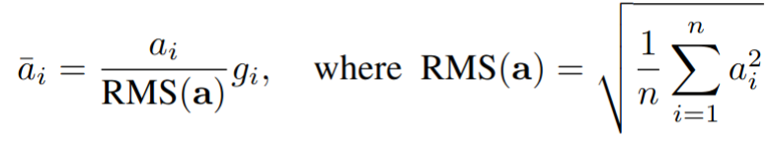
RMSNorm
Recall LayerNorm: it’s a form of centering data
Goal: address internal distribution shifts to make training more stable
How: given output vector a for some hidden layer, compute its mean μ and standard deviation σ
Then center a’ = (a - μ) / σ
Finally, scale the data: LayerNorm = γa’ + β with γ, β being learned
Zhang et al. (2019) argued that only the scaling component is necessary
They proposed simpler variant: not using mean centering
Result was scaling and normalization based on root-mean-square (RMS)
They showed experimentally:
Using RMSNorm gave similar or more effective performance

Slide 31
SwiGLU Activations
Combination of two forms of activations: Swish and GLU
Swish activations:
Swish(x, β) = x·σ(βx) where x is input vector, σ is sigmoid, β is learned
Roughly: smooth, non-monotonic version of ReLU
GLU activations:
GLU(x, W, V, b, c) = σ(xW + b) ⊗ (xV + c) where W, V are linear projections, b and c their biases, ⊗ is element-wise product
Note this means some LLMs have three projections in MLP layers
Here, W is typical up projection, V is 2nd new up projection
SwiGLU activations:
SwiGLU(x, W, V, b, c, β) = Swish_{β}(xW + b) ⊗ (xV + c)
Found to significantly increase performance compared to ReLU and Swish activations

Slide 32
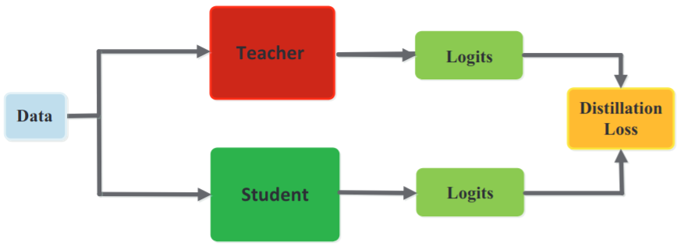
Model Distillation (1)
Proposed by Hinton et al. (2015)
Often referred to as knowledge distillation
Motivation: models are functions
Have function by smaller model (student) behave as function by larger model (teacher)
How?
Hinton proposed using teacher's (token) distribution as target for student
Model distribution is richer than final predictions, especially with higher temperature, which they suggested should be increased during training

Slide 33
Model Distillation (2)
Common choices for distillation loss:
KL-Divergence (distance between distributions)
Mean squared error (MSE)
Combination of the two, or with others
Distillation loss often linearly combined with CE loss for LM
DistilBERT also used cosine embedding loss, aligns teacher/student vectors
Can also include targets from multiple teachers (multi-signal distillation)
Distillation is quite popular today
As mentioned, the Llama-3.2 family has two small models (1B and 3B) distilled from larger models Llama-3.1 (8B and 70B)
Companies like DeepSeek provided smaller models in their family, students were models like Llama or Qwen, teacher was their flagship model DeepSeek-R1

Slide 34
Sparse vs Dense Models
Dense model: uses all its weights for any given input at inference time
I.e. the type of architecture used by all models discussed so far
Sparse model: only uses subset of its weights for any given input at inference time
Popular sparse architecture in LLMs: mixture-of-experts (MoE)
Scaling model parameters less expensive if model is sparse
Some MoE LLMs: the Mixtral family, DeepSeek-V3 (671B parameters)
In the following slides, we go over the basics of MoE

Slide 35
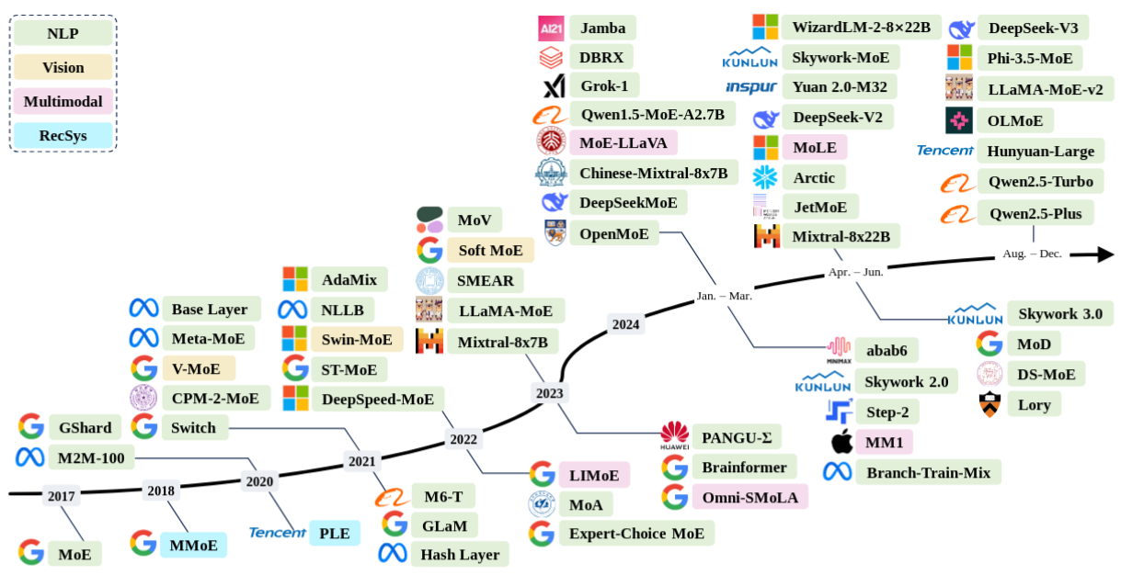
Mixture of Experts (1)
Popular architecture for deep learning models
Above arrow: open source, below arrow: closed source
Image source

Slide 36
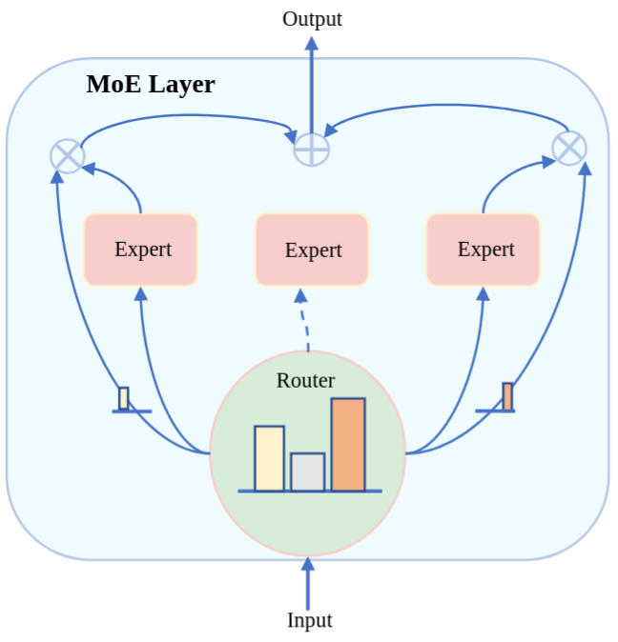
Mixture of Experts (2)
Part of the ML toolbox for many decades already
Basic intuition of MoE:
Use different "parts" of the model for different inputs given to the model
A "part" is typically a component or subnetwork within the model
Thus, expert: subnetwork specialized to handle some type of input
Concretely, a MoE layer consists of the following components:
Set of expert networks E = {E₁, E₂, …, E_{n}}
Gating/routing function G: T --> E^{k}
designed to choose set of k < n experts
for each portion of training data T
Routing strategy that determines
how data is distributed among experts
Output of MoE layer: linear combination
of experts' output weighted by G
How could we implement function G?
Image source

Slide 37
Mixture of Experts (3)
Common choice for routing function G:
G(x) = Softmax(W_{G}x) where x is typically same input given to experts
Output of G(x) typically referred to as routing scores
Interpretation of G(x): it acts as a "probabilistic switch"
Given input x, G(x)_{j} gives probability of selecting j-th expert
Thus, W_{G} ∈ R^{k x d} where d is size of x, k is number of experts
In modern NLP, Shazeer et al. (2017) used MoE in a two-layered stacked RNN (with LSTMs) for machine translation
They added a MoE layer between RNN layers (input to G, experts: tokens)
Each expert was a linear layer (they used up to thousands of experts)
G(x) was as above but they added a sparsity constraint
Sparsity: top-k(x), i.e. only k experts used for each input for efficiency
Output of MoE layer: y = ∑_{n} G(x)_{i} E_{i}(x) where G(x) = Softmax(top-k(W_{G}x))
Routing strategy: level of specialization (token-level, task-level, etc.)
E.g. select k experts per token, use per-task experts with unlearned routing

Slide 38
Training MoE
Routing examples to different experts can cause training issues
Goal of routing: select which of n experts to send each input to
Discrete decision, can be problematic for gradient-based learning
Shazeer et al. used the "probabilistic switch"
Specifically, selecting top-k experts
Their implementation of top-k did not cause problems during training
Other strategies exist, e.g. based on hashing, reinforcement learning
Another potential issue: load balancing
Shazeer et al., as well as prior work, noted routing converges to favoring few experts
Thus, vicious cycle: few experts get chosen the most, they see more data, get better at the task
Often addressed with auxiliary loss function that encourages that each expert sees an equal amount of tokens during training
Same idea was applied a few years later to the transformer architecture

Slide 39
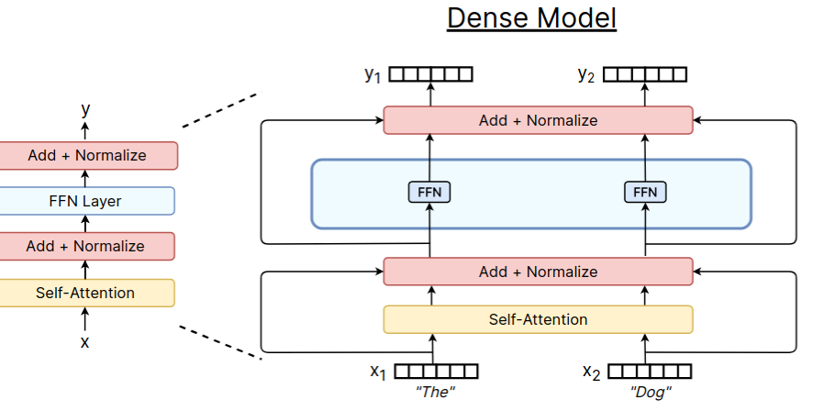
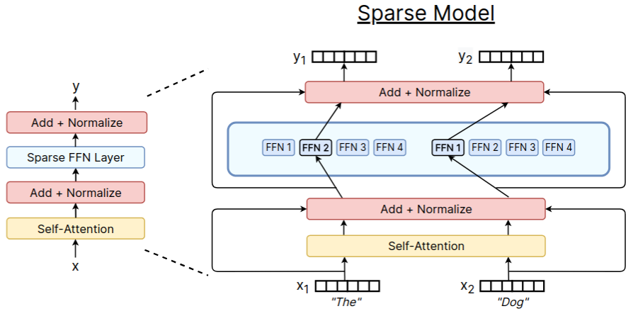
MoE in Transformers
Proposed by Lepikhin et al. (2021) and Fedus et al. (2022)
Image source

Slide 40
MoE in LLMs
Mixtral models mostly followed prior work
As shown in previous slide, i.e. Shazeer et al. with transformers
Also, softmax-based routing function, top-k routing strategy
They used SwiGLU as experts (LLM-era activations)
DeepSeek models introduced new ideas
Some shared experts always on to capture constantly needed knowledge
Split internal (large) dimension in MLP layers into two separate up-projections to allow more fine-grained experts
Note: term "expert" can be misleading, depends on routing strategy
Resulting experts not necessarily "experts" in math, translation, etc.
Routing strategy can, but often doesn't, make such decisions
Instead, model is allowed to organize experts as needed during training
It's more akin to using multiple self-attention heads
Result can be experts in subtasks, e.g. a "copy-paste" attention head
For more on MoE, see here or here.

Slide 41
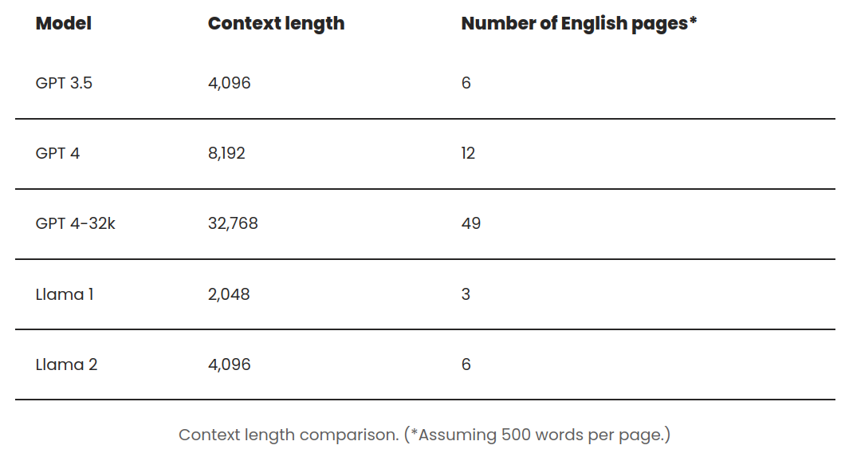
Context Window (1)
Something not discussed so far: size of context window
Expensive due to quadratic cost of attention
Constant effort to increase size with every new model
Image source

Slide 42
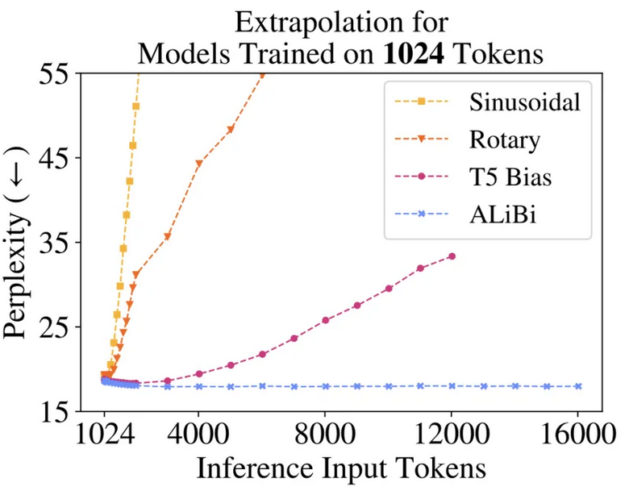
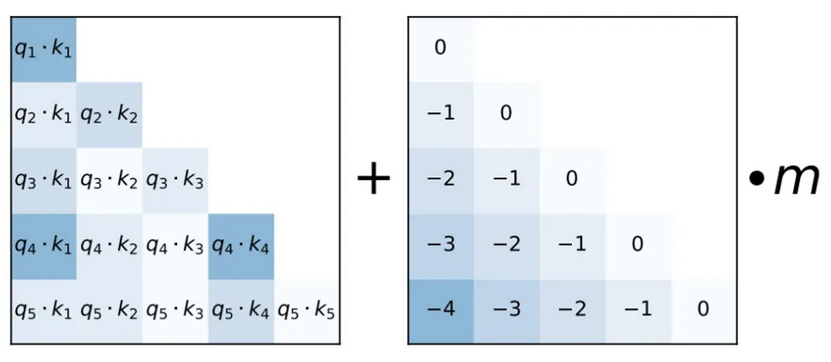
Context Window (2)
Several methods developed to increase context length
Different types of methods: e.g. positional embeddings, more efficient types of attention, new model architectures, we discuss a few below
ALiBi positional embeddings (Press et al. 2022)
Position encoded as linear term added to attention score
Allows training with shorter sequence, use longer sequence for inference
Requires using such positional embeddings during pre-training

Slide 43
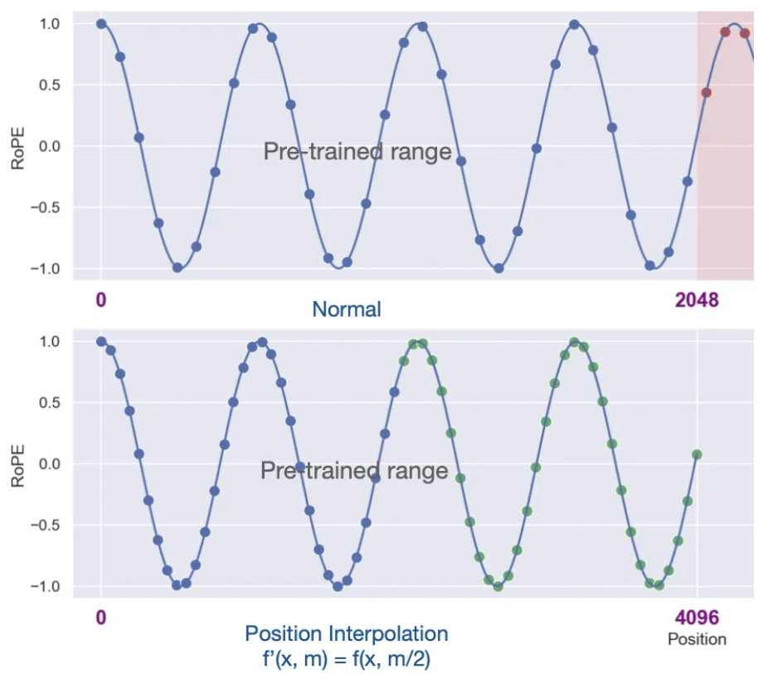
Context Window (3)
Position Interpolation (Chen et al. 2023)
Extend position embeddings beyond size used during training
With a bit of fine-tuning, applicable to models that used different positional embedding during pre-training

Slide 44
Context Window (4)
More efficient forms of attention:
Sparse attention: consider only subset of attention matrix, e.g. locality
Flash attention: GPU optimization of forward/backward pass operations
More in later tutorials
More recently, RNN-like methods:
Mamba Architecture (Dao et al. 2023): state-based model allows longer input sequences similar to how RNNs did (see also Le Bronnec et al. 2024)
TransformerFAM (Hwang et al. 2024): introduce LSTM-like mechanism in transformers
Leave-No-Context-Behind (Munkhdalai et al. 2024)
RNN-like methods too new, impact unclear
Highlights this challenge is an open-question
Parameter count/context window show scaling up big part of progress
Why?

Slide 45
Scaling Laws (1)
Chinchilla scaling laws introduced by Hoffmann et al. (2022)
Modeled cross-entropy loss as function of model size and data size
Loss measured in nats, i.e. like bits but using ln (explained in past tutorial)
Model size measured in number of parameters
Data size measured in number of tokens in training
Specifically: L(N,D) = E + A/N^{α} + B/D^{β}
N: model size,
D: data size
E: ideal loss from infinitely big model with infinite training data
A/N^{α}: represents how much model underperforms E based on its size
B/D^{β}: how much model underperforms E based on its training data size
They optimized L under constraint C = 6ND where C is compute power
They fitted A and B using data from lots of pre-training experiments
Different model sizes (70M to 16B), different data sizes (5B to 500B)

Slide 46
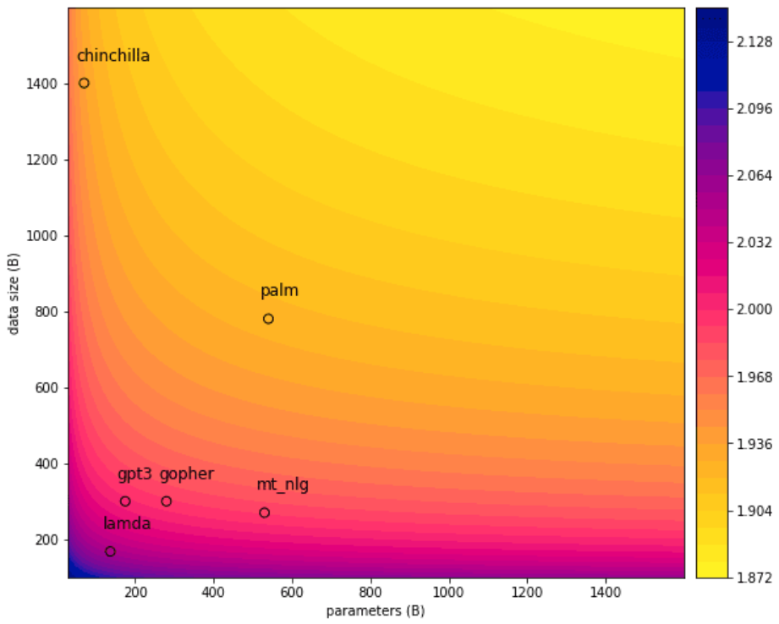
Scaling Laws (2)
They derived the following optimal sizes of model and data
N(C) = 0.6C^{0.45}
D(C) = 0.3C^{0.55}
Heatmap of loss w.r.t.
model and data size
They trained their
Chinchilla model
on more data, as
suggested by the law
It outperforms many
models, even those
with many more
parameters

Slide 47
Scaling Laws (3)
This tells us, for given compute power C (in flops), how much data to use to achieve optimal loss for a given model size
E.g. for 67B parameters, use 1.7 trillion tokens
GPT-3 trained on 300B tokens, should have had 15B parameters, not 175B
With that data size, growing model beyond 15B makes little difference
Law makes assumptions
E.g. applies to CLMs using a specific form of learning rate scheduler
Such laws nevertheless useful
E.g. test training tricks on smaller model, see how performance would scale
When plotted, scaling laws predict improvement with scale!
Limitation: focused on loss reduction, may not translate to actual tasks
For nice explanations on the topic, see here and here.

Slide 48
Scaling Laws (4)
Recently, these scaling laws have been under question
The main focus of criticism is their oversimplicity
Diaz et al. (2024) argue that despite scaling up training sets, performance on more specific settings don’t scale as described
They argue for considering other factors besides model and data size
E.g. evaluation data size, qualitative and use-case dependent evaluation metrics
Isik et al. (2025) study scaling laws by focusing on machine translation
I.e. target is not training loss, but performance on translation task
They find that size of downstream data, as well as alignment of distribution of pre-training and downstream data are also important factors
Thus, scaling laws work differently in this case
Liu et al. (2025) study how model performance can be predicted on downstream tasks
They find impactful factors like model architecture and dataset distribution

Slide 49
Pre-Training vs Fine-Tuning
Many more models
And many more details about each model
E.g. size of training set, ensemble or not (i.e. sparse vs dense), etc.
Most proprietary LLMs are accessed via APIs
Useful for research and applications
But research challenging, key information unknown
E.g. are benchmark test sets seen during training?
Note a pattern in latest LLMs
GPT-3.5: fine-tuned GPT-3
ChatGPT: fine-tuned for dialogue
LLaMA-2: focused on fine-tuning
Fine-tuning methods essential to latest LLM success
At least as measured by language understanding, safer use in applications
NLU = natural language understanding (i.e. reading comprehension)
Let's go over the basics of fine-tuning LLMs!

Slide 50
LLM Tuning

Slide 51
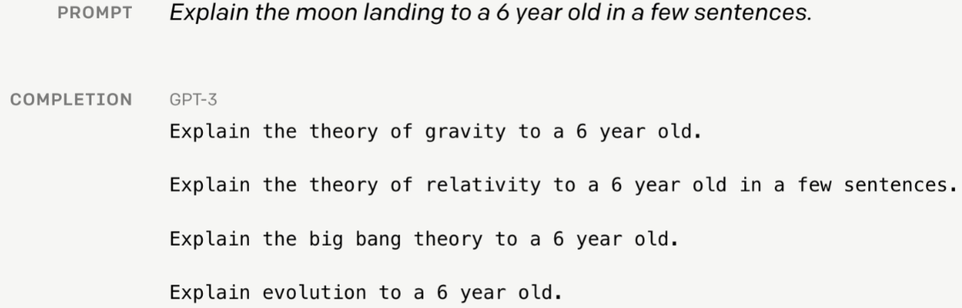
LLMs as Useful Tools (1)
Predicting next word is not the same as “follow user’s instructions”
Image source

Slide 52
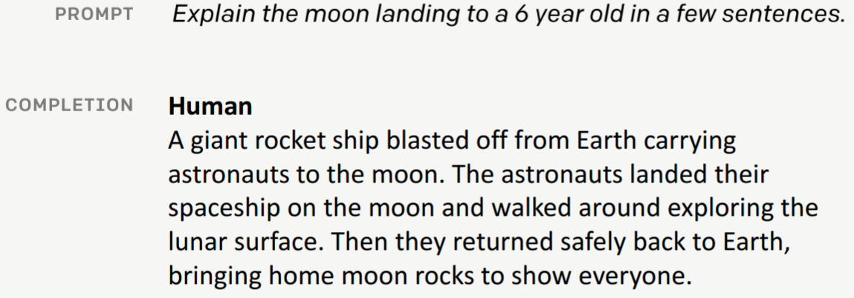
LLMs as Useful Tools (2)
Fine-tuning crucial to LLMs ability to communicate, solve tasks
Image source

Slide 53
LLMs as Useful Tools (3)
To improve usability of LLMs, tuning LLMs has focused on:
1. Performing many generative tasks, e.g. "explain moon landing"
2. Providing truthful, non-toxic answers
How to achieve the first point? Tune weights on many new tasks
Before: fine-tuning typically on chosen task, required few labels
Now: fine-tuning in many tasks, requires many labels per task
Why are more labels required for LLM tuning?
Because goal is more general: to perform well on many new tasks
In this section, common approach for LLM tuning: instruction tuning
What about the second point above?
Also in this section, main approach for this goal: RLHF

Slide 54
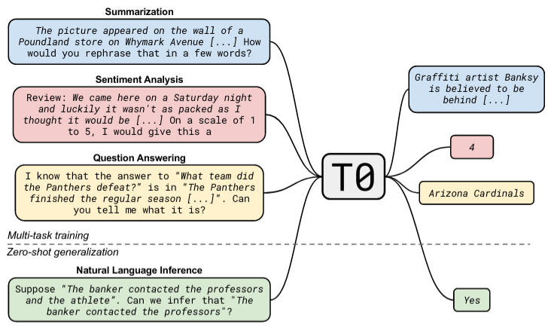
Instruction Tuning (1)
Question: can LLMs perform well on tasks not seen in training/tuning?
I.e. zero-shot generalization
That’s general goal of instruction tuning (Sanh et al., Wei et al.)

Slide 55
Instruction Tuning (2)
Instruction tuning: train models to get better at zero-shot task solving, so long as those tasks come with text-based instructions
I.e. models learn to "follow instructions"
Important: measured as models performing NEW tasks not seen during pre-training or tuning, otherwise phrase "follow instructions" is vague
How does instruction tuning work?
Update weights by training models to solve many different supervised tasks that come with instructions
I.e. a combination of (standard) fine-tuning with ICL
Common approach:
Cast NLP tasks as text-to-text (see image in previous slide)
Keep CLM objective (no switch to supervised objective, e.g. classification)
Train on some set of tasks, validate/test on DIFFERENT set of tasks
Let's visualize this.

Slide 56
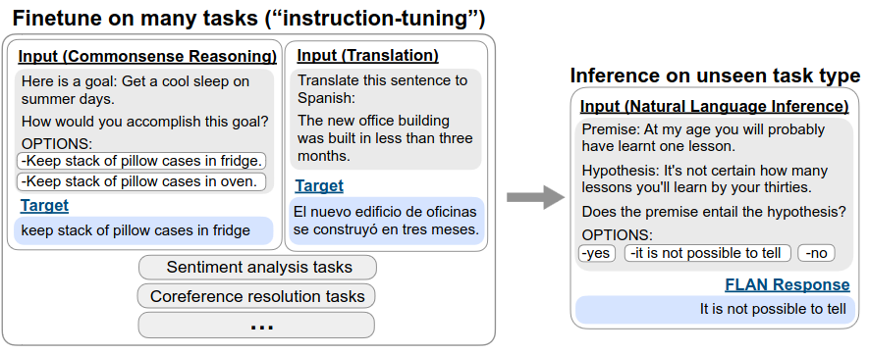
Instruction Tuning (3)
How to check that models can "follow instructions"?
Evaluate performance on tasks not seen in training or tuning
Image from Wei et al.
How does this relate to standard fine-tuning and ICL?
Instruction tuning has components of both, but also different from both

Slide 57
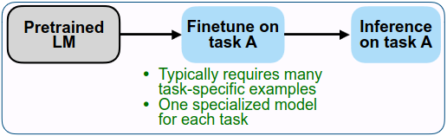
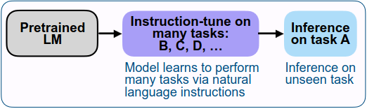
Instruction Tuning vs Fine-Tuning (1)
Following images from Wei et al.
Standard fine-tuning:
Instruction-tuning:
In both cases, note the use of the different tasks A, B, C, D, ...

Slide 58
Instruction Tuning vs Fine-Tuning (2)
Fine-tuning: update weights based on new (typically supervised) task
Goal: perform well at specific task used in fine-tuning process
Data typically as input-label pairs, e.g. (email, label) for spam detection.
Instruction-tuning: update model weights based on several (typically supervised) tasks that are text-based and include instructions
Goal: perform well on new tasks not seen during training or tuning
Tasks must include text-based instructions
E.g. "Read the following email and tell me whether it's spam or not"
In other words:
Goal is different, aim of instruction tuning is more generally useful model
Data format is different, as fine-tuning data more akin to standard ML data
Instruction tuning data includes text, instructions, similar to how humans follow instructions

Slide 59
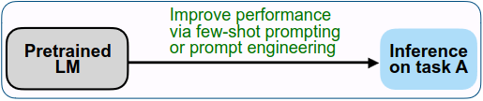
Instruction Tuning vs ICL
In-context learning: given instruction and/or examples of task, model performs task
Similar to instruction tuning: data format
Different from instruction tuning: no weight updates in ICL!
ICL:
Instruction-tuning:

Slide 60
Limitations of Instruction Tuning
Achieving generally useful models brings lots of challenges
Some tasks don’t have clear answers, e.g. write a story
LMs work at token level, some mistakes bigger than others
E.g. “Avatar is a fantasy movie”, replacing fantasy with adventure less problematic than replacing movie with book
Limitation 1: requires lots of data, since entire model often tuned
PEFT methods can also be used for this, can be competitive
Many recent benchmarks designed for LLM fine-tuning (MMLU, Big-Bench)
Limitation 2: LM objective not aligned with human intent (Ouyang et al. 2022)
Explicit intentions: models follow instructions (goal of instruction tuning)
Implicit intentions: models give answers that are truthful, non-toxic, etc.
Explicit intention can be achieved without implicit ones, e.g. a rude answer
Thus, even more general goal: tune models for human preference
Often referred to as "model alignment" (Leike et al. 2018)

Slide 61
Tuning for Human Preference (1)
Main approach: reinforcement learning for human feedback (RLHF)
Here: seminal work in context of deep learning by Christiano et al. (2017)
Roughly, basic components of reinforcement learning (RL):
An agent interacting with an environment over sequence of steps T
At time step t ∈ T, agent receives observation o ∈ O from environment, sends action a_{t} ∈ A to environment based on o --> (o₁, a₁), (o₂, a₂), ...
Environment provides scalar reward y_{t} = r(a_{t}) where r is reward function
Goal in RL: learn policy p: O -> A that predicts set of actions a_{i} ∈ A for i ∈ T that maximizes rewards over T (in deep RL, r and p are deep networks)
RL often successful in tasks where reward function is specified well
E.g. playing video games (Mnih et al, 2015)
For some tasks, specifying the reward function can be challenging
E.g. train robot to do scrambled eggs (function for good scrambled eggs?)
Idea: allow humans to provide feedback on the agent's actions
Use this human feedback to define task

Slide 62
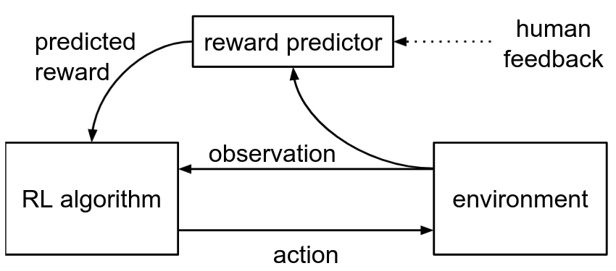
Tuning for Human Preference (2)
Christiano et al. 2017 proposed the following:
Learn reward function r: O x A --> ℝ that provides rewards aligned with human preferences while simultaneously training a successful policy
Such a method should allow solving tasks defined by desired behavior
"By desired behavior" means agents can be taught by non-experts
E.g. no need to be a chef to provide feedback on scrambled eggs
This approach now referred to as RLHF
InstructGPT: recent work that used RLHF to align LLMs

Slide 63
InstructGPT (1)
Ouyang et al. (2022) used RLHF to fine-tune GPT-3 to follow broad class of written instructions with outputs aligned with human preference
Process broken into three steps (each covered in detail in next slides):
1. Collect examples for several generative tasks, train supervised policy
Example of task: "List five ideas for how to regain enthusiasm for my career"
Human labelers provided examples of desired outputs
Recall policy: function that provides actions given observations
In the context of LLMs, actions are generating different text
So, "train policy" here was fine-tuning GPT-3 with examples from labelers
2. Collect comparison data, train reward model to mimic humans
Given tasks and model from Step 1, generate multiple outputs for each task
Human labelers choose preferred output from given pairs of outputs for tasks
Recall reward model: function from observations and actions to reward
Reward model: copy of Step 1 model that produces scalar (LM head replaced)
3. Optimize policy (Step 1) against reward model (Step 2) using PPO
Proximal policy optimization (PPO) (Schulman et al. 2017): common in RLHF

Slide 64
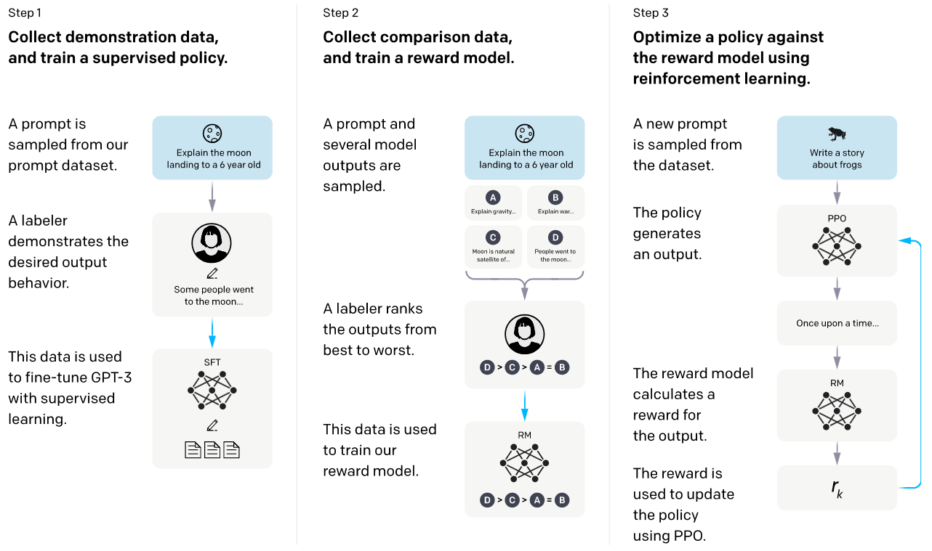
InstructGPT (2)
Visualization of the three steps (image from Ouyang et al. 2022):
Let's look at each step in more detail.

Slide 65
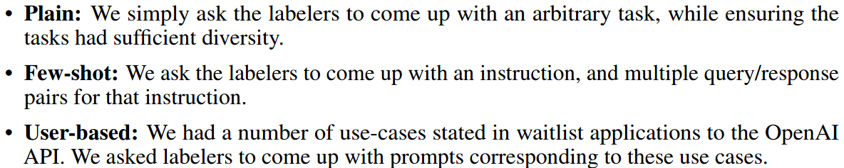
InstructGPT: Step 1
Step 1: collect examples for several tasks, train supervised policy
Tasks: prompts and outputs generated by OpenAI users (volunteers)
Examples of such "text generation tasks":
"List five ideas for how to regain enthusiasm for my career"
"Write a short story where a bear goes to the beach, makes friends with a seal, and then returns home."
Note that this requires a lot of human effort, thus very expensive!
This cost makes RLHF not easily accessible
Training policy: fine-tuning (all of) GPT-3 on examples from humans
Recall policy: function p from actions to observations, i.e. p: O -> A
Image source

Slide 66
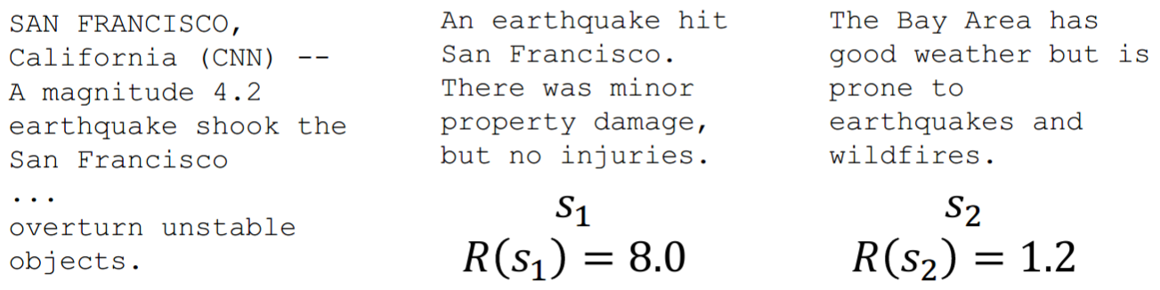
InstructGPT: Step 2 (1)
Step 2: collect comparison data, train reward model to mimic humans
Comparison data: each example is a (i) task, (ii) pair of outputs (x₁, x₂) for task from model tuned in Step 1, (iii) human-chosen preference x_{i}
Why do labelers choose from pairs of model outputs?
Human-assigned rewards as ratings can be noisy, not calibrated (see image)
To avoid this, humans are typically asked for pairwise comparisons
E.g. which summary is best from the ones above, left or right?
Chosen summary gets label 1, other gets label 0
Image source

Slide 67
InstructGPT: Step 2 (2)
Step 2: collect comparison data, train reward model to mimic humans
Recall reward model: function from actions and observations to reward
Reward is scalar number, i.e. reward model r is function r: A x O --> ℝ
Here: reward model is copy of model tuned in Step 1
But model from Step 1 is GPT-3, i.e. a language model
It does not produce a scalar, but a distribution over some vocabulary
What can we do?
They replaced language modeling head with projection to scalar
But how do we train this (beheaded) reward model?
(Averaged) Cross-entropy loss (CE), labels are 1 and 0 as needed
Specifically, given input x, model is trained to predict which output y ∈ {y₀,y₁} is preferred by humans
For reward model r_{θ} parameterized by θ and preferred output i, we have:

Slide 68
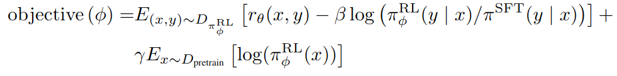
InstructGPT: Step 3 (1)
Step 3: optimize policy (Step 1) against reward model (Step 2)
In other words, improve model from Step 1 further by training it to produce higher-quality outputs preferred by humans
How do we know which outputs are preferred by humans? Reward model!
Policy gradient methods: designed for estimating RL objectives
InstructGPT relied on commonly used PPO method
Proximal policy optimization (PPO) (Schulman et al. 2017)
Details beyond our scope, e.g. value function, alternate optimization
Final RL objective:
Given reward model r_{θ} parameterized by θ and frozen policy model π^{SFT} fine-tuned in Step 1, we tune model π^{RL} parameterized by φ and initialized as copy of π^{SFT}, by maximizing the following objective:

Slide 69
InstructGPT: Step 3 (2)
Note: model π^{RL} regularized so its predictions are not far from π^{SFT}
How? Subtraction term weighted by factor β
Proportion between predictions produced by the model currently training, i.e. π^{RL}, and the π^{SFT} model used to train the reward model in Step 2
I.e. prevents policy model currently training to differ too much from model fine-tuned in Step 1 (the LLM fine-tuned on human-created labels)
And what is the term weighted by factor γ?
Here, D_{pretrain} is dataset used for pre-training original model (GPT-3)
This factor is designed to keep the model from differing too much from performance after pre-training and before fine-tuning in Step 1
I.e. we still want a LM at the end of the day

Slide 70
InstructGPT: All Together
There are several models and training objectives used for InstructGPT
Policy model: a copy of GPT-3, so a LM, fine-tuned with CLM objective
Reward model: copy of policy model (LM head replaced), trained on CE
Reinforced policy model: tuned with RL objective and signal from reward model (which learned to mimic human preference), our final LM
Both policy and reward models trained with human-labelled data
Lots of data because goal was to be good at thousands of tasks
Thus, expensive to obtain, process required constant work with labelers
RLHF applied to LLMs key step to enable construction of ChatGPT
Note that ChatGPT is a product based on some LLM (or many?)
Initially based on LLMs from the GPT-3 generation
Currently (May 2026) based on variants of GPT-5
High cost of RLHF means ChatGPT levels of performance not easily accessible
Achieving this level of performance at a reduced cost is ongoing research

Slide 71
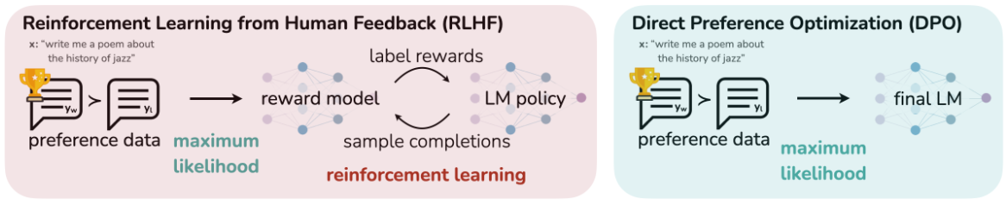
Reducing Cost of RLHF (1)
Can the cost of tuning for human preference be decreased?
Focus of current research efforts
Direct Preference Optimization (DPO) proposes such an approach
Proposed by Rafailov et al. 2023
Reparameterizes RLHF objective to avoid use of reward model
Derives closed-form solution, results in optimizing simple classification loss
Trains on "preference pairs"
E.g. which of the two answers is best

Slide 72
Reducing Cost of RLHF (2)
Bai et al. (2022) reduced human effort in LLM alignment to almost none
They build as set of principles (a "constitution") so models can use to determine whether a response is appropriate
For Step 1, the LLM itself judged and improved on its own answers, then was fine-tuned on its improved responses
For Step 2, they used the fine-tuned model to choose better aligned responses from pairs of responses
Step 3 was done as before.
They called this approach: Reinforcement Learning from AI Feedback
More recently, DeepSeek-R1 skipped the entire Step 1 (expensive human labeling)
Used out-of-the-box software tools as reward models to train their model for reasoning tasks that typically require multiple steps
Out-of-the-box reward models: code compiler, math solvers

Slide 73
Pre-Training vs Post-Training
Amount of human decisions/intervention differs across training stages
Pre-training: large scale with little human bias or intervention, e.g. do not select which websites to crawl for training data, use them all
Mid-training: optional intermediate step with some human bias, e.g. data selection (high quality data), format selection (longer inputs), etc.
Post-training: done with RLHF, DPO, etc., high human bias, specific selection of tasks, training objectives, lots of data specific to tasks, e.g. coding, agentic engineering, specific domains like medical, legal, etc.
Crucial distinction: unclear (emergent) abilities come from pre-training
E.g. unclear size of model and data requirements to get models to better understand language during pre-training, scaling laws not general
But very clear what impact post-training has on model performance
Industry likely decides/controls what to improve with post-training
E.g. see here Andrej Karpathy comment about where progress from LLMs comes from

Slide 74
Open Challenges with LLMs
Still several challenges ahead.
Hallucinations: still severely hindering potential of these tools
Cost: still highly expensive to train, but costs coming down
Reasoning: still limited in their ability to reason, try different solutions, identify mistakes
Transparency: still huge black boxes, neither user nor models can explain their output reliably
Updated information: requires updating models with newer data

Slide 75
Summary
Large Language Models
Size means new "abilities", e.g. ICL, following instructions
New "abilities" means new ways to use these models
Using LMs before:
Fine-tune pre-trained LM, e.g. BERT, requires expert knowledge
Using (L)LMs today:
Interaction via natural language, technology potentially democratized to end-users (ideally, if you can talk/write, you can use them)
In-Context Learning (ICL): given task description and/or examples, model performs task (no weight updates on model)
Instruction tuning: tune models to perform new tasks given instructions
ICL and instruction tuning give rise to prompting, prompt engineering
Despite progress, models generally not aligned to human preference
Alignment methods expensive (reinforcement learning, human feedback)

Slide 76

References
References linked in corresponding slides
© University of Mannheim

