Slide 1

Advanced Methods in Text Analytics
Multilingual NLP
Licensed under Creative Commons Attribution 4.0 International

Slide 2
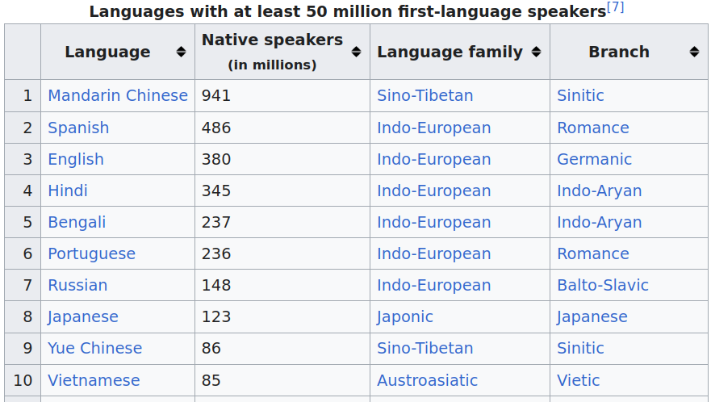
Most Spoken Languages (1)
What are the most spoken languages in the world?
According to Ethnologue, this is the distribution for native speakers
The top 10 languages cover 3 billion people (37.5% of the world)
Image source

Slide 3
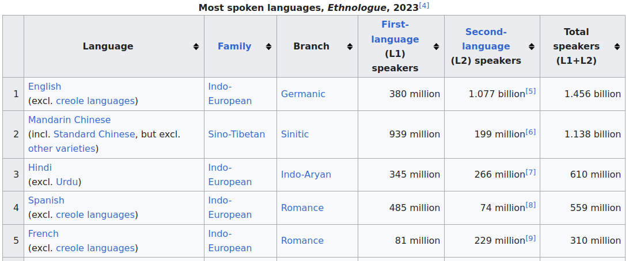
Most Spoken Languages (2)
What if we break this into native vs non-native speakers?
Again, according to Ethnologue...
The top 5 languages cover 4 billion people (50% of the world)
Image source

Slide 4
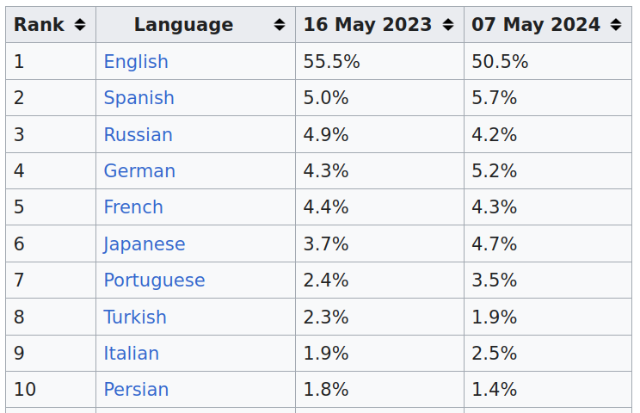
Most Spoken Languages (3)
What about language distribution as used on the world wide web?
According to W3 Technology Surveys...
English alone covers 50% of the content online (top 10 languages 84%)
Massive difference in language distribution in the world vs online

Slide 5

Why Multilingual NLP? (1)
NLP: roughly, automatically processing human language with computers
There are over 7100 human languages in the world (source)
Ideally, all of these languages have equal access to information
Google Gemini could not speak Javanese when released (Dec. 2023)
But 68 million people speak this language in Indonesia
That's the same number of people that speak Italian
Javanese is now supported, but why this limitation originally?

Slide 6
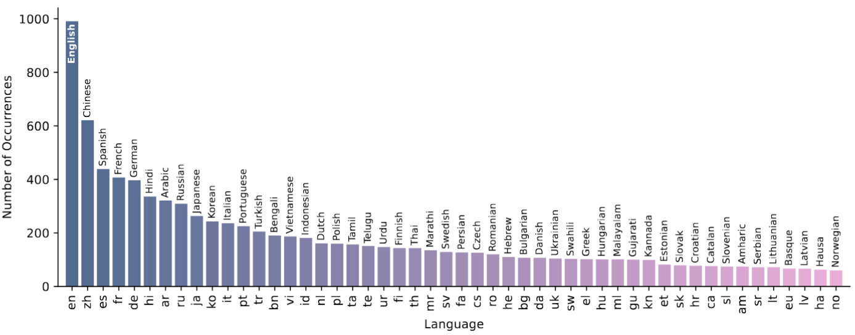
Why Multilingual NLP? (2)
State-of-the-art (SOTA) NLP methods: data hungry statistical methods
Modern language models typically trained on a massive corpus crawled from the web, where English is by far the most common
So, performance in English much better than less available languages
The Bitter Lesson in Multilingual Benchmarks (Wu et al., April 2025)
English far more common even in 2000+ recent multilingual benchmarks
Multilingual benchmark --> actual effort to get non-English data
Multilingual performance on NLP tasks weakly correlated with human evaluations

Slide 7
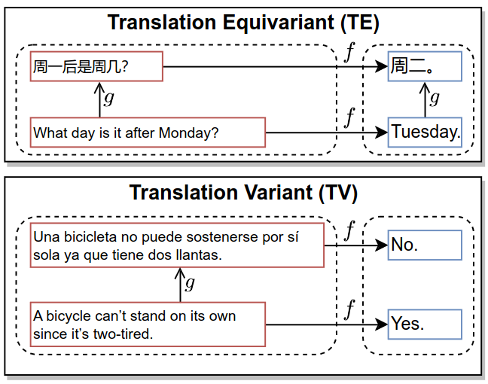
Just Translate to English?
As machine translation improves, fair question: just translate to English?
I.e. translate task to English, feed it to model, translate output back
Translation is not good enough in many cases
E.g. if output is independent of
input language, LLMs may solve
problems via translation
(Zhang et al. 2023)
Not if language changes answer
Example in image: language
independent task (top) vs
language dependent task (pun
detection, bottom)
Similarly, Wu et al. (2025) found:
Strong correlation with human eval. in STEM tasks (language independent)
Translation not enough, models worse in translation-based benchmarks

Slide 8
Multilingual NLP
Multilingual natural language processing (mNLP): NLP systems that can process multiple natural languages
But how many languages?
Ideally, the more the better!
But, the more languages, the more challenges
In this lecture:
Cross-lingual transfer (fundamental goal of mNLP)
Multilingual transformers

Slide 9
Outline
Cross-Lingual Transfer
Multilingual Transformers

Slide 10
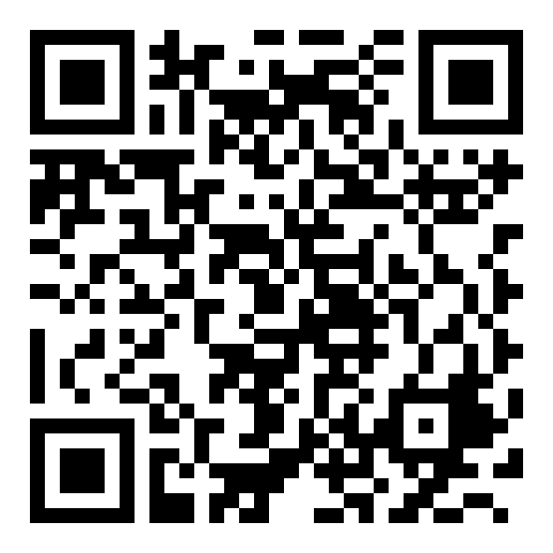
But First...
Please evaluate our course!

Slide 11
Cross-Lingual Transfer

Slide 12
What is Cross-Lingual Transfer?
Due to their statistical nature, SOTA NLP models perform much better in English than in languages less available online (Zhang et al. 2023)
E.g. GPT-3 (Brown et al. 2020) and LlaMA-2 (Touvron et al. 2023) trained on data that is heavily skewed toward English
Supervised datasets for downstream fine-tuning mostly available in English
Cross-lingual transfer: model applies knowledge obtained in some source language to a setting in a different target language
Source language s usually a high resource language, e.g. English
Target language t usually a low-resource language, e.g. Quechua
Essentially, transfer learning across languages
Task for intuition of cross lingual transfer: using an ATM to get cash
Some aspects language independent, e.g. button placement, order of actions (first insert card, etc.)
Other aspects language dependent, e.g. reading options on screen
Another example: driving a car (steering vs reading street signs)

Slide 13
Cross-Lingual Transfer in LMs (1)
General approach:
Pre-train/fine-tune LM on task T in English (source language, lots of data)
Then fine-tune/do inference on T in Javanese (target language, less data)
Why would you do that?
Some aspects of the task may be language independent
Training on language with more data may be useful to get language independent aspects of tasks
How can we measure if task is indeed transferable?
Measure performance on the task!
Baselines important, e.g. monolingual setting
Success is cross-lingual transfer suggests:
There are aspects of the task that are shared across languages
Trained models learned these shared/transferable aspects of the task
This success could enable democratization of SOTA NLP methods!
Thus, cross-lingual transfer is a fundamental goal of mNLP

Slide 14
Cross-Lingual Transfer in LMs (2)
More common setting:
First pre-train LM on English & Javanese (already support more languages)
Then fine-tune on some specific task, e.g. sentiment analysis, using data in English (safe to assume lots of data for the task in English)
Then do inference on same task using data in Javanese (where there is little data in this language for fine-tuning your LM for the task)
Easier said than done, more details to handle in most cases
E.g. why support more languages during pre-training already?
We discuss such details in the next section
How to study/enable cross-lingual transfer?
Normally, by looking into shared cross-lingual features
I.e. features that are similar across more than one language
Easy way to visualize this: cross-lingual word embeddings (CLWE)

Slide 15
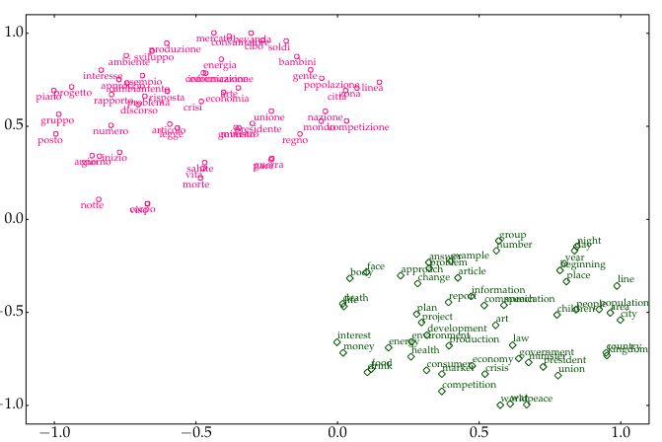
Embedding Space Alignment (1)
Say we train static word embeddings with skip-gram (Mikolov et al. 2013) in two different languages: English and Italian
The embedding space may look as shown below (clustered by language)
Image source

Slide 16
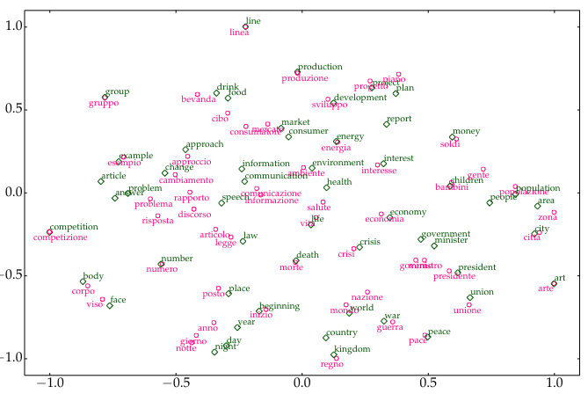
Embedding Space Alignment (2)
We may want shared features across languages, i.e. a bilingual embedding space clustered (often referred to as aligned) by meaning
This requires an alignment signal, e.g. word-to-word translations
Image source

Slide 17
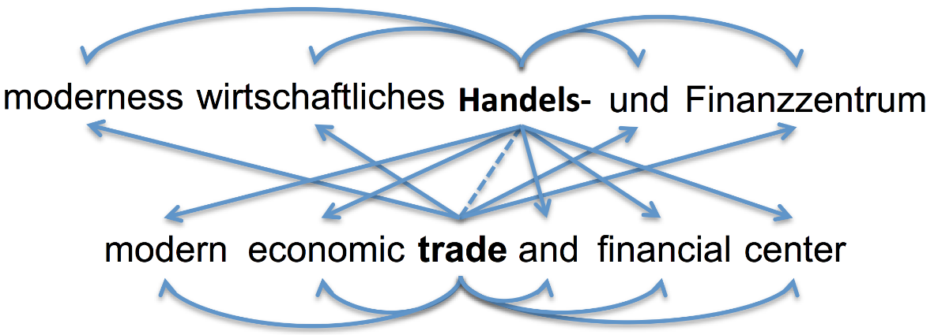
Cross-Lingual Word Embeddings (1)
Example: the bilingual skip-gram model by Luong et al. 2015
Recall skip-gram: given center word, predict neighboring words
Bilingual skip-gram: in addition to monolingual objective (curved arrows), predict surrounding words in target language (straight arrows)
Given source language s and target language t, such a method requires:
Corpora C_{s}, C_{t}, vocabularies V_{s}, V_{t} and parameters W₁^{s}, W₂^{s}, W₁^{t}, W₂^{t}
Dictionary D_{s} = {(s_{i}^{s},s_{i}^{t})} of sentence translation pairs where s_{i}^{s} ∈ V_{s}, s_{i}^{t} ∈ V_{t}

Slide 18
Cross-Lingual Word Embeddings (2)
Why does this method require parallel sentences?
I.e. why do we require translation?
And why translations of sentences and not just words?
Parallel sentences, i.e. translated sentences, is alignment signal to enforce shared features across languages
Task dependent: for skip-gram objective, which is based on predicting context words given center word, we require sentences to provide suitable context windows during training (principle of distributed semantics)
Such parallel sentences commonly found in machine translation datasets
But how do we use D_{s} to align corresponding words in W_{i}^{s} and W_{i}^{t}?
We could add a term to the training objective to force model to minimize distance between corresponding vectors for aligned words in (s_{i}^{s},s_{i}^{t}) ∈ D_{s}
What did the authors do?
Set w_{i}^{s} = w_{j}^{t} for aligned words in every example from D_{s}, where w_{i}^{s}, w_{j}^{t} are i-th and j-th row of W_{i}^{s} and W_{i}^{t}, resp. (additional word alignment needed)

Slide 19
Evaluating CLWE
Intrinsic evaluation:
Bilingual lexicon induction (BLI)
Cross-lingual word similarity (XL-SIM)
BLI: given (w_{i}^{s}, w_{i}^{t}) ∈ D_{s}, take w_{i}^{s} as query and rank all rows from W^{t} based on similarity to w_{i}^{s}, then check rank r_{i} of correct answer w_{i}^{t}
We compute metrics based on r_{i} averaged over all w_{i}
E.g. precision@1 (P@1): percentage of k pairs where r_{i} = 1
Mean reciprocal rank (MRR): average of 1/r_{i} across k pairs
XL-SIM: given (w_{i}^{s}, w_{i}^{t}) ∈ D_{s}, compare similarities of corresponding vectors with semantic similarity scores given by human annotators
Subjective task, requires averaged scores across multiple annotators
Extrinsic evaluation: use CLWE on downstream cross-lingual tasks
Zou et al. 2013 used CLWE as features in phrase-based machine translation
Entity linking: match mention in one language to entity in another language

Slide 20
Beyond CLWE
Static representations of words seldom used today
Instead, NLP relies almost exclusively on contextualized representations
Typically, these representations are provided by transformer-based language models (LMs)
Even if multilingual, static representations are still limited
Nevertheless, the following concepts are still relevant in mNLP:
Cross-lingual transfer
Alignment of representation space
In the next section:
Cross-lingual transfer using transformer-based models

Slide 21
Multilingual Transformers

Slide 22
Multilingual BERT
What could cross-lingual transfer look like with transformer-based LMs?
Any ideas?
Pires et al. 2019 developed multilingual BERT to explore this question
They framed cross-lingual transfer with BERT as follows
Pre-train BERT on corpus of concatenation of text (Wikipedia) in multiple different languages (let's call it mBERT)
Fine-tune mBERT on some task using language s (seen in pre-training)
Evaluate mBERT on same task using different language t (seen in pre-training)
They called this zero-shot cross-lingual transfer
Note: no cross-lingual supervision, e.g. parallel sentences
If successful, it would mean the model learns the task beyond its representation in some language
"Learns the task", some aspects of it at least

Slide 23
Training Multilingual LMs
Training data was highly unbalanced in mBERT
This has important implications on performance
Training corpus: concatenation of Wikipedia in 104 different languages
But size of Wikipedia is different in different languages
Number of articles in English: about 6.8M articles
Number of articles in Vietnamese: about 1.3M articles
Number of articles in Javanese: about 73000 articles
Impact on performance is predictable
Performance on more common languages is better. Why?
Transformer has more data to learn from
Learn = adjust its 100M parameters so it generalizes instead of overfitting
In addition, low-resource languages typically require more data given same number of parameters
Why?
Hint: the model uses a single shared subword vocabulary for all languages

Slide 24
Tokenization in Multilingual LMs (1)
What impact does unbalanced data across languages have on tokenization?
mBERT used WordPiece (mentioned in tokenization lecture)
Recall WordPiece: similar to BPE (covered in detail in tokenization lecture)
Start with vocabulary V made of characters
Merge pairs of tokens that increase data likelihood of n-gram LM
Keep merging until you reach desired vocabulary size
If we add frequent tokens to vocabulary, a count-based n-gram model can better estimate their probabilities.
Similar effects in other forms of tokenization, e.g. BPE, UnigramLM
In other words, multilingual vocabulary dominated by "larger" languages, as measured by training data size
Recall example from tokenization lecture: hello in English -> 1 token
Corresponding word in Hindi: namaste -> 3 tokens
Why does this matter?

Slide 25
Tokenization in Multilingual LMs (2)
Multilingual tokenization already discussed in tokenization lecture
Same message requires more tokens to be represented in low-resource languages
Given limited input length in modern LMs, low-resource languages are limited to shorter input sequences
But why does this mean low-resource languages require more data given the same number of parameters?
Because transformer needs to learn to contextualize subword tokens that belong to the same word
E.g. learn that na, ma and ste should attend to one another
Can be challenging, because subword tokens more likely to appear in different languages, but with different meanings (e.g. article a in English)
In short, tokenization crucial for performance across languages
Note vicious circle: low-resource languages train with low amounts of data, which creates problems that can be solved with more data

Slide 26
Generalizing Across Languages (1)
mBERT was indeed "surprisingly" successful despite unbalanced data
I.e. model was quite good at zero-shot cross-lingual transfer
This suggests model can do tasks beyond language, but why surprising?
How can we explain mBERTs success without alignment signal?
Recall: no alignment signal, e.g. parallel sentence translations
Several studies have focused on this question and found:
K et al. 2020: shared vocabulary not needed, model depth needed, languages should be of similar structure
Artetxe et al. 2020 show that neither shared vocabulary nor joint training is needed (given pre-trained model in language s, they froze all parameters except embedding matrix and fine-tuned on new language t)
Conneau et al. 2020 showed that independent monolingual BERT models can be aligned post-hoc by tying parameters in top layer
Dufter et al. 2020 hypothesized that mBERT is multilingual due to limited parameters, forced to share feature across languages
Blevins et al. 2022: language contamination -> no real monolingual models

Slide 27
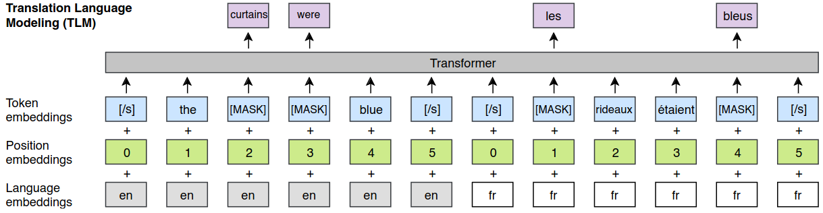
Generalizing Across Languages (2)
mBERT was the first of many multilingual transformer-based LMs
Lample et al. 2019 proposed XLM model (stands for cross-lingual LM)
Balanced data for learning tokenizer (upsampled "small" languages, downsampled "large" languages)
Additional objective: translation language modeling (TLM)
TLM: masked language modeling (MLM) but with pairs of parallel sentences (i.e. translations), i.e. alignment signal required
Note: objective no longer self-supervised but supervised

Slide 28
Generalizing Across Languages (3)
Conneau et al. 2020 proposed XLM-R
Just MLM, no more TLM
Much larger training data
Much larger vocabulary: 250K
Significantly outperformed mBERT on cross-lingual tasks
Lauscher et al. 2020 showed cross-lingual performance largely dependent on type of "size" of language and "distance" to English
Size: size of pre-training set
Distance: how structurally similar it is to English
They found performance drops a lot with smaller/more distant languages
Number of languages also impactful to cross-lingual performance
Conneau et al. 2020 found a trade-off between performance and number of languages for a fixed model size
Curse of multilinguality: more languages lead to better cross-lingual performance up to a point, after which performance generally degrades

Slide 29
Zero-Shot vs Few-Shot
Most works described so far focused on zero-shot transfer
Assumption: zero-labeled examples in target language
Perhaps more a scientific question rather than a realistic setting
E.g. "can we do it in a zero-shot setting?"
Why?
In practice, almost always possible to label a small number of examples in any target language
This would mean a few-shot cross lingual setting
Lauscher et al. 2020 proposed sequential few-shot transfer
First, fine-tune LM on specific task using "large" language, e.g. English
Then, fine-tune on same task using "small" target language, e.g. Javanese
PROs: They found massive improvements over zero-shot setting
CONs: first step expensive, not cross-lingual signal about task due to separate steps
Besides such quantitative studies, qualitative research was also done

Slide 30
Cross-lingual Transfer in mBERT (1)
Muller et al. 2021 studied the internal mechanism that allow mBERT do perform cross-lingual transfer.
Recall mBERT: pre-trained on multiple languages, fine-tuned on some source language, performed inference on another target language
First, they replaced (pre-trained) transformer layers one by one with new, randomly initialized layers, compared performance with mBERT
Method for feature attribution: what is the impact of this feature on the model prediction?
By replacing the layer with random weights and checking difference in performance, we can see how important that layer is for the model
This was done on three tasks:
Part-of-Speech (POS) tagging: (assign labels to parts of sentences, e.g. verb)
Dependency parsing: predicting dependency between parts of sentence
Named Entity Recognition (NER): identify entities in text, e.g. Jane Austen
Each task evaluated in two settings: monolingual, cross-lingual (2 lang.)

Slide 31
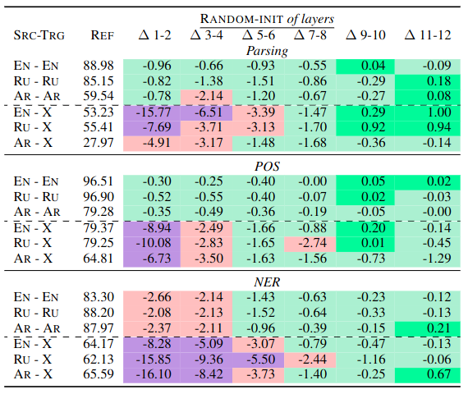

Cross-lingual Transfer in mBERT (2)
They found lower layers more important in cross-lingual setting
Replacing lower layers with
random weights had much
more impact cross-lingually
Replacing upper layers had
little impact in both settings
This suggests lower layers act
as "multilingual encoder", and
upper layers as task-specific,
language-agnostic "predictor"
Upper layers not important
for cross-lingual transfer
Lower layers much more
Important cross-lingually
than monolingually

Slide 32
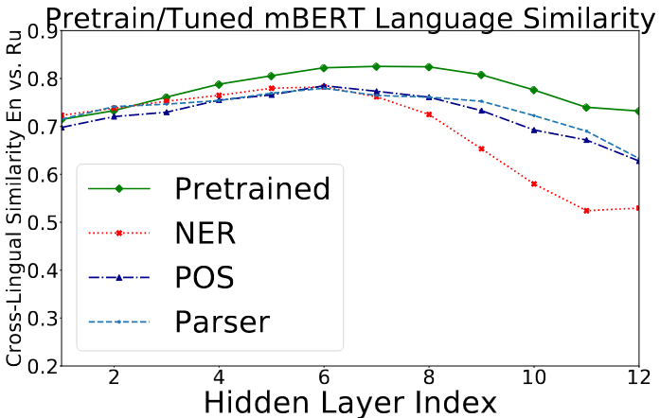
Cross-lingual Transfer in mBERT (3)
They also looked at alignment per layer
How? Average contextualized representations of input sentence in one language, compare with averaged representation in another language
They found representations more aligned toward center layers
Suggests model initially learns similar representations across languages
May be task dependent, similar results found later (Chi et al., Gaschi et al)

Slide 33
Multilingual Evaluation
mNLP: democratization of NLP methods across languages
Still an open challenge, e.g. Gemini does not speak javanese
Research still ongoing in this direction
Many multilingual tasks proposed for research, e.g.:
Americas NLI: natural language inference (NLI) covering 10 low-resource indigenous languages of the Americas
MaskhaNER: named-entity recognition (NER) on 10 low-resource african languages
Today, common to evaluate LMs on benchmarks with multiple tasks
XGLUE: 11 tasks, 19 languages
X-TREME-R: 10 tasks, 50 languages
Etc.

Slide 34
Multilinguality in LLMs (1)
Since LLMs, research in mNLP mostly reproduced prior results
I.e. no new concepts, no new findings compared to PLM-based research
Have LLMs solved mNLP?
In short, no.
Many languages still not covered
Large variance in performance across languages
Aren't some LLMs multilingual?
Yes!
Gemini supports over 40 languages
Llama-3.1 supports 8 languages officially (many more unofficially)
But cross-lingual signals usually not present during pre-training
So, ongoing research to determine whether specific changes to architecture or training regimes are necessary
E.g. cross-lingual attention (feed model cross-lingual training examples)
Or perhaps simply scaling will get us to the mNLP goal

Slide 35
Multilinguality in LLMs (2)
Recently, Ahuja et al. 2023 studied multilingual performance of LLMs
They found significant gap in performance in English vs non-English
Especially true in low-resource language with non-latin scripts
Machine translating not enough
Something that is special to LLMs: ICL
Zhang et al. (2024) studied impact of ICL demonstrations across languages
The found effectiveness of demonstration is also language dependent

Slide 36
Summary
Multilingual NLP: NLP systems that can process multiple natural languages
Cross-lingual transfer: using knowledge acquired in some source language s on a task described in another target language t
Can be accomplished in many ways depending on task, model architecture
Representation alignment: similar words in different languages clustered together in embedding space
Multilingual transformers: typically pre-trained in multiple languages
LMs designed for cross-lingual transfer
E.g. via zero-shot cross lingual transfer, sequential cross-lingual fine-tuning
Modern LLMs are already multilingual, they are trained in multiple languages
But performance across languages varies a lot given task and language
Open challenge: improve multilingual performance of LLMs

Slide 37

References
References linked in corresponding slides
Multilingual NLP by Prof. Goran Glavaš
© University of Mannheim

