Slide 1

Advanced Methods in Text Analytics
Introduction
Licensed under Creative Commons Attribution 4.0 International

Slide 2

Hello!
Daniel Ruffinelli (PostDoc)
Got a PhD with Prof. Rainer Gemulla
Research focus was machine learning applied
to knowledge graphs
Experience with ML research, ML/DL teaching
Now doing PostDoc in NLP with Prof. Simone Ponzetto
I will handle all lectures and all tutorials in this course
Focus Group: Natural Language Processing and Information Retrieval
We offer the Information Retrieval course in other semesters

Slide 3
When do we meet?
Lectures
When: Tuesdays at 13:45
Where: A5 6, Room C015
Tutorials
When: Wednesdays at 8:30
Where: A5 6, Room C015
First tutorial next week (Feb. 19th)
Basic Python
Basic PyTorch
Feel free to skip it if you're already familiar with these

Slide 4
About this course (1)
Follow-up from IS 661 Text Analytics by Prof. Strohmeier
We might briefly cover some concepts from that course
But we generally assume the content in that course is known
Official requirements of this course:
Basic: linear algebra, probability theory, calculus (basic = BSc level)
Having finished one of the following courses: Text Analytics (TA), Machine Learning (ML) or Deep Learning (DL) (mostly one of the latter two)
Examples of knowledge assumed/required for this course:
How ML models are trained (i.e. the basic training loop, which we will ask you to implement at some point in this course), plus algorithms like gradient-descent and the use of optimizers
How ML models are evaluated (i.e. the evaluation loop, which you will be asked to implement as well), metrics like accuracy, precision, recall, etc.
Additionally: you will need to code in Python/PyTorch
We provide a brief introduction in the first tutorial

Slide 5
About this course (2)
What you will learn:
Fundamentals of Deep Learning for Natural Language Processing (NLP)
Concepts/methods in latest developments in NLP research
In other words, state-of-the-art methods for NLP (active field!)
This should allow you to:
Understand large language models (LLMs) “under the hood”
Read NLP research papers
Potentially work in NLP engineering
There will be some overlap with ML/DL courses
In general, basic ML/DL is repeated in many courses (unavoidable)
We’ll point out when this is so
We’ll try to keep it to a minimum
But this is NOT a replacement for ML/DL courses
We encourage all of you to take those courses
(1) Intuition and (2) mathematical details are equally important here!

Slide 6
About this course (3)
I tend to speak very fast
This is not good for teaching!
Raise your hand and politely ask me to slow me down if necessary
This works well in practice
The course has quite a bit of content
14 weeks: 13 lectures + Final QA (or optional lecture, finishing last lecture)
Exercises almost every week
Main challenge: strike a balance between delivering all of the content and delivering it with clarity
This is why taking requirement courses is important
If you haven't, clarity of the content may suffer
Warning: this course and the Information Retrieval course are very different
In this course, we go into more depth and details

Slide 7
Course Logistics
Final grade:
100% of the grade comes from the final exam
Lectures
Goal: to introduce and discuss concepts and methods
Format: references provided in last slide of each set of lecture slides, useful references linked like this throughout the course
Tutorials
Goal: support lectures with deeper dives into same or new but related concepts/methods
Format: released one week, you work on it at home, solutions are discussed the week after

Slide 8
Tentative List of Topics
Most of our focus is on methods
Basics of ML and DL, feed-forward neural networks
Word representations, static and contextual, pre-training
Recurrent neural networks, attention
Transformers
Tokenization
Transfer learning (pre-training + fine-tuning)
Large language models (LLMs): architecture, tuning, applications
NLP Applications (LLM evaluation, common tasks)
Multilingual NLP
Less focus on tasks (we discuss some of them when needed)
Language modeling (discussed extensively throughout the course)
Machine Translation
Question Answering
Dialogue Systems

Slide 9
Reference Books
Speech and Language Processing (3rd ed. draft) by Jurafsky and Martin
https://web.stanford.edu/~jurafsky/slp3/
NLP, An ML perspective, Zhang et al.
Online access via the University library
NLP by Eisenstein et al.
https://cseweb.ucsd.edu/~nnakashole/teaching/eisenstein-nov18.pdf
Most of the content in 2nd half of the course comes from papers released in last 5 years or so
They will be referenced via links in these slides

Slide 10
Outline
What is Text Analytics?
What is Advanced Text Analytics?
Recap: Basic NLP Concepts

Slide 11
What is Text Analytics?

Slide 12
Natural Language Processing
Eisenstein: set of methods for making human language accessible to computers.
Zhang and Teng: the study of automatically processing or synthesizing human languages.
Generally: interdisciplinary area, e.g. some linguistics, some computer science, some machine learning.
Similar/related terms:
Computational linguistics: main focus is language, not computational methods
Speech processing: main focus is processing audio into text
Text Analytics: drawing value from text (we treat it as synonym to NLP)

Slide 13
Challenges
Started in the 1950s as part of artificial intelligence research
Initially thought to be easy, challenges quickly emerged
Main challenge: ambiguity in language
Semantic ambiguity: “They can fish here.”
They are allowed to fish in that location.
They put fish in cans in that location.
Lexical ambiguity: “L’avocat est juste lá.”
Is the lawyer right there?
Or is the avocado right there?
Named entity ambiguity:
“Michael Jordan is the Miles Davis of machine learning.”
Who? The basketball player or the professor at UC Berkeley?
Other challenges: idioms, e.g. he is “out of his mind”; multilingualism, e.g. many “low-resource” languages; basic knowledge not given in text

Slide 14
NLP Tasks
NLP is a broad area that studies a wide range of tasks.
Some examples of NLP tasks:
Question answering (QA)
Machine translation (MT)
Text summarization
Assisted writing
Useful to distinguish them by their inputs and outputs

Slide 15
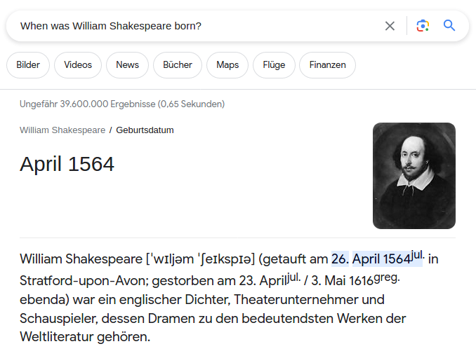
Question Answering (QA)Machine Translation

Slide 16

Machine Translation (MT) Machine Translation

Slide 17
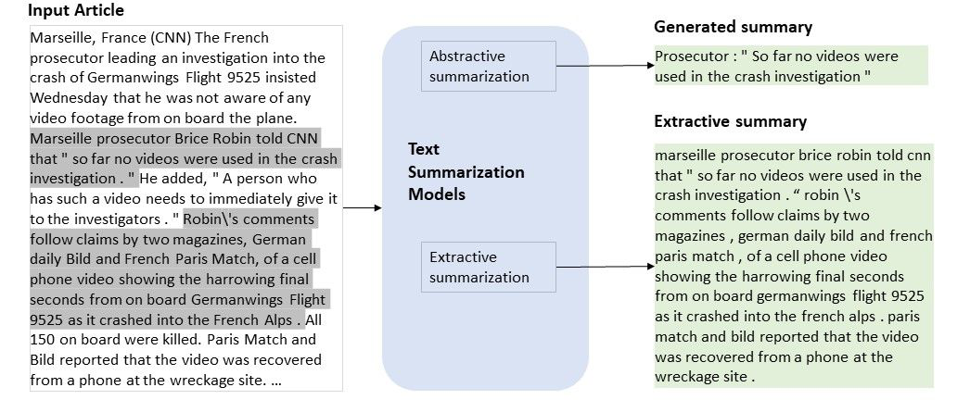
Text Summarization Machine Translation
Image source

Slide 18
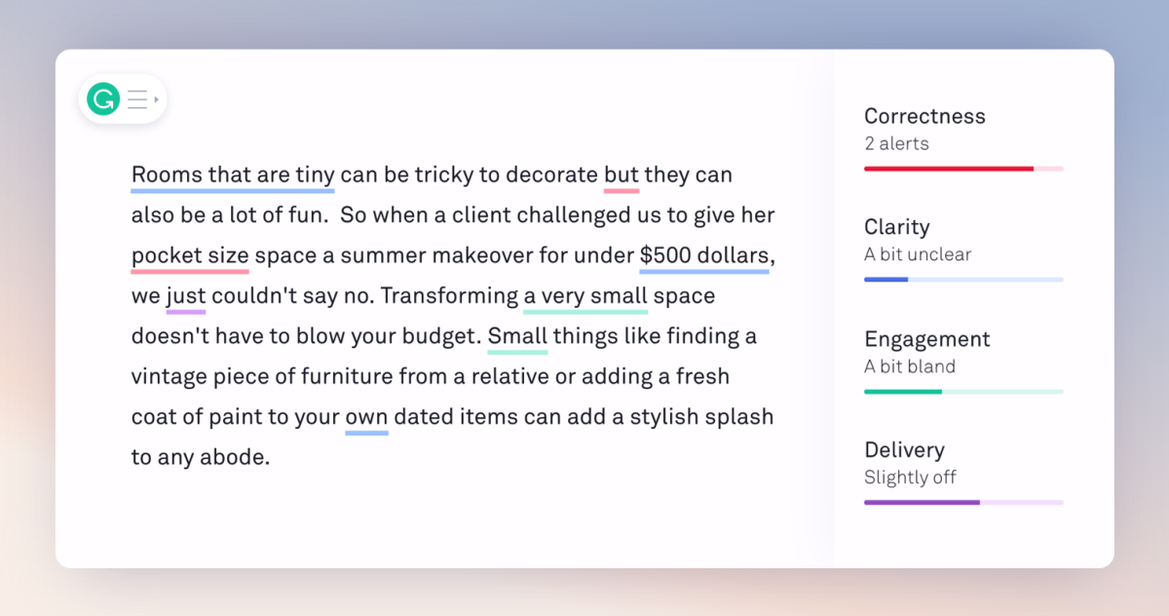
Assisted Writing Machine Translation
Image source

Slide 19
The Role of Machine Learning in NLP
Current NLP methods rely almost exclusively on ML techniques to solve tasks.
ML (specifically, Deep Learning) allows complex solutions to be built from training on large amounts of data and without requiring knowledge about linguistics
However, there are fundamental differences with NLP
Text data is discrete, unlike audio or images.
But new words are constantly created
And word distribution is highly skewed, meaning it’s challenging for algorithms to be robust on less frequent words.
Language is compositional.
Meaning units such as words can be combined to create new phrases with new meanings

Slide 20
NLP Tasks from a ML Perspective
From an ML perspective, there are fewer types of NLP tasks
Based on output of task:
Classification: model produces categorical output, e.g. one of few possible sentiments, one of thousands of possible words
Structured prediction: model produces structures with inter-related substructures, e.g. POS-tagging and dependency parsing
Regression: model produces real-valued prediction, e.g. automatic essay scoring
Based on training data:
Unsupervised: unlabelled training data
Supervised: labelled training data
Self-supervised: in-between both

Slide 21
What is Advanced Text Analytics?

Slide 22
Traditional vs Modern NLP
The term advanced mostly refers to methods
Most state-of-the-art methods today share similar foundations in deep learning
NLP has been through a revolution in the past decade.
Mostly driven by deep learning technology
Similar revolutions have taken place in Computer Vision and Speech Processing
Traditional methods: relied on expert knowledge manually injected into automated solutions, e.g. structures encoded into regular expressions
Modern NLP methods: big-data and high compute power allowed deep learning solutions to largely out-perform traditional methods in all NLP tasks without requiring expert knowledge (see The Bitter Lesson)

Slide 23
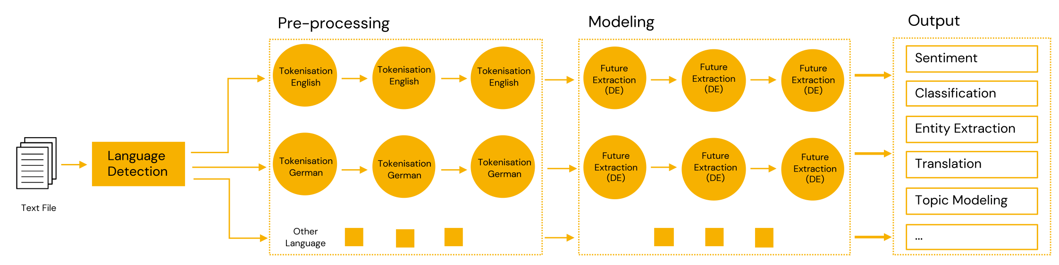
Traditional NLP
Image source
Relied heavily on pre-processing methods, feature engineering
Pre-processing may drop useful information, e.g. punctuation
Feature engineering required expensive expert knowledge
Steps were often task-dependent
Important: some of this experience could become useful again

Slide 24
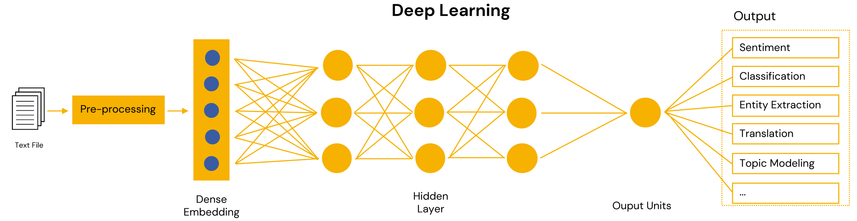
Modern NLP
Image source
Deep learning techniques based on learning generally useful representations of words (tokens), which are then used in several different types of downstream applications (QA, MT, etc.)
General intuition: learned representations encode meaning of words
Training such representations is prohibitively expensive (more later)

Slide 25
ChatGPT and Other LLMs
ChatGPT and similar models, e.g. Google’s Gemini and DeepSeek, are examples of the success of Deep Learning and the progress of NLP solutions
These models are chatbots based on large language models (LLMs), in turn based on the transformer architecture and trained with manually designed training objectives
In this course, we will cover:
How these models are designed to learn representations
How these models are trained to learn representations
How these models/representations are used in downstream applications
In short, how LLMs work internally
Some of the abilities of these models are remarkable!
Let’s go over some of them

Slide 26
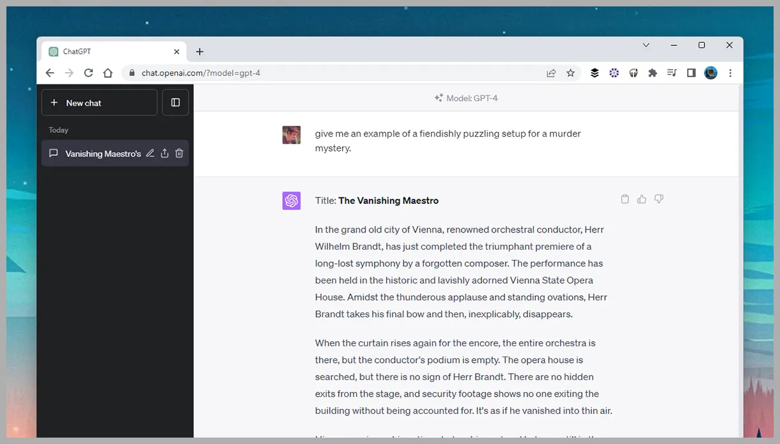
ChatGPT for Writing
Image source

Slide 27
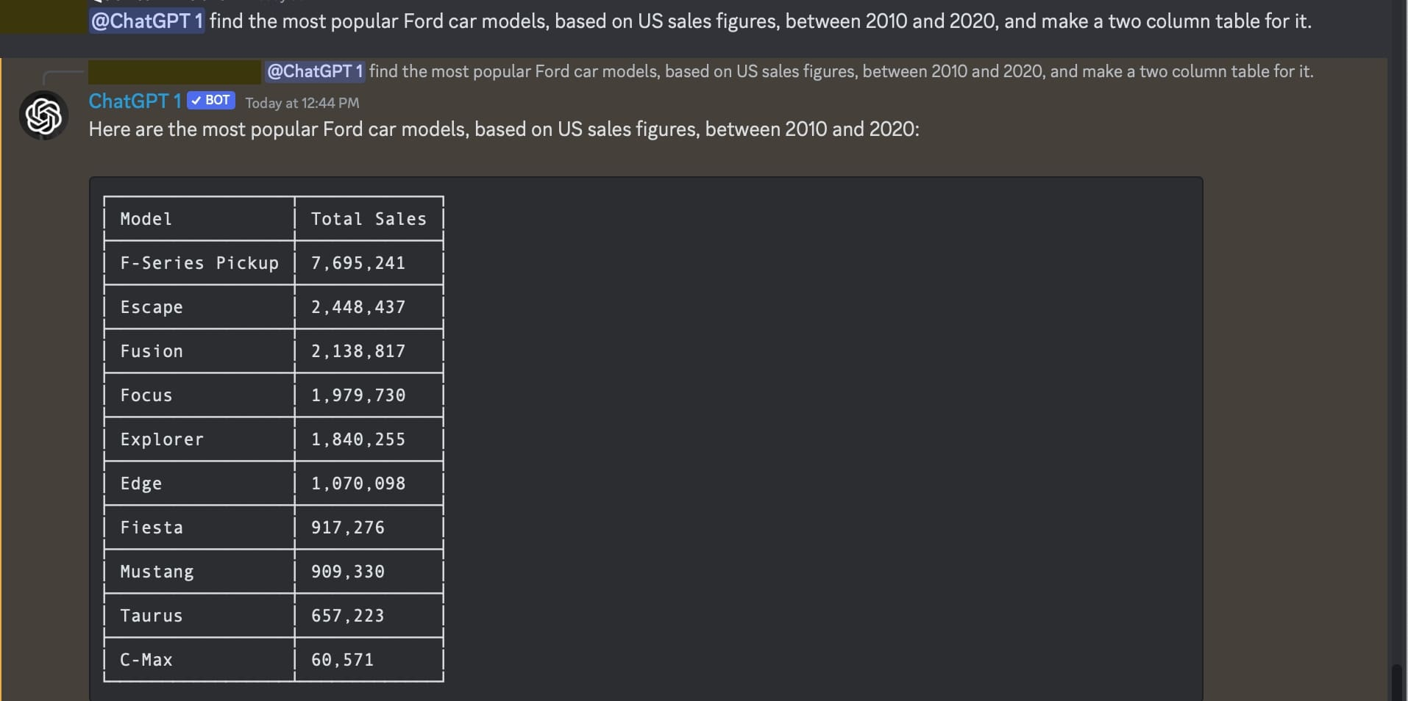
ChatGPT for Creating Tables
Image source

Slide 28
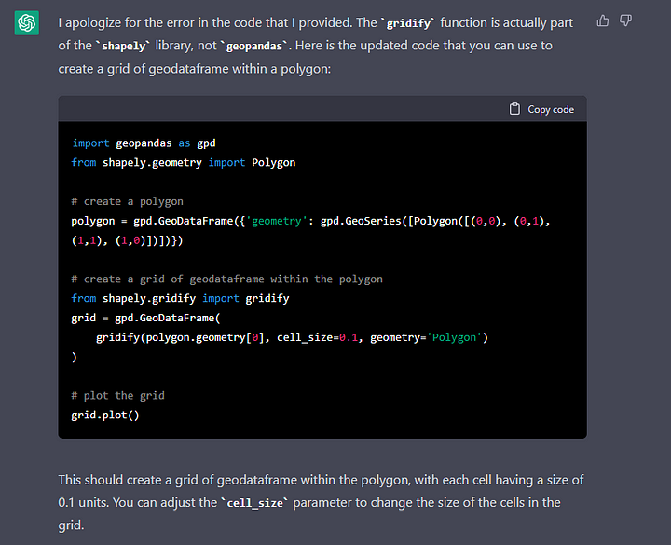
ChatGPT for Coding
Image source

Slide 29
Recap: Basic NLP Concepts

Slide 30
Contents of Text Analytics Course
Basic concepts
Basic text processing, e.g. stemming, segmentation, tokenization, normalization
Basic concepts: similarity, relatedness, disambiguation
Language modeling, POS tagging Intro to ML, DL
Word senses, word embeddings
Today:
Quick recap of some important concepts
Part of next few lectures:
Recap the rest as needed
No recap is exhaustive
Again, we assume either the TA, ML or DL course

Slide 31
Similarity and Relatedness
Concept of similarity very useful in many NLP tasks
Question: How to define/measure similarity?
Edit distance? E.g. typo graffe closest to giraffe than grail
A data base of synonyms?
Synonymity is usually a yes/no question.
Is similarity that simple?
There are other types of relations between words
E.g. went is derived from go
This more generally refers to word relatedness
Are all semantically related words similar?
Similarity: can substitute one word for the other
Relatedness: semantic correlation, but not interchangeable (more general)
Further, do we measure similarity between words or senses?
Word: Bass
Sense 1: type of fish; Sense 2: musical instrument

Slide 32
Word Sense Disambiguation
Identifying intended sense of each word in a document
“Drunk gets nine years in violin case”
Is it a violin case? Or a legal case?
Sense is a property of lemmas (roughly, roots of words), not of words themselves
Word sense disambiguation is thus:
Identify lemma
Choose correct sense
How often do words have many senses?
WordNet: big manual effort to encode sense as knowledge base of sets of synonyms (synsets)
Example: Wordnet has 8 distinct senses for the word bass
Also contains other types of relations between synsets, e.g. antonym, hyponym, hypernym, meronym, etc.
So, task is not trivial!

Slide 33
Tokenization (1)
Goal: segmenting text into words.
Words from a finite set, a vocabulary
But what exactly is a word? Not always clear
Are punctuation marks words?
And acronyms such as U.S.A.? How many words is that?
Such decisions often made by the tokenizer (TKZ)
Example: “We are the champions, my friends!”
TKZ 1: {’We’, ’are’, ’the’, ’champions’, ’my’, ’friends’}
TKZ 2: {’We’, ’are’, ’the’, ’champions’, ’,’ ’my’, ’friends’, ’!’}
TKZ 3: {’We’, ’are’, ’the’, ’UNK’, ’,’ ’my’, ’friends’, ’!’}
Thus, basic segments often referred to as tokens
What these are depends on tokenization method
High-level discussion today
We cover these in more detail later in the course

Slide 34
Tokenization (2)
Ideally:
Tokens encode meaning
Tokenization is fast! (Basic pre-processing step)
Memory efficient (often required on GPU memory)
Coverage (less chance of finding unknown token)
Question: What should our basic tokens be?
Words? Obvious suggestion, but again, what are words?
And what about written languages that don’t delimit words?
And words composed of subwords, e.g. Wahrscheinlichkeitstheorie?
Characters? Above problems solved!
Also efficient (small vocab.), even if including ALL languages
But what meaning do single characters encode? Often none
Subword? Often the best trade-off.
Encodes meaning, e.g. words token and tokenizer are related
Reasonably sized vocabulary

Slide 35
Language Modeling (1)
Predict the next word:
“Every Thursday there is a Schneckenhof …”
Which word is more likely to follow?
Meeting?
Party?
Notebook?
This suggests:
Some words are more likely to appear than others given some context
Probabilistically, a language model (LM) computes the following:
p(meeting|“Every Thursday there is a Schneckenhof”)
Generally: p(w_{n+1}|w₁,w₂,…,w_{n})
Conditional probability of w_{n+1} given joint distribution of w₁,w₂,…,w_{n}
Such a model can predict entire sequences with the chain rule
p(w₁,w₂,…,w_{n}) = p(w₁)p(w₂|w₁) p(w₃|w₁,w₂)… p(w_{n}|w₁,w₂,…,w_{n-1})

Slide 36
Language Modeling (2)
In many NLP applications, goal is producing word/token sequences
Machine translation
Summarization
Dialogue systems
The following task is therefore useful:
Given vocabulary V = {aardvark, abacus, . . . , zither}, predict probability of sequence of words p(w₁ , w₂ , . . . , w_{M} ), with w_{m} ∈ V
For example, in machine translation
Input: El café negro me gusta mucho.
Say a translation system provides the following possible answers
The coffee black pleases me much. (word-for-word translation)
I love dark coffee.
A good language model should say:
p(The coffee black pleases me much) < p(I love dark coffee)

Slide 37
Language Modeling with N-Grams
N-Gram: sequence of n words
2-gram: sequence of two words, 3-gram: sequence of three words
Example: extract all 3-grams from the following toy text corpus
Corpus: "This is the example sentence."
3-grams: "This is the", "is the example", "the example sentence"
N-gram models can model the task by counting n-grams (e.g. 3-grams):
number of times we see "is the example"
p(example|"is the") = ------------------------------------------------------
number of times we see "is the"
Answer depends on text corpus used to count n-grams:
Toy Corpus 1: "This is the example of the best scenario, this is the outcome of that same scenario, and this is the example of the worst scenario."
Toy Corpus 2: "This is the example, while this is the analogy."
Ideally, probabilities estimated from large corpus of natural language
Would be nice if it includes multiple domains (e.g. history, medicine, etc.)

Slide 38
LLMs: Large Language Models
Language models: they model the same task as n-gram models
In reality, there are variants of the language modeling task
They all relate to predicting new words given other words in same context
We'll cover the most common ones in this course
Large: they have billions of parameters that are used to estimate those probabilities (i.e. model training)
The more parameters we have, the more data we need to avoid overfitting
Where does this data come from?
LLMs are trained on corpora with trillions of words
E.g. the entire internet up to October 2023 (GPT-4o cutoff date)
This is why developing LLMs today is prohibitely expensive
Billions of parameters require lots of memory and data, thousands of GPUs
E.g. estimated cost of training Google's Gemini Ultra: 191 million USD (Stanford's 2024 AI Index Report)

Slide 39
Summary: Introduction
We went over structure of the course
Goals
Requirements
Tentative topics
References
We had an overview of text analytics
NLP
NLP Tasks
Role of ML, DL
Modern NLP Applications
We went over some basic and relevant NLP concepts
Similarity vs relatedness
Word sense disambiguation
Tokenization
Language modeling

Slide 40

References
Jurafsky et al., Chapter 2
Zhang et al., Chapter 1
Eisenstein, Chapters 1 and 4
© University of Mannheim

