Slide 1

Advanced Methods in Text Analytics
Word Representations
Licensed under Creative Commons Attribution 4.0 International

Slide 2
What are representations? (1)
Let’s represent a hypothetical country called Countryland!
What features should we use?
Area size? E.g. 400.000 km²
Population size? E.g. 20M
Continent? E.g. Europe
Let’s group those features as a single 3D feature vector
Countryland: (400.000; 20M; ‘Central Europe’)
Features can have different types
Real or integer numbers, e.g. population size
Categorical, e.g. the continents
We refer to that vector as a representation of ‘Countryland’
Is that useful for, say, inferring size of the economy?

Slide 3
What are representations? (2)
How about the following features then?
GDP? E.g. 50 billion USD
Interest rate? E.g. 2.2%
Inflation rate? E.g. 7.2%
This gives us a different representation of Countryland:
(50B; 2.2; 7.2)
Manually constructing representations: feature engineering
Often requires expertise in the area
E.g. ‘government debt to GDP’ is a common metric in Economics
Feature vectors: most typical form of input to machine learning (ML) methods

Slide 4
Can we learn useful representations?
Can we learn useful features?
Then no more feature engineering
We may not even need an Economics degree to get useful features
Yes! Deep Learning (DL) methods are useful for this.
But ML/DL is mostly engineering, so back to square one?
No! These methods are applicable to any domain, e.g. economics, applied mathematics, etc.
The learned representations may be generally useful, e.g. word representations
Potentially useful for any application with text as input

Slide 5
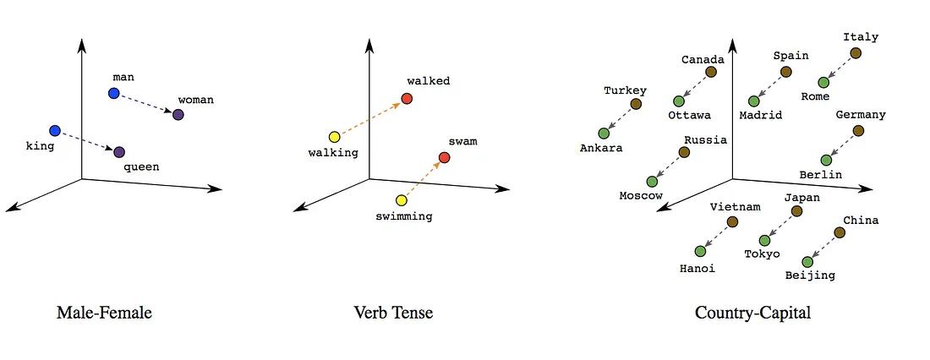
Word Embeddings
Learned vector representations of words/tokens
Can be learned in several different ways
Classic example: word2vec
Useful geometrical properties between related word vectors
Image source

Slide 6
Challenges
Not straightforward as previous examples suggest!
Vector spaces with hundreds or thousands of dimensions
Variety in methods for learning word representations
Thus, many challenges!
Here's some examples of those challenges
Interpretability:
Learned features often not interpretable (real numbers)
Geometric properties of space not straightforward (high-dimensional space)
Cost:
Train on terabytes of text
Latest LLMs have trillions of parameters
GPU memory limited
This fixed (static) word -> vector mapping seldom used anymore
But still part of architectures, relevant to understand representations

Slide 7
Outline
Machine Learning Refresher
Deep Learning Basics
Word Embeddings

Slide 8
Machine Learning Refresher

Slide 9
About this Section
Goal: discuss basic concepts and terms that will be useful for the entire course
Outline:
Basic Machine Learning Concepts
Probability Theory Refresher
Maximum Likelihood Estimation
Summary

Slide 10
What is machine learning? (1)
Methods for developing algorithms by learning from data
In contrast to manually coding knowledge we already have
Example: flying a helicopter (how many situations must we consider?)
Umbrella term encompassing many families of methods
E.g. Inductive Logic Programming, Deep Learning, etc.
Related (umbrella) terms
Artificial Intelligence: solutions that show intelligent behavior
Data Mining: extract value from data (ML usually part of that pipeline)
Machine learning in this course?
Mostly deep learning and related methods

Slide 11
What is machine learning? (2)
Classic definition:
“A computer program is said to learn from experience E with respect to some class of tasks T and performance measure P, if its performance, as measured by P, improves with experience E.”
Tom Mitchell, Machine Learning, 1997
Experience: data in some format
In our case, text (that needs to be processed so models can "read" it)
Tasks: depends on perspective
ML: classification, regression, etc.
NLP: machine translation, question answering, etc.
Performance measure: depends on task
E.g. F1 score for classification tasks, ROUGE scores for summarization

Slide 12
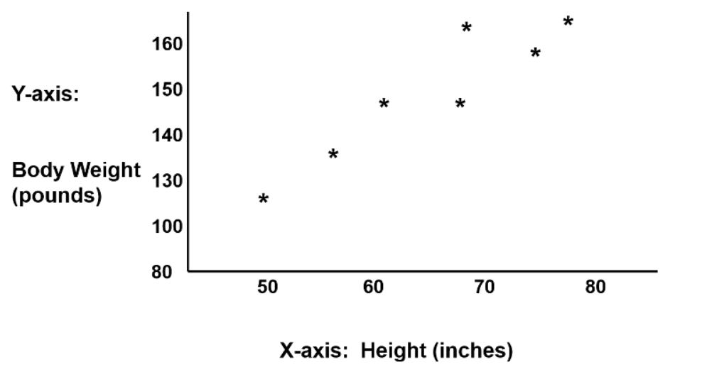
What is a task?
Task: predict weight of a person (regression, supervised)
Data: How do we represent a person?
Let’s go with a simple 2D vector: (height, weight)
We might see a linear relation between input and target
Input: 1D feature vector (usually denoted by x_{i}, here: height)
Target: weight (usually denoted by y, here: real number)
Example source

Slide 13
What is a model?
Family of methods that we choose
Each comes with a set of assumptions
E.g. based on observed data, we assume linear relation between height and weight
Thus, we choose a linear regression model
Linear regression:
Main assumption: linear relation between inputs and output
Formally: learn function f(x) = y
Here: f(height) = weight
This model comes from statistics, studied more formally, e.g. more assumptions, ML is more "relaxed", focuses on learning (generalizing)
How exactly do we learn a function?
To get there, we need to talk about parameters

Slide 14
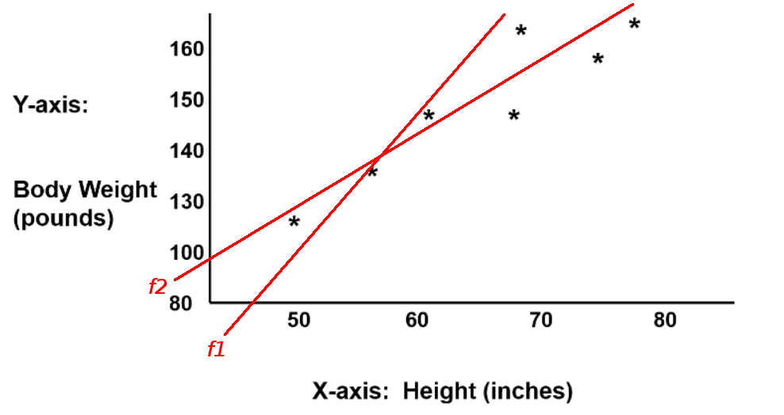
What are parameters?
We can describe the assumption in linear regression with the equation of a line:
y = mx + b where m is slope and b is y-intercept
In our case: weight = m height + b
Thus, we have two parameters: m, b
Each value assignment of m, b: different member of linear regression family
Which one fits the data better?
f₁ or f₂?
How do you know? Depends on the goal

Slide 15
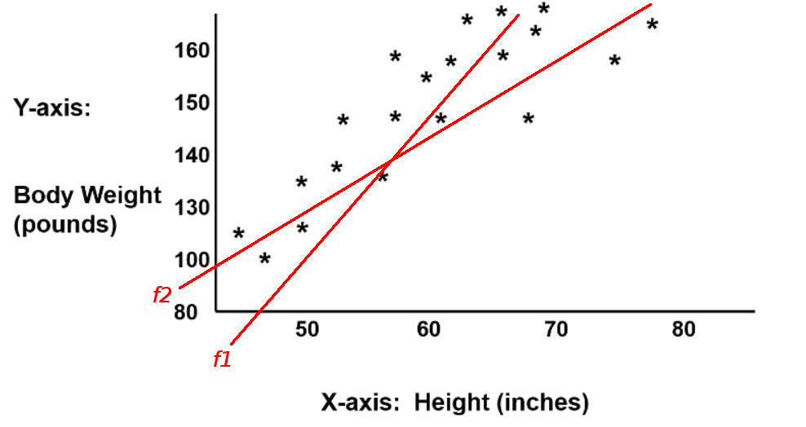
What is generalization?
Goal of ML: model should perform well at the task on new data
Not just data it was trained on
Thus, goal of training a model: generalize to unseen data
For example, which function did you say fits our data best?
f₁ or f₂?
What if we collect more data?
Before, f₂ seemed best
With more data, f₁ is best
How do we train for generalization?
We evaluate models on held-out evaluation data, represents unseen data
Train and eval data assumed from same distribution

Slide 16
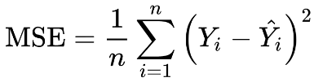
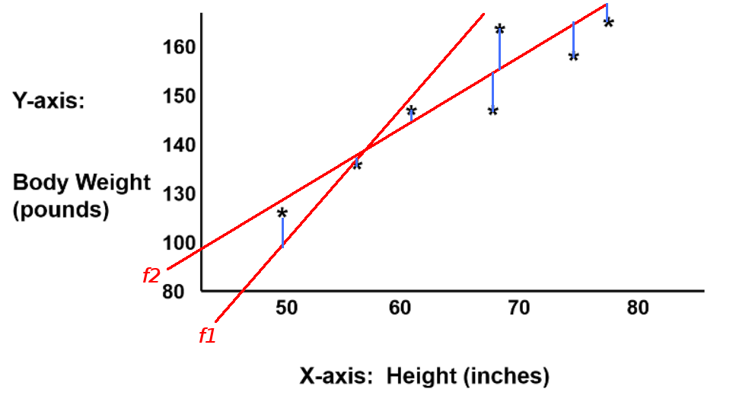
How do we evaluate a model?
How can we tell which member of the family is more suitable for our task?
We need to select a model from the many options
Performance metric
A metric we choose to evaluate how good a model is at a task
For example: mean squared error (MSE)
where:
n: # of examples
Y_{i}: target values
Y’_{i}: predicted values

Slide 17
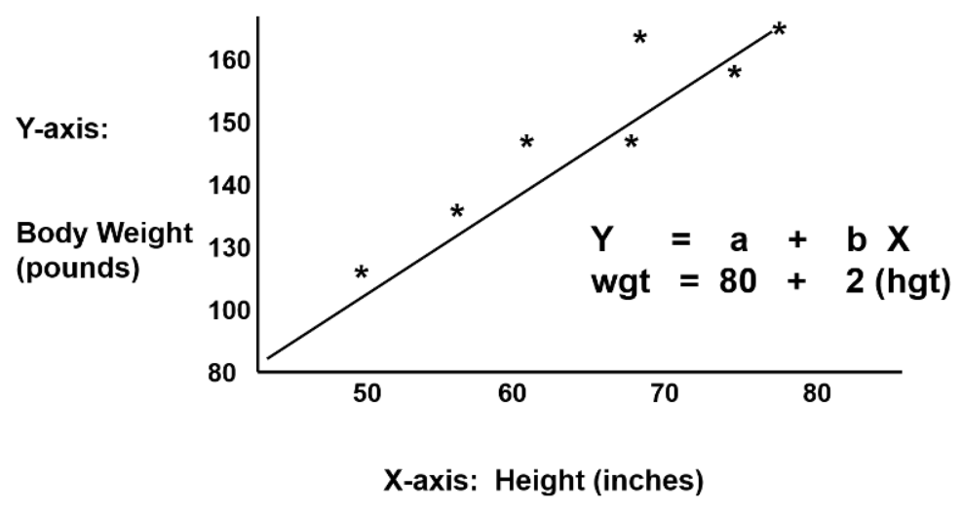
How do we use our selected model?
Model selection: choosing a value assignment for our parameters
E.g. m = 80, b = 2
To make a prediction, we make use of our selected model (function)
Important distinction: inference vs prediction
Inference: use model to learn about data generation process
Prediction: predict specific outcomes for new input points

Slide 18
What are hyperparameters?
Other parameters that are typically not learned
Instead, they are manually set by the user
Note that meta-learning does exist, e.g. AutoML
Example in linear regression: using a bias or not
No bias: line passes by origin (assumes data is centered)
See scikit-learn’s documentation on linear regression (fit_intercept)
How do we choose values for hyperparameters?
Hyperparameter optimization methods
E.g. grid search, random search (known to be better than grid search)
Requires familiarity with known tricks/experience/expert knowledge
Often involves making assumptions
E.g. this setting worked well in the past
E.g. the search space I designed benefits all models equally

Slide 19
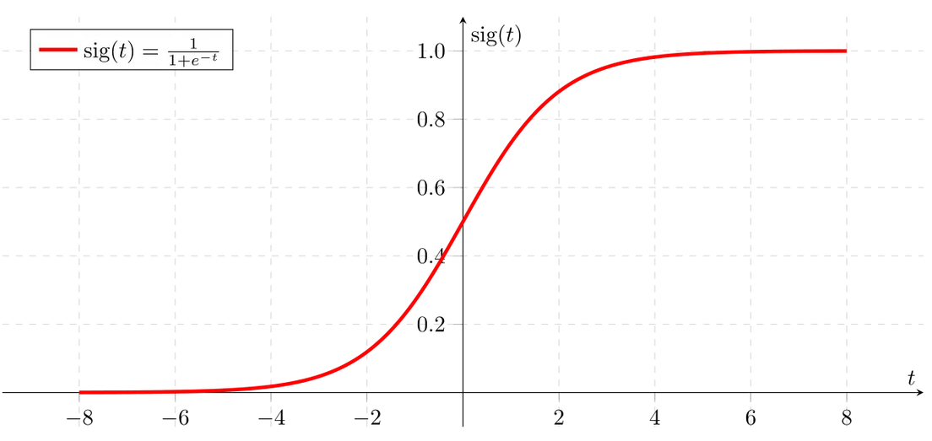
What about classification?
Logistic regression: popular model for classification
Main assumption: linear relation between inputs and output
Essentially: linear regression with a logistic function
y = σ(m x + b) where σ is the logistic (sigmoid) function
Image source
Logistic function maps inputs to real interval [0,1]
Can be interpreted as a probability distribution

Slide 20
How do we use logistic regression?
Binary classification:
P(y = 1) = σ(m x + b) --> interpreted as probability for positive class
P(y = 0) = 1 - σ(m x + b) --> complementary probability for negative class
That is, we get probabilities for both positive and negative class
We can do some inference, e.g. how much more likely is one class than the other?
But prediction?
Prediction: we decide on a threshold
p(y = 1) >= 0.5, we predict positive class
p(y = 0) < 0.5, we predict negative class
We get the following decision boundary
p(y = 1|x) = p(y = 0|x) = 0.5
Describing tasks and models with probability theory is very common!
We’ll do this often, so let’s review the basic concepts

Slide 21
Probability Theory Basics
This is a quick refresher about probability theory
This is later useful for many things
Describing tasks
Describing models, e.g. what language models do
More concepts commonly used in NLP research
Today, some basic intuitions/definitions
Random variables
Probability distributions
Independence of events
Sum rule / product rule
Joint distributions
Conditional probability
Conditional independence
Bayes rule

Slide 22
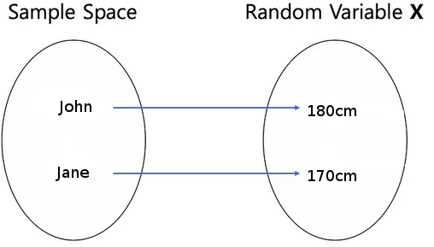
Random Variables
Function between events and something relevant about the events
Usually designed according to something we want to model
Example: say we are interested in average height of students
Event: randomly select a student
Event space: set of all students the course
Random variable X: f(student) = height of student

Slide 23
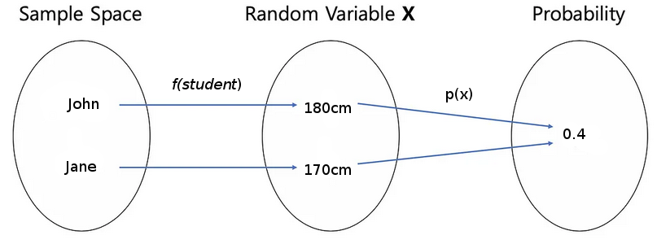
Probability Distributions (1)
Essentially a way to describe random variables
Random variables: take values as a result of some random process
Distribution of random variable: how often may each value be observed
How does a distribution describe this?
A(nother) function p(X): maps set of possible values a random variable can take to interval [0,1]

Slide 24
Probability Distributions (2)
Output of p for given event a: probability of observing event a
Written as p(X=a)
Example: what is the probability of observing a height of 185cm?
p(X = 185cm) = 0.1, i.e. probability is 10%
Discrete distributions: random variable can take finite set of values
p usually referred to as probability mass function
Continuous distributions: r.v. can take infinite set of values
p usually referred to as probability density function
Examples:
Bernoulli (discrete): models output of single binary experiment
Gaussian (continuous): normal distribution
Is X in our students’ height example discrete or continuous?
Depends on how to measure height, as reals or integers

Slide 25
Independence of events
Events A and B are independent when one event happening does not affect the probability of the other happening
For example:
Event A: Germany wins the world cup in 2014
Event B: Germany loses world cup semifinal
Event C: The stock market crashed in 2008
Which of these events are dependent/independent?
A and B are not independent
If Germany loses the semifinal, it cannot win the final
A and C are independent, as well as B and C
Very unlikely the 2008 crash has any impact on the 2014 world cup
Independence perhaps best understood with sum rule

Slide 26
Sum Rule
Probability of union of n events happening, e.g. A OR B
Formally: p(A U B) = p(A) + p(B) – p(A П B)
For example: r.v. Y shows number in die, relevant events are:
A: “We observe a multiple of 3”, i.e. either 3 or 6
B: “We observe a multiple of 2”, i.e. either 2, 4 or 6
Are A and B independent? No, see overlap in event spaces
For p(A U B) we subtract probability of overlapping events: p(Y=6)
p(A) = 1/6 + 1/6 = 1/3
p(B) = 1/6 + 1/6 + 1/6 = ½
p(y = 6) = 1/6
p(A U B) = 1/3 + ½ - 1/6 = 0.66
With independent events, last term becomes zero:
Event A: “We observe an even number”, i.e. either 2, 4 or 6
Event B: “We observe an uneven number”, i.e. either 1, 3 or 5

Slide 27
Product Rule
Probability of conjunction of n events happening, i.e. A AND B
Formally: p(A,B) = p(A|B)p(B)
p(A,B) = joint distribution of A and B
p(A|B) = conditional distribution of A given B
Side note:
All of these rules are derived from axioms of probability theory
For more, see probability theory literature
Let’s go over joint distributions and conditional distributions

Slide 28
Joint Distributions (1)
Function p(X_{1…n}) from n random variables to interval [0,1]
Distribution of all possible combinations of those n random variables
Easier to see with joint probability table
For example, joint distribution of flipping two coins A and B:
A / B | Heads | Tails
Heads | 0.1 | 0.2
Tails | 0.3 | 0.4
Note that all elements in table add up to 1, i.e. a distribution

Slide 29
Joint Distributions (2)
We can derive many things from a joint distribution
A very common operation: marginalization
Given joint distribution of A and B, derive distribution of A or B
For example, we get distribution of coin A by summing over all possible values of B with the sum rule:
A/B | Heads | Tails | p(A)
Heads | 0.1 | 0.2 | = 0.3
Tails | 0.3 | 0.4 | = 0.7
New column adds up to 1, i.e. a probability distribution
p(A) known as marginal distribution of A
This process is referred to as marginalizing out B
Normally expressed with sum rule: p(A) = ∑_{b} p(A,B = b)

Slide 30
Conditional Probability
Probability of seeing event A knowing event B was already seen
Formally, p(A|B) = p(A,B)/p(B)
Intuitively, space of all possible events shrinks (for dependent RVs)
Imagine we toss a die
A: “We observe an even number”, i.e. either 2, 4 or 6
B: “We observe a multiple of 3”, i.e. either 3 or 6
After observing A, event space for B is not {3, 6}, it is {6}
Note that p(A|B) can be derived from joint distribution p(A,B)
Marginalize out A to get p(B)
Then you have everything you need

Slide 31
Conditional Independence
Two events are independent given a third event
Observing A tells me something about B
But when observing C, A no longer says anything about B
For example:
Event A: knowing a person has good vocabulary
Event B: knowing a person’s height
Are A and B independent?
No, since children have limited vocabulary
Now consider event C: knowing a person’s age
Given C, A and B are independent, since height implies age
Once we have age, height gives us no new information
Thus, A and B are conditionally independent given C

Slide 32
Bayes‘ Rule
Apply product rule on conditional probability
That is, p(A|B) = p(A,B) / p(B) = p(B|A) p(A) / p(B)
Note that we want probability of A given B, i.e. p(A|B)
And to get it, we use marginal distribution of A, i.e. p(A)
This may seem counterintuitive
This is typically interpreted like so:
p(A) known as prior probability distribution of event A
Describes what we know/believe about event A
p(B|A) known as likelihood
Given event A, what is the likelihood that we get our data
p(A|B) known as posterior probability of A
Interpreted as updated description of A after considering what we originally know about A (prior), as well as our data (event B)
This interpretation gives rise to the frequentists vs bayesian debate
And with this, we are done with our probability refresher!

Slide 33
A Probabilistic Perspective of ML
Task: predict outcome of a coin tossed by your (unreliable) friend
Many factors: mass distribution, position in fingers, friction, etc.
Difficult to model physically
Let’s use a probabilistic model
Abstracts away complications of physical model
Probability: uncertainty of some random event, e.g. coin toss
In practice: relative frequency of observations about the event
Event in this case: seeing heads when tossing the coin
Simple Model: Bernoulli distribution
Intuition: it models outcome of single binary experiment
Formally: p(k|Θ) = Θ^{k} (1-Θ)^{1-k} where k in {0,1} is possible outcomes
Θ is the only parameter of model: probability of seeing heads
How do we get a value for this parameter so we can use our model?
We could estimate this parameter
We could blindly guess, or we could use data for that estimation!

Slide 34
Training Models: Parameter Estimation
Say your friend allows you to observe ten tosses
You observe 3 out the 10 are heads
You can estimate the value of Θ from this data
Θ = 3/10 = 0.3 chance of seeing heads in a single toss
We just counted relative frequencies
Training example: a single coin toss, i.e. y_{i} in {heads, tails}
Training data: 10 coin tosses
Relevant observations: we observe heads
With a value estimated for parameter Θ, we can make predictions!
Our model has been trained and is ready to be used on unseen data
Thus, learning a function means estimating its parameters
We don’t know the parameters of a model
Instead, we have data and use it to estimate those parameters
Let’s look at a common framework for parameter estimation

Slide 35
Maximum Likelihood Estimation (1)
Common approach for parameter estimation
Otherwise known as MLE
Finds model that maximizes likelihood of observed data
But what does likelihood mean?
Our model for the coin toss:
p(k|Θ) = Θ^{k} (1-Θ)^{1-k} is a function of k with Θ fixed (how we predict with it)
Let’s instead see it as function of Θ with fixed k, i.e. L(Θ|k) = Θ^{k} (1-Θ)^{1-k}
That is, a function of parameters given fixed data (assumed during training)
We call L(Θ|k) the likelihood function
It is not a probability distribution
Instead, we use it to find distributions that fit observed data
How do we use the likelihood function during training?
We want distribution with highest (max) probability to our data
Assumption: set of observed data is most likely sample among all data

Slide 36
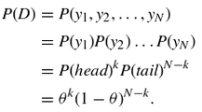
Maximum Likelihood Estimation (2)
Formally, we want Θ = max_{Θ} L(Θ|k)
Equivalently, we want Θ = argmax_{Θ} log p(k|Θ)
First, we make a common assumption: examples are i.i.d.
This stands for independent and identically distributed
Examples are independent, belong to same distribution
Then, we apply this assumption to our coin toss setting
Our model for a single example: p(k|Θ) = Θ^{k} (1-Θ)^{1-k}
The joint probability of N observed examples is then given by:
Here we used the i.i.d. assumption from line 1 to line 2

Slide 37
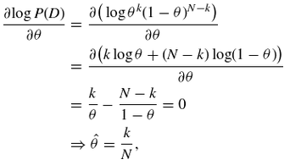
Maximum Likelihood Estimation (3)
Finally, to find this maximum value, we:
Compute the first derivative
Set it to zero
Extract a value for Θ
We obtained relative frequencies, as we had done already!
In practice, MLE often does not have a closed-form solution
Instead, we rely on numerical methods
MLE related to many aspects of ML: cross entropy, MAP, etc.

Slide 38

Empirical Risk Minimization
This is a general training approach
Main goal: estimate how a model will work in practice by averaging a loss function L(x_{i}, y_{i}) on a training set
Here x_{i} is a training example and y_{i} its corresponding label
Formally:
Note the training set is of size n here
This is the most common training approach in ML/DL/NLP.
But what is a loss function, exactly?

Slide 39
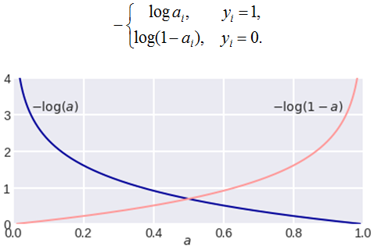
What are loss functions?
Functions that tell us how a model performs during training
Being a cost/loss, we want to minimize it
Desiderata:
Low loss: when model prediction matches given label
The closer, the lower the loss/cost
High loss: when model prediction does not match label
The farther, the higher the loss/cost
Example: log loss
Here a is model prediction
Note the desired behavior
Works with probabilistic
models only
Image source

Slide 40
Let‘s design a training objective
Combine empirical risk minimization with log loss
Assume binary classification
We have:
J = - 1/N ∑_{n} [ y_{i} log(p_{i}) + (1 - y_{i}) log (1 - p_{i}) ]
where N is size of training and p_{i} is prediction for example i
Note the following:
Labels act as indicator factors
Log loss means bad model predictions get punished
We negate the entire expression so we can minimize it
Thus, this is an optimization problem
This one can be shown to be a form of maximum likelihood estimation
Training objectives: very important in NLP
E.g. masked vs autoregressive language have different, manually designed, training objectives

Slide 41
Summary: ML Refresher
Goal: learn models that perform a task well on unseen data
Task: from some input to some output
Regression: real-valued output
Classification: categorical output
Model: abstract, often simplified version of a task
Comes with set of assumptions, e.g. linearity
Evaluation: given predictions, compute relevant metric
Training: parameter estimation
Objective functions (more not covered in refresher, e.g. regularization)
All of these concepts are common in advanced NLP!
E.g. LLMs are models with trillions of parameters
Different LLMs train on different objective functions for different tasks
Empirical risk minimization and MLE used during training
They are evaluated on various metrics relevant to various tasks

Slide 42
Deep Learning Basics

Slide 43
About this Section
Goal: discuss basic concepts and terms that will be useful for the entire course
Outline:
Basic Deep Learning Concepts
Backpropagation
Language Models with Feed-forward Neural Networks

Slide 44
Mathematical Notation
Scalars: a, b
Vectors: x, y (by default column vectors, i.e. size is n x 1)
Matrices: X, Y
Scalar product: ax
Dot product: x^{T}w (transpose because x is column vector)
Matrix-vector product: Xy
Matrix-matrix product: XY

Slide 45
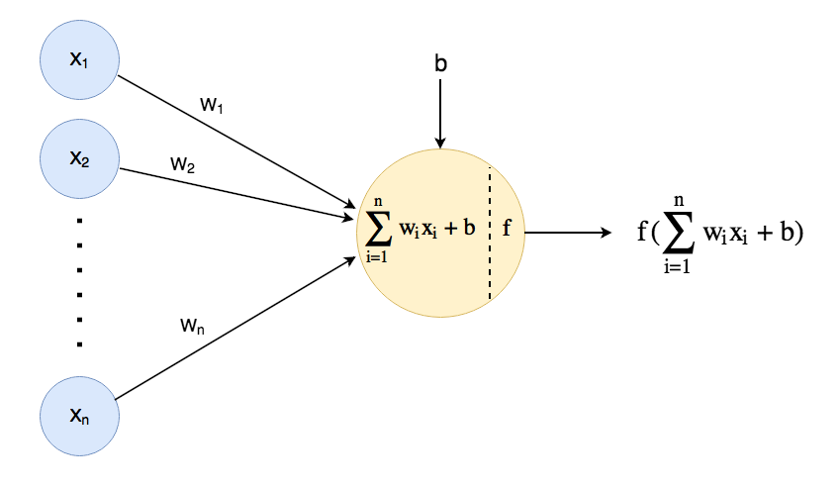
What is an artificial neuron?
Image source
Input is n-dimensional vector x
Features x_{i} multiplied with weights w_{i}, their products then added
What common operation is this?
A bias is optional, but almost always there, adds lots of flexibility to model
Then an activation function f is applied to the result
Different activation functions determine different artificial neurons

Slide 46
Types of Artificial Neurons
They are mainly distinguished by their activation functions, e.g.
Linear neuron: f(x) = x
Logistic neuron: f(x) = σ(x) (sigmoid function)
What model do we obtain with a linear neuron?
Linear regression
And with a logistic neuron?
Logistic regression
More types:
Tanh: maps to [-1,1]
ReLu: f(x) = max(0,x)
Etc.
By adjusting weights:
We learn functions!

Slide 47
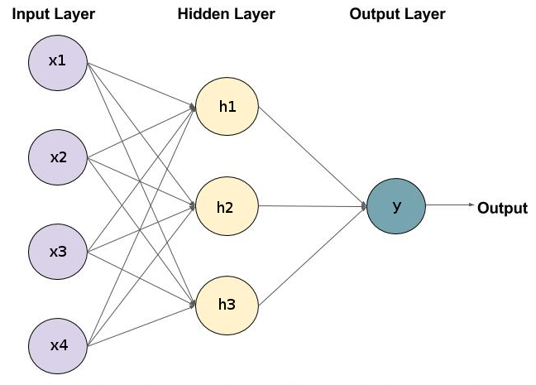
Feed-forward Neural Networks
Let’s do some feature learning!
We use hidden layers
Input to h_{i}: x (our data)
h_{i}: learned values
Input to y: h (learned!)
If y is linear neuron:
Linear regression with
learned features
If y is logistic neuron:
Logistic regression with
learned features
Thus, FNNs are a framework for designing functions (algebraic circuits)
Information flows forward (but also backward during training, more later)
Main restriction: no loops! Computations seen as directed acyclic graphs

Slide 48
Operations in FNNs
Example so far: fully-connected neural network (useful intuition)
What does it compute?
x: n x 1 input vector
h: m x 1 hidden
representation
h_{k} has n w_{i}, together: w_{k}
Let W₁ be n x m matrix
m columns, each a w_{i}
Then h = W₁^{T}x if h_{k} linear
h = f(W₁^{T}x) w. activ. f
h = f(W₁^{T}x + b) w. bias
Similarly: y = f(W₂^{T}h + b) where W₂ is m x 1, constructed as W₁
Note network y = W₃^{T}x + b exists with W₃ = W₁W_{2,} i.e. no hidden layers
Why do we always use hidden layers then?

Slide 49
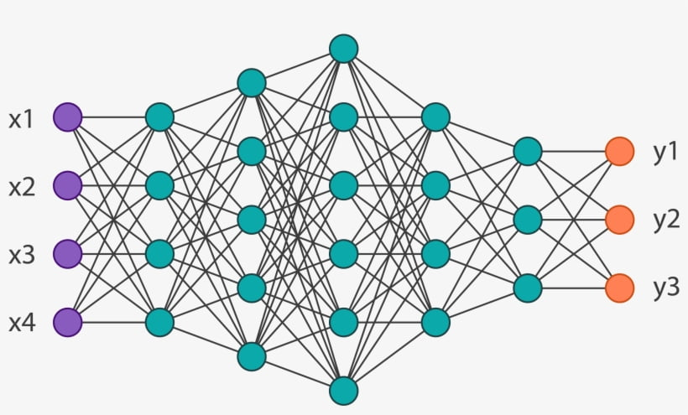
Why use Deep Networks?
When is a network deep?
Not well defined
Some say >4 hidden layers
Others say >2
More important: why?
Universality theorem
Formalities about FNN limits
to approximate functions
One takeaway: no depth needed
Why use depth then? Hidden representations!
Each hidden layer is a learned feature vector, hierarchical features
Component for designing networks: number and size of hidden layers
Smaller layers force models to learn compact but useful representations
More/larger hidden layers: more freedom, more parameters, difficult to train
More parameters -> stronger model, may overfit, requires lots of data
Image source

Slide 50
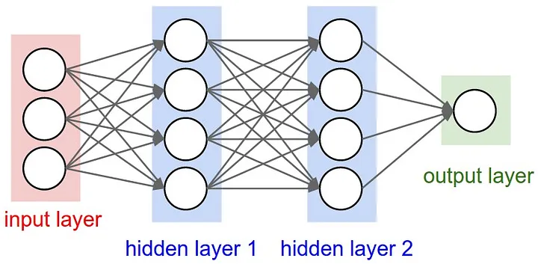
FNNs for Regression
Let’s design a fully-connected network for regression
Input: n-dimensional x
Output: real number y
So, how many input units?
What type of units?
How many output units?
What type of units?
How many hidden layers?
What size/type of units?
How to ensure this number of output units? Linear layer!
Project down to the size that you need
Remember: y = W_{k}^{T}h + b where W_{k} is m x n matrix
W_{k}^{T} projects n dimensional vector to m dimensional vector space
Linear transformation are everywhere in Deep Learning!
Image source

Slide 51
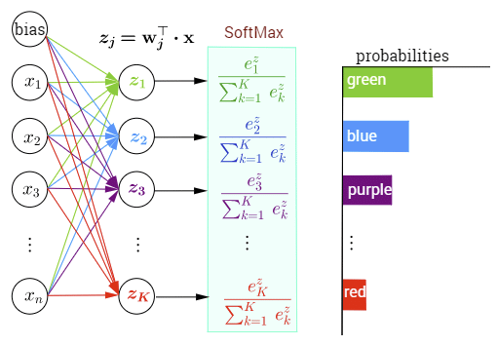
FNNs for Classification
Let’s design a fully-connected network for classification
Input: n-dimensional x
Output: one of K classes
So, how many input units?
What type of units?
How many output units?
How do we ensure that?
What type of units?
How to get predictions?
Softmax layer
Softmax function: turns given vector into probability vector
x is a probability vector if x_{i} Є [0,1] for all i and Σ_{i} x_{i} = 1 (see first tutorial)
Softmax layer: linear layer for projection + softmax function
Input: vector of logits; Output: probability vector for inference/prediction
Image source

Slide 52
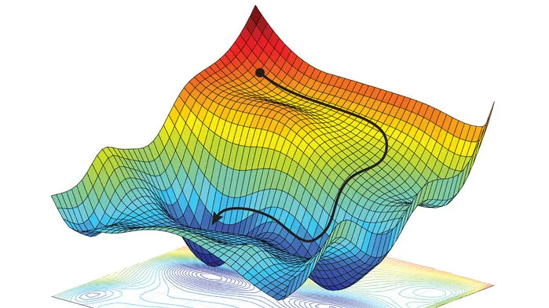
Information Flow
“Feed-forward neural networks: information flows forward”
Oversimplified! Important information flows backward during training
This influences design, inspired creation of important components
E.g. LSTMs, residual units, etc.
Training often done with gradient-based optimizers
E.g. SGD, Adagrad, etc. (briefly discussed in first tutorial)
Gradient information tells us how to update model parameters!
Forward pass
Compute function we are learning
Backward pass
Compute gradient information to
learn parameters
How to compute gradients of functions
computed by FNNs? Backpropagation!
Image source

Slide 53
Backpropagation (1)
What is a derivative?
Let y = f(h)
dy/dh asks: how much does y change when h changes?
A gradient is a multidimensional derivative
Let h be n-dimensional vector and y = f(h) a function from R^{n} to R
∂y/∂h = (∂y/∂h₁, ∂y/∂h₂,…, ∂y/∂h_{n}) is gradient of y w.r.t. x
I.e. the gradient of y w.r.t. h is also an n-dimensional (row) vector
Geometrically, gradient vector is direction of the largest change of y
What rate of change are we interested in during training?
How much does loss L change when model parameters Θ change?
I.e. ∂L/∂Θ
What if L is output of a compound parameterized function (FNN)?
E.g. L = f(y) where y = g(h|Θ₂), h = z(x|Θ₁) (z is 1st layer, g is 2nd, f is loss)
Here ∂y/∂h is a Jacobian (m x n matrix where m is size of y, n size of h)
Same for ∂h/∂x

Slide 54
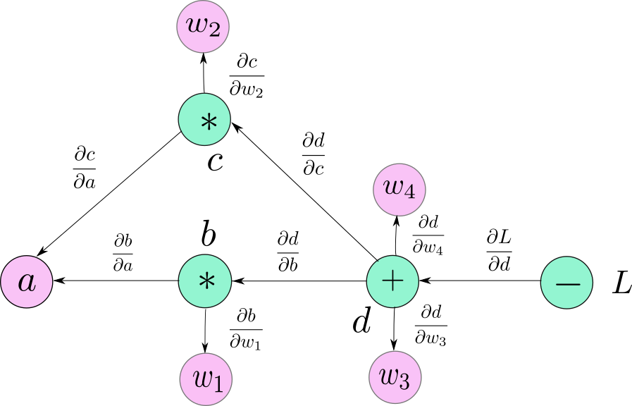
Backpropagation (2)
We propagate the change/error back using the chain rule!
Recall chain rule
Let y = g(h) and h = f(Θ)
∂y/∂Θ = ∂y/∂h ∙ ∂h/∂Θ
Take this computation graph
Internal nodes: operations
Leaves: learnable weights w_{i},
input a
Here L = d – label, d = w₃b + w₄c
We want ∂L/∂w₄ (which rate of change?)
Chain rule: ∂L/∂w₄ = ∂L/∂d ∙ ∂d/∂w₄
Similarly, ∂L/∂w₂ = ∂L/∂d ∙ ∂d/∂c ∙ ∂c/∂w₂ where c = w₂a
Note that ∂L/∂d is useful for both ∂L/∂w₄ and ∂L/∂w₂
Reusing gradients is common during backpropagation
Image source

Slide 55
Backpropagation (3)
Perhaps more important, take ∂L/∂w₂ = ∂L/∂d ∙ ∂d/∂c ∙ ∂c/∂w₂
Here, gradient ∂c/∂w₂ is multiplied by factor ∂L/∂d ∙ ∂d/∂c
∂L/∂d comes from passing gradient through minus operator in L
∂d/∂c comes from passing gradient through plus operator in d
Thus, operations have impact on their "input" gradients!
Important to consider when designing networks
E.g. plus operator has no effect on gradient
Concat operator splits gradient into two
E.g. if either ∂d/∂c or ∂L/∂d are close to zero, ∂L/∂w₂ will be small
In other words, we get little info about how to change w₂ to improve L
Generally, small gradients = slow/difficult to learn
Many challenges in training deep networks, e.g. vanishing gradients
Inspired solutions like LSTMs, residual connections (used in transformers)
Let’s look at a FNN for a practical NLP use case!

Slide 56
Language Modeling Recap
Predict the next word:
“Every Thursday there is a Schneckenhof …”
This suggests:
Some words are more likely to appear than others given some context
Probabilistically:
p(meeting|“Every Thursday there is a Schneckenhof”)
Generally: p(w_{n+1}|w₁,w₂,…,w_{n})
Conditional probability of w_{n+1} given joint distribution of w₁,w₂,…,w_{n}
w_{i} are words/tokens in some fixed vocabulary V the model can process
Such models can predict entire sequences with probability chain rule
p(w₁,w₂,…,w_{n}) = p(w₁)p(w₂|w₁) p(w₃|w₁,w₂)… p(w_{n}|w₁,w₂,…,w_{n-1})
Useful in many NLP settings, e.g. machine translation
A good language model should identify more common phrases
p(This sentence makes sense) < p(Makes sense this sentence does)

Slide 57
Language Modeling with FNNs (1)
Bengio et al. (2003) proposed a FNN that simultaneously learns:
“Distributed representations of words”
“Probability function of word sequences expressed in terms of these representations”
Size of word vectors (30, 60, 100) much smaller than vocabulary (17K)
Intuition: similar words have similar feature vectors
Thus, training sentence The cat is walking in the bedroom can be generalized to, e.g.:
A dog is walking in a room
The cat is running in a room
A dog is walking in a bedroom
The dog is walking in the room
How did they implement such a model?
A feed-forward neural network
Not the first time it was done, but the first time at that scale

Slide 58
Language Modeling with FNNs (2)
How did they model p(w_{m}|w₁,w₂…,w_{m-1})?
A mapping C between every word w_{i} ∈ V to a m-dimensional vector w_{i}
Today known as an embedding layer.
Given w_{i}, get row i in embedding matrix C (V rows, each a vector w_{i})
Function g that maps input sequence of word vectors to a probability vector of size |V|, i-th component is probability of i-th word being next
Embeddings are parameters that are learned
Function g uses these embeddings plus additional parameters ω
p(w_{i}|w₁,w₂…,w_{m-1}) = g(i, w₁,w₂…,w_{m-1}|ω) where i is index of word w_{i}
Overall, they learned function f, a composition of C and g, with a FNN
f(i, w₁,w₂…,w_{m-1}) = g(i, C(w₁),C(w₂)…,C(w_{m-1})|Θ)
All model parameters are Θ = (C, ω)
It’s easy to see what C might look like, but what does g look like?
In other words, what did their network architecture look like?

Slide 59
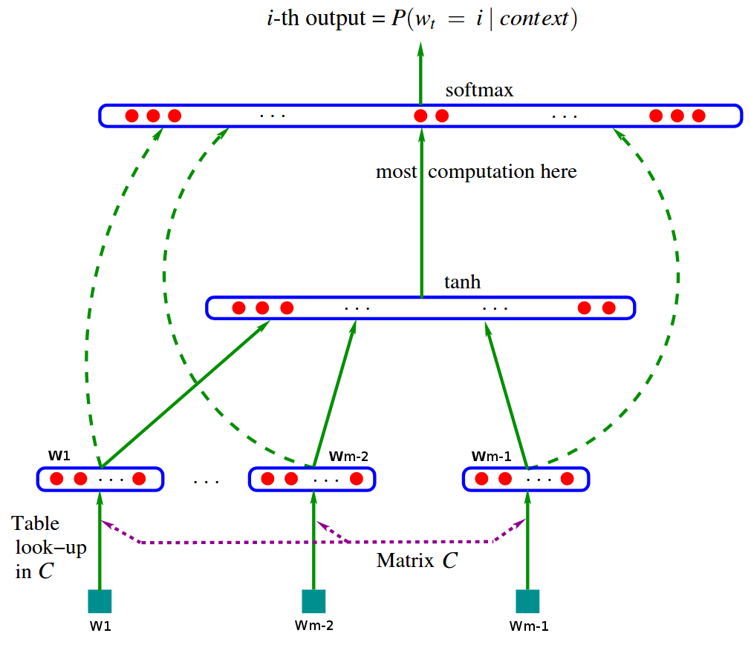
Language Modeling with FNNs (3)
1st: Get word vectors w_{i}
2nd: Concatenate vectors to
form x
3rd: Hidden layer (matrix H
transform. + tanh activ.)
4th: Optional linear layer w.
matrix W from input to
softmax layer (dashed
lines)
5th: Softmax layer (matrix U
transform. + softmax)
Overall: input to softmax
y = b + Wx + Utanh(d + Hx) where b,d are biases
Then Θ = (b, d, W, U, H, C)

Slide 60
Language Modeling with FNNs (4)
How did they train?
They estimated Θ that maximized likelihood of training data (i.e. MLE)
Specifically:
L = 1/T ∑_{m} log f(w₁,w₂…,w_{m-1}; Θ) + R(Θ)
Here, T is number of words in training corpus
Note a few things:
They average loss over the training set (empirical risk)
Penalizing term R(Θ) is regularization (weight decay on C, W, H, U)
They trained in a self-supervised manner
I.e. yes, there are labels, but no manual labeling required
Instead, they used sequences of length m in the training corpus
For each sequence, first m-1 words are input, word m is target
Many of these components still in use today!
Softmax layer, MLE, empirical risk, self-supervision

Slide 61
Summary: DL Basics
FNNs: framework for constructing parameterized real-valued functions
We design and learn these functions (algebraic circuits)
Information flows in both directions on these circuits
Forward pass: model expressivity
Backward pass: model “learnability”
Backpropagation: training deep networks, chain rule
Important: we can learn useful features with deep models!
Hidden layers interpreted as learned representations
Learned representations useful in other settings, i.e. transfer learning
E.g. style transfer, pre-training word representations
Language modeling with FNNs by Bengio et al. (2003)
Established many modeling and training components still used today
Later in the course, other types of FNNs relevant for NLP
RNNs, transformers

Slide 62
Word Embeddings

Slide 63
About this Section
Goal: introduce concepts and methods about static word embeddings
Outline:
Sparse vs Dense Word Representations
Word2Vec
Properties of Word Vectors
Evaluation of Word Vectors

Slide 64
What do we want to represent? (1)
Words? I.e. strings of symbols such as cat or dog?
No, those are representations themselves!
What do they represent?
Meaning!
We map strings such as cat or dog to concepts (or senses)
We refer to this mapping as meaning, what those words refer to
Is meaning a 1-to-1 mapping?
No, words can have many meanings (remember ambiguity?)
How do we, humans, handle word ambiguity? Context!
“I work at a bank.”
What’s more likely? A financial institution or by the river?
Again, context. Does the person work in Frankfurt? Are they fishermen?
So, we want to represent the relation between words and senses!

Slide 65
What do we want to represent? (2)
What do we want from such representations? Ideally usefulness, e.g.
Tell us if words have similar meanings, e.g. cat and dog
Tell us if words are antonyms, e.g. hot and cold
Tell us if they have positive or negative connotations, e.g. happy or sad
“Generally, a model of word meaning should allows us to draw inferences to address meaning-related tasks like question answering.” Jurafsky and Martin, 2023
Perhaps we should represent senses, then, not words!
Use something like WordNet, expert-crafted database of senses
Databases like WordNet have not worked well in practice
Missing nuance, “good” is synonym of “proficient” only in some cases
New meanings missing, e.g. genius, wicked, wizard
In practice, dealing with word representations works better
We focus on their relation to meaning (based on context)
We don’t commit to a given representation of sense

Slide 66
Sparse Word Representations
Traditional approach: sparse word vectors
Example: one-hot vectors
Given vocabulary V, represent each word with vector of size |V| using one-hot encoding
For example, given V = {cat, dog, airplane}
V_{cat} = [1, 0, 0]
V_{dog} = [0, 1, 0]
V_{airplane} = [0, 0, 1]
Problem 1: |V| can be very large
Recall Bengio’s work from 2003: |V| = 17K
Problem 2: No natural notion of similarity from such vectors
They are all equally different, e.g. with a dot product
But cat and dog are more similar to each other than to airplane
Generally, difficult to draw inferences from such representations
Let’s look at another approach that addresses these issues

Slide 67
Distributed Representations
Idea from deep learning community (Geoffrey Hinton in 1986)
Sparse representations:
Each representational component maps to single represented object
E.g. each feature in vector corresponds to one word
Distributed (or dense) representations:
Many-to-many relation between representational components and represented objects
E.g. each word is represented with a set of (distributed) features
PROs: model has freedom to use features “at will“ during learning
CONs: Less interpretable than, e.g. one-hot encoding
Given V, we know what word is represented by [0, 1, 0]
But what word is this? [0.23, 0.447, 0.02]
Using vectors to represent words also has a history in linguistics
Osgood et al. (1957) represented words with 3-dimensional vectors
Each dimension encoded known useful (non-learned) features

Slide 68
Distributional Semantics (1)
Idea from linguistics (Joos, 1950; Harris, 1954; Firth, 1957)
Not the same concept!
Distributed representations != distributional semantics
In NLP, the latter can be seen as a special case of the former
Let’s guess what the word foobar means
Foobar is often played in teams of 7.
A foobar match is divided into 3 thirds of 25 minutes each, called runs.
A foobar match is won by scoring 10 points.
What would you guess the word foobar refers to? Why?
A type of food?
A sport?
A country?
Distributional hypothesis:
“A word is characterized by the company that it keeps.” (Firth, 1957)

Slide 69
Distributional Semantics (2)
Put differently:
We define the meaning of a word by its distribution in a language
I.e. by its neighboring words, grammatical environment
Words whose neighboring words are similar, have similar meanings.
We can use this idea to build useful vector representations of words!
For example: co-occurrence matrices
Given defined context, e.g. a document, a sentence, a word window
Construct matrix C of size V x V where V is given vocabulary
Rows in matrix are words, columns are also words
m_{ij} denotes number of times word i appears in same context as word j (so, sparse)
Co-occurrence matrices useful in many applications
E.g. latent semantic analysis (LSA) --> singular value decomposition of C
Extracts vector representations from (truncated) left–singular vectors
Similar count-based methods covered in basic Text Analytics course
Word embeddings: distributional hypothesis to learn dense vectors

Slide 70
Word Embeddings
Idea: to embed higher dimensional vectors into lower dimensional vector space such that (some of) the relative properties of the higher dimensional space are kept
Hence, embedding --> (relatively) low-dimensional vector representation
Low-dimensional compared to, e.g. |V|
Size typically between 50 and 1000 dimensions
Vectors are dense (distributed) representations
Historically important approach: word2vec (Mikolov et al. 2013)
Training based on distributional semantics
Done in the context of deep learning (though this model is not deep)
Intuition:
Instead of counting words for co-occurrence, let’s train a classifier to predict whether two words are likely to appear in the same context.
Two approaches proposed for learning such a classifier
Skip-gram and continuous bag of words (CBOW) (we focus on skip-gram)

Slide 71
The Skip-Gram Algorithm
Algorithm for learning dense word vectors
Basic steps
Treat target words and neighboring context words as positive examples
Randomly sample other words in vocabulary to get negative examples
Train a classifier to predict whether two given words appear together
Use learned weights as word embeddings
Why negative examples?
In some tasks, negative examples often needed to avoid trivial solutions
E.g. push all vectors to same point, thus all vectors similar
If training objective is poorly designed, such a solution may "reach objective"
Let’s have a look at:
The task
The model
The training objective

Slide 72
Skip-Gram: The Task
Say we have the sentence:
… known as [ramen, a Japanese dish that] has recently become…
c₁ c₂ w c₃ c₄
Here, w denotes center word and c_{i} denotes context words
I.e. context window is plus/minus a few words in this case
More context --> usually more useful, not always, more later
E.g. plus/minus 1 gives us [a; ???; dish]
Plus/minus 2 gives us [ramen; a; ???; dish; that] (assumes no punctuation)
Task: given tuple (w,c), predict if c appears in context of w or not
So, binary classification
Probabilistically, P(True|w,c)
Similarly, P(False|w,c) = 1 - P(True|w,c)
How can we model these probabilities?

Slide 73
Skip-Gram: The Model (1)
How to get probability P(True|w,c)?
Key idea: based on similarity of corresponding word embeddings
I.e. a word c is likely to occur near a target word w if their corresponding embeddings e_{c} and e_{w} are similar
Probabilistically, w and c are independent given their embeddings e_{c} , e_{w}
Let Θ = [e_{1, …,} e_{|V|}]. We have P(True|w,c,Θ) (Θ often omitted for brevity)
How can we represent that similarity?
Skip-gram went with dot product, i.e. e_{c}^{T}e_{w}
But didn’t we need a probability?
Ok, then P(True|w,c) = σ(e_{c}^{T}e_{w}) where σ is the sigmoid function
Similarly, P(False|w,c) = 1 - σ(e_{c}^{T}e_{w}) = σ(-e_{c}^{T}e_{w})
The last equality results from a property of the logistic function
This is the probability of word c being in context of word w.
What if I want to provide more context? More context is better, right?

Slide 74
Skip-Gram: The Model (2)
How do we compute P(True|w,c_{1:L}) where L is size of context window?
Assumption: context words are independent of each other
Computing joint distribution of words in context becomes much simpler
Thus, we have
P(True|w,c_{1:L}) = ∏_{i in L} σ(e_{i}^{T}e_{w}) = ∑_{i in L} log σ(e_{i}^{T}e_{w}).
How is this model parameterized?
It actually learns two representations for each word
One for words as targets, one for words as context (just one vocabulary V)
Thus, parameterized by matrices W and C, both of size |V| x d where d is a hyperparameter (embedding size)
In other words, Θ = [W, C]
How was this model trained?

Slide 75
Skip-Gram: The Training Objective (1)
As with Bengio’s LM from 2003: self-supervision
Given text corpus (i.e. large sequence of text)
Iterate over sequences of size n = L*2 + 1 (L is size of context window)
For each sequence, set center word as target, other words as context
For example:
… [known as ramen, a Japanese] dish that has recently become…
c₁ c₂ w c₃ c₄
2. … known [as ramen, a Japanese dish] that has recently become…
c₁ c₂ w c₃ c₄
3. … known as [ramen, a Japanese dish that] has recently become…
c₁ c₂ w c₃ c₄
Thus, for sequences 1, 2 and 3, you get positive examples (w,c):
(ramen, known), (ramen, as), (ramen, a), (ramen, Japanese)
(a, as), (a, ramen), (a, Japanese), (a, dish)
(Japanese, ramen), (Japanese, a), (Japanese, dish), (Japanese, that)

Slide 76
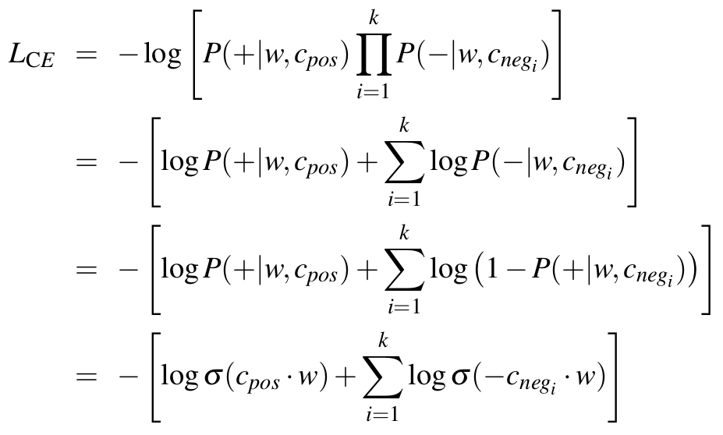
Skip-Gram: The Training Objective (2)
We also need negative examples!
Given w, we randomly sample words from V as candidates for c
For example: (ramen, ostrich), (ramen, the), (ramen, Alaska), …
They generated k (hyperparameter) negative examples per positive
Then, given (w,c_{pos}), corresponding (w,c_{neg} _{i}), and cross entropy (CE), we have:
Generally, they applied empirical risk over all training examples
Since this is negative log likelihood (NLL), they did MLE of the training set

Slide 77
Task vs Goal
Task: P(True|w,c)
What do we use that task for?
Real-world uses?
Goal: learn word embeddings!
Task designed to force model to capture properties (distributional semantics)
Original task was different, P(w_{t+j}|w_{t})
Other models have tasks and goals
E.g. GPT-style LLMs are autoregressive language models
BERT-style models are masked language models
Sometimes we want to use the model to make predictions
Other times, we just want their learned weights

Slide 78
Other Types of Static Embeddings
Word2vec is useful model for intuition/learning about embeddings
It was also successful and is historically important
But there are other ways of learning word embeddings
These are often used in practice as well
GloVe: stands for Global Vectors (Pennington et al., 2014)
Combines count-based models with methods like word2vec
Constructs co-occurrence matrix
Learns matrix factorization with least squares objective
Covered in basic Text Analytics course
fasttext: addresses problem of unknown words in word2vec
That is, new words in test that were not present in training
For this, they used representations based on subwords
Also covered in basic Text Analytics course
Static embeddings have some nice and useful properties!
At the time, they were quite impressive!

Slide 79
Properties of Word Embeddings (1)
Size of context window is important! (Levy and Goldberg, 2014)
It affects the representations we learn!
Smaller sizes tend to provide more static embeddings
Depends on immediate neighborhood
Similarity tends to be based on same parts of speech
E.g. what is similar to Hogwarts with small context window?
Other fictional schools, e.g. Sunnydale (from Buffy the Vampire Slayer)
Larger sizes tend to focus on similarity based on topic
So words with same part of speech not necessarily related
E.g. what is similar to Hogwarts with larger context window?
Dumbledore, Malfoy, half-blood
This was observed for skip-gram
Different methods may differ in such properties
But it is safe to assume the context window has an impact

Slide 80
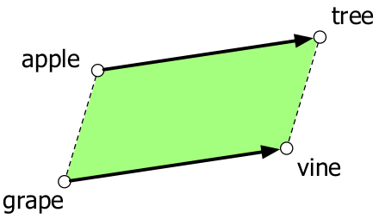
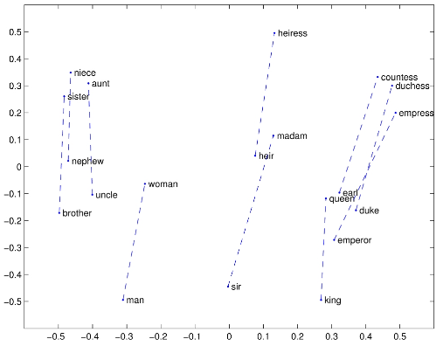
Properties of Word Embeddings (2)
They capture relational similarity
Parallelogram model from cognitive science
Example from GloVe
Skip-gram known to capture this
It’s not as smooth all the time

Slide 81
Evaluating Word Embeddings
Intrinsic evaluation:
Correlation between similarities of representations with expert-given similarity scores
Examples:
WordSim353 (2002): 353 noun pairs, e.g. (plane, car)
SimLex-999 (2015): more difficult, e.g. (cup, mug)
Another approach: analogy task (e.g. man + woman – king = queen)
Word2vec used this in their original work
Most important evaluation: extrinsic!
I.e. using the representations in NLP downstream tasks and see if performance improves

Slide 82
Summary: Word Embeddings
Vector representations of words
Sparse vs dense (distributed) representations
PROs and CONs to each
Different methods to learn them (each a different task)
Distributional semantics
Important principle
Commonly used to learn word embeddings, language models
Spoiler: also used when training LLMs
Classic way to learn dense word representations: word2vec
Specifically, the skip-gram task, model and training objective
Resulting learned representations have nice properties
In the future, other tasks for other goals
E.g. masked and autoregressive language models

Slide 83

References
Natural Language Processing: A Machine Learning Perspective, Zhang et al, 2018
Chapters 2, 3, 4 and 13
Speech and Language Processing, Jurafsky et al., 2023
Chapter 3, 6
Natural Language Processing, Eisenstein, 2018
Chapter 14
© University of Mannheim

