Slide 1

Advanced Methods in Text Analytics
Transformers
Licensed under Creative Commons Attribution 4.0 International

Slide 2
Why Transformers?
Most successful and commonly used deep learning architecture in NLP
By far!
Resilient technology
RNNs improved over FNNs
LSTMs improved over vanilla RNNs
Attention improved over vanilla encoder-decoder architectures
Transformer proposed in 2017/2018, still largely unchanged
Alternative architectures do exist/are proposed, e.g. Mamba, LSTMs
Main advantages over RNNs (previous state-of-the-art models)
Attention over arbitrarily large inputs, i.e. no recurrent connections
Flexible/powerful attention mechanism
Scalable! Parallelizable, important contrast to RNN-based models

Slide 3
Outline
Recap: Attention
Self-Attention
The Transformer Architecture

Slide 4
Recap: Attention

Slide 5
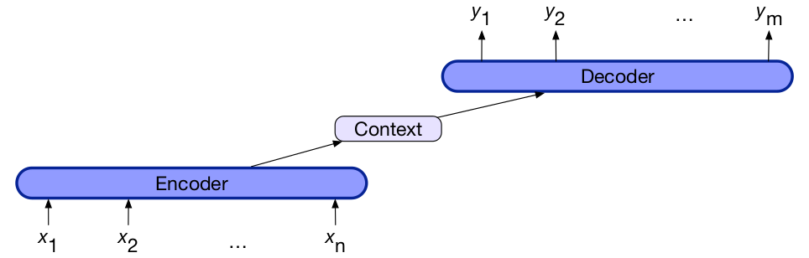
Encoder-Decoder Architecture
Goal: create contextually appropriate sequence of arbitrary length
Known as seq2seq models
Components
Encoder: typically, an RNN
Context vector: produced by encoder (typically last hidden state in RNN)
Decoder: RNN, produces task-dependent output based on context vector
Thus, input sequence represented entirely by context vector
Common applications: machine translation, dialogue systems, etc.

Slide 6
Attention (1)
Seminal work in machine translation: Bahdanau et al. (2015)
Recall: RNNs have a hard time using information far back in time
Thus, the context vector may not encode everything we need
LSTMs somewhat address this, but…
Why not allow decoder to access input sequence?
In encoder-decoder architecture:
Decoder accesses input via hidden states of encoder
Context vector is now weighted sum of hidden states in encoder
Important: context vector dependent on decoder state!
Thus, model “attends to” different parts of input to produce different parts of output
Let’s look at all of this in more detail!

Slide 7
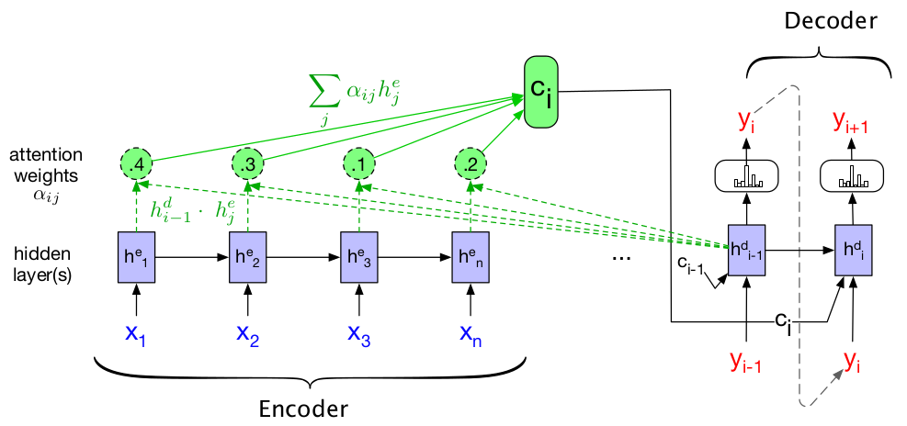
Attention (2)
c_{i} is context vector for output i, defined as c_{i} = Σ_{j=1}^{n} α_{ij} h_{j}^{e}
That is, c_{i} is a weighted sum of encoder hidden states
Coefficients α_{ij} known as attention weights
Encode how much attention is paid to input j to produce output i
Decoder output h_{i – 1}^{d} necessary, encodes output i - 1 (dashed lines)

Slide 8
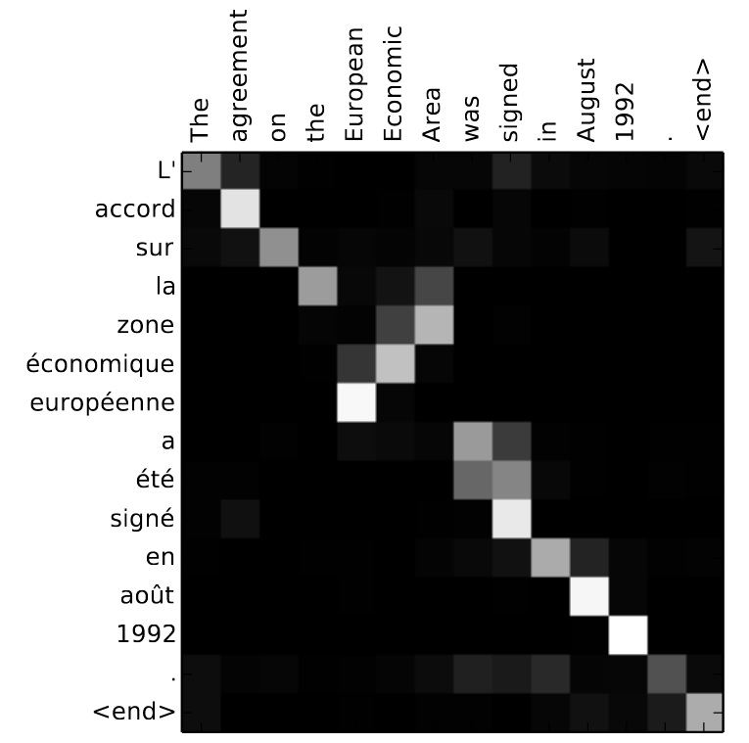
Attention (3)
Entry i,j corresponds to attention weight for input i given target token j
We can see most words are translated 1-to-1, i.e. look at nth input word to produce nth output word
But some are not so simple!
To produce word européenne, the 7th output word, model looks at 5th input word, the actual relevant one!
Relevant input can be far!
“Ich habe heute Abend Bratwurst mit Bröt und Kartoffeln gegessen.”
“Tonight I ate…”

Slide 9
How to Compute Attention Weights?
Two steps:
Compute attention scores
Combine attention scores to produce attention weights
Attention scores: how relevant each input is to encoder’s last state
Each input -> hidden states in encoder h_{j}^{e}
Each output -> decoder hidden states h_{i}^{d}
Common approach: dot-product attention
score(output i, input j) = (h_{i}^{d})^{T} h_{j}^{e}
Used to compute output i + 1
Relevance seen as similarity
Similarities computed between each input token and last decoder state
We still don’t know the relative relevance across input words
Attention weights: encode relative relevance across input words
α_{ij} = softmax(score(output i, input j)), i.e. mass of α_{ij} w.r.t. all other α_{ij'}

Slide 10
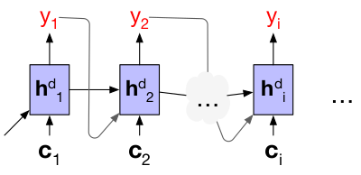
Attention: In Short
To produce output i+1:
Compute attention scores using last hidden state of decoder’s h_{i}^{d}, e.g. with dot-product attention: score(output i, input j) = (h_{i}^{d})^{T} h_{j}^{e}
Compute attention weights, e.g. using softmax across all attention scores
Compute context vector c_{i} as linear combination of encoder hidden states, where coefficients are attention weights, i.e. c_{i} = Σ_{j} α_{ij} h_{j}^{e}
Use c_{i}, along with y_{i} and h_{i}^{d}, to produce output y_{i+1}
Thus, attention allows a seq2seq model to see dynamic representation of input at each output step
Different operations can be used to compute scores and weights

Slide 11
Self-Attention

Slide 12
The Heart of Transformers
Transformers were introduced by Vaswani et al. in 2017
Virtually all of state-of-the-art NLP is based on transformers, e.g.
BERT and other masked language models that provide word representations (covered soon)
The GPT family of text-generating language models (covered soon)
Deep architecture with many components
Key component of the transformer architecture: self-attention
They proposed to drop the RNNs and “simply” focus on attention
In reality, more components aside from attention
But self-attention is main innovation, allowed for flexible and scalable attention over long sequences
More on this later
First, let’s focus on self-attention
Then on the overall architecture of the model

Slide 13
Attention as Information Retrieval
Useful intuition about attention comes from information retrieval
Say you open YouTube and input the query “cats dressed as Batman”
The search system represents each video with a set of keys
Think attributes, class properties
For example: title, description, channel_name, publication_date, etc.
For any query-key match the system finds, it returns a value
In this case, values are relevant videos, e.g. those with text similar to your query in the title, description, etc.
We can see attention as such a query-keys-values system
Given attention score score(output i, input j) = (h_{i}^{d})^{T} h_{j}^{e}, decoder state h_{i}^{d} is a query, encoder state h_{j}^{e} is a key
Context vector c_{i} represents retrieved values, but as linear combination?
Yes, so c_{i} = Σ_{j} α_{ij} h_{j}^{e} where h_{j}^{e} are again used as values
Thus, attention can be seen as a soft-retrieval system
It returns relevant values, but each weighted by how relevant they are

Slide 14
Self-Attention (1)
Attention: compare item of interest to collection of other items in a way that reveals their relevance in the current context
In encoder-decoder architecture, item of interest is decoder state, i.e. output sequence so far
Collection of other items is hidden states of encoder, i.e. input sequence
Self-attention: compare each token in given sequence, to all other tokens in the same sequence, i.e. item of interest is in same collection of items to compare with
Thus, we use representations from the same sequence as queries, keys and values
score(input i, input j) = (x_{i}^{e})^{T} x_{j}^{e}
α_{ij} = softmax(score(input i, input j))
y_{i} = Σ_{j} α_{ij} x_{j}^{e}
where x_{i} are representations of given sequence, and y_{i} are representations after attention, i.e. contextualized representations

Slide 15
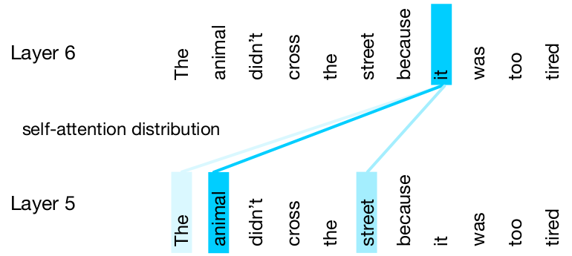
Self-Attention (2)
Again, to produce each output token we compute (potentially) different context vectors
Thus, encoders produce different representations at each output step
These representations depend on context, i.e. output produced so far, other tokens in input sequence
Hence, contextualized representations (unlike static word embeddings)

Slide 16
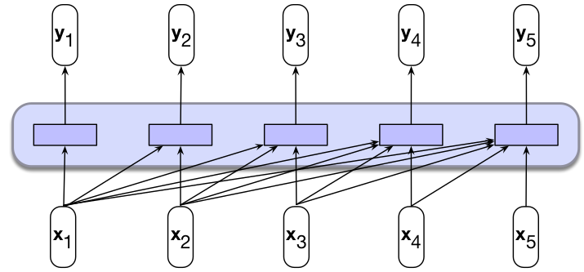
Self-Attention Layer (1)
Input: sequence of n tokens
Output: sequence of n contextualized tokens
Layer is parameterized by matrices W^{Q}, W^{K} and W^{V}
Each a linear transformation applied to input tokens x_{i}
Each transformation is applied when tokens are used in the different roles: queries, keys and values

Slide 17
Self-Attention Layer (2)
Note the contrast to attention so far, which was not parameterized!
Attention scores: dot-product
Attention weights: softmax
Before, model had to learn token representations that could be combined to provide useful context vectors
The parameters in self-attention allow for a more flexible attention mechanism
Specifically, q_{i} = W^{Q}x_{i}, k_{i} = W^{K}x_{i} and v_{i} = W^{V}x_{i}
Then:
score(input i, input j) = q_{i}^{T}k_{j}
α_{ij} = softmax(score(input i, input j))
y_{i} = Σ_{j} α_{ij} v_{j}
Note that for dot product attention, we require that W^{Q,} W^{K} Є R^{DxD'}
In general, W^{Q}, W^{K} and W^{V} can be of any size allowed by the required computations for scores and weights

Slide 18
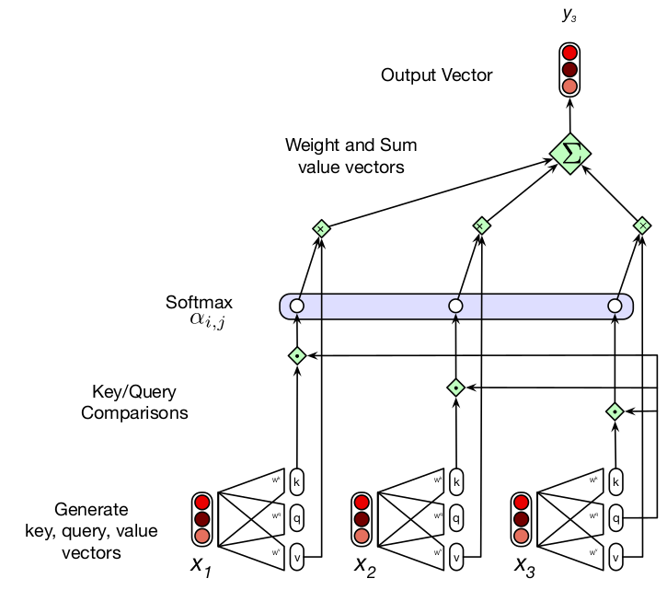
Self-Attention Layer (3)
Here, model attends only to previous tokens
Design choice, depends on task
Note:
Transformations to k, q and v
Dot products with one q and each k to compute scores
Softmax to compute weights
Linear combination with each v to get contextualized representation y

Slide 19
Self-Attention Layer (4)
The original model actually used scaled dot-product attention
score(input i, input j) = q_{i}^{T}k_{j} / √D_{k} where D_{k} is size of keys and query vectors
Done to avoid numerical stability issues when using softmax
We can represent the computation for all y_{i} as matrix products
Let X Є R^{NxD} be the matrix of N input tokens of size D
Then: Q = XW^{Q} Є R^{NxD'}, K = XW^{K} Є R^{NxD'}, V = XW^{V} Є R^{NxD}
All relevant dot products, i.e. attention scores, are in QK^{T} Є R^{NxN}
Apply row-wise softmax for attention weights: softmax(QK^{T} | √D_{k}) Є R^{NxN}
Then multiply by V to get final stacked contextualized representations
All together: Self-Attention(Q,K,V) = softmax(QK^{T} | √D_{k}) V
Cost: each y_{i} computed independently, thus highly parallelizable
But attention quadratic in input size (every item with every other item)
Thus, size of input sequence a fundamental limitation of this architecture
Transformers as FNNs, not RNNs: max. input size fixed, grows with model

Slide 20
The Transformer Architecture

Slide 21
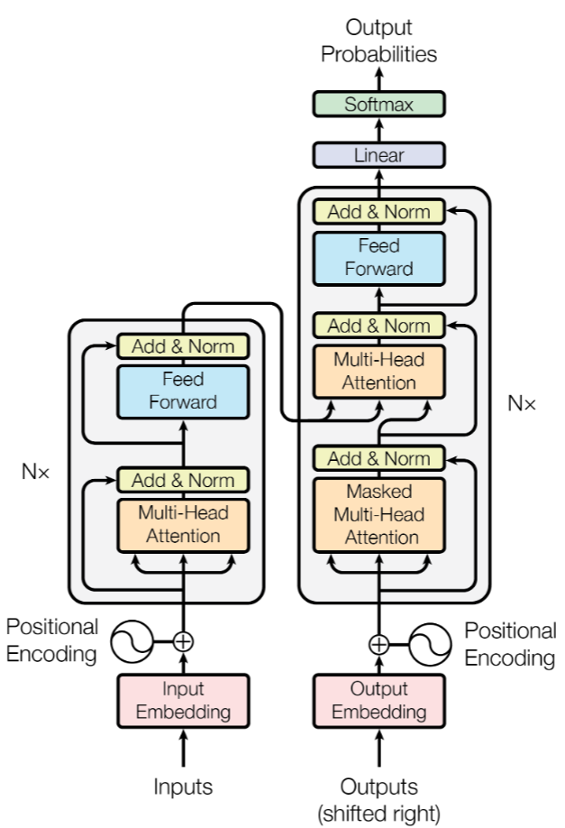
The Transformer Architecture
Originally an encoder-decoder architecture
Encoder: multi-head attention
Plus additional components
Decoder: multi-head attention
Plus additional components
Interaction between encoder/decoder:
Multi-head attention
Hence the name: Attention is All you Need
Multi-head attention: multiple self-attention layers (discussed soon)
Additionally, other components:
Positional encoding
Layer normalization
Residual connections
FNN
Let’s look at them in more detail, but first…

Slide 22
The Animated Transformer
From Google’s blog, here’s now representations are built/interact
3 encoder layers are stacked for depth (still deep learning)
3 decoder layers are also stacked

Slide 23
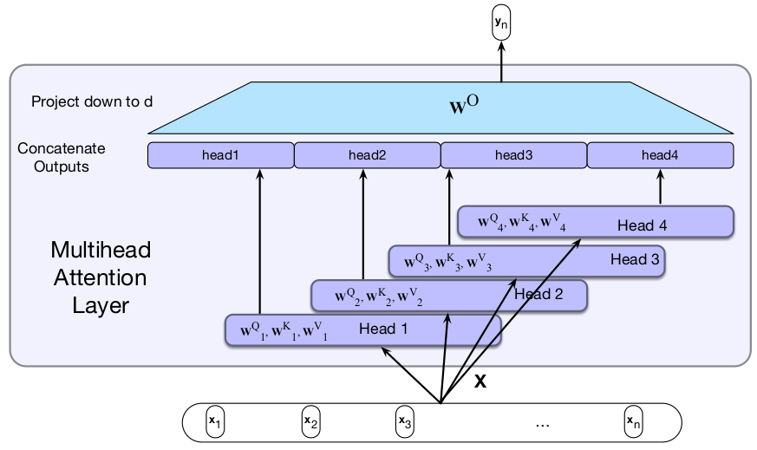
Multi-Head Attention (1)
Single-head attention: self-attention layer
Multi-head attention: multiple independent self-attention layers
Output concatenated, then projected down to input size

Slide 24
Multi-Head Attention (2)
Specifically, each attention head i has parameters W_{i}^{Q}, W_{i}^{K} and W_{i}^{V}
Since we have a projection layer at the end, dimensions of queries, keys and values can more freely change
We denote size of queries and keys by D_{k} (the same because dot product)
We denote size of values by D_{v}
Then W_{i}^{Q} Є R^{DxDk}, W_{i}^{K} Є R^{DxDk} and W_{i}^{V} Є R^{DxDv} where D is size of input tokens
As before, stack inputs of size D to form matrix X
Then, Q_{i} = XW_{i}^{Q} , K_{i} = XW_{i}^{K,} V_{i} = XW_{i}^{V}
We thus have head_{i} = Self-Attention(Q_{i},K_{i},V_{i})
Outputs of each head is concatenated, projected down to D via W^{O}
MultiHeadAttention(X ) = (head₁ (+) head₂ (+) … (+) head_{H}) W^{O}, where (+) denotes concatenation

Slide 25
Multi-Head Attention (3)
Perhaps more important: why?
What is the intuition behind this?
How can we think about multi-head attention?
Different words in a sentence relate to each other in different ways
“They happily played Mario Kart until the sun came out.”
“Mario Kart” is the object of verb played
“Mario Kart” described further by indirect complement “until the…”, etc.
A single-head attention must capture all of these dependencies
A multi-head attention splits the workload into independent heads
Think of tasking a set of people to do one job, e.g. memorize a book
Thus, multi-head attention is more powerful
But more difficult to train (more parameters)
Additional intuition: multiple convolution filters in convolution layer
Similar principle: many patterns to capture, multiple filters allows model to capture different patterns using different filters

Slide 26
Positional Encoding (1)
In the transition from RNNs to transformers, we lost something!
We no longer “see” relative positions (order) of each token in the input sequence
Each token attends to each other token, wherever they are
Think about a self-attention layer
It produces contextualized representations for each input token
If we shuffle the input sequence, the output of the linear combination that produces contextualized representations is still the same
But relative position of tokens matters in a sequence!
Solution: modify input embeddings to encode position before applying attention
For example, learn position embeddings just as you do word embeddings
E.g. embedding for position 1, 2, etc.
Then combine embeddings of positions with words before multi-head attention, e.g. by adding them up -> w₁+w_{the}

Slide 27
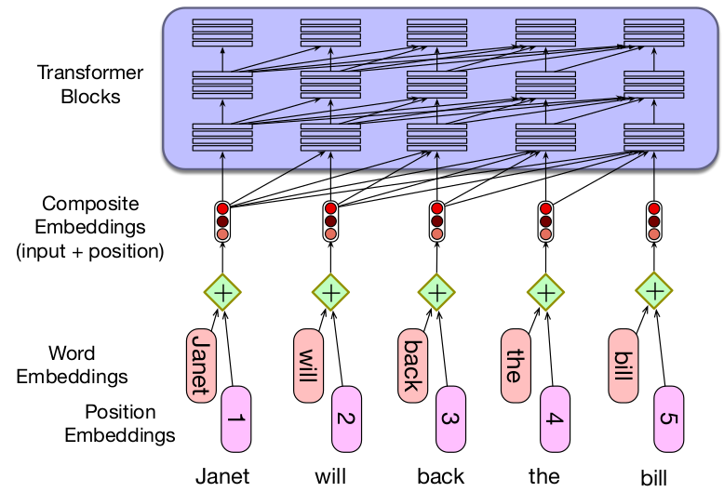
Positional Encoding (2)
Other types of positional encodings, e.g. non-parameterized ones
We’ll see some in detail in tutorials

Slide 28
Layer Normalization
Goal: normalize output of any layer in a network
Not exclusive to transformers, commonly used in deep learning models
Improves gradient-based training
It’s a form of centering the data
Given output vector x for some hidden layer, compute its mean μ and standard deviation σ
Then center x’ = (x - μ) / σ
Final value is actually LayerNorm = γx’ + β
Both γ, β are learnable parameters
Layer normalization can play important role during training
First proposed by Ba et al. (2016)
Subsequent studies have focused on its impacts
Recent architectures include more layer normalization in other parts
E.g. after input embeddings, before and after self-attention
More on this when discussing LLMs

Slide 29
Residual Connections
Recall the vanishing gradient problem:
Most operators have impact on the gradient that flows backward during training
Generally, input gradients are multiplied by an operator-specific Jacobian
This factor can make output gradient smaller than input gradient
With depth, gradients can thus vanish
Residual connections designed to address this issue (He et al. 2015)
Main idea: given operator, add its input back to its output
Addition operator has no impact on gradient, passes it backward unchanged!
Also not exclusive to transformers, commonly done in deep models
In transformers, z = LayerNorm(X + Self-Attention(X))
Thus, whatever impact Self-Attention has on the gradient, the full gradient is still preserved by the additive term X during backpropagation
We discuss this in a bit more detail in tutorials

Slide 30
Projection FNN and Cross-Attention
Often described as MLP
FNN used to transform output of multihead-attention
In reality, two linear projections, usually project up, then back down
ReLU (non-linear) activation between
Unclear exactly why, more soon
Important: cross-attention
Attention across different sequences
Note two attention layers in decoder
One attends to output of encoder
Different transformer architectures
Encoder-decoder
Encoder-only, decoder-only
More in lecture on LLMs

Slide 31
Dropout
Proposed by Srivastava et al. (2014)
Idea: randomly drop units in network (along with their connections)
It’s a form of regularization, thus, only applied during training, not at inference time
Intuitively, network is dynamic during training
Prevents model from relying too much on static architecture by introducing variability, promoting generalization
In practice, each units "zeroed" with probability p (hyperparameter)
E.g. see implementation in PyTorch
Original transformer used dropout in two places
Specifically, before applying layer normalization and residual connection
That is, z = LayerNorm(X + Dropout(Self-Attention(X)))
Also after adding positional embeddings, i.e. x = Dropout(x₁ + x)
Dropout still very common regularization method in LLMs

Slide 32
Inductive Bias in Transformers
Inductive bias: set of assumptions made by a learning model
Common story: self-attention is main innovation
But many more components in transformers
Transformer block:
Two main components: self-attention and MLP
With corresponding layer normalizations and residual connections
Let's see the role of each
Self-attention:
Linear operations between different input tokens
I.e. there is "inter-token" communication
Linearities useful for parallelization, but not expressive for learning
MLP:
Transformations applied at each token independently
I.e. "Intra-token" phase
Non-linearities introduced here for expressivity

Slide 33
Ablation
There is no fundamental theory behind the design of deep learning models
No way to accurately predict how a model will behave given its architecture
No equation that tells us exactly which components a model should have to perform a given task
Thus, ablation studies are essential!
Ablation: remove one component of the model at a time to test its impact
E.g. remove normalization layer, run model again, how does performance change?
Or remove/change positional encodings. What impact does this have in performance?
With ablation, we may gain some understanding of why a model works

Slide 34
Summary
Self-attention: main innovation in transformer architecture
Each input token contextualized based on entire input sequence
Architecture has many components
Self-attention
Positional encodings
Layer normalization
FNN
Architectures are normally deep (stacked transformer blocks)
Different flavors
Encoder-decoder, decoder-only, etc.
Large language models (LLMs) based on transformers, with variations
More layer normalizations
Different positional embeddings
Etc.

Slide 35

References
Speech and Language Processing, Jurafsky et al., 2024
Chapter 10
References linked in corresponding slides
© University of Mannheim

