Slide 1

Advanced Methods in Text Analytics
Transfer Learning
Licensed under Creative Commons Attribution 4.0 International

Slide 2
What is Transfer Learning?
“Acquiring knowledge from one task or domain, and then applying it (transferring it) to solve a new task.” Jurafsky et al. 2025
Common approach follows two-steps (Howard and Ruder, 2018):
Pre-training a model on some tasks that “allows” model to learn rich representations
Fine-tuning the learned representations (weights) in the context of a new downstream application
Why is it called pre-training?
Train model for general use before using it on specific applications
Fine-tuning refers to further updating weights of pre-trained model
Downstream task usually implies using a downstream model in combination with the pre-trained model
Updating weights may result in “catastrophic forgetting”
Focus this week: pre-training tasks and architectures
Next week: fine-tuning methods and applications

Slide 3
But First, a Word on Tokenization
Recall introduction lecture: tokenization is important!
Should we tokenize words? What are words?
Should we tokenize characters? What meaning do they encode?
Nice sweet spot: tokenize subwords
E.g. unlikeliest -> un-likely-est
Each a morpheme, i.e. a meaning-bearing unit
Byte-Pair Encoding (Sennrich et al. 2016): very common subword tokenizer, roughly as follows
Starting vocabulary V is set of characters
Find most common two-character subword, create token for it, add to V
Keep finding common and longer subwords until k new tokens are created
Thus, can handle unknown words by breaking them into characters
Variants exist, e.g. WordPiece, SentencePiece
Tokenization is the focus of an entire future lecture

Slide 4
Outline
Pre-Training
Transformer-based language models
Masked Language Models
Causal (or Autoregressive) Language Models
Fine-Tuning

Slide 5
Pre-Training

Slide 6
Pre-Training Methods
Take skip-gram as an example of pre-training
Goal: learn useful (static) representations
Task: predict whether two words are likely to be in context
In other words, the actual goal is not necessarily solving the task
There are different tasks for pre-training
Each a different training objective
Multi-task training possible, e.g. objective is linear combination of tasks
Most common pre-training tasks/approaches
Masked Language Models (MLMs)
Causal (or Autoregressive) Language Models (CLMs)
Different task -> usually different architecture and objective
MLM: BERT, encoder-only transformer
CLM: GPTs, decoder-only transformer
Other variants exist, all based on the transformer architecture
First: transformer-based LMs, then: MLMs and CLMs

Slide 7
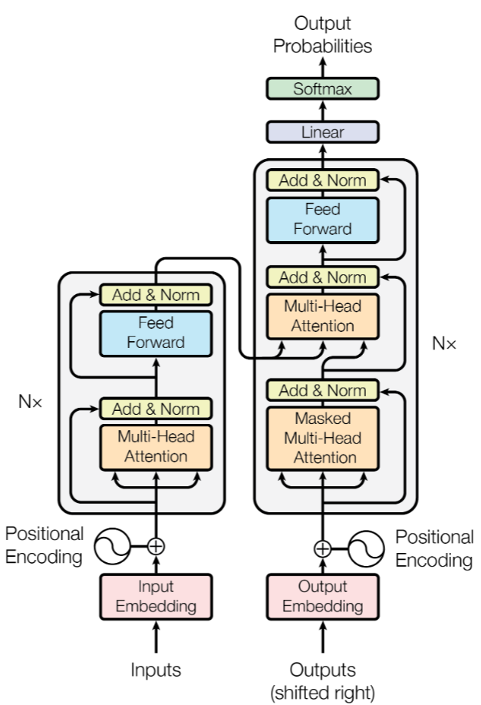
Encoder-Only and Decoder-Only
Recall the transformer architecture
Encoder-decoder
Some models use only the encoder
Input: tokenized input sequence
Output: contextualized input tokens
Other models use only the decoder
Input: start symbol, previous outputs
Output: new generated word
Both can be stacked

Slide 8
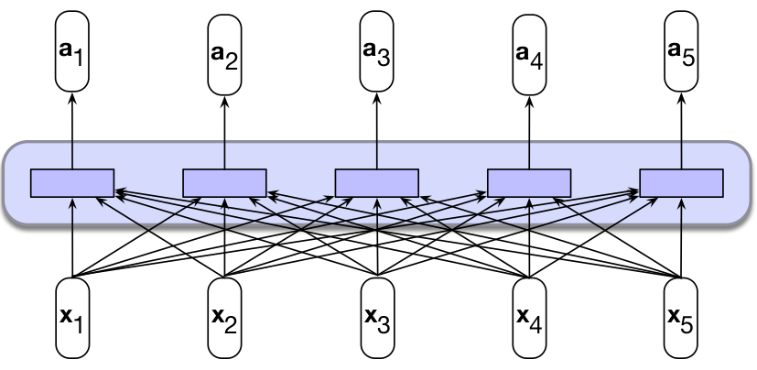
Recap: Self-Attention Layer (1)
Input: sequence of n tokens
Output: sequence of n contextualized tokens (here, bidirectional)
Layer is parameterized by W^{Q}, W^{K} and W^{V}
Each a transformation for using tokens as: queries, keys, values
Thus, same words gets different representations based on context
“They broke in tears when they heard they got the new flat.”
“They broke the world record by 2 seconds flat.”

Slide 9
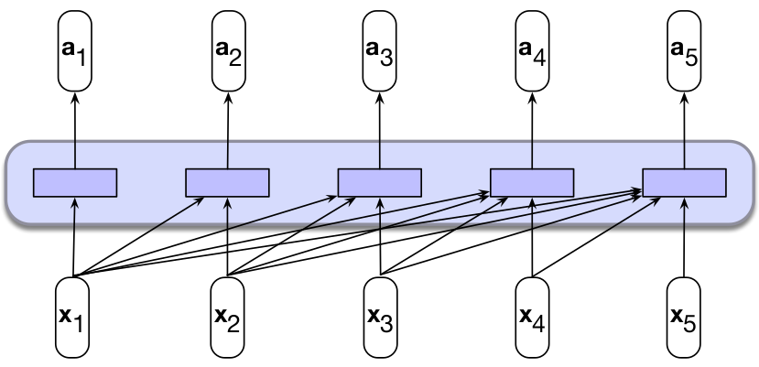
Recap: Self-Attention Layer (2)
Self-attention can also be causal
Token at time step t attends only to previous inputs (< t)
Input and output still the same as any self-attention layer
But "context" of each output embedding is only inputs from previous steps
Recall that without positional embeddings, there is no "time"

Slide 10
The Language Modeling Head (1)
A transformer block/layer typically outputs token representations
Transformer block/layer = self-attention + MLP
Output embeddings are same size as input embeddings
Can either be a sequence in encoder-only models
Or a single token per time-step in decoder-only models
How do we turn these outputs into a language model?
Each representation fed to a "classification head" (a downstream model)
Classification head: softmax layer that projects to space of possible classes
Language modeling head: projects to vocabulary space
I.e. same mechanism used for language modeling with RNNs
If the task is to predict next word:
Feed contextualized representation of input at time step t to LM head to predict word at time step t + 1
Let's visualize this!

Slide 11
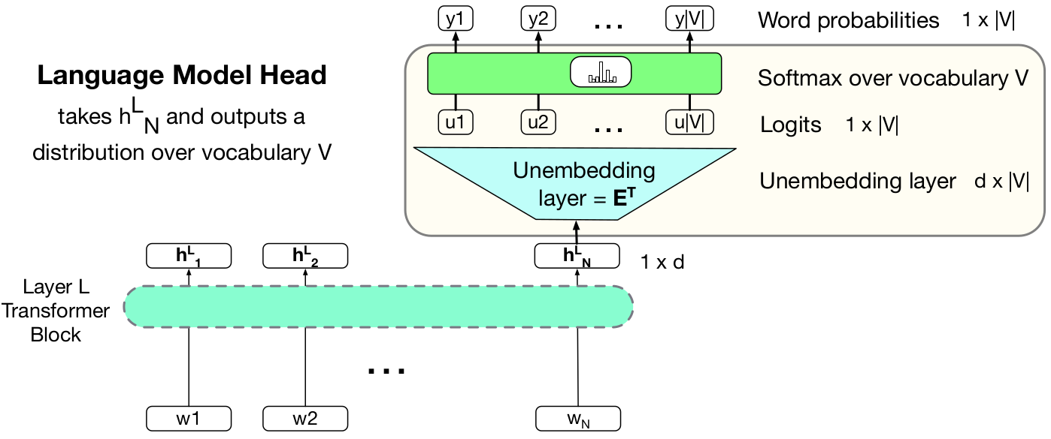
The Language Modeling Head (2)
h^{L}_{N} ∈ R^{d} is output embedding of block L at time step N
Unembedding layer U ∈ R^{d x |V|} projects from d to |V| (vocabulary space)
Output is logits, used as input to softmax function (no weights)
Note that U is same size as initial (static) embedding layer E ∈ R^{|V| x d}
Hence, we usually set to be U = E^{T} (weight tying, Press et al. 2017)
Weight tying: use same matrix as E and U, known to improve performance

Slide 12
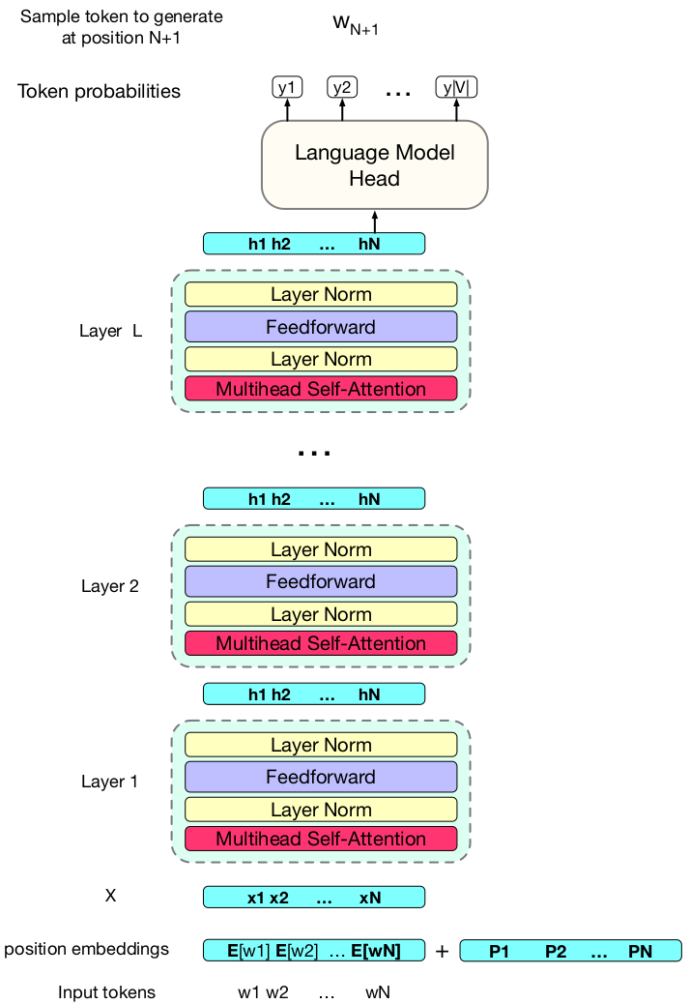
Transformer-Based LMs
All together:
(Static) input embeddings E[w_{i}]
Positional embeddings p_{i} (added)
L transformer layers (blocks)
Language model head
For each transformer layer/block
Input: sequence of embeddings of size d
Output: sequence of embeddings of size d
For language model head
Input: single embedding of size d
Output: probability of each token in vocab. V
Input to downstream model depends on task
E.g. for sequence classification, we need to
represent entire input sequence
For sequence labelling, each token
representation is classified

Slide 13
Masked Language Models

Slide 14
Masked Language Models (1)
Using information about the future in a sequence is often not suitable
E.g. in text generation, we use past generated words to generate new ones
We don’t want to train a model to use information that isn't available at inference time
But often the entire input sequence is available during inference!
E.g. in machine translation we get an entire document to translate
In dialogue scenarios, we get entire input from user at each turn
And looking at subsequent tokens can be useful for certain tasks
Tasks that require labeling each sequence element (token-level classification)
E.g. part-of-speech tagging (adjectives come before nouns in English)
Generally, we obtain richer representations by using more context
With transformers, we control that in the self-attention layers
If we can't look at future tokens: causal self-attention
If we can look at future tokens: bidirectional self-attention

Slide 15
Masked Language Models (2)
Contextualized representations from bidirectional self-attention layers consider context from both sides of each input word
Masked language modeling: predicting masked words in input sequence
Masked words: hidden, usually replaced with [MASK] token
Architecture: we use bidirectional transformer encoders to train models to predict masked words in the input sequence
What exactly does masking mean? The training approach should clarify!

Slide 16
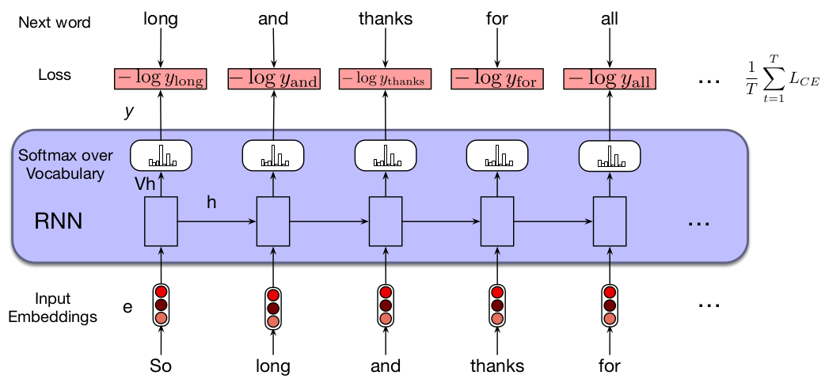
Training Masked Language Models (1)
Recall training RNNs
We predict the next word given previous ones
The loss corresponding to each input word is measured against next word in input sequence, final loss is average over all tokens
Can we do that here?
No, bidirectional self-attention looks at next word!
Task of predicting next word therefore trivial

Slide 17
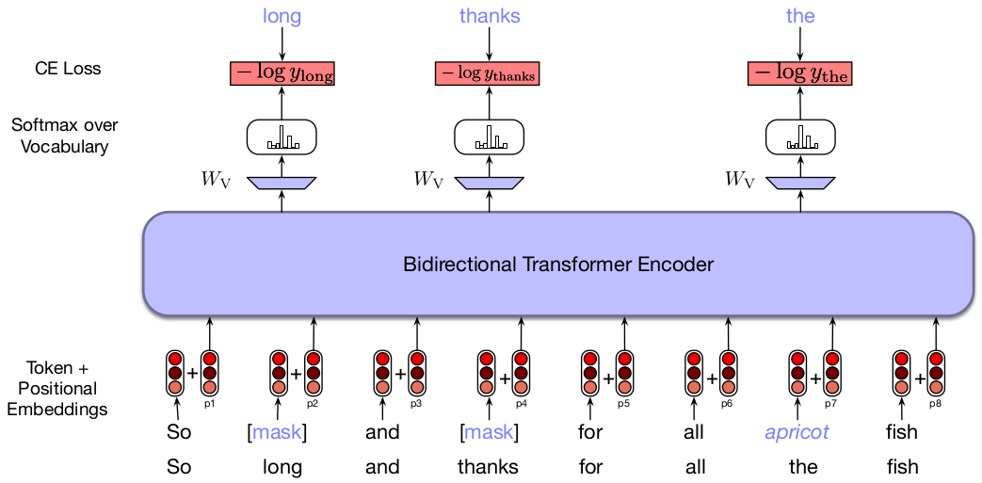
Training Masked Language Models (2)
Instead, cloze task, i.e. fill-in the blank (Taylor, 1953)
“Turn ____ homework in.”
Many examples from same sentence: “Turn your __________ in.”
Loss averaged over masked tokens only, all tokens "attended" to
Note: self-supervision, predict parts of input using rest of input
More details by discussing quintessential MLM: BERT

Slide 18
The BERT Model (1)
BERT: Bidirectional Encoder Representations from Transformers
Seminal work by Devlin et al. 2018
A clear success case is transfer learning
Revolution: jump in state-of-the-art performance in several NLP tasks
Defined masked language modeling as discussed today
Goal: learn representations of language
Not predict masked words, i.e. not the task from training objective
Thus, similar to word embeddings, but now using transformers
Their general architecture:
Encoder-only transformer
12 stacked layers of transformer encoders, each with 12 attention heads
Hidden layers of size 728
Max input length: 512 tokens (recall: attention cost quadratic in this length)
Overall: 100M parameters

Slide 19
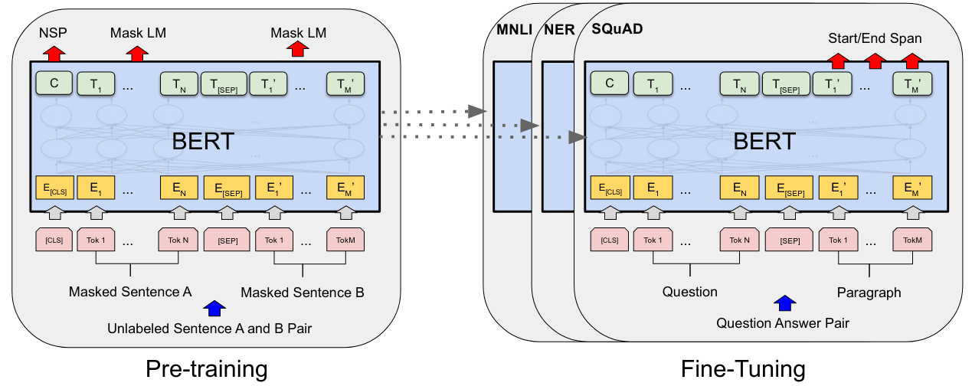
The BERT Model (2)
Pre-training -> Fine-tuning framework
Pre-training designed to include both token level and sentence level tasks
Fine-tuning required minimal changes to pre-training architecture
Let’s discuss some of these important design choices

Slide 20
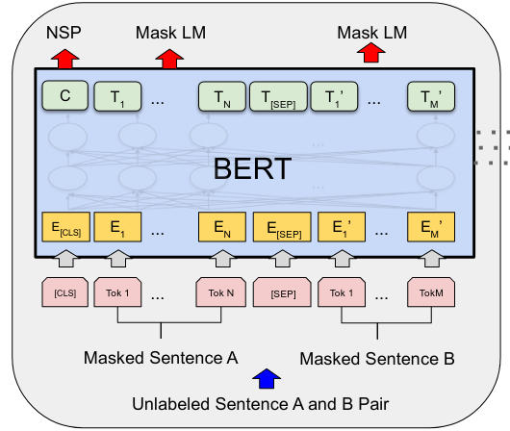
Pre-Training BERT (1)
Two level representations
Both in same input sequence
Token level
E_{i} inputs, T_{i} outputs
Sentence level
[CLS], [SEP] inputs
C, T_{[SEP]} outputs
Thus, model “aware” of sentence pairs
Useful for downstream tasks
E.g. (question, answer) pairs
[CLS] token meant for sequence classification
Final representation C used as sequence representation
[SEP] token separates two input sentences

Slide 21
Pre-Training BERT (2)
They (pre-)trained with two self-supervised tasks
Masked language modeling (MLM), i.e. fill-in the blank
Next sentence prediction (NSP), e.g. for QA, natural language inference
For MLM training objective:
Replaced 15% of input tokens in training corpus
80% of that time replaced with [MASK] token
10% of that time replaced with another random token
10% left unchanged
Output token T_{i} fed to softmax for classification, original word as target
Why all of this? Because [MASK] token never seen at inference time!
So, model does should not rely on this signal to make such predictions
For next sentence prediction objective:
Binary classification: next sentence or not? ([CLS] token to softmax layer)
50% of examples were subsequent sentences in training corpus (positives)
50% of examples had 2nd sentence be a randomly chosen one (negatives)

Slide 22
Pre-Training BERT (3)
Final loss: combined loss of both MLM and NSP training objectives
Training corpus
BooksCorpus: 800M words
English Wikipedia: 2.5B words
(Much less data than used for training large language models today)
Important: training data must be full documents, not shuffled sentences (often a valid approach)
Why?
Tokenization: WordPiece subword embeddings
Vocabulary size: 30K
Recall: subwords is nice balance between words and characters
It took 40 epochs to converge model during training
With the hardware at the time (64 Google TPUs), that was 4 days

Slide 23
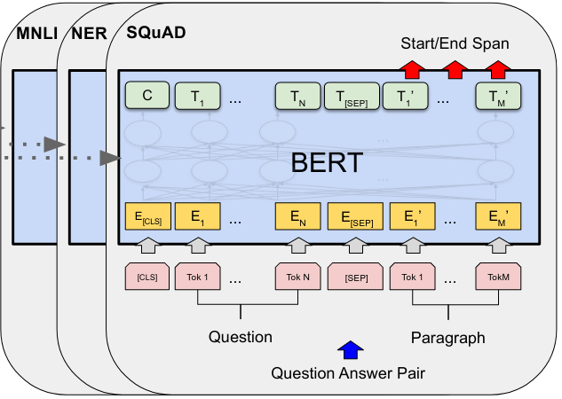
Fine-Tuning BERT (1)
Straightforward: representations computed by BERT used as input for downstream model
Note: requires using entire model, not just its weights as word2vec
Can handle tasks where input is single sequence, e.g. sequence labeling (NER) and sequence classification, or pairs of sequences, e.g. QA (SQuAD) or NLI (MNLI)
Given input data, e.g. sequence to classify:
Sequence fed as input to BERT
BERT output passed to classification head (each token for sequence labeling, CLS token for sequence classification)
Let's visualize this!

Slide 24
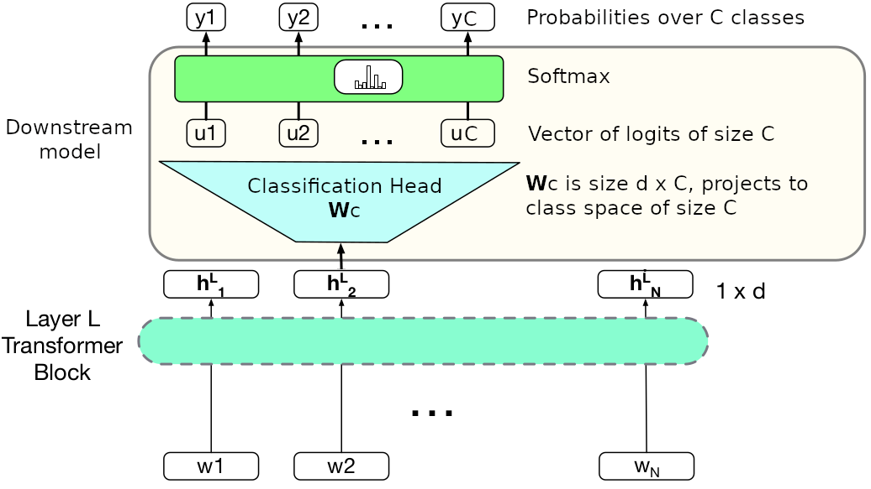
Fine-Tuning BERT (2)
Here's an example for sequence labeling, i.e. we classify each token h^{L}_{i}
Downstream model is linear projection W_{C} to classification space C
During fine-tuning, W_{C} + all model parameters were updated
Fine-tuning model often took 1 hour (doable compared to pre-training)
For sequence classification task, CLS token used as downstream input

Slide 25
Variations of BERT (1)
BERT’s architecture was highly influential
Spawned several variants of the original model
RoBERTa (Liu et al. 2019)
More than a variant, the result of a reproduction study
They reimplemented, retrained, did more ablation
Proposed changes such as:
(1) Dynamic masking, i.e. sampling tokens for masking for each input sequence during training (as opposed to once before entire training run)
(2) Training without NSP loss (no more sentence pairs)
SpanBERT (Joshi et al. 2020)
Masked entire subsequences instead of individual tokens (i.e. a span)
Marked masked span with special tokens (start-of-span, end-of-span)
Model trained on additional objective Span Boundary Objective (SBO)
They outperformed BERT in span-based tasks, e.g. span-based QA
This model was concurrent with RoBERTa

Slide 26
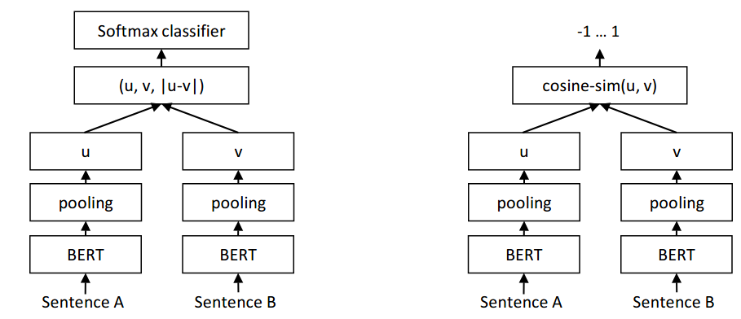
Variations of BERT (2)
Sentence-BERT (Reimers et al. 2019): better sentence embeddings
Siamese network architecture (here, two BERTs with shared weights)
Pooling BERT output vectors (MEAN/MAX) to get sentence embedding
Training (left): Feed sentence vectors to classification/regression head
Inference (right): for regression, cosine similarity between sentences
Results: better sentence embeddings vs [CLS] token, other methods

Slide 27
Causal Language Models

Slide 28
Autoregressive Text Generation
Recall autoregressive generation: word generated at each time-step is conditioned on word generated at previous time-step
Concrete steps:
Feed starting symbol <s>, model produces softmax distribution over vocabulary
Sample next word w_{i} from softmax distribution (using some sampling method)
Add sampled word to previous input sequence, i.e. "<s> w_{i}", feed to model
Model produces new softmax distribution, sample next word w_{i+1} again
Repeat steps 3-4 with latest sampled word until symbol </s> is sampled
Sampling methods important part of generation, as seen in tutorials
Greedy decoding: sample most probable word
Top-k: sample from top k words
Top-p: sample from words that make up top p probability mass
More involved sampling methods exist
Before we look at causal language models, let’s have a quick look at a very common and less simple sampling method in more detail

Slide 29
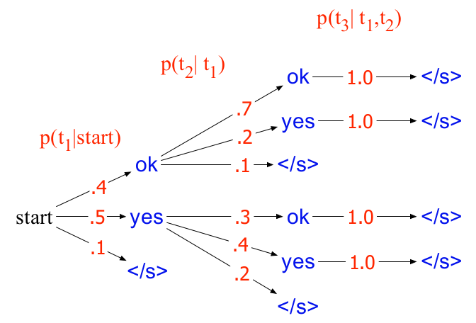
Beam Search (1)
Say we have a pre-trained LM that can produce distributions for next word prediction
Assume further our vocabulary is V = {yes, ok, </s>}
In the following example, the most probable sequence is “ok ok </s>”
But greedy sampling would fail to predict it, it would first choose “yes”

Slide 30
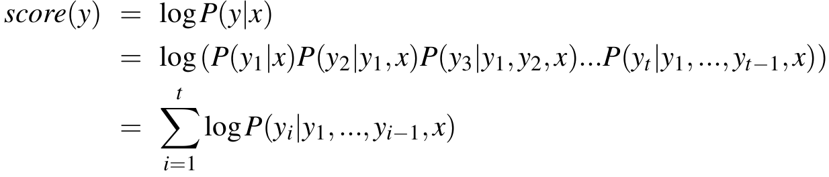
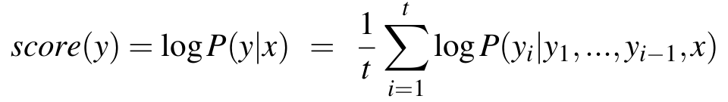
Beam Search (2)
The previous example illustrates that when we want the most probable sequence, shortsighted approaches may not be suitable
Shortsighted: only considering the probability of the next word
Beam Search:
Iteratively sample top k most probable words (i.e. also greedy)
The score of each possible word is based on the probabilities of the previously sampled words, i.e. consider the probability of the sequence
Score of sequence of y_{i} words given some input x, e.g. in translation, is:
We normalize by sequence length to avoid favoring shorter sequences:

Slide 31
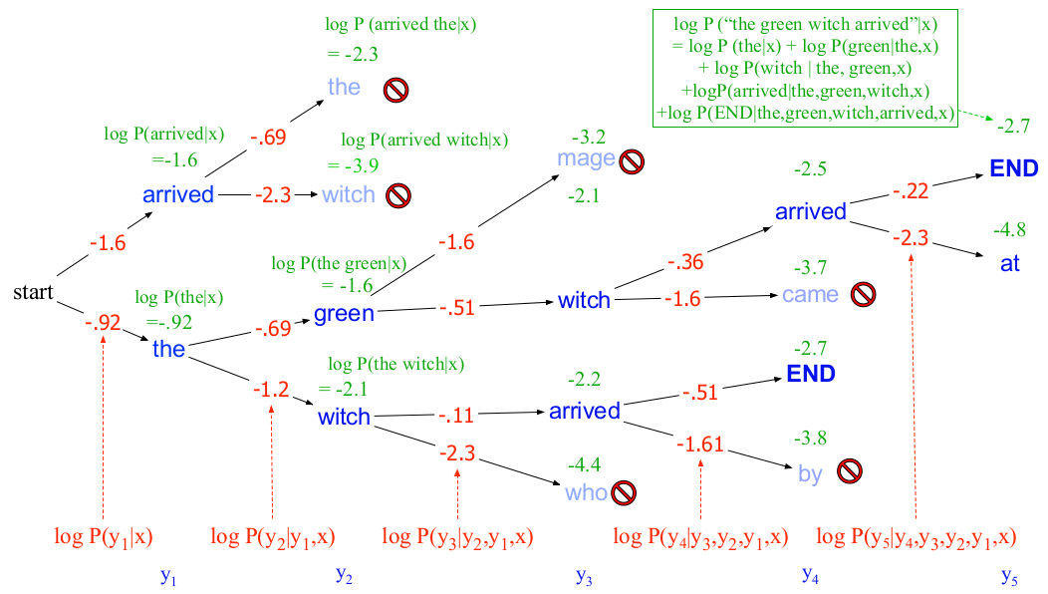
Beam Search (3)
At each time step:
Select top k probably words from distribution over vocabulary
Predict next word with each of the k top words, i.e. k x V probabilities
Each next word is scored by its probability times the probability of its path
We pick the top k most probable paths, and continue the process

Slide 32
Beam Search (4)
Beam search is widely used in text-generation applications:
E.g. machine translation, summarization
Generally applications where we compare different output sequences
However, it has shortcomings
Cost intensive
Size of beam, i.e. value of k, still greedy, can miss better solutions
Sampled sequences often similar to one another (Li and Jurafsky, 2016)
Variants have been proposed, e.g. diverse beam search
Divides sampled sequences into different sampling groups
Promotes diversity between sequences in different sampling groups
Still, beam search remains a very common sampling method

Slide 33
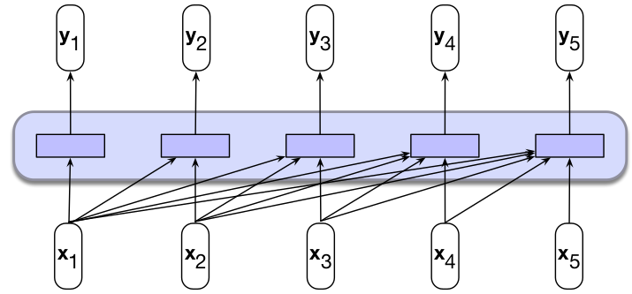
Causal Language Models
Causal language modeling: given sequence of words, predict next word
Context window/prompt: given input sequence words
Architecture: we use causal self-attention in transformers (only look back)
Text autoregressively generated with CLMs generally based on:
Model predictions, i.e. softmax over V
Size of context window (quadratic cost in self-attention using transformers)
Sampling strategy/heuristic (beam search a common one)
Let's see how to train a CLM using transformers.
Then we'll go over some seminal transformer-based CLMs

Slide 34
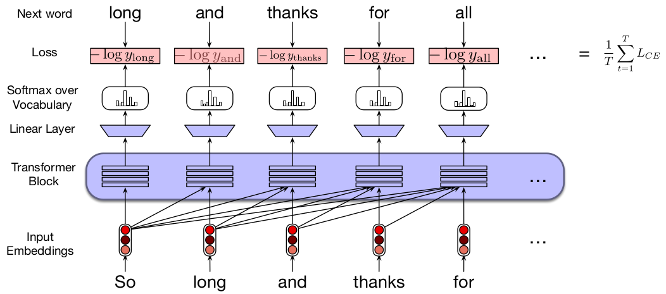
Training Causal Language Models
Teacher forcing does apply here:
Construct training sequences from given corpus in self-supervised manner
Given sequence, force each subsequence as input, next word as target
Compute loss between model’s prediction and target word
Average loss over all predictions in given sequence
Note: computing loss for each word is independent, parallelizable

Slide 35
Generative Pre-Trained Transformer
That is what GPT stands for (Radford et al. 2018)
Published at time when pre-training & fine-tuning framework was new
Unclear what tasks to pre-train on
Unclear how to use learned representations in downstream models
Some of this still unclear, but pragmatic success with some architectures, e.g. BERT, GPT
GPT: autoregressive language modeling is a useful pre-training task
Goal: “…learn universal representations that transfer with little adaptation to a wide range of tasks.”
So, transfer learning, important to avoid task-specific customization
Two-step process:
Pre-train on large corpus in self-supervised manner
Fine-tune model on downstream tasks in supervised manner
Supervised downstream tasks need not be related to pre-training corpus (again, transfer learning)

Slide 36
GPT Architecture, Training, Fine-Tuning
Their general architecture (117M parameters):
Decoder-only transformer (i.e. no self-attention layer attending to encoder)
12 layers of transformer decoders, each with 12 attention heads
Hidden layers of size 728, position-independent MLP of size 3072
Max input length: 512 tokens (attention cost quadratic in this length)
So, architecture quite similar to BERT, except decoder-only
In fact, BERT heavily borrowed from GPT, as claimed by the BERT authors
Pre-Training
Self-supervised causal language modeling on BooksCorpus
Tokenization: byte pair encoding (vocabulary size: 40K)
Fine-tuning
Task inputs fed to pre-trained model to produce final representation h^{L}_{N,} i.e. representation of token N in layer L, h^{L}_{N} then fed to classification head
They fine-tuned all parameters using the classification objective + the CLM objective

Slide 37
GPT Variants
GPT-2 (Radford et al. 2019): mostly same architecture as GPT-1
Moved around/added more layer normalization (more in LLMs lecture)
Initialized weights passed by residual layers (scaled them down)
Vocabulary expanded to 50K
Context window expanded from 512 to 1024 (again, quadratic cost)
Largest variant: 1.5B parameters
Their language model was able to do NLP tasks such as QA, machine translation and summarization without training/tuning for it (zero-shot)
GPT-3 (Brown et al. 2020): same as GPT-2
Used sparse attention, cost from O(n²) to O(n√n) where n is input length
Corpus: Common Crawl dataset (1 trillion words)
Largest variant: 175B parameters
Achieved great performance in few-shot tasks described in prompts
We'll discuss these zero-shot/few-shot settings in future LLMs lecture.

Slide 38
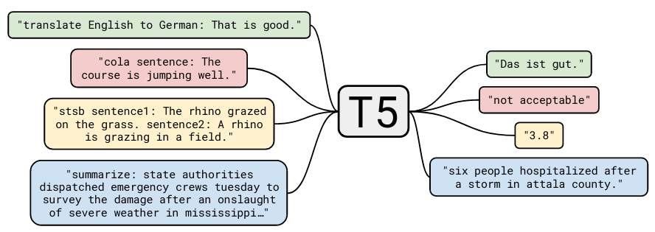
Other Transformer-Based Models
T5 (Raffel et al. 2020): explored different training objectives, datasets
Encoder-decoder architecture, so cross attention from decoder to encoder!
They cast all tasks as text-to-text for this purpose, e.g. stsb is sentence similarity, model trained to generate one of possible classes
Electra (Clark et al. 2020): different task, predict whether word was replaced randomly or not, so binary classification, not masking
More efficient training, competitive with larger models on some datasets

Slide 39
Which Architecture is Best?
No golden rule
Encoder-decoder better?
Encoder-only?
Decoder-only?
What about all other design decisions?
Which positional encodings?
Which tokenization approach?
Generally unclear
Pragmatic evidence exists, e.g. studies like RoBERTa, T5
But results change as training/models/data change or scale up

Slide 40
The BERT Legacy
Large language models (LLMs) currently hugely successful
They are almost exclusively transformer-based decoder-only models
I.e. they generate tokens one step at a time
However, for many applications, encoder-only models are arguably more suitable
E.g. classification tasks where input is token/sequence representation, retrieval where input is query/document representation
Evidence of this: BERT-like models are some of the most popular models in HuggingFace Hub (vast repository of pre-trained models)
Recently, BERT has received a "modern touch"
Mostly an update after all the lessons from pre-training decoder-only LLMs
ModernBERT (2024): introduces improvements mostly for speed
E.g. different positional embeddings, alternating attention (not all layers attend to entire input sequence)
NeoBERT (2025): concurrent with ModernBERT, similar improvements

Slide 41
Summary: Pre-Training
Transfer learning:
Pre-training: train model on some task(s) that “allows” model to learn rich representations, usually from large amounts of text. Representations then useful in downstream applications
Fine-tuning: update learned representations (weights) in context of new downstream application, usually using new downstream model/component, e.g. a classification head
Pre-training now mostly done with transformer-based models
Different kinds of pre-training objectives, two dominant ones
Masked language modeling (MLM)
Causal language modeling (CLM)
Different kinds of architectures
Encoder-only, typically used for training MLMs
Decoder-only, typically used for training CLMs
Encoder-decoder, cross-attention (decoder also attends to encoder outputs)

Slide 42
Fine-Tuning

Slide 43
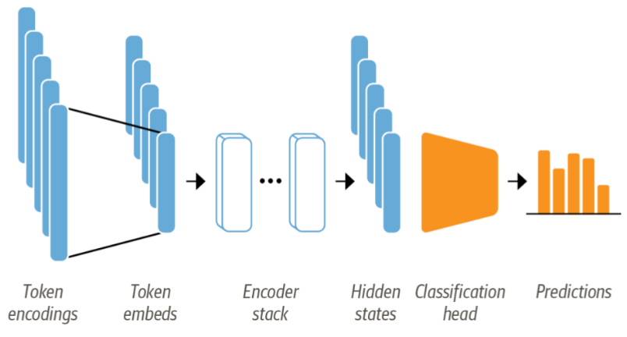
What is Fine-Tuning?
Traditionally, updating weights of pre-trained model when training on new downstream task
Resulting contextualized representations tuned to the new task
New = not used/seen during pre-training
Downstream task usually implies additional downstream model
Downstream model usually comes with its separate weights
These weights must be trained (e.g. classification head in image below)
Image source

Slide 44
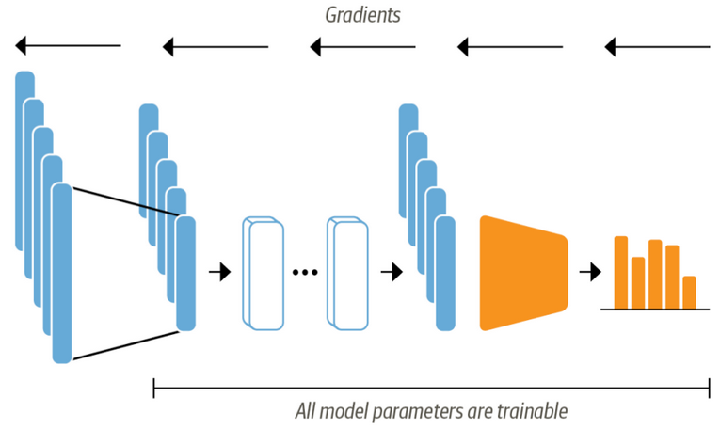
To Update or Not to Update (1)
Updating pre-trained weights may result in “catastrophic forgetting”
Encoded information during pre-training lost/replaced
Pre-training can be very expensive
E.g. META AI's Llama3 CLM (400B parameters) trained with 16.000 GPUs
Catastrophic forgetting can potentially undo some/much of that effort
Understanding how specific knowledge is stored in weights is open question

Slide 45
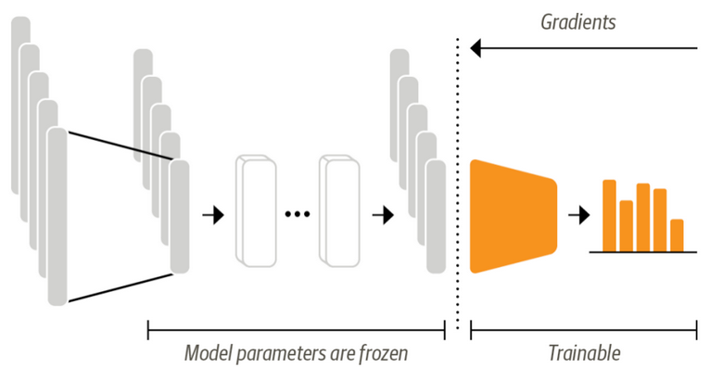
To Update or Not to Update (2)
“Freezing” (some or all) pre-trained weights means not updating them
Still referred to as fine-tuning, because we use a downstream model
Definition unclear, so relevant questions when discussing fine-tuning:
Freezing or not freezing weights? Same or different training objective?
Which downstream model? How does it interact with pre-trained model?
How are downstream examples constructed/fed to model?
This section: downstream tasks, basic/parameter efficient fine-tuning

Slide 46
Types of Downstream Tasks
Two main types:
Sequence classification: predict label for entire input sequence
Sequence labeling: predict label for each input token
In each case, we need to:
Get general information encoded in pre-trained model
Use this information with downstream model designed for downstream application
How to get information encoded in pre-trained model?
Depends on downstream task
Generally, we use some of the representations in the model, e.g. tokens in any (usually last) encoder layers
No golden rules, open question is what each layer encodes, usability for different tasks, e.g. multilingual transformers
How to use pre-trained information with downstream models?
Again, depends on application (let’s see some cases)

Slide 47
Sequence Classification (1)
Example: Say we are interested in sentiment classification
Three labels: positive, negative, neutral
We have:
A good mount of input sequences and corresponding sentiment labels
A pre-trained transformer LM
How can we use these resources to solve this task?
In other words, how do we use this pre-trained model to solve this task?
Is it clear why we think this is a good idea in the first place?
Usually: we get single sentence representation from model
Then feed this representation to a classifier that predicts 1 of three possible labels.
Downstream classifier usually referred to as classification head
How can we get a sentence representation?
And what types of architecture can our classifier head have?

Slide 48
Sequence Classification (2)
How to get a sentence representation from our transformer?
[CLS] token if available, e.g. in BERT
Mean pooling over (contextualized) output tokens (as in T5)
What types of architectures can we use for our classifier head?
No general restrictions
Simple/common approach? Softmax layer (linear layer + softmax function)
In the case of our sentiment classification task
Let y Є R^{d} be the sentence embedding we use, e.g. CLS token
Then, our classifier is y_{CLS} = Softmax(W_{C} y), parameterized by W_{C} Є R^{3xd}
But the classifier can be move involved
E.g. fully-connected FNN with as many layers/architecture you want
As usual, the more parameters, the more data required for training
Let's visualize this!

Slide 49
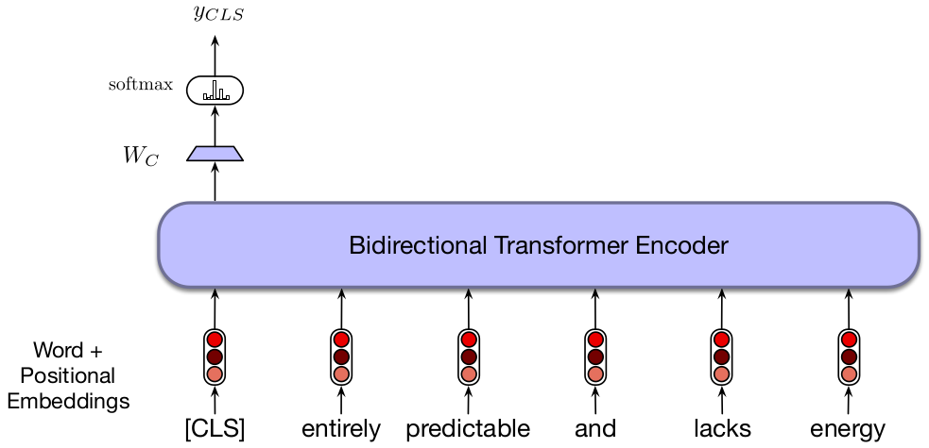
Sequence Classification (3)
We assume an architecture where [CLS] token is available
Recall: we need labeled data for our task to train W_{C} (not pre-trained), i.e. no more self-supervision, but loss is still typically cross entropy

Slide 50
Pair-Wise Sequence Classification
Some problems involve classifying two sentences
Logical entailment: does one sentence entail the other?
Paraphrase detection: is one sentence paraphrasing the other?
Common such task: natural language inference (NLI)
Given two sentences, identify relation between the two
E.g. entails, contradicts, neutral
How can we fine-tune a pre-trained transformer for NLI?
Feed single representation for entire input sequence to classifier head
Input sequence includes pair of sentences, [SEP] token
Any other way?
Again, no golden rules!
E.g. feed each sentence separately, concatenate representations for classifier input
Different approaches may have different impact on pre-trained weights during fine-tuning

Slide 51
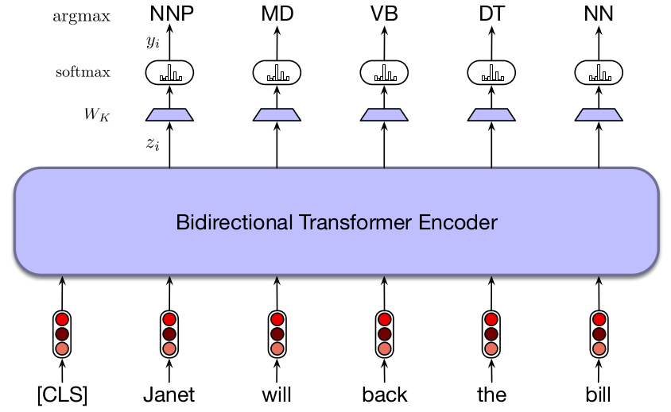
Sequence Labeling
Example: Say we are interested in part-of-speech (POS) tagging
Each input token gets one of k labels, e.g. verb, noun, modifier, etc.
How do we fine-tune a classifier for this approach?
Classifier head fed each output token for prediction, i.e. y_{i} = Softmax(W_{K}z_{i}) where z_{i} is contextualized representation of token i

Slide 52
How Feasible is Fine-Tuning?
Pre-training a (large) language model is expensive
BERT (2018) had 100M parameters, LLMs today in the billions/trillions
Is fine-tuning LMs less costly than pre-training?
Not necessarily, still tuning the entire pre-trained model
E.g. fine-tuning with same objective -> continued pre-training
Store copy of tuned model for each task you tune it for!
But, usually requires less time/data due to pre-trained "bootstrap"
Do you need to fine-tune entire pre-trained LM?
Perhaps just train a few layers, perhaps the last layers only?
Recall concept of hierarchical representations
We can choose what to freeze!
That is the basic idea behind parameter efficient fine-tuning (PEFT)
This name used in NLP community, relatively new
Similar approaches already used in Computer Vision before that

Slide 53
Parameter Efficient Fine-Tuning
What if you have small amount of data?
Or not enough compute power to continue training a large transformer
Lots of weights -> lots of data for training, lots of compute power
PEFT: fine-tune small subset of pre-trained weights
Advantages
Requires less data, compute power
Less prone to overfitting to whatever data you have
Disadvantages
Usually worse performance than standard fine-tuning
Different approaches suggested in recent years
Let’s go over some of the most popular ones

Slide 54
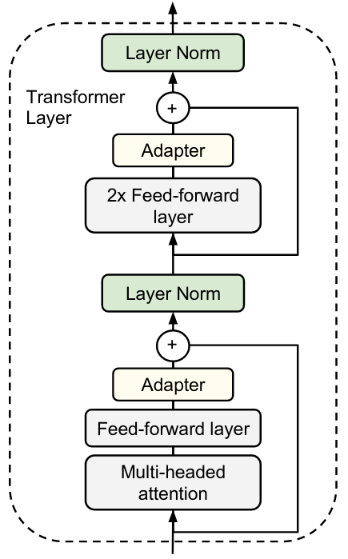
Adapters (1)
Used by Rebuffi et al. for computer vision tasks in 2017
Houlsby et al. (2019) proposed it in NLP, applied it to transformers
Main idea: insert adapter modules
in transformer block, tune adapter
weights only during fine-tuning
Adapter layer: tunable layer added to
transformer block, originally two, one
after self-attention layer and another
after projection layer

Slide 55
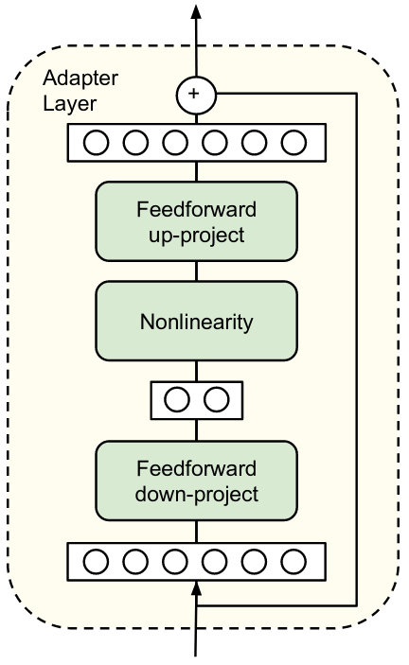
Adapters (2)
Adapter layer should not have many parameters
Thus, easier/less expensive to tune
Originally, between 0.5 and 8% of
pre-trained model
Components in adapter layer
Projection layer down to bottleneck
dimension m
Non-linearity
Projection up to original input size d
# parameters: 2md + m + d
Two projections + output biases
Bottleneck size: controls trade-off
between model performance and
parameter efficiency

Slide 56
Adapters (3)
Important: initialization should result in (close to) identity function
Why?
Training needs to continue in
fine-tuning process
We start with a working forward pass!
Random init would break that function!
Residual connection inside adapter
layer serves this purpose
Initialize adapter weights to zero
Then you get identity
Recall residual connections add
input back to output
Let y = f(x) be the operator.
With residual connection, y = f(x) + x
Thus operator is identity if f(x) = 0

Slide 57
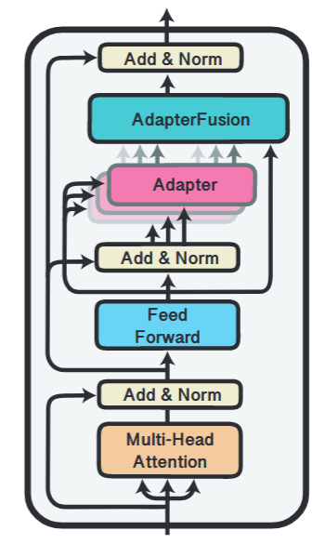
Adapters (4)
Other architectures possible
Bapna et al. (2019) use only single adapter
layer after projection layer
Pffeifer et al. (2021) proposed to
combine several task-specific adapters
Task-specific adapters combined with
attention mechanism
Allows classifier to use information
from several different tasks in
non-destructive manner
No catastrophic forgetting compared to
fine-tuning same adapter on new task

Slide 58
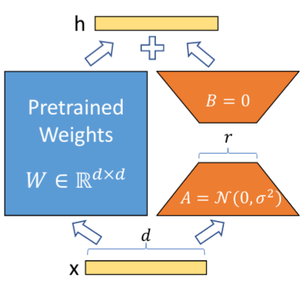
Low-Rank Adaptation (1)
LoRA: Low-rank adaptation (Hu et al. 2021)
Similar to adapters, adds trainable modules to transformer block
Specifically, two projection layers
parallel to projection layer in
transformer
Perspective: updated weight W’
during fine-tuning is W’ = W_{O} + ∆W_{O}
Simulate this effect by freezing W_{O},
adding parallel projections AB
Thus, W’ = W_{O} + AB
A projects down to small size
Thus, AB is low-rank factorization of ∆W_{O}
As with adapters, initialization must be identity
They achieve this by setting B = 0, so that AB = 0

Slide 59
Low-Rank Adaptation (2)
Downside to all adapters in general?
(Slightly) higher inference costs
We add more parameters!
LoRA designed to prevent this
Once adapter is learned, original
W_{O} can be updated by merging back AB
That is, final weight W = W_{O} + AB
Thus, no additional inference costs
But catastrophic forgetting possible
Generally, adapters have trade-offs
CON: increased inference cost
PRO: prevent catastrophic forgetting,
original model frozen, adapters can
always be removed (gives rise to
modular deep learning)

Slide 60
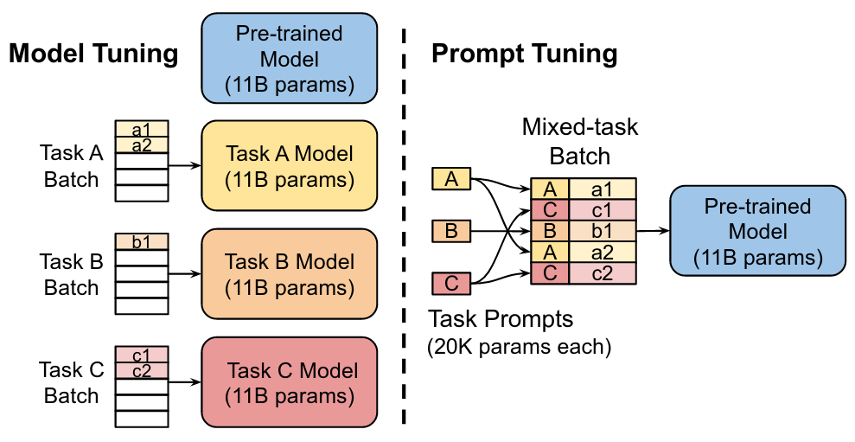
Prompt Tuning (1)
PEFT method, different from adapters, proposed by Lester el al. (2021)
GPT-3: performs well on new tasks using in-context learning
In-context learning: describe task and provide few examples in prompt
Advantage? No fine-tuning! Same frozen model used for different tasks!
Problem? Approach sensitive to prompt, gives rise to prompt design
Main idea: prepend task-specific tokens to input sequences (prompt)
Then, during fine-tuning, only new task-specific tokens are updated
Each task A, B, C gets
new task token A, B, C
Prepend task examples
with task tokens, e.g.
prepend A to a1, a2
Tune only task tokens
At inference, use new
tokens in same way

Slide 61
Prompt Tuning (2)
As with T5 model, they cast tasks as text-to-text
Normally: downstream classification is p(y|X) where X is input sequence (prompt) and y is single class label, e.g. 0 or 1 if binary
Text-to-text: we have p(Y|X), where Y is generated output sequence that represent class label, e.g. "neutral" for sentiment analysis
Fine-tuning: p_{Ѳ}(Y|X) where Ѳ is pre-trained model parameters we tune
Prompting: prepend tokens P to input sequence
Normally, P made up of known tokens from pre-trained embedding layer
E.g. P = "Summarize the following article into a single sentence"
Performance sensitive to chosen prompt, may require prompt design
Prompt tuning: add fixed prompt P per task using special new tokens
ѲP = new tokens added to vocabulary
Then: pѲ;ѲP(Y|[P,X]) but we only tune ѲP
Fixed prompt removes need for prompt design
Similar approaches: prefix tuning by Li et al. (2021), P-Tuning by Liu et al. (2022)

Slide 62
Another Perspective on Tasks
We can classify downstream tasks as follows:
Sequence classification
Sequence labeling
Etc.
We can also classify tasks based on available data, usually:
Few shot: few examples available
Zero shot: no examples available (just text description)
These definitions are not so consistent in the literature
More details in future LLM lecture

Slide 63
Summary: Fine-Tuning
Difficult to define
Generally, using pre-trained model PT on new task not seen during training
May or may not imply updating pre-trained model parameters Ѳ_{PT}
Usually includes use of downstream model DM, e.g. classification head
Parameters of downstream model Ѳ_{DM} are definitely trained
Relevant questions when discussing fine-tuning:
Freezing or not freezing weights? Same or different training objective?
Which downstream model? How does it interact with pre-trained model?
How are downstream examples constructed/fed to model?
Parameter Efficient Fine-Tuning (PEFT)
Updating all model parameters Ѳ_{PT} can be prohibitely expensive
PEFT: tune only subset of parameters of Ѳ_{PT} , or new added parameters Ѳ_{FT}
Most common PEFT approaches: adapters, LoRA

Slide 64

References
Speech and Language Processing, Jurafsky et al., 2024
Chapters 10 and 11
Natural Language Processing: A Machine Learning Perspective, Zhang et al., 2021
Chapter 17
References linked in corresponding slides
© University of Mannheim

