Slide 1

Advanced Methods in Text Analytics
Tokenization
Licensed under Creative Commons Attribution 4.0 International

Slide 2
What is Tokenization?
Often forgotten/neglected/unglamorous aspect of NLP
But still present in all LMs (from n-grams to LLMs), thus important topic!
We assume text is nicely "chopped up" into segments before processing it
Much like printers, some don't care about the details behind this process
They just what it to work!
Generally, tokenization is the process of splitting text into finite strings that act as representation of that text for computers to process it
These substrings often referred to as tokens (Webster and Kit, 1992)
For example, take the string "Tokenization won't be neglected anymore."
If we split it based on whitespace separation (each token is underlined):
Tokenization won't be neglected anymore. (5 tokens)
If we further split punctuation marks:
Tokenization won ' t be neglected anymore . (8 tokens)
Using the Llama3-70B tokenizer (center dot represents whitespace):
Token ization ⋅won 't ⋅be ⋅neglected ⋅anymore . (8 different tokens)

Slide 3
Goal of Tokenization (1)
Why are there different tokenization approaches?
Because decision on how to split text into tokens isn't trivial
Highly depends on what we want those tokens to do/represent
The linguistic goal: traditionally, tokens thought of as words
Makes sense in some tasks, e.g. POS tagging
But often not clear what a word is
E.g. word "won't" was tokenized in three different ways in previous slide
Hence, in this lecture we make distinction between words and tokens
Token: these finite substrings we get as output of tokenization process
Word: string that is, by itself, semantically meaningful in some language
Still, linguistically, we may want tokens to be approximations of words
E.g. why break word "won't" into meaningless tokens like "won" and "'t"?
Many similar examples, e.g. "copy-paste" makes sense by itself
Models may learn the semantics of the same representations used by us
Producing word-like tokens less common today, known as pre-tokenization

Slide 4
Goal of Tokenization (2)
The systems goal: favor system-level requirements over linguistic motivations
E.g. segmenting text into higher number of tokens increases memory consumption of input sequence of a language model (LM)
Slide 2: different tokenizers split same text into different number of tokens
So, if using fewer tokens means we can support longer input sequences at the cost of "tokens being approximations of words", then so be it.
E.g. use single token for "tokenization" instead of "token" and "ization"
This perspective more common today, largely motivated by the success of deep learning methods and the need to scale them
In short, goal of tokenization not straightforward
Linguistically, we want tokens to be approximation of words
From a systems perspective, we are happy to drop this linguistic motivation in favor of decisions that improve our systems in any way
In this lecture, we focus on tokenization as part of pipeline of LMs

Slide 5
Outline
Tokenization in Language Models
Common Tokenization Methods

Slide 6
Tokenization in
Language Models

Slide 7
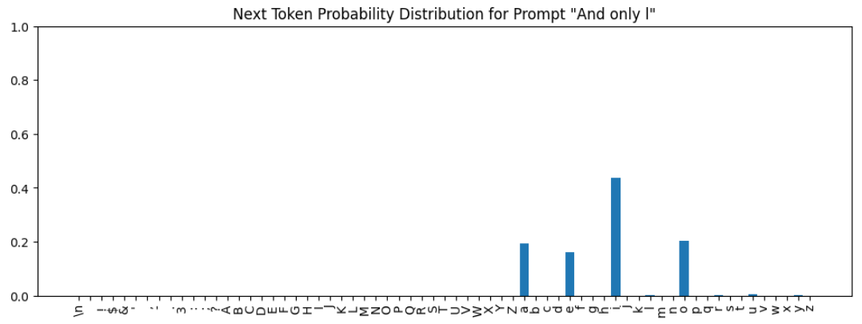
Role of Tokenization in LMs
Tokens are the atomic units seen/handled by LMs.
Set of tokens known to LM: vocabulary
Each token in vocabulary mapped to representation vector of size d
I.e. the typical (static) embedding table/matrix, impacts model size/costs
Input sequences broken into finite sequence of known tokens
E.g. Token ization ⋅won 't ⋅be ⋅neglected ⋅anymore.
Output sequences are composed of set of these known tokens
Next word distribution assigns probability to each of these tokens
Image source

Slide 8
Tokenizers
Component of NLP system, e.g. LM, in charge of tokenization process
Bidirectional mapping between text and corresponding sequence of tokens
Important: entire separate system from LM
They can also be "trained", separately, different training data (details soon)
After that, they act as encoding/decoding function
Encoding
Input: text
Output: corresponding sequence of tokens
Decoding
Input: sequence of tokens
Output: corresponding text
Sequence of tokens = sequence of
integers
IDs mapped to rows of static embedding
matrix, e.g. 123, 4673, 56724
Text
Tokenizer
Sequence of tokens
Language Model

Slide 9
Impact of Tokenization in LMs (1)
Tokenization is behind several phenomena observed when using LMs
Sometimes they are a partial explanation for an observation
Sometimes they entirely explain an observation
Let's look at some examples
This app can help illustrate some of these issues
Select tokenizer on top right, each output token has a different color
String processing, e.g. reverse the string "elephant"
Llama3's tokenizer breaks word elephant into tokens "ele" and "phant"
Difficulty in arithmetic, e.g. "1123 + 245 =" (answer is 1368)
Numbers not broken into digits
E.g. 1123 split into "112" and "3", 11233 into "1123" & "33"
Ongoing research, e.g. Singh et al. 2024
Difficulty spelling, e.g. "how many letters E in the word 'elephant'?"
Again, model sees tokens "ele" and "phant"

Slide 10
Impact of Tokenization in LMs (2)
Performance in languages other than English usually worse
Partly due to lower amount of LM training data in other languages
But partly due to lower amount of data when training tokenizer as well
For example, number of tokens in following words from Llama3-8B:
Hello 1 token
안녕하세요 2 tokens
नमस्ते 3 tokens
Often, words in other languages are split into more tokens
This has to do with the way tokenizers are trained (details soon)
Impact?
More memory requirement for same word in different language
More money spent using LLMs closed behind APIs (prices per token)
Similar arguments behind preferences such as using YAML vs JSON as input
Next section: we go over some popular tokenization methods.

Slide 11
Common Tokenization
Methods

Slide 12
Word-Level Tokenization
Referred to tokenizers that produce word-like tokens
Follows linguistic goal of tokens being approximations of words
Today, this process referred to as pre-tokenization
Goal of approximating words no longer a priority
But still an important part of pre-processing (more later)
May include other steps, e.g. normalization, spell correction
Main advantage: interpretable!
Tokens are representations of words/concepts we understand.
Main disadvantage: inability to deal with rare or new words
Rare words in training replaced with special UNK token (from unknown)
During inference, UNK used to represent out-of-vocabulary words
Out-of-vocabulary words (OOV) = words not seen during training
Using UNK during inference bad for: text generation, extracting useful features from OOV words, e.g. "desertification" comes from "desert"
Another disadvantage: large/changing vocab. (hundreds of thousands)

Slide 13
Character-Level Tokenization
Addresses main disadvantages of word-level tokenizers
If we assume a finite set of symbols (a script), we can represent OOV words as sequence of its symbols, plus size of vocabulary is small/finite
For example, if script is English alphabet, we have 26 symbols.
Embedding matrix: 26 x d (plus whatever words you add to vocabulary)
If word "elephant" is OOV, represent it as "e" "l" "e" "p" "h" "a" "n" "t"
Disadvantages?
In some languages, characters may not encode meaning (linguistic goal)
Vectors per character increases length of representation (systems goal)
E.g. Llama3 breaks "elephant" into "ele" and "phant", i.e. 2 x d
If we break it into characters, it's 8 x d, so more memory consumption, more costly computations, parameters may have to encode more, etc.
Also, vocabulary may still be large (e.g. Unicode has 150K characters)
The currently accepted intermediate sweet spot? Subword tokenizers!
But it's ongoing research; systems change, tokenizers may accommodate

Slide 14
Subword-level Tokenization
Split word-like tokens into smaller units called subwords
Set of all possible subwords is finite, determined from training data
Vocabulary also includes all characters, used to represent OOV words
Advantages:
Vocabulary size finite, many tokens still semantically meaningful
Can handle OOV words well (breaks them into known subwords)
Disadvantage:
Many ways to choose subword units, affects performance
E.g. manually constructed, linguistically informed rules, may favor morphologically rich languages (lots of inflections, compounding, etc.)
More generally, subword segmentation may not favor non-morphologically rich languages, e.g. arabic or hebrew
Most common approach today? Byte-Pair-Encoding (BPE)
Input to BPE is output of pre-tokenization process
So, let's have a better look at this first

Slide 15
Pre-Tokenization (1)
Can be generally described as classic pre-processing step
Classic: rule-based
Often forgotten but still present today!
Follows normalization step
Normalization:
Removing unnecessary whitespaces
Turn all characters into lower case
Removing accents
Etc.
Goal of pre-tokenization: split raw text into word-like segments
These segments are foundation to final tokens used by LMs
Common pre-tokenization approaches:
Split by whitespace and punctuation (similar to what we do in tutorials)
Split by character (e.g. in symbol-based languages like Chinese)
More specific rules based on useful linguistic properties

Slide 16
Pre-Tokenization (2)
Important: output of pre-tokenization used as input to train tokenizer
Examples of rules used in GPT-2
The following regex pattern:
's|'t|'re|'ve|'m|'ll|'d|
?\p{L}+|
?\p{N}+|
?[^\s\p{L}\p{N}]+
|\s+(?!\S)|
\s+
Details beyond the scope
But note rules for contractions, spaces
followed by letters or numbers, etc.
Important: rules hand-crafted, language dependent
Character-based languages split by character
But characters often have meaningful parts, require different rules
Text
Pre-Tokenizer (rule-based)
Sequence of segments
Train Tokenizer

Slide 17
Byte-Pair-Encoding (1)
Breakthrough in subword tokenization
Originally a data compression algorithm (Gage, 1992)
Recently popularized by its use in machine translation (Sennrich, 2016)
It’s a fast and simple heuristic
Known to improve downstream performance
Idea: instead of defining tokens a priori, let data tell us what our tokens should be
A priori: rules, e.g. "each word is a token", or "each character is a token"
If we pick the right subwords, we could handle OOV rather well!
BPE in short:
1. Starting "base vocabulary" V is set of characters
2. Find most common two-character subword, create token for it, add to V
3. Replace every instance of two-character subword from Step 1 with its token
4. Keep finding common and longer subwords until k new tokens are created
Let's look at this process in more detail.

Slide 18
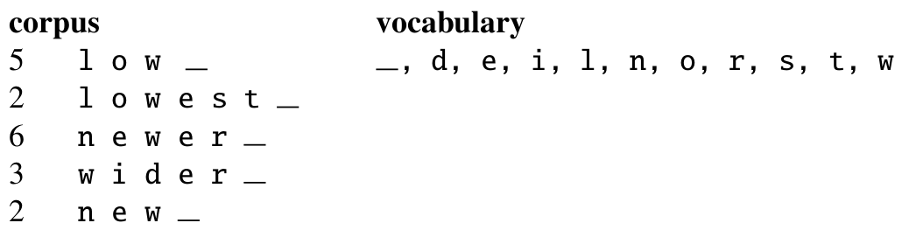
Byte-Pair-Encoding (2)
The algorithm runs "inside words", i.e. no merges across words
These "words" first determined by pre-tokenization step
I.e. word boundaries depend pre-tokenization rules
Boundary represented by added special symbol, e.g. an underscore _
So, for a tiny input corpus of 18 word tokens, we have the following frequencies for each word, as well as our base vocabulary:
The algorithm then counts all pairs of adjacent symbols
Most common is "er" (appears in newer and wider, so 9 times in corpus)
It then merges the two symbols into new token, adds it to vocabulary

Slide 19
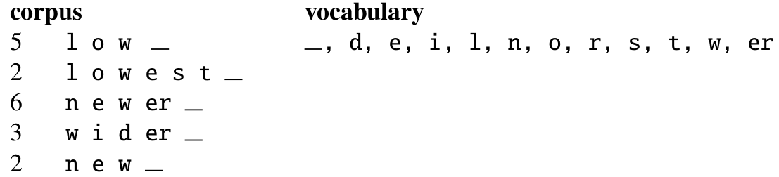
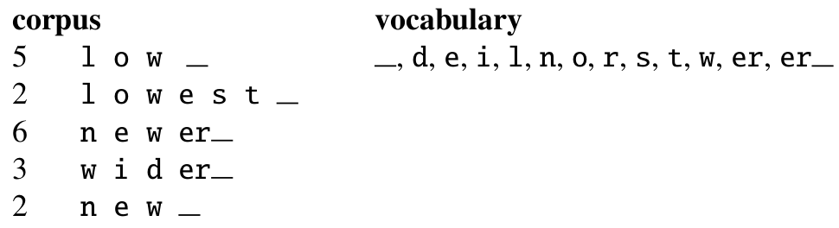
Byte-Pair-Encoding (3)
We count adjacent tokens again (note "er" is now a token)
Most common adjacent tokens are now "er" and "_", which we add to V
The process continues until we add k tokens to our base vocabulary
k is a hyperparameter,
This loop often referred to as training the tokenizer

Slide 20
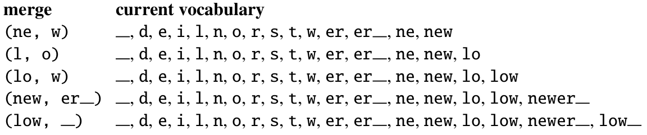
Byte-Pair-Encoding (4)
In the end, for k = 8, we would derive the following merge rules:
Note that we added two full words: newer_ and low_.
In real-world settings, k is in the thousands, so many words get full tokens.
Then, for encoding a word into tokens, we proceed as follows:
We break input sequence into characters
Apply merges in learned order, e.g. first merge "e" and "r" into "er"
Note that encoding ensures we use tokens of highest possible level
Thus, many words tokenized as full word
Only OOV words would be represented by subword tokens
E.g. "lower" in our toy setting would be "low" and "er_"

Slide 21
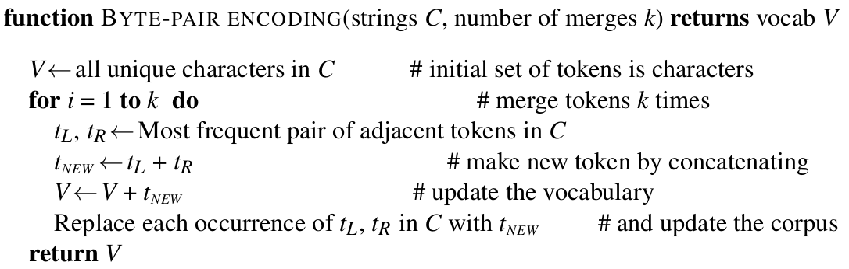
Byte-Pair-Encoding (5)
The algorithm for "learning" the tokenizer is thus the following.
Several methods exist that are similar to BPE.
WordPiece (Schuster and Nakajima, 2012) focused on Japanese and Korean (can't be relied on space-separated tokens)
Instead of merging most common pairs of tokens, merged pairs that increase data likelihood of an n-gram LM trained with this updated vocabulary

Slide 22
UnigramLM and SentencePiece
Another common approach: UnigramLM (Kudo, 2018)
Adopts same idea of evaluating subword candidates by impact on LM
UnigramLM in short:
Starts with very large vocabulary, much larger than what we would want
At every iteration, trains unigram LM on current vocabulary, then drops lowest probability items from vocabulary
Process is repeated until desired vocabulary size is reached
Their probabilistic approach allowed for interesting observations:
A string can be broken down into different equally probable segmentations
They found that using "sampled segmentation" instead of a deterministic mapping between string and set of tokens improved performance on MT
Similar idea adopted by BPE-Dropout (Provilkov et al. 2020): token merges are randomly skipped to produce segmentation variety.
SentencePiece (Kudo and Richardson, 2018):
Software library for BPE and UnigramLM, thus often ambiguous reference

Slide 23
The Tokenization Spectrum
Word-level tokens:
Meaningful representations, interpretable, often helps LM performance
Why? Intuition: easier for models to learn since representation units closer to language being learned, learned relations between representations similar to relations between words
Larger, potentially infinite vocabulary, difficult to handle OOV words
Character-level tokens:
Smaller vocabulary but potentially meaningless representations, often associated with lower LM performance
May require higher capacity models to learn to use representations well
BPE-like processes require more merges/data (i.e. larger vocabulary, more parameters) to get to meaningful subwors/words
Character-level tokens
Word-level tokens

Slide 24
Handling OOV Words
How does BPE handle OOV words?
Breaks them down into subwords
Can go as far "down" as base vocabulary
Thus, BPE dependent on base vocabulary to handle OOV words
If we still can't identify a character in a word, we assign UNK token
Common choices of base vocabulary:
Unicode (database for all symbols in all languages and beyond)
Raw Bytes (used by OpenAI's models, META's Llama models, etc.)
Unicode:
PROs: lookup table for "all" symbols (or subsets thereof), ~150K entries
CONs: still a finite lookup table, changes over time, e.g. emojis were added
Raw Bytes:
PROs: tiny base vocabulary, impossible to find OOV words
CONs: meaningless base vocabulary, likely requires stronger models
Why impossible to find OOV? Let's discuss this in a bit more detail

Slide 25


Falling Back to Bytes
Unicode:
Mapping from real-world symbol to unique ID
UTF-8 (stands for Unicode Transformation Format):
How to encode Unicode IDs into bytes, i.e. blocks of 8-bits
English alphabet dominant due to US role in Computer Science history
Thus, such characters typically use single byte: a-z, A-Z, 0-9, etc.
Languages with other scripts added later
Thus, single characters from other languages often require more bytes, e.g. japanese symbol か used to make questions (i.e. common) uses 3 bytes
So, starting with raw bytes as base vocabulary is a clever idea
All text boils down to byte patterns established by both Unicode and UTF-8
I.e. base vocabulary only has 256 tokens
This approach taken by GPT-2 and other OpenAI models, many LLMs since
Note: for fixed vocabulary size K, English has benefits
We'll come back to this in future lectures

Slide 26
How to Select Number of Merges?
Do we simply choose a desired vocabulary size?
Usually the standard approach
But how to reason about this?
More and larger subwords may lead to more memorization, less fundamental understanding (Kharitonov et al. 2021)
Optimal choice may depend on task and language (Mielke et al. 2019)
Always challenging to develop general solutions
This choice directly relates to where in tokenization spectrum we lie

Slide 27
Can We Get Rid of Tokenization?
E.g. by simply using characters as tokens, i.e. we never merge anything
Something like Unicode encodes all symbols from past and present
Some language models designed around processing bytes
But what about semantics?
Deep-enough transformers may be able to pick up semantics enough to outperform subword-based models (Al-Rfou et al. 2019)
But more work is needed to understand this better
And what about input length?
Lots of characters still need longer input sequence in terms of memory/parameters/cost
But this may become less of an issue with recent work on infinite attention
Another alternative: learn tokens based on visual representations, i.e. symbols (e.g. Rust et al. 2022)

Slide 28
Summary
Tokenization is often neglected, described as unglamorous
But it has a clear impact on the representations learned by models
Thus, also a clear impact on downstream applications
Several types of tokenization approaches exist
Word-level
Character-level
Subword-level
Difficult to learn/advocate for one single approach
Subword is most common today (esp. BPE and UnigramLM)
But research is ongoing to better understand impact of different methods
Tokenization has a direct impact on evaluating model performance and on models' ability to perform in different languages
More in future lectures

Slide 29

References
Speech and Language Processing, Jurafsky et al., 2024
Chapter 2
Between words and characters: A Brief History of Open-Vocabulary Modeling and Tokenization in NLP, Mielke et al, 2021
Let's build the GPT Tokenizer, Andrej Karpathy, 2024
References linked in corresponding slides
© University of Mannheim

