Slide 1

Advanced Methods in Text Analytics
NLP Applications
Licensed under Creative Commons Attribution 4.0 International

Slide 2
The Story So Far
This course was focused on the latest methods for NLP
Basic ML and DL (fundamental for understanding NLP methods)
Recap of basic NLP (e.g. n-gram language models)
FNNs for language modeling
Static Word Embeddings (specifically, the skip-gram approach)
RNNs for language modeling
The Transformer Architecture
Transfer Learning (pre-training + fine-tuning)
Tokenization
Large Language Models (LLMs)
Multilingual NLP (next lecture)
In this lecture: common applications of these methods
Specifically, how LLMs are evaluated on specific NLP tasks, e.g. natural language inference (NLI), natural language understanding (NLU), etc.
Real-world NLP applications, e.g. machine translation, dialogue systems

Slide 3
Outline
LLM Evaluation
Real-World Applications

Slide 4
LLM Evaluation

Slide 5
Why the focus on LLMs?
In this section: methods for evaluating LLMs
But why LLMs, specifically?
Recall LLM lecture:
Most NLP tasks today solved with pre-trained language models (LMs)
Pre-trained LMs: models like BERT (2018), or LLMs like LlaMA-3 (2023)
How to use BERT? Already covered in Transfer Learning lecture
But how to evaluate/use LLMs still unclear/challenging in most settings
Why?
Virtually all LLMs are causal language models (CLMs)
Recall CLMs: LM trained to predict next word in input token sequence
But many NLP tasks are evaluated as classification tasks
E.g. sentiment analysis is usually the task of predicting one of three labels: "positive", "negative" or "neutral"
Important question: how to use a CLM for classification tasks?
Henceforth, acronyms LLM and CLMs used interchangeably

Slide 6
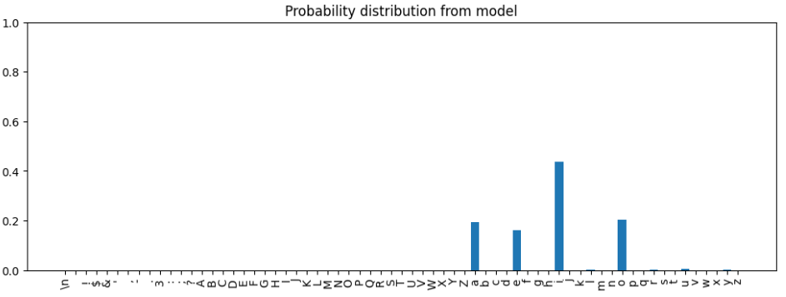
LMs as Functions
At the core, a LM is a (learned) function f: T --> P
T is set of all possible sequences of words (i.e. tokens) from vocabulary V of one (or more) natural languages, e.g. English, German, etc.
P is probability simplex of size |V|
In other words, p = f(t) for t ∈ T and p ∈ P provides a probability distribution over V, i.e. LLMs output a probability value for every word in V
Visually, for any t ∈ T with T = {a, b, … abalon, … , elephant, … , Ente...}, f(t) provides such a distribution:
Image source

Slide 7
Interpreting LLM Outputs
Function f does not say anything about:
1. How to interpret the distributions in P
2. How to use the distributions in P
1. How do we typically interpret a distribution p ∈ P given by LLMs?
p_{i} = f(t)_{i} is conditional probability that i-th word in V is next given t ∈ T
The training process of CLMs allows us to interpret p
Models "forced" to adjust parameters so next words get high probabilities
Different training objective --> different interpretation of p
E.g. p in masked language models (MLMs), p_{i} = f(t)_{i} is conditional probability i-th word is "surrounded by" given t ∈ T (recall that we don’t use MLMs like that, we use them for their contextualized representations)
Similarly, we could train an "inverse CLM" if we construct the corresponding training examples using self-supervision
Interpreting p is about doing inference with the model
One use of p would be for making predictions (inference != prediction)

Slide 8
Using LLM Outputs
2. How do we typically use a distribution p ∈ P given by LLMs?
Most common application: autoregressive text generation
Recall autoregressive generation: each word in generated sequence of words is predicted conditioned on previous words in sequence
It's a natural application given the training process in CLMs
How do we use p for autoregressive text generation?
Given initial prompt t (starting sequence of words), sample next word w from output distribution p given by LLM (e.g. using beam search)
Set t = t + w, then repeat step above until stopping criterion is satisfied
Different sampling methods (e.g. top-k) show we can use p differently
Note we can use p for other applications
E.g. compute probability of some t ∈ T using the chain rule
That is, p(t) = p(t₁|prompt)p(t₂|prompt,t₁)…p(t_{n}|prompt,t₁,…,t_{n-1})
Important question revisited: how to use p for classification tasks?
Let's see how GPT-3 did it (arguably the first LLM)

Slide 9
Evaluating GPT-3 For Classification
GPT-3 showed increasingly more ICL ability as model got larger
ICL (in-context learning): given prompt with text instructions for a task and/or corresponding examples of the task, LLM is able to "solve" the task without weight updates
The model was evaluated on two kinds of tasks
Free-form completion: output is any text, e.g. translation (discussed later)
Multiple choice completion: only limited set of output tokens are meaningful, e.g. the set of labels in classification tasks (discussed now)
Example of (a very general) classification task: LAMBADA dataset
Task: complete last word in given sequence, i.e. language modeling task
Correct answer "far" from missing slot, it tests long-range dependencies
How was this task done with ICL? Example from GPT-3 authors:
"Alice was friends with Bob. Alice went to visit her friend ___. --> Bob.
George bought some baseball equipment, a ball, a glove and a ___. --> "
Which sampling method would be suitable for prediction?

Slide 10
Per-Token Likelihood (1)
GPT-3 was evaluated on classification tasks using greedy sampling
Specifically, they would compare log-probability of all tokens in each label
Note that even a single label may take more than one token
E.g. word "positive" may use single token, whereas word "neutral" may use two: "neu" and "tral" (imagine "positive" more common than "neutral")
If we compare log-probabilities across labels with different numbers of tokens, we may be biased by token length of some labels
Thus, GPT-3 evaluation normalized log-probabilities by number of tokens
Concretely, the normalized prediction score for prediction sequence t_{m:n} given input sequence t_{1:m-1} is given by:
s(t_{m:n}) = (1 / (n-m)) * Σ_{i=m}^{n} log p(t_{i}|t_{1:i-1})
That is, these are the probabilities from output distribution p given by a CLM, but normalized by length (in number of tokens) of output sequence
Let's visualize this!

Slide 11
Per-Token Likelihood (2)
Say LLM-1 that tokenizes two labels as follows
Label "positive" in 1 token, label "neutral" in 2 tokens: "neu" and "tral"
Imagine the following unnormalized prediction scores for each label
That is, s(t_{m:n}) = Σ_{i=m}^{n} log p(t_{i}|t_{1:i-1})
P_{LLM-1}("positive") = log p("positive"|<s>) = 0.6
P_{LLM-1}("neutral") = log p("neu"|<s>) + log p("tral"|"neu") = 0.3 + 0.5 = 0.8
P_{LLM-1}("neutral") > P_{LLM-1}("positive") so we'd pick label "neutral"
But note "neutral" has higher score due to its number of tokens
Now let's normalize those scores by token length
That is, s(t_{m:n}) = (1 / (n-m)) * Σ_{i=m}^{n} log p(t_{i}|t_{1:i-1})
P_{LLM-1}("positive") = log p("positive"|<s>) = 0.6
P_{LLM-1}("neutral") = log p("neu"|<s>) + log p("tral"|"neu") = (0.3+0.5)/2 = 0.4
Now we'd pick label "positive"
Thus, normalizing log-probabilities by token-length is crucial!

Slide 12
Per-Character Likelihood
Different tokenizers may encode a given input sequence in a different numbers of tokens
E.g. word "namaste" in LlaMA-3 uses 3 tokens
Another LLM specialized on Hindi might use a single token
In this case, we can normalize scores by number of bytes
E.g. s(t_{m:n}) = Σ_{i=m}^{n} log p(t_{i}|t_{1:i-1}) / Σ_{i=m}^{n} B_{i} where B_{i} is number of bytes in token t_{i}, i.e. we normalize by length in bytes, not in tokens
Recall decoding with BPE-style tokenizers: start from bottom characters, then merge in order of merges found during tokenizer training
A new token that comes from merging two n-bytes token takes 2n bytes
Thus, only sensitive to spelling/vocabulary (i.e. still a problem when comparing across languages)
Note: it's not common to compare log-probabilities across models
We can't assume LLMs are calibrated
But may be necessary to compare across languages (more in next lecture)

Slide 13
From Prediction Scores to Metrics
Whether unnormalized or not, prediction scores are aggregations of the probabilities of tokens in the generated answer
Given those probabilities, we can use them as with any classifier to compute performance metrics
For example, for classification tasks, we can pick label l ∈ L with highest probability for each example x, where L is set of labels for given task
Then, given pairs of inputs and outputs (x,l), we can compute metrics like accuracy or F1-Score.
More recently, as models got better, it's often enough to do greedy sampling, as models almost always predict one possible label.
I.e. we don’t restrict ourselves to L, but instead compare probabilities across the entire vocabulary
Reminder: we can use output distribution however we want
For example, authors of GPT-3 found benefit on some tasks by computing probabilities of output sequences when removing some tokens used for formatting, e.g. "Answer: "

Slide 14
Verbalizers (1)
Sampling methods can be changed for different text generation tasks
E.g. greedy for factual-based question answering, top-p for creative tasks
Similarly, we can use LM output in different ways to make predictions
The process of mapping a string to a label in a classification task is often formalized with verbalizers (Schick et al. 2021)
Verbalizer: injective function v: L --> V that maps labels from some set of labels L to language model vocabulary V
Injective: each element in domain mapped to distinct element in range, i.e. no two elements in domain get mapped to same element in range
Prompt
LM
Distribution p
Sampling Method
Generated Text
Prompt
LM
Distribution p
v⁻¹
Predicted Label

Slide 15
Verbalizers (2)
Some examples of verbalizers for a binary classification task can be:
Label "True" --> Token "True", label "False" --> Token "False"
Label "True" --> Token "1", label "False" --> Token "0"
Label "Positive" --> Token "pos", label "Negative" --> Token "neg"
The choice of verbalizer must be specified to the model
Can be done via examples in ICL demonstrations
Or by specifying the expected labels in instructions in a zero-shot setting
Again, the choice of verbalize can make a difference on model performance
Can be especially evident in weaker models that may prefer natural sounding labels over numerical ones
So far: how to use output of LLM for classification tasks
What about "generative" or "free-form" tasks?
E.g. summarization or translation.
This brings us to the core of LLM evaluation

Slide 16
Challenges in LM Evaluation
Key challenge according to Biderman et al. (2024): language ambiguity
Many syntactically different ways to express semantically equivalent ideas
Best tools to say if two sentences are semantically equivalent? LLMs!
I.e. we can't have a model evaluate itself
How about human effort?
Humans can always manually evaluate the output of models
But this is expensive, evaluation data has hundreds/thousands of examples
And humans can certainly also make mistakes
Instead, human effort usually goes to creation of gold answers in benchmark construction
Given gold answers, we can compute metrics automatically
E.g. ROUGE score compute lexical overlap with gold answer
BLEU is a score designed for machine translation
Exact-match: proportion of answers that exactly matches gold answer
Note that metrics can be flawed, e.g. BLUE has issues, ROUGE has issues

Slide 17
Model-Based Metrics (1)
Idea: replace human effort with LLM effort
Motivation 1: benchmark performance scores often miss nuance
Instruction-tuned vs non-instruction tuned models often perform the same
But humans known to prefer answers given by aligned models
Motivation 2: ChatGPT shown to outperform humans as annotator
Gilardi et al. (2023) found ChatGPT to be better than crowd workers
Huang et al. (2023) found ChatGPT great at picking nuanced hate speech
LLMs-as-a-Judge: ask model to evaluate generated answer
Judge model often (but not necessarily) different from evaluated model
Judge model must be strong LLM, very common choice: GPT-4
Open source alternative proposed recently: Prometheus
How to use an LLM as an evaluator? Again, freedom.
Pairwise comparison: model chooses from given pair of answers
Single answer grading: model provides score to answer (give ICL examples)
Reference-guided grading: model compares answer to gold answer

Slide 18
Model-Based Metrics (2)
Important 1: reading generally easier than writing for LLMs
I.e. evaluating text not the same task as generating text
Thus, even same model may evaluate its own answers given right prompt
This is what self-alignment is based on
Important 2: LLM-as-a-judge useful on settings without gold answers
Model-based metrics when reference answers are available not new
Example: BERTScore
Simple idea: given reference answer, compute token-level similarity with tokens in generated answer
They use greedy matching to match each generated token to most similar token in gold answer
Metrics only one component of LLM evaluation
Another key component: benchmarks

Slide 19
Evaluation Benchmarks
Benchmarks: standard datasets used by academia and industry to test model performance on some task
They are essential for progress in academia
But test data must be treated as unseen (honor code)
Too much focus on benchmarks can also be problematic
Performance on benchmark may not translate well to real-world settings
After some years, researchers may inevitably overfit to test data by using known tricks from prior work
In the era of LLMs, difficult to know if some models may not have seen test data from benchmarks during training (data contamination)
Common to find flaws in widely used benchmarks after some years
See nice overview of importance and desiderata of benchmarks here
Hundreds of benchmarks have been released over the years
We go over just a few in the following slides
Some classics, some commonly used for evaluating LLMs

Slide 20
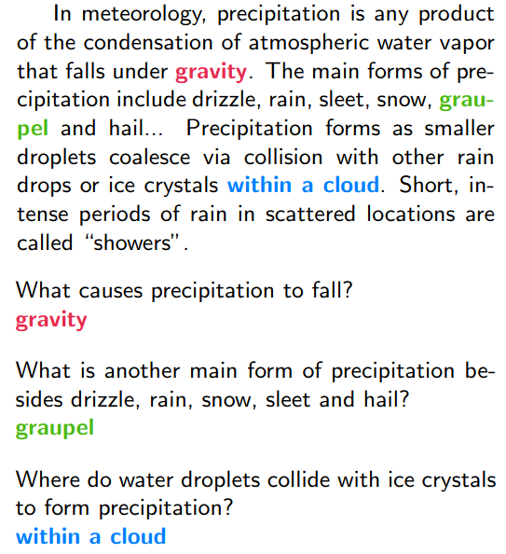
Question Answering
The SQuAD dataset (Rajpurkar et al. 2016)
Task: question answering to test reading comprehension
Questions:
About Wikipedia articles
Answers:
Segment (span) of text in article
Supervised data point:
(paragraph, question, answer)
Evaluation metrics:
Exact matching of answers
Proportion overlap with answer
Multilingual version:
XQUAD (Artetxe et al. 2020)
SQuAD, professionally translated

Slide 21
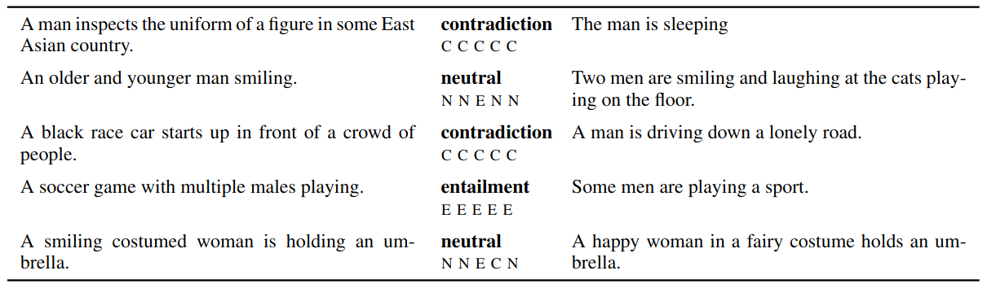
Natural Language Inference
The NLI dataset (Bowman et al. 2015)
Task: natural language inference
Supervised data point: (sentence 1, sentence 2, label)
Set of labels L = {entailment, contradiction, neutral}
Evaluation metric: accuracy
Multilingual version: XNLI (Conneau et al. 2018)
Extended NLI datasets to 15 languages, including low-resource ones

Slide 22
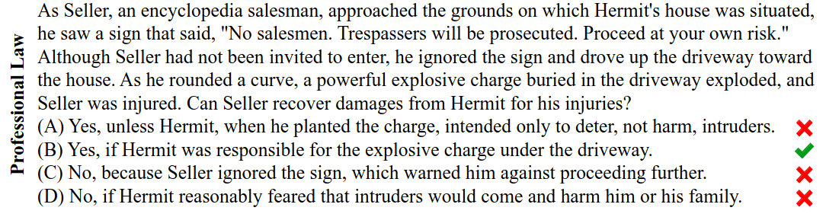
Language Understanding
The MMLU dataset (Hendrycks et al. 2021)
Task: multitask language understanding
Subjects: elementary mathematics, history, compute science, law, etc.
Supervised data point: (multiple-choice question, correct answer)
Evaluation metric: accuracy
This dataset is commonly used to evaluate LLMs
Model performance on it is even commonly reported in the news

Slide 23
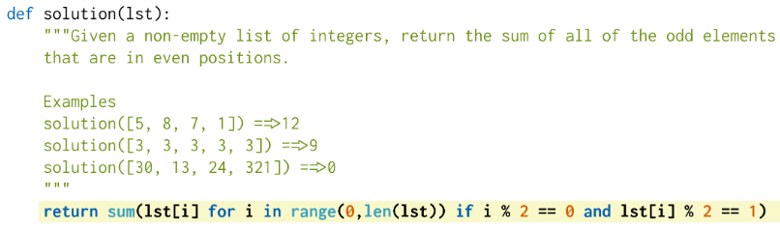
Code Generation
The Human Eval dataset (Chen et al. 2021)
Task: code generation
Specifically, generate stand-alone Python functions from docstrings
Supervised data point: (function definition, unit tests)
Function definition: signature and docstring
Evaluation metrics: pass@k
Generate k solutions, say problem is solved if 1 passes unit tests

Slide 24
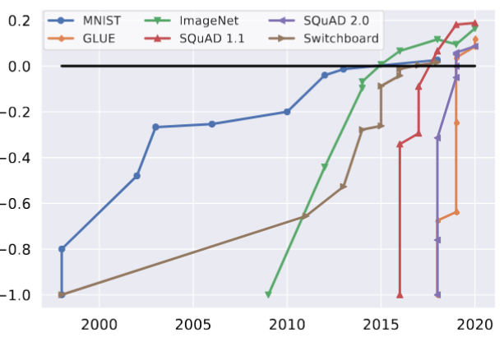
Issues with Benchmarks (1)
Benchmarks essential to scientific progress, but they do have issues
Validity: how well benchmarks assess performance on a task
Subramonian et al. (2023) found consistent disagreement among NLP researchers w.r.t. definitions of tasks, translation of tasks to benchmarks
In other words, tasks and benchmarks are not so clear cut
Sometimes it's not clear what the task really is
Sometimes it's not clear how benchmark really measures the task
Saturation: when models exceed
humans in performance
Natural when using benchmarks
Lately saturation reached faster
Does not mean task is solved
Usually harder versions follow

Slide 25
Issues with Benchmarks (2)
Important concern with LLMs: benchmark leakage
LLMs train on vast amounts of data scraped from the internet
Benchmarks are publicly available online
This includes test data (remember the honor code)
Data contamination: evaluating on examples included in training data
Evaluation examples need not be included explicitly in training data
But it's safe to assume this helps models perform better on benchmark
Roberts et al. (2023) found that GPT-4 performs better on benchmarks released before its cut-off date
Similar findings were reported by Li et al. (2023)
Data memorization: when models reproduce benchmarks verbatim
Xu et al. (2024) used a method based on PPL and n-gram overlap to study how much can a model reproduce instances of public benchmarks
They found many models to be able to do that, e.g. Aquila and Qwen
But many models seem to be cleaner, e.g. Llama, DeepSeekMath

Slide 26
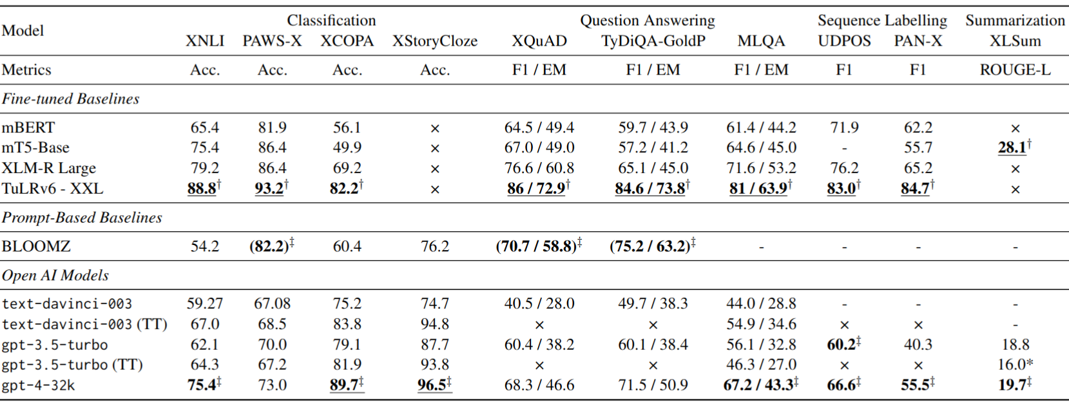
PLMs vs LLMs
Fair question: why use CLM (seq2seq) for (discrete) classification tasks?
Why not something more designed for that, e.g. a MLM?
Ahuja et al. (2023) report fine-tuned PLMs better than LLMs
Columns: tasks, underlined results: best overall, PLMs almost always better
Gap may have decreased since then, but question still fair

Slide 27
Summary
Model evaluation is:
Essential part of ML/DL/LLM pipeline
Designed to test particular skill, performance on some task
Interpreted, as its results usually imply something about the model
Challenging, benchmarks/metrics can be flawed
Requires as much care as other parts of the pipeline: data, model, training
To paraphrase George Box: all evaluations can be flawed, but most are useful
Thus, engaging with model evaluation always requires critical thinking
What do the results mean?
Why do they look like that?
Can model architecture explain them?
Can data explain them?
Can metrics explain them?
Can analysis of individual errors explain them?

Slide 28
Real-World Applications

Slide 29
The Machine Translation Task
Usually abbreviated as MT
Translation generally complex
Translating novels, poetry, etc. has nuance, artistry
MT use cases more grounded
Information access: translate websites to local language
Computer-aided translation (CAT): start with MT-generated draft
On-the-fly speech translation: real-time translation, recent application
Some aspects of language are universal across multiple languages
E.g. words for referring to people or common actions, e.g. eating, sleeping
But many challenges due to language diversity, e.g.
Word order: “He wrote a letter to a friend”
Tomodachi ni tegami-o kaita -> friend to letter wrote
Lexical divergence: words should be translated in context
Bass (the fish) vs bass (the instrument)

Slide 30
Common Approach
Encoder-decoder transformer
Most common architecture for MT
Often trained at sentence level
Get large set of parallel sentences (pairs in source and target languages)
Model maximizes probability of target sequence of tokens
Encoder produces context vector h, decoder uses it to generate output
h = encoder(x)
y_{i+1} = decoder(h, y₁, y₂, …, y_{i})
Training data requires sentence alignment
Multilingual embedding space used to check sentence similarity
Common: use shared vocabulary between source and target language
How? Run tokenizer in corpus that contains both languages
Usually based on subwords, e.g. BytePair Encoding (BPE)
Recently, WordPiece and SentencePiece are used more often

Slide 31
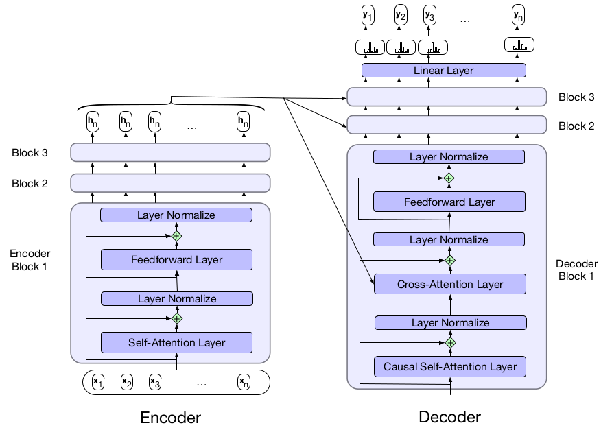
Encoder-Decoder Architecture
Important change: modified cross-attention
Queries come from previous layer (as usual), keys/values from encoder

Slide 32
MT Evaluation
Two common dimensions
Adequacy: does translation capture exact meaning?
Fluency: is translation grammatically correct, clear, readable
Two main approaches
Human’s rate based on two dimensions (expensive, requires experience)
Automatic methods
Automatic methods often based on:
N-gram overlap with human translations (i.e. supervised)
Embedding similarity

Slide 33
What are Dialogue Systems?
Programs that communicate with users in natural language
Often referred to as conversational agents
Two main categories
Task-oriented systems
Chatbots
Task oriented dialogue systems
Goal: use conversation to help complete tasks
E.g. give directions to control appliances, find restaurants, make calls, etc.
Common instance: digital assistants, e.g. Siri, Alexa, etc.
Chatbots
Goal: designed for extended conversations
Needs to account for properties of human dialogue
E.g. we take turns, acknowledging understanding, making inferences, etc.

Slide 34
Chatbots
Originally rule-based
E.g. Eliza would paraphrase what used said, turn it into therapy-like questions
Others are corpus-based
Train on large corpus of billions of tokens of dialogue
Create answers via retrieval (fetch answer from DB) or generation
Hybrid architectures
Combine rule-based with neural/corpus architectures
Arguably more reflective of real-world tools
E.g. Paranjape et al. (2020) built a system with entity linking to identify topic, dialogue act classifier to detect if user is asking question or making a statement, user intent classifier to detect if user wants to change topics
Response generation done with GPT-2 fine-tuned on dialogue dataset
Let’s look at response generation in a bit more detail

Slide 35
Response Generation
Two main approaches
Retrieval-based
Generation-based
Retrieval-based answers
Train model on corpus C of dialogue (set of “turns”)
Treat user input as query q
Score each turn in C as potential answer to q, choose most likely one
Generation-based answers
Modeled as encoder-decoder task
Encode user input with encoder, decoder generates response conditioned on user input + generated answer so far
Generation usually tuned to prevent most likely answers that may break the flow of conversation, e.g. “I don’t know”
Fine-tuning LLMs now common

Slide 36
Dialogue System Evaluation
More straightforward if goal is perform specific task
E.g. was the restaurant booked? Was the event added to the calendar?
Human-based approach: user satisfaction rating
Users interact with the system
Then fill-in multiple-choice questionnaire
Since expensive, heuristics often used
They tend to correlate well with user satisfaction rating
Heuristics often measure two things:
How well system allows user to achieve their goals with minimal cost?
Task error rate, e.g. how often was the event added to calendar after every interaction?

Slide 37
Summary
Many more real-world applications:
Question Answering
Information Retrieval
RAG (Retrieval-enhanced LLMs)
Speech Recognition
Text-to-Speech
Given an understanding of the fundamental methods:
Easy to understand architectures specific to given settings
Easy to reason about task/models/data

Slide 38

References
Multiple Choice Normalization in LM Evaluation by Leo Gao
Speech and Language Processing, Jurafsky and Martin, 2024
Chapters 13, 15
The Evolving Landscape of LLM Evaluation by Sebastian Ruder
References in corresponding slides
© University of Mannheim

