Slide 1

Advanced Methods in Text Analytics
State Space Models
Licensed under Creative Commons Attribution 4.0 International

Slide 2
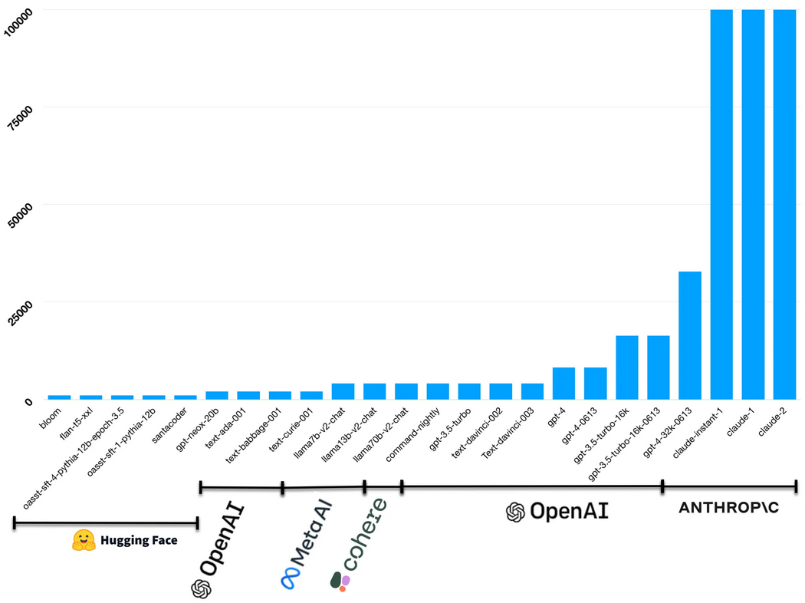
An Alternative to Transformers (1)
Transformer-based models dominate NLP
Most applications tackled with learned representations
Learned representations obtained with transformers
Great, right?
Except for quadratic cost
on input sequence length
Severely limits size of
context fed to models
Many efforts to reduce
cost, e.g.
FlashAttention (2022)
Recent efforts to get
infinite context, e.g.
TransformerFam (2024),
Leave No Context
Behind (2024)
Image source

Slide 3
An Alternative to Transformers (2)
Enter: state-space models
Approach from control theory
They are sequence models that do not use self-attention
Great at modeling very long-range sequences (e.g. 1M tokens)
Today:
State space models, including S4 model (precursor to Mamba), introduced structure to state space models for efficiency, reached SOTA in long range dependency tasks
Relation to RNNs (you already know more about this than you think)
The Mamba architecture, recent state space model, showed competitive performance in causal language modeling when compared with LLMs twice its size (using less memory and compute)
Warning:
Much of this comes from a research area that most NLP researchers (myself included) are likely unfamiliar with
Some things will be discussed in detail, others will be kept at high-level
As in the literature, many things illustrated with equations, not images

Slide 4
Outline
State Space Models
The Mamba Architecture

Slide 5
State Space Models

Slide 6
Continuous State Space Models (1)
Long range dependencies: big challenge in sequence modelling
Materialized by Long Range Arena Benchmark (Tay et al. 2021)
Wide range of tasks requiring processing between 1K and 16K tokens
Most families of sequence models have variants to tackle this challenge
E.g Lipschitz RNNs (Erichson et al. 2021), FlashAttention-2 (Dao et al. 2023)
Family of models that excel at this: state space models (SSMs)
A continuous-time latent state model does the following:
1. Maps 1-dimensional signal x(t) to n-dimensional latent state h(t)
2. Projects latent state (plus input signal) to 1-dimensional output signal y(t)
Concretely:
1. dh(t)/dt = Ah(t) + Bx(t)
2. y(t) = Ch(t) + Dx(t)
Here, A, B, C, D are learned parameters and t is time (usually D = 0 for simplicity because term Dx(t) is seen as "skip connection" between input and output, easy to compute)

Slide 7
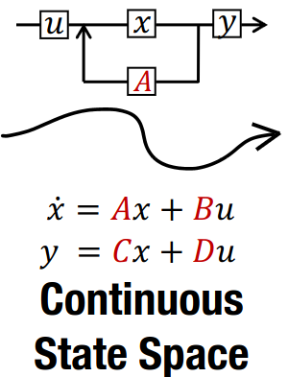
Continuous State Space Models (2)
Let's note a few things about SSMs:
dh(t)/dt = Ah(t) + Bx(t)
y(t) = Ch(t) + Dx(t)
The 1st equation is differential
Describes how h changes over time
The 2nd equation is signal-to-signal model
Both dh(t)/dy and y(t) fully described by
current input signal and hidden state
I.e. a Markov decision process
Ideally, state encodes all past history,
enables us to determine future output y(t)
Great, but this is NLP!
What are we supposed to do we these continuous SSMs?
We are all about processing discrete sequences here, right?
Yes, so let's discretize SSMs
Gu et al. 2022

Slide 8
Discrete State Space Models (1)
There are several ways to discretize a continuous signal
Think of it as sampling a continuous signal at fixed time intervals
Different SSMs use different approaches, each with different properties
Simple way to get an intuition for discretization: the Euler method
Let's start with our continuous model:
dh(t)/dt = Ah(t) + Bx(t) (1)
y(t) = Ch(t) + Dx(t) (2)
1st, we clean up notation a bit: x_{t} = x(t), h_{t} = h(t) and h_{t+1} = h(t + Δ)
2nd, by definition of a derivative: dh(t)/dy = (h(t + Δ) - h(t)) / Δ (3)
Then, by plugging (3) in (1), we have:
h_{t+1} - h_{t} = Δ(Ah_{t} + Bx_{t})
h_{t+1} = ΔAh_{t} + ΔBx_{t} + h_{t}
h_{t+1} = h_{t}(ΔA + I) + ΔBx_{t}
h_{t+1} = (I + ΔA)h_{t} + (ΔB)x_{t}

Slide 9
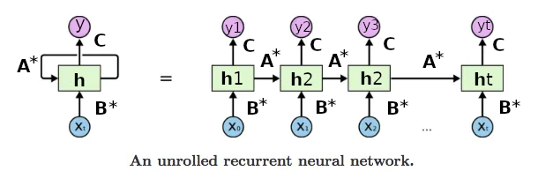
Discrete State Space Models (2)
If we now set A* = (I + ΔA), B* = ΔB and set D = 0, we have:
h_{t+1} = A*h_{t} + B*x_{t} (1)
y_{t} = Ch_{t} (2)
Does that look familiar?
I hope we haven't forgotten! It looks like an RNN
Discrete SSMs are essentially linear RNNs (i.e. seq2seq models)
I.e. RNN with activation f = I when computing h, i.e. h_{t+1} = f(A*h_{t} + B*x_{t})
Computing A*, B* (discretization) can be seen as first step in compute graph
Image source

Slide 10
Discrete State Space Models (3)
As mentioned, different SSMs use different approaches for discretization
None actually uses the Euler method
E.g. S4 uses a bilinear method:
A* = (I - Δ/2 A)⁻¹(I + Δ/2 A)
B* = (I - Δ/2 A)⁻¹ ΔB
Mamba uses a process called zero-order hold:
A* = exp(ΔA)
B* = (ΔA)⁻¹(exp(ΔA) - I) ΔB
Such models are thus parameterized by θ = [Δ, A, B, C]
Ok, fine, so we are back to (linear) RNNs. Is that it?
Not quite, as RNNs fell out of favor for two specific reasons
1. Difficulty modeling long range dependencies
2. Slow to train due to sequential computation of hidden states
SSMs need to deal with these issues to be successful
Let's have a high-level look at how SSMs addressed these "RNN challenges"

Slide 11
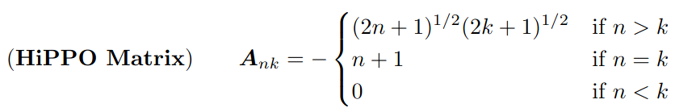
Modeling Long Sequences with SSMs
HiPPO framework introduced by Gu et al. 2020
High-order Polynomial Projection Operators
Math-heavy work (described as "a bit of magic" by some sources)
Essentially, framework that proposes a principled way of initializing matrix A so state h(t) can memorize input sequence x
Specifically, a complex matrix in the following upper triangular form:
More generally, they formalized notion of memory as online function approximation (based on approximation theory and signal processing)
The framework derived GRUs and LMUs from first principles
Their results put SSMs on the map, reported massive improvements
E.g. from 68% to 98% on sequential MNIST benchmark
Still, SSMs were expensive to train compared to Transformers
One RNN challenge down, one to go

Slide 12
Training SSMs Efficiently
Important property of SSMs: linear time invariance (LTI)
Well known connection with convolutions (yet no citation in papers!)
In short, because computing h_{t+1} is linear, we can unroll SSMs as follows:
h₀ = B*x₀ h₁ = A*B*x₀ + B*x₁ h₂ = A*²B*x₀ + A*B*x₁ + B*x₂
y₀ = CB*x₀ y₁ = CA*B*x₀ + CB*x₁ y₂ = CA*²B*x₀ + CA*B*x₁ + CB*x₂
and so on, where initial state h₋₁ = 0.
Thus, for input sequence x, the entire output sequence is y = K ☉ x where ☉ is the (discrete) convolution operation and K is the following (giant) convolution filter:
K = (CB*, CA*B*, CA*²B*,…, CA*^{|x| - 1}B*)
I.e., we can compute entire forward pass as single global convolution!
Can be computed efficiently with Fast-Fourier Transforms (FFTs) once K is known
But computing K is expensive (repeated matrix multiplication by A*)
Achieving this in linear time was a main contribution of the S4 model

Slide 13
Structured State Space Models
S4: structured state space sequence models (Gu et al. 2022)
Again, math-heavy paper, only high-level discussion here
Main contribution:
Computing global kernel K in linear time (normally quadratic)
They enforce structure to parameter matrix A in SSMs
A is special form of diagonal matrix: diagonalizable by normal matrices
Work far from trivial, as matrix A had to retain the properties of the HiPPO matrix that accounts for the success of SSMs at long range dependencies
An S4 layer was proposed to construct deep S4 models
S4 block: SSM seq2seq model + dropout + non-linearity + linear projection
Since S4 processes single scalar, S4 block contains H copies of S4 model
Then, each block processes inputs of size (batch size, input length, hidden size), same as RNNs, Transformers (but S4 is linear in input length!)
Can be computed as convolution (training) or autoregressively (inference) (nicely shown in code here)
So, with S4 we get efficient SSM training without performance loss
Now let's recap SSMs vs RNNs before we look at Mamba

Slide 14
SSMs vs RNNs
While similar, there are important differences between SSMs and RNNs
1. SSMs (and linear RNNs) can be efficiently parallelized (global convolution)
2. SSMs are "linear RNNs" but with special requirements for how to compute some parameters (discretization)
3. SSMs are complex valued and initialized according to the HiPPO theory
Also, note that while SSM matrices A*, B* are equivalent to RNN parameters, they actually share parameters themselves (usually Δ and A)
In short, these differences are important, account for success of SSMs!
After S4's success, recent work "resurrected RNNs" (Orvieto et al. 2023)
Started with a linear RNN, "ablated" their way to reach S4's performance
Specifically, they introduced diagonalization, special initialization and parameterization, as well as normalization to RNNs
Insightful in terms of where success of SSMs comes from
Having "covered" how both RNN challenges were addressed by SSMs, we can now discuss Mamba!
This because the model is an extension of the S4 architecture

Slide 15
The Mamba Architecture

Slide 16
Motivation
Perspective proposed by authors:
"A fundamental problem of sequence models is compressing context into a small state"
For example, self-attention is:
Effective: does not compress context at all, stores it entirely (KV cache in causal LMs)
Inefficient: KV cache takes linear space in input sequence length
Conversely, RNNs are:
Efficient: compress context in hidden state h (size usually much smaller than the long range sequences we want to model with SSMs)
Ineffective: especially for long sequences, as performance depends on how well they compress context (though the "RNN resurrection" paper improved considerably on this thanks to research in SSMs)
In short, efficient vs effective trade-off summarized by how well a model compresses their state
Proposed fundamental principle for building sequence models: selectivity

Slide 17
Improving SSMs with Selection
Selectivity: context-aware ability to focus on or filter out inputs into a sequential state
Sounds awfully familiar, right?
In other words, an attention-like mechanism that controls how information propagates or interacts between elements of a sequence
Is it really an attention-like mechanism?
Yes! The main Mamba design innovation is allowing more access to input sequence by letting the SSM parameters be input-dependent
Recall attention on RNNs was basically: Hey, why don’t we just access the input at each inference step instead of just interacting with the hidden state?
Mamba is the SSM that asks the same question (likely inspired by the success of the Transformer).
Specifically, some parameters became functions of input sequence x
Matrix B = W_{B}x, matrix C = W_{C}x where W_{B}, W_{C} are learned projections
Problem: this change means we lose the ability to train SSMs efficiently
Let's see why

Slide 18
Improving SSMs with Selection?
Recall efficient training of SSMs:
Given input sequence x, entire output sequence is y = K ☉ x where ☉ is (discrete) convolution operation and K is the following (giant) convolution kernel: K = (CB*, CA*B*, CA*²B*,…, CA*^{|x| - 1}B*)
Efficient! Compute kernel elements separately, apply convolution theorem
Now, note the following:
h_{t} depends on h_{t+1} because h_{t+1} = A*h_{t} + B*x_{t}
Since B = f(x), B* = f(x) because B* is a function (discretized form) of B
For t = 1, x = [x₁], for t = 2, x = [x₁, x₂], for t = n, x = [x₁, x₂, …, x_{n}]
So, B* is now time dependent, i.e. B*_{t}
Thus, a more accurate notation now is: h_{t+1} = A*h_{t} + B*_{t}x_{t} since B* is a function of x, which changes per time step (autoregressive models)
In other words, hidden states now need to be computed in sequence
We lost one of the two improvements SSMs had over RNNs
So, another main contribution from Mamba: make training efficient again

Slide 19
Hardware-Aware Selectivity
To regain training efficiency, the authors did two things:
1. Switch from convolution to a scan operation
2. Implement scan in a GPU-optimized way
Scan: otherwise known as a cumulative sum
E.g. given sequence x = [3, 2, 6], output is sequence y₁ = 3, y₂ = 5, y₃ = 11
Can be parallelized to be computed in log n (nicely shown here)
Already used for efficiently training linear RNNs (Orvieto et al. 2023)
So, in short: what is Mamba?
An S4 model (structured SSM) with Selectivity
An S4 model trained with the Scan operation
Hence, authors described it as an S6 model
Transformers vs Mamba: overall training costs for sequence of length n
Memory: O(n) vs O(1) (KV cache vs hidden state)
Runtime: O(n²) vs O(n) (self-attention vs GPU-optimized SSM)
In other words, massive improvements!
If performance on par with LLMs, we may have a new king

Slide 20
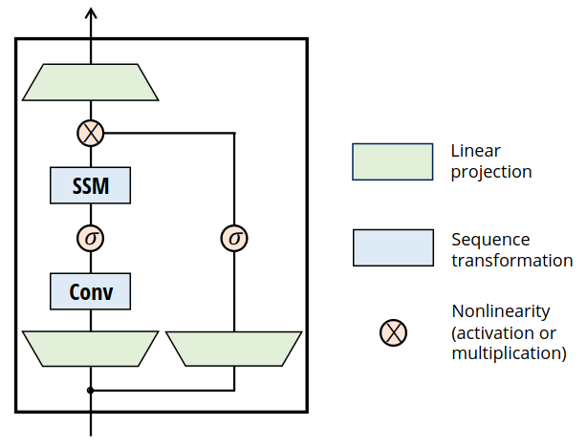
The Mamba Block
As with the Transformer, we have a Mamba block
Inter-token communication:
Transformer: self-attention
Mamba: SSM
Intra-token computation:
Transformer: MLP
Mamba: MLP
Efficiency:
Transformer: linear attention
Mamba: linear RNN
Expressivity:
Transformer: non-linearity between MLP projections
Mamba: non-linearity between MLP projections
In practice:
Up-projection by a factor of 2 (compared to usual 4 in LLMs)
Silu/Swish activations, optional layer normalization before/after block
Gu et al. 2023

Slide 21
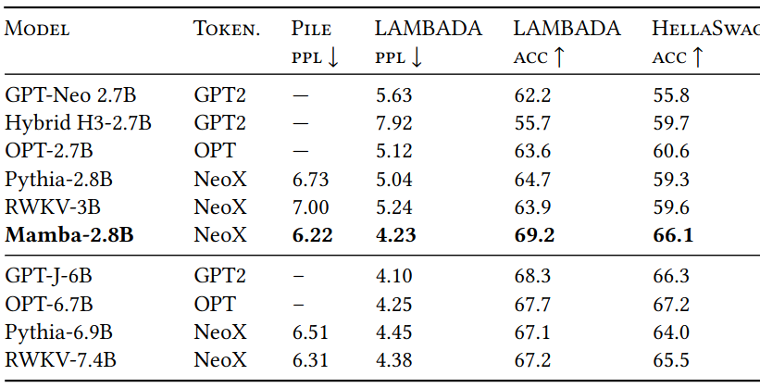
Mamba vs LLMs
Some results on downstream tasks (with 5x faster inference compared to transformer-based LLMs)
Some concerns from the community:
Are baselines strong enough? E.g. no latest OpenAI models
More importantly, why no comparison with larger LLMs?
Gu et al. 2023

Slide 22
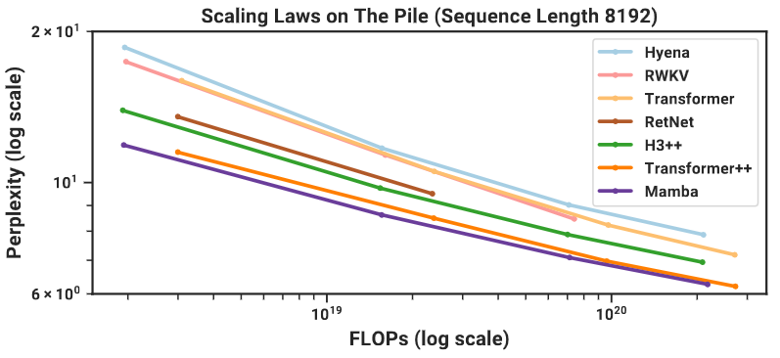
Scaling Laws
Authors also provided scaling laws on all tested tasks (here only LM)
They followed the Chinchilla protocol
Roughly, statistical model that measures loss as function of model size
"First attention-free model to match performance of very strong Transformer recipe (Transformer++)" (with cheaper memory/compute!)
Transformer++ recipe: Rotary, SwiGLU, MLP, RMSProp, no linear bias, higher learning rate (PaLM, LLaMA)
Gu et al. 2023

Slide 23
A Different Paradigm (1)
Nice discussion on a potential paradigm shift by Kola Ayonrinde
Specifically about using pre-trained causal language models (CLMs)
Sources of information in transformer-based CLMs at inference time?
Training data, i.e. pre-trained weights (long-term memory, but compressed)
In-context data, i.e. prompt (short-term memory, must be read every time)
Do we have selectivity when using such CLMs?
Yes, via prompting (what to leave in or out), RAG, etc.
This because entire prompt is accessed (attention) to predict next tokens
What about when using SSM-based CLMs like Mamba?
Training data is there in the same way, i.e. compressed long-term memory
Selectivity is a core design of the system as it reads any input
But in-context data is also long-term now! Why?
Because we can store the last hidden state, plug it in later as needed!
Transformers not designed to have a state or representation plugged in
They must instead "read" the entire input to produce contextualized vectors

Slide 24
A Different Paradigm (2)
This is essentially a new form of prompting
Swapping hidden states as needed
A modularity akin to swapping LoRA modules
Remember: SSMs are very good at long range dependencies
We could potentially read entire set of textbooks, store hidden state h_{n}
Then, at inference time, use h_{n} as initial state of our prompt
Question: can transformers' contextual embeddings also act as states?
There is already some work on this, so maybe...
And with that, our discussion on SMMs comes to an end
So, let's summarize!

Slide 25
Summary
State Space Models (SSMs):
Sequence models similar to linear RNNs, but with key differences
Differences make them very good at long range dependencies
This ability comes from principled design choices (HiPPO framework)
Mamba Architecture:
SSM with attention-like mechanism for selectively using input sequence
Performs competitively with LLMs twice its size
Scaling laws show promise for scaling up the model
SSMs vs Transformers
SSMs much more efficient, memory: O(1) vs O(n), compute: O(n) vs O(n²)
But no results on Mamba vs largest LLMs yet, e.g. 70B or larger

Slide 26

References
Efficiently Modeling Long Sequences with Structured State Spaces by Gu et al, 2022
The Annotated S4 by Sasha Rush and Sidd Karamcheti
Resurrecting Recurrent Neural Networks for Long Sequences by Orvieto et al. 2023
Mamba: Linear-Time Sequence Modeling with Selective State Spaces by Gu and Dao, 2023
Mamba Explained by Kola Ayonrinde
Mamba from Scratch by Algorithmic Simplicity
References linked in corresponding slides
© University of Mannheim

