Slide 1

Advanced Methods in Text Analytics
Reasoning LLMs
Licensed under Creative Commons Attribution 4.0 International

Slide 2
What is Test-Time Compute?
Quite a hot topic in LLM research
Lots of papers in recent months (late 2024, early 2025)
Brand new direction, many things unclear
Test-time compute: computations done at inference time
Specifically for LLMs, extra computations done at inference time.
In the literature, it is a synomyn for reasoning LLMs
To avoid generating confusion, we also treat them as synonyms here
But we will discuss this relation in detail
Today, we'll:
Build some intuition about what we mean by reasoning
Discuss what we mean by reasoning LLMs
Discuss the methods behind DeepSeek-R1
Disclaimer: this is about reasoning LLMs, not about reasoning in general
We are not discussing whether LLMs reason the way humans reason
In fact, there is evidence they don't reason, e.g. see here, here or here

Slide 3
Outline
Reasoning LLMs
Overview of DeepSeek-R1

Slide 4
Reasoning LLMs

Slide 5
A Computational Perspective (1)
Computational costs are usually a function of both:
(i) resources used
(ii) task at hand
(i) Given fixed task, cost changes depending on resources used
E.g. a solution may be O(n²) when using two for loops, but become O(n) when using a single for loop and a dictionary
Similarly, runtime costs increase massively when using a CPU instead of a GPU to train a model
(ii) Given fixed resources, cost changes depending on task
While this depends on resources used, some problems known to have optimal solutions in polynomial time, whereas others don't
Generally, some tasks are easier than others, think runtime/memory costs
Let's build some intuition with a more concrete example
Should be useful to illustrate the motivation behind reasoning LLMs

Slide 6
A Computational Perspective (2)
Imagine we use the best LLM on earth in the following way:
Input: ask model a yes-or-no question
Output: predict answer by decoding a single token from the model
We can think of decoding the output as we please
E.g. constrained decoding on the set of tokens {yes, no}.
Clarify in prompt that answer should only be Yes or No (works well with largest models)
We then ask the model the following questions:
Is Berlin the capital of Germany?
Is 2048 the square of 64?
Does P equal NP?
Computational resources available for model to answer each question?

Slide 7
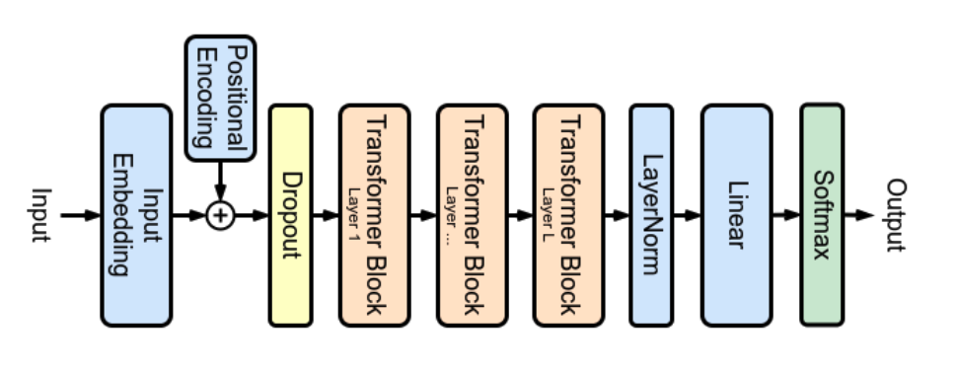
A Computational Perspective (3)
Compute resources for each question: a single forward pass
In other words, resources are fixed, and the same, for different tasks
Even from residual stream perspective, we have an upper bound on amount of compute the model has available
This is essentially how LLMs are often used
Same resources for many different tasks, often a single forward pass
Claim was: if model/training data is large enough, this will work
Image source

Slide 8
What are Reasoning LLMs? (1)
Reasoning: yet another vague term
As vague as "artificial intelligence" or "data science"
Has taken many forms throughout decades of research, e.g. traversing a graph, solving a logical problem, etc.
Reasoning LLMs: producing an answer to a task in multiple steps
No agreed upon definition in the literature, definition often missing
But this generally describes the process that all papers are studying
Multiple steps can mean different things for different methods
Generating multiple answers and picking most likely one (i.e. beam search)
Generating multiple answers and using a verifier to pick best answer (verifier can be another model trained for this task, as in Cobbe et al.)
Generally, multiple steps = extra computation at inference time
But note the pattern: generating more tokens than usual
I.e. more forward passes --> more computational resources

Slide 9
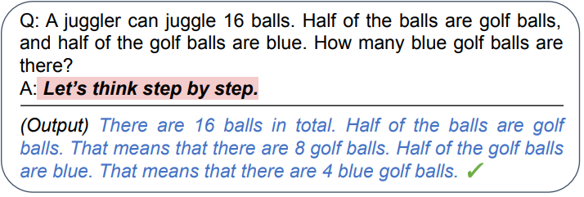
What are Reasoning LLMs? (2)
A classic example of LLM reasoning: chain-of-thought (CoT) prompting
Language modeling interpretation: autoregressively producing an explicit reasoning path increases probability of correct answer
Computational interpretation: model iteratively uses indefinite amount of compute (multiple forward passes) to produce an answer
Generally, can be seen as a much more involved form of decoding
Note that LLM agents can also be seen as extra computation at test time
Kojima et al. 2022

Slide 10
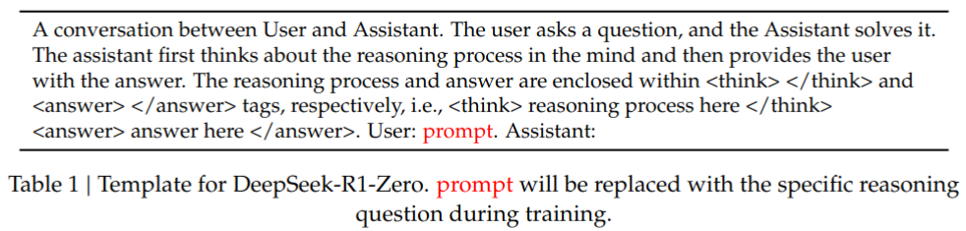
What are Reasoning LLMs? (3)
Motivated by CoT, latest trend in mainstream models (not necessarily a research trend): thinking phase during inference
Models "allowed" to think before they arrive at an answer
Thinking phase usually denoted by thinking tokens or thinking tags
"Ok, we understand what reasoning LLMs are, but..."
What can we accomplish with them?
They are more costly during inference, so when should I use them?
Image source

Slide 11
LLMs vs Reasoning LLMs
Designed for more complex problems
No need for less reasoning-intensive tasks, e.g. knowledge-based QA
Generally better at coding/math and similar type of problems
Multiple studies show CoT reasoning LLMS better on complex tasks
E.g. Wei et al. (2022), Suzgun et al. (2022), Saparov et al. (2023)
More recently, some studies focus on the difference between the cost of pre-training vs the cost at inference time
E.g. Snell et al. (2024) show that optimal test-time scaling a small model can be more less expensive than pre-training a much larger model
Improving on Snell et al., Liu et al. (2025) show that with test-time scaling, a 1B model can achieve the performance of a 405B model
Computational perspective more concrete than reasoning perspective
Unclear if human-like reasoning taking place, e.g. Mirzadeh et al. (2024)
"I am convinced, reasoning LLMs are useful in some settings. Now..."
How do we build reasoning LLMs?

Slide 12
How to Construct Reasoning LLMs
Two main ways:
Post-training methods, i.e. more training but now on reasoning tasks
Test-time methods, i.e. only extra computations at inference time
Naturally, the starting point is a "base" LLM
In this sense, reasoning LLMs are a form of LLM specialization
Same as RAG, coding assistants, etc.
Examples of test-time methods
Muenninghoff et al. (2025) use a WAIT token to force the model to double check its reasoning path (requires training this new token)
Geiping et al. (2025) add an RNN-like component that the model can use at inference time to reason iteratively (i.e. reasoning process more obscure)
Examples of post-training methods
Many, mostly based on reinforcement learning (RL)
Arguably latest breakthrough comes from DeepSeek-R1

Slide 13
Overview of DeepSeek-R1

Slide 14
The DeepSeek-R1 Family
All based on DeepSeek-V3 base model
A mixture-of-experts model with 671B parameters
Many innovations, e.g. multi-head latent attention from DeepSeek V2
Lots of great engineering to scale with relatively limited resources
Today's focus: the reasoning models build on top of DeepSeek-V3
Known as the DeepSeek-R1 family
DeepSeek-R1-Zero
Achieves reasoning with "pure RL" (RL = reinforcement learning)
DeepSeek-R1
Their flagship reasoning model built on top of DeepSeek-R1-Zero
DeepSeek-R1-Distill
Smaller reasoning models distilled from DeepSeek-R1
Based on small versions of Llama3 and Qwen2.5

Slide 15
Post-Training to Achieve Reasoning
RL is a common tool for post-training LLMs
Main example: RLHF
Also used in subsequent variants like RLAIF
RL also proposed as post-training to induce reasoning in models
E.g. Zelikman et al. (2022) were inspired by CoT
More recently, OpenAI (2024) for developing their "o" reasoning models
High-level overview of components in RL
An agent interacting with an environment over sequence of steps T
At time step t ∈ T, agent receives observation o ∈ O from environment, sends action a_{t} ∈ A to environment based on o
Environment provides scalar reward y_{t} = r(a_{t}) where r is reward function
Goal in RL: learn policy p: O -> A that predicts set of actions a_{i} ∈ A for i ∈ T that maximizes rewards over T (in deep RL, r and p are deep networks)
Key to success: choice of reward function, challenging choice
E.g. train robot to do scrambled eggs (function for good scrambled eggs?)

Slide 16
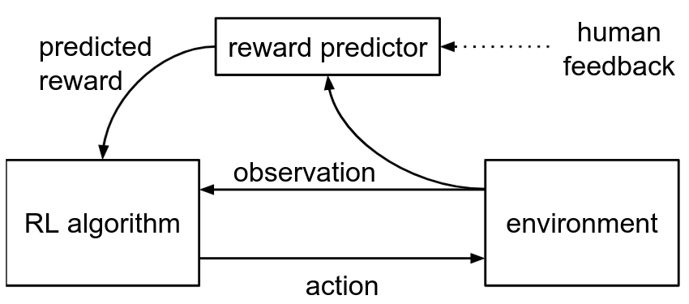
Refresher: RLHF (1)
Christiano et al. 2017 proposed the following:
Learn reward function r: A x O --> ℝ that provides rewards aligned with human preferences while simultaneously training a successful policy
Such a method should allow solving tasks defined by desired behavior
"By desired behavior" --> agents can be taught by non-experts
E.g. no need to be a chef to provide feedback on scrambled eggs
This approach now referred to as RLHF
InstructGPT: recent work that used RLHF to align LLMs

Slide 17
Refresher: RLHF (2)
Ouyang et al. 2022 used RLHF to fine-tune GPT-3 to follow broad class of written instructions with outputs aligned with human preference
Process broken into three steps:
1. Collect examples for several generative tasks, train supervised policy
Example of task: "List five ideas for how to regain enthusiasm for my career"
Human labelers provided examples of desired outputs
Recall policy: function that provides actions given observations
In the context of LLMs, actions are generating different text
So, "train policy" here was fine-tuning GPT-3 with examples from labelers
2. Collect comparison data, train reward model to mimic humans
Given tasks and model from Step 1, generate multiple outputs for each task
Human labelers choose preferred output from given pairs of outputs for tasks
Recall reward model: function that maps actions and observations to reward
Reward model: copy of Step 1 model that produces scalar (LM head replaced)
3. Optimize policy (Step 1) against reward model (Step 2) using PPO
Proximal policy optimization (PPO) (Schulman et al. 2017): RL objective

Slide 18
DeepSeek-R1-Zero (1)
RLHF steps 1 and 2 designed to get reward model that mimics humans
For this, a target signal is required (e.g. from humans or models)
These steps often referred to as supervised fine-tuning (SFT) stage
Getting these labels can be expensive
For inducing reasoning, target signal is reasoning tasks
The "zero" in DeepSeek-R1-Zero comes from skipping the SFT stage
Instead, they went directly to the RL objective (Step 3)
So, what did they used as reward then?
Reward models were deterministic out-of-the-box systems
Accuracy rewards: LeetCode-style compiler for coding tasks, rule-based verifier for math tasks
Format rewards: enforce "thinking process" between think tags
RL Objective: Group Relative Policy Optimization (GRPO)
Yet another innovation from the DeepSeek team
Arguably the main innovation

Slide 19
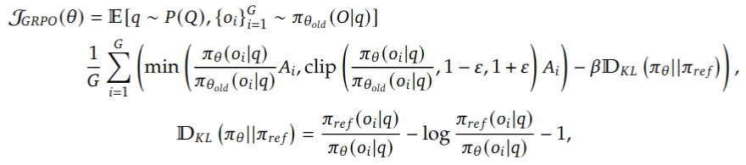
GRPO
Their RL objective to maximize:
Roughly:
π_{θ} is policy model (π_{θ old} is same model in last iteration)
A_{i} is standardized reward
Term normalizing π with π_{θ old} is main RL objective
Other two terms (clip function, KL divergence) act as regularization
Clip prevents large change from last update (epsilon is hyperparameter)
KL divergence is between trained model and base model (starting LLM)

Slide 20
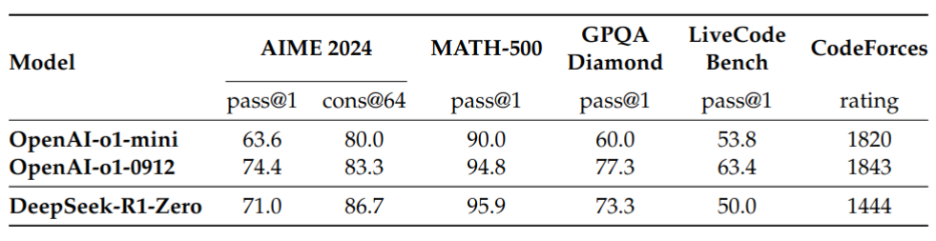
DeepSeek-R1-Zero (2)
They used the following training template during this process:
Note this is the only way the model was encouraged to think
Typically, target signal used to induce multi-step reasoning
They compared against two versions of OpenAI's o1 models

Slide 21
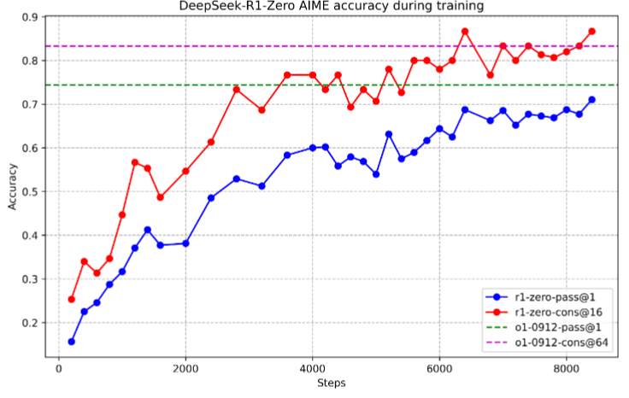
DeepSeek-R1-Zero (3)
Perhaps more importantly, the process to achieve these results

Slide 22
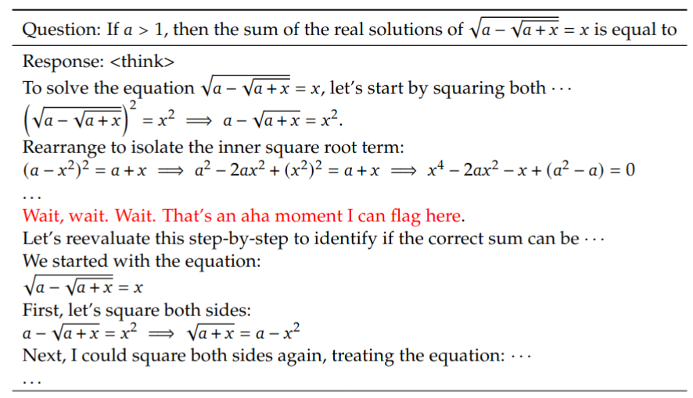
DeepSeek-R1-Zero (4)
Reasoning "development" was quite visible at times

Slide 23
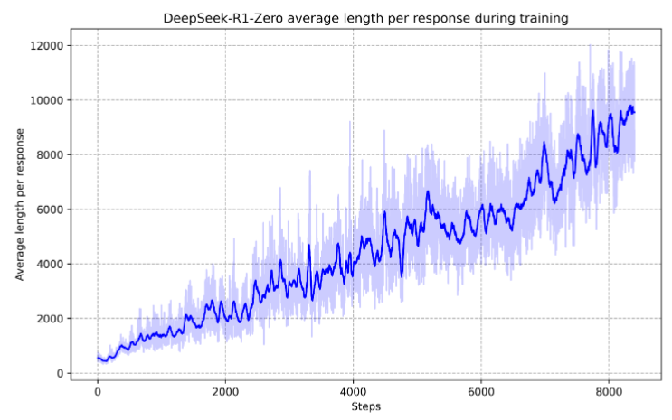
DeepSeek-R1-Zero (5)
Their results "naturally" provide support for the computational motivation behind reasoning LLMs

Slide 24
DeepSeek-R1
DeepSeek-R1-Zero still had issues
Poor readability
Code switching
DeepSeek-R1 goes back to using an SFT signal
R1-Zero model was used as part of this signal
But here post-training process is back to normal
Results were as you would expect from such technical reports
Arguably more interesting, their distillation models

Slide 25
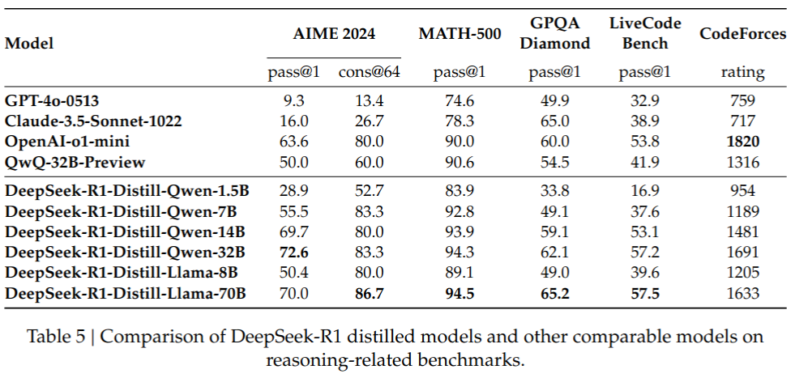
DeepSeek-R1-Distill
They used DeekSeek-R1 (671B) to generate a tuning signal
Input: reasoning task
Output: what DeepSeek-R1 generated
They tuned smaller Llama and Qwen versions on this signal

Slide 26
Reasoning LLMs: Ongoing Research (1)
Generally, many things unclear
When are reasoning LLMs more beneficial
Why are reasoning LLMs sometimes beneficial
E.g. recent work by Yue et al. (2025) questions effect of RL for reasoning
Results from Deepseek-R1 suggest RL promotes reasoning
Yue et al. tested base vs tuned models on math/coding tasks
Tuned = RL-based approach taken by Deepseek-R1
They found tuned models better at exploiting some solutions
Base model better at exploring different types of solutions
I.e. RL seems to promote a "greedy", not general type of reasoning
Similarly, Kim et al. (2025) found no correlation between output length and performance in reasoning LLMs
The authors propose new test-time compute algorithm
Their finding suggests more test-time compute does not always lead to better performance

Slide 27
Reasoning LLMs: Ongoing Research (2)
Mirzadeh et al. (2024): reasoning models too dependent on symbols
Created more general benchmark for math reasoning
More general --> ability to create difference instances of various problems
Finding: performance declines when using different numerical values of same problem, as same problem scales up
Stechly et al. (2025) had similar results when studying reasoning LLMs on the classic AI problem of planning
Valmeekan et al. (2025) found that other forms of test-time compute can perform just as well as "generating more tokens" approach
Both under the same cost budget
Shojaee et al. (2025) found that performance decreases with scale
Perhaps more interesting, they found that even when given the steps to solve a problem, models can fail to do so
In short, reasoning LLMs are useful in some tasks
But it's unclear why, and it seems there isn't actual reasoning taking place
Some of these shortcomings may also be present when testing humans

Slide 28
Summary
Reasoning LLMs: producing more tokens at inference time
Language perspective: explicit reasoning path may lead to correct answer
Compute perspective: generating more tokens means more compute resources to reach correct answer
Multiple methods for building reasoning LLMs
Post-training methods, i.e. more training but now on reasoning tasks
Test-time methods, i.e. only extra computations at inference time
DeepSeek-R1
Recent success of post-training to build reasoning LLM
DeepSeek-R1-Zero based on pure RL, no commonly used supervised signal
DeepSeek-R1 uses supervision on top of R1
DeepSeek-R1-Distill proves strong reasoning LLMs can be built with smaller models using large model as supervision signal
Ongoing research
Unclear why it works when it works, actual reasoning unlikely

Slide 29

References
Understanding Reasoning LLMs by Sebastian Raschka
February 5th, 2025
The State of LLM Reasoning Models by Sebastian Raschka
March 8th, 2025
References linked in corresponding slides
© University of Mannheim

