Slide 1

Advanced Methods in Text Analytics
Recurrent Neural Networks
Licensed under Creative Commons Attribution 4.0 International

Slide 2
Language is a Temporal Phenomenon
Language is essentially a signal over time
Sounds flow to form semantically meaningful messages
Words flow to form sentences, sentences to form paragraphs, etc.
Different language models (LMs) represent/use time differently
N-gram LMs? Predict next word based on previous n - 1 words
FNN-based LMs? Move input window over time
This lecture, new type of model: recurrent neural networks (RNNs)
Represent time differently (quite explicitly)
Addresses some issues with FNN-based LMs like Bengio's (e.g. input size)
New challenges, e.g. gradient flow over time
RNNs were essentially replaced by the transformer architecture
But their modeling approach important, may become relevant again (Gu et al. 2023)
We look at the transformer architecture in the next lecture slides

Slide 3
Outline
Recurrent Neural Networks
Training RNNs
The Encoder-Decoder Architecture

Slide 4
Recurrent Neural Networks

Slide 5
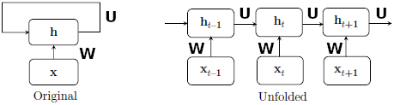
Recurrent Neural Networks (RNNs)
Useful goal (in NLP): learn a representation of a sequence
So, representation learning but for a given sequence, not a single word
Note a fully-connected neural network can also be used for this
How? Let's look at vanilla RNNs
Input: sequence x₁, x₂, …, x_{n} over n time steps (numbers, words, etc.)
Requires: initial hidden state h₀
Output: sequence of hidden states h₁, h₂, …, h_{n}
Key difference to fully-connected LMs like Bengio's LM (2003)
h_{t} = f(Wx_{t} + Uh_{t-1} + b) wh. W, U linear transformations, b bias, f is activation
I.e. hidden states computed from previous hidden state and current input

Slide 6
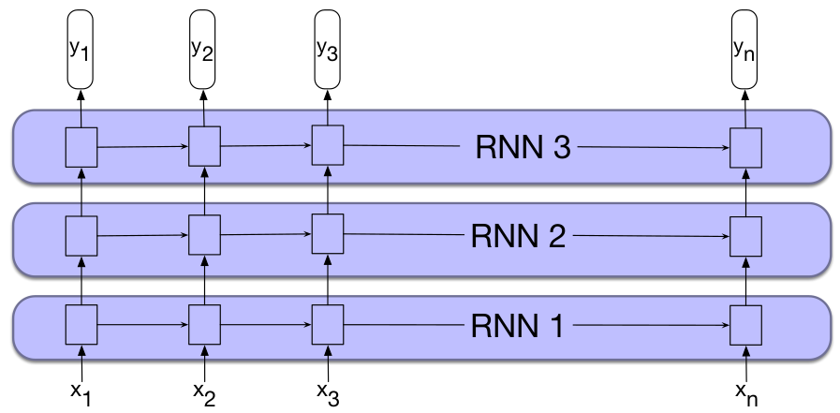
RNNs are Deep in Time
W, U are shared across time steps --> RNNs are deep in time
Unfolded diagram does not show different layers! It's the same layer!
But RNNs can also be deep in the traditional sense (stacked RNNs)
Input to layer i is sequence produced by layer i – 1
Weights are shared
across time, not across
layers

Slide 7
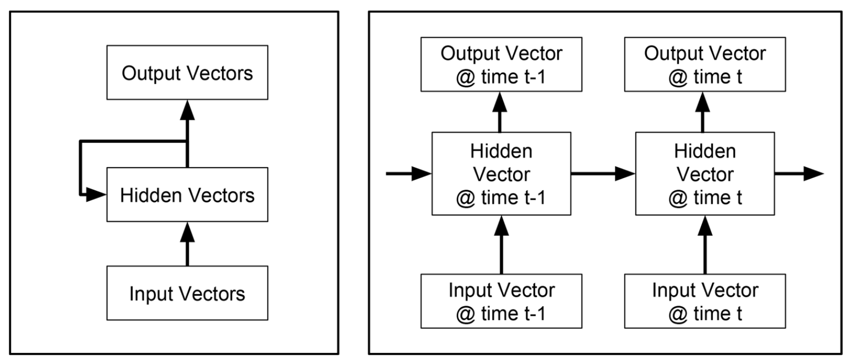
RNNs are Expressive (1)
What about the output of the vanilla RNN?
What do we use as representation for the entire input sequence? Why?
In other words, how do we use an RNN for inference?
We can design RNNs to do many tasks
Design: what units my network has, how they are computed
For example, a network with an output unit y_{t} at each time step t
h_{t} = σ(Wx_{t} + Uh_{t-1} + b_{h})
y_{t} = σ(Vh_{t} + b_{y})

Slide 8
RNNs are Expressive (2)
Another type of RNN is often referred to as Jordan networks
h_{t} = σ(Wx_{t} + Uy_{t-1} + b_{h})
y_{t} = σ(Vh_{t} + b_{y})
Notice the difference?
In general, RNNs are very expressive (Chung et al., 2021)
Some tasks may require multiple output units, others just one
Some tasks may require sigmoid activations, other softmax
Important: weight sharing across time acts as model's memory/state
Intuition: hidden state h_{t} encodes input sequence up until time step t
If h_{t} = σ(Wx_{t} + Uh_{t-1} + b_{h}), x_{t} represents current input, h_{t-1} all previous ones
In principle can process inputs of any length (unlike LMs similar to Bengio's)
In practice, challenges emerge when input lengths are too long
Let's have a look at some RNN architectures for NLP
I.e. input is sequence of words/tokens

Slide 9
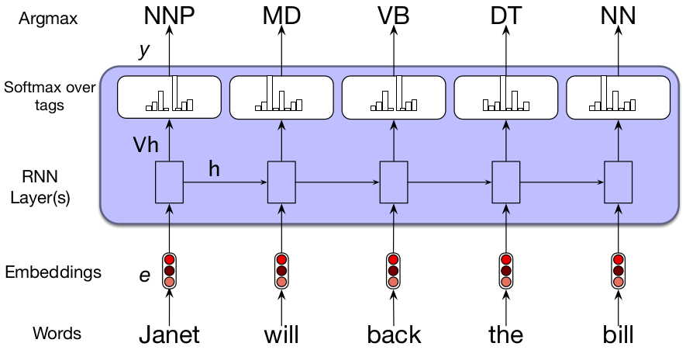
RNNs for Token-level Classification
Also referred to as sequence labeling
Goal: predict a class for each token in the input sequence
Named Entity Recognition (NER): identify and classify named entities
Input: Jim bought 300 shares of Acme Corp. in 2006.
Output: [Jim]_{Person} bought 300 shares of [Acme Corp.]_{Organization} in [2006]_{Time}.
Here's an RNN for Part-of-Speech (POS) Tagging
POS Tagging: each word can be a noun, verb, adverb, etc.
Formally:
h_{t} = f(Wx_{t} + Uh_{t-1} + b_{h})
y_{t} = softmax(Vh_{t} + b_{y})

Slide 10
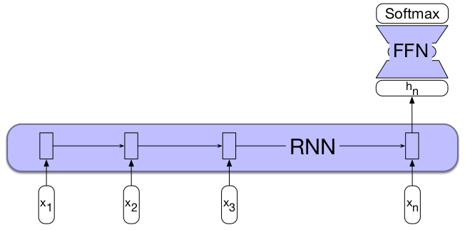
RNNs for Sequence-level Classification
Also referred to as text classification.
Goal: predict class for given sequence of text, e.g. a document
Sentiment classification: is this tweet's sentiment positive/negative/neutral?
Spam detection: is this email a spam or not?
Here's an RNN for sequence classification
We don't require outputs at each time step, just one output at the end
Alternatively, we could pool all hidden states together, use them as output
Again, no theories/principles to guide this choice, just known tricks

Slide 11
RNNs for Language Modeling (1)
Let's design an RNN for language modeling
Recall the task: p("fish"|"Thanks for all the")
Such a model can compute p(w_{1:n}) = Π_{i} p(w_{i}|w_{<i})
As with Bengio's LM, we represent each word by a learned embedding
For vocabulary V, let x_{i} ∈ R^{|V| x 1} be the one-hot vector for word i
We learn embeddings of size d, stack them in matrix E ∈ R^{|V|x d}
Then, embedding for word i is obtained as follows: e_{i} = E^{T}x_{i} ∈ R^{d x 1}
We can define the following RNN-based LM:
h_{t} = f(W_{e}e_{t} + W_{h}h_{t-1} + b_{h})
y_{t} = softmax(Uh_{t} + b_{y})
If hidden states are of size h and U projects to vocabulary space, what are the sizes of W_{e}, W_{h} and U?
W_{e} ∈ R^{h x d},W_{h} ∈ R^{h x h}, U ∈ R^{|V| x h}
Thus, θ = {E, W_{e}, W_{h}, U, b_{h}, b_{y}} (typically size of d is the same as size of h)

Slide 12
























RNNs for Language Modeling (2)
Visually:
x_{i} ∈ R^{|V|} is one-hot vectors of word i
e^{(i)} = Ex^{(i)} are word embeddings
h^{(i)} = f(W_{e}e^{(i)} + W_{h}h^{(i-1)} + b_{h}) is hidden state at time step i
y^{(i)} = softmax(Uh^{(i)} + b_{y}) ∈ R^{|V|} is output probability vector
Probability that word k follows
at time step i is then given by i-th
component of y^{(i)}, i.e. y^{(i)}[k]
The probability of an entire sequence
can be computed as follows:
p(w_{1:n}) = Π_{i} p(w_{i}|w_{1:i-1}) = Π_{i} y^{(i)}[index(w_{i})]
where index(w_{i}) indicates position of
word i in vocabulary V
books
laptops
the
students
opened
their

Slide 13
RNNs for Language Modeling (3)
Advantages of RNN LMs:
Can process any input length
Model size independent of input length (unlike Bengio's LM and similar)
Shared weights across time allow information sharing from many steps back
Disadvantages
RNN computations are slow, can't be generally parallelized (h_{i} depends on h_{i-1}, which in turn depends on h_{i-2}, etc.)
Information sharing across many steps back becomes difficult as input length grows larger
Challenges more clearly seen when looking at training approach
But first...
Another important type of RNN
Bidirectional RNNs

Slide 14

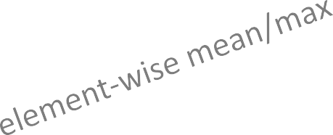
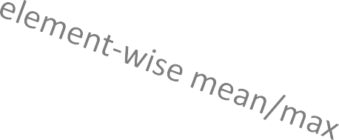
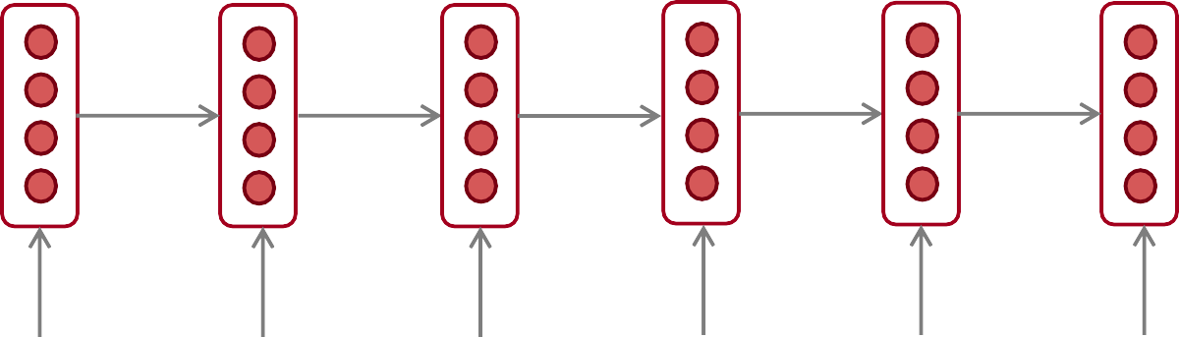
Bidirectional RNNs (1)
They "read" input from left to right and right to left
Why?
positive
Hidden state for "terribly" only encodes text from the left, but text on right might be useful
Sentence encoding
the
movie
was
terribly
exciting
!

Slide 15
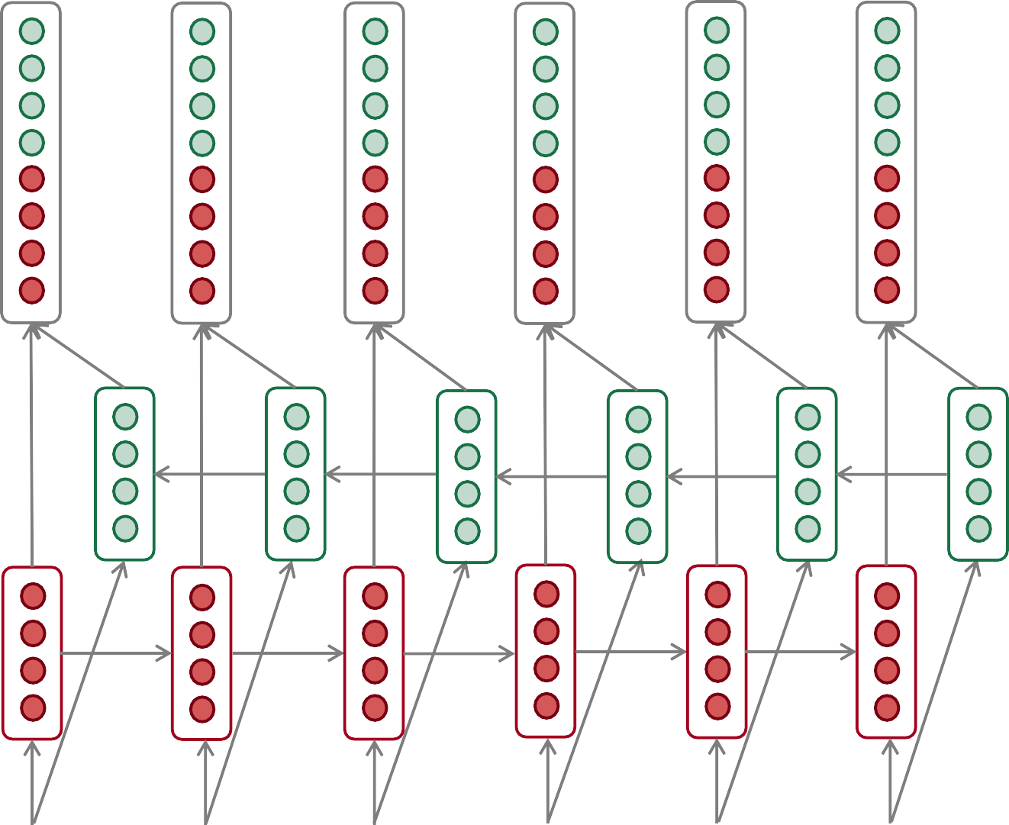
Bidirectional RNNs (2)
How?
Keep another hidden state for new direction: s^{(i)} = f(W_{e}e_{t} + W_{s}s_{t+1} + b_{s})
Concatenated hidden states
Backward RNN
Forward RNN
the
movie
was
terribly
exciting
!

Slide 16
Bidirectional RNNs (3)
Note that in previous slide, hidden states are concatenated to produce single representation of input sequence.
In practice, can aggregate them in any way, e.g. element-wise addition
How do we produce an output with the resulting hidden state?
That depends on what we need for our task
E.g. for sequence classification

Slide 17
Summary: RNNs
They are: designed to represent sequences
Either a representation for each step in sequence, or for entire sequence
They are: deep in time
Hidden state at time step t encodes sequence until t
Shared parameters across time steps
Thus, hidden states act as model memory
They are: flexible/expressive
Sequence labeling: one output per time step
Sequence classification: one output for each sequence
They can be: bidirectional
Encode sequences based on previous and subsequent steps
Main advantage for language modeling
Can encode infinitely long sequences
In practice, difficult to encode long sequences (more later)

Slide 18
Training RNNs

Slide 19
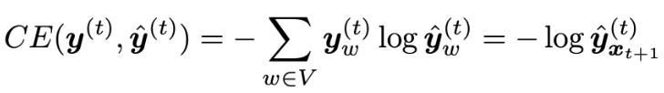
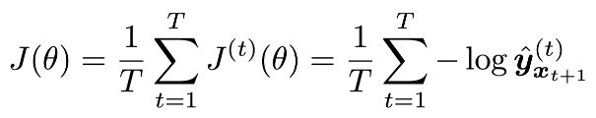
Training RNNs (1)
As with other deep networks in NLP: self-supervision + backprop
However, RNNs are deep in time
h_{t} = f(Wx_{t} + Uh_{t-1})
That is, we produce representation for different sequence at each time step
Thus, we can compute a loss value at each time step!
Specifically, the cross-entropy at time step t is given by:
where y^{(t)} is probability of true next word at time step t, and ŷ^{(t)} is predicted
probability for that next word
We then average these losses over entire input/batch/corpus, denoted T

Slide 20




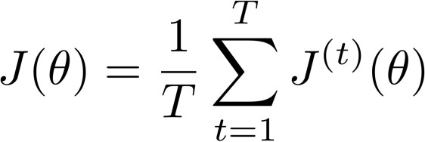








Training RNNs (2)
Visually:
Loss
+
+
+
+ … =
Predictions
…
Corpus
the
students
opened
their
…

Slide 21
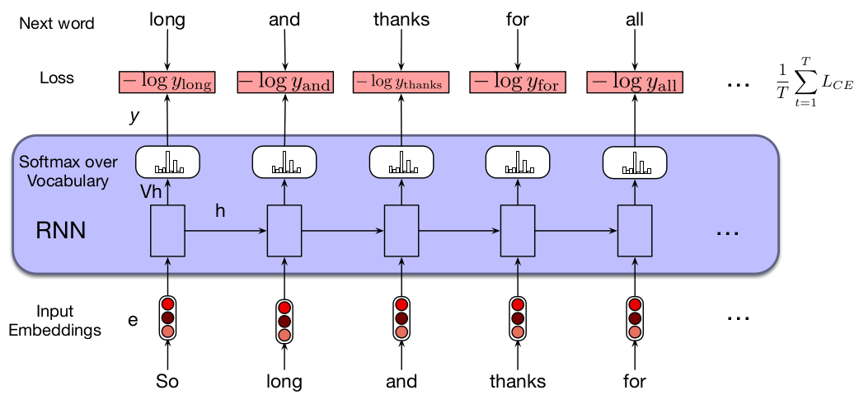
Training RNNs (3)
What is the correct/target word at each time step?
We have this thanks to self-supervision
This is known as teacher forcing: feed model true next word from history
This in contrast to using word previously predicted by model
That is what's done for text generation (more in later tutorials/lectures)

Slide 22
Weight Tying
Take a standard RNN:
x_{i} ∈ R^{|V|} is one-hot vector of word i
e^{(i)} = Ex^{(i)} are word embeddings where E ∈ R^{|V| x d}
h^{(i)} = f(W_{e}e^{(i)} + W_{h}h^{(i-1)} + b_{h}) is hidden state at time step i
y^{(i)} = softmax(Uh^{(i)} + b_{y}) ∈ R^{|V|} is output probability vector
Note that E and U are of the same size: R^{|V| x d} where d is embedding size
Weight tying (Press et al. 2016, Inan et al. 2016)
Have E and U be the same matrix (parameters shared for different roles)
I.e., same set of parameters are used both as word embeddings and for
projection to final vocabulary space
This was observed to improve LM performance
Added benefit: number of parameters considerably reduced
Remember |V| is usually in the tens to hundreds of thousands
Thus, this is commonly done (but not always)

Slide 23
The Challenge of Long-term Memory
Let's have a look at a high-level example for some intuition
Take the following sentence:
Daniel was the one who told us about the greatness of Michael I. Jordan.
Imagine an RNN encodes this sentence in its final hidden state h_{t}
I.e. h_{t} is the representation of the sentence
Ideally, h_{t} encodes enough information about the sentence to answer a variety of questions
Who told you about Michael I. Jordan?
How does Daniel feel about Michael I. Jordan?
Note the distance in time between Michael I. Jordan and Daniel.
At last time step, h_{t} has to "remember" Daniel was part of the sentence
Why can this be difficult?
The vanishing gradient problem, present in many deep models (including transformers), but nicely illustrated with RNNs (via Stanford slides)

Slide 24









Vanishing Gradient Intuition
Let J(θ) be our training objective
We need to do backpropagation through time
How do we compute the gradient of our objective w.r.t. h⁽¹⁾? I.e. what is the influence of h⁽¹⁾ on J(4)?

Slide 25
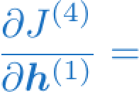
Vanishing Gradient Intuition
?

Slide 26
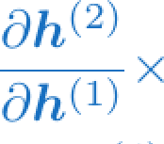
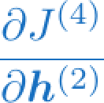
Vanishing Gradient Intuition
chain rule!

Slide 27
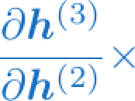
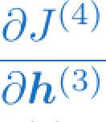
Vanishing Gradient Intuition
chain rule!

Slide 28
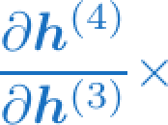
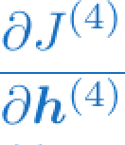
Vanishing Gradient Intuition
chain rule!

Slide 29
Vanishing Gradient Intuition
Recall: each operator has impact on gradient flow
If partial derivatives (in squares) are small, the gradient information gets increasingly small as we move backward through time
Solution?

Slide 30
Long Short-Term Memory (LSTM)
Most common unit to build RNNs (Hochreiter and Schmidhuber, 1997)
Though often "an LSTM" refers to an RNN with LSTM units
Designed to allow network be able to retain information from distant time steps
Divided this "context management" issue into two subproblems:
Removing information no longer needed from context
Adding information likely to be needed at later time steps
Importantly, LSTMs allow model to learn to manage context!
How?
They designed a new unit that is much more involved
It essentially includes a new (context) layer
It also includes new parameters, gated operations
It's a good example of how deep learning is about designing algebraic circuits for information flow

Slide 31

Intuition behind Gating Mechanisms
Suppose you were adding two quantities, a and b, but you wanted to control how much of b gets into the sum:
λ is a value between 0 and 1
We say λ acts as a “switch” or a “gate”, because it controls the amount of b that gets into the sum
If λ is learnable, a model can learn how much to "open the gate"

Slide 32
LSTM Components
Encodes RNN state at time step t in two vectors: c_{i}, h_{i}
c_{i} is new "context layer", h_{i} is hidden state as before
So input of LSTM unit at time step t is x_{t}, h_{t-1} and c_{t-1}
Introduces differentiable gating mechanisms: smooth functions that simulate logical gates
Forget gate: decides which parts of the context should be forgotten due to new input
Input/add gate: decides how much of the current input x_{i} should be written to the context vector c_{i} (to remember in future steps)
Output gate: decides which parts of the context vector should be copied to the current hidden state
Gate vectors are computed from current input x_{i} and previous state h_{i-1}
Let's look at this circuit in more detail

Slide 33
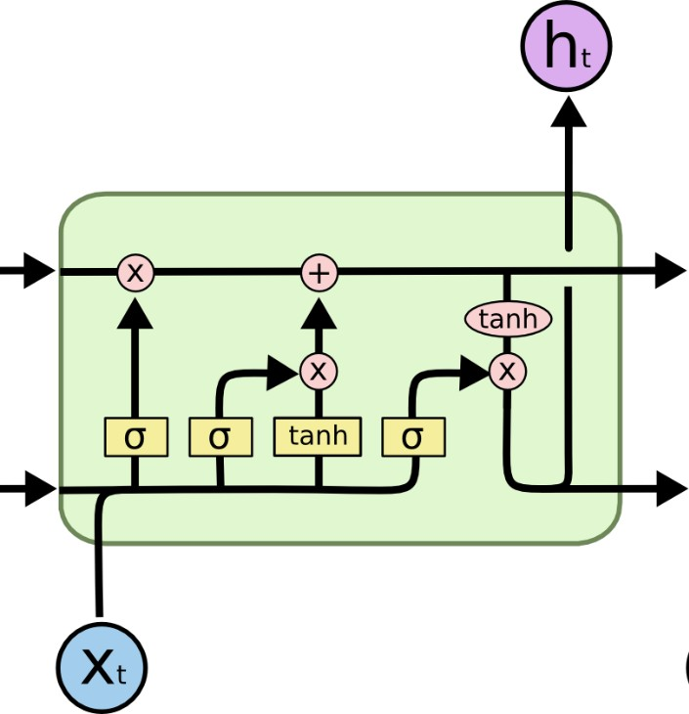
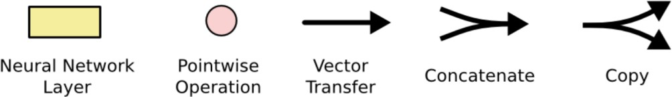
An LSTM Unit
Write some new cell content
Forget some
cell content
c_{t}
c_{t}
^{c}t-1
f
i_{t}
o_{t}
Output some cell content to the hidden state
Compute the forget gate
t
~_{c}
t
^{h}t-1
h_{t}
Compute the input gate
Compute the new cell content
Compute the output gate
/Add
Image source

Slide 34
Gates: Common Design Pattern
All gates consist of:
A linear layer
A sigmoid activation function
An element-wise (Hadamard) product with the layer being gated
The sigmoid function projects its inputs to the real interval [0, 1]
Combined with element-wise product, it acts as a soft binary mask
Values in the layer being gated that align with values near 1 in the mask are passed through nearly unchanged
Values aligned with components of the mask that are closer to zero corresponding are essentially erased

Slide 35
Forget Gate
Role: delete information from context that is no longer needed
How?
Mask f_{t} is created by adding up transformed versions of input and previous hidden step, then passed by a sigmoid function (W_{f}, U_{f} are parameters)
Mask is then multiplied element-wise by context vector c_{t-1} to remove the information that is no longer required from context

Slide 36
Input/Add Gate
First we need to compute our hidden state:
Goal of Add Gate: select information to add to current context
How?
Generate mask to select the information to add to the current context (W_{i}, U_{i} are parameters)
Add this to the modified context vector to get the new context vector

Slide 37
Output gate
Goal: select information to use from current hidden state
How?
As before, we create a mask to select information from the hidden state that is required for the current hidden state

Slide 38
Bringing It All Together
A super nice illustration of the operations!

Slide 39
Summary: Training RNNs
Backpropagation through time
Each time step depends on previous time steps
We can compute a loss value at each time step
We average losses over time
Then backpropagate w.r.t. different time steps, not different layers
Long-term memory is known to be a challenge
Illustrated by vanishing gradient problem
Addressed with different designs, e.g. LSTMs
LSTM: long short-term memory
Adds new context layer to RNNs
Designed based on gating mechanisms
Allows model to learn to use different context at each time step
Recently shown to achieve comparable performance when scaled to the size of LLMs

Slide 40
The Encoder-Decoder Architecture

Slide 41
So far...
LMs with fully-connected neural network
Sees entire input at same time, but limited to fixed maximum input size
Why? Model size (i.e. number of parameters) grows with input size
RNNs for various NLP tasks, e.g. token-level classification, LMs
Sees input one (time) step at a time, allows arbitrarily long input sequences
Shares parameters across time, so model size independent of input size
Hidden states encode sequence "seen so far"
In practice, difficult to "remember" what was seen long ago
Important aspect of architecture/tasks seen so far: fixed-size outputs
Token-level: for each input token, models produce corresponding output, e.g. labels, next word, etc.
Sequence-level: for entire input sequence, produce single output, e.g. spam or not
What about tasks where output must be sequence of arbitrary length?
Can we design an RNN for such a task?

Slide 42
Sequence-to-sequence Tasks
Machine translation
Input: J'aimerais apprendre le français un jour
Output: I would like to learn French one day
Summarization
Input: I asked Google Gemini to summarize the starting note from Google's CEO found in this article into a single sentence
Output: "The author believes the transition to AI is the most profound technological shift ever, with vast potential to improve lives and accelerate progress."
Dialogue Systems/Question Answering
Input: I then said to Gemini "That was nice! How did you learn to do that?"
Output: "I learn and improve in a few ways! Here are the key ones:
Massive Dataset Training: …
Deep Learning Algorithms: …
Feedback and Refinement: … "

Slide 43
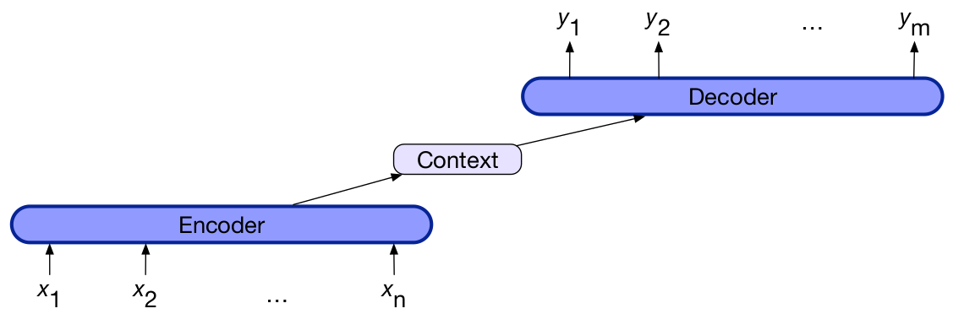
Sequence-to-sequence Models
Often abbreviated seq2seq
Input sequence and output sequence can have different lengths
Mapping between input and output tokens can be very indirect
Common architecture for seq2seq: encoder-decoder
Encoder: from input seq. to seq. of contextualized representations
Context vector: it is the vector that represents entire input sequence given sequence of contextualized representations
Decoder: given context vector, generates sequence of hidden states, from which corresponding sequence of output states can be obtained

Slide 44
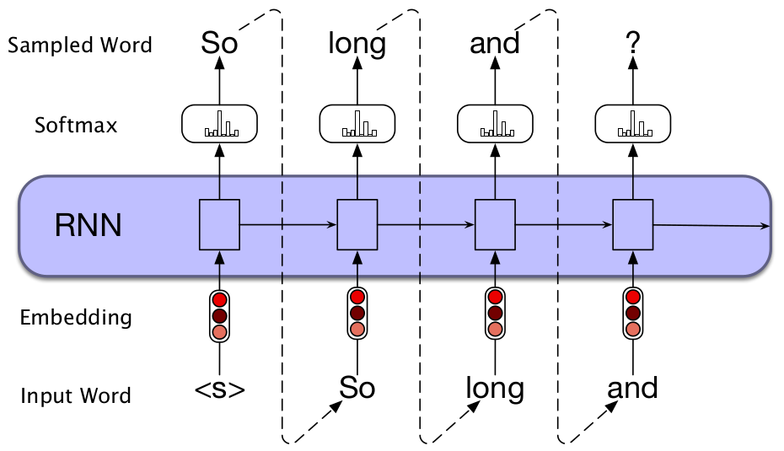
Text Generation with RNNs
To discuss seq2seq with RNNs, we first need to discuss text generation
The decoder part of a seq2seq model generates sequences (of tokens/text)
Autoregressive generation: generate sequence of tokens by repeatedly sampling the next token conditioned on previously predicted tokens
Can be broken down into three steps:
Sample word from model
(softmax) distribution
with start-of-sentence
token <s> as input
Use sampled word in
previous step as input,
sample next word as in
Step 1
Repeat Steps 1 and 2
until end-of-sentence token </s> is sampled.

Slide 45
seq2seq with RNNs (1)
Recall: hidden state h_{t} at time step t represents all t –1 steps seen so far
So, take sentence "So long and thanks for all the fish"
h₁ encodes "<s>", h₂ encodes "<s> so", h₃ encodes "<s> so long", etc.
Let's do machine translation, a common seq2seq task
Input: sequence of tokens in source language
Output: corresponding sequence of tokens in target language
How to train an RNN for machine translation (seq2seq task)?
Use a sentence separator token, commonly denoted by [SEP]
Concatenate input and target sequences, feed it to model
Let's see how this formatting of the machine translation task for RNNs looks like!

Slide 46
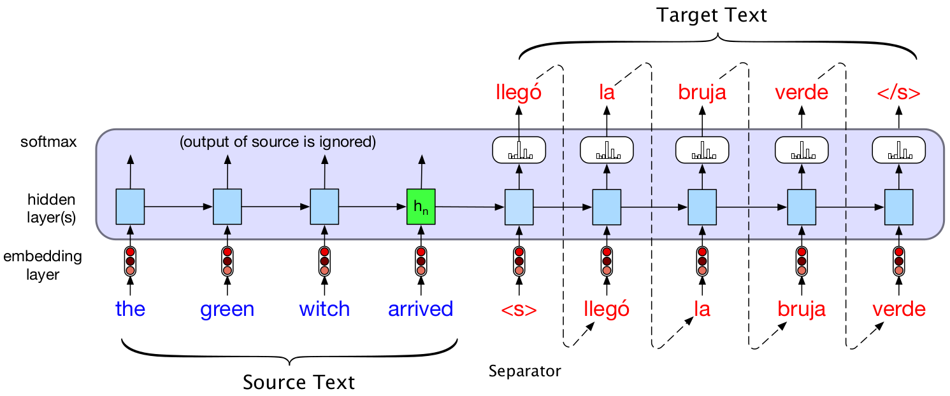
seq2seq with RNNs (2)
Note: we use a single RNN
<s> acts as sentence separator in image above
Must be different from other special tokens, e.g. start-of-sentence
Question: is this an encoder-decoder architecture?
Yes, h_{n} encodes entire input sequence, acts as context vector c
It is then fed as input to "rest of network", which acts as decoder
Special token <s> marks start of decoding, autoregressive generation

Slide 47
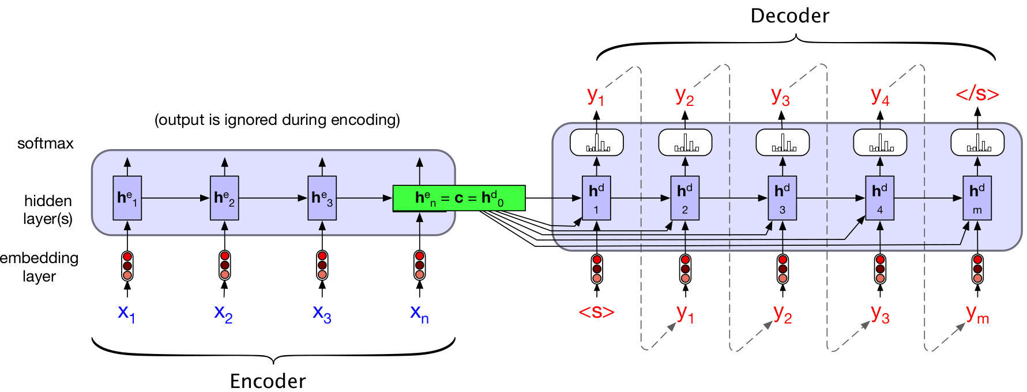
seq2seq with RNNs (3)
In more detail:
h^{e}_{t} denotes encoder hidden states at time step t, h^{d}_{t} decoder hidden states
Context vector c can be added to all decoder hidden states
That is: h^{d}_{t} = f(y_{t-1}, h^{d}_{t-1}, c)
In practice:
Stacked RNNs commonly used, encoder/decoder can be different networks
Encoder can be a biLSTM (bidirectional LSTM), reading input in both directions is useful for encoding, not possible for decoding

Slide 48
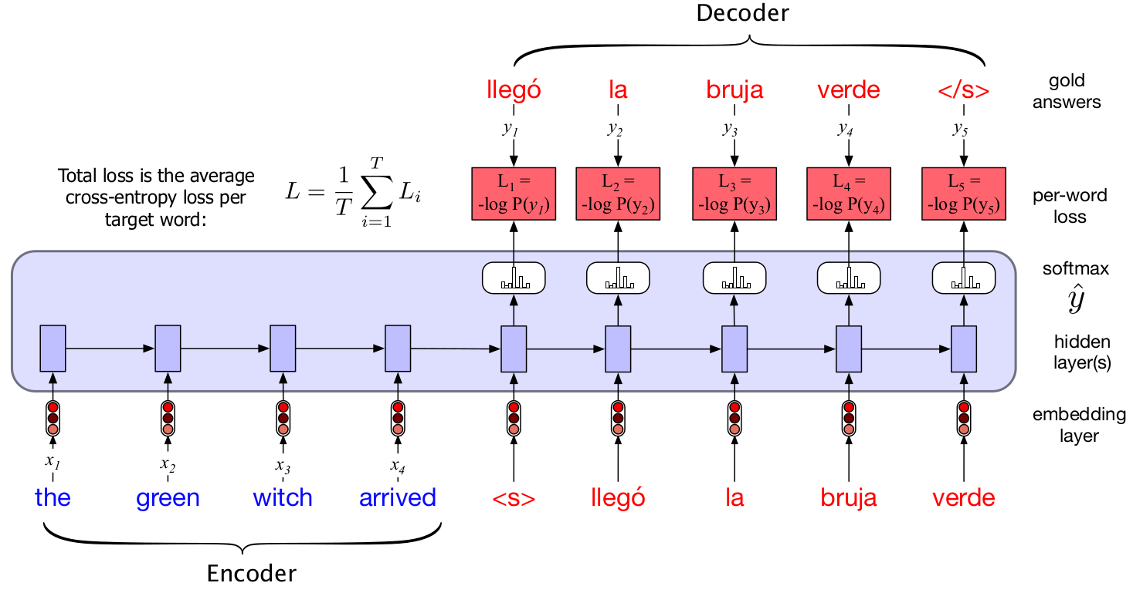
Training an Encoder-Decoder RNN
Examples: (source sequence, target sequence)
So, supervised, not just self-supervised
Training then as before, except:
We focus on average loss of target words (i.e. output must be correct)
We apply teacher forcing to train the decoder

Slide 49
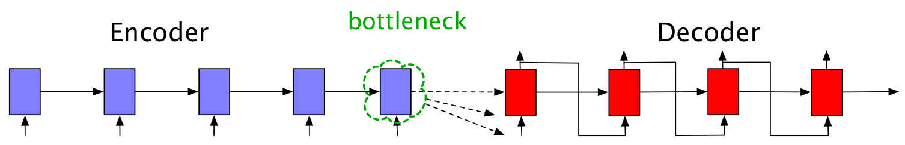
Limitations with Encoder-Decoder
Context vector c must encode entire input sequence
For a given architecture, c is of a given fixed size
But inputs can be of any length, c must encode them regardless
Hidden states are known to encode more of recent context than farther
Thus, c acts as a bottleneck
It can be shown that for some tasks/input length, c can't encode input well
The attention mechanism was designed to address this
Key to transformer architecture (next lecture)

Slide 50
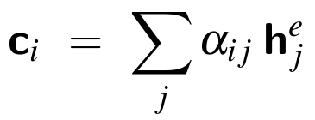
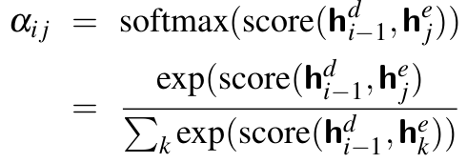
Attention
Question: why not allow decoder to access encoder hidden states directly? Would this be cheating in some way? No.
This would allow decoder to get information from all input time steps
Achieved by redefining context vector c, computing one per time step i
Formally, let c_{i} = f(h^{e}₁,…, h^{e}_{t,} h^{d}_{i-1}) be a function of all encoder hidden states h^{e}_{i} and decoder state at previous time step h^{d}_{i-1}
Most commonly, f is a weighted sum of encoder hidden states
Weights determine how much to "attend to" each hidden state
How we compute weights usually determines type of attention
Most common approach: dot-product attention
Attention scores: dot-product between encoder and decoder hidden state
Attention weights: normalized attention scores

Slide 51
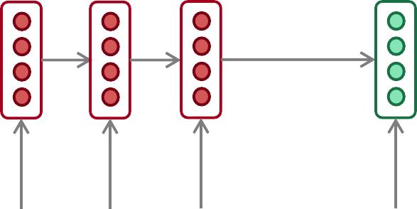
Encoder-decoder with Attention
dot product
Attention
scores
Decoder RNN
Encoder
RNN
il
a
m’ entarté
<START>
Source sentence (input)

Slide 52
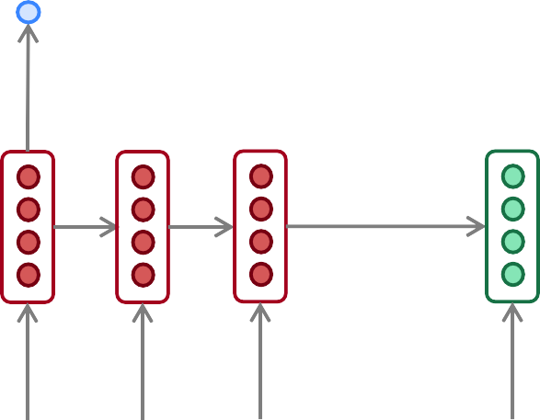
Encoder-decoder with Attention
dot product
Attention
scores
Decoder RNN
Encoder
RNN
il
a
m’ entarté
<START>
Source sentence (input)

Slide 53
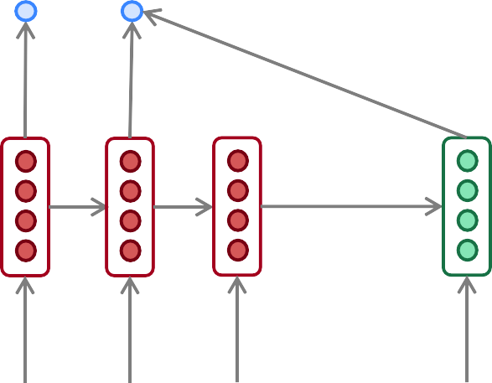
Encoder-decoder with Attention
dot product
Attention
scores
Decoder RNN
Encoder
RNN
il
a
m’ entarté
<START>
Source sentence (input)

Slide 54
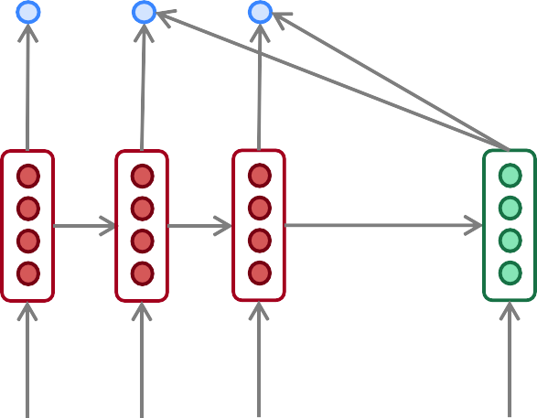
Encoder-decoder with Attention
dot product
Attention
scores
Decoder RNN
Encoder
RNN
il
a
m’ entarté
<START>
Source sentence (input)

Slide 55
Encoder-decoder with Attention
On this decoder timestep, we’re mostly focusing on the first encoder hidden state (”he”)
Attention
distribution
Take softmax to turn the scores into a probability distribution
Attention
scores
Decoder RNN
Encoder
RNN
il
a
m’ entarté
<START>
Source sentence (input)

Slide 56
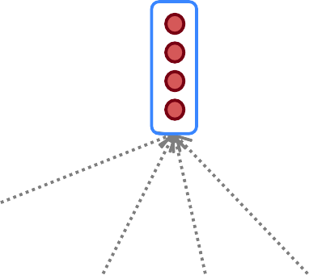
Encoder-decoder with Attention
Attention output
Use the attention distribution to take a weighted sum of the encoder hidden states.
The attention output mostly contains information from the hidden states that received high attention.
Attention
distribution
Attention
scores
Decoder RNN
Encoder
RNN
il
a
m’ entarté
<START>
Source sentence (input)

Slide 57
Encoder-decoder with Attention
Attention output
he
Concatenate attention output with decoder hidden state, then use to compute 𝑦₁ as before
Attention
distribution
𝑦₁
Attention
scores
Decoder RNN
Encoder
RNN
il
a
m’ entarté
<START>
Source sentence (input)

Slide 58
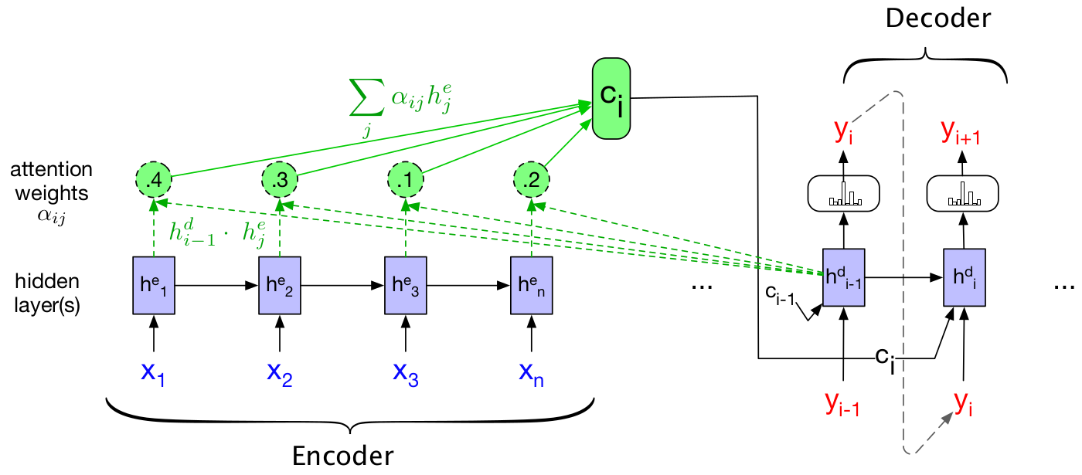
RNN Encoder-Decoder with Attention
In a single image:
Note that c_{i} is time dependent
That is, decoder can attend to different parts of input to generate different parts of the output text

Slide 59
Summary: Encoder-Decoders
Seq2seq: tasks where number of output units is variable
E.g. translation, summarization, etc.
Components
Encoder: encodes input into multiple vectors
Context vector: encodes input into single vector
Decoder: produces output states used to generate output sequence
Limitation
Context vector is fixed
Limited capacity to encode arbitrarily long sequences
Attention mechanism
Designed to bypass need to encode entire input sequence
Context vector at each time step based on linear combination of encoder hidden states
Fundamental component of transformer architecture (more in next lecture)

Slide 60

References
Speech and Language Processing, Jurafsky et al., 2024
Chapter 9
Natural Language Processing: A Machine Learning Perspective, Zhang et al, 2018
Chapter 14
Natural Language Processing, Eisenstein, 2018
Chapter 6, Section 3
Some images taken from Stanford's NLP course
https://web.stanford.edu/class/cs224n/slides/cs224n-2024-lecture05-rnnlm.pdf
This slide set is based on a previous version of this lecture created by Prof. Dr. Simone Ponzetto
© University of Mannheim

