Slide 1
Telephony
Module 7

Slide 2
Learning Outcomes
1.Determine the scope of an App.
2.Explain wireless connectivity and Mobile Apps.
3.Evaluate Android Telephony.

Slide 3
Telepony
a term used to describe the technology that allows people to make and receive phone calls over the internet.
Notes:
It is a branch of communication engineering that deals with the transmission of voice and other signals by electronic means. Telephony can be divided into two types: fixed and mobile. Fixed telephony refers to the traditional landline phones that are connected by wires. Mobile telephony refers to the wireless phones that use cellular networks or satellite systems. Telephony enables people to communicate with each other across long distances and different locations.
These are some of the topics that are covered in different courses or modules related to Android app development and telephony.

Slide 4
Deciding Scope of an App
The Objectives
The deliverables
The milestones
The resources
The stakeholders
Notes:
Deciding the scope of an app is an important step in the app development process. It helps you to clarify the purpose, features, and requirements of your app, as well as the expectations and constraints of your project. A well-defined scope can help you to avoid scope creep, which is the tendency of adding more and more features or changes to the app that were not originally planned. Scope creep can result in increased costs, delays, and risks for your app project. The objectives: What are the main goals and benefits of your app? What problem are you trying to solve or what value are you trying to provide? How will you measure the success of your app?
The deliverables: What are the specific outputs or outcomes of your app? What features and functionalities will your app offer to the users? How will you ensure the quality and usability of your app?
The milestones: What are the key stages or phases of your app development process? What are the tasks and activities involved in each stage? How will you track and report the progress of your app?
The resources: What are the budget, time, and human resources available for your app project? How will you allocate and manage them efficiently and effectively? What are the potential risks and challenges that might affect your app project?
The stakeholders: Who are the people involved in or affected by your app project? What are their roles and responsibilities? How will you communicate and collaborate with them throughout the app project?
You can use various tools and techniques to help you determine the scope of your app, such as brainstorming, interviews, surveys, user personas, user stories, scope statements, work breakdown structures, and scope baselines. You can also refer to some online resources that provide more guidance and examples on how to write a project scope for an app

Slide 5
Wireless Connectivity and Mobile Apps
Wireless connectivity can refer to the various protocols and standards that allow devices to connect to the internet or to each other, such as Wi-Fi, Bluetooth, cellular, NFC, and others.
Mobile apps are software applications that are designed to run on mobile devices, such as smartphones and tablets, and can use wireless connectivity to access online services, interact with other devices, or perform various functions.
Notes:
Wireless connectivity and mobile apps are two related topics that involve the use of wireless technologies to enable communication and data exchange between devices.

Slide 6
Example of wireless connectivity and Mobile Apps
Wi-Fi Apps
Bluetooth Apps
Cellular Apps
NFC apps
Notes:
Wi-Fi apps: These are apps that can scan, analyze, or manage Wi-Fi networks and access points. For example, NetSpot for Android¹ is a free app that can help you discover networks, find weak spots and dead zones, and measure signal strength and speed. WiFi Analyzer² is an open-source app that can help you optimize your Wi-Fi network by showing the best channels and frequencies to use.
Bluetooth apps: These are apps that can use Bluetooth to pair, control, or share data with other devices. For example, Bluetooth File Transfer is an app that can help you browse, explore, and manage files on any Bluetooth-enabled device. Bluetooth Audio is an app that can help you stream high-fidelity audio from your phone to any Bluetooth speaker or headset.
Cellular apps: These are apps that can use cellular networks to make calls, send messages, or access the internet. For example, WhatsApp is an app that can help you make voice and video calls, send text and media messages, and chat with groups over the internet. SpeedTest by Ookla³ is an app that can help you measure your internet connection speed and performance.
NFC apps: These are apps that can use NFC to communicate with other devices or tags within a short range. For example, NFC Tools is an app that can help you read, write, and program NFC tags. Google Pay is a

Slide 7
Android Telephony
Telephony is an umbrella term used to describe nearly everything relating to communication with a cellular network.
Notes:
Android Telephony framework provides us the functionalities of the mobile. It gives us information about functionalities like calls, SMS, MMS, network, data services, IMEI number, and so on.

Slide 8
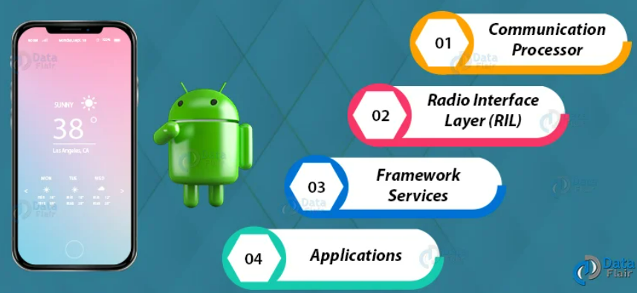
Architecture of Android Telephony
Notes:
Android Telephony architecture works in 4 layers that are :
Communication Processor
Radio Interface Layer (RIL)
Framework Services
Applications

Slide 9
Communication Processor
It is an input/output processor to distribute and collect data from a number of remote terminals.
Notes:
It is a specialized processor designed to communicate with the data communication network.

Slide 10
Radio Interface Layer
It is a bridge between the hardware and Android phone framework services. It has two main components that are:
RIL Daemon– It starts when the android system starts. It reads the system properties to find a library that is to be used for Vendor RIL.
Vendor RIL– It is also known as RIL Driver. It can be understood as a library that is specific to each modem.

Slide 11
Framework Services
The telephony Framework starts and initializes along with the system. All the queries by Application API are directed to RIL using these services.

Slide 12
Application
These are the Application UI related to telephony such as Dialer, SMS, MMS, Call tracker, etc. These applications start with the android system boot up. These are tied with framework services of telephony.
Android Telephony Framework consists of two types of packages that are:
1. Internal Telephony Packages: This is generally the used for default telephony app.apk.
2. Open Technology Packages: This is for third-party apps.

Slide 13
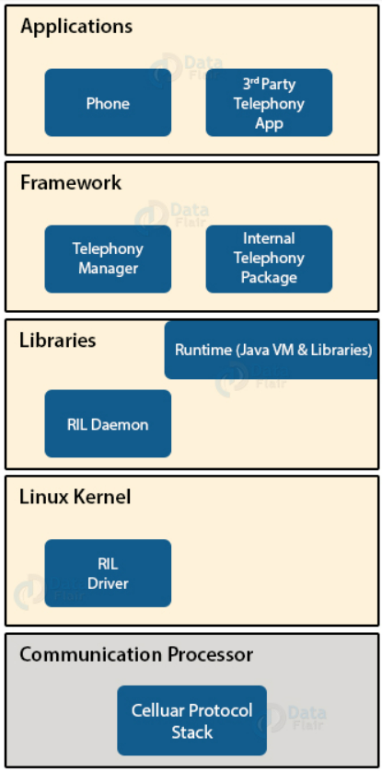
Android Telephony Framework

Slide 14
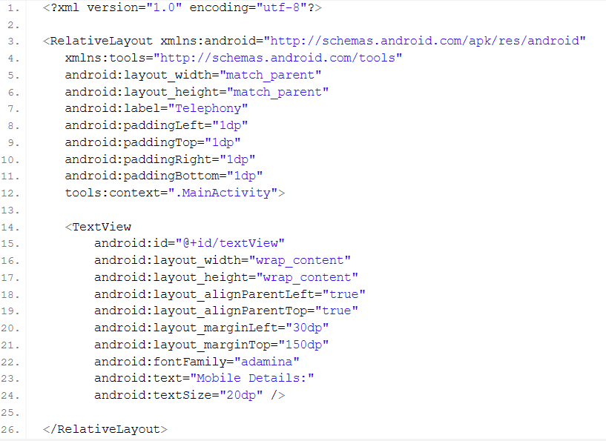

Slide 15
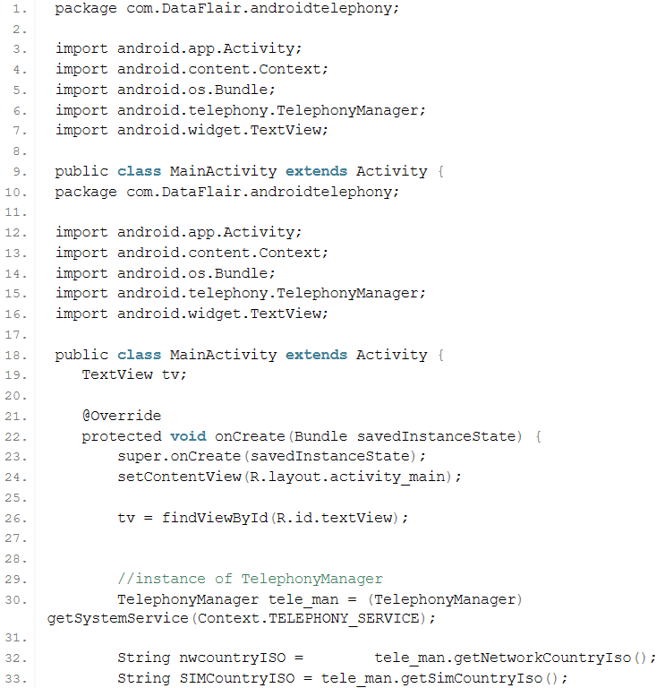

Slide 16
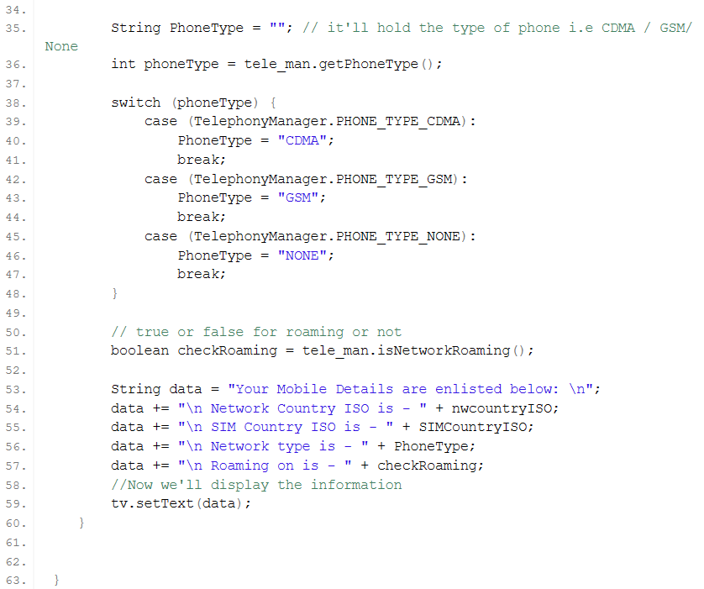

Slide 17
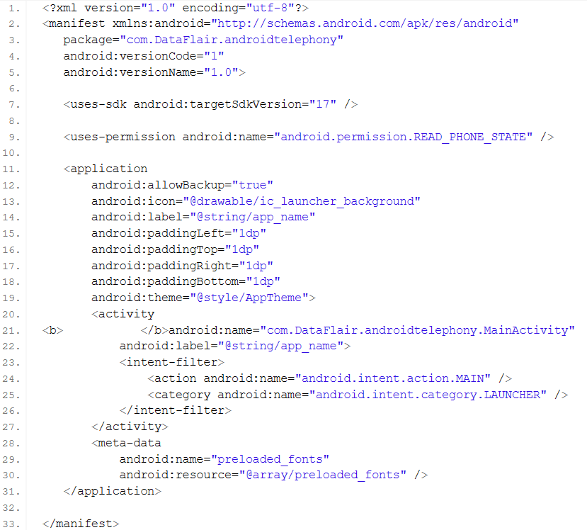

Slide 18
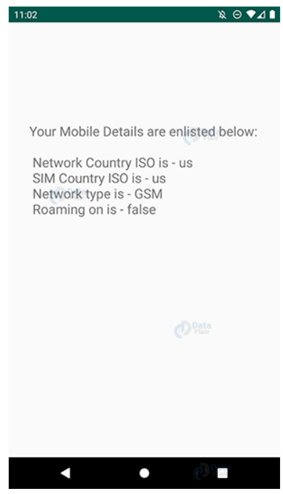
Output

Slide 19
Activity

