Slide 1
ChainSDK

Slide 2
区块链发展
区块链1.0 BTC
区块链2.0 ETH
区块链3.0 商用Killer App
区块链2.0的问题：
tps
难于开发调试
共享公链：价值波动，性能隔离
一链一应用

Slide 3
准备知识
BTC白皮书
ETH白皮书
Solidity文档
EOS/BTS白皮书（DPOS)
数据库系统
p2p协议

Slide 4
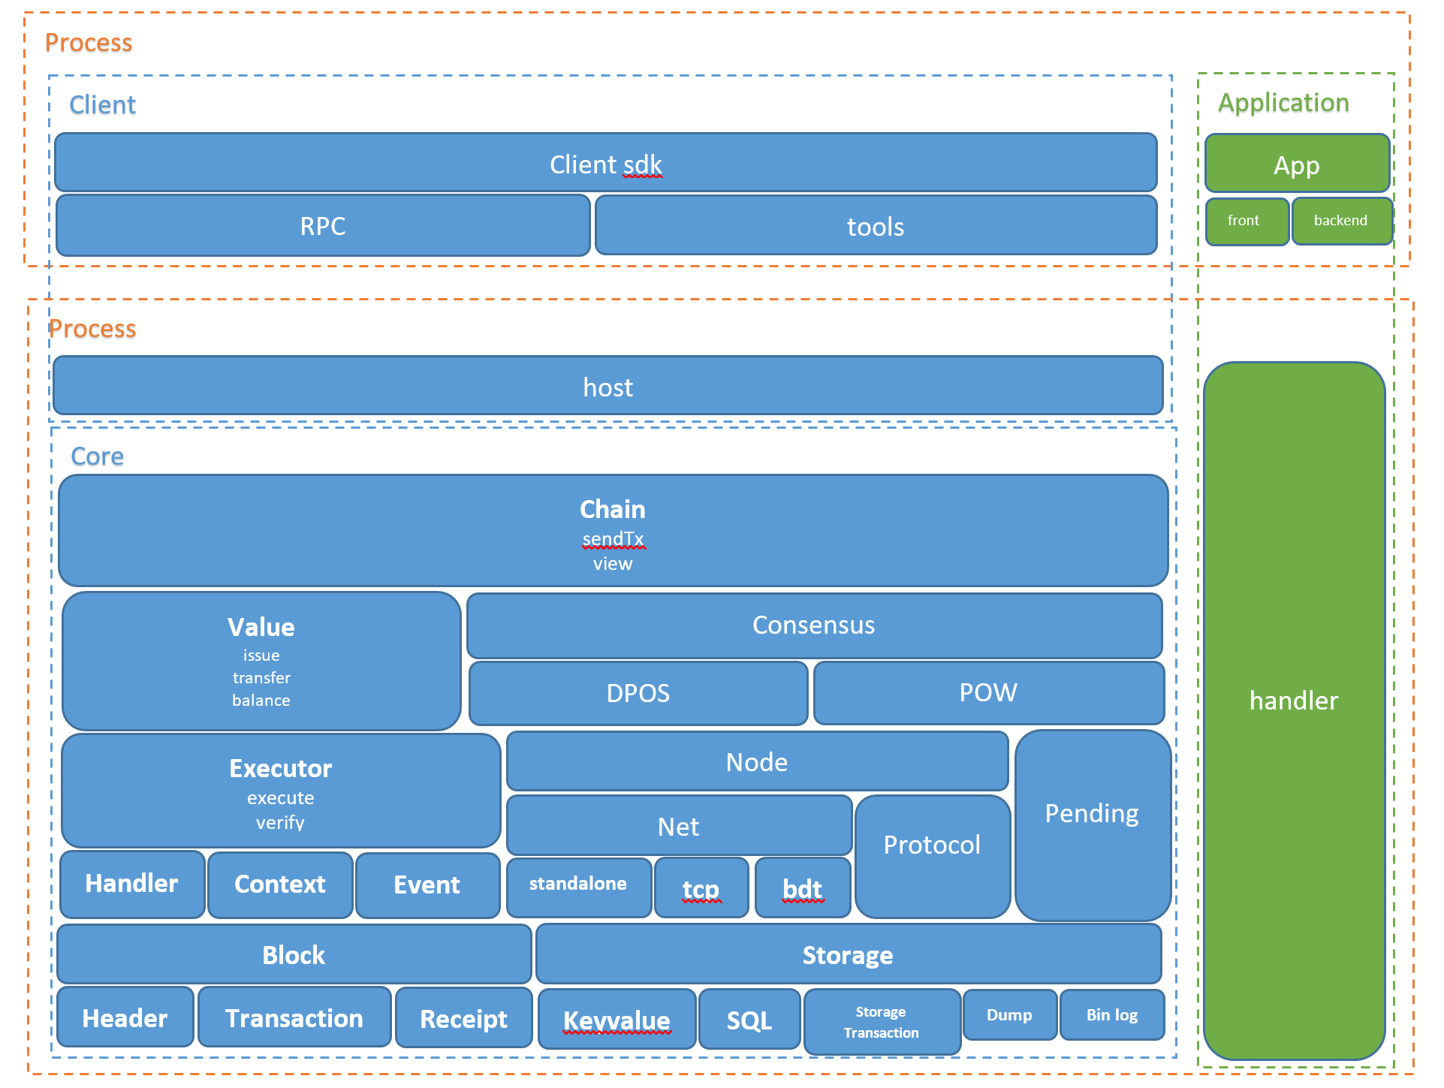
整体结构

Slide 5
App结构：Coin Demo
Contract
Create
Genesis
Miner
Peer
Wallet

Slide 6
Storage模块
KeyValue
Storage transaction
Snapshot
Redo Log
Snapshot View
Storage manager
Sqlite后端

Slide 7
Block模块
BlockHeader
number
timpstamp
preblockhash
transaction hash
receipt hash
storage hash
verify
扩展
BlockContent
transaction
receipt
扩展

Slide 8
Transaction模块
transaction
method
input
nonce
signature
扩展
receipt
return code
log

Slide 9
Pending模块
add
by nonce
by value
apply block

Slide 10
Executor模块
Handler
Tx listener
Event listener
View listener
Context
Block字段
Input
扩展
Execute
Verify

Slide 11
Node模块
Protocol同步协议
Version/version ack
Header request
Header response
Block Request
Block Response
雍塞控制
Net网络协议
Tcp
Bdt
节点管理
Inbound/outbound
Broadcast
Ban
节点发现

Slide 12
Chain
Chain
Header storage
Block storage
add transaction
View
Extend best
Get transaction/receipt
Miner
Create genesis
Create block

Slide 13
Consensus
Value
Pow
Dpos
扩展

Slide 14
Host
Host chain/miner
Rpc server
Command
扩展

Slide 15
Client sdk
Rpc client to host
Send transaction
View
get transaction/receipt
get block

