Slide 1
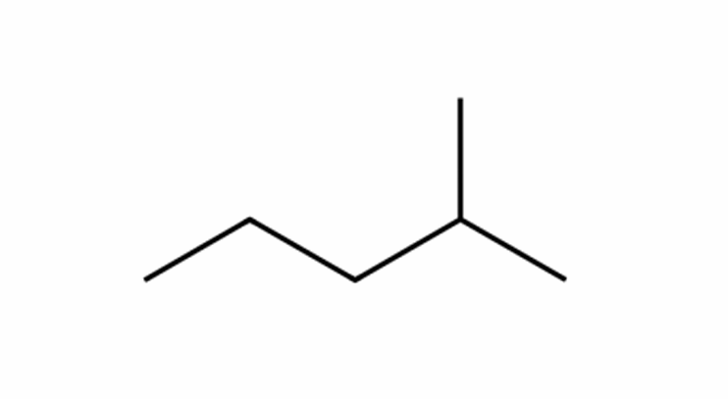
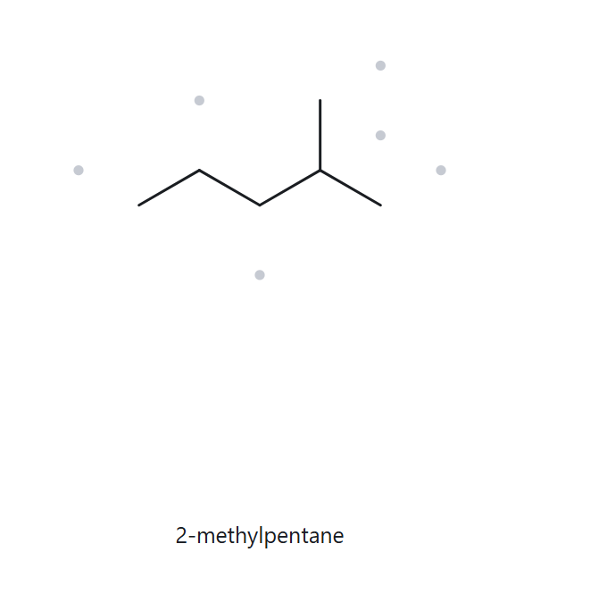

A01 · FOUNDATION · C₆H₁₄
  NUMBERED PARENT
  NAMING TRAIL
Parent: The longest continuous chain has 5 carbon atoms → pentane.
Numbering: Right to left gives 2; left to right gives 4. Choose 2 because it is the lower locant.
Substituents: One methyl group at carbon 2.
4
2
5
3
1
3 · MY NAME (WRITTEN FIRST)
4 · THE ALKANE CHECK
2-methylpentane
Match
parent confirmed lowest locants alphabetical order punctuation formula counted

Slide 2
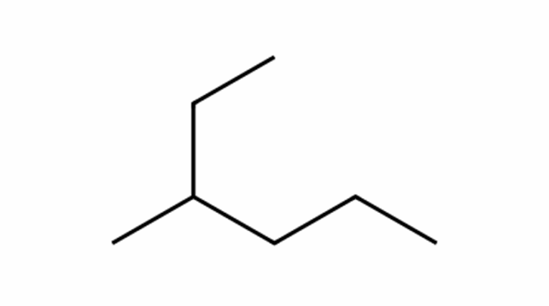
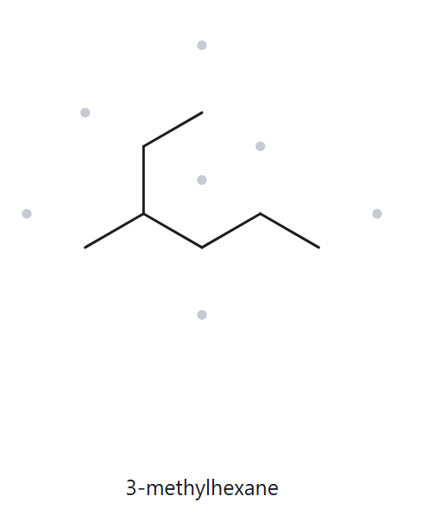
A02 · FOUNDATION · C₇H₁₆
  NUMBERED PARENT
  NAMING TRAIL
1
Parent: The longest continuous chain has 6 carbon atoms → hexane.
Numbering: Starting from the top end gives 3; starting from the right end gives 4. Choose 3 because it is the lower locant.
Substituents: One methyl group at carbon 3.
2
3
5
6
4
3 · MY NAME (WRITTEN FIRST)
4 · THE ALKANE CHECK
3-methylhexane
Match
parent confirmed lowest locants alphabetical order punctuation formula counted

Slide 3
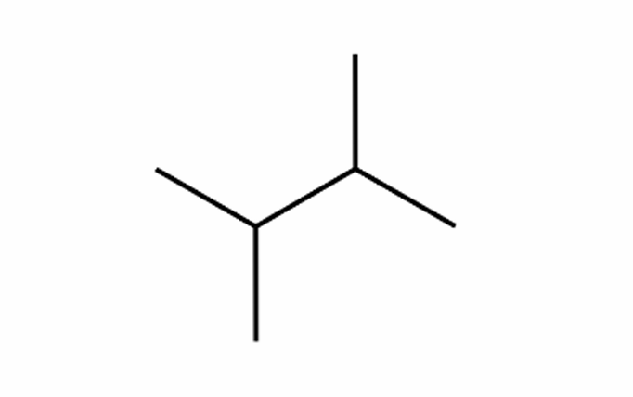
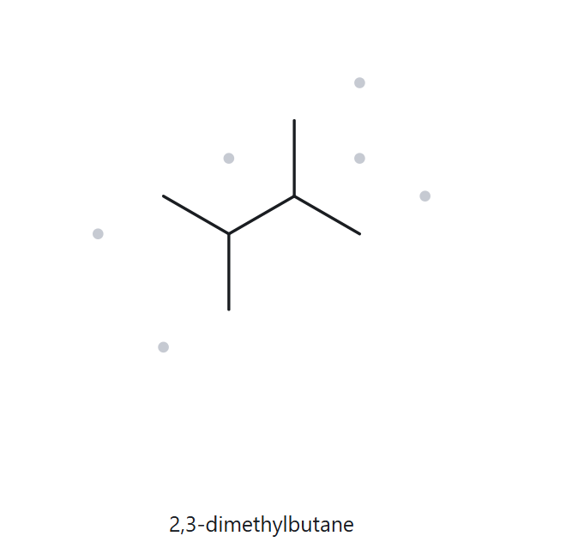
A03 · FOUNDATION · C₆H₁₄
  NUMBERED PARENT
  NAMING TRAIL
Parent: The longest continuous chain has 4 carbon atoms → butane.
Numbering: Both directions give 2,3, so either direction gives the same lowest locants.
Substituents: Two methyl groups at carbons 2 and 3 → 2,3-dimethyl.
1
3
2
4
3 · MY NAME (WRITTEN FIRST)
4 · THE ALKANE CHECK
2,3-dimethylbutane
Match
parent confirmed lowest locants alphabetical order punctuation formula counted

Slide 4
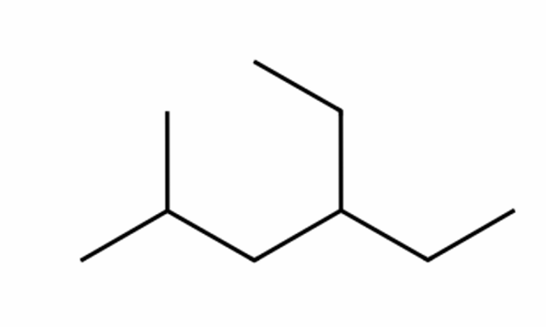
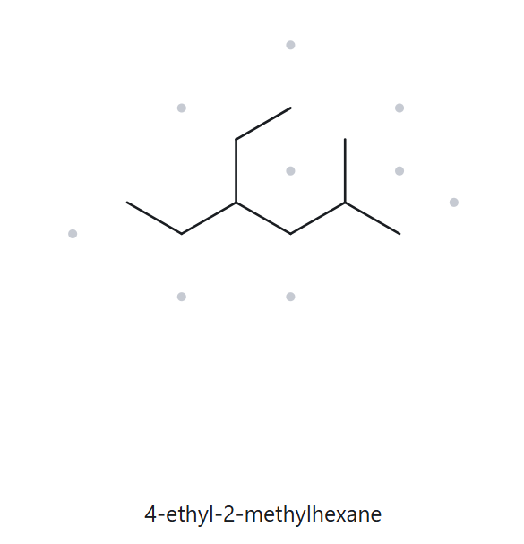
A04 · DEVELOPING · C₉H₂₀
  NUMBERED PARENT
  NAMING TRAIL
Parent: The longest continuous chain has 6 carbon atoms → hexane.
Numbering: Left to right gives 2,4; right to left gives 3,5. Choose 2,4 because 2 is lower than 3 at the first point of difference.
Substituents: Ethyl at carbon 4 and methyl at carbon 2. Cite ethyl before methyl in alphabetical order.
2
4
3
5
6
1
3 · MY NAME (WRITTEN FIRST)
4 · THE ALKANE CHECK
4-ethyl-2-methylhexane
Match
parent confirmed lowest locants alphabetical order punctuation formula counted

Slide 5
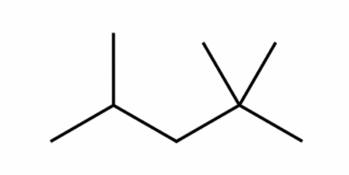
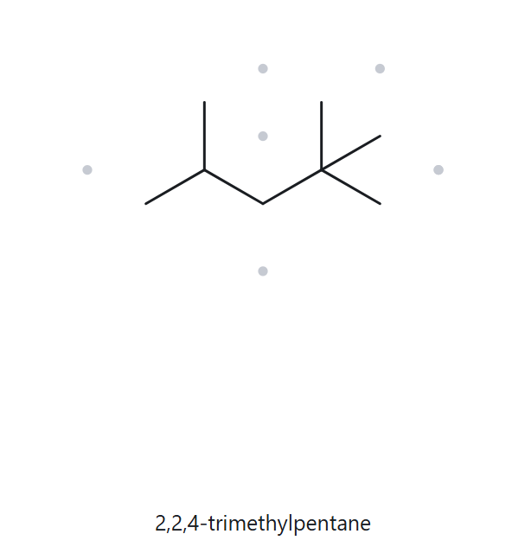
A05 · DEVELOPING · C₈H₁₈
  NUMBERED PARENT
  NAMING TRAIL
Parent: The longest continuous chain has 5 carbon atoms → pentane.
Numbering: Right to left gives 2,2,4; left to right gives 2,4,4. Choose 2,2,4 because the first locants tie, but the second locant 2 is lower than 4.
Substituents: Three methyl groups at carbons 2, 2 and 4 → 2,2,4-trimethyl.
4
2
5
3
1
3 · MY NAME (WRITTEN FIRST)
4 · THE ALKANE CHECK
2,2,4-trimethylpentane
Match
parent confirmed lowest locants alphabetical order punctuation formula counted

Slide 6
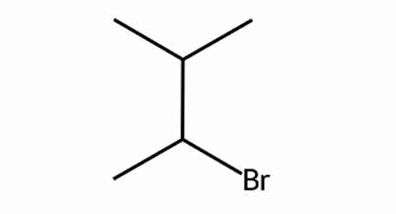
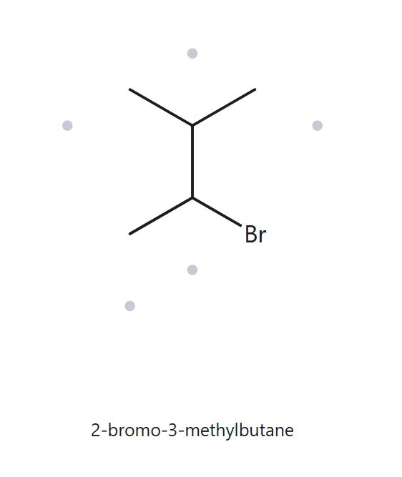
A06 · DEVELOPING · C₅H₁₁Br
  NUMBERED PARENT
  NAMING TRAIL
4
Parent: The longest continuous carbon chain has 4 carbon atoms → butane.
Numbering: Both directions give the locant set 2,3. Bromo comes before methyl alphabetically, so bromo receives the lower locant, 2.
Substituents: Bromo at carbon 2 and methyl at carbon 3, listed alphabetically.
3
2
1
3 · MY NAME (WRITTEN FIRST)
4 · THE ALKANE CHECK
2-bromo-3-methylbutane
Match
parent confirmed lowest locants alphabetical order punctuation formula counted

Slide 7
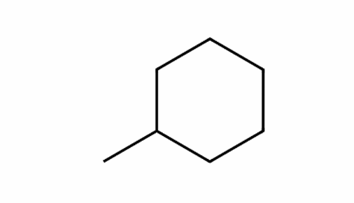
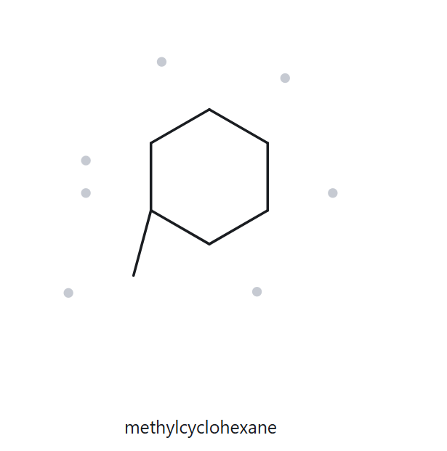
A07 · DEVELOPING · C₇H₁₄
  NUMBERED PARENT
  NAMING TRAIL
3
Parent: The parent is a 6-carbon ring → cyclohexane.
Numbering: Assign carbon 1 to the ring carbon bearing the methyl group. Either direction is equivalent. With only one substituent, the locant 1 is omitted from the name.
Substituents: One methyl group attached to the ring.
2
4
1
5
6
3 · MY NAME (WRITTEN FIRST)
4 · THE ALKANE CHECK
methylcyclohexane
Match
parent confirmed lowest locants alphabetical order punctuation formula counted

Slide 8
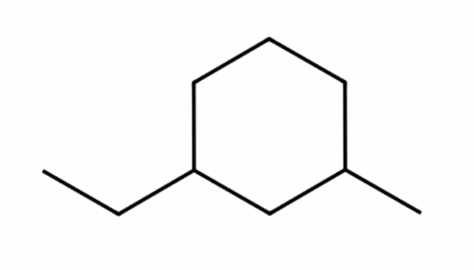
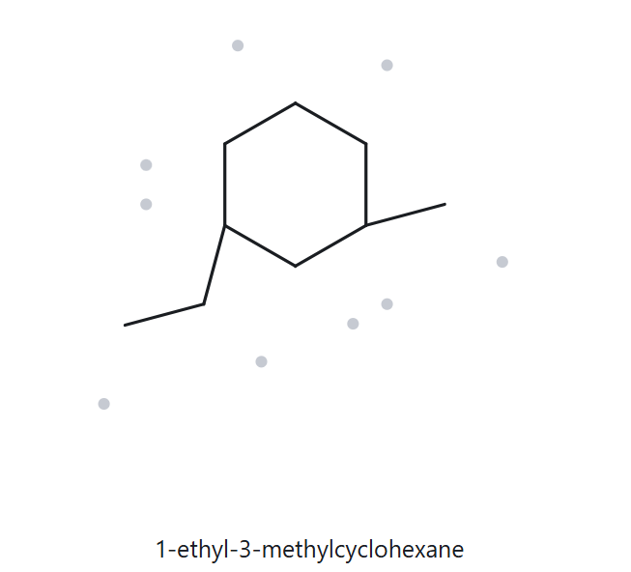
A08 · CHALLENGE · C₉H₁₈
  NUMBERED PARENT
  NAMING TRAIL
5
Parent: The parent is a 6-carbon ring → cyclohexane.
Numbering: Starting at the ethyl-bearing carbon gives 1,3 by the shorter route and 1,5 by the longer route. Choose 1,3. Starting at either substituent can give 1,3, so ethyl receives carbon 1 because it comes before methyl alphabetically.
Substituents: Ethyl at carbon 1 and methyl at carbon 3, listed alphabetically.
6
4
1
3
2
3 · MY NAME (WRITTEN FIRST)
4 · THE ALKANE CHECK
1-ethyl-3-methylcyclohexane
Match
parent confirmed lowest locants alphabetical order punctuation formula counted

Slide 9
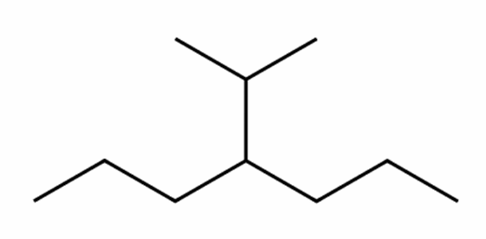
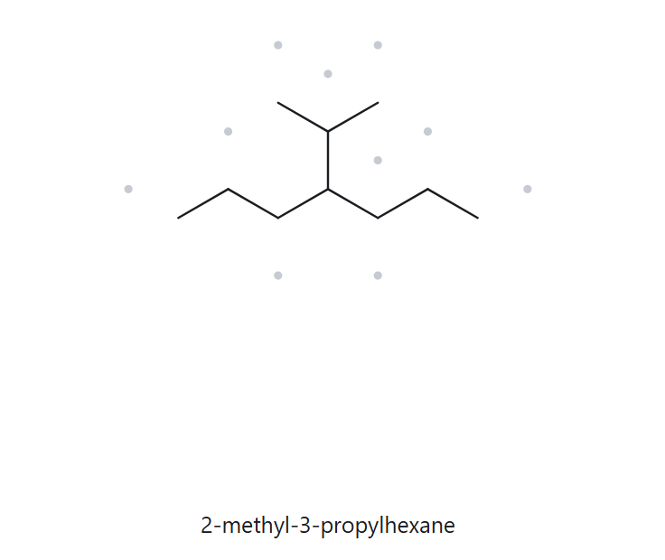
A09 · CHALLENGE · C₁₀H₂₂
  NUMBERED PARENT
  NAMING TRAIL
Parent: The longest continuous chain has 7 carbon atoms → heptane.
Numbering: Both directions place the substituent at carbon 4, so either direction gives the same locant.
Substituents: One isopropyl group at carbon 4. The group is attached through its middle carbon.
2
4
6
1
3
5
7
3 · MY NAME (WRITTEN FIRST)
4 · THE ALKANE CHECK
4-isopropylheptane
Mismatch
The correct name is 4-isopropylheptane. The longest continuous chain contains 7 carbon atoms, so the parent must be heptane. The tool incorrectly selected a 6-carbon parent chain.
parent confirmed lowest locants alphabetical order punctuation formula counted

Slide 10
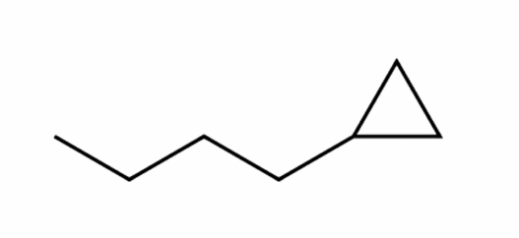
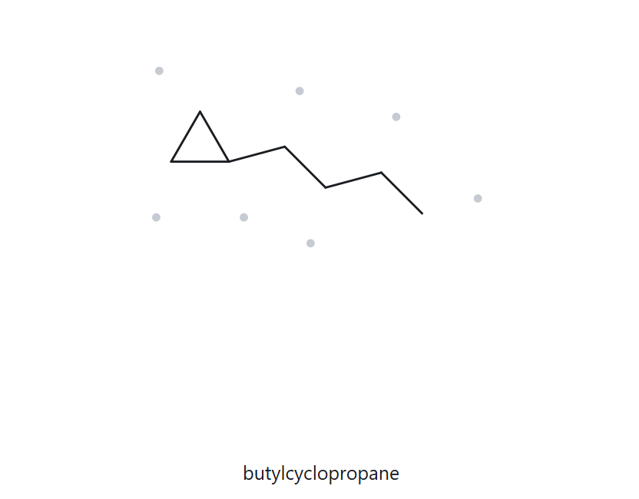
A10 · CHALLENGE · C₇H₁₄
  NUMBERED PARENT
  NAMING TRAIL
2
Parent: The parent is the 3-carbon ring → cyclopropane. Under the naming convention specified in this activity, the ring is the parent even though the attached chain has more carbons.
Numbering: Assign carbon 1 to the ring carbon bearing the butyl group. Either direction is equivalent. With only one substituent, the locant 1 is omitted from the name.
Substituents: One straight-chain butyl group attached to the ring.
1
3
3 · MY NAME (WRITTEN FIRST)
4 · THE ALKANE CHECK
butylcyclopropane
Match
parent confirmed lowest locants alphabetical order punctuation formula counted

Slide 11
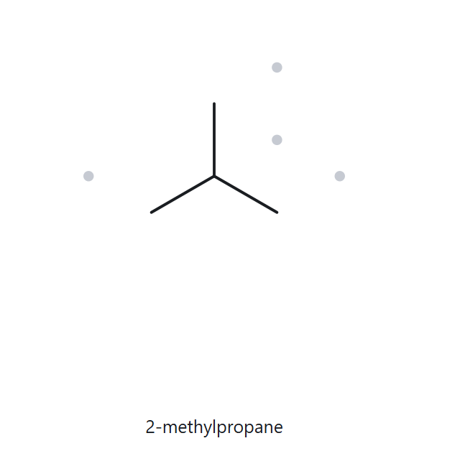
B01 · FOUNDATION · 2-methylpropane
  NAME DECODED
  BOND - LINE STRUCTURE
Parent: Propane → a 3 - carbon chain.
Substituent: One methyl group at carbon 2.
Expected formula: 3 + 1 = 4 carbons.
For an open-chain alkane, CₙH₂ₙ₊₂ → C₄H₁₀.
3. FORMULA CHECK
  BACK - CHECK
Counted from the drawing: C₄H₁₀
Open-chain alkane: CₙH₂ₙ₊₂
For n = 4: H = 2(4) + 2 = 10.
The counted and expected formulas agree.
Returned name: 2-methylpropane
Match - the returned name matches the given name.
Parent length matches Substituent positions match Formula agrees Back-check recorded

Slide 12
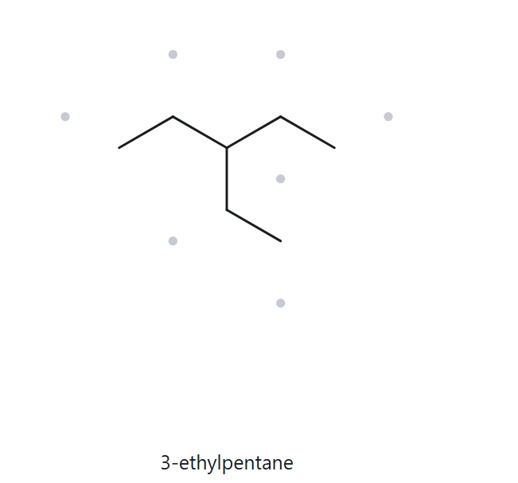
B02 · FOUNDATION · 3-ethylpentane
  NAME DECODED
  BOND - LINE STRUCTURE
Parent: Pentane → a 5-carbon chain.
Substituent: One ethyl group at carbon 3.
Expected formula: 5 + 2 = 7 carbons.
For an open-chain alkane, CₙH₂ₙ₊₂ → C₇H₁₆.
3. FORMULA CHECK
  BACK - CHECK
Counted from the drawing: C₇H₁₆
Open-chain alkane: CₙH₂ₙ₊₂
For n = 7: H = 2(7) + 2 = 16.
The counted and expected formulas agree.
Returned name: 3-ethylpentane
Match - the returned name matches the given name.
Parent length matches Substituent positions match Formula agrees Back-check recorded

Slide 13
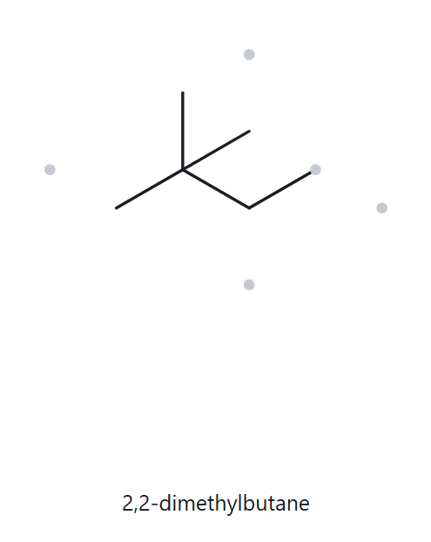
B03 · FOUNDATION · 2,2-dimethylbutane
  NAME DECODED
  BOND - LINE STRUCTURE
Parent: Butane → a 4-carbon chain.
Substituents: Two methyl groups, both at carbon 2.
Expected formula: 4 + 2 = 6 carbons.
For an open-chain alkane, CₙH₂ₙ₊₂ → C₆H₁₄.
3. FORMULA CHECK
  BACK - CHECK
Counted from the drawing: C₆H₁₄
Open-chain alkane: CₙH₂ₙ₊₂
For n = 6: H = 2(6) + 2 = 14.
The counted and expected formulas agree.
Returned name: 2,2-dimethylbutane
Match - the returned name matches the given name.
Parent length matches Substituent positions match Formula agrees Back-check recorded

Slide 14
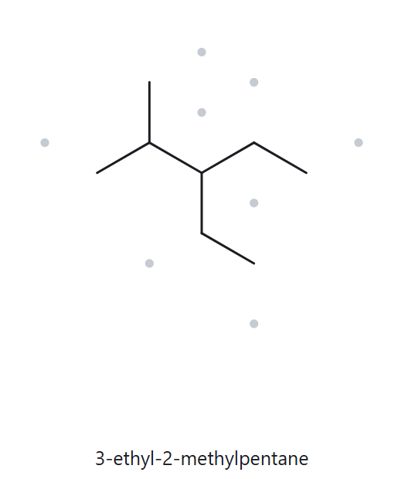
B04 · DEVELOPING · 3-ethyl-2-methylpentane
  NAME DECODED
  BOND - LINE STRUCTURE
Parent: Pentane → a 5-carbon chain.
Substituents: Ethyl at carbon 3 and methyl at carbon 2.
Expected formula: 5 + 2 + 1 = 8 carbons.
For an open-chain alkane, CₙH₂ₙ₊₂ → C₈H₁₈.
3. FORMULA CHECK
  BACK - CHECK
Counted from the drawing: C₈H₁₈
Open-chain alkane: CₙH₂ₙ₊₂
For n = 8: H = 2(8) + 2 = 18.
The counted and expected formulas agree.
Returned name: 3-ethyl-2-methylpentane
Match - the returned name matches the given name.
Parent length matches Substituent positions match Formula agrees Back-check recorded

Slide 15
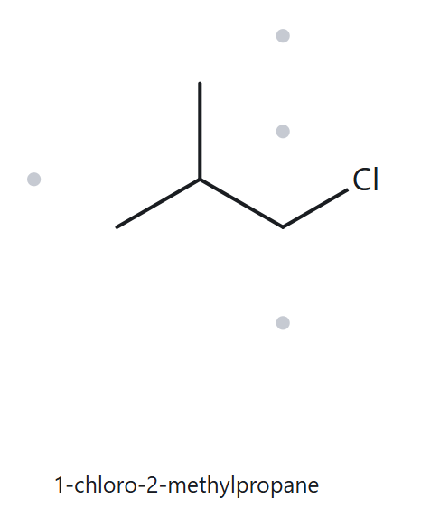
B05 · DEVELOPING · 1-chloro-2-methylpropane
  NAME DECODED
  BOND - LINE STRUCTURE
Parent: Propane → a 3-carbon chain.
Substituents: Chloro at carbon 1 and methyl at carbon 2.
Expected formula: 3 + 1 = 4 carbons.
The open-chain alkane formula is C₄H₁₀.
One Cl replaces one H → C₄H₉Cl.
3. FORMULA CHECK
  BACK - CHECK
Counted from the drawing: C₄H₉Cl
For n = 4: CₙH₂ₙ₊₂ → C₄H₁₀.
Replacing one H with Cl gives C₄H₉Cl.
The counted and expected formulas agree.
Returned name: 1-chloro-2-methylpropane
Match - the returned name matches the given name.
Parent length matches Substituent positions match Formula agrees Back-check recorded

Slide 16
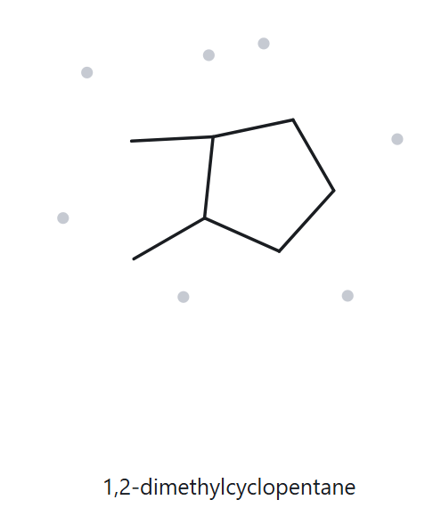
B06 · DEVELOPING · 1,2-dimethylcyclopentane
  NAME DECODED
  BOND - LINE STRUCTURE
Parent: Cyclopentane → a 5-carbon ring.
Substituents: Two methyl groups at carbons 1 and 2.
Expected formula: 5 + 2 = 7 carbons.
For a compound with one saturated ring, CₙH₂ₙ → C₇H₁₄.
3. FORMULA CHECK
  BACK - CHECK
Counted from the drawing: C₇H₁₄
One saturated ring: CₙH₂ₙ
For n = 7: H = 2(7) = 14.
The counted and expected formulas agree.
Returned name: 1,2-dimethylcyclopentane
Match - the returned name matches the given name.
Parent length matches Substituent positions match Formula agrees Back-check recorded

Slide 17
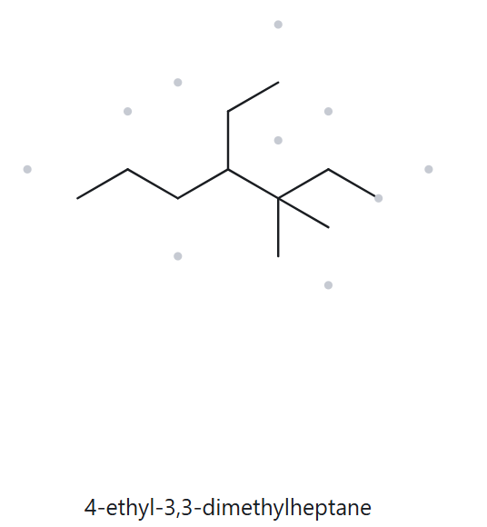
B07 · DEVELOPING · 4-ethyl-3,3-dimethylheptane
  NAME DECODED
  BOND - LINE STRUCTURE
Parent: Heptane → a 7-carbon chain.
Substituents: One ethyl group at carbon 4 and two methyl groups at carbon 3.
Expected formula: 7 + 2 + 2 = 11 carbons.
For an open-chain alkane, CₙH₂ₙ₊₂ → C₁₁H₂₄.
3. FORMULA CHECK
  BACK - CHECK
Counted from the drawing: C₁₁H₂₄
Open-chain alkane: CₙH₂ₙ₊₂
For n = 11: H = 2(11) + 2 = 24.
The counted and expected formulas agree.
Returned name: 4-ethyl-3,3-dimethylheptane
Match - the returned name matches the given name.
Parent length matches Substituent positions match Formula agrees Back-check recorded

Slide 18
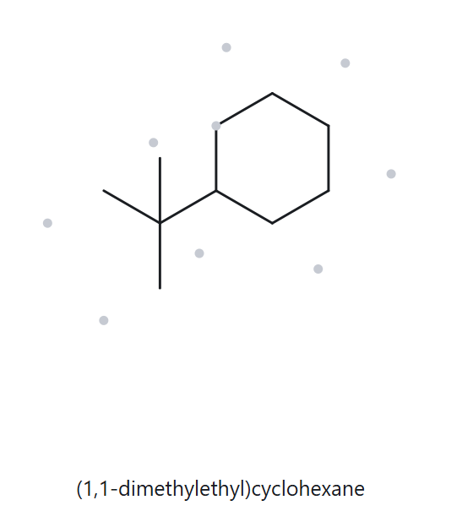
B08 · CHALLENGE · tert-butylcyclohexane
  NAME DECODED
  BOND - LINE STRUCTURE
Parent: Cyclohexane → a 6-carbon ring.
Substituent: One tert-butyl group, –C(CH₃)₃, attached to the ring through its central carbon.
Expected formula: 6 + 4 = 10 carbons.
For one saturated ring, CₙH₂ₙ → C₁₀H₂₀.
3. FORMULA CHECK
  BACK - CHECK
Counted from the drawing: C₁₀H₂₀
One saturated ring: CₙH₂ₙ
For n = 10: H = 2(10) = 20.
The counted and expected formulas agree.
Returned name: (1,1-dimethylethyl)cyclohexane
Equivalent match
The substituent names tert-butyl and (1,1-dimethylethyl) describe the same –C(CH₃)₃ group. Both names represent the same compound.
Parent length matches Substituent positions match Formula agrees Back-check recorded

Slide 19
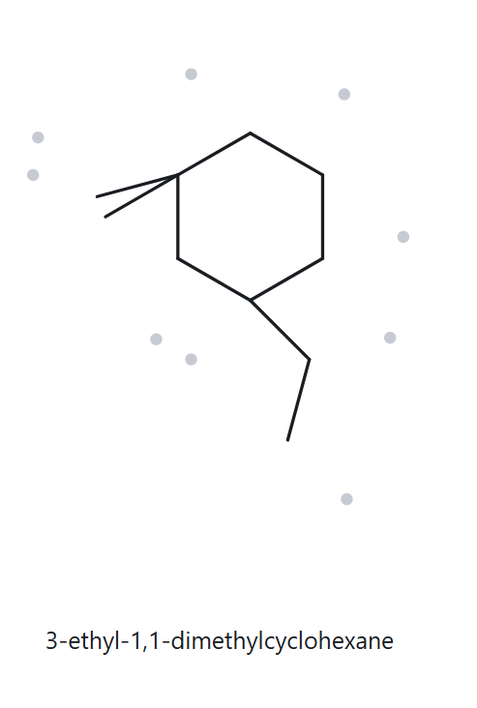
B09 · CHALLENGE · 3-ethyl-1,1-dimethylcyclohexane
  NAME DECODED
  BOND - LINE STRUCTURE
Parent: Cyclohexane → a 6-carbon ring.
Substituents: Two methyl groups at carbon 1 and one ethyl group at carbon 3.
Expected formula: 6 + 2 + 2 = 10 carbons.
For one saturated ring, CₙH₂ₙ → C₁₀H₂₀.
3. FORMULA CHECK
  BACK - CHECK
Counted from the drawing: C₁₀H₂₀
One saturated ring: CₙH₂ₙ
For n = 10: H = 2(10) = 20.
The counted and expected formulas agree.
Returned name: 3-ethyl-1,1-dimethylcyclohexane
Match - the returned name matches the given name.
Parent length matches Substituent positions match Formula agrees Back-check recorded

Slide 20
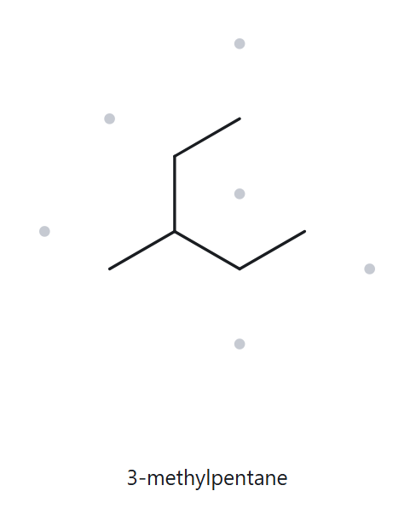
B10 · CHALLENGE · 2-ethylbutane
deliberately incorrect name
  NAME DECODED
  BOND - LINE STRUCTURE
As written: Butane → a 4-carbon chain, with an ethyl group at carbon 2.
Expected formula: 4 + 2 = 6 carbons.
For an open-chain alkane, CₙH₂ₙ₊₂ → C₆H₁₄.
3. FORMULA CHECK
  BACK - CHECK
Counted from the drawing: C₆H₁₄
Open-chain alkane: CₙH₂ₙ₊₂
For n = 6: H = 2(6) + 2 = 14.
The counted and expected formulas agree.
Returned name: 3-methylpentane
Mismatch - the given name is incorrect.
The given name 2-ethylbutane uses a 4-carbon parent even though the longest continuous chain has 5 carbon atoms. The correct parent is pentane, with a methyl group at carbon 3. Therefore, the correct name is 3-methylpentane.
Parent length matches Substituent positions match Formula agrees Back-check recorded

