Slide 1
Chapter 10
Computer Arithmetic
Notes:
We begin our examination of the processor with an overview of the arithmetic and
logic unit (ALU). The chapter then focuses on the most complex aspect of the ALU,
computer arithmetic. The logic functions that are part of the ALU are described in
Chapter 12, and implementations of simple logic and arithmetic functions in digital
logic are described in Chapter 11.
Computer arithmetic is commonly performed on two very different types of
numbers:
integer and floating point. In both cases, the representation chosen is a crucial
design issue and is treated first, followed by a discussion of arithmetic operations.
This chapter includes a number of examples, each of which is highlighted in a
shaded box.

Slide 2
Overflow
OVERFLOW RULE:
If two numbers are added, and they are both positive or both negative, then overflow occurs if and only if the result has the opposite sign.
Rule
Notes:
On any addition, the result may be larger than can be held in the word size
being used. This condition is called overflow. When overflow occurs, the ALU must
signal this fact so that no attempt is made to use the result.
Figures 10.3e and f show examples of overflow. Note that overflow can occur
whether or not there is a carry.

Slide 3
Subtraction
SUBTRACTION RULE:
To subtract one number (subtrahend) from another (minuend), take the twos complement (negation) of the subtrahend and add it
to the minuend.
Rule
Notes:
Subtraction rule.

Slide 4
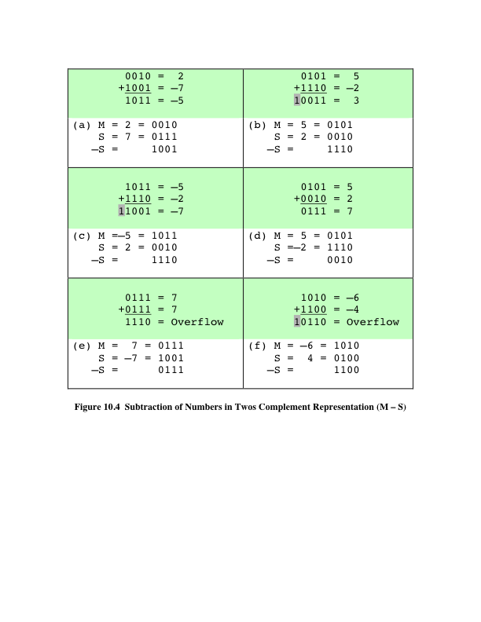
Subtraction
Notes:
Thus, subtraction is achieved using addition, as illustrated in Figure 10.4. The
last two examples demonstrate that the overflow rule still applies.

Slide 5
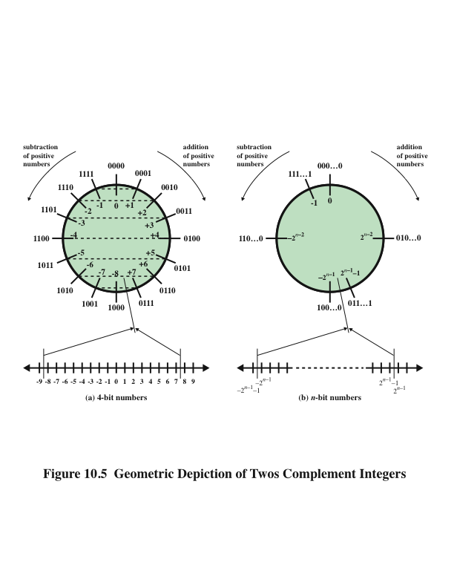
Geometric Depiction of Twos Complement Integers
Notes:
Some insight into twos complement addition and subtraction can be gained by
looking at a geometric depiction [BENH92], as shown in Figure 10.5. The circle in
the upper half of each part of the figure is formed by selecting the appropriate segment
of the number line and joining the endpoints. Note that when the numbers are
laid out on a circle, the twos complement of any number is horizontally opposite that
number (indicated by dashed horizontal lines). Starting at any number on the circle,
we can add positive k (or subtract negative k) to that number by moving k positions
clockwise, and we can subtract positive k (or add negative k) from that number by
moving k positions counterclockwise. If an arithmetic operation results in traversal
of the point where the endpoints are joined, an incorrect answer is given (overflow).

Slide 6
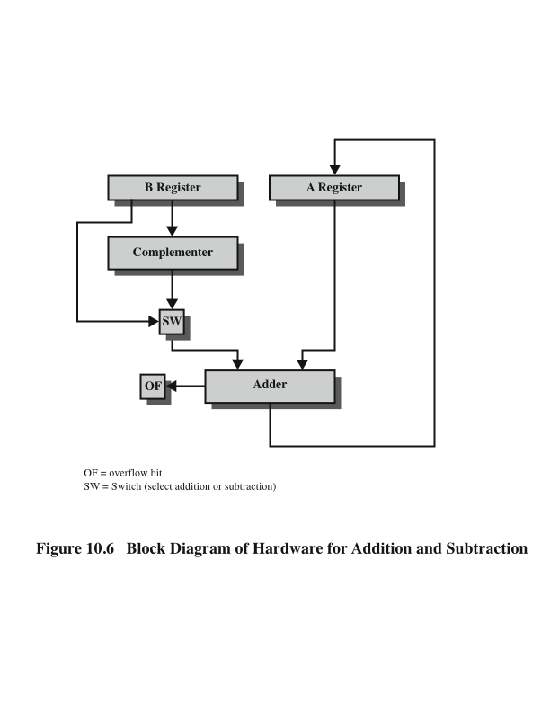
Hardware for Addition and Subtraction
Notes:
Figure 10.6 suggests the data paths and hardware elements needed to accomplish
addition and subtraction. The central element is a binary adder, which is presented
two numbers for addition and produces a sum and an overflow indication.
The binary adder treats the two numbers as unsigned integers. (A logic implementation
of an adder is given in Chapter 11.) For addition, the two numbers are
presented to the adder from two registers, designated in this case as A and B registers.
The result may be stored in one of these registers or in a third. The overflow
indication is stored in a 1-bit overflow flag (0 = no overflow; 1 = overflow). For
subtraction, the subtrahend (B register) is passed through a twos complementer
so that its twos complement is presented to the adder. Note that Figure 10.6 only
shows the data paths. Control signals are needed to control whether or not the complementer
is used, depending on whether the operation is addition or subtraction.

Slide 7
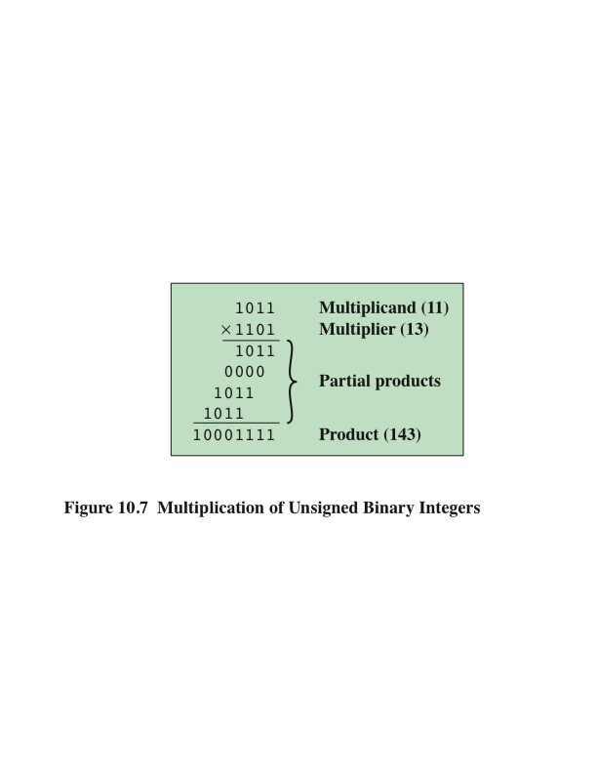
Multiplication
Notes:
Compared with addition and subtraction, multiplication is a complex operation,
whether performed in hardware or software. A wide variety of algorithms have been
used in various computers. The purpose of this subsection is to give the reader some
feel for the type of approach typically taken. We begin with the simpler problem of
multiplying two unsigned (nonnegative) integers, and then we look at one of the most
common techniques for multiplication of numbers in twos complement representation.
Figure 10.7 illustrates the multiplication of unsigned
binary integers, as might be carried out using paper and pencil. Several important
observations can be made:
1. Multiplication involves the generation of partial products, one for each digit in the
multiplier. These partial products are then summed to produce the final product.
2. The partial products are easily defined. When the multiplier bit is 0, the partial
product is 0. When the multiplier is 1, the partial product is the multiplicand.
3. The total product is produced by summing the partial products. For this operation,
each successive partial product is shifted one position to the left relative
to the preceding partial product.
4. The multiplication of two n-bit binary integers results in a product of up to 2n
bits in length (e.g., 11 * 11 = 1001).
Compared with the pencil-and-paper approach, there are several things we can
do to make computerized multiplication more efficient. First, we can perform a running
addition on the partial products rather than waiting until the end. This eliminates
the need for storage of all the partial products; fewer registers are needed. Second,
we can save some time on the generation of partial products. For each 1 on the multiplier,
an add and a shift operation are required; but for each 0, only a shift is required.

Slide 8
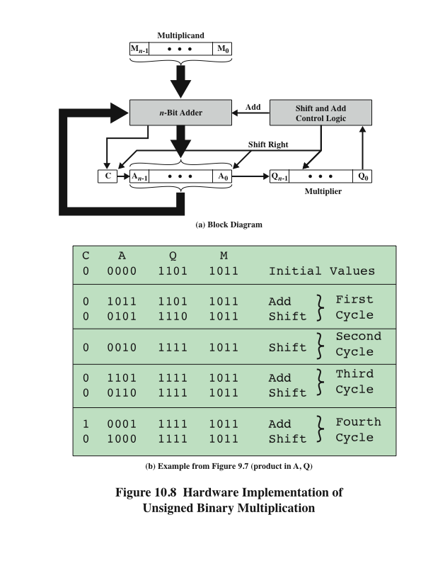
Hardware Implementation of Unsigned Binary Multiplication
Notes:
Figure 10.8a shows a possible implementation employing these measures. The
multiplier and multiplicand are loaded into two registers (Q and M). A third register,
the A register, is also needed and is initially set to 0. There is also a 1-bit C register,
initialized to 0, which holds a potential carry bit resulting from addition.

Slide 9
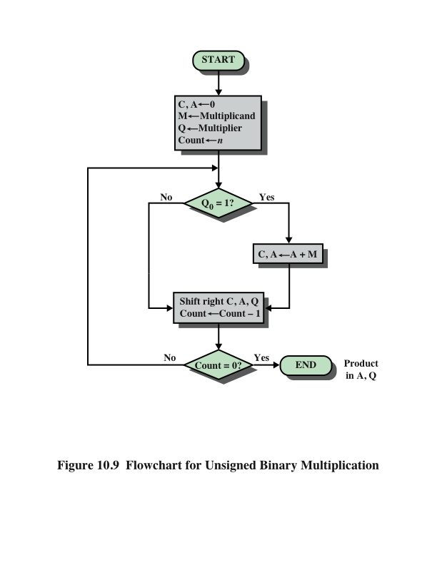
Flowchart for Unsigned Binary Multiplication
Notes:
The operation of the multiplier is as follows. Control logic reads the bits of the
multiplier one at a time. If Q₀ is 1, then the multiplicand is added to the A register
and the result is stored in the A register, with the C bit used for overflow. Then all
of the bits of the C, A, and Q registers are shifted to the right one bit, so that the C
bit goes into A_{n-1}, A₀ goes into Q_{n-1} and Q₀ is lost. If Q₀ is 0, then no addition is
performed, just the shift. This process is repeated for each bit of the original multiplier.
The resulting 2n-bit product is contained in the A and Q registers. A flowchart
of the operation is shown in Figure 10.9, and an example is given in Figure 10.8b.
Note that on the second cycle, when the multiplier bit is 0, there is no add operation.

Slide 10
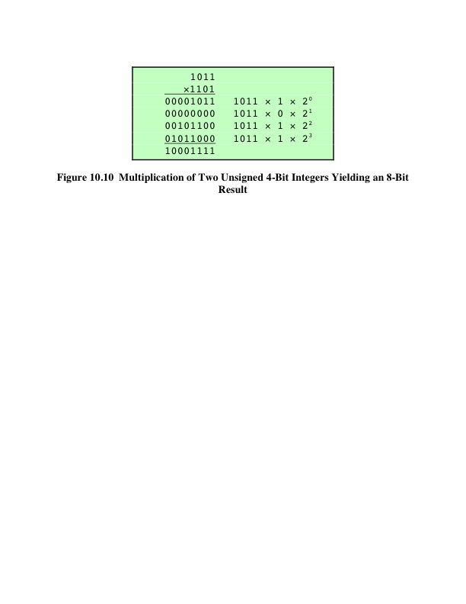
Twos Complement Multiplication
Notes:
Figure 10.10 recasts Figure 10.7 to make the generation of partial products by multiplication explicit.
The only difference in Figure 10.10 is that it recognizes that the partial products
should be viewed as 2n-bit numbers generated from the n-bit multiplicand.

Slide 11
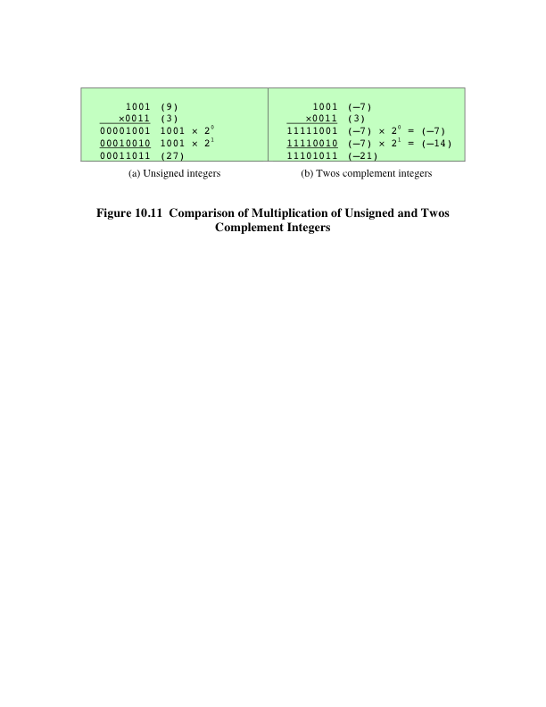
Comparison
Notes:
Now we can demonstrate that straightforward multiplication will not work if
the multiplicand is negative. The problem is that each contribution of the negative
multiplicand as a partial product must be a negative number on a 2n-bit field; the sign
bits of the partial products must line up. This is demonstrated in Figure 10.11, which
shows that multiplication of 1001 by 0011. If these are treated as unsigned integers,
the multiplication of 9 * 3 = 27 proceeds simply. However, if 1001 is interpreted
as the twos complement value -7, then each partial product must be a negative
twos complement number of 2n (8) bits, as shown in Figure 10.11b. Note that this is
accomplished by padding out each partial product to the left with binary 1s.

Slide 12
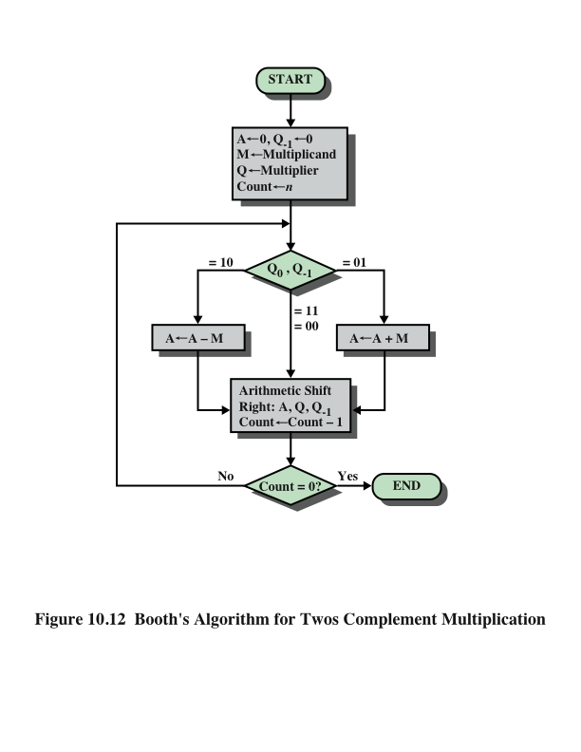
Booth’s
Algorithm
Notes:
Booth’s algorithm is depicted in Figure 10.12 and can be described as follows.
As before, the multiplier and multiplicand are placed in the Q and M registers,
respectively. There is also a 1-bit register placed logically to the right of the least
significant bit (Q₀) of the Q register and designated Q₋₁ its use is explained shortly.
The results of the multiplication will appear in the A and Q registers. A and Q₋₁
are initialized to 0. As before, control logic scans the bits of the multiplier one at a
time. Now, as each bit is examined, the bit to its right is also examined. If the two
bits are the same (1–1 or 0–0), then all of the bits of the A, Q, and Q₋₁ registers are
shifted to the right 1 bit. If the two bits differ, then the multiplicand is added to or
subtracted from the A register, depending on whether the two bits are 0–1 or 1–0.
Following the addition or subtraction, the right shift occurs. In either case, the right
shift is such that the leftmost bit of A, namely, A_{n-1} not only is shifted into A_{n-2},
but also remains in A_{n-1}. This is required to preserve the sign of the number in A
and Q. It is known as an arithmetic shift, because it preserves the sign bit.

Slide 13
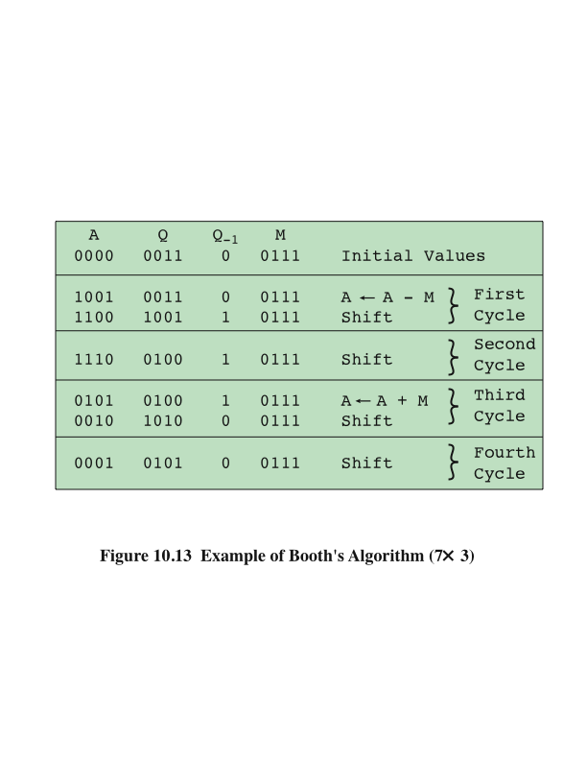
Example of Booth’s Algorithm
Notes:
Figure 10.13 shows the sequence of events in Booth’s algorithm for the multiplication
of 7 by 3.

Slide 14
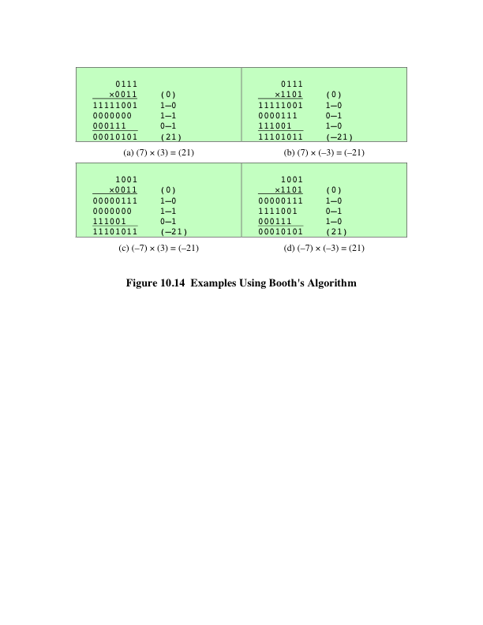
Examples Using Booth’s Algorithm
Notes:
More compactly, the same operation is depicted in Figure 10.14a.
The rest of Figure 10.14 gives other examples of the algorithm. As can be seen, it
works with any combination of positive and negative numbers. Note also the efficiency
of the algorithm. Blocks of 1s or 0s are skipped over, with an average of only
one addition or subtraction per block.

Slide 15
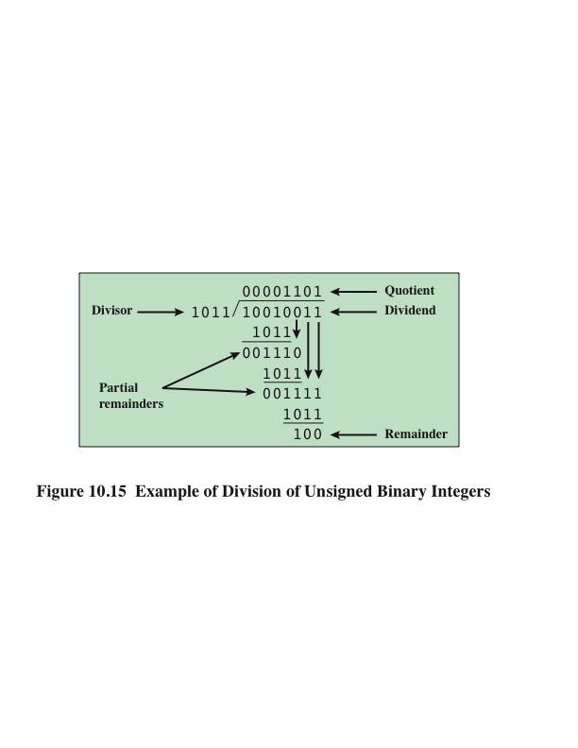
Division
Notes:
Division is somewhat more complex than multiplication but is based on the same
general principles. As before, the basis for the algorithm is the paper-and-pencil
approach, and the operation involves repetitive shifting and addition or subtraction.
Figure 10.15 shows an example of the long division of unsigned binary integers.
It is instructive to describe the process in detail. First, the bits of the dividend
are examined from left to right, until the set of bits examined represents a number
greater than or equal to the divisor; this is referred to as the divisor being able to
divide the number. Until this event occurs, 0s are placed in the quotient from left
to right. When the event occurs, a 1 is placed in the quotient and the divisor is subtracted
from the partial dividend. The result is referred to as a partial remainder.
From this point on, the division follows a cyclic pattern. At each cycle, additional
bits from the dividend are appended to the partial remainder until the result is
greater than or equal to the divisor. As before, the divisor is subtracted from this
number to produce a new partial remainder. The process continues until all the bits
of the dividend are exhausted.

Slide 16
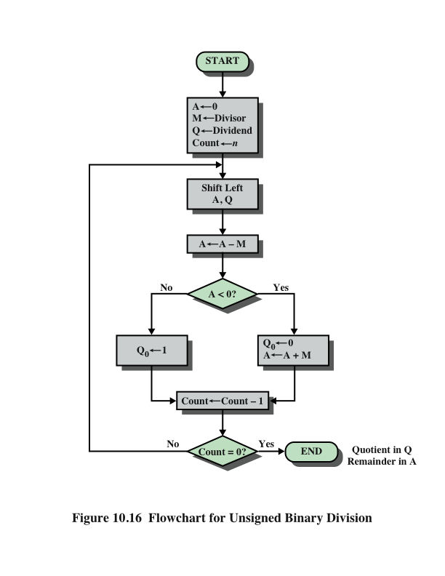
Flowchart for Unsigned Binary Division
Notes:
Figure 10.16 shows a machine algorithm that corresponds to the long division
process.

Slide 17
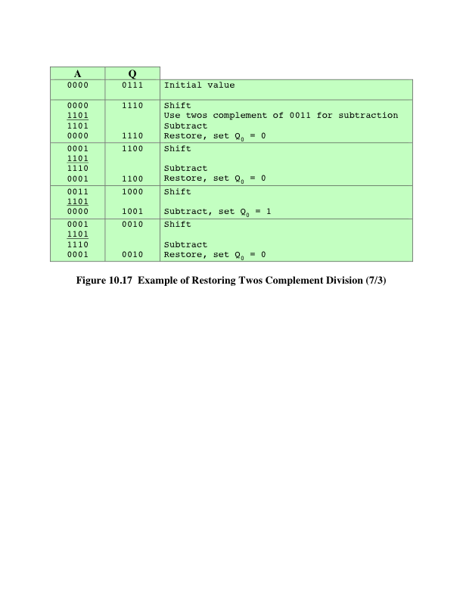
Example of Restoring Twos Complement Division
Notes:
Example of restoring twos complement division.

Slide 18
Floating-Point Representation
Principles
With a fixed-point notation it is possible to represent a range of positive and negative integers centered on or near 0
By assuming a fixed binary or radix point, this format allows the representation of numbers with a fractional component as well
Limitations:
  Very large numbers cannot be represented nor can very small fractions
  The fractional part of the quotient in a division of two large numbers could be lost
Notes:
With a fixed-point notation (e.g., twos complement) it is possible to represent a
range of positive and negative integers centered on or near 0. By assuming a fixed
binary or radix point, this format allows the representation of numbers with a fractional
component as well.
This approach has limitations. Very large numbers cannot be represented, nor
can very small fractions. Furthermore, the fractional part of the quotient in a division
of two large numbers could be lost.

Slide 19
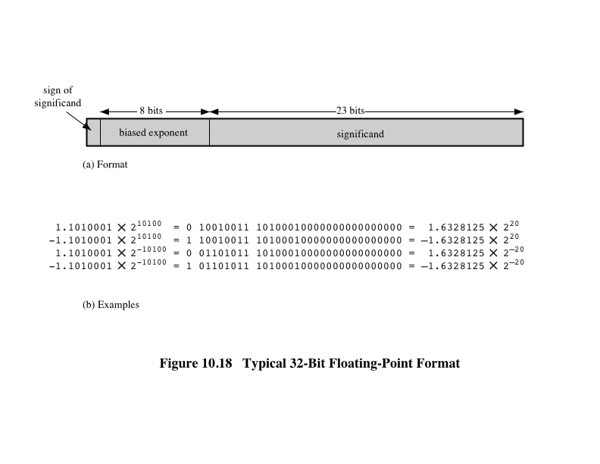
Typical 32-Bit Floating-Point Format
Notes:
The principles used in representing binary floating-point numbers are best
explained with an example. Figure 10.18a shows a typical 32-bit floating-point format.
The leftmost bit stores the sign of the number (0 = positive, 1 = negative).
The exponent value is stored in the next 8 bits. The representation used is known as
a biased representation. A fixed value, called the bias, is subtracted from the field
to get the true exponent value. Typically, the bias equals (2^{k-1} - 1), where k is the
number of bits in the binary exponent. In this case, the 8-bit field yields the numbers
0 through 255. With a bias of 127 (2⁷ - 1), the true exponent values are in the range
-127 to +128. In this example, the base is assumed to be 2.

Slide 20
Floating-Point
Significand
The final portion of the word
Any floating-point number can be expressed in many ways
Normal number
  The most significant digit of the significand is nonzero
The following are equivalent, where the significand is expressed in binary form:
0.110 * 2⁵
110 * 2²
0.0110 * 2⁶
Notes:
Table 10.2 shows the biased representation for 4-bit integers. Note that when
the bits of a biased representation are treated as unsigned integers, the relative magnitudes
of the numbers do not change. For example, in both biased and unsigned
representations, the largest number is 1111 and the smallest number is 0000. This is
not true of sign-magnitude or twos complement representation. An advantage of
biased representation is that nonnegative floating-point numbers can be treated as
integers for comparison purposes.
The final portion of the word (23 bits in this case) is the significand.
Any floating-point number can be expressed in many ways.
To simplify operations on floating-point numbers, it is typically required that they
be normalized. A normal number is one in which the most significant digit of the
significand is nonzero. For base 2 representation, a normal number is therefore one
in which the most significant bit of the significand is one.

Slide 21
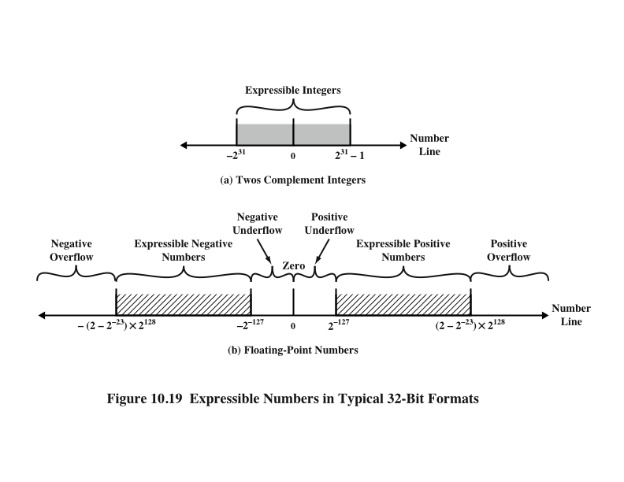
Expressible Numbers
Notes:
Figure 10.19 indicates the range of numbers that can be represented
in a 32-bit word. Using twos complement integer representation, all of the
integers from -2³¹ to 2³¹ - 1 can be represented, for a total of 2³² different numbers.
With the example floating-point format of Figure 10.18, the following ranges
of numbers are possible:
• Negative numbers between -(2 - 2⁻²³) * 2¹²⁸ and -2⁻¹²⁷
• Positive numbers between 2⁻¹²⁷ and (2 - 2⁻²³) * 2¹²⁸
Five regions on the number line are not included in these ranges:
• Negative numbers less than -(2 - 2⁻²³) * 2¹²⁸, called negative overflow
• Negative numbers greater than 2⁻¹²⁷, called negative underflow
• Zero
• Positive numbers less than 2⁻¹²⁷, called positive underflow
• Positive numbers greater than (2 - 2⁻²³) * 2¹²⁸, called positive overflow
The representation as presented will not accommodate a value of 0.
However, as we shall see, actual floating-point representations include a special
bit pattern to designate zero. Overflow occurs when an arithmetic operation
results in an absolute value greater than can be expressed with an exponent of 128
(e.g., 2¹²⁰ * 2¹⁰⁰ = 2²²⁰). Underflow occurs when the fractional magnitude is too
small (e.g., 2⁻¹²⁰ * 2⁻¹⁰⁰ = 2⁻²²⁰). Underflow is a less serious problem because
the result can generally be satisfactorily approximated by 0.
It is important to note that we are not representing more individual values
with floating-point notation. The maximum number of different values that can be
represented with 32 bits is still 2³². What we have done is to spread those numbers
out in two ranges, one positive and one negative. In practice, most floating-point
numbers that one would wish to represent are represented only approximately.
However, for moderate sized integers, the representation is exact.

Slide 22
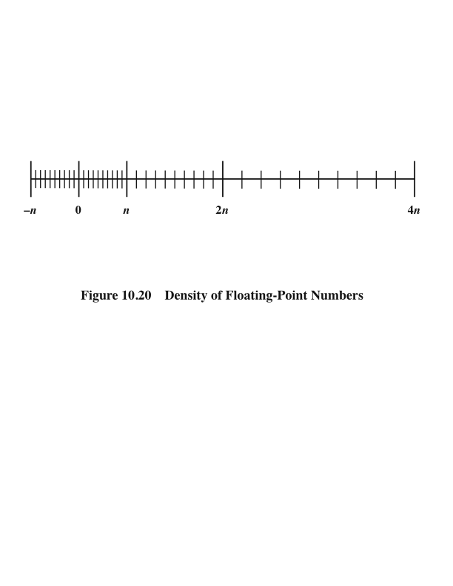
Density of Floating-Point Numbers
Notes:
Also, note that the numbers represented in floating-point notation are not
spaced evenly along the number line, as are fixed-point numbers. The possible values
get closer together near the origin and farther apart as you move away, as shown
in Figure 10.20. This is one of the trade-offs of floating-point math: Many calculations
produce results that are not exact and have to be rounded to the nearest value
that the notation can represent.

Slide 23
IEEE Standard 754
Most important floating-point representation is defined
Standard was developed to facilitate the portability of programs from one processor to another and to encourage the development of sophisticated, numerically oriented programs
Standard has been widely adopted and is used on virtually all contemporary processors and arithmetic coprocessors
IEEE 754-2008 covers both binary and decimal floating-point representations
Notes:
The most important floating-point representation is defined in IEEE Standard 754,
adopted in 1985 and revised in 2008. This standard was developed to facilitate the
portability of programs from one processor to another and to encourage the development
of sophisticated, numerically oriented programs. The standard has been
widely adopted and is used on virtually all contemporary processors and arithmetic
coprocessors. IEEE 754-2008 covers both binary and decimal floating-point representations.
In this chapter, we deal only with binary representations.

Slide 24
IEEE 754-2008
Defines the following different types of floating-point formats:
Arithmetic format
  All the mandatory operations defined by the standard are supported by the format. The format may be used to represent floating-point operands or results for the operations described in the standard.
Basic format
  This format covers five floating-point representations, three binary and two decimal, whose encodings are specified by the standard, and which can be used for arithmetic. At least one of the basic formats is implemented in any conforming implementation.
Interchange format
  A fully specified, fixed-length binary encoding that allows data interchange between different platforms and that can be used for storage.
Notes:
IEEE 754-2008 defines the following different types of floating-point formats:
• Arithmetic format: All the mandatory operations defined by the standard are
supported by the format. The format may be used to represent floating-point
operands or results for the operations described in the standard.
• Basic format: This format covers five floating-point representations, three
binary and two decimal, whose encodings are specified by the standard, and
which can be used for arithmetic. At least one of the basic formats is implemented
in any conforming implementation.
• Interchange format: A fully specified, fixed-length binary encoding that allows
data interchange between different platforms and that can be used for storage.

Slide 25
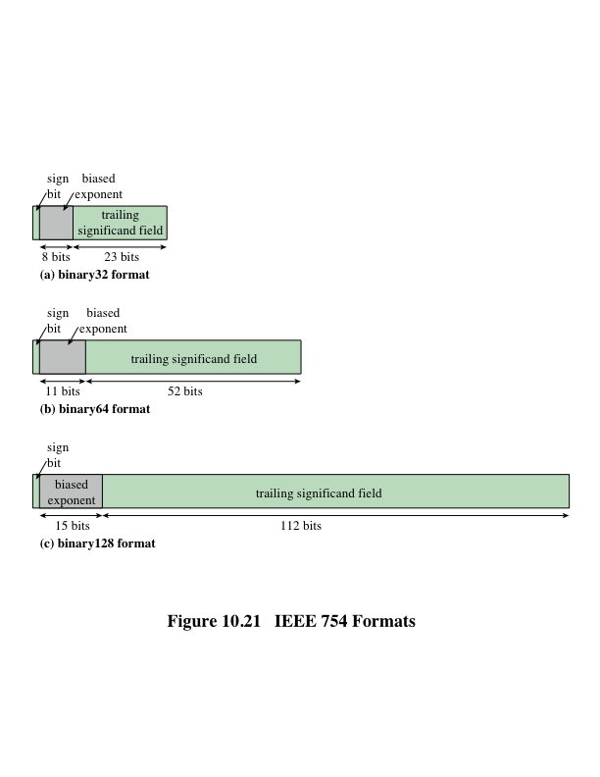
IEEE 754 Formats
Notes:
The three basic binary formats have bit lengths of 32, 64, and 128 bits, with
exponents of 8, 11, and 15 bits, respectively (Figure 10.21).

Slide 26
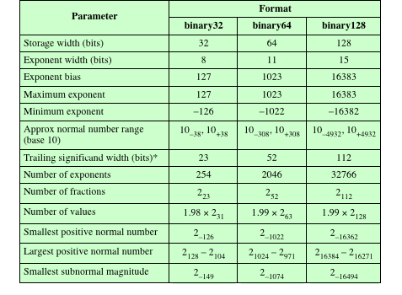
Table 10.3
IEEE 754
Format
Parameters
* not including implied bit and not including sign bit
Notes:
Table 10.3 summarizes
the characteristics of the three formats. The two basic decimal formats have bit
lengths of 64 and 128 bits. All of the basic formats are also arithmetic format types
(can be used for arithmetic operations) and interchange format types (platform
independent).

Slide 27

Additional Formats
Extended Precision Formats
Extendable Precision Format
Provide additional bits in the exponent (extended range) and in the significand (extended precision)
Lessens the chance of a final result that has been contaminated by excessive roundoff error
Lessens the chance of an intermediate overflow aborting a computation whose final result would have been representable in a basic format
Affords some of the benefits of a larger basic format without incurring the time penalty usually associated with higher precision
Precision and range are defined under user control
May be used for intermediate calculations but the standard places no constraint or format or length
Notes:
In addition, the standard defines extended precision formats, which
extend a supported basic format by providing additional bits in the exponent
(extended range) and in the significand (extended precision). The exact format
is implementation dependent, but the standard places certain constraints on the
length of the exponent and significand. These formats are arithmetic format types
but not interchange format types. The extended formats are to be used for intermediate
calculations. With their greater precision, the extended formats lessen the
chance of a final result that has been contaminated by excessive round-off error;
with their greater range, they also lessen the chance of an intermediate overflow
aborting a computation whose final result would have been representable in a basic
format. An additional motivation for the extended format is that it affords some
of the benefits of a larger basic format without incurring the time penalty usually
associated with higher precision.
Finally, IEEE 754-2008 defines an extendable precision format as a format
with a precision and range that are defined under user control. Again, these formats
may be used for intermediate calculations, but the standard places no constraint or
format or length.

Slide 28
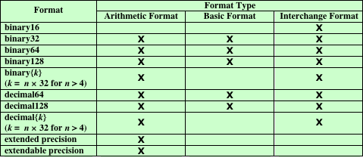
Table 10.4
IEEE Formats
Table 10.4 IEEE Formats
Notes:
Table 10.4 shows the relationship between defined formats and format types.

Slide 29
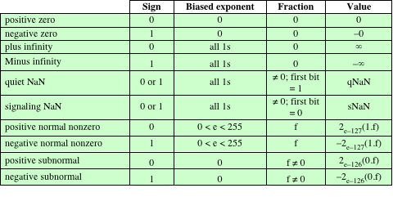
Interpretation of IEEE 754
Floating-Point Numbers
(a) binary 32 format
Table 10.5 Interpretation of IEEE 754 Floating-Point Numbers (page 1 of 3)
Notes:
Not all bit patterns in the IEEE formats are interpreted in the usual way;
instead, some bit patterns are used to represent special values. Table 10.5 indicates
the values assigned to various bit patterns. The exponent values of all zeros (0 bits)
and all ones (1 bits) define special values.
The following classes of numbers are
represented:
• For exponent values in the range of 1 through 254 for 32-bit format, 1 through
2046 for 64-bit format, and 1 through 16382, normal nonzero floating-point
numbers are represented. The exponent is biased, so that the range of exponents
is -126 through +127 for 32-bit format, and so on. A normal number
requires a 1 bit to the left of the binary point; this bit is implied, giving an
effective 24-bit, 53-bit, or 113-bit significand. Because one of the bits is implied,
the corresponding field in the binary format is referred to as the trailing
significand field.
• An exponent of zero together with a fraction of zero represents positive or
negative zero, depending on the sign bit. As was mentioned, it is useful to have
an exact value of 0 represented.
• An exponent of all ones together with a fraction of zero represents positive
or negative infinity, depending on the sign bit. It is also useful to have a representation
of infinity. This leaves it up to the user to decide whether to treat
overflow as an error condition or to carry the value and proceed with whatever
program is being executed.
• An exponent of zero together with a nonzero fraction represents a subnormal
number. In this case, the bit to the left of the binary point is zero and the true
exponent is -126 or -1022. The number is positive or negative depending on
the sign bit.
• An exponent of all ones together with a nonzero fraction is given the value
NaN, which means Not a Number, and is used to signal various exception
conditions.
The significance of subnormal numbers and NaNs is discussed in Section 10.5.

Slide 30
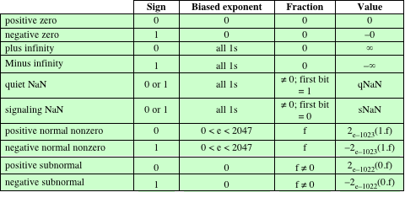
Interpretation of IEEE 754
Floating-Point Numbers
(b) binary 64 format
Table 10.5 Interpretation of IEEE 754 Floating-Point Numbers (page 2 of 3)
Notes:
Table 10.5 continued.

Slide 31
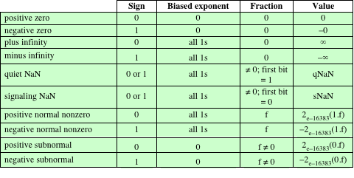
Interpretation of IEEE 754
Floating-Point Numbers
(c) binary 128 format
Table 10.5 Interpretation of IEEE 754 Floating-Point Numbers (page 3 of 3)
Notes:
Table 10.5 continued.

Slide 32
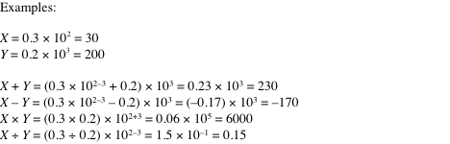
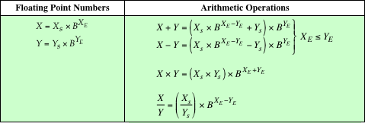
Table 10.6 Floating-Point Numbers and Arithmetic Operations
Notes:
Table 10.6 summarizes the basic operations for floating-point arithmetic. For addition
and subtraction, it is necessary to ensure that both operands have the same
exponent value. This may require shifting the radix point on one of the operands to
achieve alignment. Multiplication and division are more straightforward.
A floating-point operation may produce one of these conditions:
• Exponent overflow: A positive exponent exceeds the maximum possible exponent
value. In some systems, this may be designated as + ∞ or - ∞.
• Exponent underflow: A negative exponent is less than the minimum possible
exponent value (e.g., -200 is less than -127). This means that the number is
too small to be represented, and it may be reported as 0.
• Significand underflow: In the process of aligning significands, digits may flow
off the right end of the significand. As we shall discuss, some form of rounding
is required.
• Significand overflow: The addition of two significands of the same sign may
result in a carry out of the most significant bit. This can be fixed by realignment,
as we shall explain.

Slide 33
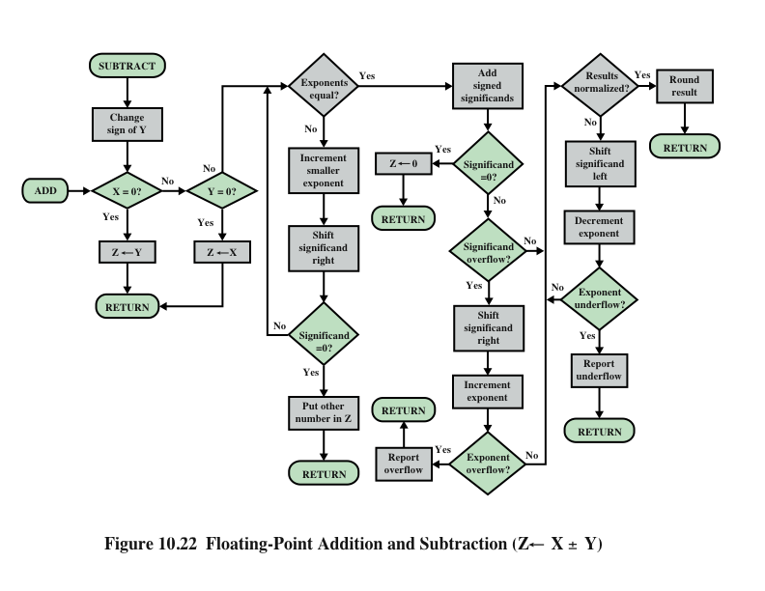
Floating-Point Addition and Subtraction
Notes:
In floating-point arithmetic, addition and subtraction are more complex than multiplication
and division. This is because of the need for alignment. There are four
basic phases of the algorithm for addition and subtraction:
1. Check for zeros.
2. Align the significands.
3. Add or subtract the significands.
4. Normalize the result.
A typical flowchart is shown in Figure 10.22. A step-by-step narrative highlights
the main functions required for floating-point addition and subtraction. We
assume a format similar to those of Figure 10.21. For the addition or subtraction
operation, the two operands must be transferred to registers that will be used by the
ALU. If the floating-point format includes an implicit significand bit, that bit must
be made explicit for the operation.
Phase 1: Zero check. Because addition and subtraction are identical except
for a sign change, the process begins by changing the sign of the subtrahend if
it is a subtract operation. Next, if either operand is 0, the other is reported as
the result.
Phase 2: Significand alignment. The next phase is to manipulate the numbers
so that the two exponents are equal.
Alignment may be achieved by shifting either the smaller number to the
right (increasing its exponent) or shifting the larger number to the left. Because
either operation may result in the loss of digits, it is the smaller number that is
shifted; any digits that are lost are therefore of relatively small significance. The
alignment is achieved by repeatedly shifting the magnitude portion of the significand
right 1 digit and incrementing the exponent until the two exponents are
equal. (Note that if the implied base is 16, a shift of 1 digit is a shift of 4 bits.) If this
process results in a 0 value for the significand, then the other number is reported
as the result. Thus, if two numbers have exponents that differ significantly, the
lesser number is lost.
Phase 3: Addition. Next, the two significands are added together, taking into
account their signs. Because the signs may differ, the result may be 0. There
is also the possibility of significand overflow by 1 digit. If so, the significand
of the result is shifted right and the exponent is incremented. An exponent
overflow could occur as a result; this would be reported and the operation
halted.
Phase 4: Normalization. The final phase normalizes the result. Normalization
consists of shifting significand digits left until the most significant digit (bit, or
4 bits for base-16 exponent) is nonzero. Each shift causes a decrement of the
exponent and thus could cause an exponent underflow. Finally, the result must
be rounded off and then reported. We defer a discussion of rounding until after
a discussion of multiplication and division.

Slide 34
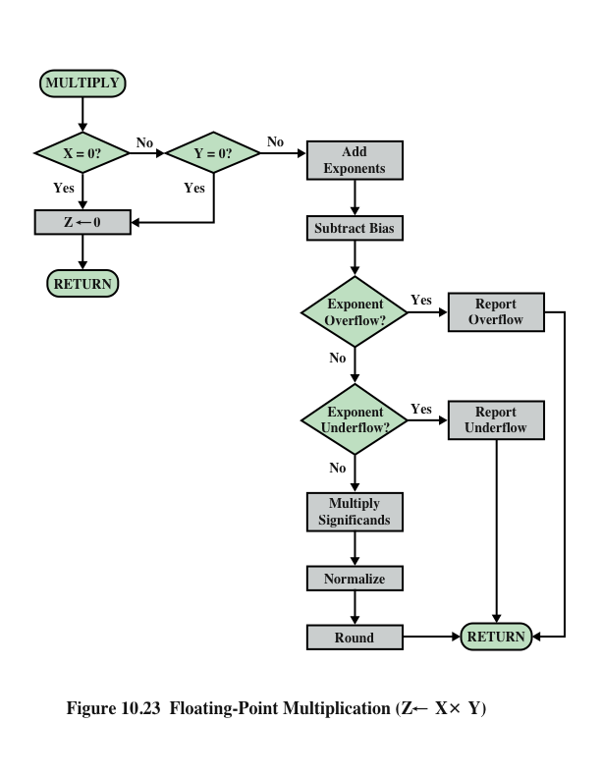
Floating-Point Multiplication
Notes:
Floating-point multiplication and division are much simpler processes than addition
and subtraction, as the following discussion indicates.
We first consider multiplication, illustrated in Figure 10.23. First, if either
operand is 0, 0 is reported as the result. The next step is to add the exponents. If
the exponents are stored in biased form, the exponent sum would have doubled
the bias. Thus, the bias value must be subtracted from the sum. The result could
be either an exponent overflow or underflow, which would be reported, ending the
algorithm.
If the exponent of the product is within the proper range, the next step is to
multiply the significands, taking into account their signs. The multiplication is performed
in the same way as for integers. In this case, we are dealing with a sign-magnitude
representation, but the details are similar to those for twos complement
representation. The product will be double the length of the multiplier and multiplicand.
The extra bits will be lost during rounding.
After the product is calculated, the result is then normalized and rounded,
as was done for addition and subtraction. Note that normalization could result in
exponent underflow.

Slide 35
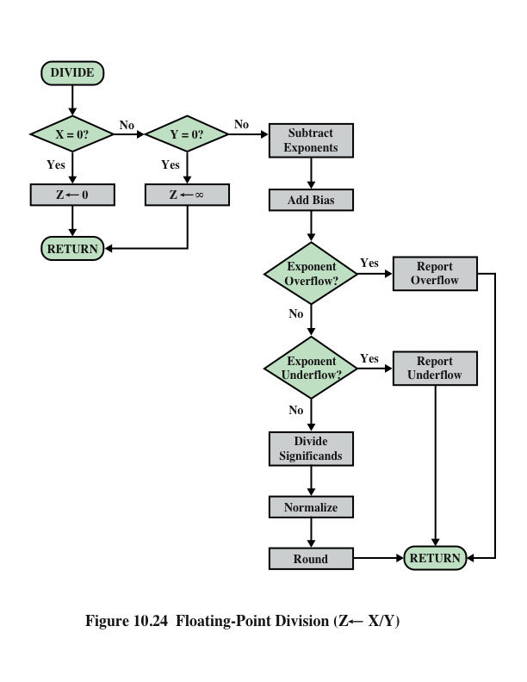
Floating-Point Division
Notes:
Finally, let us consider the flowchart for division depicted in Figure 10.24.
Again, the first step is testing for 0. If the divisor is 0, an error report is issued,
or the result is set to infinity, depending on the implementation. A dividend of 0
results in 0. Next, the divisor exponent is subtracted from the dividend exponent.
This removes the bias, which must be added back in. Tests are then made for exponent
underflow or overflow.
The next step is to divide the significands. This is followed with the usual normalization
and rounding.

Slide 36
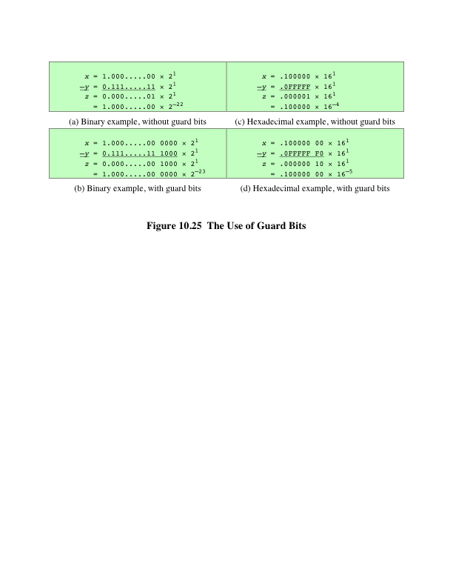
Precision Considerations
Guard Bits
Notes:
We mentioned that, prior to a floating-point operation, the exponent
and significand of each operand are loaded into ALU registers. In the case of the
significand, the length of the register is almost always greater than the length of the
significand plus an implied bit. The register contains additional bits, called guard
bits, which are used to pad out the right end of the significand with 0s.

Slide 37
Precision Considerations
Rounding
IEEE standard approaches:
  Round to nearest:
    The result is rounded to the nearest representable number.
  Round toward +∞ :
    The result is rounded up toward plus infinity.
  Round toward -∞:
    The result is rounded down toward negative infinity.
  Round toward 0:
    The result is rounded toward zero.
Notes:
Another detail that affects the precision of the result is the rounding
policy. The result of any operation on the significands is generally stored in a longer
register. When the result is put back into the floating-point format, the extra bits
must be eliminated in such a way as to produce a result that is close to the exact
result. This process is called rounding.
A number of techniques have been explored for performing rounding. In fact,
the IEEE standard lists four alternative approaches:
• Round to nearest: The result is rounded to the nearest representable number.
• Round toward H: The result is rounded up toward plus infinity.
• Round toward +∞: The result is rounded down toward negative infinity.
• Round toward -∞: The result is rounded toward zero.
Let us consider each of these policies in turn. Round to nearest is the default
rounding mode listed in the standard and is defined as follows: The representable
value nearest to the infinitely precise result shall be delivered.
The standard also addresses the special case of extra bits of the form 10000.…
Here the result is exactly halfway between the two possible representable values.
One possible technique here would be to always truncate, as this would be the simplest
operation. However, the difficulty with this simple approach is that it introduces
a small but cumulative bias into a sequence of computations. What is required
is an unbiased method of rounding. One possible approach would be to round up or
down on the basis of a random number so that, on average, the result would be unbiased.
The argument against this approach is that it does not produce predictable,
deterministic results. The approach taken by the IEEE standard is to force the result
to be even: If the result of a computation is exactly midway between two representable
numbers, the value is rounded up if the last representable bit is currently 1 and
not rounded up if it is currently 0.

Slide 38
Interval Arithmetic
Provides an efficient method for monitoring and controlling errors in floating-point computations by producing two values for each result
The two values correspond to the lower and upper endpoints of an interval that contains the true result
The width of the interval indicates the accuracy of the result
If the endpoints are not representable then the interval endpoints are rounded down and up respectively
If the range between the upper and lower bounds is sufficiently narrow then a sufficiently accurate result has been obtained
Minus infinity and rounding to plus are useful in implementing interval arithmetic
Truncation
Round toward zero
Extra bits are ignored
Simplest technique
A consistent bias toward zero in the operation
  Serious bias because it affects every operation for which there are nonzero extra bits
Notes:
The next two options, rounding to plus and minus infinity, are useful in implementing
a technique known as interval arithmetic. Interval arithmetic provides an
efficient method for monitoring and controlling errors in floating-point computations
by producing two values for each result. The two values correspond to the
lower and upper endpoints of an interval that contains the true result. The width of
the interval, which is the difference between the upper and lower endpoints, indicates
the accuracy of the result. If the endpoints of an interval are not representable,
then the interval endpoints are rounded down and up, respectively. Although
the width of the interval may vary according to implementation, many algorithms
have been designed to produce narrow intervals. If the range between the upper
and lower bounds is sufficiently narrow, then a sufficiently accurate result has been
obtained. If not, at least we know this and can perform additional analysis.
The final technique specified in the standard is round toward zero. This is,
in fact, simple truncation: The extra bits are ignored. This is certainly the simplest
technique. However, the result is that the magnitude of the truncated value is always
less than or equal to the more precise original value, introducing a consistent bias
toward zero in the operation. This is a serious bias because it affects every operation
for which there are nonzero extra bits.

Slide 39
IEEE Standard for Binary Floating-Point Arithmetic
Infinity
Is treated as the limiting case of real arithmetic, with the infinity values given the following interpretation:
  - ∞ < (every finite number) < + ∞
For example:
5 + (+ ∞ ) = + ∞ 5÷ (+ ∞ ) = +0
5 - (+ ∞ ) = - ∞ (+ ∞ ) + (+ ∞ ) = + ∞
5 + (- ∞ ) = - ∞ (- ∞ ) + (- ∞) = - ∞
5 - (- ∞ ) = + ∞ (- ∞ ) - (+ ∞ ) = - ∞
5 * (+ ∞ ) = + ∞ (+ ∞ ) - (- ∞ ) = + ∞
Notes:
IEEE 754 goes beyond the simple definition of a format to lay down specific practices
and procedures so that floating-point arithmetic produces uniform, predictable
results independent of the hardware platform. One aspect of this has already been
discussed, namely rounding. This subsection looks at three other topics: infinity,
NaNs, and subnormal numbers.
Infinity arithmetic is treated as the limiting case of real arithmetic, with
the infinity values given the following interpretation:
- ∞ < (every finite number) < + ∞
With the exception of the special cases discussed subsequently, any arithmetic
operation involving infinity yields the obvious result.

Slide 40
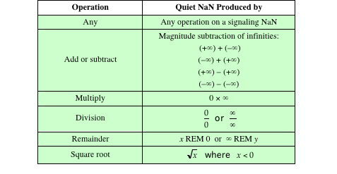
IEEE Standard for Binary Floating-Point Arithmetic
Quiet and Signaling NaNs
    Signaling NaN signals an invalid operation exception whenever it appears as an operand
    Quiet NaN propagates through almost every arithmetic operation without signaling an exception
Table 10.7
Operations that Produce a
Quiet NaN
Notes:
A NaN is a symbolic entity encoded in floating-point
format, of which there are two types: signaling and quiet. A signaling NaN
signals an invalid operation exception whenever it appears as an operand. Signaling
NaNs afford values for uninitialized variables and arithmetic-like enhancements
that are not the subject of the standard. A quiet NaN propagates through almost
every arithmetic operation without signaling an exception. Table 10.7 indicates
operations that will produce a quiet NaN.
Note that both types of NaNs have the same general format (Table 10.4): an
exponent of all ones and a nonzero fraction. The actual bit pattern of the nonzero
fraction is implementation dependent; the fraction values can be used to distinguish
quiet NaNs from signaling NaNs and to specify particular exception conditions.

Slide 41
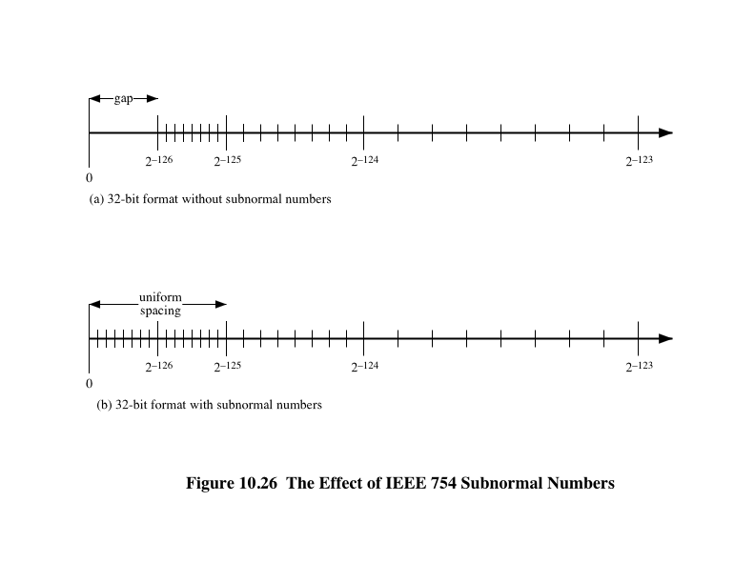
IEEE Standard for Binary Floating-Point Arithmetic
Subnormal Numbers
Notes:
Subnormal numbers are included in IEEE 754 to handle
cases of exponent underflow. When the exponent of the result becomes too small
(a negative exponent with too large a magnitude), the result is subnormalized by
right shifting the fraction and incrementing the exponent for each shift until the
exponent is within a representable range.
Figure 10.26 illustrates the effect of including subnormal numbers. The representable
numbers can be grouped into intervals of the form [2^{n}, 2^{n+1}]. Within each
such interval, the exponent portion of the number remains constant while the fraction
varies, producing a uniform spacing of representable numbers within the interval. As
we get closer to zero, each successive interval is half the width of the preceding interval
but contains the same number of representable numbers. Hence the density of
representable numbers increases as we approach zero. However, if only normal numbers
are used, there is a gap between the smallest normal number and 0. In the case of
the 32-bit IEEE 754 format, there are 2²³ representable numbers in each interval, and
the smallest representable positive number is 2⁻¹²⁶. With the addition of subnormal
numbers, an additional 2²³ - 1 numbers are uniformly added between 0 and 2⁻¹²⁶.
The use of subnormal numbers is referred to as gradual underflow [COON81].
Without subnormal numbers, the gap between the smallest representable nonzero
number and zero is much wider than the gap between the smallest representable
nonzero number and the next larger number. Gradual underflow fills in that gap
and reduces the impact of exponent underflow to a level comparable with roundoff
among the normal numbers.

Slide 42
Summary
Computer
Arithmetic
Chapter 10
  Integer arithmetic
  Negation
  Addition and subtraction
  Multiplication
  Division
  Floating-point arithmetic
  Addition and subtraction
  Multiplication and division
  Precision consideration
  IEEE standard for binary floating-point arithmetic
ALU
Integer representation
  Sign-magnitude representation
  Twos complement representation
  Range extension
  Fixed-point representation
  Floating-point representation
  Principles
  IEEE standard for binary floating-point representation
Notes:
Chapter 10 summary.

