Slide 1
Minimum Spanning Trees
Definition of MST
Generic MST algorithm
Kruskal's algorithm
Prim's algorithm

Slide 2
Definition of MST
Let G=(V,E) be a connected, undirected graph.
For each edge (u,v) in E, we have a weight w(u,v) specifying the cost (length of edge) to connect u and v.
We wish to find a (acyclic) subset T of E that connects all of the vertices in V and whose total weight is minimized.
Since the total weight is minimized, the subset T must be acyclic (no circuit).
Thus, T is a tree. We call it a spanning tree.
The problem of determining the tree T is called the minimum-spanning-tree problem.

Slide 3
Application of MST: an example
In the design of electronic circuitry, it is often necessary to make a set of pins electrically equivalent by wiring them together.
Running cable TV to a set of houses. What’s the least amount of cable needed to still connect all the houses?

Slide 4
Here is an example of a connected graph
and its minimum spanning tree:
8
7
b
c
d
9
4
2
a
11
i
14
e
4
7
6
8
10
h
g
f
1
2
Notice that the tree is not unique:
replacing (b,c) with (a,h) yields another spanning tree
with the same minimum weight.

Slide 5
Growing a MST
GENERIC_MST(G,w)
1 A:={}
2 while A does not form a spanning tree do
3 find an edge (u,v) that is safe for A
4 A:=A∪{(u,v)}
5 return A
Set A is always a subset of some minimum spanning tree..
An edge (u,v) is a safe edge for A if by adding (u,v) to the subset A, we still have a minimum spanning tree.

Slide 6
How to find a safe edge
We need some definitions and a theorem.
A cut (S,V-S) of an undirected graph G=(V,E) is a partition of V.
An edge crosses the cut (S,V-S) if one of its endpoints is in S and the other is in V-S.
An edge is a light edge crossing a cut if its weight is the minimum of any edge crossing the cut.

Slide 7
8
7
b
c
d
9
4
2
S↑
a
11
i
14
e
↑ S
4
7
6
8
10
V-S↓
h
g
f
↓ V-S
1
2
This figure shows a cut (S,V-S) of the graph.
The edge (d,c) is the unique light edge crossing the cut.

Slide 8
The algorithms of Kruskal and Prim
The two algorithms are elaborations of the generic algorithm.
They each use a specific rule to determine a safe edge in the GENERIC_MST.
In Kruskal's algorithm,
  The set A is a forest.
  The safe edge added to A is always a least-weight edge in the graph that connects two distinct components.
In Prim's algorithm,
  The set A forms a single tree.
  The safe edge added to A is always a least-weight edge connecting the tree to a vertex not in the tree.

Slide 9
Kruskal's algorithm (simple)
(Sort the edges in an increasing order)
A:={}
while (E is not empty do) {
take an edge (u, v) that is shortest in E
and delete it from E
If (u and v are in different components)then
add (u, v) to A
}
Note: each time a shortest edge in E is considered.

Slide 10
Kruskal's algorithm
1 function Kruskal(G = <N, A>: graph; length: A → R+): set of edges
2 Define an elementary cluster C(v) ← {v}.
3 Initialize a priority queue Q to contain all edges in G, using the weights as
keys.
4 Define a forest T ← Ø //T will ultimately contain the edges of the MST
5 // n is total number of vertices
6 while T has fewer than n-1 edges do
7 // edge u,v is the minimum weighted route from u to v
8 (u,v) ← Q.removeMin()
9 // prevent cycles in T. add u,v only if T does not already contain a path
// between u and v.
10 // the vertices has been added to the tree.
11 Let C(v) be the cluster containing v, and let C(u) be the cluster containing u.
13 if C(v) ≠ C(u) then
14 Add edge (v,u) to T.
15 Merge C(v) and C(u) into one cluster, that is, union C(v) and C(u).
16 return tree T

Slide 11
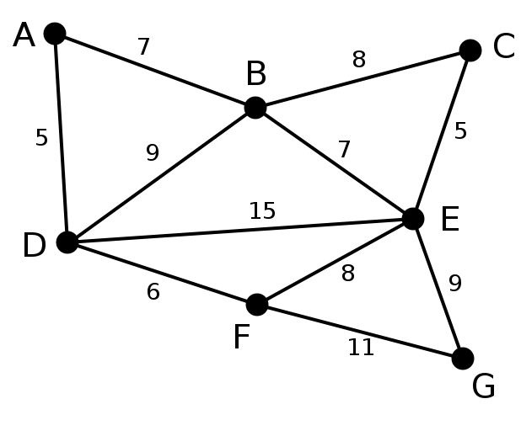
Kruskal's algorithm
This is our original graph. The numbers near the arcs indicate their weight. None of the arcs are highlighted.
http://Wikipedia/kruskals

Slide 12
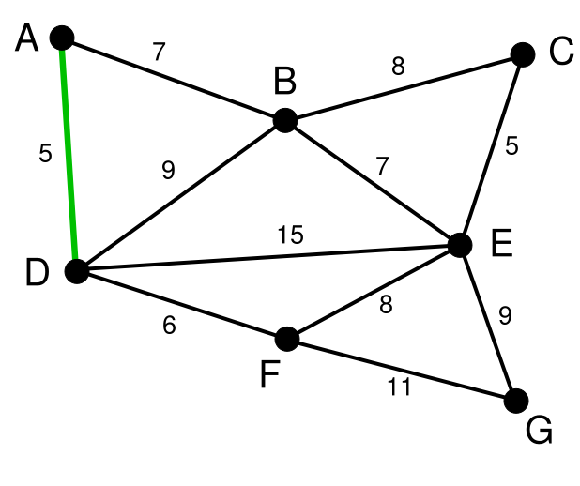
Kruskal's algorithm
AD and CE are the shortest arcs, with length 5, and AD has been arbitrarily chosen, so it is highlighted.
http://Wikipedia/kruskals

Slide 13
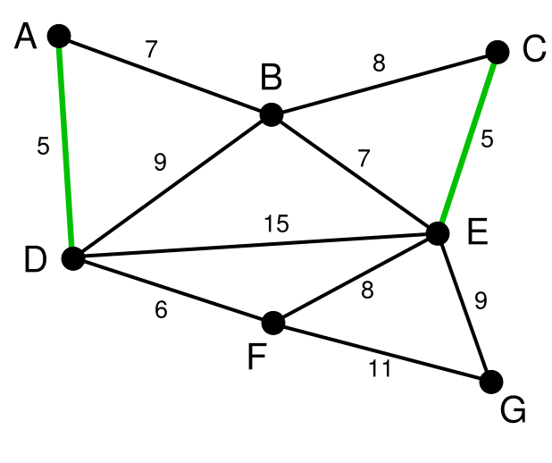
Kruskal's algorithm
CE is now the shortest arc that does not form a cycle, with length 5, so it is highlighted as the second arc.
http://Wikipedia/kruskals

Slide 14
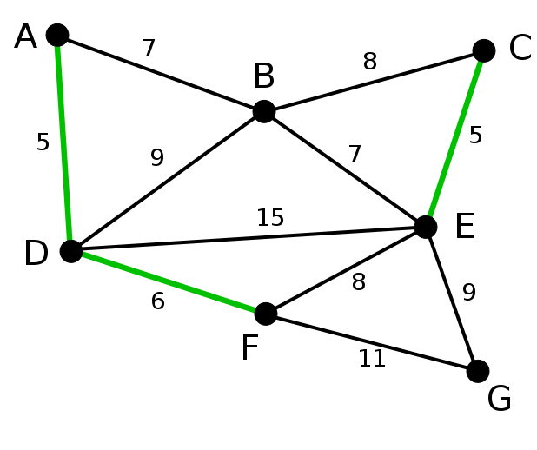
Kruskal's algorithm
The next arc, DF with length 6, is highlighted using much the same method.
http://Wikipedia/kruskals

Slide 15
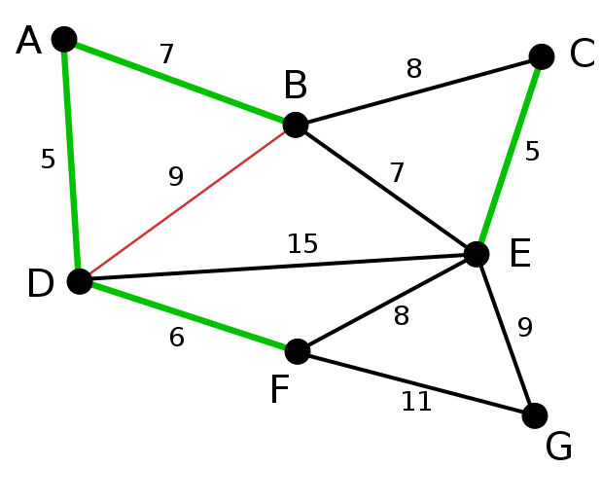
Kruskal's algorithm
The next-shortest arcs are AB and BE, both with length 7. AB is chosen arbitrarily, and is highlighted. The arc BD has been highlighted in red, because there already exists a path (in green) between B and D, so it would form a cycle (ABD) if it were chosen.
http://Wikipedia/kruskals

Slide 16
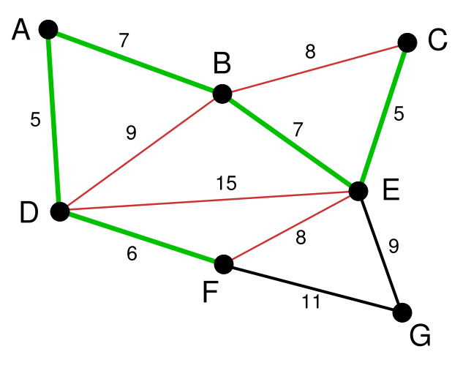
Kruskal's algorithm
The process continues to highlight the next-smallest arc, BE with length 7. Many more arcs are highlighted in red at this stage: BC because it would form the loop BCE, DE because it would form the loop DEBA, and FE because it would form FEBAD.
http://Wikipedia/kruskals

Slide 17
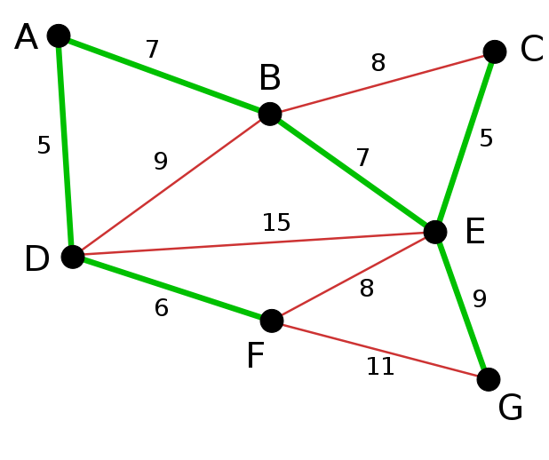
Kruskal's algorithm
Finally, the process finishes with the arc EG of length 9, and the minimum spanning tree is found.
http://Wikipedia/kruskals

Slide 18
Prim's algorithm (simple)
MST_PRIM(G,w,r){
  A={}
  S:={r} (r is an arbitrary node in V)
  Q=V-{r};
  while Q is not empty
  do {
  take an edge (u, v) such that
  u∈S and v∈Q (v∉S ) and (u,v) is the shortest edge
  add (u, v) to A,
  add v to S and delete v from Q
  }
}

Slide 19
Prim's algorithm
Initialization
for each vertex in graph
set min_distance of vertex to ∞
set parent of vertex to null
set minimum_adjacency_list of vertex to empty list
set is_in_Q of vertex to true
set min_distance of initial vertex to zero
add to minimum-heap Q all vertices in graph, keyed by min_distance
inputs: A graph, a function returning edge weights weight-function, and an initial vertex
Initial placement of all vertices in the 'not yet seen' set, set initial vertex to be added to the tree, and place all vertices in a min-heap to allow for removal of the min distance from the minimum graph.
Wikipedia

Slide 20
Prim's algorithm
The while loop will fail when remove minimum returns null. The adjacency list is set to allow a directional graph to be returned.
time complexity: V for loop, log(V) for the remove function
while latest_addition = remove minimum in Q
set is_in_Q of latest_addition to false
add latest_addition to (minimum_adjacency_list of (parent of latest_addition))
add (parent of latest_addition) to (minimum_adjacency_list of latest_addition)
time complexity: E/V, the average number of vertices
for each adjacent of latest_addition
if ((is_in_Q of adjacent){
and (weight-function(latest_addition, adjacent) < min_distance of adjacent))
set parent of adjacent to latest_addition
set min_distance of adjacent to weight-function(latest_addition, adjacent)
}
time complexity: log(V), the height of the heap
update adjacent in Q, order by min_distance
Wikipedia

Slide 21
Prim's algorithm
Grow the minimum spanning tree from the root vertex r.
Q is a priority queue, holding all vertices that are not in the tree now.
key[v] is the minimum weight of any edge connecting v to a vertex in the tree.
parent[v] names the parent of v in the tree.
When the algorithm terminates, Q is empty; the minimum spanning tree A for G is thus A={(v,parent[v]):v∈V-{r}}.
Running time: O(||E||lg |V|).

Slide 22
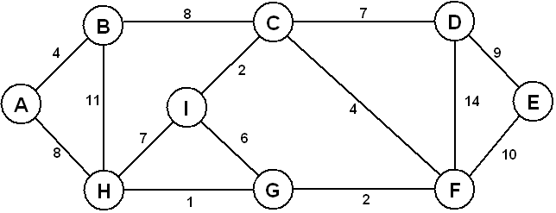
Prim's algorithm

Slide 23
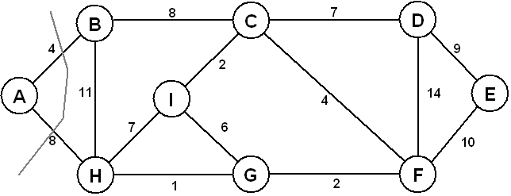
Prim's algorithm

Slide 24
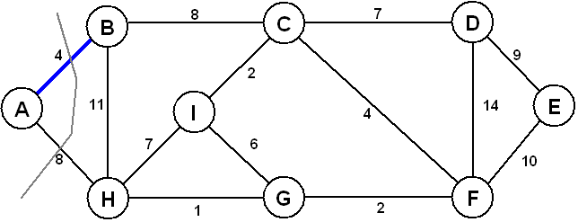
Prim's algorithm

Slide 25
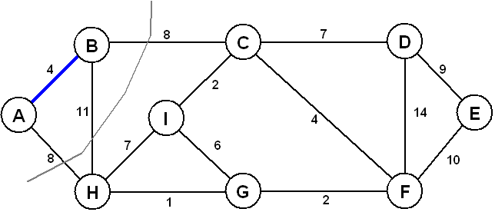
Prim's algorithm

Slide 26
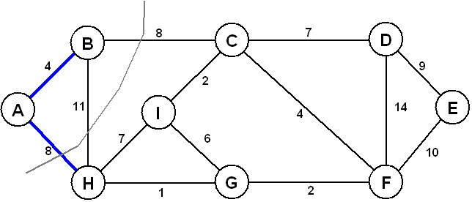
Prim's algorithm

Slide 27
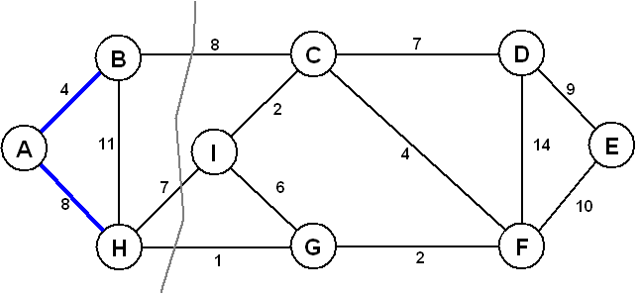
Prim's algorithm

Slide 28
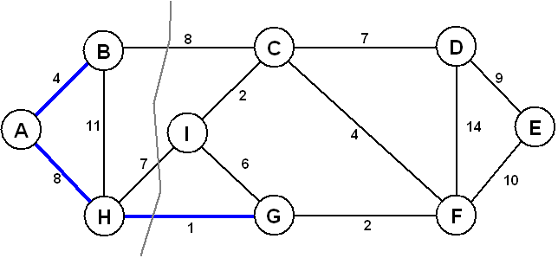
Prim's algorithm

Slide 29
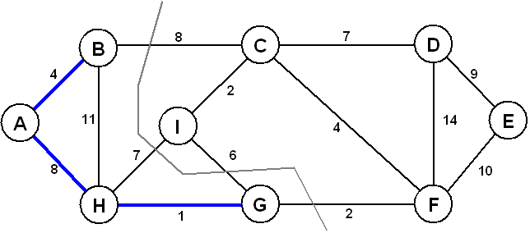
Prim's algorithm

Slide 30
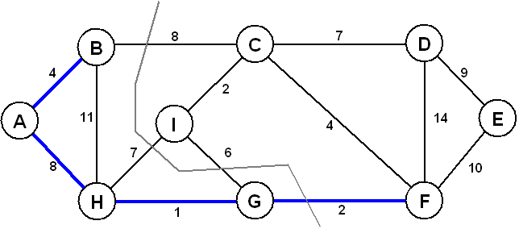
Prim's algorithm

Slide 31
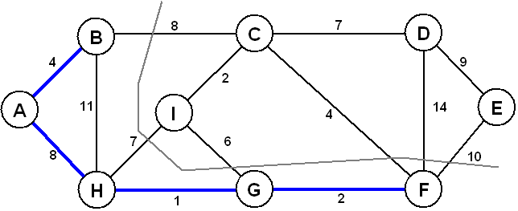
Prim's algorithm

Slide 32
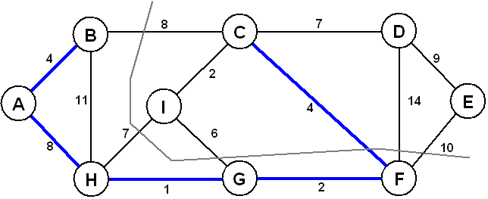
Prim's algorithm

Slide 33
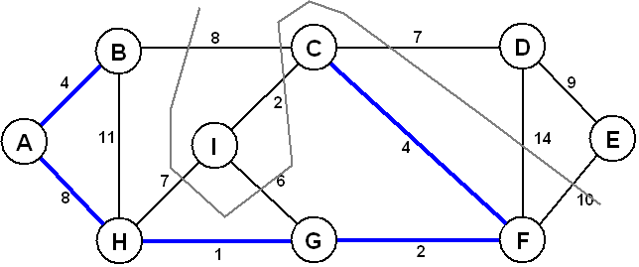
Prim's algorithm

Slide 34
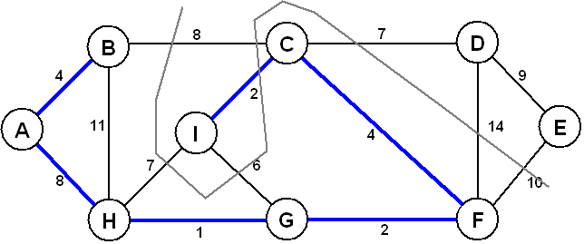
Prim's algorithm

Slide 35
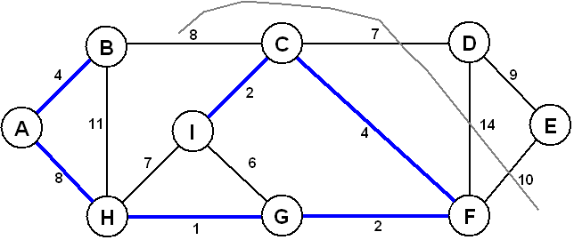
Prim's algorithm

Slide 36
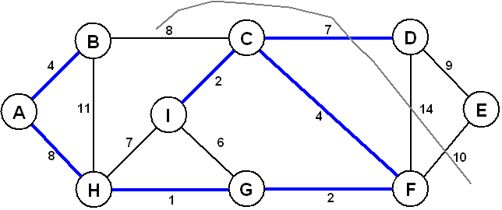
Prim's algorithm

Slide 37
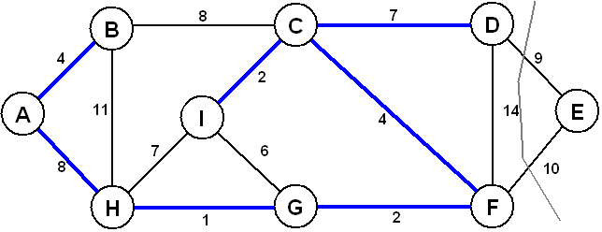
Prim's algorithm

Slide 38
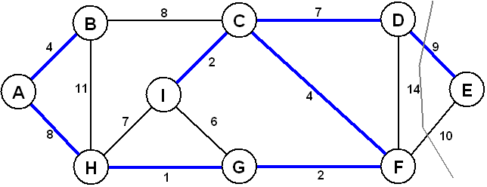
Prim's algorithm

Slide 39
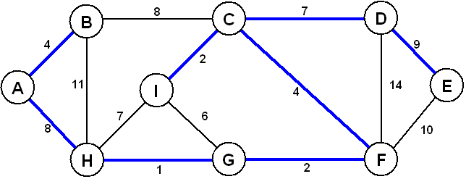
Prim's algorithm

