Slide 1
Linear-Time Sorting Algorithms

Slide 2
Sorting So Far
O(n²) sorts:
  Easy to code
  Fast on small inputs (less than ~50 elements)

Slide 3
Sorting So Far
Heap sort:
  Uses the very useful heap data structure
    Complete binary tree
    Heap property: parent key > children’s keys
  O(n lg n) worst case
  Sorts in place
  Fair amount of shuffling memory around

Slide 4
Sorting So Far
Merge sort:
  Divide-and-conquer:
    Split array in half
    Recursively sort subarrays
    Linear-time merge step
  O(n lg n) worst case
  Doesn’t sort in place

Slide 5
Sorting So Far
Quick sort:
  Divide-and-conquer:
    Partition array into two subarrays, recursively sort
    All of first subarray < all of second subarray
    No merge step needed!
  O(n lg n) average case
  Fast in practice
  O(n²) worst case
    Naïve implementation: worst case on sorted input
    Address this with randomized quicksort

Slide 6
How Fast Can We Sort?
First, an observation: all of the sorting algorithms so far are comparison sorts
  The only operation used to gain ordering information about a sequence is the pairwise comparison of two elements
  Theorem: all comparison sorts are Ω(n lg n)

Slide 7
Sorting In Linear Time
Counting sort
No comparisons between elements!
But…depends on assumption about the numbers being sorted
  We assume numbers are in the range 1.. k
The algorithm:
  Input: A[1..n], where A[j] ∈ {0, 1, 2, …, k}
  Output: B[1..n], sorted (notice: not sorting in place)
  Also: Array C[0..k] for auxiliary storage

Slide 8
Counting Sort
General idea behind counting sort:
For each input element x, determine the number of elements less than x. Note: This information is found through counting, not through comparisons. Use this information to place x into the correct position in the output array.
For example, if there are 12 elements less than x, then x can be placed in the 13th position.

Slide 9
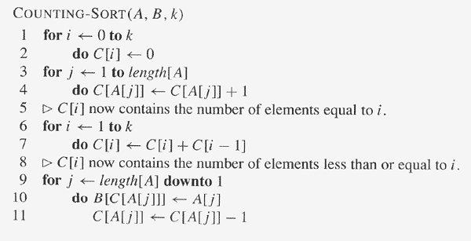
COUNTING-SORT assumes that each of the input elements is an integer
in the range 0 to k, inclusive.
A [1..n] is the input array, B [1..n] is the output array, C [0..k] is a
temporary working array.

Slide 10
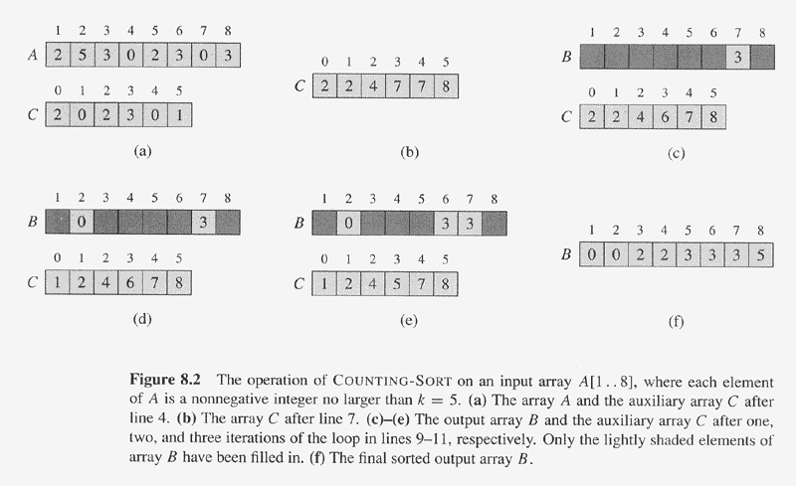

Slide 11
COUNTING-SORT assumes that each of the input elements is an integer
in the range 0 to k, inclusive.
A [1..n] is the input array, B [1..n] is the output array, C [0..k] is a
temporary working array.
Takes time O(k)
Takes time O(n)
The running time of COUNTING-SORT is Θ(k+n), which is Θ(n) if k ≤ n.

Slide 12
Counting Sort
Cool! Why don’t we always use counting sort?
Because it depends on range k of elements

Slide 13
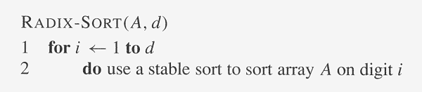
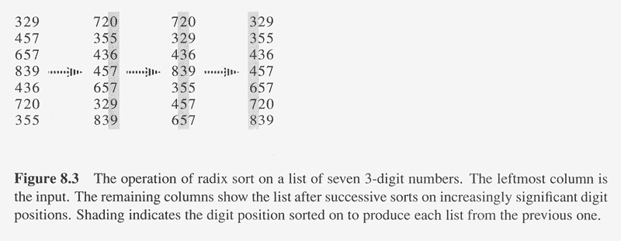
Radix Sort

Slide 14
Radix Sort
Intuitively, you might sort on the most significant digit, then the second msd, etc.
Problem: lots of intermediate piles of cards (read: scratch arrays) to keep track of
Key idea: sort the least significant digit first
  RadixSort(A, d)
  for i=1 to d
  StableSort(A) on digit i
  Example: Fig 9.3

Slide 15
Radix Sort
Can we prove it will work?
Sketch of an inductive argument (induction on the number of passes):
  Assume lower-order digits {j: j<i}are sorted
  Show that sorting next digit i leaves array correctly sorted
    If two digits at position i are different, ordering numbers by that digit is correct (lower-order digits irrelevant)
    If they are the same, numbers are already sorted on the lower-order digits. Since we use a stable sort, the numbers stay in the right order

Slide 16
Radix Sort
What sort will we use to sort on digits?
Counting sort is obvious choice:
  Sort n numbers on digits that range from 1..k
  Time: O(n + k)
Each pass over n numbers with d digits takes time O(n+k), so total time O(dn+dk)
  When d is constant and k=O(n), takes O(n) time
How many bits in a computer word?

Slide 17
Radix Sort
Problem: sort 1 million 64-bit numbers
  Treat as four-digit radix 2¹⁶ numbers
  Can sort in just four passes with radix sort!
Compares well with typical O(n lg n) comparison sort
  Requires approx. lg n operations per number being sorted (approx. 20 for 1 million numbers)
So why would we ever use anything but radix sort?

Slide 18
Radix Sort
In general, radix sort based on counting sort is
  Fast
  Asymptotically fast (i.e., O(n))
  Simple to code
  A good choice
To think about: Can radix sort be used on floating-point numbers?

Slide 19
Bucket Sort
Bucket sort
  Assumption: input is n reals from [0, 1)
  Basic idea:
    Create n linked lists (buckets) to divide interval [0,1) into subintervals of size 1/n
    Add each input element to appropriate bucket and sort buckets with insertion sort
  Uniform input distribution  O(1) bucket size
    Therefore the expected total time is O(n)
  These ideas will return when we study hash tables

