Slide 1
Hashing
Lecture based on information from http://www.nist.gov/dads/

Slide 2
Uses of Hashing
Encryption
Error Correction
Valid file structure
Dictionary Lookup

Slide 3
Hashing - Terms
A dictionary in which keys are mapped to array positions by hash functions.
Having the keys of more than one item map to the same position is called a collision.
There are many collision resolution schemes, but they may be divided into open addressing and chaining.
Perfect hashing avoids collisions, but may be time-consuming to create.
Load Factor - The number of elements in a hash table divided by the number of slots. Usually written as α (alpha).

Slide 4
Hash Function
Any well-defined procedure or mathematical function for turning some kind of data into a relatively small integer, that may serve as an index into an array.
The values returned by a hash function are called:
  Hash values
  Hash codes
  Hash sums
  or simply hashes
List of hash functions from Wikipedia

Slide 5
Hashing - More Terms
Key The part of a group of data by which it is sorted, indexed, cross referenced
Collision - When two or more items should be kept in the same location, especially in hash tables, that is, when two or more different keys hash to the same value.
Collision Resolution Scheme - A way of handling collisions, that is, when two or more items should be kept in the same location.

Slide 6
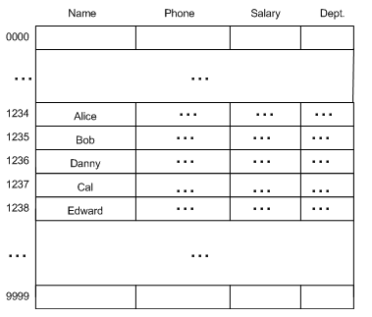
Example Hash Function
If we design the proper hash function, we could (in theory) insert and retrieve info in O(1) time.
For example our hash function here is:
H(x) = last four digits of x
Where x = ssn.
http://msdn.microsoft.com/

Slide 7
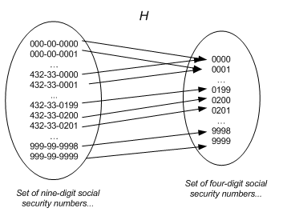
Basic Idea
In other words, our hash function h(x) “maps” a social security number to a specific value.
See any problems??
http://msdn.microsoft.com/

Slide 8
Hash Function
Assume that the hashtable has size M
There is a hashfunction H, which maps an element to a value p in 0,….M-1, and the element is placed in position p in the hashtable.
If H(i) = k, then the element is added to Hashtable[k].
The simplest example is the mod function
H(i) = i modulo M.

Slide 9
Basic Example
Hash function: i % M
Size of hashtable:M = 5
List of values: 1 , 3, 9, 8
1
3
9
8
Where does 8 go??

Slide 10
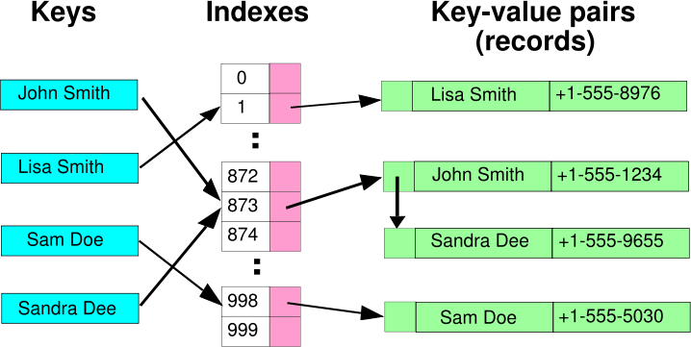
Collision
What is a collision
http://msdn.microsoft.com/

Slide 11
Collision
Hash functions are chosen so that the hash values are spread over 0,…..M-1, and there are only minimal collisions.
If we have a hash function that never results in a collision we have what’s called a “Perfect Hash”
Typically, collisions exist and must be dealt with.
Dealing with collisions is called “Collision Resolution”

Slide 12
Collision Resolution
Two major classes of collision resolution
  Open addressing
  Chaining

Slide 13
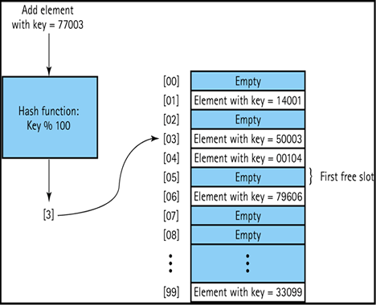
Open addressing
Open Addressing places the hashed value IN the hash table
http://faculty.juniata.edu/kruse/cs2java/hashing.htm

Slide 14
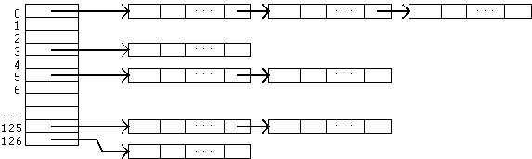
Chaining
Chaining places the hashed value in a list POINTED to by the hash table
http://faculty.juniata.edu/kruse/cs2java/hashing.htm

Slide 15
Chaining
Separate Chaining - A scheme in which each position in the hash table has a list to handle collisions.
  Each position may be just a link to the list (direct chaining) or may be an item and a link, essentially, the head of a list.
  In the latter, one item is in the table, and other colliding items are in the list.
Direct Chaining - A collision resolution scheme in which the hash table is an array of links to lists.
  Each list holds all the items with the same hash value.

Slide 16
Separate Chaining (collision resolution)
M = 9
Insert 12
h(12 mod 9) = 3
Insert 10
h(10 mod 9) = 1
insert 13
h(13 mod 9) = 4
insert 19
h(19 mod 9) = 1
insert 28
h(28 mod 9) = 1
1
10
19
28
3
12
9
13

Slide 17
Collision Resolution
Open Addressing - A class of collision resolution schemes in which all items are stored within the hash table.
  In case of collision, other positions are computed and checked (a probe sequence) until an empty position is found.
  Some ways of computing possible new positions are less efficient because of clustering.
  Three methods of Open Addressing Collision Resolution are
    1- linear probing 2- quadratic probing 3- double hashing
  Probe Sequence - The list of locations which a method for open addressing produces as alternatives in case of a collision.
  Open addressing has the possibility of clustering values in the hash table

Slide 18
Clustering
The tendency for entries in a hash table which uses open addressing to be stored together (in close proximity), even when the table has ample empty space to spread them out.
  Primary Clustering - The tendency for some collision resolution schemes to create long runs of filled slots at the hash function position.
  Secondary Clustering - The tendency for some collision resolution schemes to create long probe sequences of filled slots.

Slide 19
Linear Probing
A hash table in which a collision is resolved by putting the item in the next empty place in the array following the occupied place. Even with a moderate load factor, primary clustering tends to slow retrieval.

Slide 20
Quadratic Probing
A method of open addressing for a hash table in which a collision is resolved by putting the item in the next empty place given by a probe sequence. The space between places in the sequence increases quadratically.
The space between places in the sequence increases quadratically.
(h(K) + i²) + mod m

Slide 21
Pseudo Random Probing
You tell me….

Slide 22
Double Hashing
A method of open addressing for a hash table in which a collision is resolved by searching the table for an empty place at intervals given by a different hash function, thus minimizing clustering.
Example: 1 + k mod (m-1) could be your second hash function
Helps with secondary clustering

Slide 23
Probing Example(collision resolution)
M = 9
Insert 12
h(12 mod 9) = 3
Insert 10
h(10 mod 9) = 1
insert 13
h(13 mod 9) = 4
insert 19
h(19 mod 9) = 1
insert 28
h(28 mod 9) = 1
1
1
10
19
28
10
3
3
12
9
9
13
12
13
19
28
Linear Probing Chaining

Slide 24
Hashing Functions
What makes a good hash function.
  Any key is as likely to hash to any of the 1…m slots as any other.
Types of functions
  Use key value as index (direct access)
  Interpret keys as natural numbers
  Multiplication
  Division

Slide 25
Perfect Hashing
A hash function that maps each different key to a distinct integer. Usually all possible keys must be known beforehand. A hash table that uses a perfect hash has no collisions.

Slide 26
Not only numbers
We may want to store elements which are not numbers, e.g., names.
Then we use a function to convert each element to an integer and hash the integer.
Example:
Jones
J = ascii(J) = 74 +
o = ascii(o) = 111 +
n = ascii(n) = 110+
e = ascii(e) = 101 +
s = ascii(s) = 115
hash value = 511 % (size of array)

Slide 27
Example Functions
Interpret Keys
Convert a key to a natural number using radix-128
k = mgr
mgr = ascii(m)*128^{^0} + ascii(g)*128^1 + ascii(r)*128^2
h(k) = h(mgr) = 109*1 + 103*128 + 114*16384
= 1881069 (maybe) :)

Slide 28
Example Functions
Direct Access
Use a data value as index to the table
Not always possible

Slide 29
Example Functions
Division
h(k) = k mod m
  where k is the key value and m is the table size
Try to avoid certain values of m.
m should no be a power of 2, since m = 2^p, then h(k) is just the p lowest-order bits of k.
Powers of 10 should also be avoided
Tables with sizes that are primes not to close to powers of 2 are good

Slide 30
Example Functions
Division
Example
  n = 2000 character strings where each character has 8 bits
  We don’t mind searching average of 3 elements in a search so we set hash table size m = 701
  701 is chosen because it is a prime near 2000/3 but not close to a power of 2
  2000/3 is the load factor or α

Slide 31
Example Functions
Multiplication
Formal Definition: h(k) = floor(m(k A (mod 1))) , where m is usually an integer 2^{p} and A is an irrational number (or an approximation thereto) 0 < A < 1. The modulo 1 operation removes the integer part of k × A.
Example: A = 0.61803399
m = 19
k = 7
floor(19(7*0.61803399(mod 1))) floor(6.19852067) 6
Example (not of perfect hashing)

Slide 32
Example Functions
Elf Hash
/*---ElfHash----------------------------------------------------------------- *
The published hash algorithm used in the UNIX ELF format * for object files. Accepts a pointer to a string to be hashed * and returns an unsigned long.
*-------------------------------------------------------------------------*/
unsigned long ElfHash(const unsigned char *name) {
unsigned long h=0, g;
while (*name) {
h = (h << 4) + *name++;
if (g = h & 0xF0000000)
h ^= g >> 24; h &= ~g;
}
return h;
}
Bitwise Operators

Slide 33
Special-purpose hash functions
In many such cases, one can design a special-purpose (heuristic) hash function that yield many fewer collisions than a good general-purpose hash function.
For example, suppose that the input data are file names such as FILE0000.CHK, FILE0001.CHK, FILE0002.CHK, etc., with mostly sequential numbers. For such data, a function that extracts the numeric part k of the file name and returns k mod n would be nearly optimal.
Needless to say, a function that is exceptionally good for a specific kind of data may have dismal performance on data with different distribution.

Slide 34
Checksum Hash functions
One can obtain good general-purpose hash functions for string data by adapting certain checksum or fingerprinting algorithms.
Some of those algorithms will map arbitrary long string data z, with any typical real-world distribution --- no matter how non-uniform and dependent --- to a fixed length bit string, with a fairly uniform distribution.
This string can be interpreted as a binary integer k, and turned into a hash value by the formula h = k mod n.
This method will produce a fairly even distribution of hash values, as long as the hash range size n is small compared to the range of the checksum function.
Bob Jenkins' LOOKUP3 algorithm[1] uses a 32-bit checksum. A 64-bit checksum should provide adequate hashing for tables of any feasible size.

Slide 35
Cryptographic Hash
Hash functions, such as MD5, have even stronger uniformity guarantees than checksums or fingerprints, and thus can provide very good general-purpose hashing functions. However, the uniformity advantage may be too small to offset their much higher cost.

