Slide 1
Quicksort
Analysis of Quick Sort

Slide 2
Quick sort
Quicksort an n-element array:
Divide: Partition the array into two subarrays around a pivot x such that elements in lower subarray ≤ x ≤ elements in upper subarray.
Conquer: Recursively sort the two subarrays.
Combine: Trivial.
≤ x
x
≥ x
Key: Linear-time partitioning subroutine.

Slide 3
Partition
All the action takes place in the partition() function
  Rearranges the subarray in place
  End result: two subarrays
    All values in first subarray ≤ all values in second
  Returns the index of the “pivot” element separating the two subarrays
  Implementation of partition()varies
p
q
r
≤ x
x
≥ x

Slide 4
Pseudocode for quicksort
QUICKSORT(A, p, r)
  if p < r
    then q ← PARTITION(A, p, r) QUICKSORT(A, p, q–1)
      QUICKSORT(A, q+1, r)
Initial call: QUICKSORT(A, 0, n-1)
n = size of array

Slide 5
Partition Algorithm
int Partition(A, beg, end):
  Select an element to act as the “pivot” (Ex. A[beg])
  Swap values so that all values to the right of the pivot are larger than pivot and all values to the left are less than the pivot. Values equal to the pivot can be to the left or right, depending on how you write the code.
  After partition is called, the pivot will be in the correct position of the array.
  Return the index of the pivot.

Slide 6
Partition Example
Scan from end opposite of pivot until number less than pivot is encountered.
6
10
5
8
13
3
2
11
Swap and begin scanning from opposite end. Repeat process.
2
10
5
8
13
3
6
11
2
6
5
8
13
3
10
11
2
3
5
8
13
6
10
11
2
3
5
6
13
8
10
11
  Quick-sort with Hungarian (Küküllőmenti legényes) folk dance

Slide 7
Analysis of quicksort
Assume all input elements are distinct.
In practice, there are better partitioning algorithms for when duplicate input elements may exist.
Let T(n) = worst-case running time on an array of n elements.

Slide 8
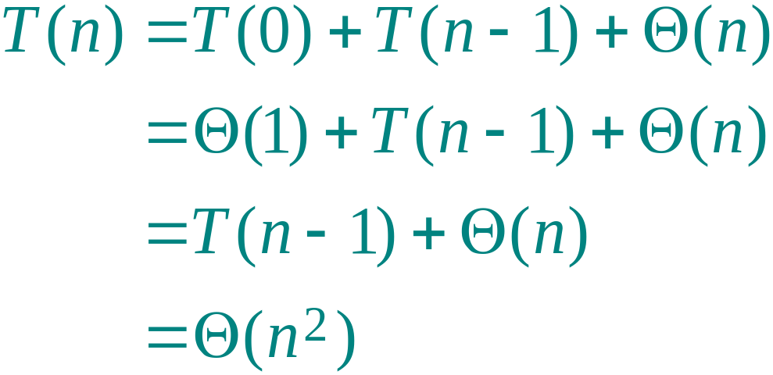
Worst-case of quicksort
Input sorted or reverse sorted.
Partition around min or max element.
One side of partition always has no elements.
(arithmetic series)

Slide 9
Best-case analysis
(For intuition only!)
If we’re lucky, PARTITION splits the array evenly:
T(n) = 2T(n/2) + Θ(n)
= Θ(n log n)
(same as merge sort)

Slide 10
Quicksort Runtimes
Best-case runtime T_{best}(n) ∈ Θ(n log n)
Worst-case runtime T_{worst}(n) ∈ Θ(n²)
Worse than mergesort? Why is it called quicksort then?
Its average runtime T_{avg}(n) ∈ Θ(n log n )

