Slide 1
Huffman Codes
Provide a unique way of using Binary Tree to “compress” data.
Each letter gets a binary code

Slide 2
Huffman Codes
Binary trees can be used in an interesting way to construct minimal length encodings for messages when the frequency of letters used in the messages is known. A special kind of binary tree, called a Huffman coding tree is used to accomplish this.

Slide 3
Huffman Codes
Letter | Frequency
E | 29
I | 5
N | 7
P | 12
S | 4
T | 8

Slide 4
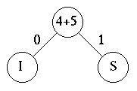
Huffman Tree
To build the Huffman tree, we sort the frequencies into increasing order (4, 5, 7, 8, 12, 29).
Then we choose the two smallest values, 4 and 5, and construct a binary tree with labeled edges:
Letter | Frequency
S | 4
I | 5
N | 7
T | 8
P | 12
E | 29

Slide 5
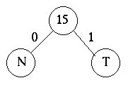
Next, we replace the two smallest values 4 and 5 with their sum, getting a new sequence, (7, 8, 9, 12, 29).
We again take the two smallest values and construct a labeled binary tree:
Letter | Frequency
N | 7
T | 8
S,I | 9
P | 12
E | 29

Slide 6
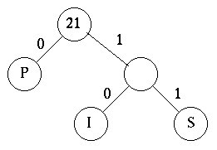
We now have the frequencies (15, 9, 12, 29)
Which must be sorted into (9, 12, 15, 29)
The two lowest are selected once again.

Slide 7
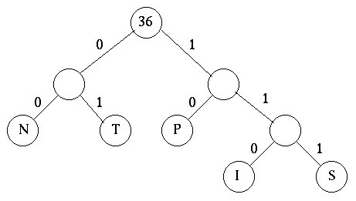
Now, we combine the two lowest which are 15 and 21 to give the tree below:

Slide 8
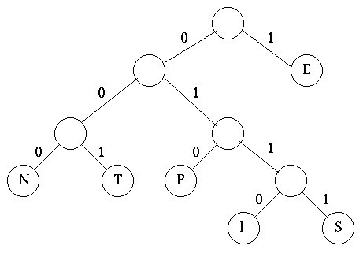
The two remaining frequencies, 36 and 29, are now combined into the final tree. Notice that it does not make any difference which one is placed as the left subtree and which in the right subtree.

Slide 9
From this final tree, we find the encoding for this alphabet:
Letter | Code
E | 1
I | 0110
P | 010
N | 000
S | 0111
T | 001

Slide 10
Using this code, a message like SENT would be coded as 01111000001.
This code is called a prefix encoding. As soon as a 1 is read, you know it is an E.
0110 is an I - you do not need to see any more bits.
When a 01 is seen, it is either I or P or S, etc.

Slide 11
If the message had been coded in the "normal" way, each letter would have required 3 bits.
The entire message is 65 characters long so 195 bits would be needed to code the message (3*65).
Using the Huffman code, the message requires:
1*29+4*5+3*12+3*7+4*4+3*8=146 bits.

Slide 12
This code can be applied to the English Language by using average frequency counts for the letters.

