Slide 1
AVL Trees
Terry Griffin
Computer Science II
Midwestern State University

Slide 2

The AVL tree overview and explanation of it’s operations were all taken from http://en.wikipedia.org/wiki/AVL_tree
Wikipedia’s copy write information can be viewed here: http://en.wikipedia.org/wiki/Wikipedia:Copyrights

Slide 3

AVL Tree Overview
A self-balancing binary search tree (the first such data structure to be invented).
The heights of the left and right subtrees differ by no more than 1 level.
Lookup, insertion, and deletion all take O(log n) time in both the average and worst cases.
Additions and deletions may require the tree to be rebalanced by one or more tree rotations.

Slide 4
AVL Tree Overview
The balance factor of a node is the height of its right subtree minus the height of its left subtree.
A node with balance factor 1, 0, or -1 is considered balanced.
A node with any other balance factor is considered unbalanced and requires rebalancing the tree.
The balance factor is either stored directly at each node or computed from the heights of the subtrees.

Slide 5
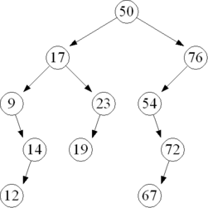
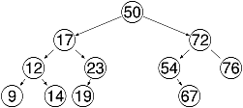
Non AVL Tree Height Balanced Tree
images: wikipedia.org

Slide 6
Operations
The basic operations of an AVL tree generally involve carrying out the same algorithms as would be carried out on an unbalanced binary search tree.
The difference is they are preceded or followed by one or more of the so-called "AVL rotations."

Slide 7
Insertion
Insertion into an AVL tree may be carried out by inserting the given value into the tree as if it were an unbalanced binary search tree, and then retracing one's steps toward the root updating the balance factor of the nodes.
Retracing is stopped when a node's balance factor becomes 0, 1, or -1.
If the balance factor becomes 0 then the height of the subtree hasn't changed because of the insert. The insertion is finished.

Slide 8
Insertion
If the balance factor becomes 2 or -2 then the tree rooted at this node is unbalanced, and a tree rotation is needed.
The tree rotation will always leave the subtree evenly balanced. The rotation can be done in constant time.

Slide 9
Insertion
Similar to an unbalanced binary search tree, insertion takes O(height) time.
This is O(height) to find the insertion point plus O(height) to check for any needed rotations.
The balanced nature of the AVL tree provides us with an upper bound on its height:
  at most 1.44 lg(n + 2)
  So the insertion process in total takes O(log n) time.

Slide 10
Deletion
If the node is a leaf, remove it.
If the node is not a leaf, replace it with either the largest in its left subtree or the smallest in its right subtree, and remove that node.
Thus the node that is removed has at most one child.
After deletion retrace the path back up the tree to the root, adjusting the balance factors as needed.

Slide 11
Deletion
The retracing can stop if the balance factor becomes -1 or 1 indicating that the height of that subtree has remained unchanged.
If the balance factor becomes 0 then the height of the subtree has decreased by one and the retracing needs to continue.
If the balance factor becomes -2 or 2 then the subtree is unbalanced and needs to be rotated to fix it.
If the rotation leaves the subtree's balance factor at 0 then the retracing towards the root must continue since the height of this subtree has decreased by one.
This is in contrast to an insertion where a rotation resulting in a balance factor of 0 indicated that the subtree's height has remained unchanged.

Slide 12
Deletion
The time required is O(h) for lookup plus O(h) rotations on the way back to the root.
So the operation can be completed in O(log n) time.

Slide 13
Lookup
Lookup in an AVL tree is performed exactly as in an unbalanced binary search tree.
But is guaranteed to takes O(log n) time, since an AVL tree is always kept balanced (this is not guaranteed in a BST).
No special provisions need to be taken, and the tree's structure is not modified by lookups.

Slide 14
Rotation
A tree rotation is an operation on a binary search tree that changes the structure without interfering with the order of the elements.
A tree rotation moves one node up in the tree and one node down.
They are used to change the shape of the tree, and in particular to decrease its height by moving smaller subtrees down and larger subtrees up, resulting in improved performance of many tree operations.

Slide 15
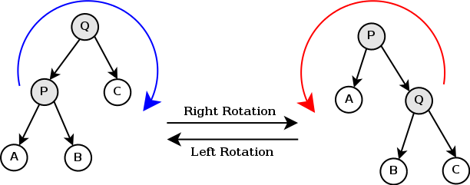
Rotation

Slide 16
Right Rotation
Root
Q
P
C
A
B

Slide 17
Right Rotation
Root
Q
P
C
A
B

Slide 18
Right Rotation
Root
Q
P
C
A
B

Slide 19
Right Rotation
Root
Q
P
C
B
A

Slide 20
Right Rotation
Root
P
Q
A
C
B

Slide 21
Right Rotation
Root
P
A
Q
B
C

Slide 22
Left Rotation
Root
P
A
Q
B
C

Slide 23
Left Rotation
Root
P
A
Q
B
C

Slide 24
Left Rotation
Root
P
A
Q
B
C

Slide 25
Left Rotation
Root
P
A
Q
B
C

Slide 26
Left Rotation
Root
Q
P
C
A
B

Slide 27
Left Rotation
Root
Q
P
C
A
B

Slide 28
Left Rotation
Root
Q
P
C
A
B

Slide 29
Left Rotation
Root
Q
P
C
A
B

Slide 30
Double Rotations
What if we added a node that ended up as one of B’s Children??
Root
Q
P
C
A
B

Slide 31
Double Rotations
Is our tree balanced?? No so we do a right rotation, correct?
Root
Q
P
C
A
B
D

Slide 32
Double Rotations
Lets try….
Root
Q
P
C
A
B
D

Slide 33
Double Rotations
Lets try….
Root
Q
P
C
A
B
D

Slide 34
Double Rotations
Lets try….
Root
Q
P
C
A
B
D

Slide 35
Double Rotations
Are we balanced??
Root
P
A
Q
C
B
D

Slide 36
Double Rotations
The reason our right rotation did not work, is because the left subtree has a positive balance factor, and is thus right heavy.
Root
Q
P
C
A
B
D

Slide 37
Double Rotations
To fix the problem, we must do a “left rotation” on the “right” subtree to make it left heavy.
Then can do a “right rotation” on the rest of the tree and it will be balanced.
Root
Q
P
C
A
B
D

Slide 38
Double Rotations
Do a left rotation on the “right subtree”
Root
Q
P
C
SubRoot
A
B
D

Slide 39
Double Rotations
Do a left rotation on the “right subtree”
Root
Q
P
C
SubRoot
A
B
D

Slide 40
Double Rotations
Do a left rotation on the “right subtree”
Root
Q
P
C
SubRoot
A
B
D

Slide 41
Double Rotations
Now our “left” subtree is “left” heavy and we can do a “right” rotation on the tree itself
Root
Q
B
C
P
D
A

Slide 42
Double Rotations
Now our “left” subtree is “left” heavy and we can do a “right” rotation on the tree itself
Root
Q
B
C
P
D
A

Slide 43
Double Rotations
Now our “left” subtree is “left” heavy and we can do a “right” rotation on the tree itself
Root
Q
B
C
P
D
A

Slide 44
Double Rotations
Now our “left” subtree is “left” heavy and we can do a “right” rotation on the tree itself
Root
Q
B
C
P
D
A

Slide 45
Double Rotations
Now our “left” subtree is “left” heavy and we can do a “right” rotation on the tree itself
Root
Q
B
C
P
D
A

Slide 46
Double Rotations
Now our “left” subtree is “left” heavy and we can do a “right” rotation on the tree itself
Root
Q
B
D
P
C
A

Slide 47
Double Rotations
Now our “left” subtree is “left” heavy and we can do a “right” rotation on the tree itself
B
Root
P
Q
A
D
C

Slide 48
An Extended Example
Insert 3,2,1,4,5,6,7, 16,15,14

Slide 49
An Extended Example
Insert 3,2,1,4,5,6,7, 16,15,14
Insert Value
3

Slide 50
An Extended Example
Insert 3,2,1,4,5,6,7, 16,15,14
Calculate Balance Factor
3
0

Slide 51
An Extended Example
Insert 3,2,1,4,5,6,7, 16,15,14
Insert Value
3
0
2

Slide 52
An Extended Example
Insert 3,2,1,4,5,6,7, 16,15,14
Calculate Balance Factors
3
1
2
0

Slide 53
An Extended Example
Insert 3,2,1,4,5,6,7, 16,15,14
Insert Value
3
1
2
0
1

Slide 54
An Extended Example
Insert 3,2,1,4,5,6,7, 16,15,14
Calculate BF’s
3
2
2
1
1
0

Slide 55
An Extended Example
Insert 3,2,1,4,5,6,7, 16,15,14
Rotate and re-calculate
2
0
1
3
0
0

Slide 56
An Extended Example
Insert 3,2,1,4,5,6,7, 16,15,14
Insert Value
2
0
1
3
0
0
4

Slide 57
An Extended Example
Insert 3,2,1,4,5,6,7, 16,15,14
Calculate BF’s
2
-1
1
3
0
-1
4
0

Slide 58
An Extended Example
Insert 3,2,1,4,5,6,7, 16,15,14
Insert Value
2
-1
1
3
0
-1
4
0
5

Slide 59
An Extended Example
Insert 3,2,1,4,5,6,7, 16,15,14
Calculate BF’s
2
-1
1
3
0
-2
4
-1
5
0

Slide 60
An Extended Example
Insert 3,2,1,4,5,6,7, 16,15,14
Rotate and re-calculate
2
-1
1
4
0
0
3
5
0
0

Slide 61
An Extended Example
Insert 3,2,1,4,5,6,7, 16,15,14
Insert Value
2
-1
1
4
0
0
3
5
0
0
6

Slide 62
An Extended Example
Insert 3,2,1,4,5,6,7, 16,15,14
Calculate BF’s
2
-2
1
4
0
-1
3
5
0
-1
6
0

Slide 63
An Extended Example
Insert 3,2,1,4,5,6,7, 16,15,14
Rotate and re-calculate
4
0
2
5
0
-1
1
3
6
0
0
0

Slide 64
An Extended Example
Insert 3,2,1,4,5,6,7, 16,15,14
Insert a value
4
0
2
5
0
-1
1
3
6
0
0
0
7

Slide 65
An Extended Example
Insert 3,2,1,4,5,6,7, 16,15,14
Calculate BF’s
4
0
2
5
0
-2
1
3
6
0
0
-1
7
0

Slide 66
An Extended Example
Insert 3,2,1,4,5,6,7, 16,15,14
Rotate and re-calculate
4
0
2
5
0
0
1
3
6
7
0
0
0
0

Slide 67
An Extended Example
Insert 3,2,1,4,5,6,7, 16,15,14
Insert a Value
4
0
2
5
0
0
1
3
6
7
0
0
0
0
16

Slide 68
An Extended Example
Insert 3,2,1,4,5,6,7, 16,15,14
Calculate BF’s
4
-1
2
5
0
-1
1
3
6
7
0
0
0
-1
16
0

Slide 69
An Extended Example
Insert 3,2,1,4,5,6,7, 16,15,14
Insert a value
4
-1
2
5
0
-1
1
3
6
7
0
0
0
-1
16
0
15

Slide 70
An Extended Example
Insert 3,2,1,4,5,6,7, 16,15,14
Calculate BF’s
4
-1
2
5
0
-1
1
3
6
7
0
0
0
-2
16
1
15
0

Slide 71
An Extended Example
Insert 3,2,1,4,5,6,7, 16,15,14
Rotate and Re-calculate
4
-1
2
5
0
-1
1
3
6
7
0
0
0
-2
16
1
15
0

Slide 72
An Extended Example
Insert 3,2,1,4,5,6,7, 16,15,14
Rotate and Re-calculate
4
-1
Right subtree
left heavy!!
2
5
0
-1
1
3
6
7
0
0
0
-2
16
1
15
0

Slide 73
An Extended Example
Insert 3,2,1,4,5,6,7, 16,15,14
Rotate
4
-1
Right rotate subsubtree
2
5
0
-1
1
3
6
7
0
0
0
-2
16
1
15
0

Slide 74
An Extended Example
Insert 3,2,1,4,5,6,7, 16,15,14
Rotate
4
-1
Right rotate subsubtree
2
5
0
-1
1
3
6
7
0
0
0
-2
15
1
16
0

Slide 75
An Extended Example
Insert 3,2,1,4,5,6,7, 16,15,14
Rotate
4
-1
Left rotate subtree
2
5
0
-1
1
3
6
7
0
0
0
-2
15
1
16
0

Slide 76
An Extended Example
Insert 3,2,1,4,5,6,7, 16,15,14
Rotate
4
-1
Left rotate subtree
2
5
0
-1
1
3
6
15
0
0
0
-2
7
16
0
1

Slide 77
An Extended Example
Insert 3,2,1,4,5,6,7, 16,15,14
Re-calculate BF’s
4
-1
2
5
0
-1
1
3
6
15
0
0
0
0
7
16
0
0

Slide 78
An Extended Example
Insert 3,2,1,4,5,6,7, 16,15,14
Insert Value
4
-1
2
5
0
-1
1
3
6
15
0
0
0
0
7
16
0
0
14

Slide 79
An Extended Example
Insert 3,2,1,4,5,6,7, 16,15,14
Calculate Bf’s
4
-1
2
5
0
-2
1
3
6
15
0
0
0
1
7
16
-1
0
14
0

Slide 80
An Extended Example
Insert 3,2,1,4,5,6,7, 16,15,14
Rotate and Re-calculate
4
-1
2
5
0
-2
1
3
6
15
0
0
0
1
7
16
-1
0
14
0

Slide 81
C++ Implementation
Before we talk about the specifics of AVL, lets visit again the basics of the BST.
  Inserting
  Deleting
  Searching

Slide 82
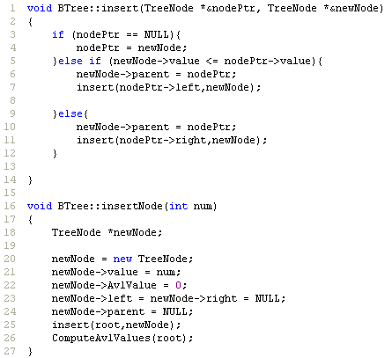
BST Insert

Slide 83
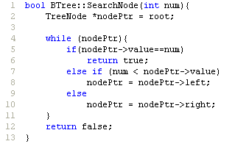
BST Search

Slide 84
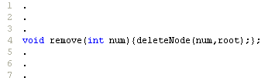
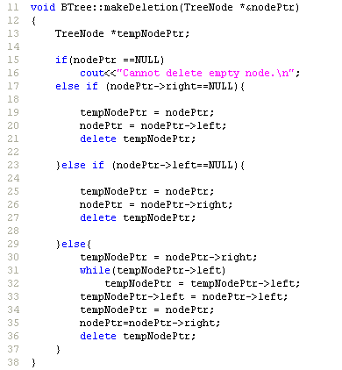
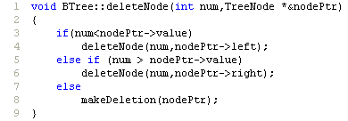
BST Delete

Slide 85
AVL Implementation
All methods mimic a BST implementation
  (with one tiny modification: rotations).
The addition of rotation keeps the tree balanced (as stated previously)
Rotations also add some complexity to the implementation.

Slide 86
AVL Implementation
Methods that “I” (meaning, not necessarily the best implementation) added to maintain the balance factor of each node (aka: AVL rules )
  Height – the height of a given tree.
  AvlValue – the Avl Value of a tree node.
  LeftHeavy – Is the left subtree heavier than the right?
  RightHeavy – Is the right subtree heavier than the left?
  RotateLeft – Performs a left rotation from a given node.
  RotateRight – Performs a right rotation from a given node.
  ComputeAvlValues – Computes avl values for entire tree.

Slide 87
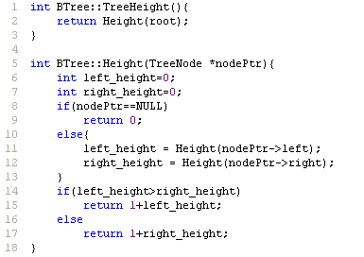
Height

Slide 88

AvlValue

Slide 89
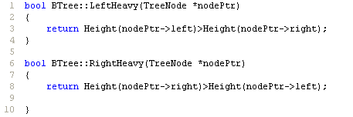
Left / Right Heavy

Slide 90
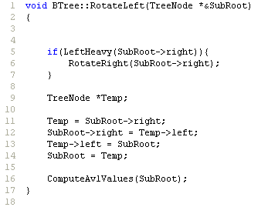
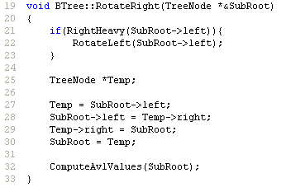
Rotate Left/Right

Slide 91
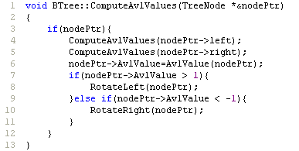
ComputeAvlValues

