Slide 1
Cmps 4663 Crypto
implementing our own public key Encryption layer

Slide 2
Terms
Just a few
Alice – Message sender or Receiver
Bob – Same as Alice
Usually Alice send to Bob (A to B get it!).
Eve – Eavesdropper (assumed to be intercepting signal , packets, whatever)
Packet Sniffer – Something that grabs and logs every packet sent on a network. This is a pretty easy task (google wireshark or snort).

Slide 3




INTRODUCTION
Oversimplified Symmetric Key Example
Bob wants to send a message to Alice
Bob
Alice
Did you know syphilis is still a thing? Lol. Ummmm We need to talk.
Did you know syphilis is still a thing? Lol. Ummmm We need to talk.
Eve
Eve employs her packet sniffer.

Slide 4




Just encrypt
Oversimplified Symmetric Key Example
Bob wants to send a message to Alice
Bob
Alice
I promise. Its not syphilis. Doc said Covid 19 and Syphilis have exact symptoms.
Eve

Slide 5
Send a Key
Oversimplified Symmetric Key Example
Bob wants to send a message to Alice
Bob
Alice
Eve

Slide 6

Send a Key
Oversimplified Symmetric Key Example
Bob wants to send a message to Alice
Bob
Alice
Eve

Slide 7
Send a Key
YES!!
Oversimplified Symmetric Key Example
Bob wants to send a message to Alice
Bob
Alice
Yes, you should go get tested for Syph errr Covid. And probably your sister.
YES!!
Eve

Slide 8
Resolution?
Bob
Assume there is always an EVE.
Alice
Eve

Slide 9

Resolution?
Bob
Use public key encryption!
Alice
Eve

Slide 10

Public key
Bob wants to send a message to Alice
Bob
Alice
We assume Eve is always listening!
Eve

Slide 11



Public key
Generate Keys
Bob and Alice Generate Keys
Bob
Alice
BOB
Public
Private
Public
Private
ALICE
BOB
Eve
ALICE

Slide 12
Public key
Swap Keys
Bob and Alice Swap Public Keys
Bob
Alice
ALICE
BOB
BOB
Public
Private
Public
Private
ALICE
BOB
Eve
ALICE

Slide 13
Public key
Swap Keys
They save their own keys, and each others public key.
Bob
Alice
ALICE
BOB
BOB
BOB
Eve
ALICE
ALICE

Slide 14
Public key
Save Each Others Public Key
Now when Bob wants to send Alice a message
He encrypts it with her public key
ALICE
BOB
BOB
Bob
Alice
ALICE
BOB
Eve
ALICE

Slide 15
Public key
Use Public Key to Encrypt
Now when Bob wants to send Alice a message
He encrypts it with her public key
ALICE
BOB
BOB
Bob
Alice
ALICE
ALICE
IUHFIUBADFIUAFOIUDFIOAUDHFQIUWFQPIUWEDHQOEWYRQERQEWRQPOEIWFJQIBUVCQIUGEWFKUQHEWBCA
BOB
Eve
ALICE

Slide 16
Public key
Use Private Key to Decrypt
When Alice receives the message, she decrypts it
with her private key
ALICE
BOB
BOB
Bob
Alice
ALICE
Do you know what HIPAA is? It means you can’t tell anyone about my Syph errr Covid.
ALICE
IUHFIUBADFIUAFOIUDFIOAUDHFQIUWFQPIUWEDHQOEWYRQERQEWRQPOEIWFJQIBUVCQIUGEWFKUQHEWBCA
BOB
Eve
ALICE

Slide 17

Client server
Flask Server1.py
Flask Server2.py
Client1.py
Client2.py

Slide 18
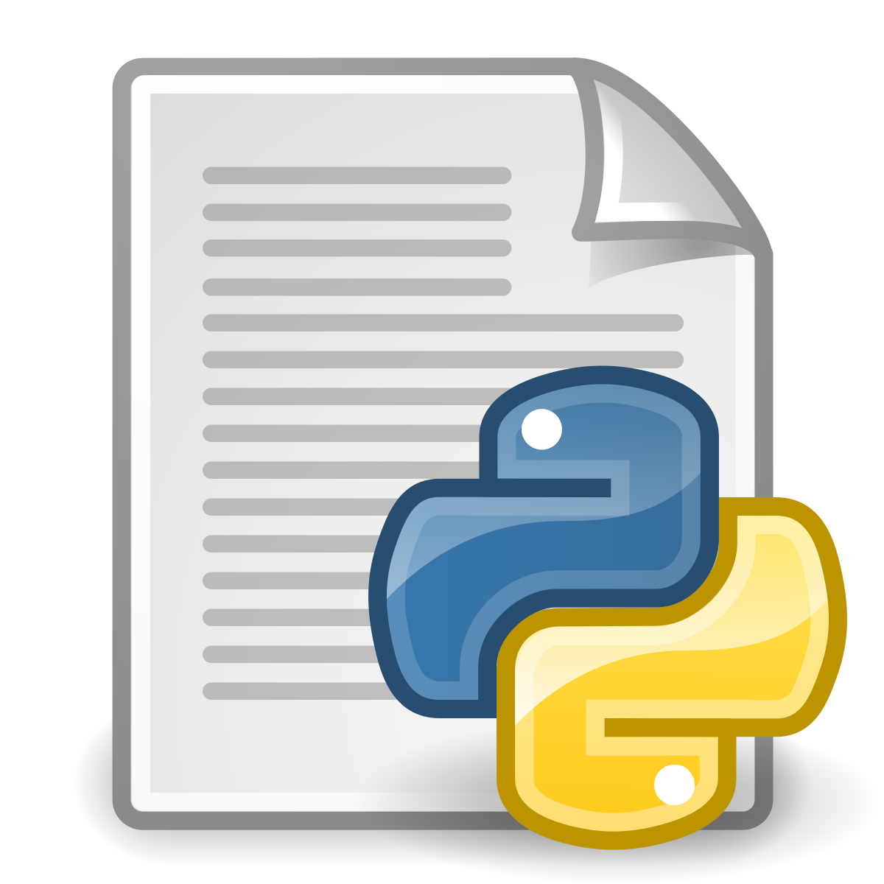

Client server
Flask Server1.py
Flask Server2.py
Client1.py
Client2.py

Slide 19
Client server
server.py
client.py

Slide 20
Client server
server.py
client.py
Our connection to “outside” world (other computers)
Listens on port for GET and POST requests
No interactive console
No connection to outside world
Our local interface to “server”
Provides interactive console

Slide 21
Flask
server.py
Flask
server.py
Client.py
Client.py

Slide 22

Flask
server.py
Flask
server.py
Client.py
Client.py

