Slide 1
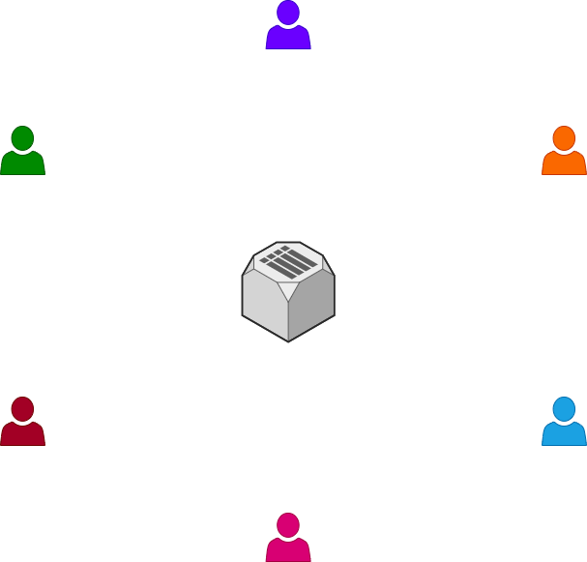






MESSAGE PASSING PROJECT
Uploading User Info

Slide 2






MESSAGE PASSING PROJECT
Uploading Public Keys

Slide 3
MESSAGE PASSING PROJECT
Download Public Keys

Slide 4


MESSAGE PASSING PROJECT
Encrypt w/ Public Key
Message Passing

Slide 5


MESSAGE PASSING PROJECT
Decrypt w/ Private Key
Message Passing

Slide 6
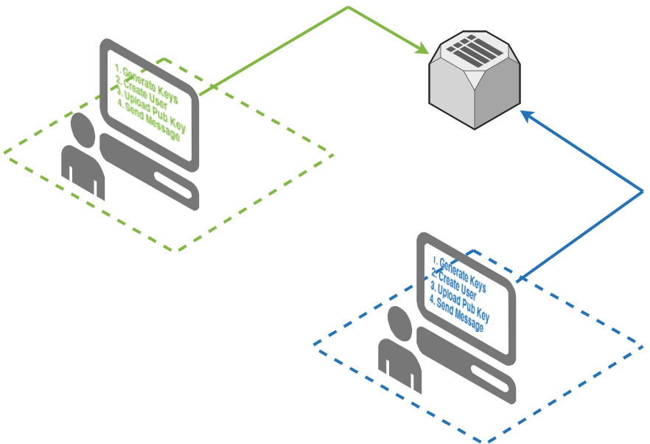
MESSAGE PASSING PROJECT
def sendMessage(from_id,to_id,message,token):
posturl = "http://msubackend.xyz/api/?route=postMessage"
payload = {
'from_id':from_id,
'to_id':to_id,
'message':message,
'token':token
}
headers = {'Content-Type': 'application/json’}
r = requests.post(posturl, headers=headers, json=payload)
from crypto_class import Crypto
C = Crypto()
C.generate_keys()
C.store_keys()
def publishKey(pubkey,uid,token):
posturl = "http://msubackend.xyz/api/?route=postPubKey"
payload = {
'pub_key':pubkey
'uid':uid,
'token':token
}
headers = {'Content-Type': 'application/json’}
r = requests.post( posturl, headers=headers, json=payload)
def createUser():
posturl = "http://msubackend.xyz/api/?route=postUser"
payload = {
'fname':"Quinton",
'lname':'tarantino’,
'screen_name':'pulpfiction’,
'email':'tarantino@imrich.com’,
'token':'12345’
}
headers = {'Content-Type': 'application/json’}
r = requests.post( posturl, headers=headers, json=payload)
return r.text['data'][uid]

Slide 7
MESSAGE PASSING PROJECT
from crypto_class import Crypto
C = Crypto()
C.generate_keys()
C.store_keys()
GENERATE KEYS

Slide 8

MESSAGE PASSING PROJECT
from crypto_class import Crypto
C = Crypto()
C.generate_keys()
C.store_keys()
GENERATE KEYS

Slide 9
MESSAGE PASSING PROJECT
from crypto_class import Crypto
C = Crypto()
C.generate_keys()
C.store_keys()
GENERATE KEYS

Slide 10

MESSAGE PASSING PROJECT
from crypto_class import Crypto
C = Crypto()
C.generate_keys()
C.store_keys()
GENERATE KEYS

Slide 11


MESSAGE PASSING PROJECT
def createUser():
posturl = "http://msubackend.xyz/api/?route=postUser"
payload = {
'fname':"Quinton",
'lname':'tarantino’,
'screen_name':'pulpfiction’,
'email':'tarantino@imrich.com’,
'token':'12345’
}
headers = {'Content-Type': 'application/json’}
r = requests.post( posturl, headers=headers, json=payload)
return r.text['data'][uid]
CREATE USER

Slide 12
MESSAGE PASSING PROJECT
def createUser():
posturl = "http://msubackend.xyz/api/?route=postUser"
payload = {
'fname':"Quinton",
'lname':'tarantino’,
'screen_name':'pulpfiction’,
'email':'tarantino@imrich.com’,
'token':'12345’
}
headers = {'Content-Type': 'application/json’}
r = requests.post( posturl, headers=headers, json=payload)
return r.text['data'][uid]
CREATE USER
1009287
1339500

Slide 13
MESSAGE PASSING PROJECT
def createUser():
posturl = "http://msubackend.xyz/api/?route=postUser"
payload = {
'fname':"Quinton",
'lname':'tarantino’,
'screen_name':'pulpfiction’,
'email':'tarantino@imrich.com’,
'token':'12345’
}
headers = {'Content-Type': 'application/json’}
r = requests.post( posturl, headers=headers, json=payload)
return r.text['data'][uid]
CREATE USER
1009287
1339500

Slide 14
MESSAGE PASSING PROJECT
def publishKey(pubkey,uid,token):
posturl = "http://msubackend.xyz/api/?route=postPubKey"
payload = {
'pub_key':pubkey
'uid':uid,
'token':token
}
headers = {'Content-Type': 'application/json’}
r = requests.post( posturl, headers=headers, json=payload)
PUBLISH KEY
1009287
1339500

Slide 15
MESSAGE PASSING PROJECT
def publishKey(pubkey,uid,token):
posturl = "http://msubackend.xyz/api/?route=postPubKey"
payload = {
'pub_key':pubkey
'uid':uid,
'token':token
}
headers = {'Content-Type': 'application/json’}
r = requests.post( posturl, headers=headers, json=payload)
PUBLISH KEY
1009287
1009287
1339500
1339500

Slide 16
MESSAGE PASSING PROJECT
def publishKey(pubkey,uid,token):
posturl = "http://msubackend.xyz/api/?route=postPubKey"
payload = {
'pub_key':pubkey
'uid':uid,
'token':token
}
headers = {'Content-Type': 'application/json’}
r = requests.post( posturl, headers=headers, json=payload)
PUBLISH KEY
1009287
1339500

Slide 17
MESSAGE PASSING PROJECT
SEND MESSAGE
GET ACTIVE USERS
GET PUBLIC KEY OF RECEIVER
ENCRYPT W/ RECEIVER PUBLIC KEY
SEND MESSAGE
1009287
1339500

Slide 18
MESSAGE PASSING PROJECT
GET ACTIVE USERS
GET PUBLIC KEY OF RECEIVER
ENCRYPT W/ RECEIVER PUBLIC KEY
SEND MESSAGE
SEND MESSAGE
http://msubackend.xyz/api/?route=getActive&token=[replace with your token]
{
"data": [
{
"uid": "102",
"last_connect": "1605891415"
},
{
"uid": "103",
"last_connect": "1605891422"
}
],
"count": 2,
"success": true
}

Slide 19
MESSAGE PASSING PROJECT
GET ACTIVE USERS
GET PUBLIC KEY OF RECEIVER
ENCRYPT W/ RECEIVER PUBLIC KEY
SEND MESSAGE
SEND MESSAGE
http://msubackend.xyz/api/?route=getPubKey&token=[replace with your token]&uid=23412
{
"data": [
{
"uid": ”23412",
"pubkey": "-----BEGIN PUBLIC KEY-----\nMIIBIjANBgkqhkiG9w0BAQEFAAOCAQ8AMIIBCgKCAQEAvI2QjAT3naoP8ZGFwKmc\n9b01//L0uUVKOZHRpnPGFgGklrFtqtljLcWlHnpzyq8SuI+4o8pPoDKLDLIREmbe\nfyiLTxs/nKFoOBUOOsY9PqdIruZU5oZDUgzg8wy5ODQIAR4SuxtnbSmy3IFp2zJB\nbNK1X4BLe/DsC+Xloc/R08EgKGUukXgMryhIKYCkrAyT/9YV5mxJzGvqYekqg0SL\nVGHkpH7UO7TQu9UpTCTasPjwePLKAb0PsmIDkjuBgkJo35hwK8HfIiYtwQxCdDWi\nINA7XYoy5/D11GauZN0a2/7mZU4uDY6iw2Js7wNlm6job93JVGTq4Fc9QGEZz6Pk\nTwIDAQAB\n-----END PUBLIC KEY-----"
}
],
"count": 1,
"success": true
}

Slide 20
MESSAGE PASSING PROJECT
GET ACTIVE USERS
GET PUBLIC KEY OF RECEIVER
ENCRYPT W/ RECEIVER PUBLIC KEY
SEND MESSAGE
SEND MESSAGE
def encrypt(self,plaintext):
# Encrypting With Public Key
# make sure the text is "bytes"
# this is typically shown like this: b'message' (see the b before the quotes?)
plaintext = str.encode(plaintext)
encrypted = self.public_key.encrypt(
plaintext,
padding.OAEP(
mgf=padding.MGF1(algorithm=hashes.SHA256()),
algorithm=hashes.SHA256(),
label=None
)
)
return encrypted

Slide 21
MESSAGE PASSING PROJECT
def sendMessage(from_id,to_id,message,token):
posturl = "http://msubackend.xyz/api/?route=postMessage"
payload = {
'from_id':from_id,
'to_id':to_id,
'message':message,
'token':token
}
headers = {'Content-Type': 'application/json’}
r = requests.post(posturl, headers=headers, json=payload)
SEND MESSAGE
1009287
1339500

Slide 22



MESSAGE PASSING PROJECT
RECEIVE MESSAGES
1009287
1339500

