Slide 1
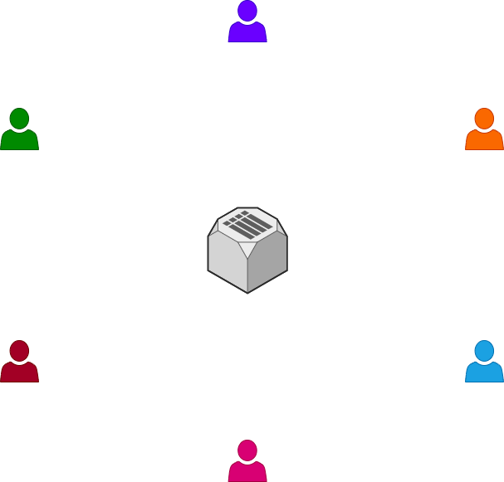






MESSAGE PASSING PROJECT
Uploading User Info

Slide 2






MESSAGE PASSING PROJECT
Uploading Public Keys

Slide 3
MESSAGE PASSING PROJECT
Download Public Keys

Slide 4


MESSAGE PASSING PROJECT
Encrypt w/ Public Key
Message Passing

Slide 5


MESSAGE PASSING PROJECT
Decrypt w/ Private Key
Message Passing

Slide 6
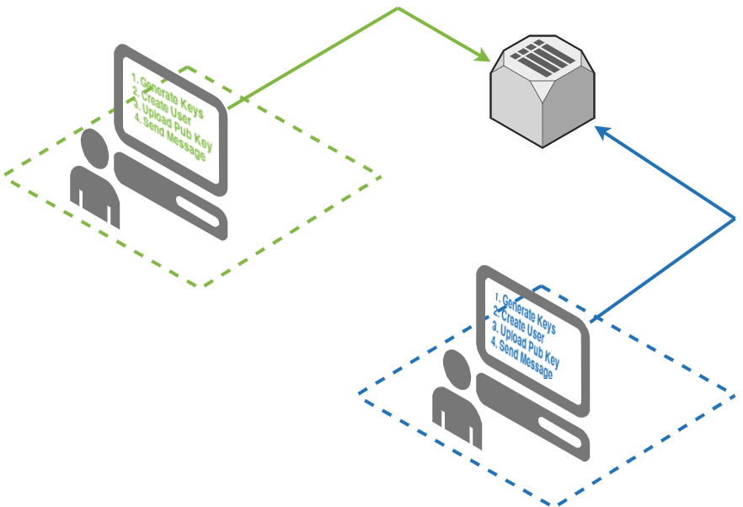
MESSAGE PASSING PROJECT
def sendMessage(from_id,to_id,message,token):
posturl = "http://msubackend.xyz/api/?route=postMessage"
payload = {
'from_id':from_id,
'to_id':to_id,
'message':message,
'token':token
}
headers = {'Content-Type': 'application/json’}
r = requests.post(posturl, headers=headers, json=payload)
from crypto_class import Crypto
C = Crypto()
C.generate_keys()
C.store_keys()
def publishKey(pubkey,uid,token):
posturl = "http://msubackend.xyz/api/?route=postPubKey"
payload = {
'pub_key':pubkey
'uid':uid,
'token':token
}
headers = {'Content-Type': 'application/json’}
r = requests.post( posturl, headers=headers, json=payload)
def createUser():
posturl = "http://msubackend.xyz/api/?route=postUser"
payload = {
'fname':"Quinton",
'lname':'tarantino’,
'screen_name':'pulpfiction’,
'email':'tarantino@imrich.com’,
'token':'12345’
}
headers = {'Content-Type': 'application/json’}
r = requests.post( posturl, headers=headers, json=payload)
return r.text['data'][uid]

Slide 7
MESSAGE PASSING PROJECT
from crypto_class import Crypto
C = Crypto()
C.generate_keys()
C.store_keys()
GENERATE KEYS

Slide 8

MESSAGE PASSING PROJECT
from crypto_class import Crypto
C = Crypto()
C.generate_keys()
C.store_keys()
GENERATE KEYS
API call: None
Uses local crypto class

Slide 9
MESSAGE PASSING PROJECT
from crypto_class import Crypto
C = Crypto()
C.generate_keys()
C.store_keys()
GENERATE KEYS
API call: None
Uses local crypto class

Slide 10

MESSAGE PASSING PROJECT
from crypto_class import Crypto
C = Crypto()
C.generate_keys()
C.store_keys()
GENERATE KEYS
API call: None
Uses local crypto class

Slide 11


MESSAGE PASSING PROJECT
def createUser():
posturl = "http://msubackend.xyz/api/?route=postUser"
payload = {
'fname':"Quinton",
'lname':'tarantino’,
'screen_name':'pulpfiction’,
'email':'tarantino@imrich.com’,
'token':'12345’
}
headers = {'Content-Type': 'application/json’}
r = requests.post( posturl, headers=headers, json=payload)
return r.text['data'][uid]
CREATE USER
API call: http://msubackend.xyz/api/?route=postUser

Slide 12
MESSAGE PASSING PROJECT
def createUser():
posturl = "http://msubackend.xyz/api/?route=postUser"
payload = {
'fname':"Quinton",
'lname':'tarantino’,
'screen_name':'pulpfiction’,
'email':'tarantino@imrich.com’,
'token':'12345’
}
headers = {'Content-Type': 'application/json’}
r = requests.post( posturl, headers=headers, json=payload)
return r.text['data'][uid]
CREATE USER
1009287
1339500
API call: http://msubackend.xyz/api/?route=postUser

Slide 13
MESSAGE PASSING PROJECT
def createUser():
posturl = "http://msubackend.xyz/api/?route=postUser"
payload = {
'fname':"Quinton",
'lname':'tarantino’,
'screen_name':'pulpfiction’,
'email':'tarantino@imrich.com’,
'token':'12345’
}
headers = {'Content-Type': 'application/json’}
r = requests.post( posturl, headers=headers, json=payload)
return r.text['data'][uid]
CREATE USER
1009287
1339500
API call: http://msubackend.xyz/api/?route=postUser

Slide 14
MESSAGE PASSING PROJECT
def publishKey(pubkey,uid,token):
posturl = "http://msubackend.xyz/api/?route=postPubKey"
payload = {
'pub_key':pubkey
'uid':uid,
'token':token
}
headers = {'Content-Type': 'application/json’}
r = requests.post( posturl, headers=headers, json=payload)
PUBLISH KEY
1009287
1339500
API call: http://msubackend.xyz/api/?route=postPubKey

Slide 15
MESSAGE PASSING PROJECT
def publishKey(pubkey,uid,token):
posturl = "http://msubackend.xyz/api/?route=postPubKey"
payload = {
'pub_key':pubkey
'uid':uid,
'token':token
}
headers = {'Content-Type': 'application/json’}
r = requests.post( posturl, headers=headers, json=payload)
PUBLISH KEY
1009287
1009287
1339500
1339500
API call: http://msubackend.xyz/api/?route=postPubKey

Slide 16
MESSAGE PASSING PROJECT
def publishKey(pubkey,uid,token):
posturl = "http://msubackend.xyz/api/?route=postPubKey"
payload = {
'pub_key':pubkey
'uid':uid,
'token':token
}
headers = {'Content-Type': 'application/json’}
r = requests.post( posturl, headers=headers, json=payload)
PUBLISH KEY
1009287
1339500
API call: http://msubackend.xyz/api/?route=postPubKey

Slide 17
MESSAGE PASSING PROJECT
SEND MESSAGE
GET ACTIVE USERS
GET PUBLIC KEY OF RECEIVER
ENCRYPT W/ RECEIVER PUBLIC KEY
SEND MESSAGE
1009287
1339500

Slide 18
MESSAGE PASSING PROJECT
GET ACTIVE USERS
GET PUBLIC KEY OF RECEIVER
ENCRYPT W/ RECEIVER PUBLIC KEY
SEND MESSAGE
SEND MESSAGE
http://msubackend.xyz/api/?route=getActive&token=[replace with your token]
{
"data": [
{
"uid": "102",
"last_connect": "1605891415"
},
{
"uid": "103",
"last_connect": "1605891422"
}
],
"count": 2,
"success": true
}

Slide 19
MESSAGE PASSING PROJECT
GET ACTIVE USERS
GET PUBLIC KEY OF RECEIVER
ENCRYPT W/ RECEIVER PUBLIC KEY
SEND MESSAGE
SEND MESSAGE
http://msubackend.xyz/api/?route=getPubKey&token=[replace with your token]&uid=23412
{
"data": [
{
"uid": ”23412",
"pubkey": "-----BEGIN PUBLIC KEY-----\nMIIBIjANBgkqhkiG9w0BAQEFAAOCAQ8AMIIBCgKCAQEAvI2QjAT3naoP8ZGFwKmc\n9b01//L0uUVKOZHRpnPGFgGklrFtqtljLcWlHnpzyq8SuI+4o8pPoDKLDLIREmbe\nfyiLTxs/nKFoOBUOOsY9PqdIruZU5oZDUgzg8wy5ODQIAR4SuxtnbSmy3IFp2zJB\nbNK1X4BLe/DsC+Xloc/R08EgKGUukXgMryhIKYCkrAyT/9YV5mxJzGvqYekqg0SL\nVGHkpH7UO7TQu9UpTCTasPjwePLKAb0PsmIDkjuBgkJo35hwK8HfIiYtwQxCdDWi\nINA7XYoy5/D11GauZN0a2/7mZU4uDY6iw2Js7wNlm6job93JVGTq4Fc9QGEZz6Pk\nTwIDAQAB\n-----END PUBLIC KEY-----"
}
],
"count": 1,
"success": true
}

Slide 20
MESSAGE PASSING PROJECT
GET ACTIVE USERS
GET PUBLIC KEY OF RECEIVER
ENCRYPT W/ RECEIVER PUBLIC KEY
SEND MESSAGE
SEND MESSAGE
def encrypt(self,plaintext):
# Encrypting With Public Key
# make sure the text is "bytes"
# this is typically shown like this: b'message' (see the b before the quotes?)
plaintext = str.encode(plaintext)
encrypted = self.public_key.encrypt(
plaintext,
padding.OAEP(
mgf=padding.MGF1(algorithm=hashes.SHA256()),
algorithm=hashes.SHA256(),
label=None
)
)
return encrypted

Slide 21
MESSAGE PASSING PROJECT
def sendMessage(from_id,to_id,message,token):
posturl = "http://msubackend.xyz/api/?route=postMessage"
payload = {
'from_id':from_id,
'to_id':to_id,
'message':message,
'token':token
}
headers = {'Content-Type': 'application/json’}
r = requests.post(posturl, headers=headers, json=payload)
SEND MESSAGE
1009287
1339500

Slide 22


MESSAGE PASSING PROJECT
RECEIVE MESSAGES
1009287
1339500

Slide 23
MESSAGE PASSING PROJECT
RECEIVE MESSAGES
1009287
1339500

Slide 24
MESSAGE PASSING PROJECT
RECEIVE MESSAGES
1009287
1339500

Slide 25
MESSAGE PASSING PROJECT
RECEIVE MESSAGES
1009287
1339500

Slide 26
MESSAGE PASSING PROJECT
RECEIVE MESSAGES
1009287
1339500

