Slide 1
“Big Data”:
Motivation behind this course.

Slide 2
DEFINITION: “Big Data”
Big Data is used in the singular and refers to a collection of data sets so large and complex, it’s impossible to process them with the usual databases and tools.

Slide 3
“Big Data”
Big Data is:
Hard to capture Store Search | Share Analyze Visualize

Slide 4
“Big Data”
Analyzing all this information, creates another enormous data set!!
Companies pursue Big Data because it can be revelatory in:
Spotting business trends
Improving research quality
Gaining insights

Slide 5
“Big Data”
Ok. From where ??
Mobile devices Tracking systems RFID Sensor networks Social networks | Internet searches Automated Record keeping Video archives E-commerce ...

Slide 6
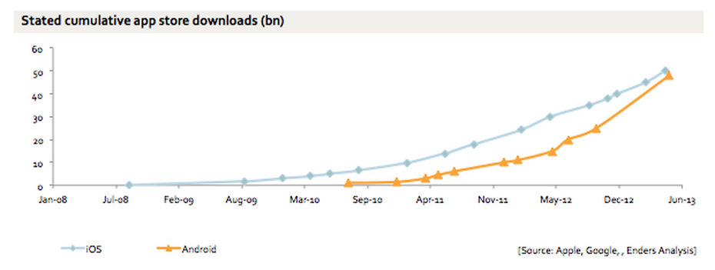
Mobile devices
Smartphones and tablets outsold desktop and laptop computers in 2011. There are more Smartphones in the U.S. in 2012 than people!
The phone in your pocket has more programmable memory, more storage and more capability than several large IBM computers.

Slide 7
Tracking Systems
Vehicle Tracking Systems (Fleet Management)
Package Tracking Systems (Ups, FedEx, Etc.)
Patient Tracking Systems
Endless …

Slide 8
RFID
RFID stands for Radio Frequency IDentification, a technology that uses tiny computer chips smaller than a grain of sand to track items at a distance.
When it picks up the energy, the chip sends back its unique identification number to the reader device, allowing the item to be remotely identified.
Each tiny chip is hooked up to an antenna that picks up electromagnetic energy beamed at it from a reader device.
These chips can beam back information anywhere from a couple of inches to up to 20 or 30 feet away.

Slide 9
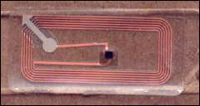
RFID
Shown at left is a magnified image of actual RFID tag found in Gillette Mach3 razor blades.
The chip appears as the tiny black square.
The coil of wires surrounding the chip is the antenna, which transmits your information to a reader device, which can be located anywhere!

Slide 10
RFID
This technology is rapidly evolving and becoming more sophisticated. Now RFID chips can even be printed, meaning the dot on a printed letter "i" could be used to track you.
RFID chips can be well hidden. For example they can be sewn into the seams of clothes, sandwiched between layers of cardboard, and molded into plastic or rubber.
Unlike a bar code, these chips can be read from a distance, right through your clothes, wallet, backpack or purse -- without your knowledge or consent -- by anybody with the right reader device.
Many large corporations, including Philip Morris, Procter and Gamble, and Wal-Mart, have begun experimenting with RFID chip technology and have recently placed an order for up to 500 million RFID tags from a company called Alien Technology

Slide 11
Sensor Networks
A wireless sensor network (WSN) of spatially distributed autonomous sensors to monitor physical or environmental conditions, such as temperature, sound, pressure, etc. and to cooperatively pass their data through the network to a main location.
http://www.makershed.com/products/wireless-sensor-node

Slide 12
Social Networks
Facebook collects 63 different pieces of data for its API, more than any other social network.
Facebook’s “like” button is pressed 2.7 billion times every day across the web.
At its peak on Aug. 3, 2013, Twitter was processing 143,199 tweets per second globally.

Slide 13
Internet Searches
Cookies:
They don’t just store small amounts of information on your hard drive.
Session cookies: are temporary and are deleted when the browser is closed. These types of cookies are often used by e-commerce sites to store items placed in your ‘shopping cart,’ and can serve many other purposes as well.
Persistent cookies: are designed to store data for an extended period of time. Each persistent cookie is created with an expiration date, which may be anywhere from a few days to several years in the future. Once the expiration date is reached, the cookie is automatically deleted.

Slide 14
Cars and Big Data?
Computers in cars will know where you go, when you go, how fast you go, how many times you stop along the way, whether you stay in your lane, what your average MPG is, how you like your temperature, how close you get before stepping on the brake, and tens of thousands of other facts….instantly.
Collecting all of this data rapidly allows a car to:
  Anticipate where you are going by looking at driving history
  Check road signs using sensors to know what the speed limit is or if a stop sign is approaching
  Alert and activate your braking and steering systems if pedestrians are in the street or you’re too close to the curb or you drift into another lane or you doze off.

Slide 15
Cars and Big Data?
In September 2012, California passed a law allowing self-driving cars to be tested on its roads.
In 2040, it is anticipated people will not need to get driver’s licenses. Cars will be able to drop someone off and then go find a parking space.
There have recently been tests of self-driving tanks in the Army.
The thing you see on top of a self-driving car is called the Ladar system (Laser Detection And Ranging) which can provide 3D images of everything around the vehicle to at least 50 yards. Engineers are working to hide Ladar within the chassis of a car so it won’t look so ugly.
Google Proof of Concept

Slide 16
Cars and Big Data?
Cars will have wireless devices inside and wifi will be embedded in intersections and traffic signs.
Wireless connectivity will be mandated by 2020.
$25 million has been allocated to the project. GM, Ford, Toyota, Honda, Nissan, VW, Hyundai and Mercedes Benz have done the basic legwork.
Cars talking to cars is the future of vehicle safety.

Slide 17
Why are they collecting all this data?
Target Marketing
Targeted Information
To send you catalogs for exactly the merchandise you typically purchase.
To suggest medications that precisely match your medical history.
To “push” television channels to your set instead of your “pulling” them in.
To send advertisements on those channels just for you!
To know what you need before you even know you need it based on past purchasing habits!
To notify you of your expiring driver’s license or credit cards or last refill on a Rx, etc.
To give you turn-by-turn directions to a shelter in case of emergency.

Slide 18
Examples of big data…..
Walmart handles more than 1 million customer transactions every hour, which is imported into databases estimated to contain more than 2.5 petabytes * of data — the equivalent of 167 times the information contained in all the books in the US Library of Congress.
FICO Credit Card Fraud Detection System protects 2.1 billion active accounts world-wide.
The volume of business data worldwide, across all companies, doubles every 1.2 years, according to estimates
(1 Petabyte = 1000000000000000B = 1000⁵ B = 10¹⁵ B = 1 million gigabytes)
* Think of the hard drive on your computer at home having 500 gigabytes. Now multiply that by 2,000!

Slide 19
Examples of Big Data
A 2011 study predicted that roughly 1.8 zettabytes (say what? A zettabyte is equal to 1 billion terabytes. A terabyte is equal to 1024 gigabytes) of data would be generated in that year alone. That's the same amount of data that would be created if everyone in the U.S. posted 3 Tweets every 60 seconds for a little under 27,000 years.
A health care consultancy has made the data coming out of medical practices the focus of its thriving business. The company collects billing and diagnostic code data from 10,000 doctors on a daily, weekly and monthly basis to create a virtual clinical integration model. The consulting company analyzes the data to help the groups understand how well they are meeting the FTC guidelines for negotiating with health plans and whether they qualify for enhanced reimbursement based on offering a more cost-effective standard of care.
It also sends them automated information to better take care of patients, like creating an automated outbound calling system for pediatric patients who weren’t up to date on their vaccinations.

Slide 20
Examples of Big Data
With a smart meter, a utility company goes from collecting one data point a month per customer (using a meter reader in a truck or car) to receiving 3,000 data points for each customer each month, while smart meters send usage information up to four times an hour.
One small Midwestern utility is using smart meter data to structure conservation programs that analyze existing usage to forecast future use, price usage based on demand and share that information with customers who might decide to forestall doing that load of wash until they can pay for it at the nonpeak price.

Slide 21
Examples of Big Data
Global position satellite technology now allows trucking firms to track their trucks - and the merchandise inside them. Practically anything you can attach an RFID tag to can be tracked. How a company uses that information – to re-route trucks to create efficient routes, alert customers to deliveries, and forecast and price services – depends on the ability to manage and analyze data effectively.

Slide 22
Big Brother Needs Big Data
In March 2012, the Obama Administration announced the Big Data Research and Development Initiative, $200 million in new R&D investments, which will explore how Big Data could be used to address important problems facing the government. The initiative was composed of 84 different Big Data programs spread across six departments.
http://tinyurl.com/85oytkj
The U.S. Federal Government owns six of the ten most powerful supercomputers in the world.

Slide 23

How Companies Like Use Big Data To Make You Love Them
Article by Sean Madden, May 2012, an expert in service design and innovation strategy.
Last month, I talked to Amazon customer service about my malfunctioning Kindle, and it was great. Thirty seconds after putting in a service request on Amazon’s website, my phone rang, and the woman on the other end--let’s call her Barbara--greeted me by name and said, "I understand that you have a problem with your Kindle." We resolved my problem in under two minutes, we got to skip the part where I carefully spell out my last name and address, and she didn’t try to upsell me on anything. After nearly a decade of ordering stuff from Amazon, I never loved the company as much as I did at that moment.
The fact is, Amazon has been collecting my information for years--not just addresses and payment information but the identity of everything I’ve ever bought or even looked at. And while dozens of other companies do that, too, Amazon’s doing something remarkable with theirs. They’re using that data to build our relationship.

Slide 24
What are some impacts of Big Data?
Decisions like your credit score and your insurance rates may be based on the analysis of big data, for good or bad.
After Haiti’s 2010 earthquake, Columbia University tracked the movements of 2 million refugees by the SIM cards in their cell phones and were able to determine where health risks would likely develop.
Why companies collect, buy and sell Big Data?

Slide 25
Is Big Data good or bad for consumers?
How would you feel about paying more for the same product than the person checking out in front of you?
The real challenge: are you willing to get better value and more innovation for some loss of privacy?
Since there is no way to stop the accumulation of Big Data, should its use be regulated by the Federal government?

Slide 26
How Can You Avoid Big Data?
Pay cash for everything!
Never go online!
Don’t use a telephone!
Don’t use any rewards / saver cards!
Don’t fill any prescriptions!
Never leave your house!

Slide 27
References:
Stu Miller
Chief Operating Officer
The Rehab Documentation Company
www.rehabdocumentation.com

Slide 28
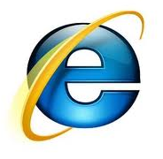
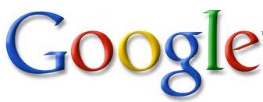


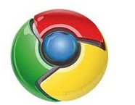

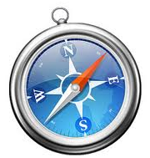


What is collecting all this data?
Web Browsers
Search Engines
Microsoft’s
Internet Explorer
Google’s
Mozilla’s FireFox
Microsoft’s
(Non-profit foundation,
used to be Netscape)
Google’s Chrome
Yahoo’s
Apple’s Safari
IAC Search’s
Time-Warner’s AOL
Explorer

Slide 29
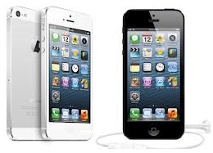
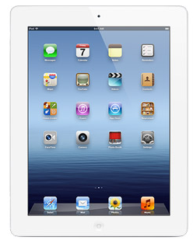
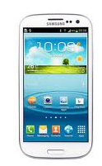
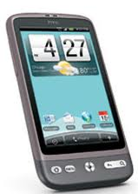
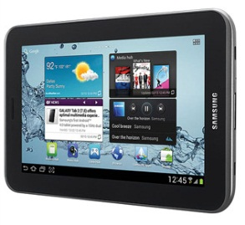
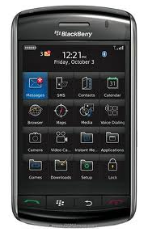
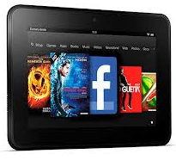
What is collecting all this data?
Smartphones & Apps
Tablet Computers & Apps
Apple’s iPhone
(Apple O/S)
Apple’s iPad
Samsung, HTC.
Nokia, Motorola
(Android O/S)
Samsung’s Galaxy
RIM Corp’s Blackberry
(BlackBerry O/S)
Amazon’s Kindle Fire

Slide 30
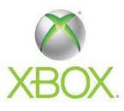
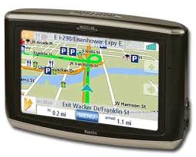
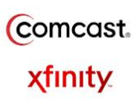
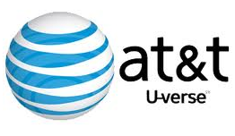
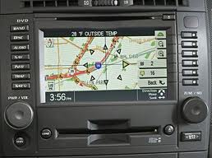
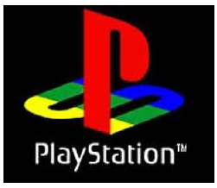


What is collecting all this data?
Games Boxes and GPS Systems
Internet Service Providers

Slide 31
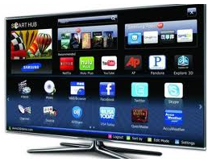


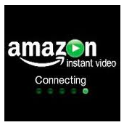
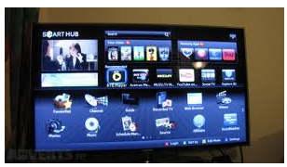
What is collecting all this data?
Movie Rental Sites
HDTV’s and Blu-Ray Players with built-in Internet connectivity

Slide 32


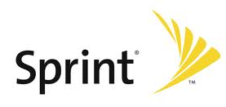
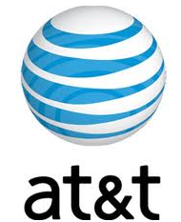

What is collecting all this data?
Hospitals & Other Medical Systems
Banking & Phone Systems
Pharmacies
Laboratories
Imaging Centers
Emergency Medical Services (EMS)
Hospital Information Systems
Doc-in-a-Box
Electronic Medical Records
Blood Banks
Birth & Death Records
Can you hear me now?
(Heh heh heh!)

Slide 33
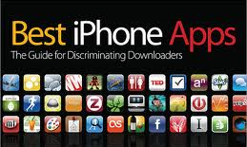
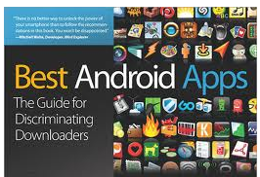
What is collecting all this data?
A real pain in the apps!
What are they collecting?
Restaurant reservations (Open Table)
Weather in L.A. in 3 days (Weather+)
Side effects of medications (MedWatcher)
3-star hotels in New Orleans (Priceline)
Which PC should I buy and where (PriceCheck)

Slide 34
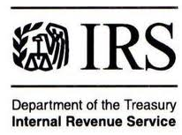





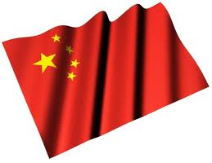
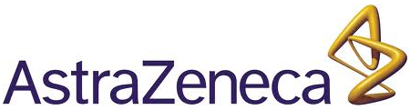
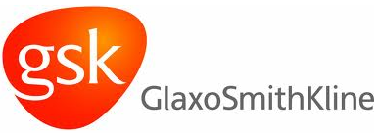
Who is collecting all of this data?
Government Agencies
Big Pharmaceutical Companies
(Hey, I didn’t say which government!)

Slide 35
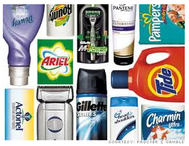

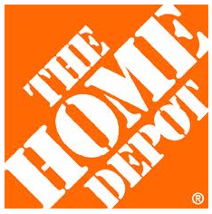

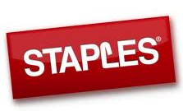
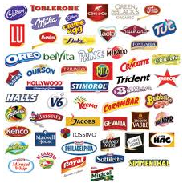
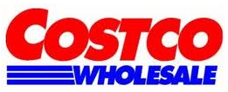

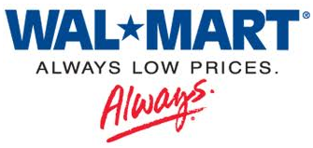
Who is collecting all this data?
Consumer Products Companies
Big Box Stores

Slide 36
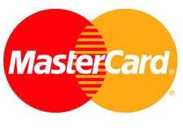
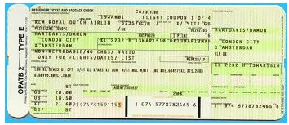
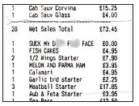
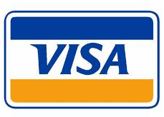
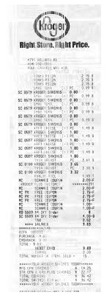

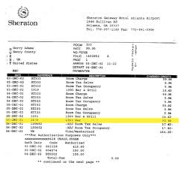
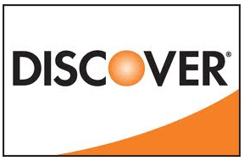
Who is collecting what?
Credit Card Companies
What data are they getting?
Airline ticket
Restaurant check
Grocery Bill
Hotel Bill

