Slide 1
Databases, MySQL, and PHP
Peterson

Slide 2
The Social Network
The first thing we're gonna need is a lot of pictures. Unfortunately, Harvard doesn't keep a public centralized facebook so I'm going to have to get all the images from the individual houses that people are in. Let the hacking begin.
First up is Kirkland. They keep everything open and allow indexes in their Apache configuration, so a little w-get magic is all that's necessary to download the entire Kirkland facebook. Kids' stuff.
Dunster is intense. You have to do searches and your search returns more than twenty matches, nothing gets returned. And once you do get results they don't link directly to the images, they link to a PHP that redirects or something. Weird. This may be difficult. I’ll come back later. ~ Jessie Eisenberg as Mark Zuckerberg in The Social Network

Slide 3
MySQL
“my sequel” or “my ess cue el”
all types of database applications including e-commerce, airline reservation systems, and online social networks
known for its performance, reliability and ease-of-use
Any http address that ends with PHP has likely consulted a MySQL database

Slide 4
PHP
PHP Hypertext Preprocessor
server-side scripting language
constructs dynamic web pages on the fly
combines html with information derived from a database
most popular language to create web sites
other commercial and open source languages like ASP.NET, Java, ColdFusion, Perl, Ruby, and Python

Slide 5
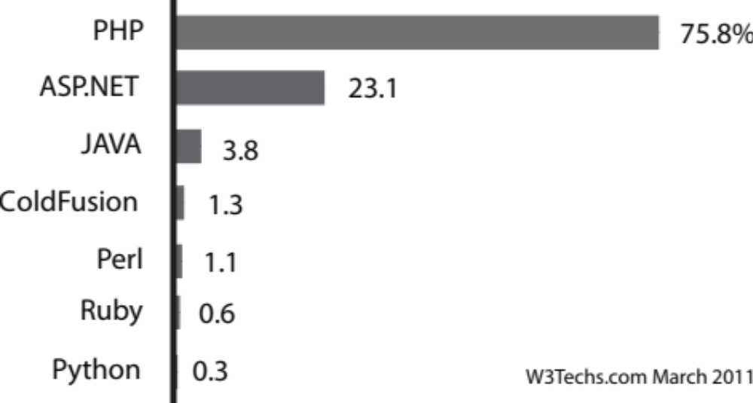
Preprocessors

Slide 6
FOSS
Free and Open Source Software
MySQL - no longer open source because it is now owned and supported by Oracle
  the largest database company in the world
FOSS presents an alternative for software distribution, thereby challenging commercial software packages
many thousands of installations and millions of users

Slide 7
Long-term viability of software
always best to stay with those that have the greatest number of users
  commercial or open source
Especially important with databases
  Data stored in a specific way that can only be read by a certain program
  If the data can’t be read, the data may be lost

Slide 8
Flat files and relational databases
Flat files (Excel)
  All data stored in the same number of fields in a table format
  Good for summing, adding, columns of data.
Relational database
  multiple tables of data that are tied together by a key field or fields
  less duplication of data
  better ability to query the data

Slide 9
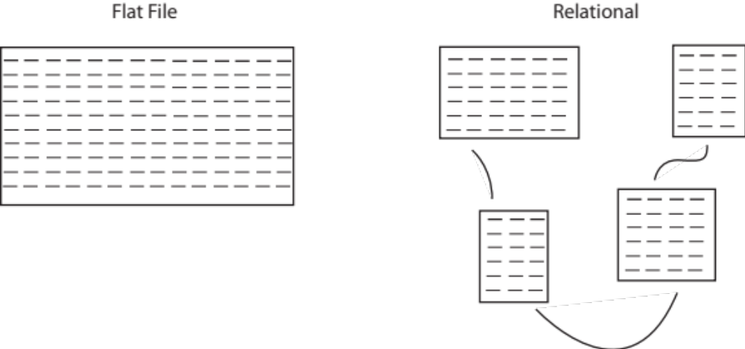
Flat file vs. Relational

Slide 10
SQL
Structured Query Language
  computer language designed to input, manipulate, query, and extract data
  set of statements that result in certain actions on data stored in relational tables
create table cities (
city VARCHAR(30),
location GEOMETRY NOT NULL,
SPATIAL INDEX(location),
PRIMARY KEY (city)
);
INSERT INTO cities (city, location) VALUES ("Omaha", GeomFromText('POINT(41.25 -96)'));
INSERT INTO cities (city, location) VALUES ("Atlanta", GeomFromText('POINT(33.755 -84.39)'));

Slide 11
Other types of databases
Hierarchical database
  organizes data in a tree-like structure
  defines a parent/child relationship
  each parent can have many children but each child has only one parent
  folder or directory structure for storing files on a computer is an example of a hierarchical data structure
NOSQL- promotes the use of non-relational databases and does not require fixed table schemas as with the relational model

Slide 12
Relational Databases
matrix of tables
horizontal rows in the table – called tuples
Fields refer to the columns of the table
Domain refers to the possible values for a field
  if the field contains percentages, then the domain of values could only fall between 0 and 100

Slide 13
Keys
Each table has a field that contains a distinct identifier, or key, that specifies a record
  A common field is used to relate any two tables
  key that uniquely identifies a record is called a primary key
  foreign key in another table defines the common field between two tables
  foreign key helps to ensure referential integrity
    enforces valid relationships between tables
    no foreign key can contain a value that does not match a primary key in the corresponding table

Slide 14
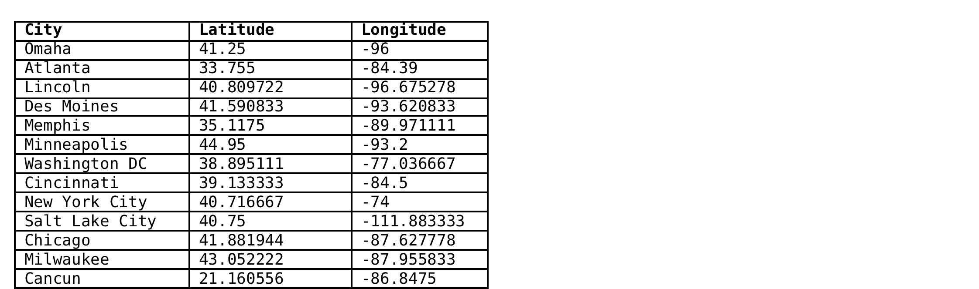

City column is the primary key. It matches the City_Name column in the second table

Slide 15
SQL
Development of relational databases began in 1970 by IBM
  product called SEQUEL
  associated language to manipulate the data became known as SQL
  standardized by the American National Standards Institute (ANSI) in 1986

Slide 16
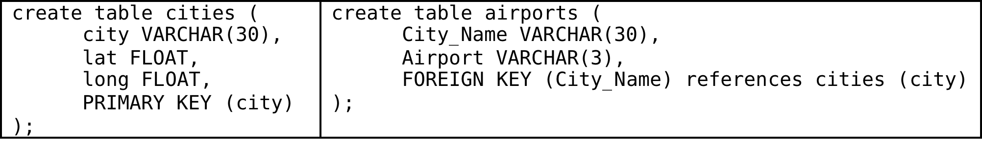
Types of SQL statements
language can be categorized into statements that define how the data is:
  structured, input, and manipulated

Slide 17
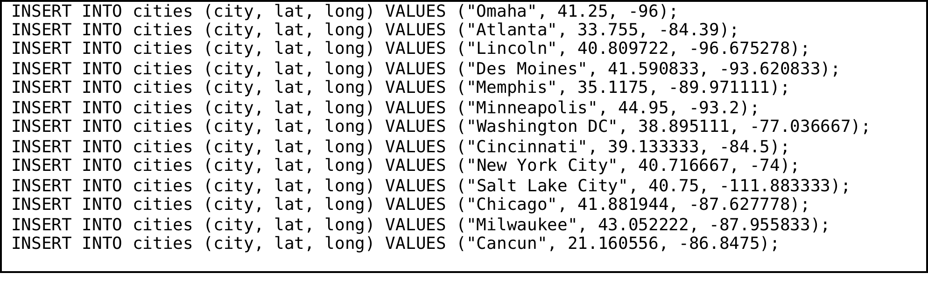
Data input

Slide 18
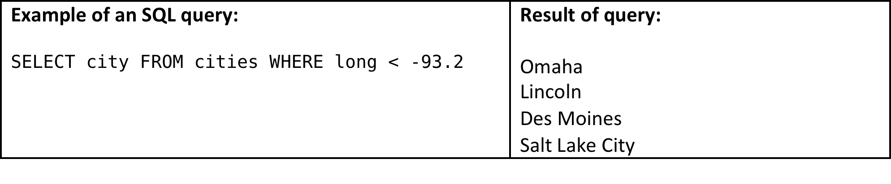
Data manipulation
In this case, values of longitude that are west of Minneapolis, or less than -93.2, are selected.

Slide 19
Spatial SQL
Open Geospatial Consortium (OGC) is an international consortium of companies, agencies, and universities participating in the development of conceptual solutions that can be useful with all kinds of applications that manage spatial data
In 1997, the OGC published the OpenGIS® Simple Features Specifications
With version 5.0.16, MySQL supports a subset of spatial extensions to enable the generation, storage, and analysis of geographic features.

Slide 20
Spatial extensions
Spatial extensions refer to a SQL language that has been extended with a set of commands that code geometry types
specification describes a set of SQL geometry types, as well as functions on those types to create and analyze geometry values

Slide 21
Geographic features in SQL
anything in the world that has a location
  An entity. For example, a mountain, a pond, a city.
  A space. For example, town district, the tropics.
  A definable location. For example, a crossroad, as a particular place where two streets intersect.
  It is associated with a Spatial Reference System, which describes the coordinate space in which the object is defined.
  It belongs to some geometry class.

Slide 22
SQL spatial extensions
GEOMETRY: a base-level spatial extension that supports any type of point, line or area feature
POINT, LINESTRING, and POLYGON restrict their values to a particular geometry type
MULTIPOINT, MULTILINESTRING, MULTIPOLYGON, and GEOMETRYCOLLECTION. GEOMETRYCOLLECTION can store a collection of objects of any type

Slide 23
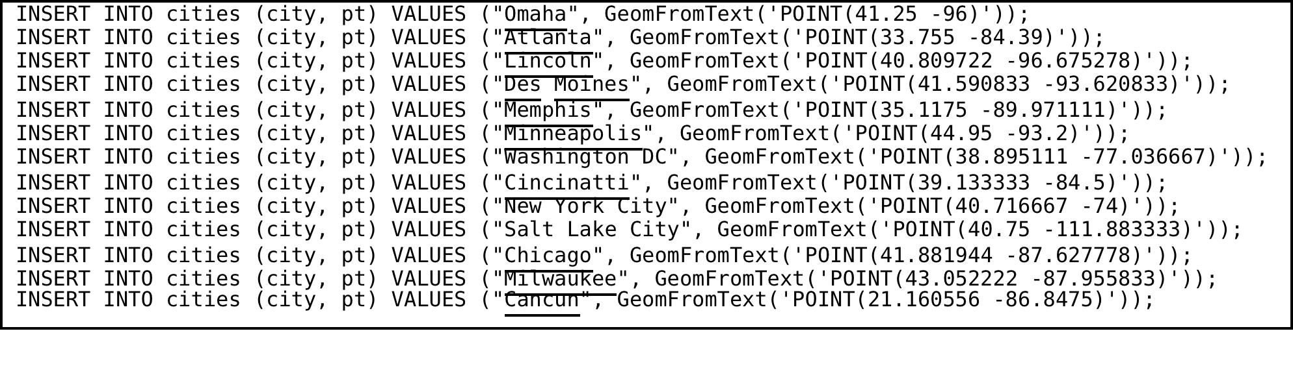
POINT SQL extension
MySQL statements to input latitude and longitude using the POINT SQL spatial extension

Slide 24
PHP
Personal Home Page Tools – by Rasmus Lerdorf starting in the mid-1990s
  born in Greenland, and growing up in Denmark and Canada
  he could not have known that his software would run massive websites like Wikipedia and Facebook.

Slide 25
PHP installation
Scripting language that runs on a server
  major Free and Open Source (FOSS) software components such as the Linux operating system, the Apache web server, MySQL, and PHP, are referred to by the acronym LAMP
  can be downloaded and installed in unison on almost any computer
  Problems with maintaining a server

Slide 26
PHP
PHP can be embedded within an HTML file.
  But, to execute, the file must reside on a server.
  PHP generates HTML that is then sent to the client
<html>
<head>
<title>PHP Test</title>
</head>
<body>
<?php echo '<p>Hello World</p>'; ?>
</body>
</html>

Slide 27
PHP parsing
PHP preprocessor looks for opening (“<?php”) and closing tags (“?>”)
Whatever exists between these delimiters is processed by PHP
tags can be within an HTML document or they can write the entire HTML document

Slide 28
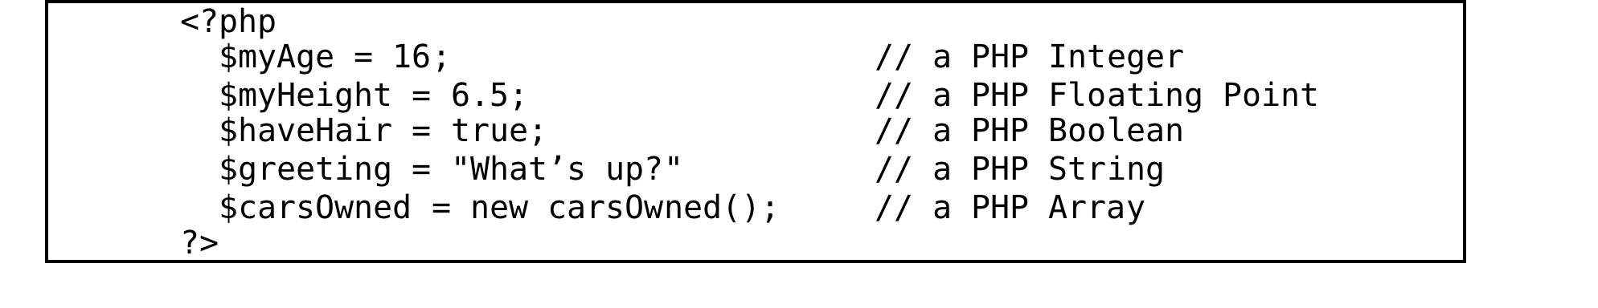
PHP variable types

Slide 29
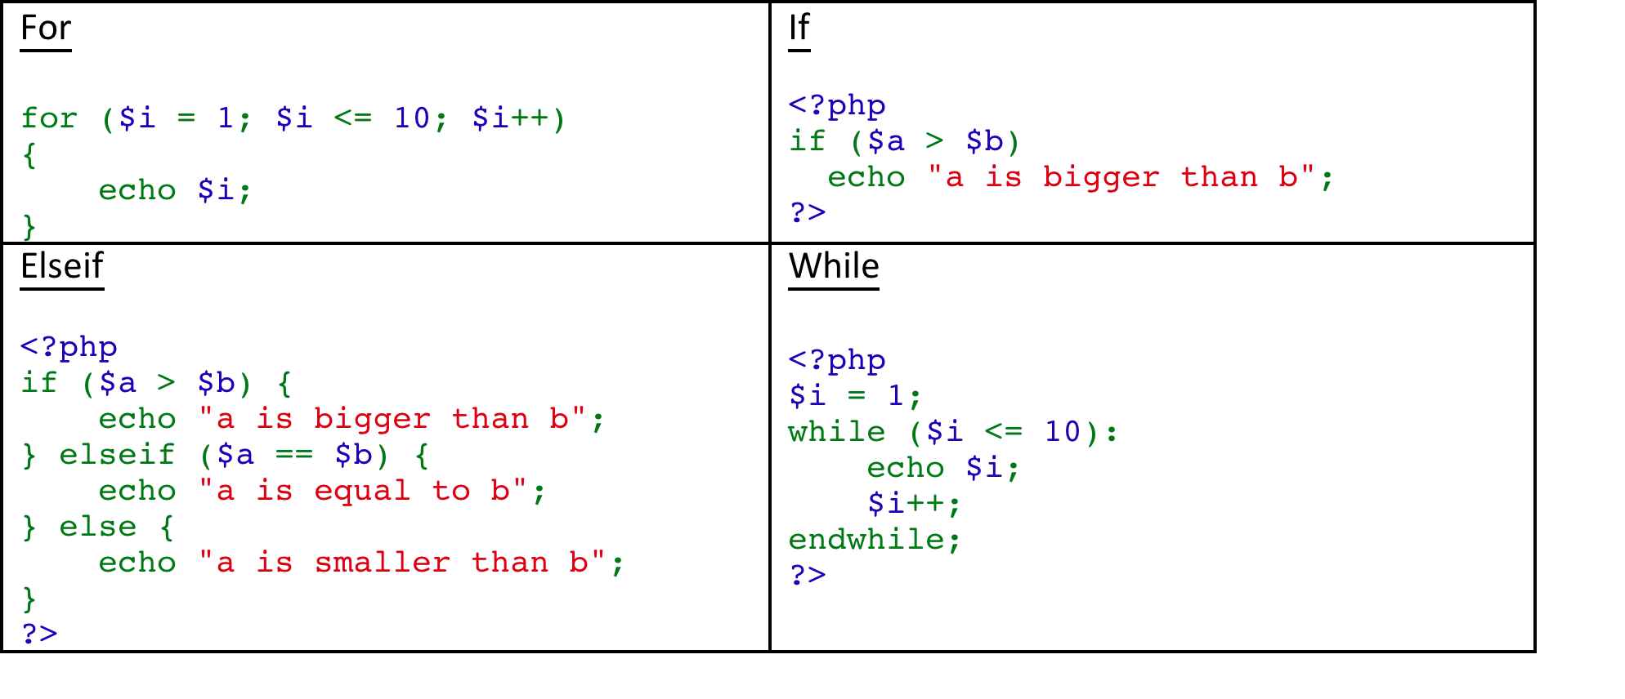
PHP control structures

Slide 30
PHP cookies
mechanism to store data in a remote browser
Cookies can be set using the setcookie() and setrawcookie() functions.
Setcookie() is done in the HTML header before anything else is sent to the browser.
time delay can be set in case the browser page needs to be adjusted based on what is found in the cookie data

Slide 31
PostgreSQL
Truly open source database that is similar to MySQL
  the two databases are very similar – both being based on SQL
  PostgreSQL is more SQL compliant
  MySQL has greater support by Internet service providers.
  PostgreSQL has many sponsors and developers
  it is not controlled by any one company

Slide 32
POSTGIS
An extension to PostreSQL
  adds greater compliance with the OGC Spatial Extension
  PostGIS "spatially enables" the PostgreSQL server, allowing it to be used as a backend spatial database for geographic information systems (GIS).
  follows the OpenGIS Simple Features Specification for SQL and has been certified as compliant with the "Types and Functions" profile
  not commonly offered by online commercial providers, especially those offering minimal services at no cost

