Slide 1
MySQL spatial indexing for GIS data in a web 2.0 internet application
Brian Toone
Samford University
brtoone@samford.edu

Slide 2

What is Web 2.0?
Mind Map by Markus Angermeier

Slide 3

Our focus
Mind Map by Markus Angermeier

Slide 4
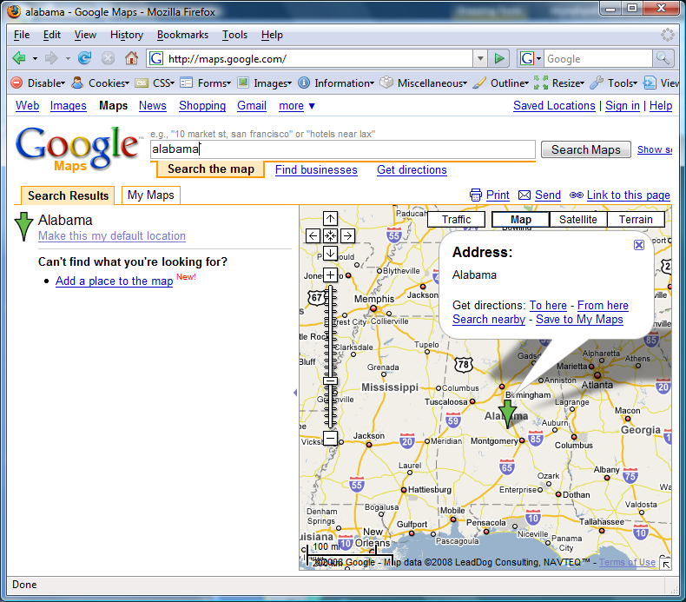

Geographic Information Systems Web 2.0
Google Maps
Interactive Maps require data retrieval as the user interacts with the map

Slide 5

How does it work?
Short answer: AJAX
Long answer: Asynchronous JavaScript And XML
  Dynamic web pages (DHTML) respond to user events (e.g., onmousemove, onclick, etc…)
  Typical response is to change visual appearance
  (e.g., highlight a table cell, display a drop-down menu)
  AJAX allows retrieval of new data from the web server
  (e.g., fetch new map data, populate a drop-down box)
  User can continue to interact with the page during data retrieval (i.e., no need to wait for page reload)

Slide 6
The Problem
GIS Datasets can be VERY large
Example
  National Elevation Dataset by the USGS
  Even with 30m sampling, ~60 GB
A Web2.0 application even when downloading data “in the background” cannot download that much data without forcing the user to wait a long time!
Frequently, we only need a small portion of the data, but finding the relevant data can also take too long

Slide 7
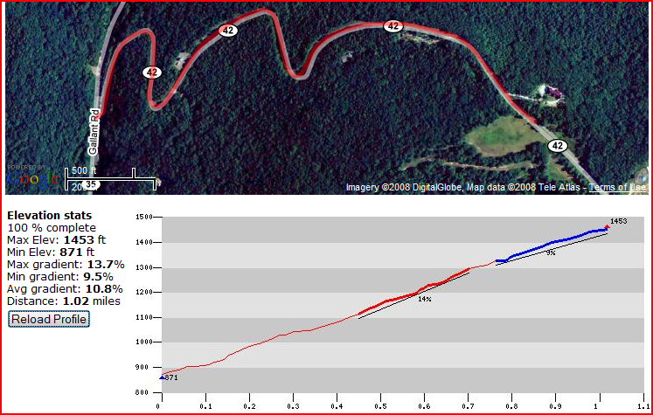
The Problem, cont’d
“Needle in a haystack”
Consider the example of an elevation profile:
Update the profile as user adds new points
Small number of points need to be retrieved quickly

Slide 8
The Problem, cont’d
NEEDLE: Elevation sample points required (~200 data points)
HAYSTACK: The Central Alabama portion of the NED (~39,700,000 data points)
One additional problem: frequently we are interested in finding the nearest neighbor because the sample points we are looking for are not available in the dataset

Slide 9
The problem, cont’d
Traditional database index speeds up
  Random access to data within a table
  Efficient ordered access to data
Sounds good so far, but…
  Finding a geographic point requires matching on TWO different fields (latitude and longitude)

Slide 10
The Solution
Spatial indexing
  Optimizes retrieval based on geographic location
  Example: find matches within database that contain a geographic region or point
MySQL support
  OpenGIS Geometry Model (e.g., points, lines, polygons)
  Fields (table columns) supported by MySQL
  GEOMETRY, POINT, LINESTRING, POLYGON
  Spatial indexing - R-Trees with quadratic splitting
  Query support – Currently limited to MBR only

Slide 11
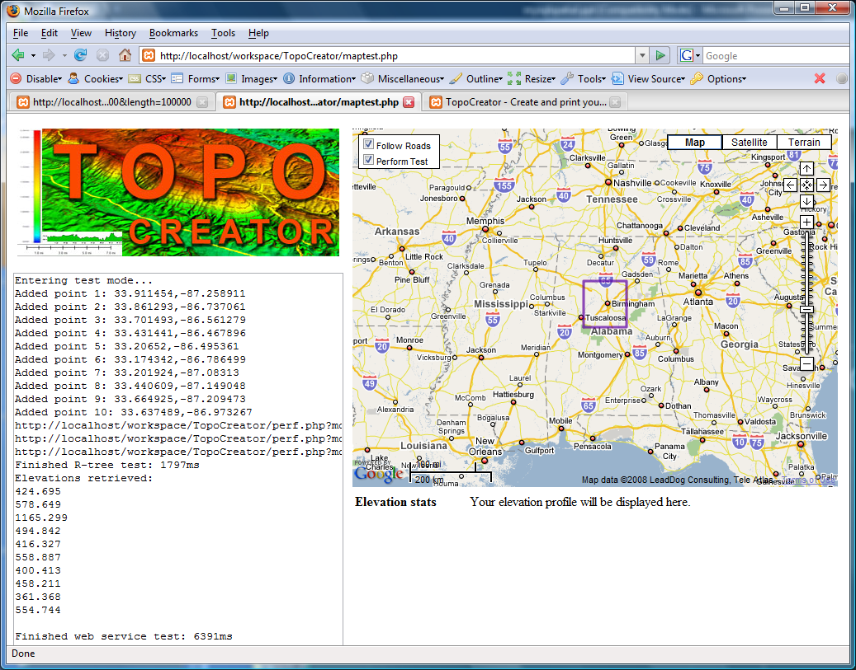
Experimental setup
Measure length of time to
retrieve elevations for 10
sample points under the
following conditions:
  MySQL table with typical
  B-tree index
  MySQL table with
  spatial index (R-tree)
  External web-service
  provided by the USGS
Purple area shows portion of
Central Alabama covered by
30 million sample points. Points
were added to the test set by clicking ten times within the
purple area. Effort was made to evenly distribute the clicks.

Slide 12
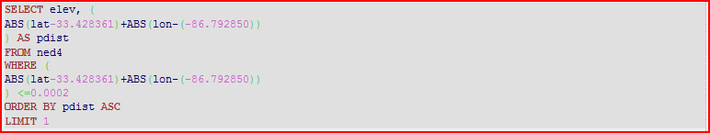
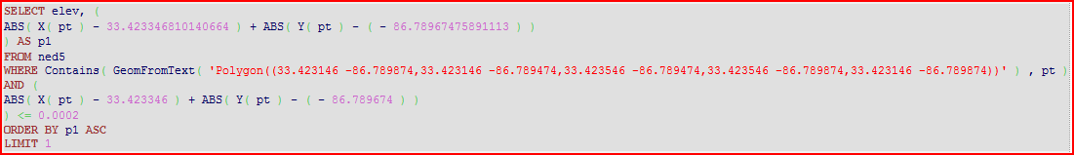
Experimental setup, cont’d
After the 10 test points were selected, three queries to retrieve the requested elevations were issued in parallel
External web service (Details omitted, used as a reference)
B-tree query:
R-tree query:

Slide 13
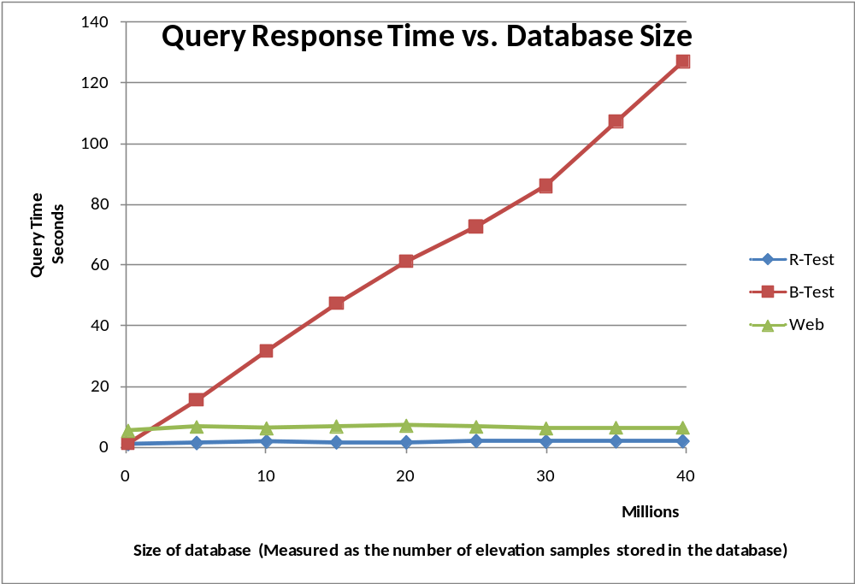

Results
Response time to find all 10 elevations was measured against various database sizes
R-tree (spatial) indexing was the clear winner

Slide 14
Conclusion
MySQL spatial support exists for geospatial data
MySQL spatial indexing can dramatically improve performance of spatial queries
MySQL spatial support still under development
  MySQL index sacrifices speed for generality (MBR)
  Future MySQL support may change these results
  Development has been slow (v3 to v6)

Slide 15
Future Work
Investigate schema based optimizations (i.e., index is the database structure itself). Consider each of the following options:
  Separate tables for storing elevation data for separate geographic regions (e.g., states, counties)
  Separate tables for blocks of data of different shapes (square, rectangle, circular, etc…)
  Maintain application index to select the necessary table(s) to search for a given set of points
Compare storage requirements in addition to speed

Slide 16
Thank you!
Questions?
For more information
  brtoone@samford.edu
  http://faculty.samford.edu/~brtoone

