Slide 1
Views (Widgets) and Layouts
CS 240 – Advanced Programming Concepts

Slide 2
Views and Input Handling
Android views tutorial
Tutorialspoint Android – UI Controls
Event handling with listeners
Tutorialspoint Android Event Handling
developers – Andriod Guide – UI Events

Slide 3
Family Map Client Views
TextView (text labels)
text, textAppearance
.setClickable(boolean) – make clickable
.setOnClickListener(View.OnClickListener)
EditText (text fields)
inputType, ems
.addTextChangedListener(TextWatcher)
Space (blank space)
set layout_width and layout_height to specific values (e.g., 30dp)
Button
text
.setOnClickListener(View.OnClickListener)
ImageView (display image)
.setClickable(boolean) – make clickable
.setImageDrawable(IconDrawable) – set icon to display
.setOnClickListener(View.OnClickListener)
Switch (on/off)
.setChecked(boolean) – set check state
.setOnCheckedChangeListener(CompoundButton.OnCheckedChangeListener)
SearchView
.setFocusable(boolean) – accept key focus
.setIconified(boolean) – make always visible
.requestFocusFromTouch() – request focus when touched
.setOnQueryTextListener(SearchView.OnQueryTextListener)
ScrollView
Wrap around any view to make it scrollable
RecyclerView
Dynamic list of items
ExpandableListView
Expandable list of items

Slide 4
The Layout Problem
Positioning views on the screen where you want them with the right sizes
You don’t know exactly how big the device’s screen will be, so a layout needs to adjust dynamically to different screen sizes
You can have different layout XML files for different screen sizes, but you can’t have a different file for EVERY possible size, so a layout needs to adjust the best it can
For a desktop UI, the analogous problem is adjusting the layout when the user expands and contracts the window
How is extra space allocated (i.e., who gets bigger when the window expands, and who stays the same size?)

Slide 5
Layout – Blank Space Between Views
1. Margins
2. Space View
layout_marginTop
Space
View
layout_width
View
View
layout_marginLeft
layout_marginRight
layout_height
2
layout_marginBottom
1

Slide 6
Layout - Scrolling
Any activity that can become too big to fit on the screen should allow the user to scroll (by swiping)
Any view that can become too big to fit in its rectangle should also allow the user to scroll
This is one way to handle the fact that you don’t really know how big the device screen will be
To make a view scrollable, nest it in a ScrollView
ScrollView lets the user scroll whenever the nested view is too big for the available space

Slide 7
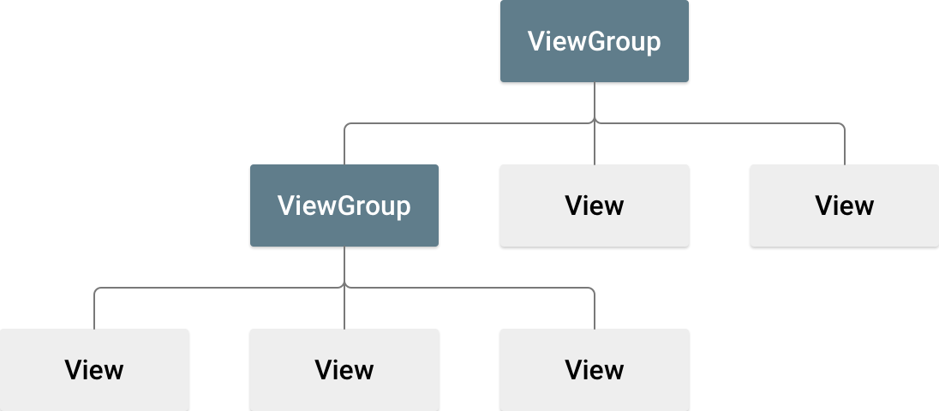
Layouts (ViewGroups)
Tutorialspoint: Android – UI Layouts
developer.android.com Declaring Layouts
A layout arranges its child views on the screen
Sets each child’s width, height, and location on the screen
Already seen LinearLayout and FrameLayout
3

Slide 8
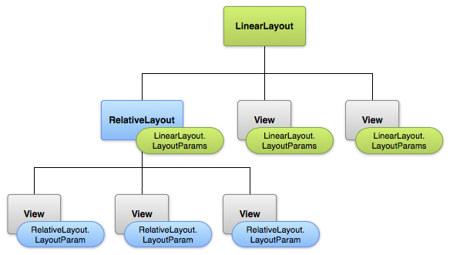
Layout Settings
layout_* attributes tell the parent layout manager how to lay out the view
4

Slide 9
Universal Layout Settings (apply to all views)
layout_width, layout_height
match_parent
Make my size match my parent’s size
wrap_content
Make me just big enough to display my contents
Hard-coded size (e.g., 30dp)
px – pixels
in – inches
mm – millimeters
pt – points (1/72 of an inch)
dp – density-independent pixels, 1/160 of an inch)
sp – scale-independent pixels (similar to dp, but scaled by user’s font size preference)

Slide 10

LinearLayout
5
Arranges children in either vertical column or horizontal row
Important attributes
orientation – vertical or horizontal
gravity – if the children don’t take up all the space inside the LinearLayout, where should they be placed (center, top, bottom, left, right, etc.)
How should available empty space inside the LinearLayout be allocated to the children?
Put layout_weight attributes on the children indicating what proportion of the empty space each child would like to have
layout_weight values are numbers. Absolute values don’t matter, just the relative sizes of the weights
layout_weight=”0” means the child does not want any empty space
layout_height=”0dp” or layout_width=”0dp” means let that dimension be controlled entirely by the weight

Slide 11
LinearLayout cont.
5
Suppose there are three children
Scenario #1
If the weights are 0, 0, 0, nobody will get any extra space, and the children will be positioned according to the LinearLayout’s gravity attribute
Scenario #2
If the weights are 1, 1, 1, the empty space will be allocated to the children equally
Scenario #3
If the weights are 0, 1, 0, then the middle child will get all the empty space and the first and third children won’t get any

Slide 12

GridLayout
Arranges children in a row/column grid
Important attributes
rowCount, columnCount
Child layout attributes
layout_row, layout_column – location of child in the grid
layout_rowSpan, layout_columnSpan – the number of rows and columns occupied by the child (can span more than one row and one column)
layout_gravity – if the child doesn’t take up all the space in its group of cells where should it be placed? (center, top-left, bottom-middle, etc.)
layout_rowWeight, layout_columnWeight – numbers indicating what proportion of available empty space should be allocated to this child (in both vertical and horizontal dimensions)
6

Slide 13

RelativeLayout
A
B
C
7
Arranges children relative to the sides of the parent and/or relative to each other
For example, to build the layout above:
A
layout_alignParentTop, layout_alignParentLeft, layout_alignParentRight
B
layout_alignParentLeft, layout_alignParentBottom, layout_below=“A”, layout_toLeftOf=“C”
C
layout_alignParentRight, layout_alignParentBottom, layout_below=“A”, layout_toRightOf=“B”

Slide 14
FrameLayout
Contains a single child (usually)
Useful for allocating space for views that are dynamically added or removed at runtime (like fragments, but could be any view)
If a fragment does not dynamically appear and disappear, you do not need to embed it in a FrameLayout. Instead, you can just hard-code the fragment in the XML layout file using a <fragment> element
Example: MapFragment contains static Google Map fragment that can be embedded in a <fragment> element
8

Slide 15

RadioGroup
Subclass of LinearLayout
Can be horizontal or vertical
RadioButtons nested in RadioGroup are mutually exclusive (only one can be selected at a time)
9

Slide 16
Layout Exercises
Login Fragment
Map Fragment
Person Activity
Settings Activity
What do the layouts for MainActivity and EventActivity have in common?

Slide 17
Layout Exercises cont.
Login Fragment
Map Fragment
Person Activity
Settings Activity
What do the layouts for MainActivity and EventActivity have in common?
They both contain a single fragment
MainActivity is dynamic, so its layout should contain a <FrameLayout>
EventActivity is not dynamic, so its layout could contain a <FrameLayout> or <fragment>

Slide 18
Citations
Margins. Created by Ken Rodham.
Space View. Created by Ken Rodham.
ViewGroup. developer.android.com. (CC 2.5, see below)
LinearLayout Flow Chart. developer.android.com. (CC 2.5)
LinearLayout. developer.android.com. (CC 2.5)
GridLayout. developer.android.com. (CC 2.5)
RelativeLayout. developer.android.com. (CC 2.5)
FrameLayout. Created by Ken Rodham.
RadioGroup. developer.android.com. (CC 2.5)
For all images from developers.android.com:
Portions of this [presentation] are reproduced from work created and shared by the Android Open Source Project and used according to terms described in the Creative Commons 2.5 Attribution License. Content License.

