Slide 1


Open Source
Ana María Martínez Gómez
anamma06@gmail.com
@Ana06
@anamma_06

Slide 2
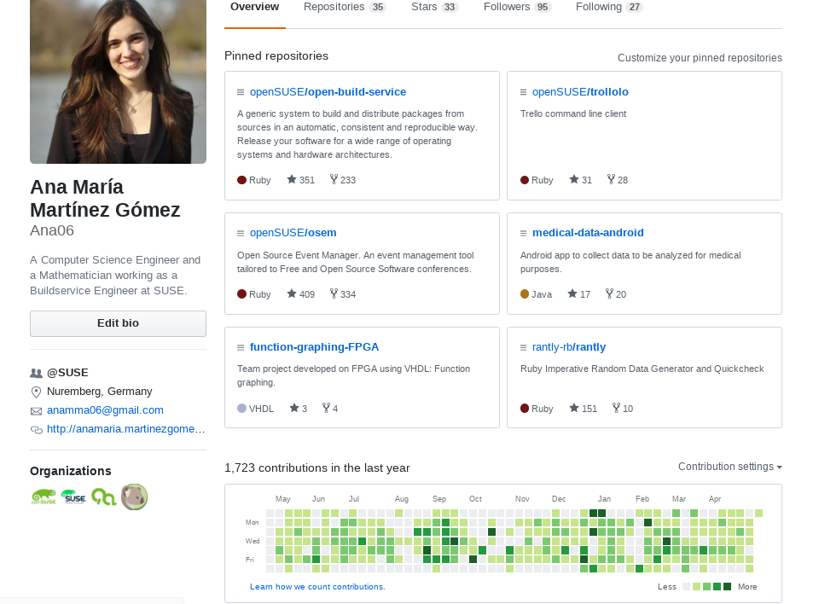
https://github.com/Ana06

Slide 3
Why open source?

Slide 4
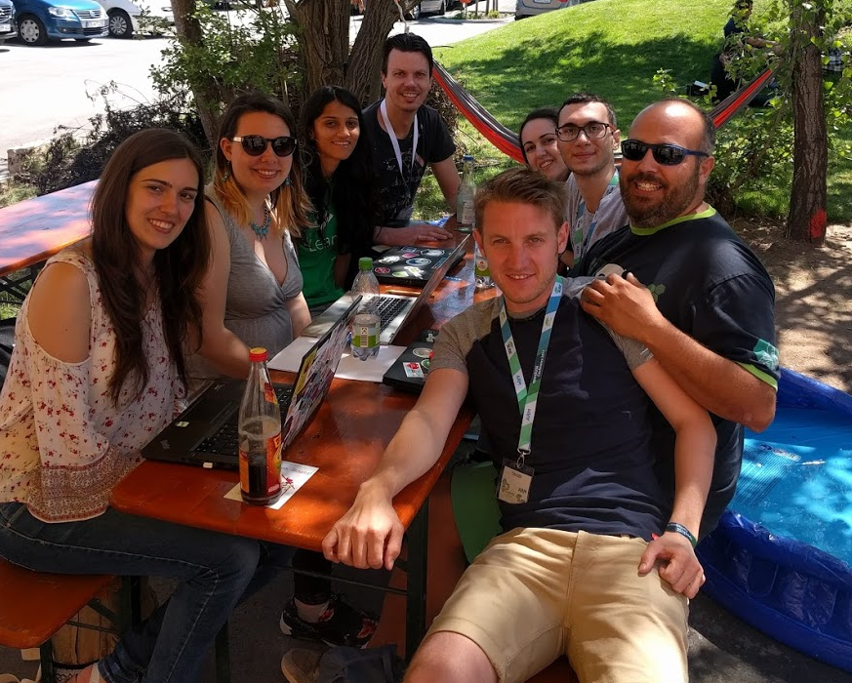
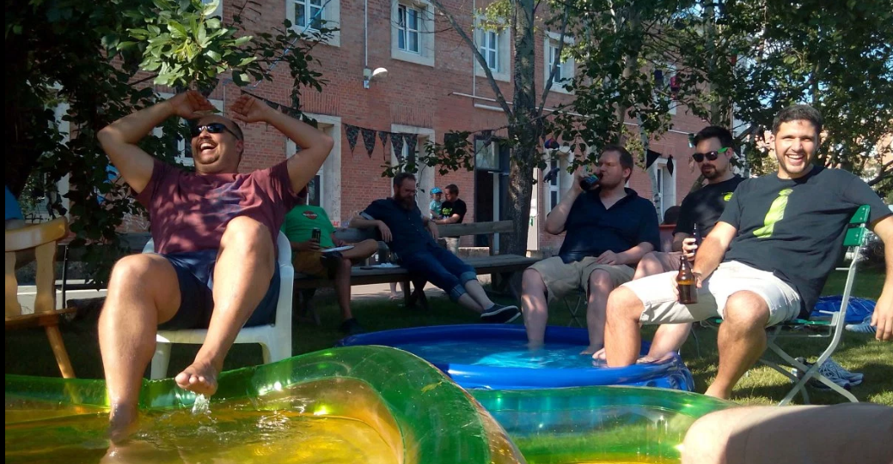
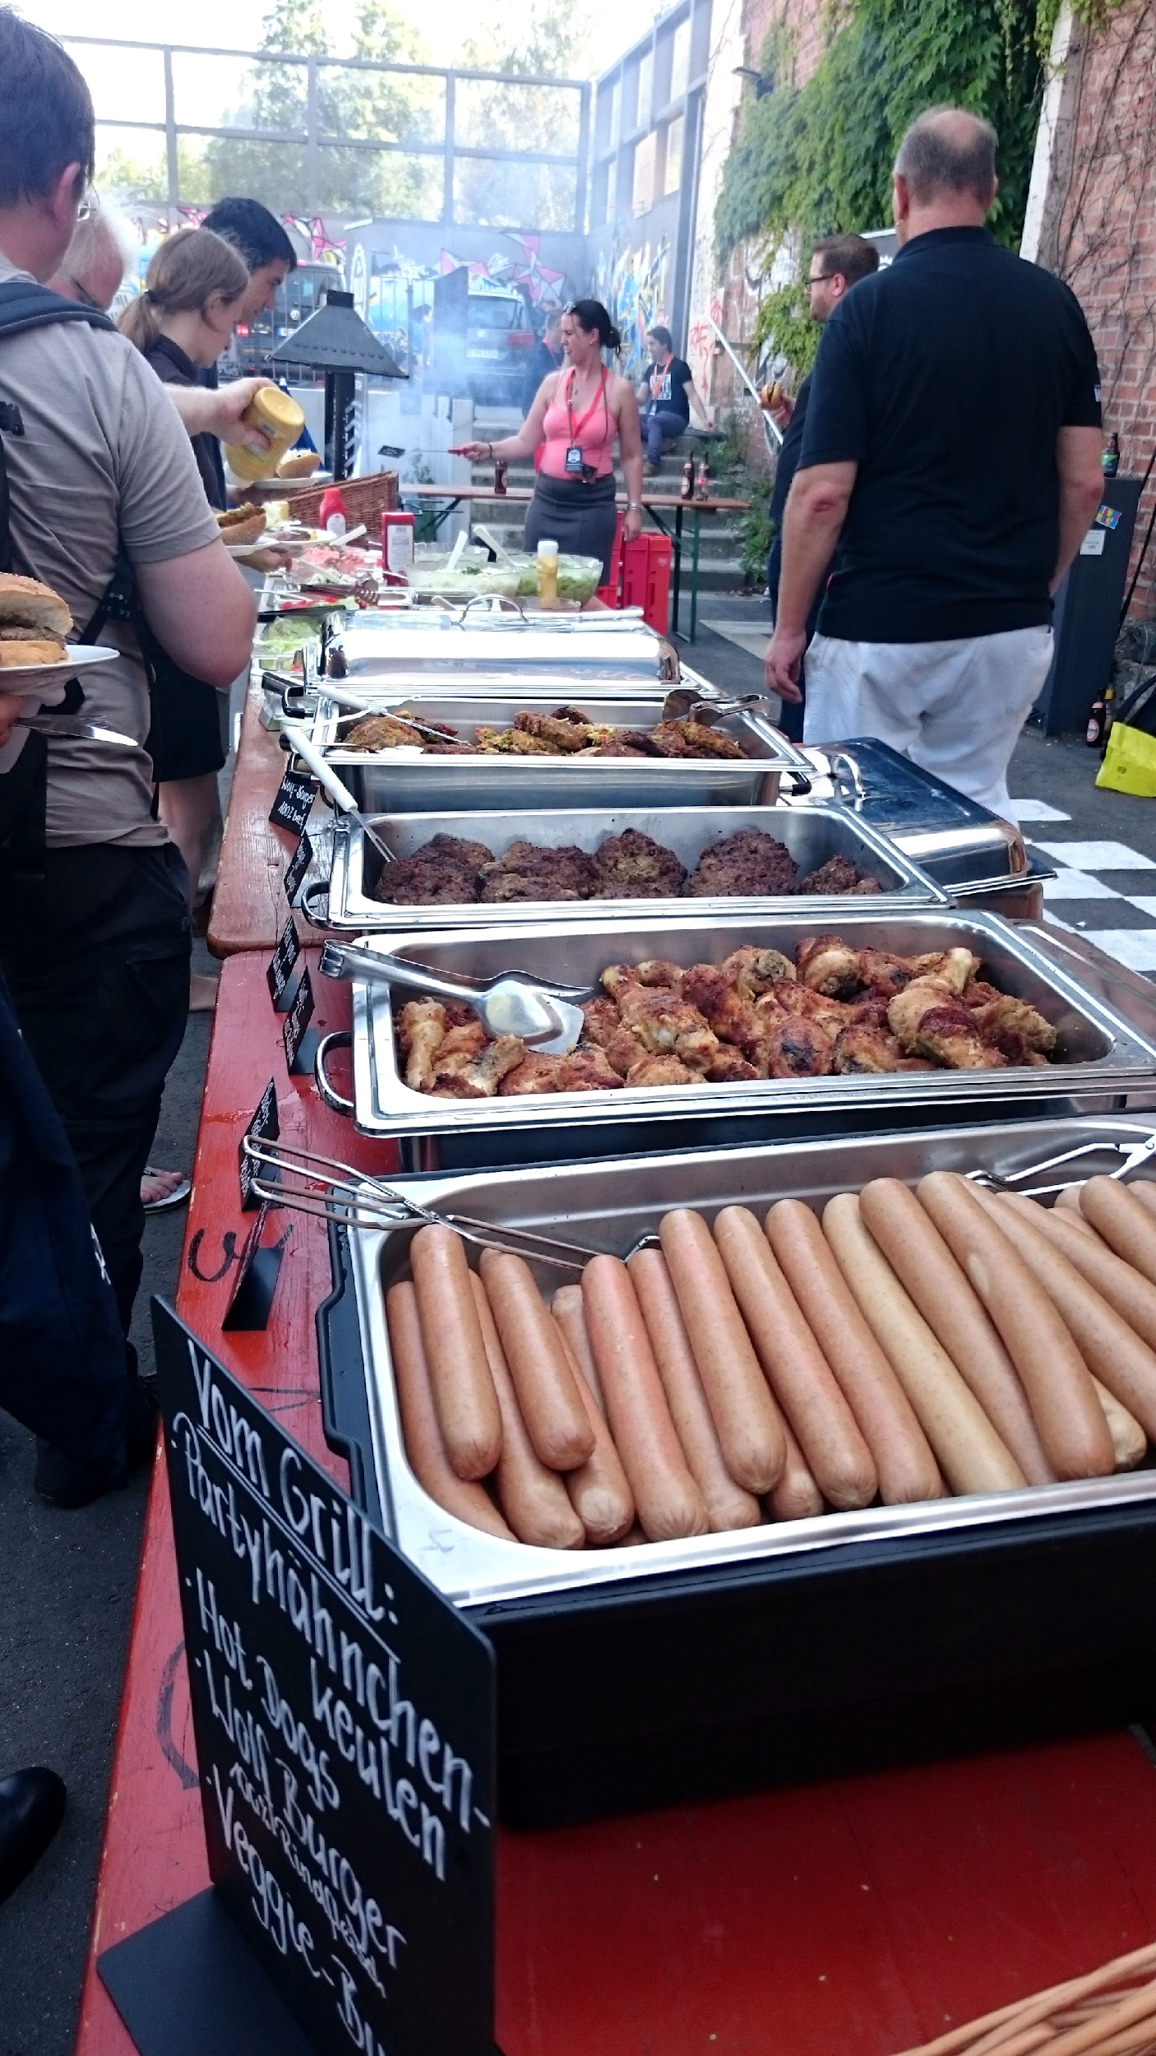
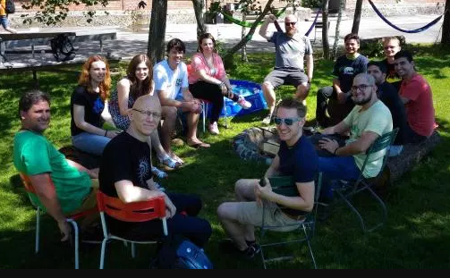
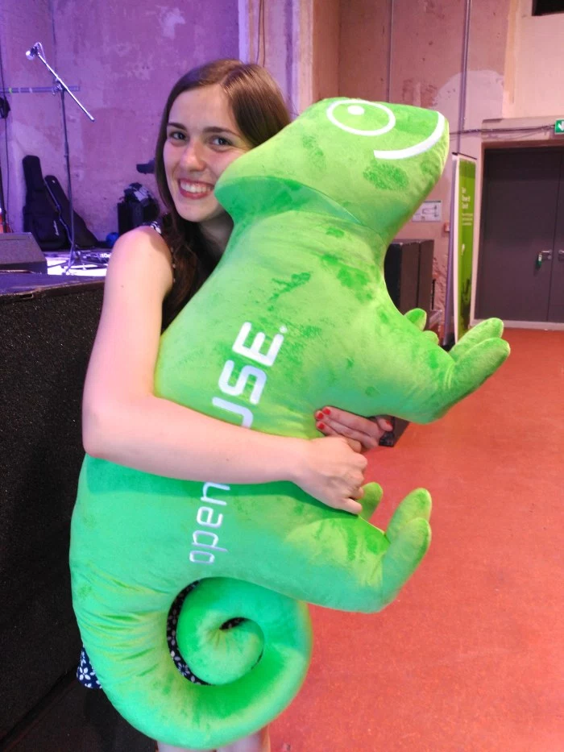
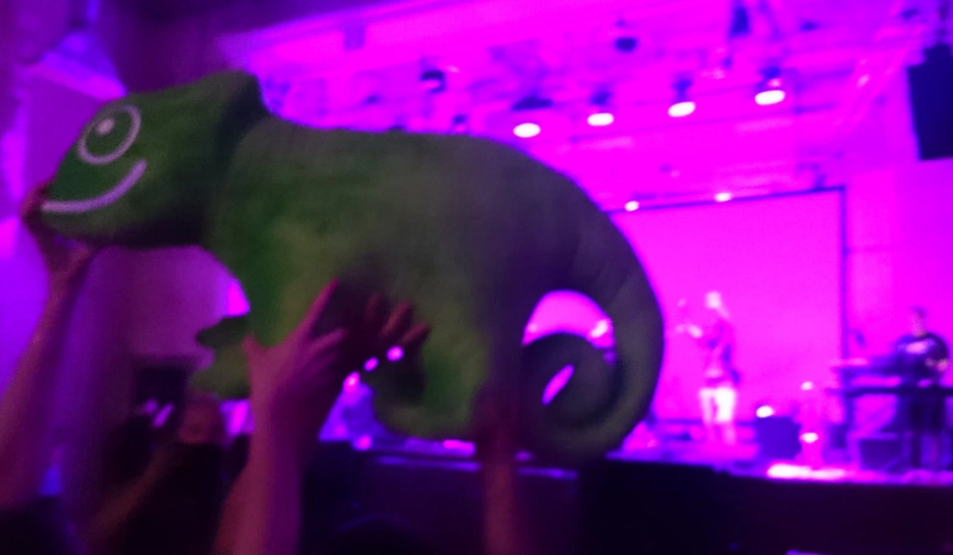
It is fun!

Slide 5
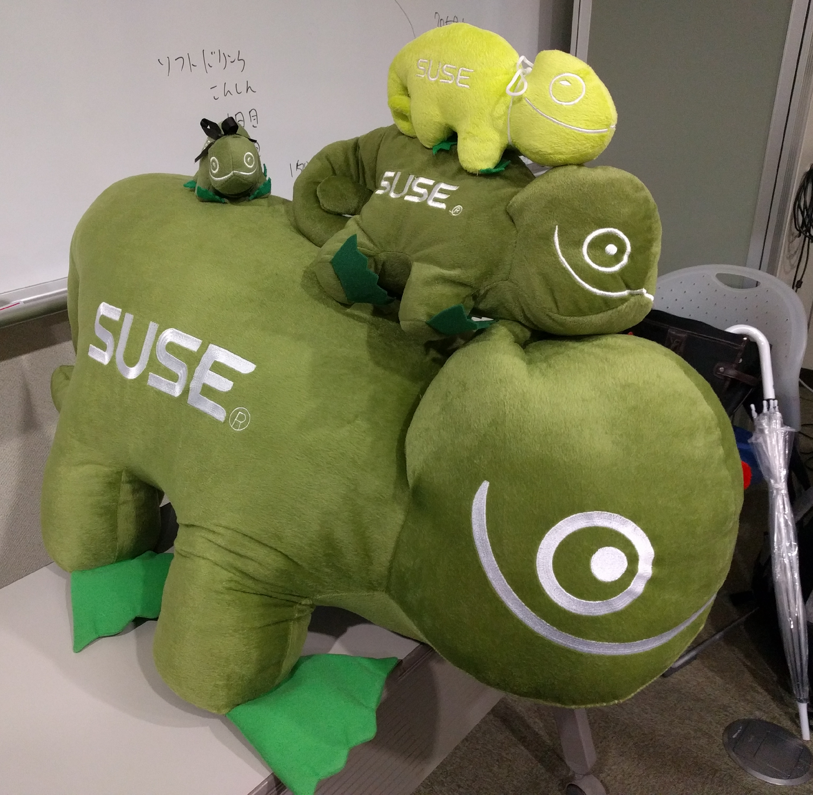
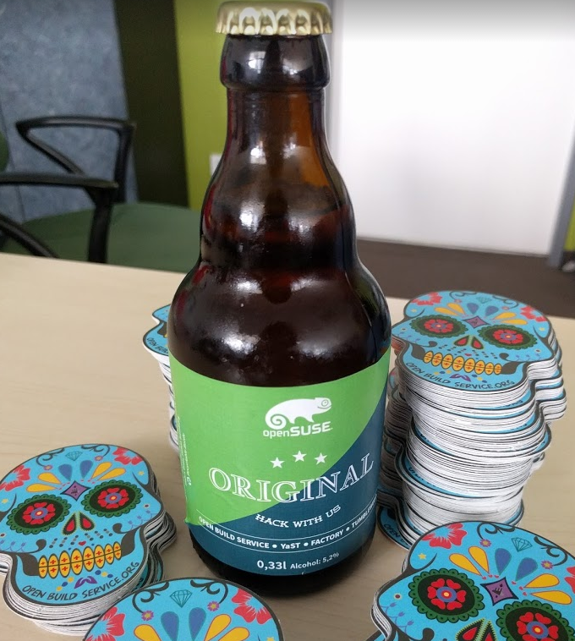
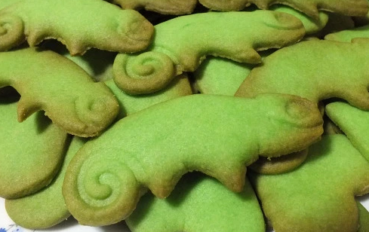
It is fun!

Slide 6
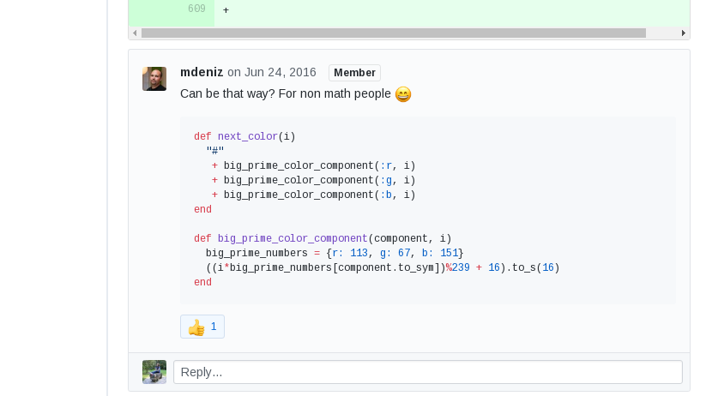
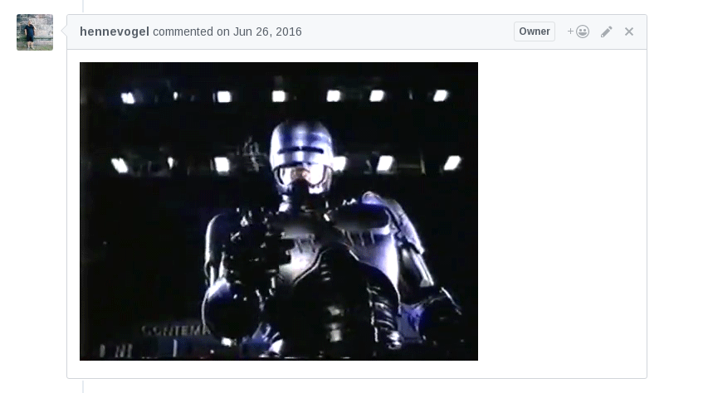
It is fun!

Slide 7
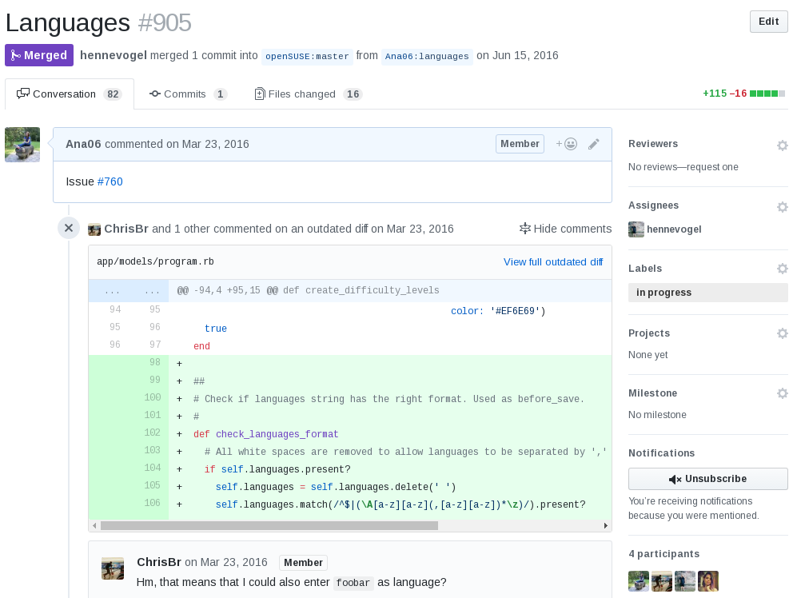
I learn a lot

Slide 8
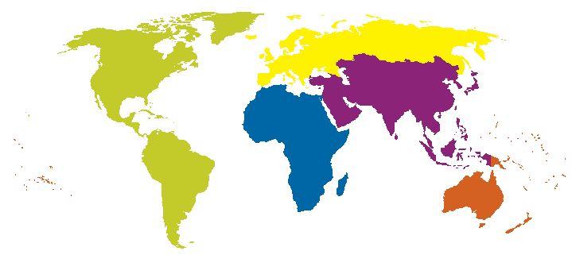
People

Slide 9
Projects

Slide 10


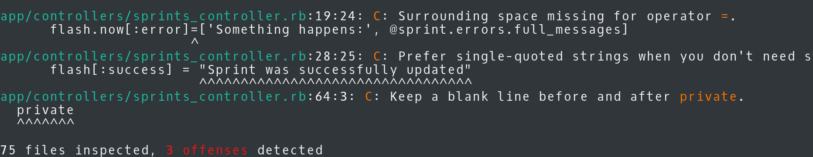
Code style checkers
Rubocop (Ruby)
HAML-Lint (Ruby)
Pep8 (Python)
Coala (54 languages)

Slide 11
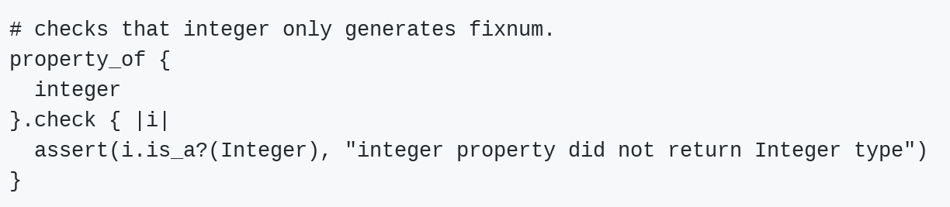
Rantly

Slide 12

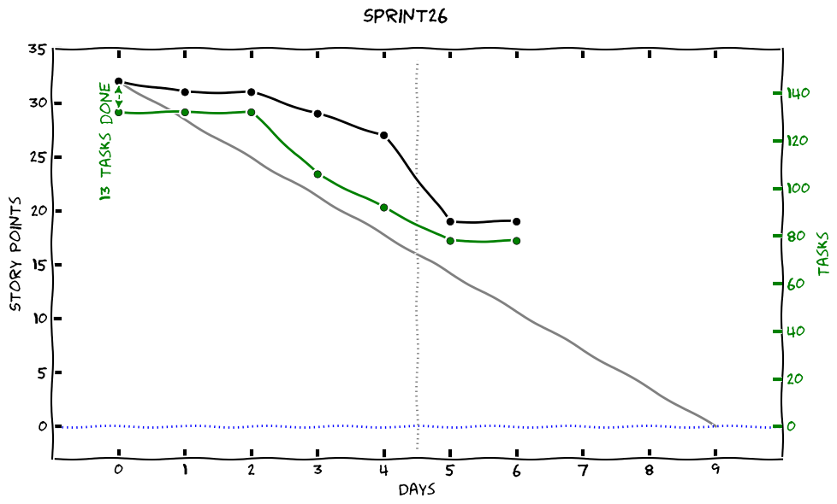
Trollolo

Slide 13
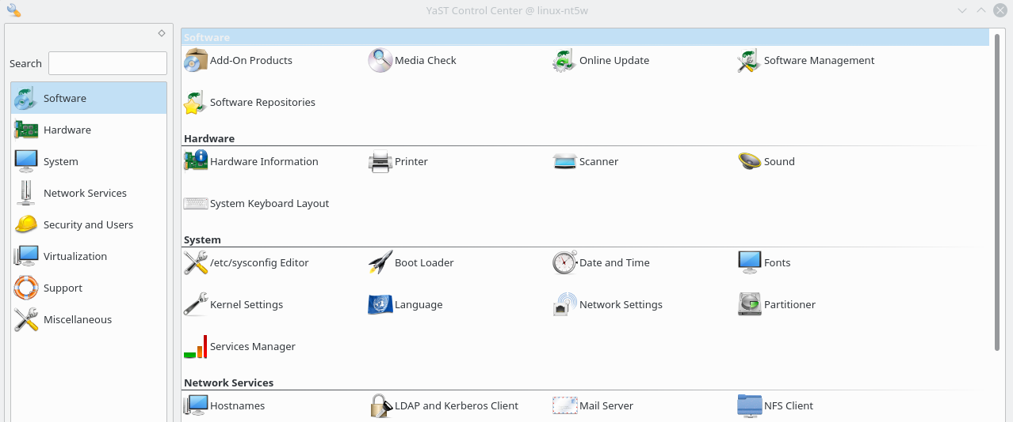
YaST

Slide 14

Rails

Slide 15
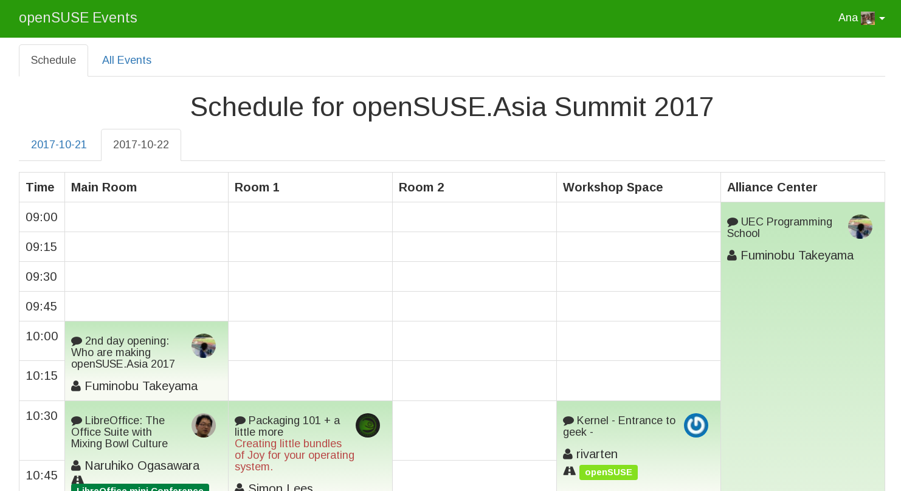
OSEM

Slide 16
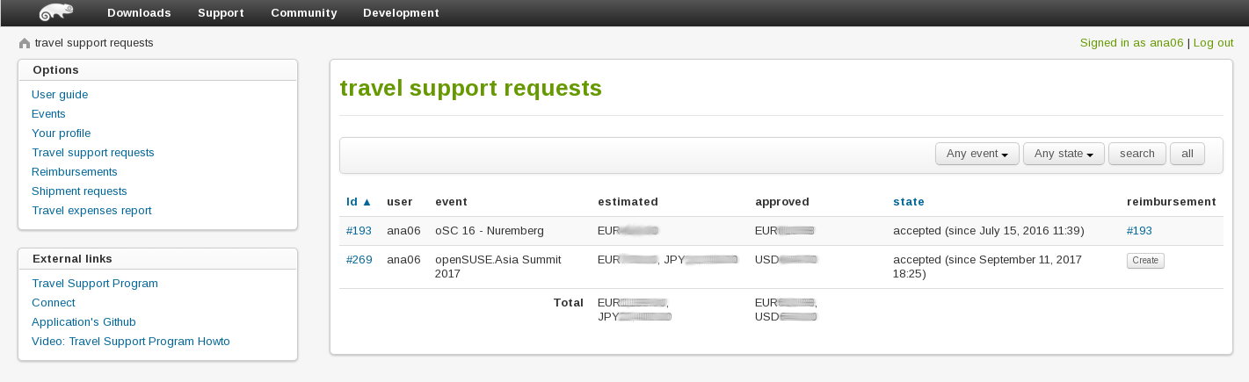
Travel support

Slide 17
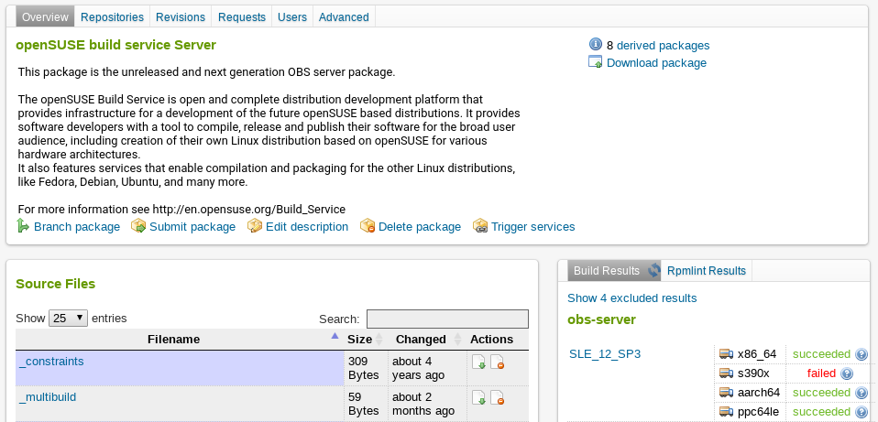
Open Build Service

Slide 18
And there is more out there!

Slide 19
But I need some help...

Slide 20

Hacktoberfest
4 pull requests 1-31 October
GET A T-SHIRT

Slide 21

GSoC
university students work on an open source project in summer
Work on a real project
Get to know open source
You won’t be alone (mentors)
Learn many things
Make friends
Earn money

Slide 22
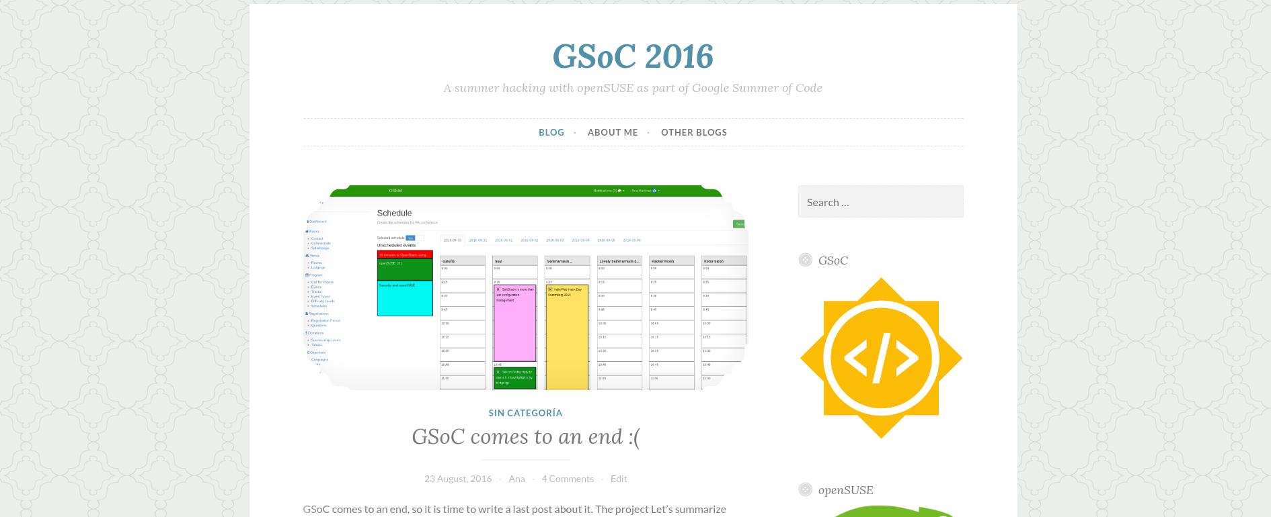
https://gsocwithopensuse.wordpress.com

Slide 23
Thanks!
Ana María Martínez Gómez
anamma06@gmail.com
@Ana06
@anamma_06

