Slide 1
Property testing
Ana María Martínez Gómez
anamma06@gmail.com
Github: @Ana06
Twitter: @anamma_06

Slide 2
Why not unit tests?
How many tests are enough?
How can you be sure that you have covered all possible cases (including edge cases)?

Slide 3

Is it possible to write a test to avoid that a perverse programmer could create an incorrect implementation?
Note: Perverse programmer in this context means a programmer with the intention to break your code

Slide 4

What are property tests?
Property: high-level specification of behavior
Generate random examples which must verify the property

Slide 5


Property tests vs unit tests
Property test: describe the behavior and check it for several random examples
Unit tests: run always the same examples and check the return value with a concrete value

Slide 6
Example

Slide 7
Examples
If age > 18
smoke
Test
If age = 18 → smoke
If age = 17 → don’t smoke

Slide 8
Examples
If age > 18
smoke
-----------------------------
If age < 17 || age > 18
smoke

Slide 9
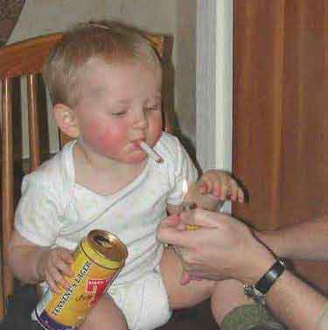
Examples

Slide 10
Property tests in Ruby

Slide 11
Rantly
for generating random test data
its Test::Unit extension for property-based testing
https://github.com/rantly-rb/rantly

Slide 12
Example – with Ruby!

Slide 13
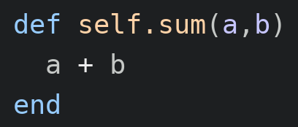
Write a function which add two numbers together
Easy!

Slide 14
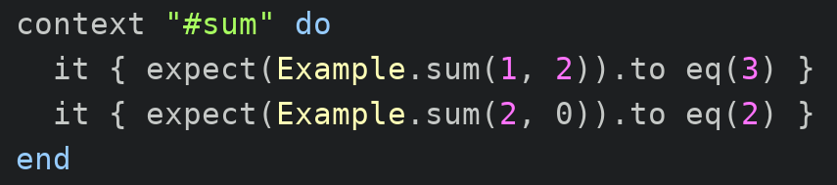
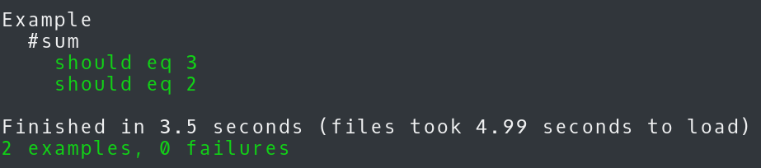
Write tests for sum
With unit tests:
With 2 examples should be enough

Slide 15

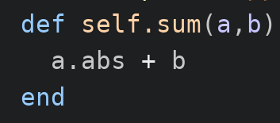
And then the perverse programmer acts
Note: Perverse programmer in this context means a programmer with the intention to break your code

Slide 16
Will the test fail?
With unit tests:
No!

Slide 17
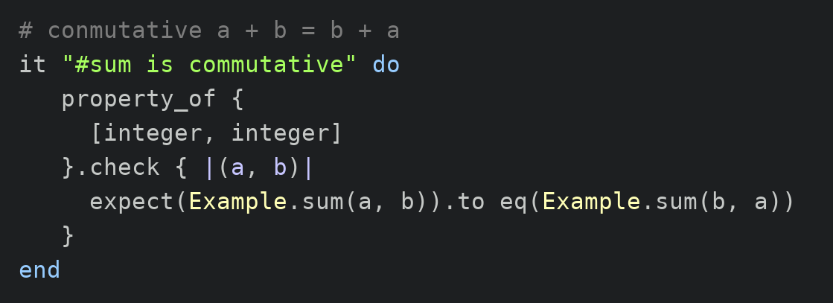
Write tests for sum
With property tests:
Using addition properties:
commutative, associative, identity element and distributive

Slide 18
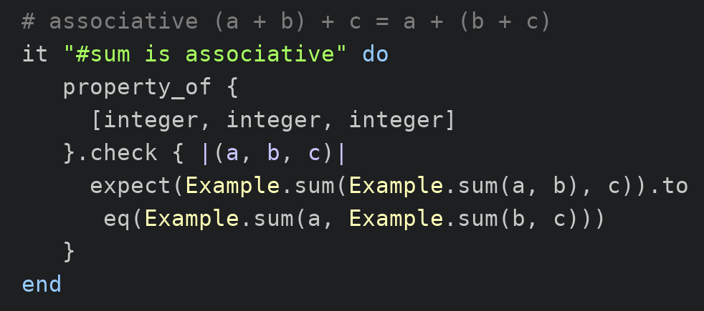
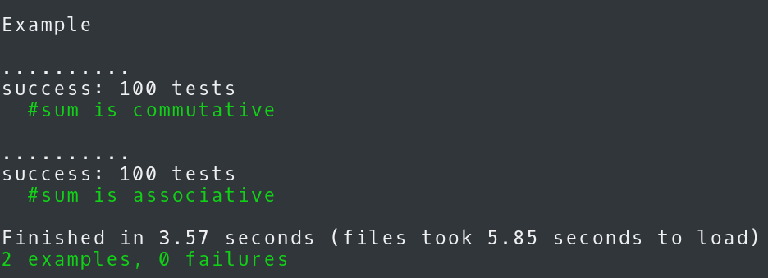

Slide 19
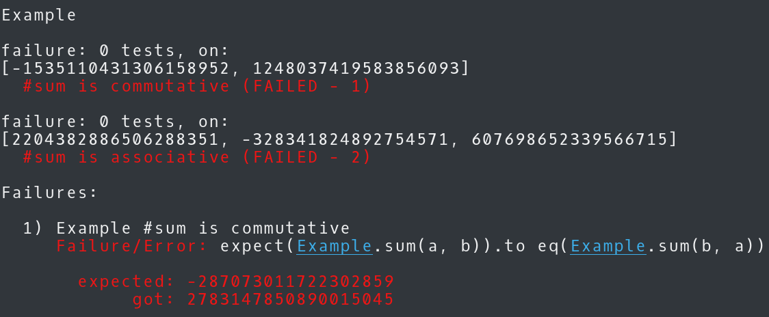
Will the test fail?
With property tests:
Yes!!!

Slide 20
We can test more complex things
OBS project.rb#self.valid_name?
With unit tests:

Slide 21
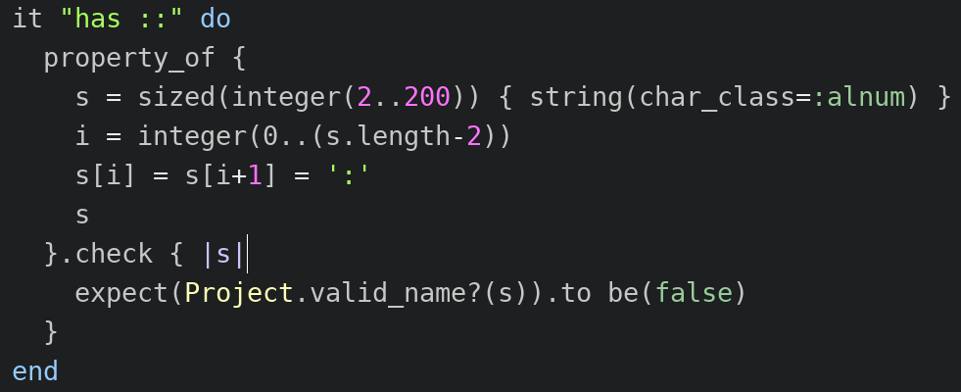
We can test more complex things
OBS project.rb#self.valid_name?
With property tests:

Slide 22
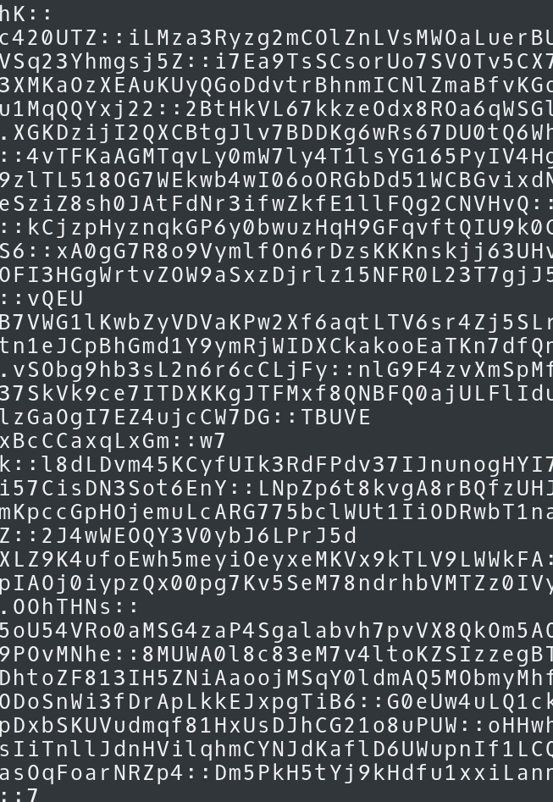
Tested examples:
With property tests (100): With unit tests (1):

Slide 23
Should you use property tests?

Slide 24
Problems
We have to be able to give an specification
Designing the properties involves a lot of work
But we get automated tests and unambigous specifications

Slide 25
How to design properties?

Slide 26
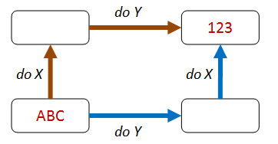
How to design properties?
Different paths, same destination
Test oracle
Notes:
- sum: commutative, associative
- two algorithms – one new more efficient
- sorting a list
- Test oracle (click)

Slide 27
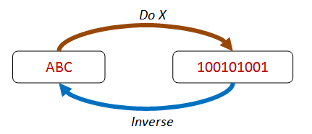
How to design properties?
There and back again
Notes:
- reverse of a list
- doing nothing also verify the property

Slide 28
How to design properties?
There and back again
reverse
[1, 2, 3, 4]
[4, 3, 2, 1]
reverse
Notes:
- reverse of a list
- doing nothing also verify the property

Slide 29
How to design properties?
There and back again
reverse
[1, 2, 3, 4]
[1, 2, 3, 4]
reverse
Notes:
- reverse of a list
- doing nothing also verify the property

Slide 30

How to design properties?
Some things never change
Notes:
- the elements in the list are the same, or the sum of them
- sum: identity element

Slide 31
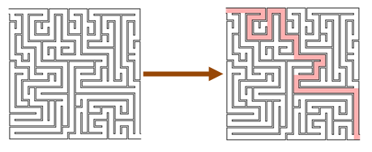
How to design properties?
Hard to implement, easy to verify
Notes:
That a goal has been reach

Slide 32
Rantly development

Slide 33
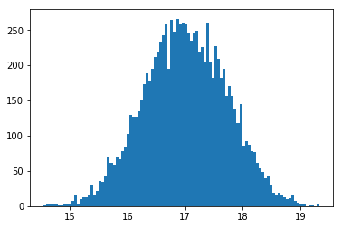
What’s new?
Generate floats with Normal distribution
Notes:
Random generation in Ruby is quite limited – only uniform distribution – point with same probability
I would suggest starting with a normal distribution, also called Gaussian distribution. This distribution could be really useful for property testing, for example for generating random numbers that are closer to a limit case.

Slide 34
Resources

Slide 35
Resources
http://fsharpforfunandprofit.com/posts/property-based-testing-2
https://github.com/rantly-rb/rantly
https://www.sitepoint.com/the-how-and-why-of-property-based-testing-in-ruby

Slide 36
Mutant tests
Ana María Martínez Gómez
ammartinez@suse.de
Github: Ana06

Slide 37

Are your tests good enough?

Slide 38
Could a perverse programmer break your code without your tests noticing it?
Note: Perverse programmer in this context means a programmer with the intention to break your code

Slide 39

Are you sure?
Rspec sucesses
100% coverage

Slide 40
Mutation
MUTANT
Make a small change in the code
MUTANT DIES
TEST FAILS
TEST PASSES
ZOMBIE

Slide 41
Mutation testing
Find missing or inadequate tests
Find dead code
Evaluate our test suite

Slide 42
Examples
If age > 18
smoke
-----------------------------
If age < 18
smoke

Slide 43
Examples

Slide 44
Examples
buy_chocolate = true
-----------------------------
buy_chocolate = false

Slide 45

Examples

Slide 46
Example

Slide 47
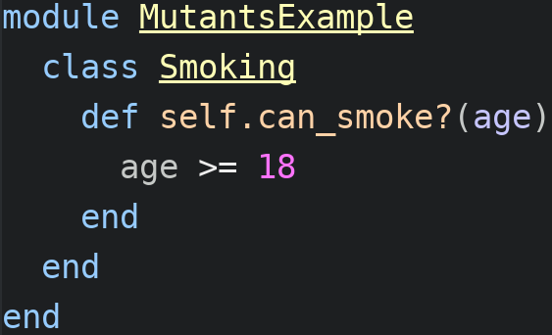
Let’s write a can_smoke? method

Slide 48
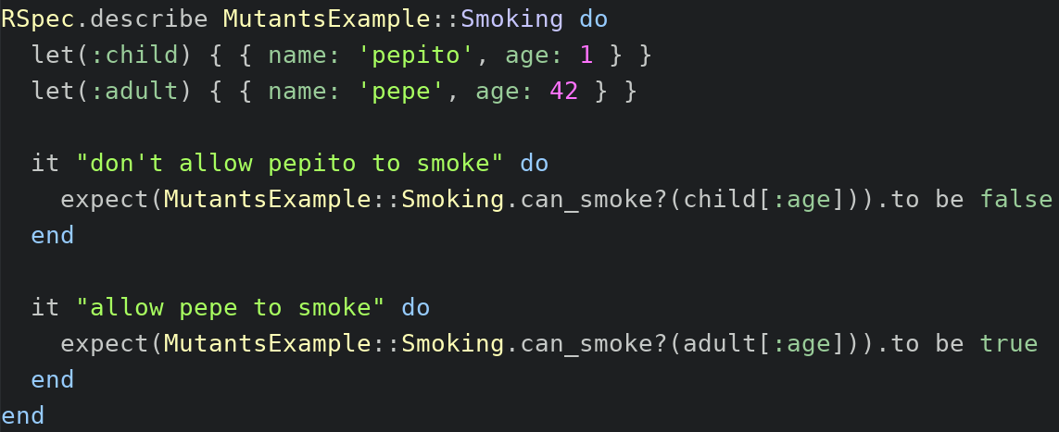
Test can_smoke? method

Slide 49

Is our test good enough?

Slide 50
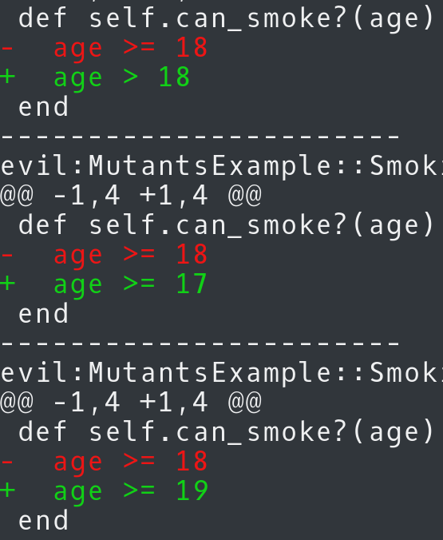
Let’s run mutant testing!

Slide 51

Let’s run mutant testing!

Slide 52
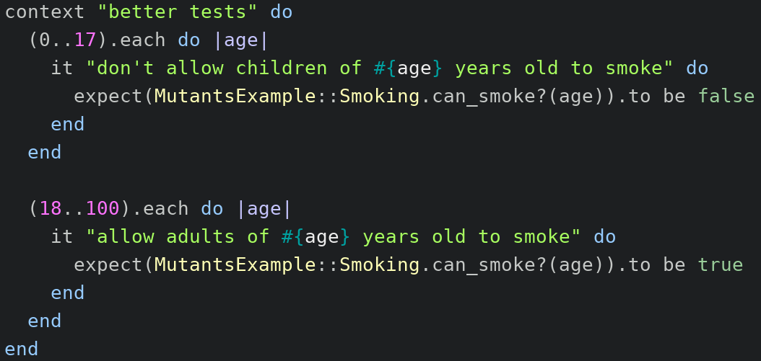
How can we solve it?
100 test cases

Slide 53

What about property tests?

Slide 54
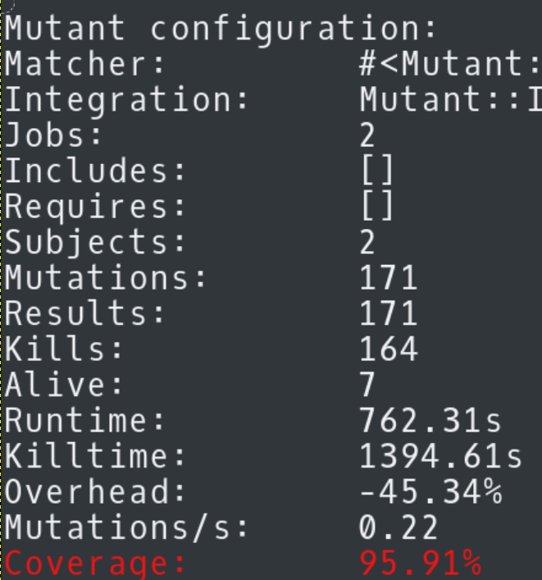
How does it looks like?
vagrant exec bundle exec mutant --use rspec CommentPolicy

Slide 55
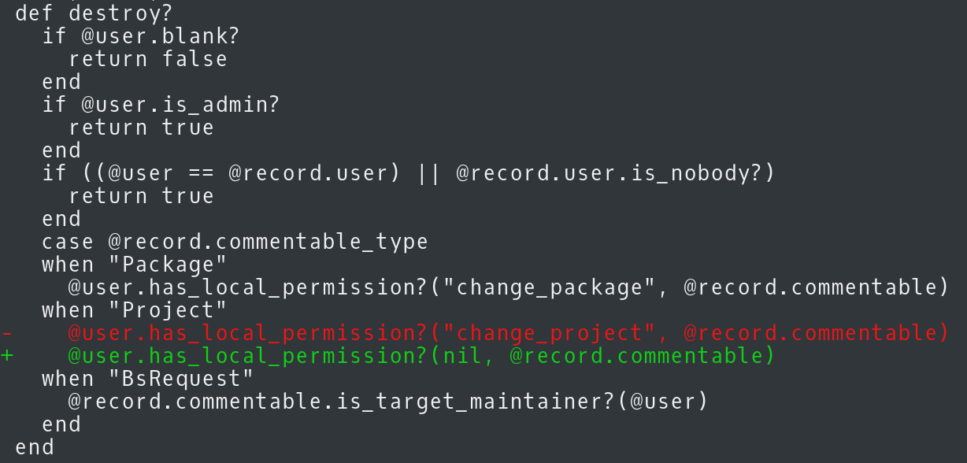
Failures

Slide 56
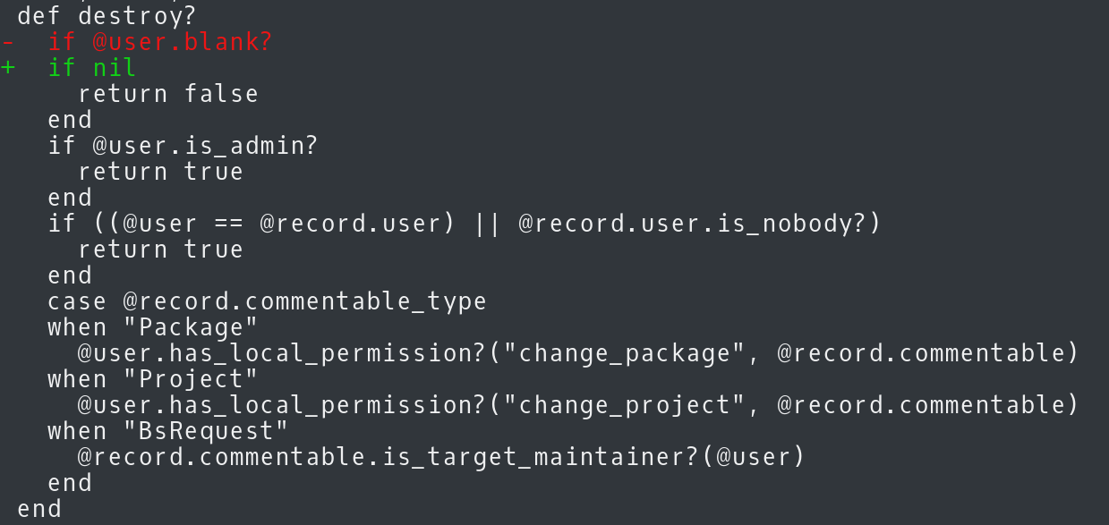
Failures

Slide 57

There are some problems!

Slide 58
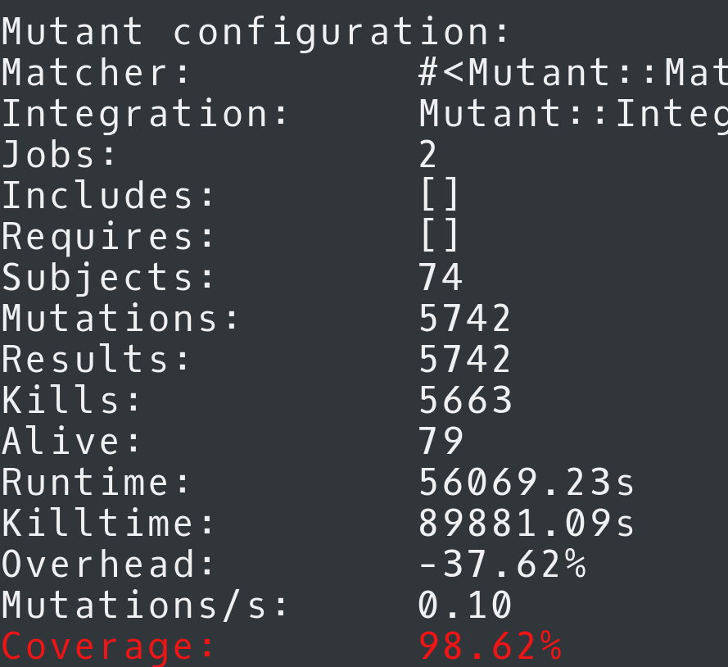
How much does it take?
vagrant exec bundle exec mutant --use rspec User
MORE THAN 15
HOURS
ONLY FOR ONE MODEL!

Slide 59
Thanks!
Ana María Martínez Gómez
anamma06@gmail.com
Github: @Ana06
Twitter: @anamma_06

