Slide 1
Analysis of Long-term care in Senior Housing.
Group-11
Kavya Vijay - 0789148
Julie Kunnuvila Thomas - 0792998
Deep Johal - 0787880
Mahesh Bhanudas Gujarathi - 0791269
Rugveda Rajendra Shirgaonkar - 0780896
For work repository, click here

Slide 2
Table of contents
Introduction
Problem Statement
About the Company
Goals
Objectives
Data
Preprocessing
Summary of findings
Tools and Techniques
Challenges
Future work
Conclusion
References

Slide 3
Introduction
Senior Housing plays a really important role in modern healthcare .
Senior Housing provides the crucial care needed by the senior citizens under one roof.
As a society , we should focus on building a safer environment for our elders .
This project , we aim to use our findings and identify how we can satisfy the need of more senior housing in the province of Ontario.

Slide 4
Problem Statement
Provision of senior housing communities is a complex issue. It requires thorough analysis to understand the challenges and opportunities for improvement.
At the time of emergencies , senior citizens don’t have the minimal help our seniors need. Due to the covid-19,Seniors started moving into senior homes.
With having more seniors' homes with several services, We can provide a better healthcare and assistance .

Slide 5
The waiting period after applying and getting a room in a senior
home is over a year .
This migration in turn increases the demand of building new senior homes. The availability rate is getting lower.
This needs to be addressed because the need for senior homes has the same priority as those given to building new hospitals and rehabs.

Slide 6
About the company
MECP specializes in manufacturing affordable medical equipment in Canada.
They are expanding business to provide products for long term Care housing.
Currently, MECP is trying to understand the market feasibility of their products and services in senior housing.

Slide 7
Goals
The goal of this analysis is to
understand the current state of long-term care in senior housing communities and prove that we need more senior housing in future.
identify key challenges and opportunities.
develop recommendations for improving the provision of long-term care services to meet the needs of older adults.

Slide 8
Objectives
Identify the population growth of senior citizens in Canada to understand the estimate of senior housing required in Canada.
Identify the cost estimation and vacancies of senior housing in Ontario.
Convey this relation of population growth and senior housing increase to MECP, which could give them more insights about the budget and marketing scope of the senior housing market in Canada.

Slide 9
As availability and affordability of the rooms and licensed beds play a crucial role in the process, we worked to find out how they are related to the growing need of more senior homes.

Slide 10
Dataset
Population estimates by age and sex of ontario and canada- This data contains the population by age groups of male, female and both the sexes from the year 2018 to 2022 in Ontario as well as canada
https://www.cmhc-schl.gc.ca/en/professionals/housing-markets-data-and-research/housing-data/data-tables/rental-market/seniors-rental-housing-canada-provinces-metropolitan-areas. This data contains the information about the standard space vacancy rate and average rent for standard space of senior housing in main cities in ontario.
Census Data- This data contains the information about the life expectancy,population by age group of both the sexes from 1971 to 2022.

Slide 11
Population estimates of Canada from World bank. - This is a part of open data published by World Bank. It has various estimates and data about GDP, Sex ratio, Employment rate, etc globally. We decided to keep our scope of usage specific to Canada with Population estimates.
Ontario_LTC_csv - This data is scrapped from Ontario’s long term care lookup. It contains location of LTC, Licensed beds, and wait times in days.

Slide 12
Preprocessing
Multiple data sources used, necessitating data cleaning
Web-scraped data required additional cleaning
Joining of datasets done based on city and region names
Null values removed
Geographical data used to create longitude and latitude for each long-term care facility
Data pertained to all of Canada, but only Ontario was utilized
Private data removed to adhere to ethical data usage principles
Unknown regions with null values also removed.

Slide 13
Summary of Findings

Slide 14
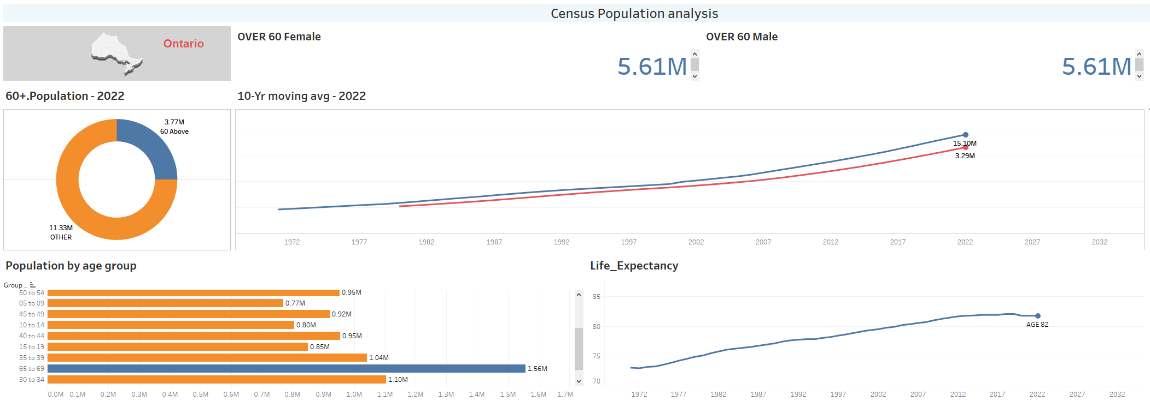
Census population analysis

Slide 15
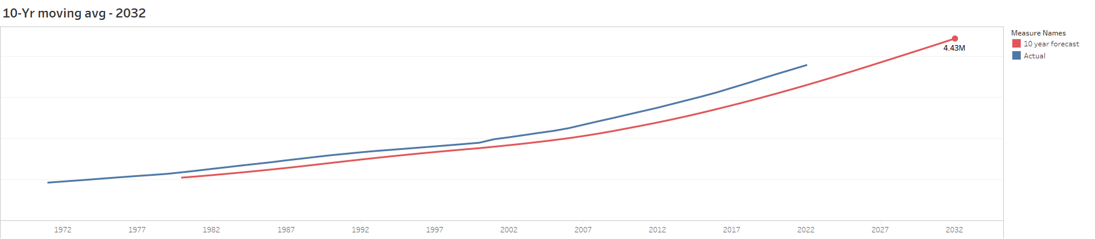
Population projection for over next 10 years

Slide 16
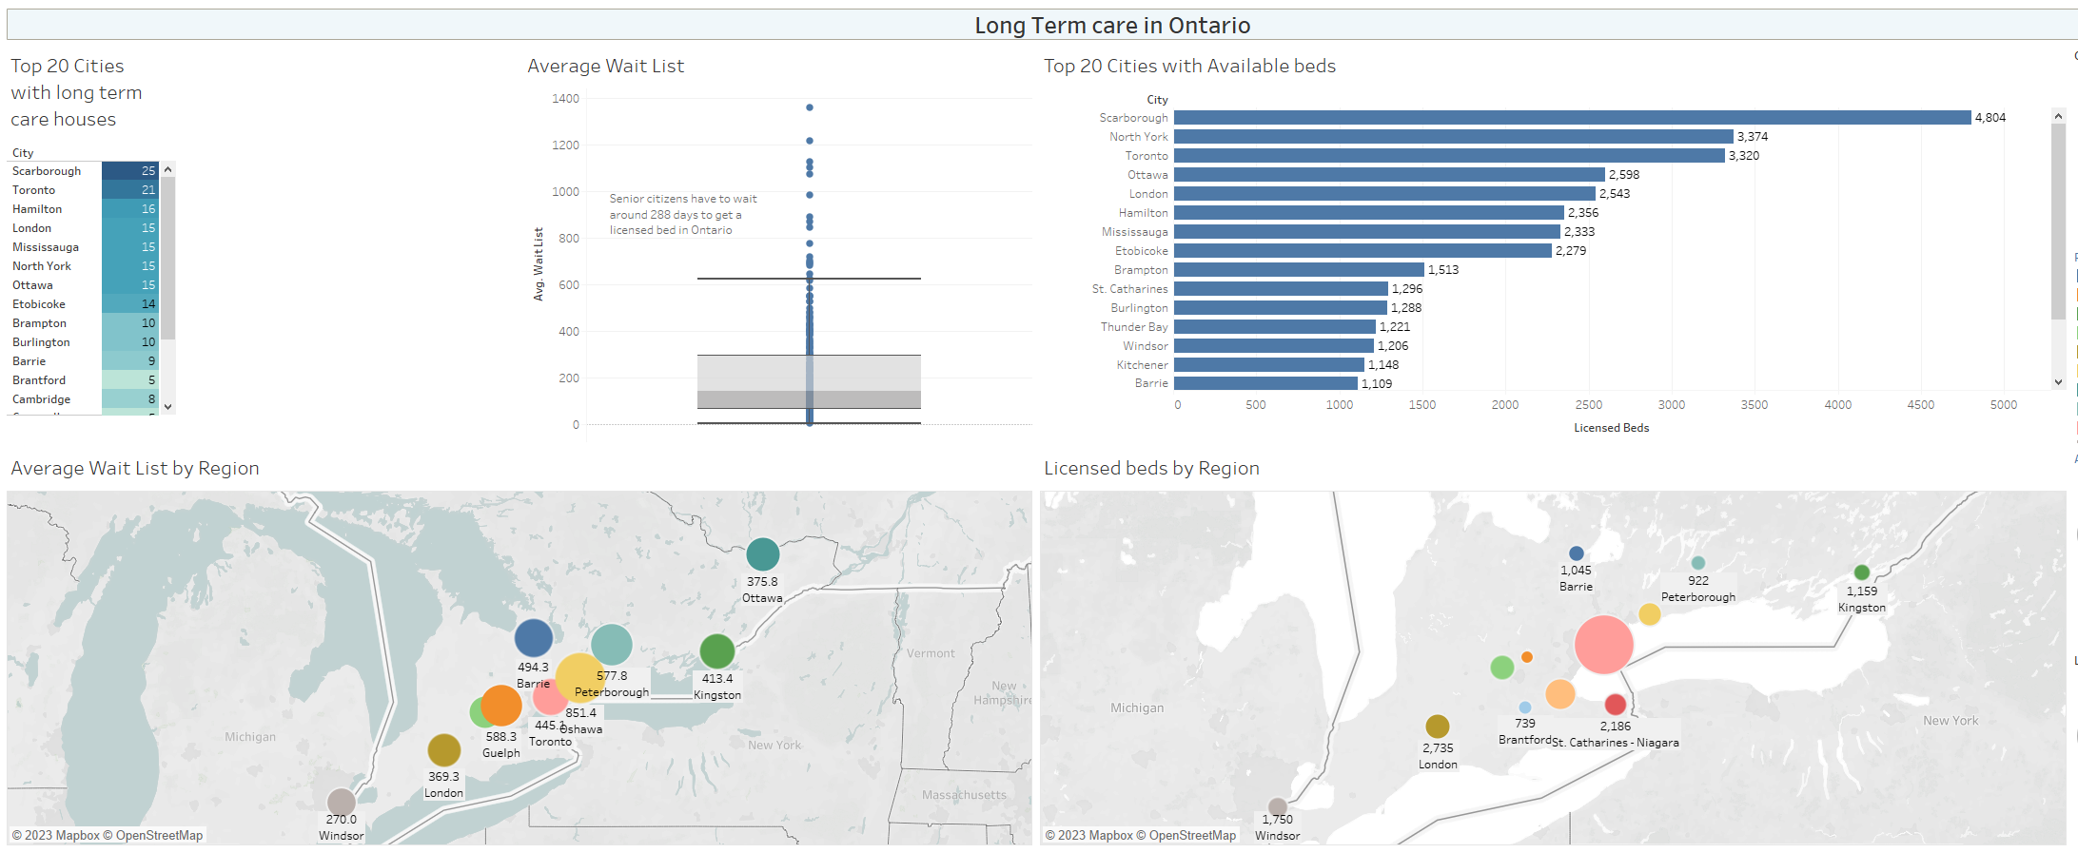
Summary of long-term care in Ontario
On a average, 288 Senior citizens are waiting to get a licensed bed in Ontario

Slide 17
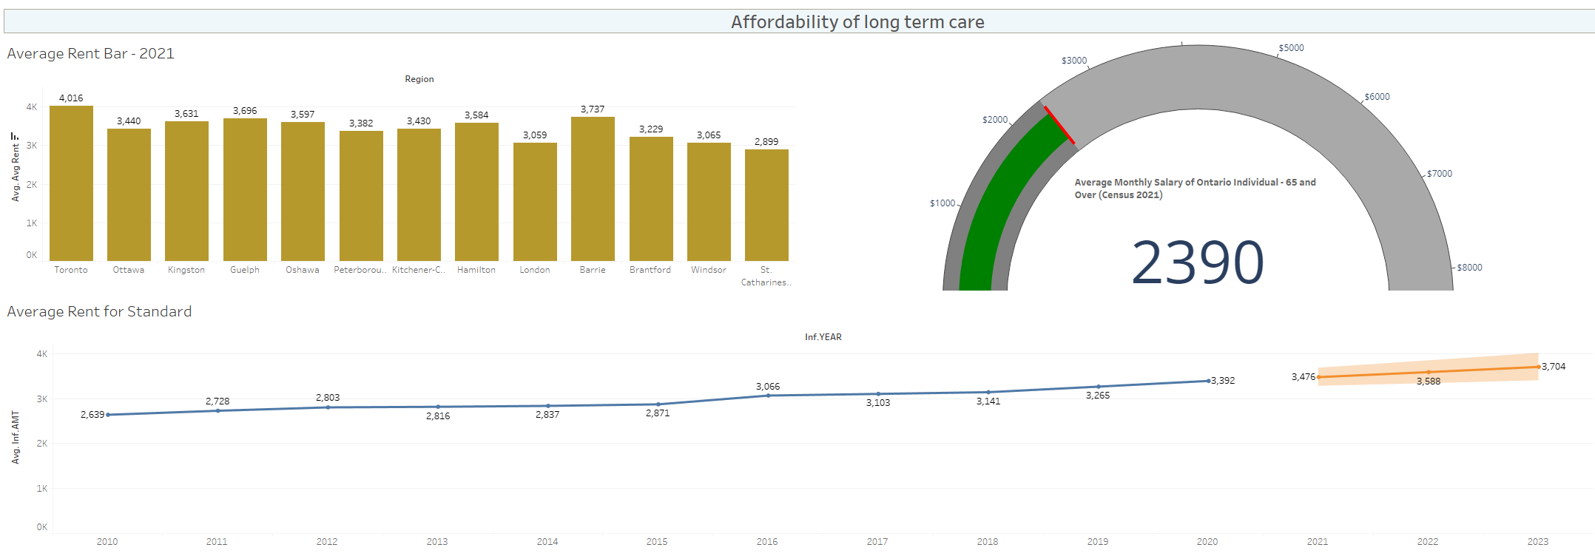
Affordability of long-term care
The estimated average rent of long term care is $3588 whereas the average monthly salary of an individual in ontario 65 and above is $2390

Slide 18
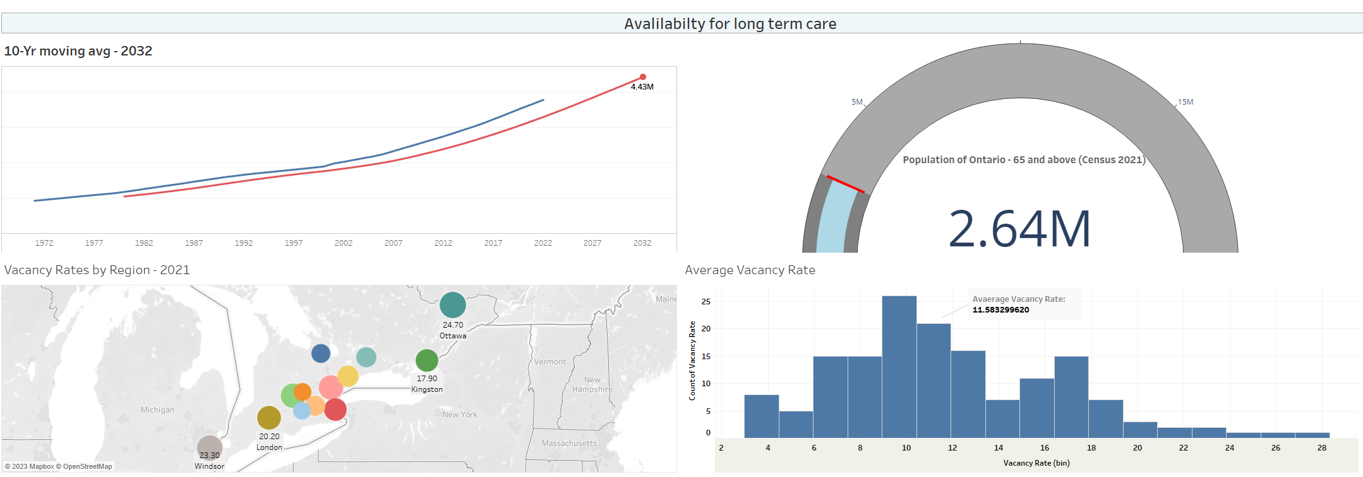
Availability of long-term care

Slide 19
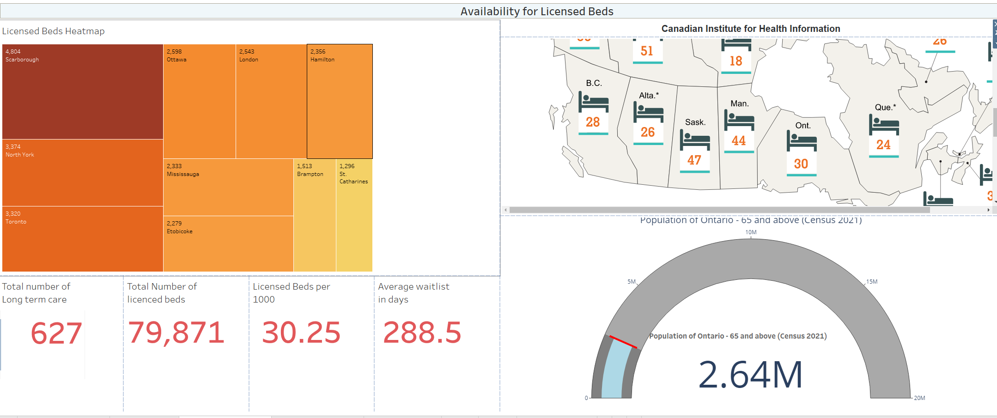
Availability of Licensed beds

Slide 20



In Ontario
2.64M
Population Age 65+
627
LTC Homes
79,870
LTC Beds

Slide 21
Tools and Techniques
Microsoft office(word ,excel, powerpoint)
Python(numpy , pandas, matplotlib )
Tableau
Power BI

Slide 22
Challenges
Challenges in collecting long-term care data due to sensitive personal information and privacy concerns
Difficulty in merging multiple datasets into a single cohesive dataset
Cleaning datasets poses a challenge due to varying data sizes and incomplete information
Addressing null values and unknown regions in datasets
Obtaining the longitude and latitude of long-term care homes for accurate location tracking

Slide 23
Future work
Contact long-term care homes to gather more data on the medical conditions of individuals residing in long-term care homes
Conduct research on the diseases and medical conditions commonly found among senior individuals in Ontario
Perform a comprehensive analysis of the medical facilities and resources available in long-term care homes.

Slide 24
Conclusion
There are 2.64 million old aged people in Ontario.
The overall population of old aged people is increasing in Ontario.
The average monthly salary of an individual in Ontario 65 and above is $2390.
There are 79,870 licensed beds and 627 long-term care homes in Ontario.
The estimated average rent of long-term care in Ontario is $3588.
On an average, 288 Senior citizens are waiting to get a licensed bed in Ontario
Based on the analysis and findings, it can be concluded that Ontario needs more long-term care in the coming years.

Slide 25
References
https://www.ontario.ca/page/government-ontario
https://www.cihi.ca
https://www.statcan.gc.ca/en/start
https://www.cmhc-schl.gc.ca/en

Slide 26
Thank You!

