Slide 1
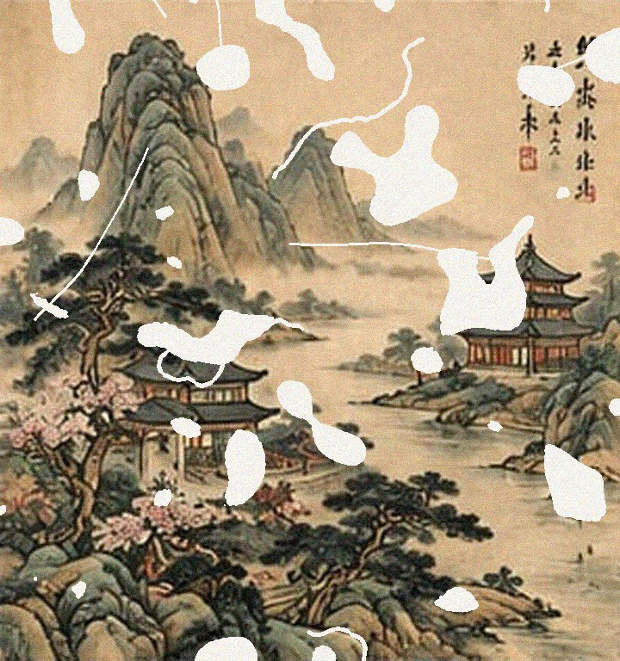
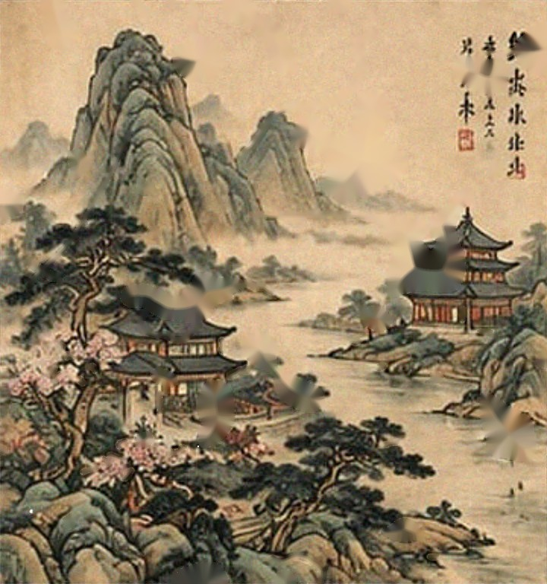
Wavelet Transform Based Restoration of Damaged Chinese Painting
DIGITAL IMAGE PROCESSING · CASE STUDY
Shivam Mandlekar · [Co-author 2] · [Co-author 3]
Guide: [Mentor Name]
Damaged input
Restored output
Department of Electronics and Computer Science
Ramdeobaba University, Nagpur
PSNR 16.12 → 24.77 dB
SSIM 0.565 → 0.835
RBU, EN, DIP · 2026–27
Notes:
Good morning. Our case study is about restoring a damaged Chinese painting digitally, using the wavelet transform. On the right you can see the damaged input we start from and the restored output we end with. In numbers, the image quality improves from a PSNR of 16.12 dB to 24.77 dB, and SSIM from 0.565 to 0.835. I will explain how we got there and what we learned.

Slide 2
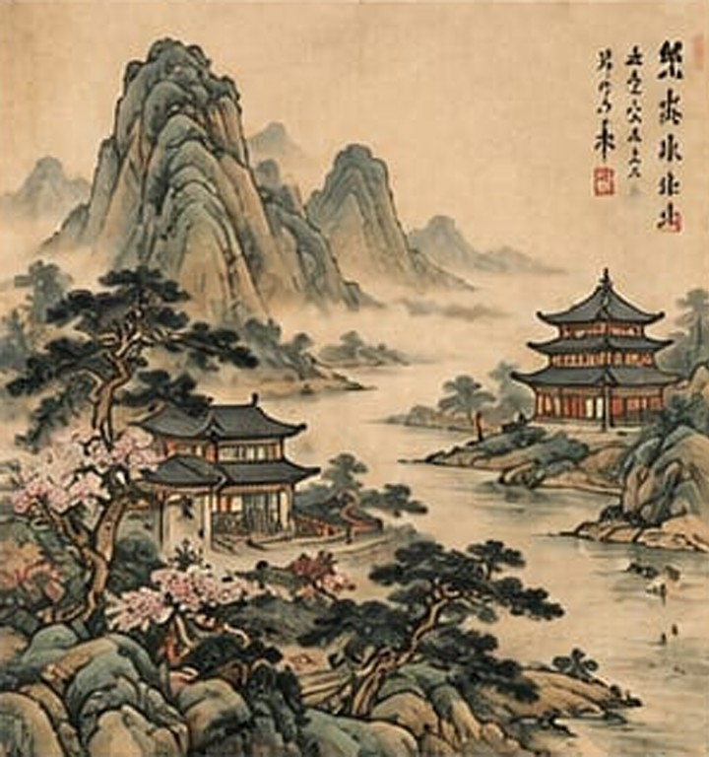




Why restore Chinese paintings digitally?
Fragile heritage
Ink and pigment on thin paper or silk. Rolling, insects, mould and light cause tears, losses, scratches and fading.
Physical restoration is irreversible
Conservation ethics demand minimal intervention, reversibility and full documentation.
Digital copies allow virtual restoration
A plausible recovered state can be computed and discussed without touching the object.
The DIP toolset
Wavelets for multiresolution analysis and denoising, inpainting for missing regions, MSE / PSNR / SSIM for proof.
Reference painting: traditional-style shan shui landscape, 720 × 768 px
Notes:
Chinese paintings are made of ink and pigment on very thin paper or silk, so over centuries they tear, lose pieces, get scratched and fade. Physical restoration is skilled but partly irreversible, and conservation ethics ask for minimal intervention. Digital copies let us try a virtual restoration first, without touching the object. Digital image processing gives us the tools: wavelets, inpainting, and objective quality metrics. This is the reference painting we used.

Slide 3
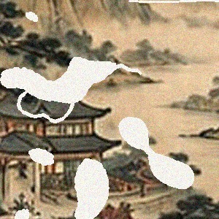
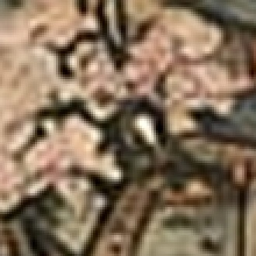
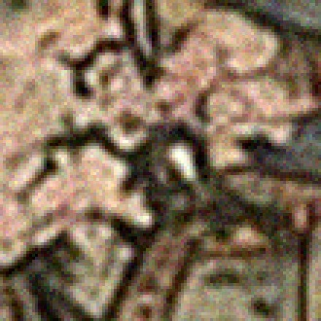
Two degradations in one image
Missing information
Corrupted information
Torn and missing patches
Cracks and scratches
Paint is physically gone
Scan and ageing noise
Covers all intact paint
Brush strokes must survive
clean
→ must be FILLED (inpainting)
noisy
→ must be DENOISED (wavelets)
Before either: locate the damage automatically. After both: prove the result with MSE, PSNR and SSIM.
Notes:
The key insight is that a damaged scan suffers from two different problems at the same time. Where the paint is physically gone, there is no data, so it must be filled, which is inpainting. Everywhere else the paint is there but covered in noise, so it must be denoised without blurring the brush strokes, which is where wavelets come in. Before either step we must find the damage automatically, and afterwards we must prove the result with objective metrics.

Slide 4
Case questions and aim
AIM
Study and implement the wavelet transform to reduce noise and restore a degraded painting by decomposing it into frequency components, and evaluate the reconstruction with MSE, PSNR and SSIM.
Q1
Q2
Q3
Q4
Can damaged regions be detected and segmented automatically, and how accurately?
Does wavelet thresholding reduce noise while preserving detail?
Does wavelet + inpainting beat conventional inpainting on MSE, PSNR and SSIM?
How sensitive is it to wavelet, level, threshold rule, noise and damage?
Recall 1.000 · Dice 0.895
Noise −53.4%, edges kept
Yes: +1.83 dB, +0.223 SSIM
Threshold rule matters most
Notes:
Our aim was to implement the wavelet transform for noise reduction and restoration and to evaluate it with MSE, PSNR and SSIM. We framed it as four questions. Can we detect the damage automatically? Does wavelet thresholding remove noise but keep detail? Does combining wavelets with inpainting beat inpainting alone? And how sensitive is the method to its settings? The red line under each card previews the answer we found.

Slide 5








Setting and stakeholders
Setting
Stakeholders
Google Colab, CPU runtime: about 46 s for the whole notebook
Museums and archives
Conservators
Faithful, documented digital copies
Damage maps and reversible previews
Python: NumPy, OpenCV, PyWavelets, scikit-image
Art historians
Students and faculty
Fixed random seed (42): every number is reproducible
Authentic detail; restored areas marked
Learn, build and evaluate DIP
302 × 316 px source, resized to 720 × 768 px
Open-source developers
General public
Provide the algorithms and tools
Access heritage digitally
Notes:
This was an academic lab study, run entirely in a free Google Colab notebook with open-source Python libraries. A fixed random seed means anyone can rerun it and get the same numbers. Although it is a lab case, the real problem involves several stakeholders: museums and archives who own the works, conservators who need damage maps, historians who need authentic detail, us as students, the open-source developers whose tools we used, and the public who view heritage online.

Slide 6
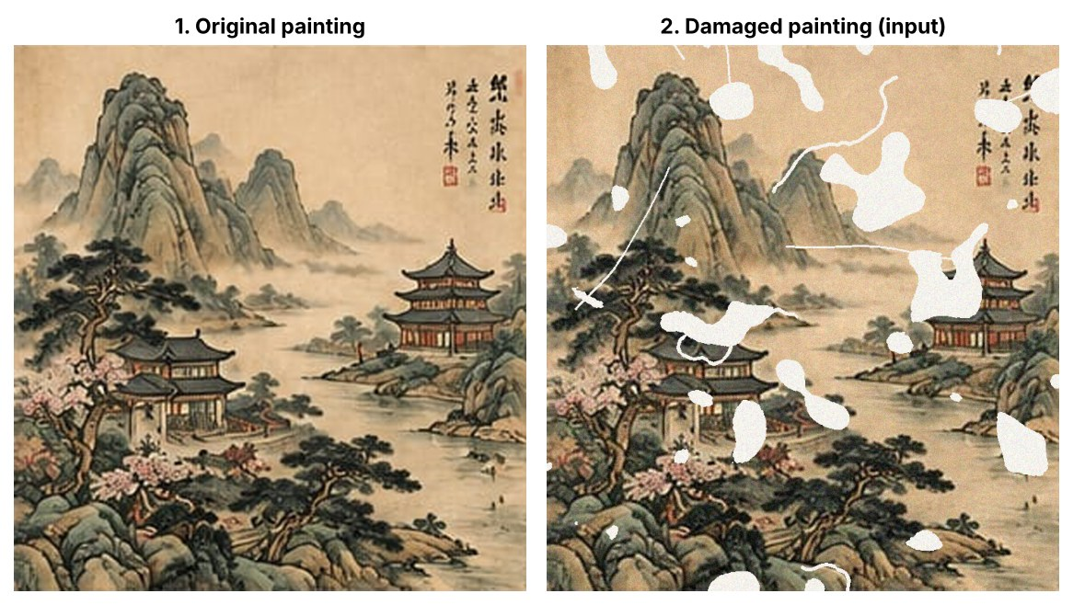
Creating a measurable test case
10.76%
of the painting damaged (ground truth)
Damage | Setting
Torn / missing patches | irregular blobs, ≈ 10%
Cracks and tears | 4, each 4 px wide
Scratches | 6, each 2 px wide
Scan noise | Gaussian, σ = 0.05
Fading / yellowing | off for evaluation
A known damage mask and a known noise level give the ground truth for MSE, PSNR, SSIM and detection scores.
Notes:
To measure restoration objectively we need the true answer, so we started from an undamaged painting and damaged it in a controlled, recorded way. We added torn patches, cracks, scratches and Gaussian scan noise. In total 10.76 percent of the painting is damaged. Because we know exactly which pixels were damaged and how much noise was added, we can score both the detection and the restoration.

Slide 7
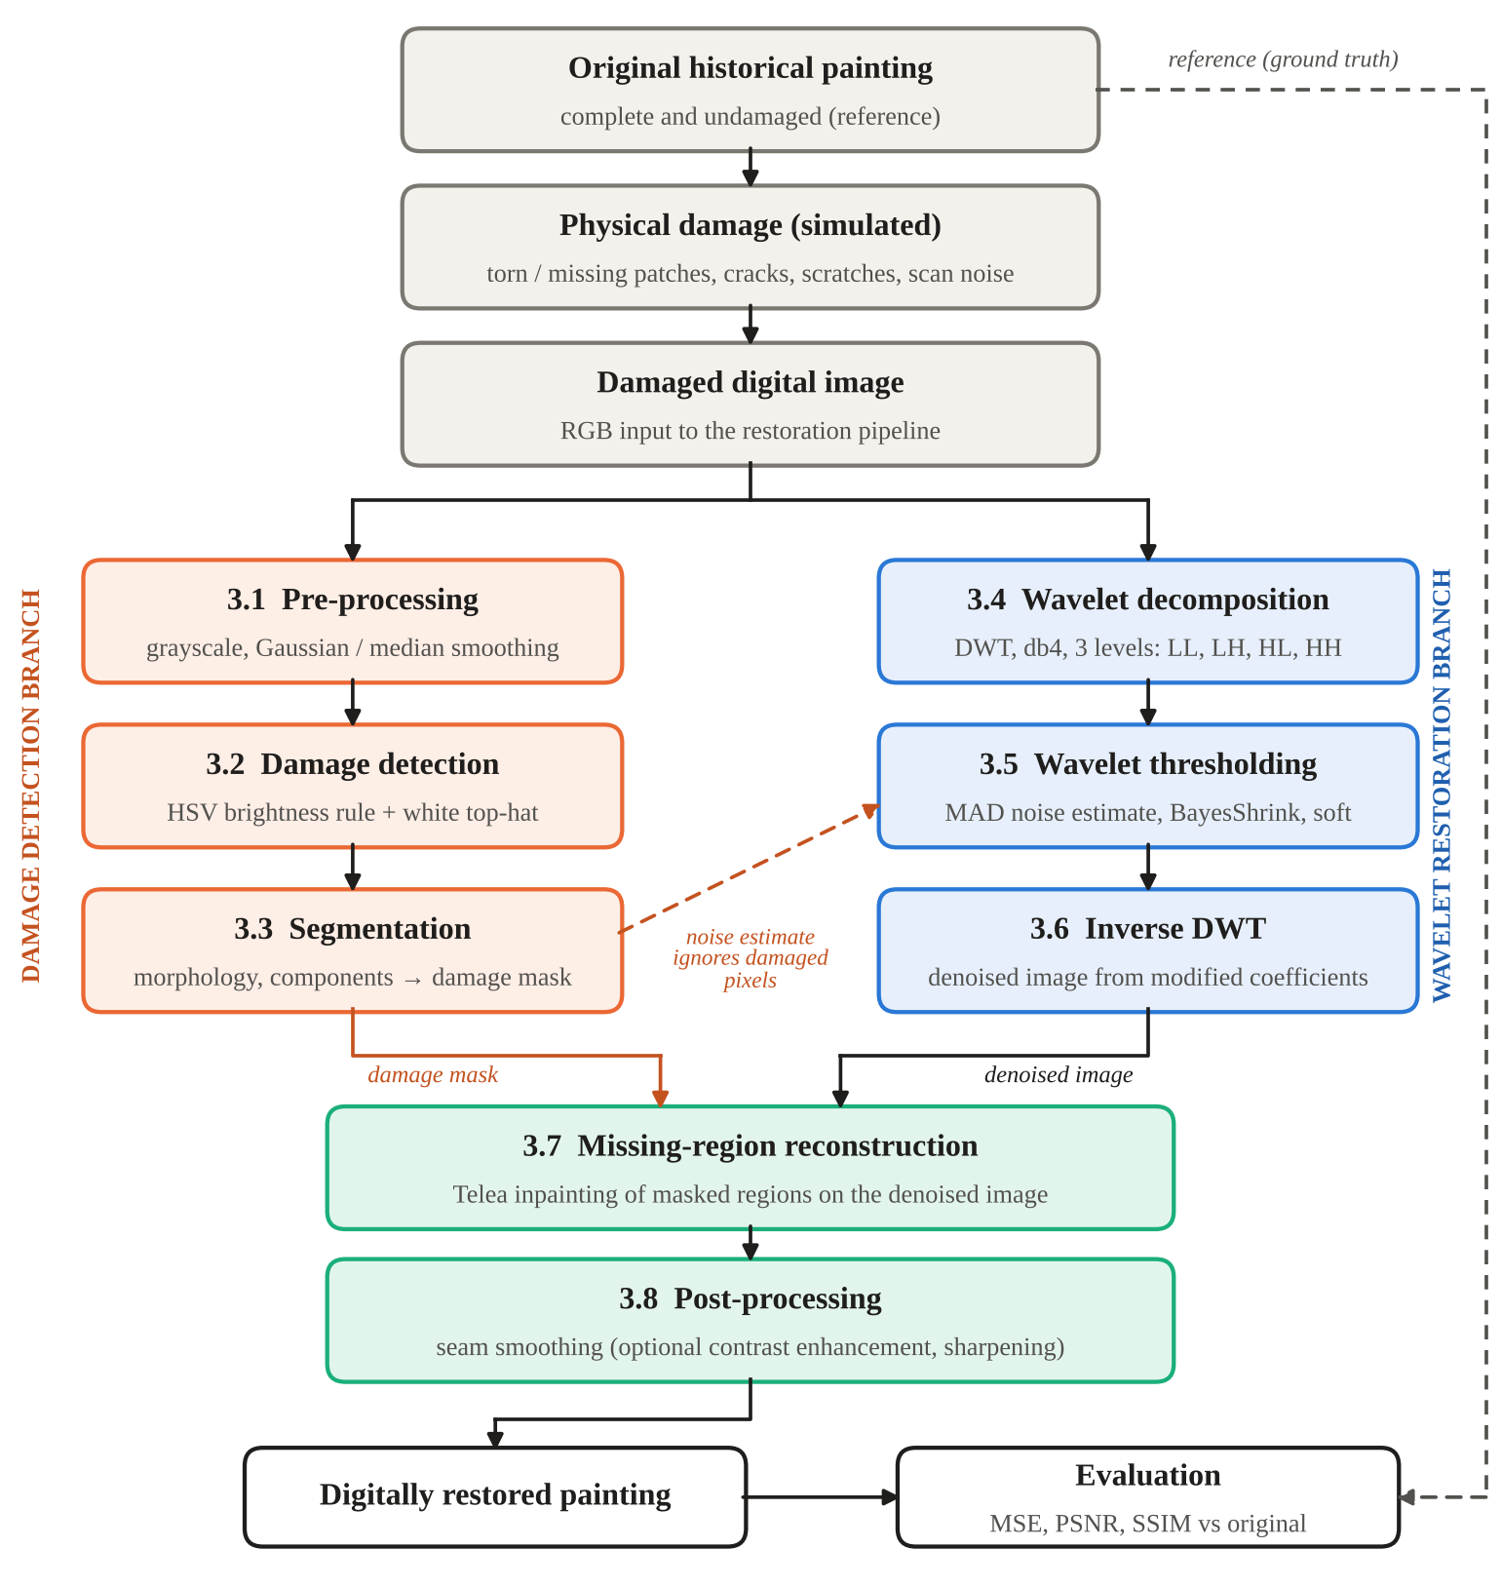
Method: an eight-stage pipeline
1
Damage detection branch (3.1–3.3)
Grayscale and smoothing → HSV brightness rule + white top-hat → morphology → binary damage mask
2
Wavelet restoration branch (3.4–3.6)
db4 DWT, 3 levels → BayesShrink soft thresholding of detail bands → inverse DWT = denoised image
3
Merge and evaluate (3.7–3.8)
Telea inpainting of masked regions → seam smoothing → MSE, PSNR, SSIM against the original
Inverse DWT runs before inpainting: filling holes inside the wavelet domain was also tested and scored lower.
Notes:
Here is the full method. The damaged image goes into two parallel branches. The left branch finds the damage and produces a binary mask. The right branch removes noise in the wavelet domain: decompose with db4, threshold the detail coefficients, and reconstruct. The two meet at stage 3.7, where the masked regions are filled by inpainting, then the seams are smoothed and the result is compared with the original. Note that we do the inverse DWT before inpainting; we tested filling holes in the wavelet domain and it did worse.

Slide 8
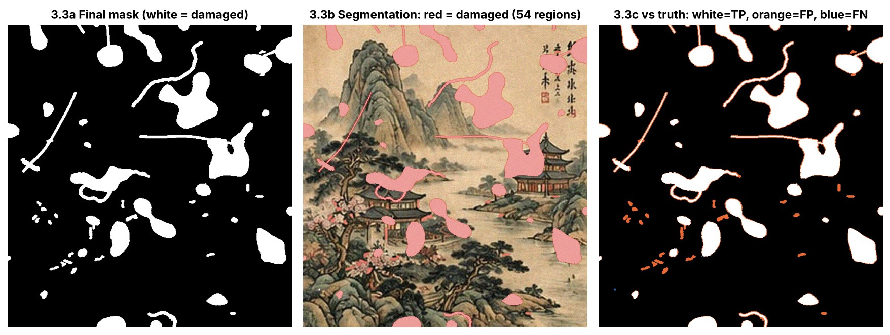
3.1–3.3 Finding the damage
3.1
Pre-processing
Grayscale; Gaussian (σ = 1.2) and 3 × 3 median copies used for detection only
3.2
Damage detection
Losses: V ≥ 225 and S ≤ 40 in HSV. Scratches: white top-hat > 28
1.000
0.811
0.895
0.88%
3.3
Segmentation
Closing, remove specks < 30 px, add 2 px margin → 54 damaged regions
Recall
Precision
Dice
False alarm on clean original
Over-detection of 2.51 points: 1.94 from the deliberate safety margin, 0.57 from small bright details such as blossoms.
Notes:
Exposed backing paper is bright and almost colourless, so large losses are found with a simple HSV rule. Thin scratches get blurred by smoothing, so we find them with a morphological white top-hat. Morphology then cleans the map and adds a two-pixel safety margin. We found every damaged pixel: recall 1.000 and Dice 0.895. The extra detections are mostly the safety margin we added on purpose, plus a few bright blossoms. On the clean original the detector flags under one percent of pixels.

Slide 9
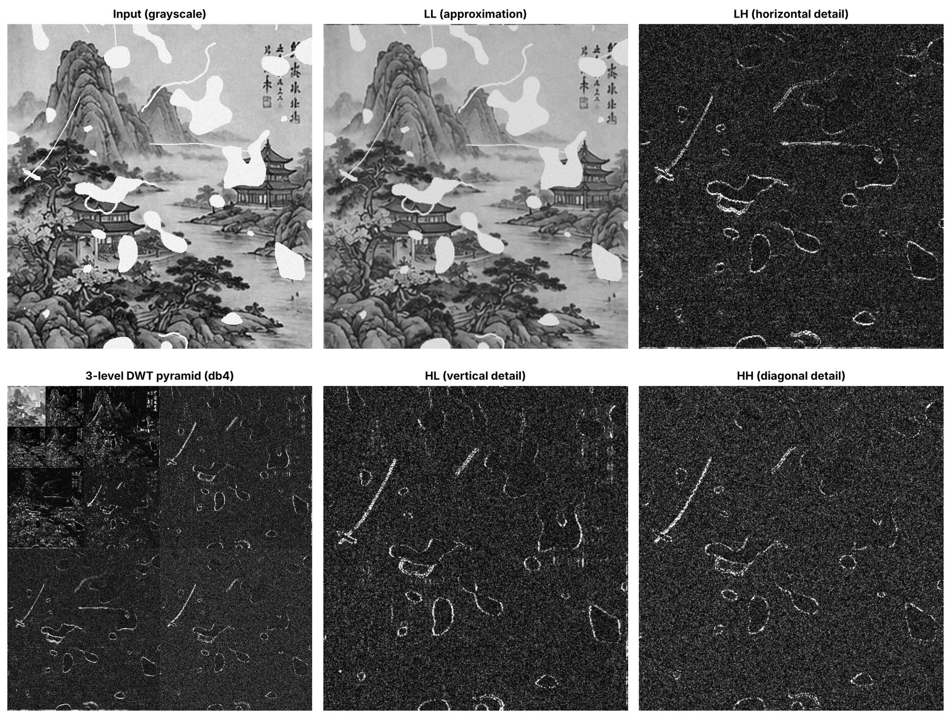
3.4 Wavelet decomposition (DWT)
99.66%
of the image energy stays in LL (level 1)
LH 0.13% · HL 0.12% · HH 0.09%
db4 wavelet: 8 taps, 4 vanishing moments
3 levels, periodic extension, each RGB channel
Detail bands carry edges + noise, so only these are thresholded; LL is kept
Notes:
The discrete wavelet transform splits each colour channel into an approximation band, LL, and three detail bands: horizontal, vertical and diagonal. Repeating on LL gives the pyramid on the bottom left. Almost all the energy, 99.66 percent, stays in LL. The detail bands are mostly fine noise, with real edges showing up as a few large coefficients. That is exactly why thresholding the detail bands can remove noise while keeping structure.

Slide 10
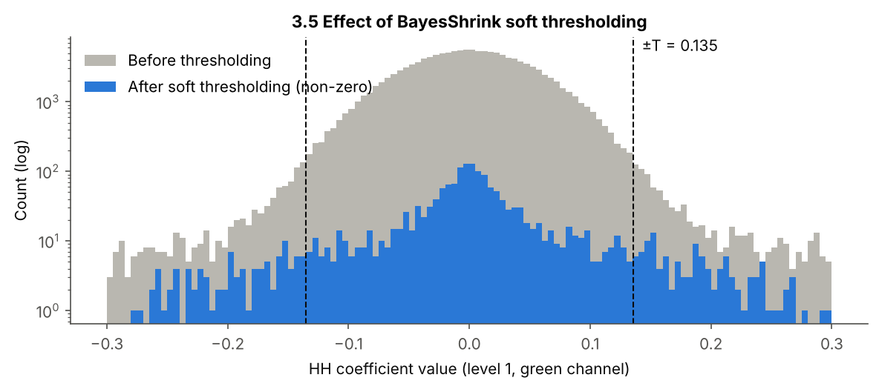
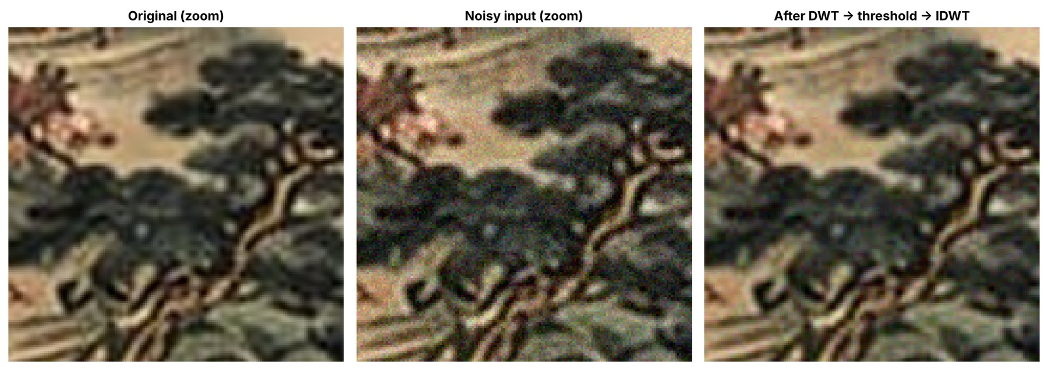
3.5–3.6 Thresholding and inverse DWT
Noise estimate (MAD)
σ_{n} = median( |HH₁| ) / 0.6745
BayesShrink threshold
T_{B} = σ_{n}² / σ_{X} , σ_{X} = √max( σ_{Y}² − σ_{n}², 0 )
Soft thresholding
η(d) = sign(d) · max( |d| − T_{B}, 0 )
0.0498
98.8%
7.7%
estimated σ (true 0.050)
of HH₁ coefficients zeroed
of HH₃ coefficients zeroed
−53.4% noise
on the intact area after inverse DWT (error std 0.0498 → 0.0232)
Notes:
We estimate the noise level from the finest diagonal band using the median absolute deviation; it gave 0.0498 against the true 0.050. BayesShrink then picks a separate threshold for every sub-band, and soft thresholding shrinks coefficients towards zero. The threshold adapts automatically: 98.8 percent of the finest diagonal coefficients are removed, but only 7.7 percent at the coarsest level, where real structure lives. After the inverse DWT, noise on the intact area falls by 53.4 percent, and the zoom on the right shows the brush strokes survive.

Slide 11
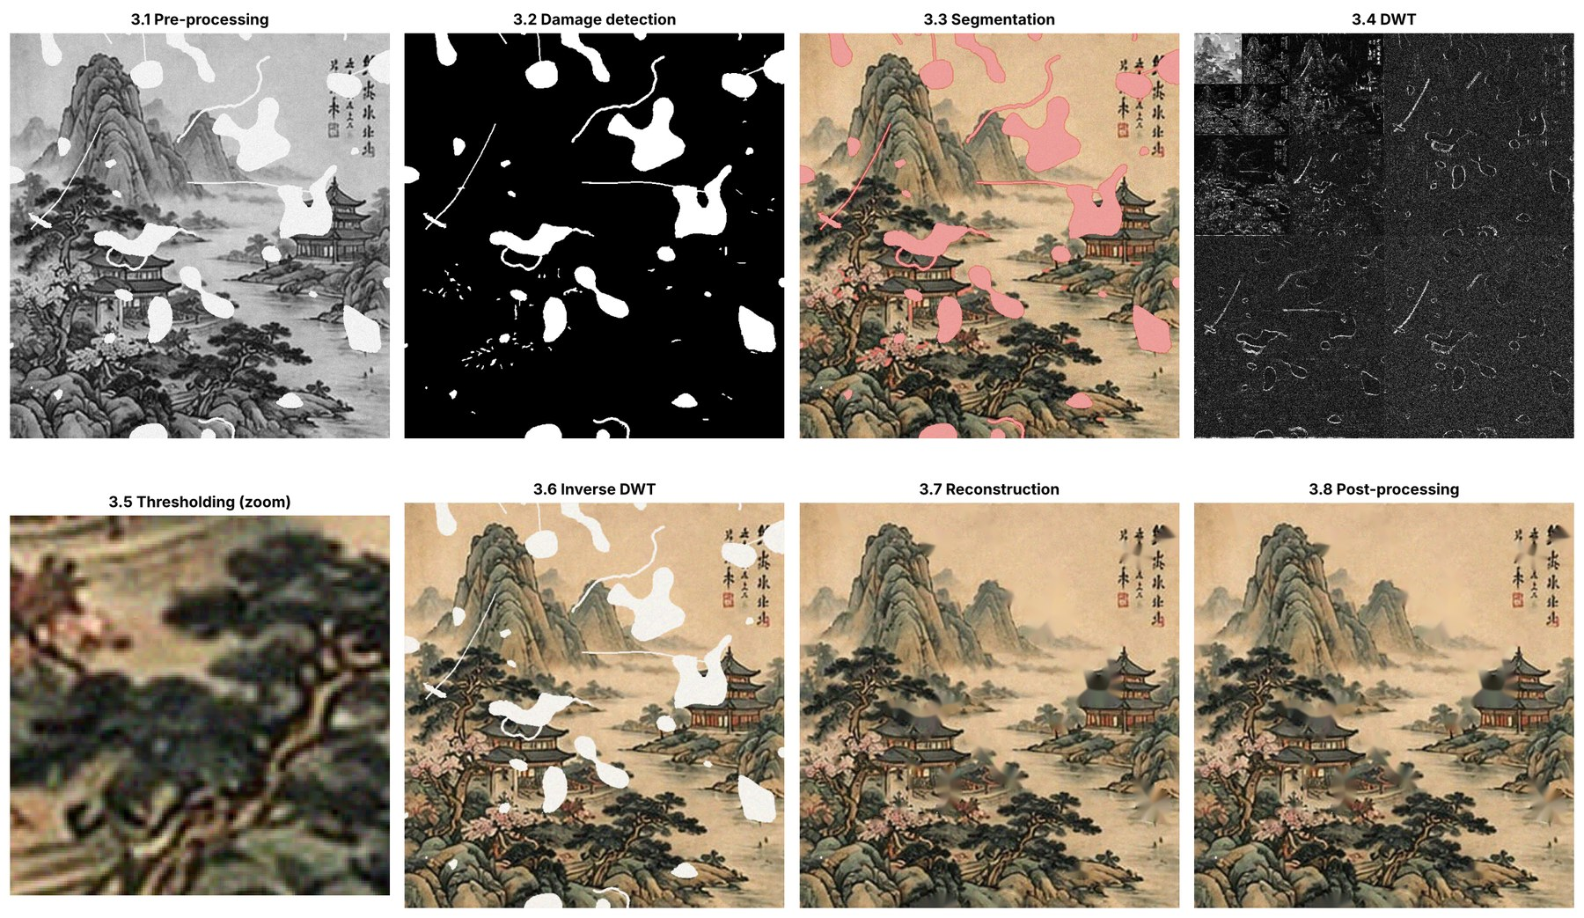
3.7–3.8 Filling the losses
3.7
Telea inpainting
Fills each masked region from its boundary inwards (radius 5 px), working on the denoised image so noise is not spread into the fills
3.8
Seam smoothing
Edge-preserving bilateral blend on a thin ring around each fill
Optional CLAHE + sharpening is reported separately: it changes pixel values.
Notes:
Wavelets cannot invent content where the paint is gone, so stage 3.7 fills the masked regions with Telea's fast-marching inpainting. It works from the edge of each hole inwards, averaging nearby known pixels. We run it on the denoised image so that noise is not copied into the fills. Stage 3.8 smooths the seams. This figure shows the output of all eight stages in order. A contrast-enhanced version exists too, but we report it separately because it deliberately changes pixel values.

Slide 12
Results: objective comparison
Method | MSE ↓ | PSNR (dB) ↑ | SSIM ↑
Damaged image (input) | 1589.63 | 16.12 | 0.565
Telea inpainting | 330.27 | 22.94 | 0.612
Navier–Stokes inpainting | 337.83 | 22.84 | 0.611
Wavelet denoising only | 1436.84 | 16.56 | 0.793
Wavelet-domain iterative inpainting | 284.93 | 23.58 | 0.817
Proposed: wavelet + inpainting (final) | 217.00 | 24.77 | 0.835
Proposed + display enhancement | 491.08 | 21.22 | 0.760
Proposed vs Telea alone
+1.83 dB
PSNR
+0.223
SSIM
−34.3%
MSE
Same detected mask for every method. MSE on the 0–255 scale; PSNR and SSIM against the undamaged original.
Notes:
This table compares eight variants, all using the same detected mask. Inpainting alone raises PSNR to about 23 dB, but SSIM barely moves because the noise is still there. Wavelet denoising alone raises SSIM but leaves the holes, so PSNR stays low. Our combination is best on all three metrics: PSNR 24.77 dB, SSIM 0.835 and MSE 217. Against Telea inpainting alone that is 1.83 dB better, 0.223 more SSIM, and 34 percent less error. Notice the last row: the contrast-enhanced version looks crisper but scores worse.

Slide 13
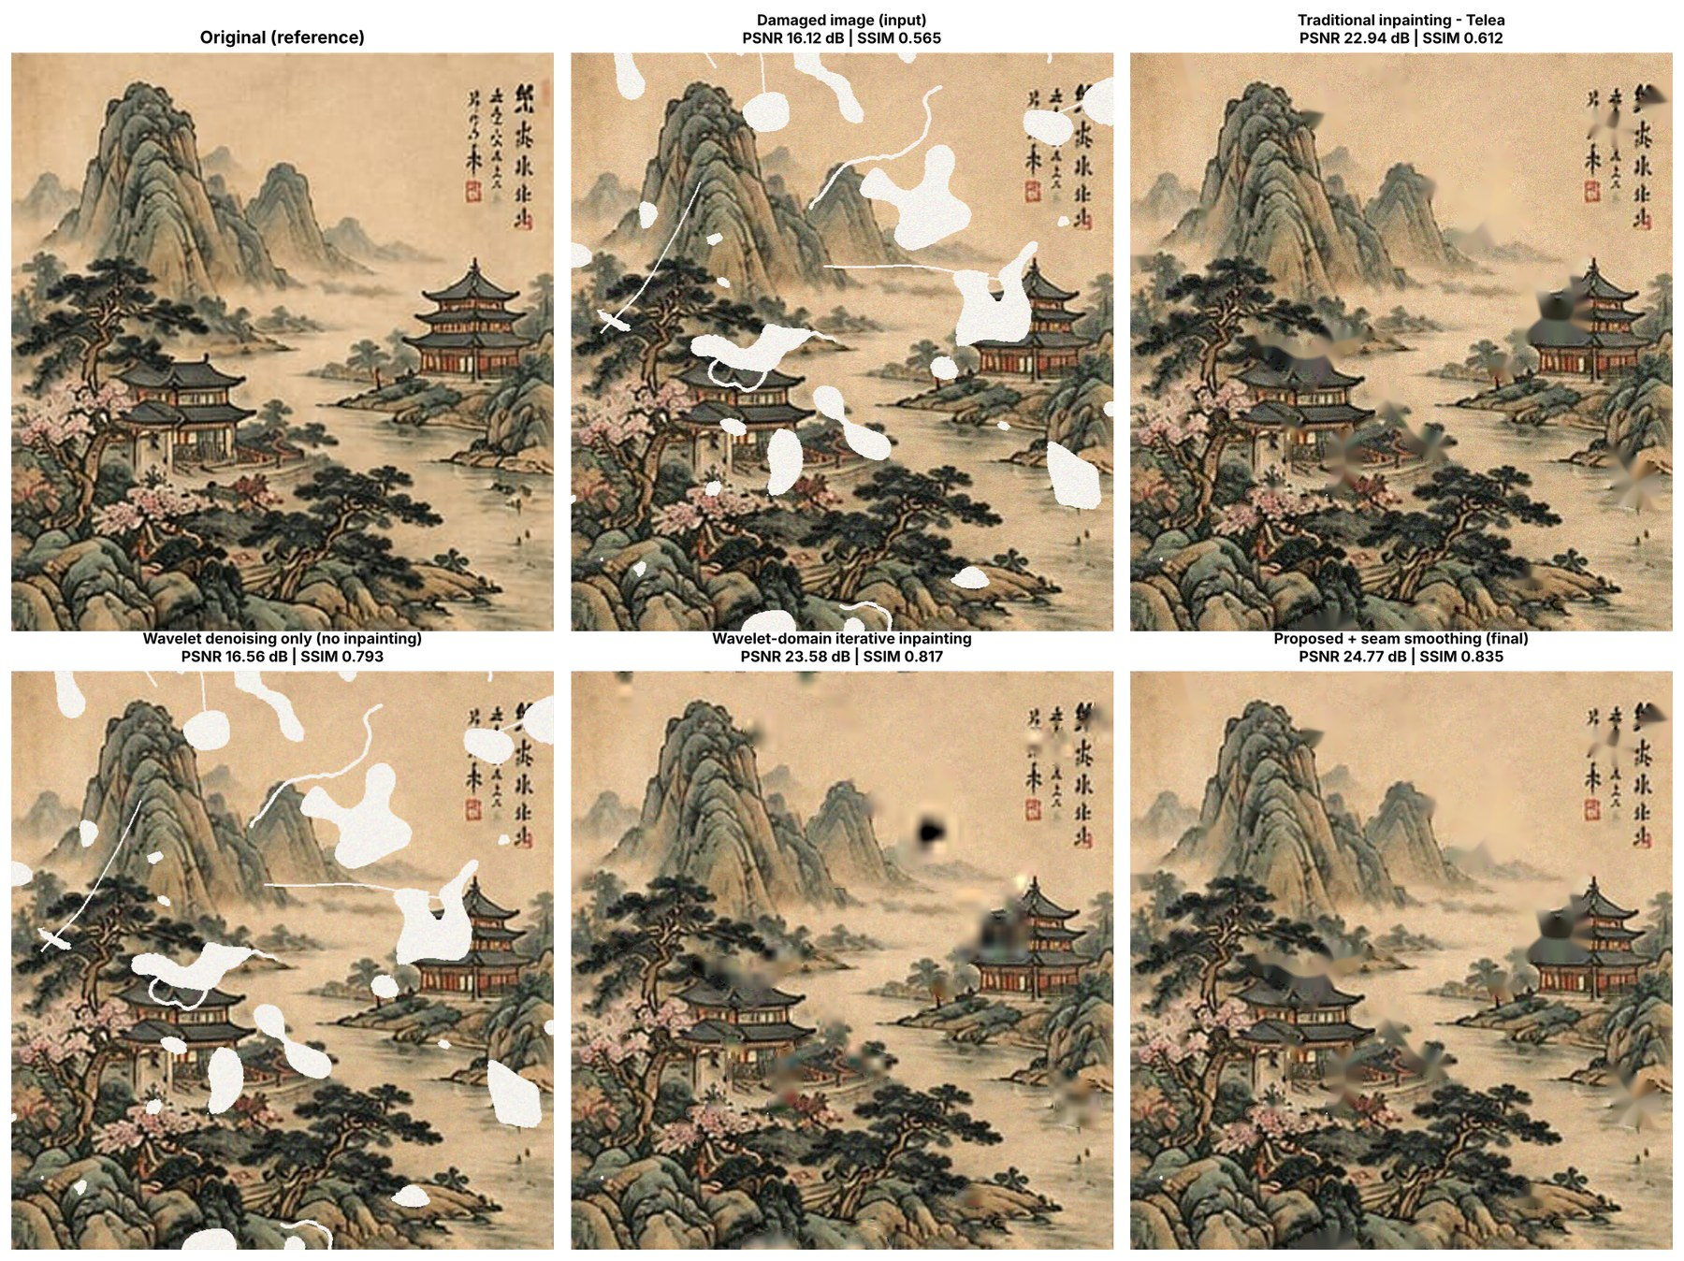
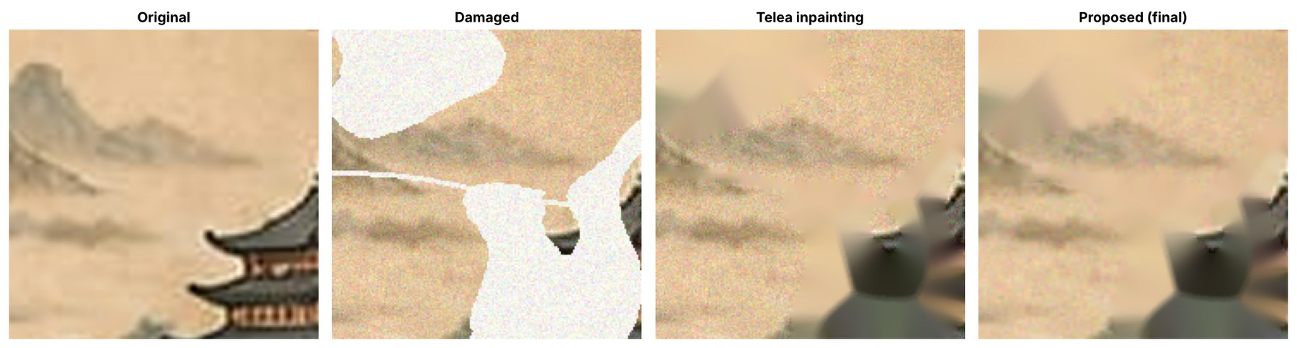
Results: visual comparison
Most damaged area: original · damaged · Telea · proposed
Noise grain disappears while strokes stay sharp
Scratches and cracks vanish over sky, water and paper
Telea alone keeps the grain everywhere
Large losses over roofs, pines and the inscription become smooth, structureless fills
Notes:
Visually, the proposed result removes the grain and the scratches in plain areas almost completely. Telea alone fills the holes but the grain stays everywhere. Be honest about the weakness: large losses over detailed content, like the pavilion roofs, the pines and the calligraphy, are filled with smooth patches of plausible colour but no structure. No single-image method can recover content that is truly gone.

Slide 14
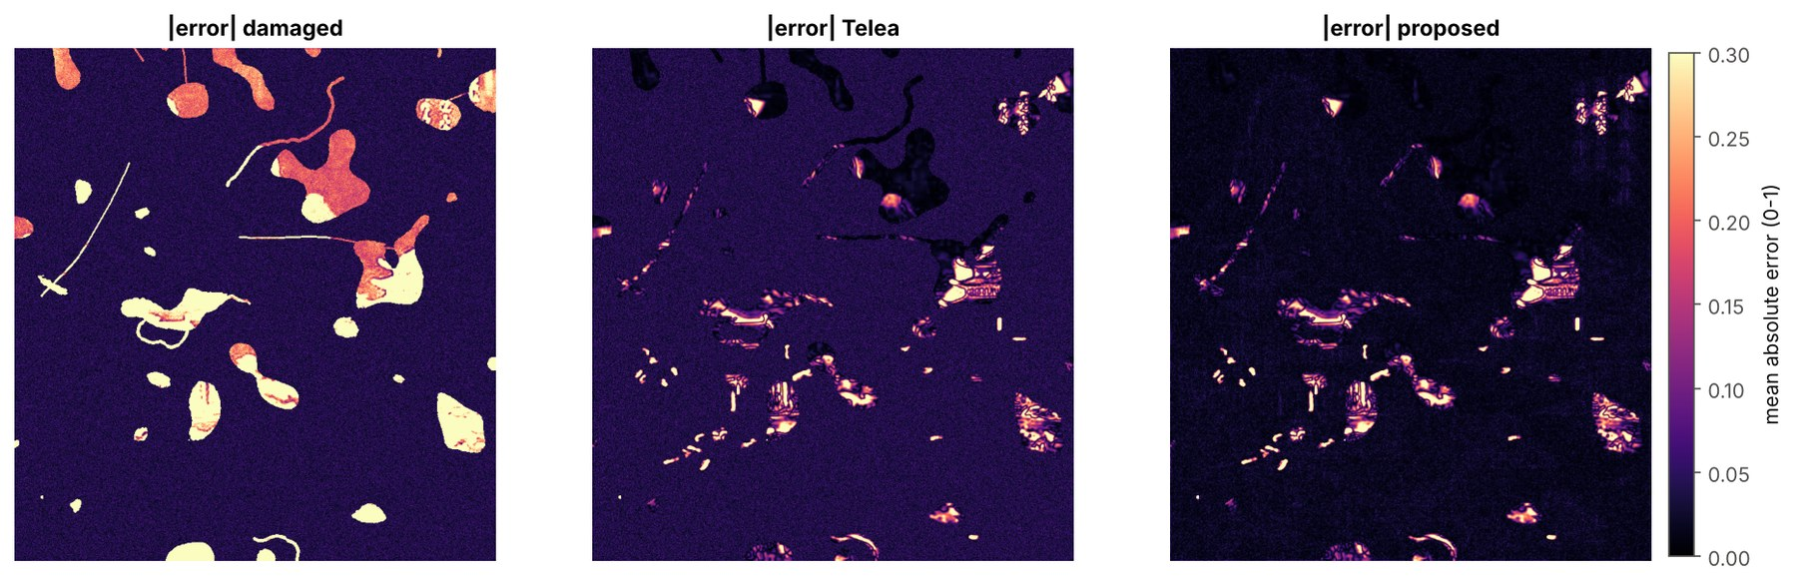
Where the improvement comes from
Absolute error: damaged · Telea · proposed
≈ 16.8 dB
+4.08 dB
inside holes for every inpainting method
on intact paint from wavelet denoising
The gain comes from cleaning what survives, not from better hole filling.
Notes:
This is the most important analysis. We split PSNR into the damaged area and the intact area. Inside the holes, Telea and our method are practically identical, about 16.8 dB. On the intact paint, our method reaches 29.08 dB against 25.00 for Telea, a gain of 4.08 dB. So the improvement comes almost entirely from denoising the paint that survived, not from filling the holes better. The error maps confirm it: the noise floor disappears, while errors inside large holes remain.

Slide 15
Sensitivity: wavelet and threshold rule
Smooth wavelets beat Haar by ≈ 0.44 dB. Level 1 → 2 adds 0.24 dB; beyond level 2, ≤ 0.02 dB.
Every alternative is worse. VisuShrink over-smooths (−1.76 dB); hard thresholding leaves speckle.
Notes:
We changed one setting at a time. On the left, smooth wavelets like db4, sym4 and coif2 beat the blocky Haar wavelet by about 0.44 dB, and going beyond two decomposition levels barely matters. On the right, every alternative to soft BayesShrink thresholding is worse. The single universal VisuShrink threshold over-smooths and costs 1.76 dB, and hard thresholding leaves speckle. So the threshold rule matters far more than the exact wavelet.

Slide 16
Sensitivity: noise level and amount of damage
Gap grows 0.26 → 4.62 dB as noise rises.
At σ = 0.10: proposed 24.11 · Telea 19.49 · damaged 15.24 dB
Gap shrinks 2.43 → 0.88 dB as holes grow.
At 25%: proposed 21.81 · Telea 20.93 · damaged 12.34 dB
Notes:
Next we varied the noise level and the amount of damage. As noise rises, Telea inpainting drops by more than 5 dB while our method drops by less than 1 dB, so the gap grows from 0.26 to 4.62 dB. As the holes grow, both methods decline and the gap shrinks from 2.43 to 0.88 dB, because errors inside the holes, where both methods use the same inpainting, start to dominate. So wavelets help most when noise is the bigger problem.

Slide 17
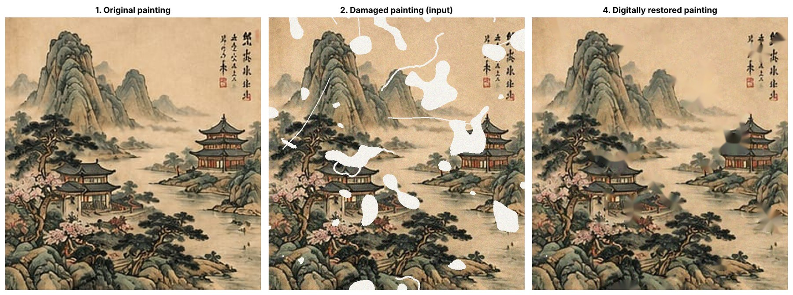
Outcomes: before and after
16.12 → 24.77 dB
0.565 → 0.835
−86.3%
−53.4%
PSNR (+8.65 dB)
SSIM (+0.270)
MSE (1589.6 → 217.0)
noise on intact paint
≈ 0.3 s per image (detection + restoration) on a CPU, using only free software.
Notes:
Here is the overall outcome: original, damaged, and restored. PSNR rose by 8.65 dB, SSIM by 0.27, the mean squared error fell by 86 percent and the noise on intact paint fell by 53 percent. The whole detection and restoration takes about 0.3 seconds per image on an ordinary CPU, with free, open-source software. We also get a documented damage map as a by-product.

Slide 18
Lessons learned
1
Complementary, not interchangeable
2
Threshold rule beats wavelet choice
3
Order of operations matters
Holes ≈ 16.8 dB for all methods; wavelet denoising adds 4.08 dB on intact paint.
VisuShrink costs 1.76 dB; Haar vs db4 only 0.44 dB.
Denoise, then inpaint. Wavelet-domain hole filling: 15.16 vs 16.83 dB.
4
Detection sets the ceiling
5
Wavelets shine when noise is high
6
Looking better ≠ more faithful
2.51% over-detection costs ≈ 3 dB of fidelity on authentic paint.
Advantage grows from 0.26 dB to 4.62 dB across noise levels.
CLAHE + sharpening look crisper but lose 3.55 dB PSNR.
Notes:
Six lessons, each backed by our numbers. One: denoising and inpainting solve different problems and you need both. Two: choosing the right threshold rule matters far more than choosing the wavelet. Three: the order matters; denoise first, then inpaint. Four: detection quality limits everything that follows. Five: wavelets are most valuable when noise is high. Six: a result that looks better is not necessarily more faithful to the original.

Slide 19



Relevance and future work
Where it applies
What's next
Museums and archives
Damage maps for condition reports; virtual previews before treatment
1
Learned damage detection (e.g. U-Net)
Other fragile material
2
Exemplar-based or deep (LaMa) inpainting inside holes, wavelet denoising outside
Manuscripts, miniature paintings and archival photographs
3
Translation-invariant or directional wavelets for sharper edges
Education
Colour spaces, morphology, wavelets, inpainting and metrics in one free notebook
4
Multispectral and infrared capture
Technology
A review tool where conservators accept or reject each fill
5
JPEG 2000 is DWT-based; photo, document and OCR pre-processing
Notes:
Where does this matter today? Museums and archives can use automatic damage maps and virtual previews. The same pipeline can be adapted to manuscripts, miniature paintings and old photographs. It is also a compact teaching example, and wavelets are used widely in industry, for example JPEG 2000. Next steps would be a learned damage detector, smarter inpainting inside the holes, better wavelets for edges, multispectral imaging, and a tool that keeps a conservator in the loop.

Slide 20
Limitations
Single image
Low-resolution source
Other paintings may behave differently
302 × 316 px enlarged: smoother than a real scan
Synthetic damage
Hand-tuned detection
No stains, foxing, flaking pigment or colour shifts
Thresholds suit bright exposed backing only
Pixel metrics only
Classical baselines
No conservator or user evaluation; one random seed
No exemplar-based or deep-learning inpainting compared
Test image
The findings demonstrate the technique, not an actual conservation outcome.
Traditional-style reproduction, not an authenticated artwork
Notes:
We want to be clear about the limits. It is one painting, from a low-resolution source that was enlarged, which makes it smoother than a real scan. The damage is synthetic, so real stains and colour shifts are not covered, and our detection thresholds only suit bright exposed backing. We used pixel metrics but no expert evaluation, and we did not compare deep-learning inpainting. So our results demonstrate the technique rather than a real conservation outcome.

Slide 21
Conclusion
1
An eight-stage pipeline detects damage, denoises with db4 wavelets and BayesShrink, then inpaints the losses
2
PSNR 16.12 → 24.77 dB and SSIM 0.565 → 0.835; +1.83 dB over inpainting alone
3
Denoising and inpainting are complementary; detection quality sets the ceiling
4
A low-cost, reproducible, open-source aid for non-invasive heritage restoration
Digitally restored painting
Notes:
To conclude: we built an eight-stage pipeline that finds the damage, removes noise with db4 wavelets and BayesShrink thresholding, and fills the losses by inpainting. It raised PSNR from 16.12 to 24.77 dB and SSIM from 0.565 to 0.835, and beat inpainting alone by 1.83 dB. The main lesson is that denoising and inpainting complement each other, and detection quality sets the limit. It is a low-cost, reproducible tool that can support non-invasive restoration of cultural heritage.

Slide 22
Key references
S. G. Mallat, “A theory for multiresolution signal decomposition: the wavelet representation,” IEEE Trans. PAMI, 11(7), 674–693, 1989.
I. Daubechies, “Ten Lectures on Wavelets,” SIAM, 1992.
D. L. Donoho and I. M. Johnstone, “Ideal spatial adaptation by wavelet shrinkage,” Biometrika, 81(3), 425–455, 1994.
S. G. Chang, B. Yu and M. Vetterli, “Adaptive wavelet thresholding for image denoising and compression,” IEEE Trans. Image Process., 9(9), 1532–1546, 2000.
A. Telea, “An image inpainting technique based on the fast marching method,” Journal of Graphics Tools, 9(1), 23–34, 2004.
M. Bertalmío, A. L. Bertozzi and G. Sapiro, “Navier–Stokes, fluid dynamics, and image and video inpainting,” Proc. IEEE CVPR, 2001.
Z. Wang, A. C. Bovik, H. R. Sheikh and E. P. Simoncelli, “Image quality assessment: from error visibility to structural similarity,” IEEE Trans. Image Process., 13(4), 600–612, 2004.
G. R. Lee et al., “PyWavelets: A Python package for wavelet analysis,” Journal of Open Source Software, 4(36), 1237, 2019.
Notes:
These are the key references behind the method: Mallat and Daubechies for wavelets, Donoho and Johnstone and Chang et al. for wavelet shrinkage, Telea and Bertalmío for inpainting, Wang et al. for SSIM, and PyWavelets for the implementation. The full list of sixteen references is in our report.

Slide 23
Thank you
Questions?
Shivam Mandlekar · [Co-author 2] · [Co-author 3] | Guide: [Mentor Name]
Department of Electronics and Computer Science, Ramdeobaba University, Nagpur · RBU, EN, DIP 2026–27
Notes:
Thank you for listening. We are happy to take questions. If useful, we can show the Colab notebook running live; it reproduces every number in this presentation.

