Slide 1

A Critical Analysis on User Experience aspects of a Learning Management System

Slide 2
Abstract
Learning Management Systems offers a great platform for a virtual learning environment. In other words, its an application that handles all aspects of a learning process.
This analysis has been done on a popular learning management system – “Blackboard Learn” which is used widely by students and faculty for learning purposes.
Blackboard Learn is a web based software that has a scalable, customizable architecture combined with various features for communication and content sharing / delivery.
We will be using this link https://blackboard.neu.edu for analysis

Slide 3
User Experience Analysis – What is good ? 1) Login and Homepage
A user friendly website with a good color combination (does not hurt my eyes in dark and low contrast).
Auto login using husky id saves lot of time. No registration required !
Features are categorized conveniently on navigation bar.
The content structure on home page is logically arranged to a great extent. For Example: Priority to “My Announcements” section as compared to “My Courses” section.

Slide 4
This product can be accessed conveniently by handicap, impaired users since it conforms to WCAG 2.0 guidelines.
How did I know if its WCAG compliant ? Just try to access each element on the page by using keyboard only !! **Although this is just one of the guideline**

Slide 5
2) Course Page and other sub-pages
Critical components/views are placed appropriately on the page.
Side Navigation panel enhances site visibility to the user.
Key Features on this page:
“To Do” section displays submission due dates that keeps a student on track.
Discussion board is a great feature where users can discuss topics and share information inform of posted messages.
Grades can be instantly viewed. User is updated with his/her performance in course.
Different 3rd party learning materials (Lynda etc.) can be accessed via Tools. Tons of resources on a single page !!

Slide 6
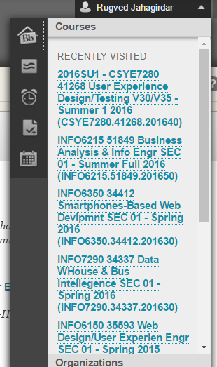
Immediate improvements
Blackboard needs to revamp their content distribution service. Sometimes, video lectures that are captured using Hi-definition recording devices tends to pixelate while streaming. Buffering takes a lot of time.
Global Navigation Menu appears too cluttered. Although it’s functionality is unique and it provides a comprehensive view, it also reduces look and feel of the menu bar.
Blackboard can make use of virtual agents to deliver instructional content. For Example: Lynda.com uses a virtual agent to deliver a presentation.

Slide 7
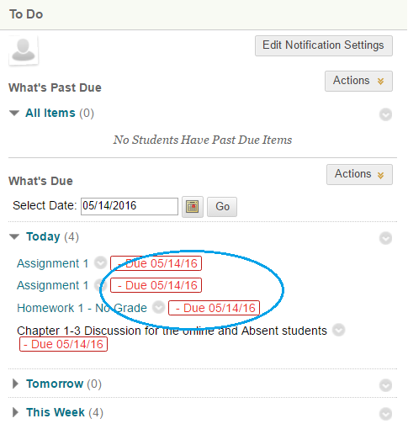
Serious upgrades are required on real time status update services. For Example: Many times in spite of uploading assignment prior to due date, the status fails to change under “To Do” section of course page.
Content visibility of older date stamp is inconsistent. No Archiving facilities provided yet.
Tools Section has redundant data and links. Need to revisit this page and update links if possible.
Site feedback forms unavailable to students !
Refer MOQUPS for Redesign Wireframes.

Slide 8
Conclusion on Immediate Improvements
Overall blackboard is a robust, scalable and highly customizable product and carries an upward business value.
However, it needs to review certain critical back-end logic including services and provide flawless support to enhance the learning process.
Blackboard also needs to improve its user interface and make things more simple and clear.
I would recommend developing a product that is powerful and efficient like blackboard and also elegant like Moodle.
Refer https://app.moqups.com/rugvedj/UX61eC2GWc/view for mockup wireframes of Blackboard Redesign

Slide 9


Toughest competitors so far ?
Moodle is another open source product that has been used widely amongst various academic institutions.
This application uses the “freemium” payment model, which implies that basic elements are available for free, but exclusive features are chargeable.
Moodle has very similar features to blackboard but stands apart in its user interface. As a result, user experience is highly enhanced while using Moodle. GUI is less cluttered as compared to Blackboard.
Lynda.com is slowly venturing into a LMS from traditional online education delivery system.

Slide 10
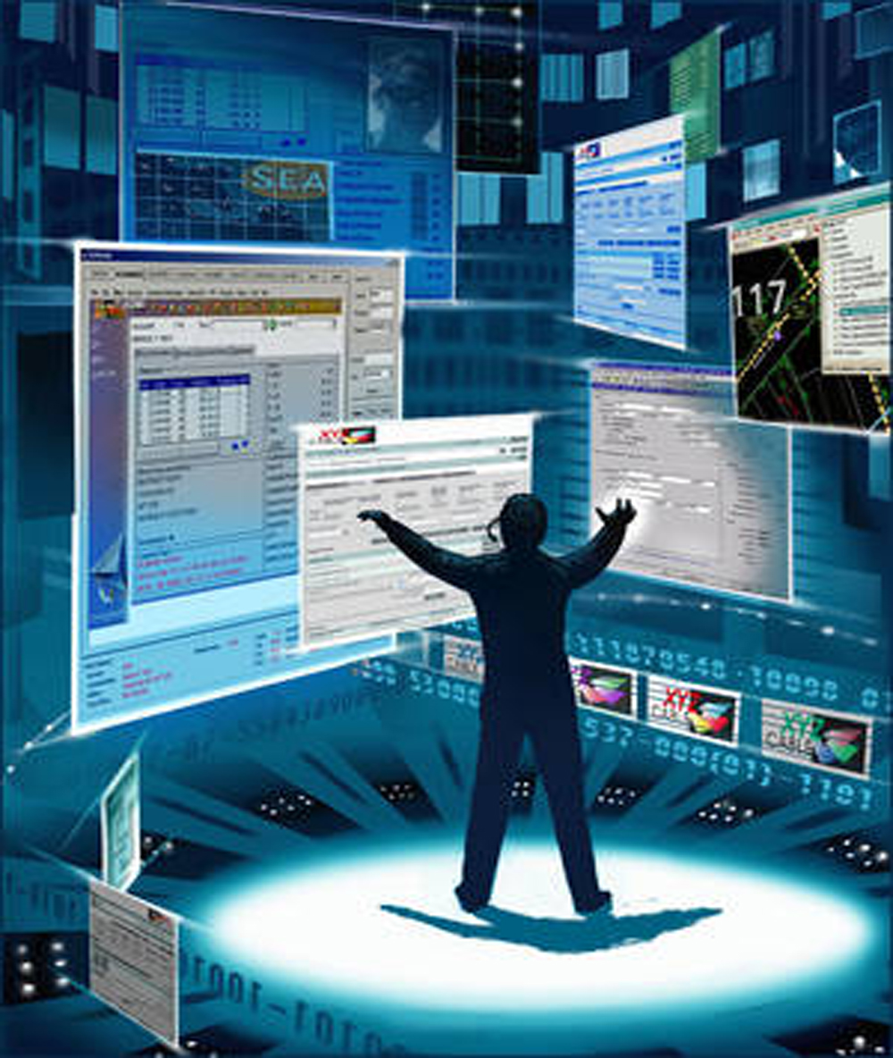
Taking Blackboard to a new Level
Blackboard can be converted into an artificially intelligent virtual agent by itself. This agent will act as an instructor / private tutor / personal assistant to any student who has enrolled in a program.
Virtual Agent will deliver relevant Course Materials, Videos, Podcasts to each student.
Major focus will be on delivering content through interactive and user-friendly means. How ? Support multiple languages. Agent can capture user accent in few iterations !
Anti Plagiarism / Idea Theft detection mechanisms

Slide 11

Thank You !

Slide 12
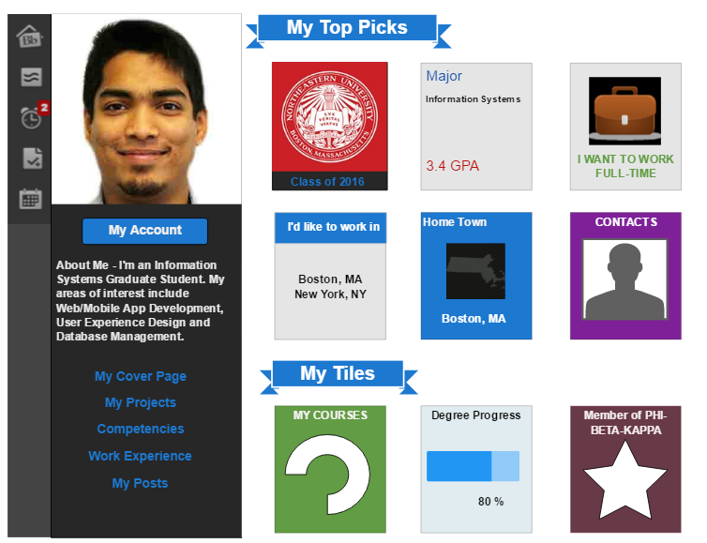
Sample Redesign Wireframes
Global Navigation Menu

Slide 13
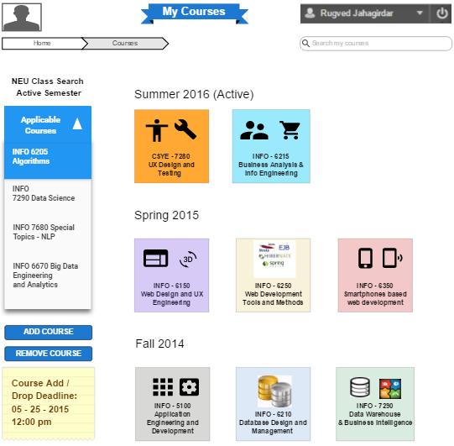
Course List Page

Slide 14
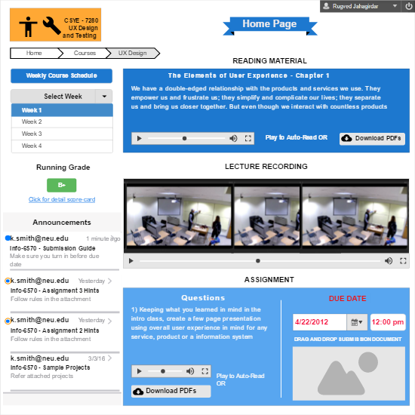
My Course Page

Slide 15
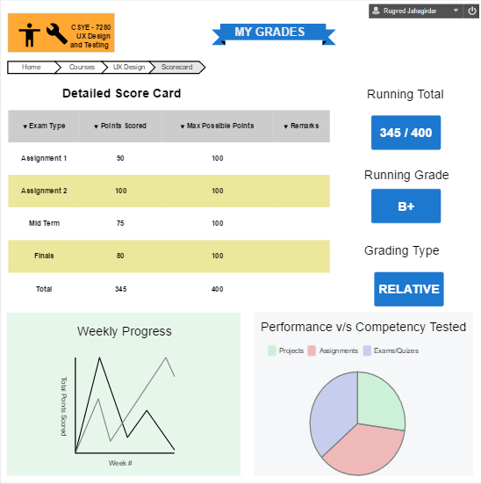
My Grades Page

