Slide 1




||Jai Sri Gurudev|| Sri Adichunchanagiri Shikshana Trust ® SJB INSTITUTE OF TECHNOLOGY No. 67, BGS Health & Education City, Dr. Vishnuvardhan Road, Kengeri, Bengaluru - 560 060 Approved by AICTE - New Delhi. An Autonomous Institution, Affiliated to Visvesvaraya Technological University, Belagavi, Accredited by NAAC A+, Accredited by NBA. Certified by ISO 9001-2015 Department of Computer Science & Engineering
THEME 1:
“Campus Event LifeCycle Management System”
Under the guidance of:
Vijayalakshmi B
Assistant Professor
Dept. of CSE, SJBIT
Presented by:
Roopashree B R (1JB23CS127)
Ruha (1JB23CS129)
Sanjana N (1JB23CS135)
Fasi Ahmed (1JB24CS401)

Slide 2


Campus Event Lifecycle Management System
Department of Computer Science and Engineering
SJB Institute of Technology

Slide 3

THE CHALLENGE
Problem Statement
Manual & Inefficient
Traditional campus event management relies heavily on manual processes, leading to errors, delays, and poor overall event management.
Manual event registration & duplicate registrations
Payment verification delays & attendance fraud
Manual attendance tracking & delayed certificate generation
Lack of centralized participant management & high administrative workload

Slide 4




OUR SOLUTION
Proposed Solution
We developed a Campus Event Lifecycle Management System to automate the complete event workflow.
Registration & Payments
QR-Based Attendance
Student event registration with integrated payment verification system and transaction tracking.
QR-based attendance tracking with live toggle updates — no manual marking required.
Admin Dashboard
Certificates & Feedback
Centralized admin dashboard with bulk participant upload and comprehensive event management tools.
Automatic certificate generation unlocked after feedback submission by participants.

Slide 5
TECH STACK
Technologies Used
Frontend
Backend
Libraries & Services
HTML & CSS
Bootstrap
JavaScript
AJAX
Python
Django Framework
QRCode
ReportLab
Pandas
OpenCV
Django Email Services
Database
SQLite
A fully Python-powered stack with Django at its core, supported by specialized libraries for QR generation, PDF creation, and data handling.

Slide 6
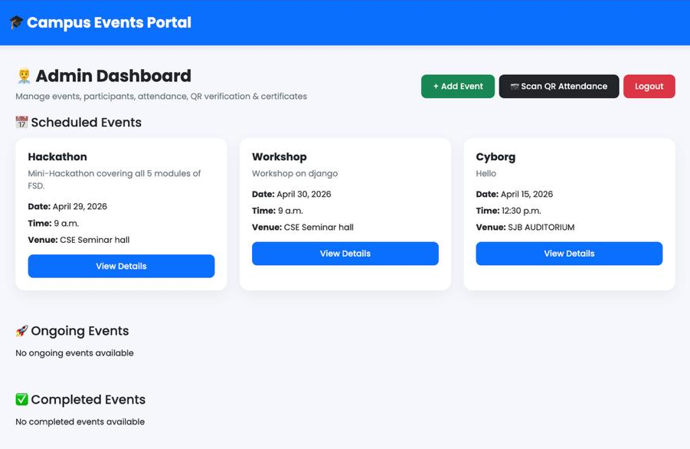
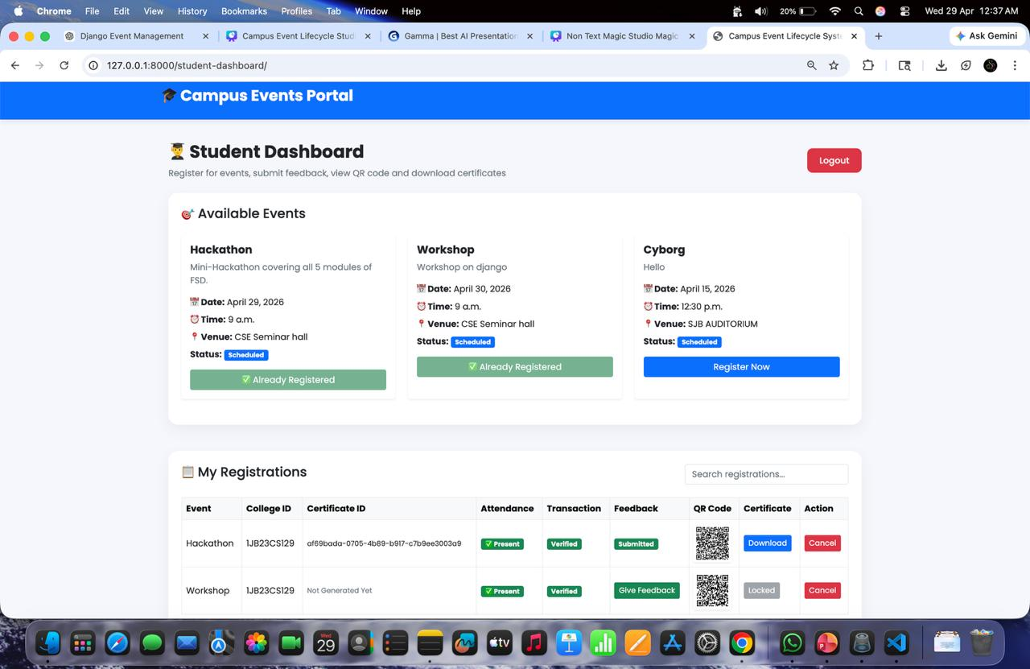
MODULES
Main Modules
Admin Module
Student Module
Create and manage events
Verify payments
Mark attendance
Generate certificates
View feedback
Register for events
Submit transaction ID
Track payment status
Download certificates
Submit feedback

Slide 7

HIGHLIGHTS
Key Features
Payment Verification
QR-Based Attendance
AJAX Live Updates
Payment verification before registration approval ensures only confirmed participants gain access to events.
Automatic attendance marking via QR scan eliminates fraud and speeds up the check-in process.
AJAX-based live attendance toggle updates the dashboard in real-time without requiring a page refresh.
Dynamic Certificates
Bulk CSV Upload
Dynamic PDF certificate generation unlocked only after feedback submission, ensuring complete participation.
Bulk participant upload using CSV files drastically reduces administrative effort for large-scale events.

Slide 8

CONCLUSION
Final Outcome
Project Impact
Our system reduces manual work and improves the complete event management process — making it faster, more secure, and efficient.
Faster Workflow
Accurate Attendance
Automated processes from registration to certificate delivery eliminate bottlenecks and delays.
QR-based tracking ensures precise, fraud-free attendance records for every event.
Secure Verification
Better Experience
Payment and identity verification safeguards event integrity and admin confidence.
Improved admin control and a smoother student journey from registration to certificate download.

Slide 9
THANK YOU

