Slide 1

Real-Time Fraud And Behavior Intelligence System
1
© 2025–2027 Cognizant | Private

Slide 2

Real-Time Fraud And Behavior Intelligence System | Business Plan (1/2)
Problem Description & Business Scenario :
Due to an increase in online transaction activity and cashless payment transactions, digital banking fraud is becoming more common. The conventional method for identifying fraud is reactive and based on predefined rules, which makes it difficult to cope with changing fraud patterns. In addition, there is lack of transparency among customers when their transactions are flagged as frauds.
Problem Scope:
The proposed problem addresses the detection of fraud transaction patterns at the transaction level. It will not be used to detect any sort of interbank fraud activities.
Target Users/Stakeholders:
Banks and other financial organizations can prevent fraud in real-time, while the fintech platforms can ensure the safety of transactions for their customers.
“Current systems detect fraud but fail to explain and prevent it effectively.”
WHY
Solution Overview:
We propose a Real-Time Fraud + Behavior Intelligence System that uses machine learning and user behavior analysis to
detect fraudulent transactions instantly and take immediate action.
Technical Details:
Machine Learning Models: Random Forest / Logistic Regression
Backend: Python (Flask) , Frontend: Web-based dashboard
Data Inputs: Transaction history, location, spending patterns and Real-time API for transaction processing
How

Slide 3
Real-Time Fraud And Behavior Intelligence System | Business Plan (1/2)
Innovation:
Combines fraud detection with behavior intelligence
Provides Explainable AI through chatbot (tells why fraud detected)
Real-time risk scoring for every transaction
Market Potential:
With the rapid increase in the number of digital transactions and online banking services, there is a huge requirement for intelligent fraud detection systems, hence making this product very scalable and relevant.
How
Primary Benefits: Provides for real-time detection and prevention of fraudulent transactions thereby making the process of digital payments much more secure.
Efficiency & Flexibility: Automated monitoring of fraud using AI technology which dynamically adapts according to changes in user behaviors and transactions.
Time & Cost Saving: Reduces financial loss and saves time required to analyze fraud manually.
Scalability: Scalable within banking institutions and fintech applications that handle high transaction volumes.
Social Impact: Enhances trust in digital transactions by ensuring safer, more transparent, and secure payment experiences for users.
WHAT

Slide 4

Financials & Timelines | Business Plan (2/2)
Cloud & AI: Basic cloud deployment for backend APIs and real-time processing Tools & Dev: 100% open-source — Python, Flask, React, PostgreSQL, ML libraries Team: Student developers, 4–6 weeks development effort Total Cost: Low-cost implementation (~$5–$10 for prototype level)
Investments
What does it take & How much does it cost to solve?
ROI: Reduction in financial fraud losses and faster fraud detection Happy Customers: Improved trust through secure and transparent transactions Operational Efficiency: Automated fraud monitoring reduces manual effort What if not solved: Continued financial losses, rising fraud risks, and reduced customer confidence
Returns
Quantify the benefits &
What if I don’t solve?
Timelines
Week 1–2: Data collection, basic UI development, and initial model setup Week 3: Backend APIs (Flask) and database integration Week 4–5: ML model training, behavior intelligence, and fraud detection system Week 6: Testing, optimization, and deployment
Time to realize benefits

Slide 5

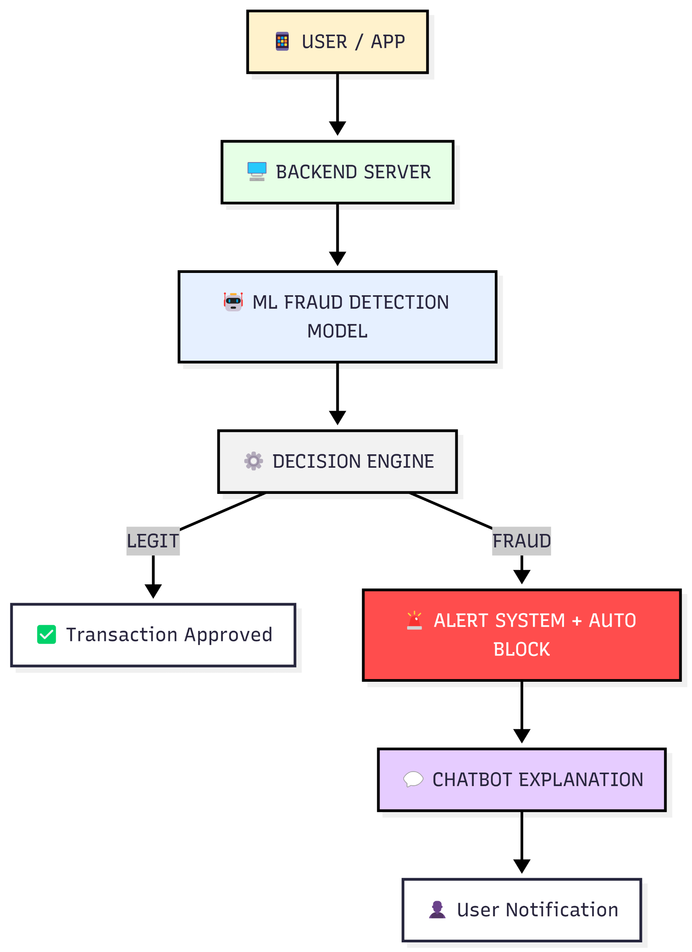
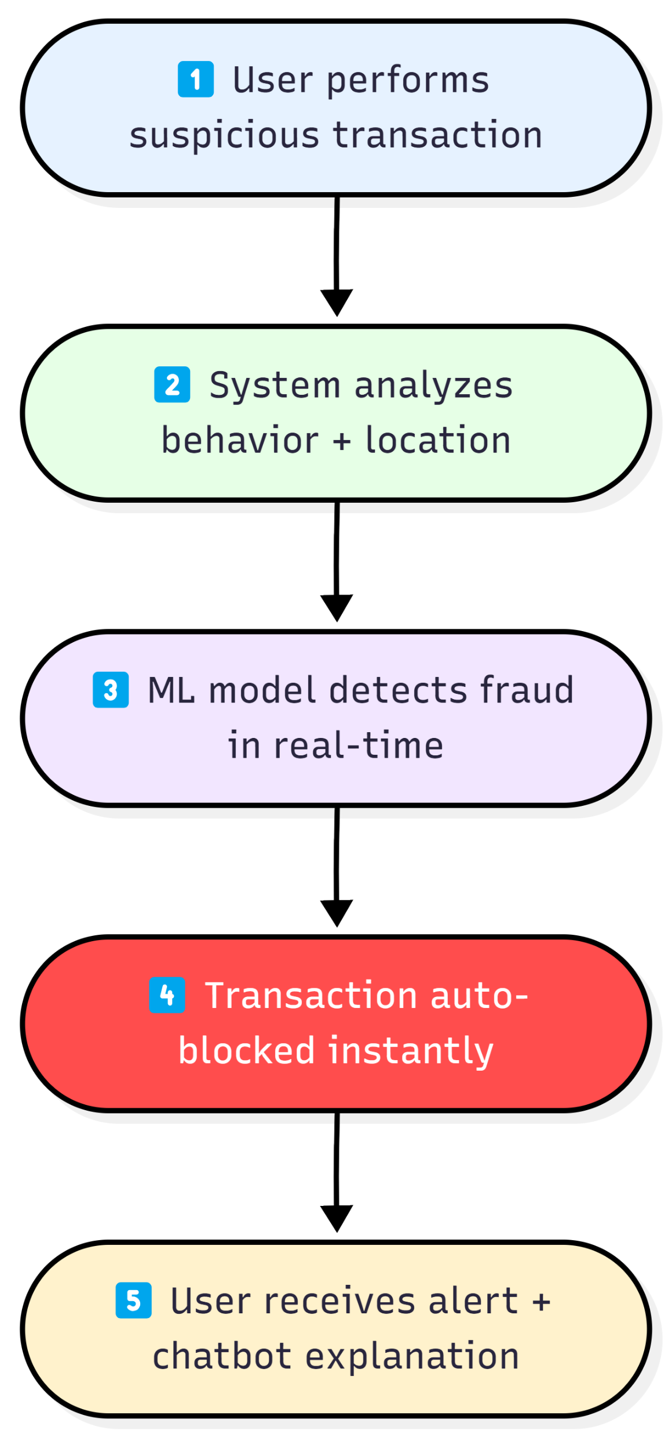
System Architecture & Live Demo Flow
Architecture
Live Demo Flow
Example: Usual Spendings ₹100, ₹200… Abnormal Transaction ₹50,000 → Fraud Score 92% → Blocked
Thank you

