Slide 1

Predicting Player Rating by Player Position for European Football
Springboard Intermediate Data Science: Python
Capstone Project Final Report
Prepared by: Ruhama Ahale (ruhama.ahale@gmail.com)
Mentor: Raghunandan Patthar
Link to Project Code (ipynb)
Link to Project Report (pdf)
October 2017

Slide 2
TABLE OF CONTENTS
INTRODUCTION
PROBLEM
REQUIREMENT
DATA SOURCE
METHODOLOGY
DATA WRANGLING
DATA EXPLORATION
DATA MODELING
FEATURE SELECTION
MODEL COMPARISON
PREDICTION
RESULTS
LIMITATIONS
RECOMMENDATIONS
FUTURE WORK
APPENDIX

Slide 3
INTRODUCTION

Slide 4

PROBLEM
Player transfers in association football are multimillion dollar deals, every year clubs pay millions of dollars to sign new players. The client, a European football club wants a list of top players for each playing position so that they can shortlist desirable candidates from the players available on the transfer list.
Neymar
$263m
Barcelona → PSG
At more than $263m, Neymar’s transfer from Barcelona to PSG is the most expensive transfer in football history!
Paul Pogba
$116m
Juventus→ Manchester United
Zinedine Zidane
$67m
Juventus→ Real Madrid
Ronaldo
$20m
PSV Eindhoven→ Barcelona
Johan Cruyff
$2m
Ajax →Barcelona
Diego Maradona
$7m
Barcelona → Napoli

Slide 5

REQUIREMENT
The client wants a model that can predict the aggregated overall rating of a player at each age of the player. In addition to the list of top players at playing positions they also want to know the significant attributes that affect the player rating for each position
Player ratings are calculated based on player attribute stats as well as other factors such as the league the player is associated with, the specific circumstances which resulted in an attribute score and various other factors, this data (attribute and rating) is made available by EA Sports FIFA (game)
Our aim is to predict these ratings based only on the player attribute stats available to us from the FIFA game data and use these predicted ratings to identify the top players in each position
Finishing
#3
Forward
Shot Power
Ball Control
Reactions
Prediction Algorithm
Long Shots
Positioning
Short Passing
Volleys
Under 25 years
Dribbling
Alvaro Morata

Slide 6
DATA SOURCE
The data we will use for this problem is sourced from several websites such as Football-Data-MX-API: scores, lineup, team formation and events Sofifa: players and teams attributes from EA Sports FIFA games, FIFA series and all FIFA assets property of EA Sports;
It is curated by Hugomathien and made available on Kaggle [here]
Data available from 2008 to 2016 in form of SQLite database
TABLES:
Match: Match details data for each match like match_date, home_team, opponent_team, player_ids of players playing in the match, player_id at each playing coordinate
Player: Player details like player_id, player_name, birthdate, height, weight
Player_Attributes: Attributes sourced from several sources for each match player has played like player_id, preferred_foot, attacking_work_rate, overall_rating, crossing, finishing, heading_accuracy, short_passing etc.
Country: country_id, country_name
League: id, country_id, league_name

Slide 7
METHODOLOGY
DATA WRANGLING
DATA EXPLORATION
DATA MODELING
Feature Selection
Aggregate
Handle Missing Values
Hypothesis Testing: Difference Between Groups, Normality, Linearity, Multicollinearity
Feature Reduction (PCA)
Regression Models: Linear, Polynomial, Ridge, Lasso, SVR
Model Comparison
Prediction
Data Distribution
Clean
Merge

Slide 8
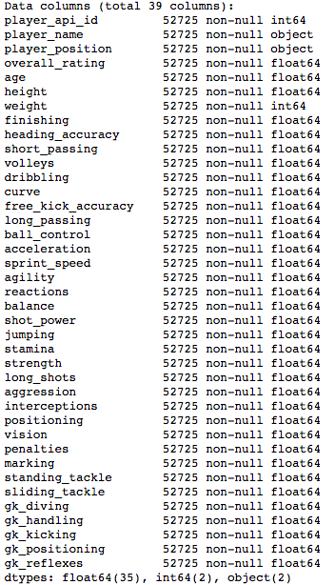
DATA WRANGLING
Player positions are calculated for each player using Match data
Player, Player Attributes, Positions files are merged to get all player data in a single data table, the variables in this table can be seen in the adjoining image
Less than 5% of the data was missing i.e. some features were not available for some players, also data from the season 2008-09 was very inconsistent. These missing values were removed from the final dataset
Data was aggregated using the mean function for each player at each age of the player because the model requirement is to get predicted scores for a player at players current age
Player data information

Slide 9
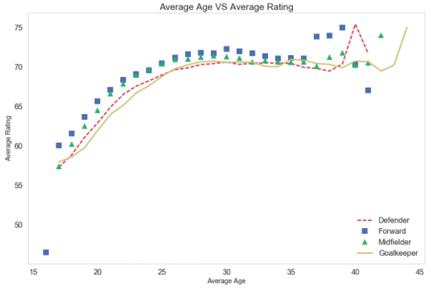
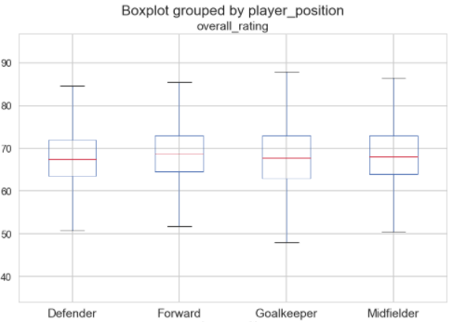
DATA EXPLORATION
It is assumed that a players playing position and players age affects the players rating.
We test these assumptions and find that player rating tends to increase until the player reaches approximately 30, while after 30 the growth stops and eventually ratings go down
We can use the entire dataset available to build a model to predict player rating, however, our assumption that player position affects players rating is correct. We tested the hypothesis that there is no significant difference between mean ratings of different position groups using the one way ANOVA test and based on results of the test we rejected the hypotheses
As a result, we will build prediction model separately for each position
Player ratings start to drop
Boxplot shows mean difference between groups

Slide 10
DATA MODELING

Slide 11
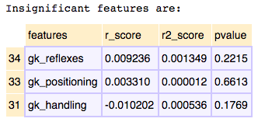
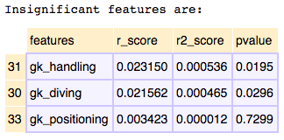
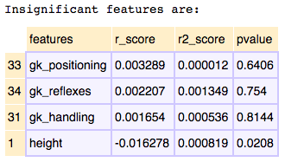
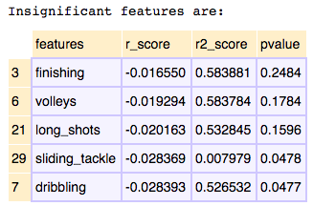
FEATURE SELECTION
Players at different positions have different skill sets, based on the available attribute set we identify features that are significantly affecting the player rating
As the dataset is very large with many features (36). We select features for each player position such that if there is no significant relationship between player rating and feature we discard the feature.
The selected features are scaled to increase modeling accuracy
Principal Component Analysis is performed on the scaled feature data to reduce dimensionality and the new components are selected basis scree plot.
These new components are used in two of the models: Linear Regression and Polynomial Regression as these models do not work well with high dimensions
Defender:
Forward:
Midfielder:
Goalkeeper:
The respective insignificant features for each of these positions are excluded from the data modeling for the position

Slide 12
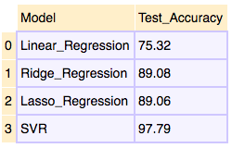
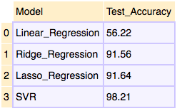
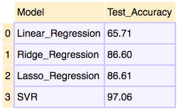
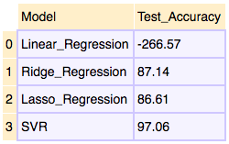
MODEL COMPARISON
All datasets are split into train and test data (80-20 split)
Models are optimized on train data by obtaining best parameters and performing K-fold Cross Validation
Best fitting model is selected for each position by comparing the test accuracy and root mean square error of the model
The following modeling techniques were used:
Linear Regression
Polynomial Regression
Ridge Regression
Lasso Regression
Support Vector Regression (SVR)
For each position Polynomial Regression had overfitting issues and was thus not considered
SVR was the best fit model for predicting ratings for each player position. As such, the predicted player ratings for last ages (in data) of players were computed using SVR.
Defender Model Comparison
Forward Model Comparison
Midfielder Model Comparison
Goalkeeper Model Comparison
Support Vector Regression (SVR) is the best fitting model

Slide 13
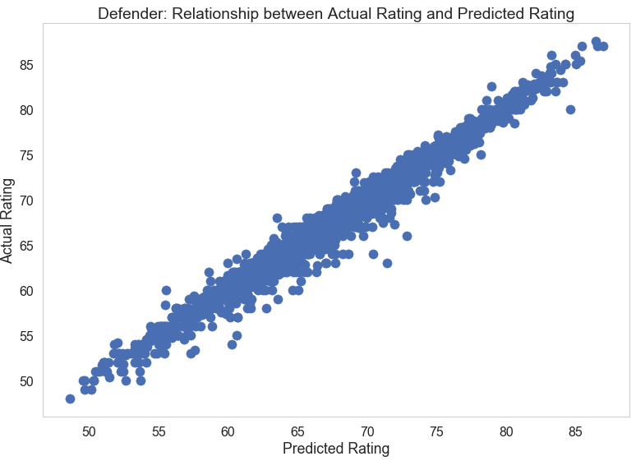
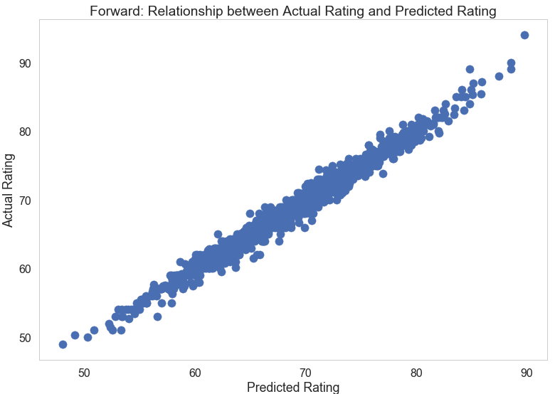
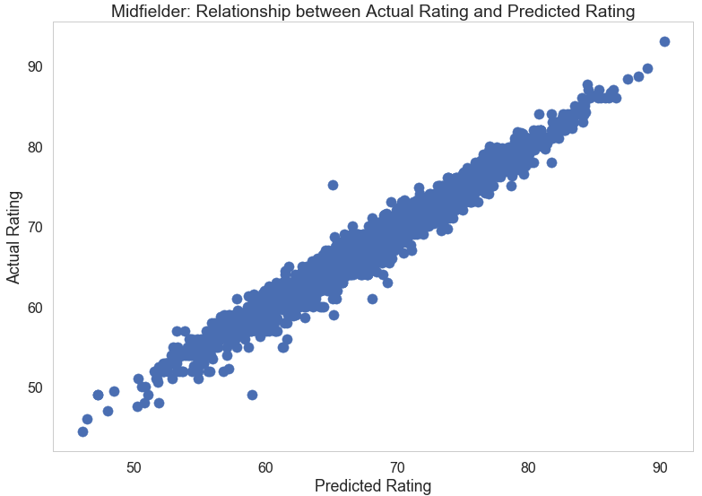
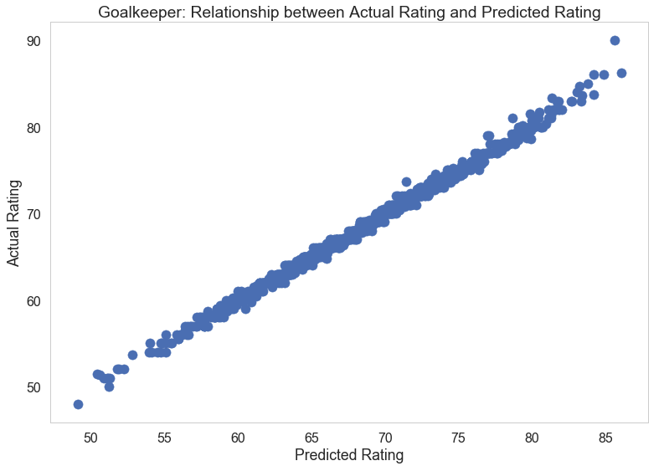
PREDICTION
The scatter plots of the actual vs predicted ratings for all four positions show almost negligible dispersion indicating that our predictions have high accuracy

Slide 14
RESULTS
MOST SIGNIFICANT FEATURES
We identified the top attributes which have very high correlation with the ratings of players for each position
We identified top players by position overall and also top players by position under age of 25 years
The list of these top players is available in the appendix (slide 19)
Our models have been successful in predicting player rating using only the attribute stats available with more than 97% accuracy
Our predicted ratings are for 2016*, some of our predicted top players such as Neymar, Lukaku, Morata were transferred this season. This shows how useful our list can be for player selection
The final list can be filtered by age, country, league or other player details based on clients requirement. This will help narrow down the search as desired
DEFENDER
Standing Tackle, Interceptions, Marking, Sliding Tackle and Reaction
FORWARD
Ball Control, Reactions, Positioning, Finishing, Volleys, Shot Power, Long Shots, Short Passing and Dribbling
MIDFIELDER
GOALKEEPER
Ball Control, Reactions, Vision, and Short Passing
Goalkeeping positioning, Goalkeeping Reflexes, Goalkeeping Diving and Goalkeeping Handling
*2017 data will be added to the analysis in the future

Slide 15
LIMITATIONS
There are certain limitations in the data that reduce the robustness of the models we have developed:
Not all historical data is available for each player. Knowing that the FIFA (game) Player Ranking is based on historical data of player, we do not have this data for each player. A lot of information will not be learned by the model due to the absence of this data.
Data related to ranks of leagues, teams and countries is also not available in this data. This information would have made the model more accurate as these factors play an important role in determining player ranking.
There is not enough historical data available for each player, if it were, a time series model could be built to predict the future ratings of players
There was country and league data missing for few players and more than 20% players from our players’ data had not been active in the last two years. These players were excluded from featuring in the top players lists.

Slide 16
RECOMMENDATIONS
The player rating increases with age and for Defender, Midfielder and Forwards around the age range of 30-35 the rating starts to drop
For goalkeepers, the trend is different with ratings remaining high from ages 25 onwards
The general assumption that player rating falls as age increases is true only after age range of 30-33 years. This information can be used on the best players given by the models to make better selections
We have identified the current best players and this list can be used to filter out potential new additions to the club
The top significant features that are identified in this study should be further analyzed and these skills should be identified early in newer players to improve their performance

Slide 17
FUTURE WORK
Add FIFA 17 game data to get current player list
Analyze effect of age, nationality on player attributes
Identify patterns in attributes of top players
Make predictions for more specific player positions
Use attribute patterns of top players to identify potentially high performing newcomers
Analyze historical performance of players to make future predictions

Slide 18
Thank You

Slide 19
APPENDIX

Slide 20
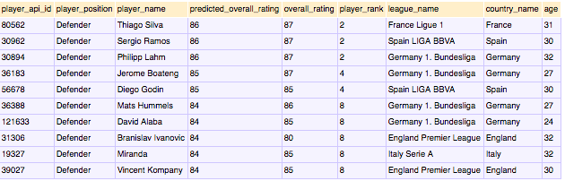
TOP 10 DEFENDERS

Slide 21
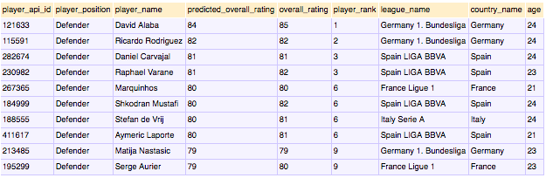
TOP 10 DEFENDERS
UNDER 25

Slide 22
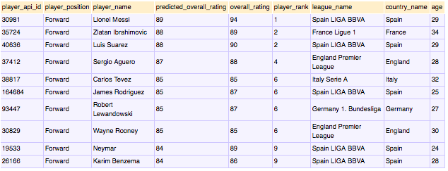
TOP 10 FORWARDS

Slide 23
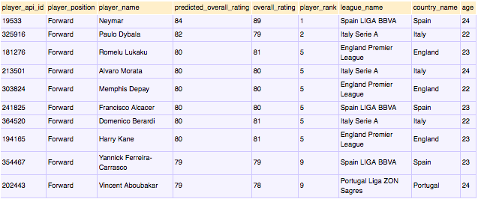
TOP 10 FORWARDS
UNDER 25

Slide 24
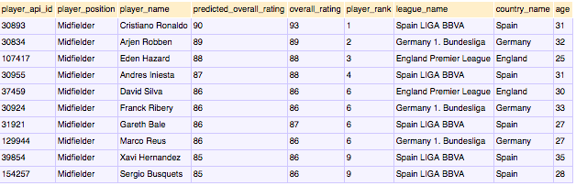
TOP 10 MIDFIELDERS

Slide 25
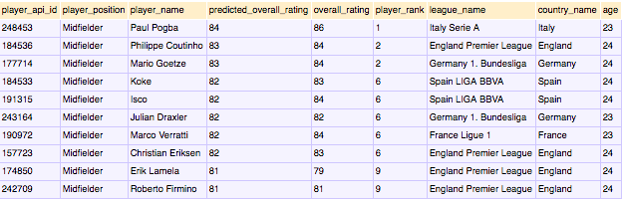
TOP 10 MIDFIELDERS
UNDER 25

Slide 26
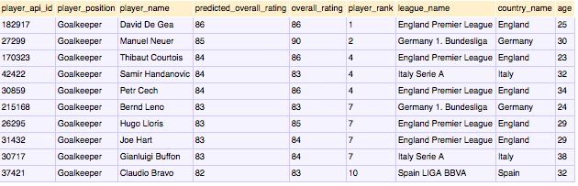
TOP 10 GOALKEEPERS

Slide 27
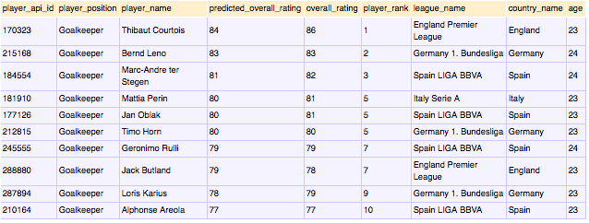
TOP 10 GOALKEEPERS
UNDER 25

