Slide 1
Identifying Top Players and Significant Player Attributes Based on Player Position for European Football
Springboard Intermediate Data Science: Python
Capstone Project Final Report
Prepared by: Ruhama Ahale (ruhama.ahale@gmail.com)
Mentor: Raghunandan Patthar
October 2017

Slide 2
Table of Contents
INTRODUCTION
DATA ACQUISITION AND CLEANING
DATA SOURCE
HANDLING MISSING VALUES
METHODOLOGY
DATA PREPARATION
DATA EXPLORATION
MODELING TECHNIQUES
POSITIONAL DATA INSIGHTS
RESULTS
LIMITATIONS
FUTURE WORK
CLIENT RECOMMENDATIONS

Slide 3
Summary
Content Overview
Thomas the Tank Engine has 18.6B+ views (earned + owned) and 16.6K loyal creators creating 102.2K YouTube videos
In Last 365 days, 3.7K creators have created more than 24.7K videos for Thomas & Friends, this content gained 2.1B views and 2.9M engagement
Owned Content - Organic viewership MoM growth for the last 12 months (Dec’15 to Nov’16) is negative at -4%, subscriber growth is at -1% MoM. Thomas & Friends needs to focus on creating more popular content to drive growth
The top owned video has around 34M views and 19K engagements whereas the top performing earned video has over 146M views and 30K engagement, more than 4X the owned views
The top 8% of channels videos contribute to 50% of the total organic lifetime views, some of the content is performs over its lifetime gaining high views long after its upload
Earned Content – The UGC space for this industry is very active, top creators are creating engaging, shareable content which feature popular kids toys like Kinder Surprise, Peppa Pig, Spiderman, Superman, Paw Patrol etc.
Dedicated Thomas & Friends creators have higher subscriber base than Thomas & Friends, with potential 5.4M subscribers of top creators as compared to 465K subscribers of Thomas & Friends, these creators create average 30 videos per month. Thomas & Friends needs to increase the upload frequency
Audience Overview
Thomas & Friends has content catering majorly to kids under 13 years of age. The channel has majority viewership of 42% in the last 12 months, coming from under 6 boys and girls (ages 25-34-assuming children watching from their parents accounts)

Slide 4
DATA PREPARATION
DATA EXPLORATION
DATA MODELING
Feature Selection
Aggregate
Handle Missing Values
Hypothesis Testing: Difference Between Groups, Normality, Linearity, Multicollinearity
Feature Reduction (PCA)
Regression Models: Linear, Polynomial, Ridge, Lasso, SVR
Model Comparison
Prediction
Data Distribution
Merge

Slide 5
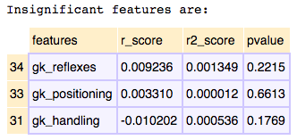
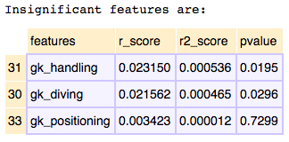
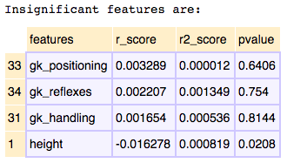
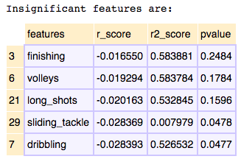
Defender:
Forward:
Midfielder:
Goalkeeper:

Slide 6
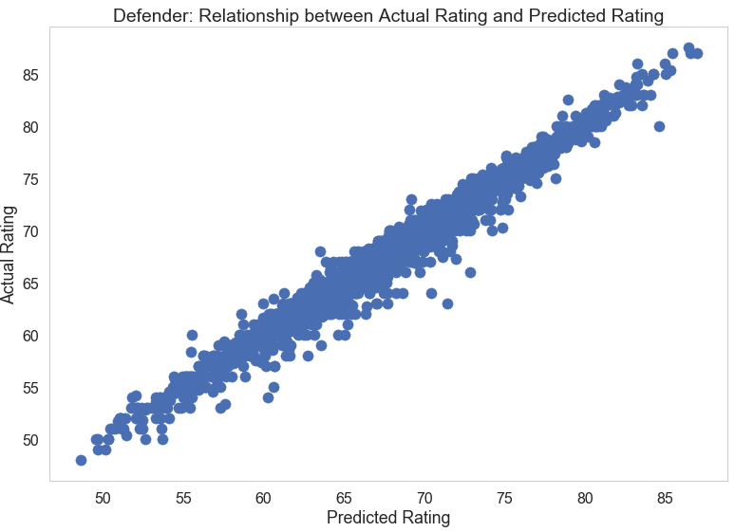
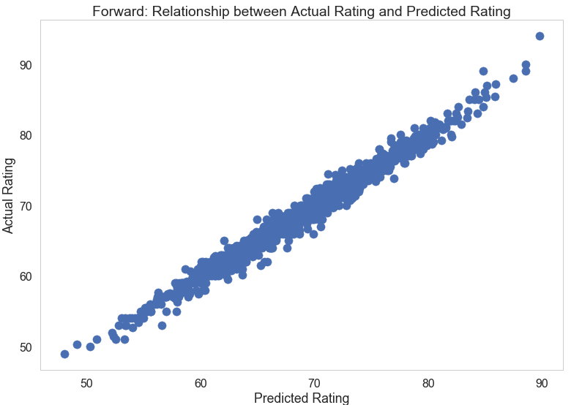
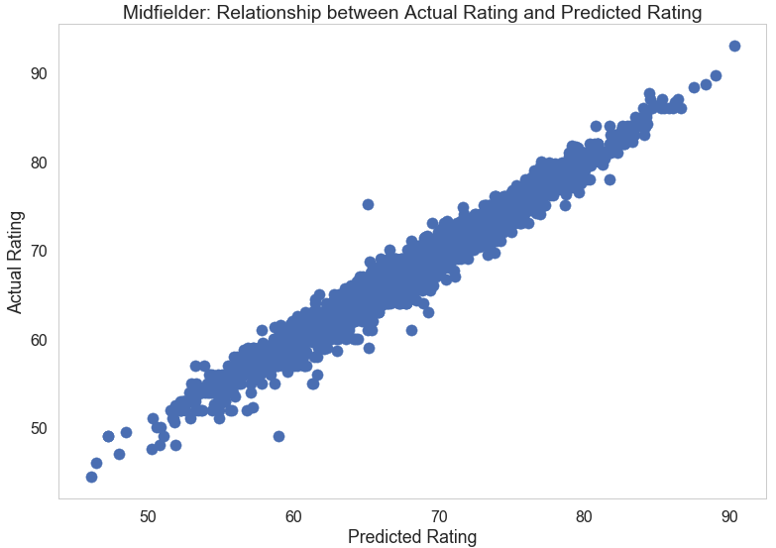
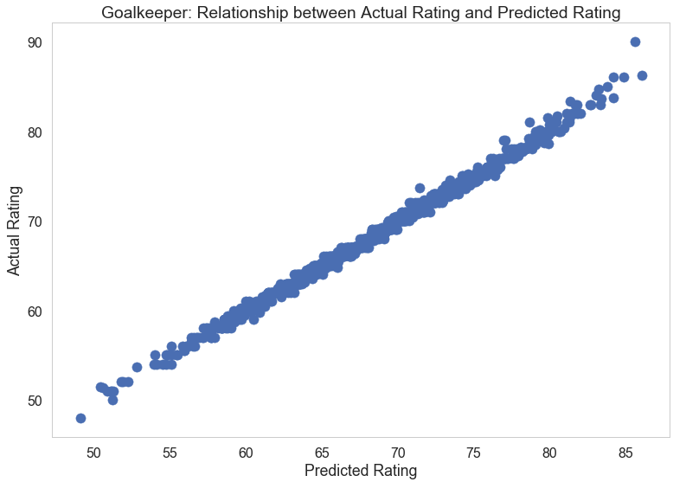

Slide 7
title
a
b
c
model1
a
b
c
titlex
model2

Slide 8
Future Work
Consistently create good hygiene content
Add search viewership by creating popular and trending content
Acquire new subscribers
Increase frequency of video uploads
Keep audiences engaged

Slide 9
Future Work
Consistently create good hygiene content
Add search viewership by creating popular and trending content
Acquire new subscribers
Increase frequency of video uploads
Keep audiences engaged

Slide 10
APPENDIX

Slide 11
Thank You

