Slide 1

Rummy Card Game
By: Ruhani Jindal and Celeste Lopez-Boulton
CS40S-007 Final Project 2025
Notes:
Add visual

Slide 2

Table of Contents
Objective
About Rummy
Problem statement
Why Rummy?
Solution methodology
Experimental Framework
Process, Challenges, and Lessons
Timeline
Our Code
Results
Conclusion and Future work
Development Tools & External Materials
Thank you

Slide 3
Objective
To program a fully functionable rummy card game
Including...
User friendly interface
Computer logic
Smooth transition between player and computer
A stats board at the end of a game

Slide 4
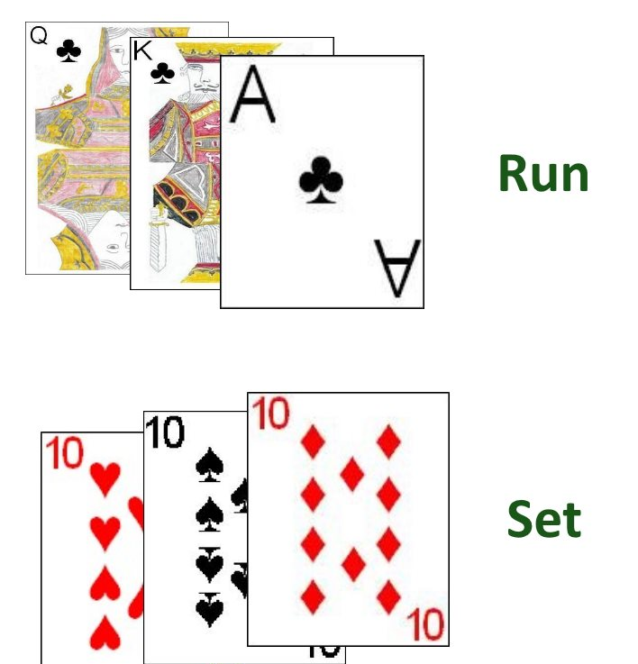
About Rummy
Goal
Be the first to get rid of all your cards. Each round starts by the player picking up a card and ends with discarding a card.
Game
1. Players create 'melds'
Runs: consecutive sequences of three or more cards of the same suit
Sets: collections of three or more cards of the same rank with different suits
2. Layoff a card
Put down a card that matches one of the existing melds

Slide 5
Problem Statement
How do we simulate a card game between the user and the computer?
Questions
What structures will we use to create logical meld and layoff functions?
How will we simulate computer logic?
How do we create a visually appealing user interface without graphics?

Slide 6
Why Rummy?
Strikes a balance between simplicity and complexity
Challenging but not 'impossible'
Incorporates user input and internal decision-making

Slide 7
Solution Methodology
User Interface + Setup
Computer Moves and Logic Functions
Functions to accept player input and perform actions
Clear instructions for the players
Notes:
For our Rummy game, Celeste and I divided the programming tasks efficiently. We kept the user interface simple by using the console so we could focus on coding logic. The computer’s moves are based on logical functions that analyze the best melds and layoffs, similar to how a player would make decisions. We split these tasks, with Celeste working on melds and me focusing on layoffs.
For the player, we implemented similar functions where they input their melds or layoffs, and the program checks for validity. Since not everyone is familiar with Rummy, we also included a built-in instructions feature, making the game easy to understand for new players.

Slide 8
Experimental Framework
Original Plan vs What we did
  Planned to split up tasks with Celeste doing the backend coding and Ruhani doing the frontend coding
  We shifted to a more parallel development style with more granular task division
  Adaptability helped us a lot
Notes:
Our original plan was to split the work by major components — Celeste handled the backend game logic, like card manipulation and computer AI, while I focused on the user interface and overall game flow. But as we got deeper into development, we realized a more effective approach was to break things down into smaller, more manageable tasks so we could work in parallel.
For instance, Celeste focused on separate functions for detecting sets and runs in the meld logic, while I worked on sorting and layoff functions at the same time. This shift sped up our progress and helped avoid merge conflicts.
Overall, we moved from a more linear approach to a parallel one, which made a big difference. It showed us how important flexibility and smart task management are for hitting our project goals.

Slide 9
Process, Challenges, and Lessons
Iterative Development Process
GitHub Version Control
Extensive Debugging & Testing
Meld Detection Complexity
Computer AI Challenges
Debugging
Importance of Collaboration
Notes:
Iterative Development: We adopted an iterative development approach, focusing on implementing core functionalities first (deck creation, dealing, drawing) and then gradually adding more complex features (melding, computer AI, scoring).
Version Control: GitHub played a crucial role in our workflow, enabling us to track changes, manage versions, and collaborate effectively. We used branches for individual features and merged them into the main branch after thorough testing.
Debugging: Debugging consumed a significant portion of our development time. We encountered numerous challenges related to card manipulation, meld detection, and computer AI logic. We used print statements, debugging tools within Thonny, and thorough testing to identify and resolve these issues.
Testing: We conducted regular testing throughout the development process, ensuring that each feature functioned correctly before moving on to the next. We also performed user testing with peers to gather feedback and identify areas for improvement.
Task Management: We used Microsoft Outlook to communicate and track progress, ensuring that we stayed on schedule and addressed any roadblocks promptly.
Challenges and Lessons Learned:
Complexity of Meld Detection: Implementing the meld detection logic, especially for runs, proved to be more challenging than anticipated. We had to carefully consider various edge cases and ensure that the logic was robust and accurate.
Computer AI: Developing a simple but functional computer AI required careful planning and implementation. We had to balance the need for logical decision-making with the constraints of our development timeline.
Debugging Time: We underestimated the amount of time required for debugging. This highlighted the importance of thorough testing and careful planning.
Collaboration: Working collaboratively on a complex project required effective communication and coordination. We learned the importance of clear communication, regular meetings, and a shared understanding of the project goals.
In summary, our experimental framework involved a flexible and iterative approach, adapting to the challenges we encountered and leveraging version control and collaboration tools to achieve our project goals.

Slide 10
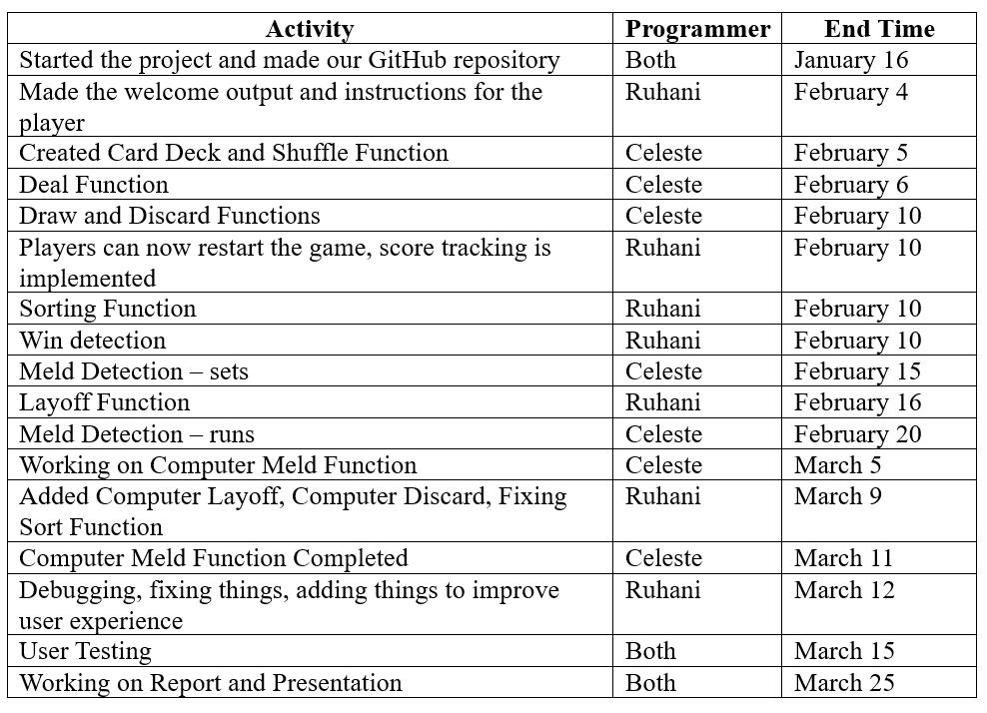
Timeline

Slide 11
How the Code Works
meld()
Ask user for type (runs or sets).
Go to respective section of code.
Input: 1 2 3 (1st card, 2nd card, 3rd card), must be in ascending order.
Runs
Is the meld valid?
Are the suits matching?
rank_to_value(), simple dictionary
valid = True
for i in range(len(cards) - 1):
current_card = hand[cards[i] - 1]
next_card = hand[cards[i + 1] - 1]
if current_card.suit == next_card.suit:
# handle ace as both high and low (ace-king case)
if (current_card.rank == 'A' and next_card.rank == '2') or \
(current_card.rank == 'K' and next_card.rank == 'A'):
continue
# check for consecutive rank values using the rank_to_value helper
elif rank_to_value(next_card.rank) == rank_to_value(current_card.rank) + 1:
continue
else:
valid = False
break
else:
valid = False

Slide 12
Code
# convert the list to numbers, added try/except block to catch non-integer input
try:
cards = list(map(int, cards))
except ValueError:
print("Error: please enter valid card numbers separated by spaces.")
continue
# check that at least 3 cards are selected, added this check
if len(cards) < 3:
print("Error: a meld must consist of at least 3 cards.")
continue
# check if all indexes are valid
if any(card > len(hand) or card < 1 for card in cards):
print("Error: invalid card index. please select valid cards from your hand.")
continue
# check that the selected cards form a valid set:
valid = True
for i in range(len(cards) - 1):
if hand[cards[i + 1] - 1].rank != hand[cards[i] - 1].rank:
valid = False
break
Sets
Is the meld valid?
Are the ranks matching?
If the meld is valid...
Add it to the meld list.
for i in sorted(cards, reverse=True):
card_to_add = hand[i - 1]
new_meld.insert(0, card_to_add)
hand.remove(card_to_add)
melds.append(new_meld) # append the new meld (as a sublist) to the global melds list

Slide 13
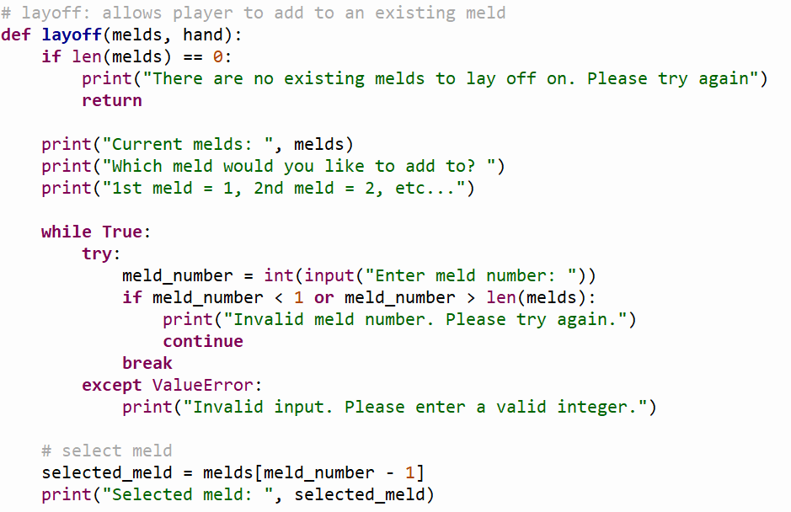
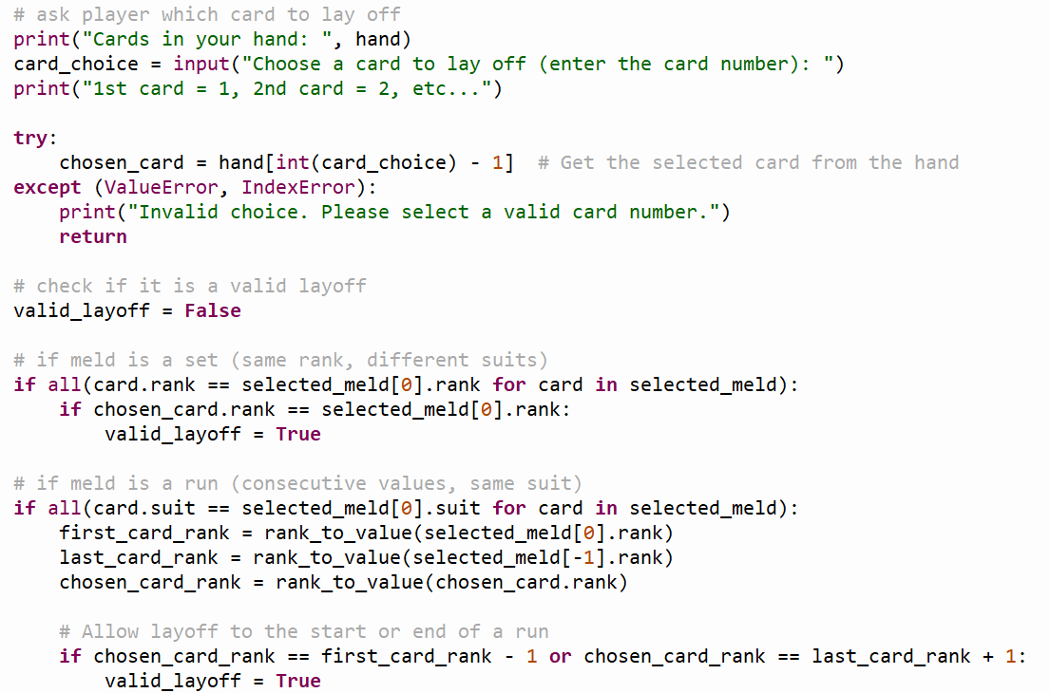
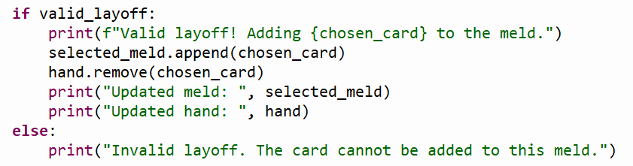
Layoff
Is the card a valid addition to the meld?
Similar to meld function
If the card is valid...
Add it to the meld

Slide 14
Results
Fully functional Rummy game
Player vs. computer gameplay
Logical computer AI moves
Valid gameplay and win conditions
Simple, intuitive CLI
Notes:
We built a fully functional Rummy game where you can play against the computer. The game allows for drawing, melding, and discarding cards while ensuring that all moves are valid and the game concludes when a player finishes their melds and discards their last card. The computer AI makes logical decisions, even if it's not expert-level, and the game is driven by a simple, easy-to-use command-line interface that clearly shows game progress and prompts for actions.

Slide 15
Conclusion and Future Work
Achieved key goals: Gameplay, AI, valid rules, and UI
Great learning experience in Python and game logic
Future Enhancements:
Improved AI with different difficulty levels
Transition from CLI to a graphical user interface
Multiplayer support
Extend framework to other card games
Advanced meld and layoff logic; better error handling
Notes:
In conclusion, our project successfully met our goals by implementing a player vs. computer game with working AI and valid gameplay rules through a clear UI. This project was a great learning opportunity that deepened our understanding of Python, game logic, and user interaction. Looking ahead, there are many exciting possibilities: we can improve the AI by adding difficulty levels, upgrade to a graphical interface, introduce multiplayer modes, adapt the framework for other card games, and refine our game logic further with advanced meld and layoff features, along with enhanced error handling.

Slide 16
Development Tools & External Materials
Development Tools:
Python & Thonny IDE
GitHub for version control
Microsoft Outlook for team communication
Hardware:
Laptops with Python installed
Learning Resources:
YouTube, w3schools.com, GeeksforGeeks.org
Notes:
For this project, we used a range of tools and resources that were key to our success. We developed our game in Python using the Thonny IDE, managed our code on GitHub for effective version control, and coordinated our work through Microsoft Outlook. We all worked on a laptop with Python installed, and we improved our understanding with additional learning materials from YouTube, w3schools, and GeeksforGeeks. These resources played a critical role in helping us overcome challenges and complete our project.

Slide 17

Thank You ☺

