Slide 1
MongoDB

Slide 2
[
{
_id: 1,
name: “Ravi”,
age: 23,
type: 1,
status: “P”,
favorites: {artist: “Picasso”, food: “Pizza”},
finished: [17,3],
badges: [“blue”, “black”],
points: [
{points: 85, bonus: 20},
{points: 75, bonus: 10},
],
},
{
_id: 2,
name: “Vinod”,
age: 35
}
]
key-value payer
(key -> value)
Named Tuple
(tuple-key -> tuple)
(tuple-key, attrib-key -> attrib-value)
named array
named-key -> array
(array-key, position -> array-element)
(array-key, value-list -> matching-values)
Named array or unnamed tuples

Slide 3
SQL SELECT and MongoDB find()
MongoDB is a collection of documents
The basic query primitive
db.<collection>.find(<query filter>, <projection>).<cursor-modifier>
Like FROM clause, specifies the collection to use
Projection variables
In SELECT clause
How many results to return etc.
Like WHERE clause, specifies which documents to return

Slide 4
Some simple Queries
Query 1:
SQL
SELECT * FROM employees;
MongoDB
db.employees.find()
Query 2:
SQL
SELECT name. salary FROM emplyees;
MongoDB
db.employees.find(
{},
{name: 1, salary: 1}
)
{name: 1, salary: 1, _id: 0}

Slide 5
Adding Query conditions
Query 3:
SQL SELECT last_name, salary from employees WHERE name = “Ravi”;
MongoDB db.employees.find({name: “Ravi”}, {last_name: 1, salary: 1, _id:0})
Query 4:
SQL SELECT DISTINCT last_name, salary from employees WHERE salary > 1000000;
MongoDB db.employees.distinct({salary : {$gt: 1000000}}, {last_name: 1,
salary: 1, _id: 0})

Slide 6
Comparison
Name | Description
$eq | Matches values that are equal to a specified value.
$gt | Matches values that are greater than a specified value.
$gte | Matches values that are greater than or equal to a specified value.
$in | Matches any of the values specified in an array.
$lt | Matches values that are less than a specified value.
$lte | Matches values that are less than or equal to a specified value.
$ne | Matches all values that are not equal to a specified value.
$nin | Matches none of the values specified in an array.

Slide 7
Logical and Array …
$and Joins query clauses with a logical AND returns all documents that match the conditions of both clauses.
$not Inverts the effect of a query expression and returns documents that do not match the query expression.
$nor Joins query clauses with a logical NOR returns all documents that fail to match both clauses.
$or Joins query clauses with a logical OR returns all documents that match the conditions of either clause.
ARRAY operations:
$in Matches any of the values specified in an array
$nin Matches none of the values specified in an array

Slide 8
Regular expressions
Query 5:
Count the numbers of employees whose names have partial string
“kar” in it – must be case insensitive
db.employees.find({name: “kar” }).count()
db.employees.find({name: {$regex: /kar/i} }).count()
Query 6:
Same, but last_name start with “Tendul”
db.employees.find({name: {$regex: /^Tendul/} }).count()
Same with “Ten” and ends with “kar”
db.employees.find({name: {$regex: /^Ten.*kar$/} }).count()

Slide 9
Array operations
{ _id: 1,
iten: “bud”,
qty: 10,
tags: [“popular”, “summer”, “Japanese”],
rating: “good”
}
Find items which are tagged as “popular” or “organic”
db.inventory.find({tags: {$in: [“popular”, “organic”]}})
Find items which are not tagged as “popular” nor “organic”
db.inventory.find({tags: {$nin: [“popular”, “organic”]}})
Find the 2nd and 3rd elements or tags
db.inventory.find({}, {tags: {$slice: [1, 2]}}}
db.inventory.find({}, {tags: {$slice: -2}}}
Find a document whose 2nd element in tags is “summer”
db.inventory.find({}, {tags.1: “summer”}

Slide 10
Compound statements
{ _id: 1,
item: “bud”,
qty: 10,
tags: [“popular”, “summer”, “Japanese”],
rating: “good”,
price: 3.99
}
db.inventory.find({
$and : [
{$or: [{price: 3.99}, {price: 4.99}]}
{$or: [{rating: “good”}, qty: {$lt : 20}]}
{item: {$ne: “Coors”}}
]
})
SELECT * FROM inventory
WHERE ((price = 3.99) OR (price = 4.99)) AND
((rating = “good”) OR (qty < 20)) AND
item != “Coors”

Slide 11
Queries over nested elements
{
_id: 1.
points: [
{points: 96, bonus: 20},
{points: 35, bonus: 10}
]
_id: 2,
points: [
{points: 53, bonus: 20},
{points: 64, bonus: 12}
]
_id: 3,
points: [
{points: 81, bonus: 8},
{points: 95, bonus: 20}
]
}
db.users.find({‘points.0.points’: {$lte: 80}})
db.users.find({‘points.points’: {$lte: 80}})
db.users.find({‘points.points’: {$lte: 81},
“points.bonus”: 20} {_id: 0, points.:1})

Slide 12
Aggregation function
SELECT COUNT(*) FROM employees;
db.employees.count()
distinct db.employees.count({addr: {$exists: true}})
Get the distinct values of an array
Data: {_id: 1, places: [USA, France, USA, India, Spain, UK, Spain]}
db.countryDB.distinct(places)
[USA, France, Spain, India, UK]
db.countryDB.distinct(places).length()
5

Slide 13
db.orders.aggregate(
[
{$match: {status: “A”} },
{$group: {_id: “$cust_id”, total: {$sum: “$amount”} } }
]
)
Role of aggregation framework
Grouping, aggregate functions, sorting, …

Slide 14
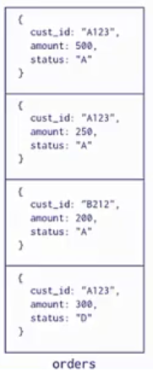
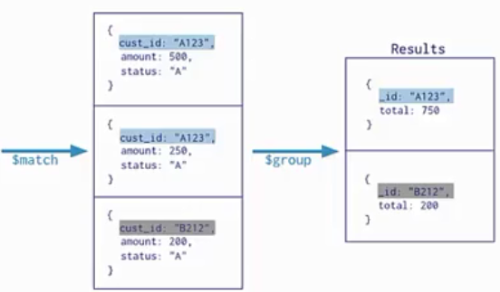

Slide 15
Join in MongoDB
Order:
{_id: 1, item: “abc”, price: 12, quantity: 2}
{_id: 2, item: “jkl”, price: 20, quantity: 1}
{_id: 3}
inventory:
{_id: 1, sku: “abc”, description: “product 1”, instock: 120}
{_id: 2, sku: “def”, description: “product 2”, instock: 80}
{_id: 3, sku: “ijk”, description: “product 3”, instock: 60}
{_id: 4, sku: “jkl”, description: “product 4”, instock: 70}
{_id: 5, sku: null, description: “incmopletye”}
{}

Slide 16
db.orders.aggregate([
{$lookup: {
from: “inventory”,
localField: “item”,
foreignField: “sku”,
as: “inventory_order_docs”
}
}
])

