Slide 1

Mining of Massive Datasets: Course Introduction
Note to other teachers and users of these slides: We would be delighted if you found this our material useful in giving your own lectures. Feel free to use these slides verbatim, or to modify them to fit your own needs. If you make use of a significant portion of these slides in your own lecture, please include this message, or a link to our web site: http://www.mmds.org
Mining of Massive Datasets
Jure Leskovec, Anand Rajaraman, Jeff Ullman Stanford University
http://www.mmds.org

Slide 2
What is Data Mining? Knowledge discovery from data

Slide 3
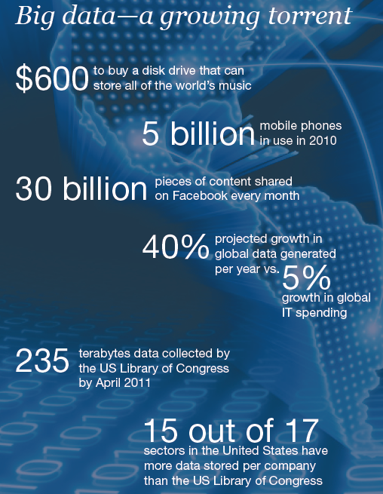
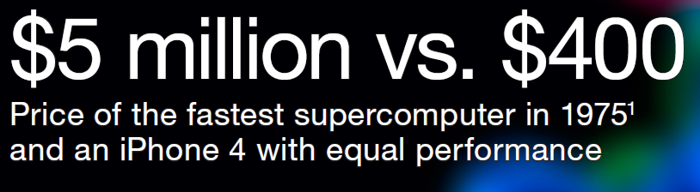

Slide 4

Data contains value and knowledge

Slide 5
Data Mining
But to extract the knowledge data needs to be
Stored
Managed
And ANALYZED ← this class
Data Mining ≈ Big Data ≈ Predictive Analytics ≈ Data Science

Slide 6
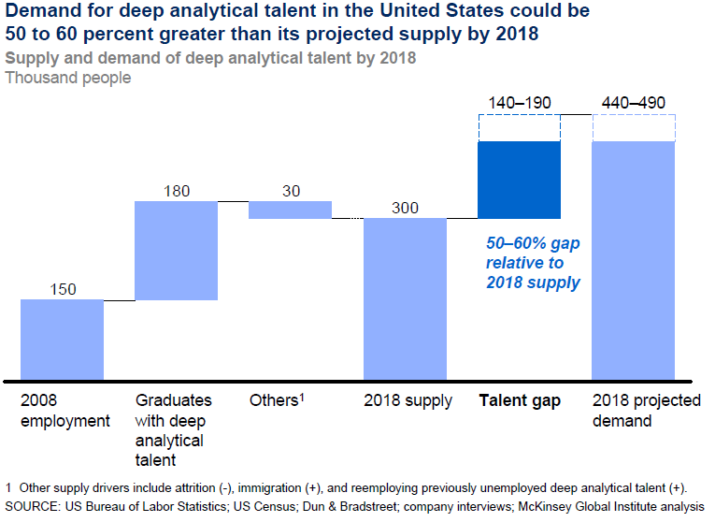
Good news: Demand for Data Mining

Slide 7
What is Data Mining?
Given lots of data
Discover patterns and models that are:
Valid: hold on new data with some certainty
Useful: should be possible to act on the item
Unexpected: non-obvious to the system
Understandable: humans should be able to interpret the pattern

Slide 8
Data Mining Tasks
Descriptive methods
Find human-interpretable patterns that describe the data
Example: Clustering
Predictive methods
Use some variables to predict unknown or future values of other variables
Example: Recommender systems

Slide 9
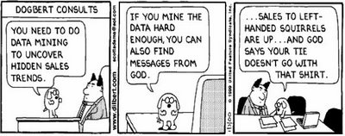
Meaningfulness of Analytic Answers
A risk with “Data mining” is that an analyst can “discover” patterns that are meaningless
Statisticians call it Bonferroni’s principle:
Roughly, if you look in more places for interesting patterns than your amount of data will support, you are bound to find crap

Slide 10
Meaningfulness of Analytic Answers
Example:
We want to find (unrelated) people who at least twice have stayed at the same hotel on the same day
10⁹ people being tracked
1,000 days
Each person stays in a hotel 1% of time (1 day out of 100)
Hotels hold 100 people (so 10⁵ hotels)
If everyone behaves randomly (i.e., no terrorists) will the data mining detect anything suspicious?
Expected number of “suspicious” pairs of people:
250,000
… too many combinations to check – we need to have some additional evidence to find “suspicious” pairs of people in some more efficient way

Slide 11
What matters when dealing with data?
Challenges
Usage
Quality
Context
Streaming
Scalability
Collect
Prepare
Text
Data
Modalities
Ontologies
Networks
Signals
Represent
Structured
Multimedia
Model
Reason
Visualize
Data Operators

Slide 12
Data Mining: Cultures
Data mining overlaps with:
Databases: Large-scale data, simple queries
Machine learning: Small data, Complex models
CS Theory: (Randomized) Algorithms
Different cultures:
To a DB person, data mining is an extreme form of analytic processing – queries that examine large amounts of data
Result is the query answer
To a ML person, data-mining is the inference of models
Result is the parameters of the model
In this class we will do both!
CS Theory
Machine Learning
Data Mining
Database systems

Slide 13
This Class: CS246
This class overlaps with machine learning, statistics, artificial intelligence, databases but more stress on
Scalability (big data)
Algorithms
Computing architectures
Automation for handling large data
Statistics
Machine
Learning
Data Mining
Database systems

Slide 14
What will we learn?
We will learn to mine different types of data:
Data is high dimensional
Data is a graph
Data is infinite/never-ending
Data is labeled
We will learn to use different models of computation:
MapReduce
Streams and online algorithms
Single machine in-memory

Slide 15
What will we learn?
We will learn to solve real-world problems:
Recommender systems
Market Basket Analysis
Spam detection
Duplicate document detection
We will learn various “tools”:
Linear algebra (SVD, Rec. Sys., Communities)
Optimization (stochastic gradient descent)
Dynamic programming (frequent itemsets)
Hashing (LSH, Bloom filters)

Slide 16
How It All Fits Together
High dim. data
Locality sensitive hashing
Clustering
Graph data
PageRank, SimRank
Community Detection
Infinite data
Filtering data streams
Web advertising
Dimensionality reduction
Spam Detection
Queries on streams
Machine learning
SVM
Decision Trees
Perceptron, kNN
Apps
Recommender systems
Association Rules
Duplicate document detection

Slide 17
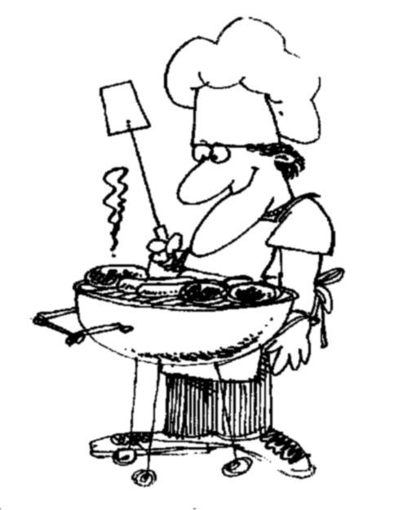
I ♥
data
How do you want that data?

Slide 18
About the Course

Slide 19
2014 CS246 Course Staff
TAs:
We have 9 great TAs!
Sean Choi (Head TA), Sumit Arrawatia, Justin Chen, Dingyi Li, Anshul Mittal, Rose Marie Philip, Robi Robaszkiewicz, Le Yu, Tongda Zhang
Office hours:
Jure: Wednesdays 9-10am, Gates 418
See course website for TA office hours
For SCPD students we will use Google Hangout
We will post Google Hangout links on Piazza

Slide 20
Course Logistics
Course website:
http://cs246.stanford.edu
Lecture slides (at least 30min before the lecture)
Homeworks, solutions
Readings
Readings: Book Mining of Massive Datasets with A. Rajaraman and J. Ullman
Free online: http://www.mmds.org

Slide 21
Logistics: Communication
Piazza Q&A website:
https://piazza.com/class#winter2013/cs246
Use Piazza for all questions and public communication with the course staff
If you don’t have @stanford.edu email address, send us your email and we will manually register you to Piazza
For e-mailing us, always use:
cs246-win1213-staff@lists.stanford.edu
We will post course announcements to Piazza (make sure you check it regularly)
Auditors are welcome to sit-in & audit the class

Slide 22
Work for the Course
(1+)4 longer homeworks: 40%
Theoretical and programming questions
HW0 (Hadoop tutorial) has just been posted
Assignments take lots of time. Start early!!
How to submit?
Homework write-up:
Stanford students: In class or in Gates submission box
SCPD students: Submit write-ups via SCPD
Attach the HW cover sheet (and SCPD routing form)
Upload code:
Put the code for 1 question into 1 file and submit at: http://snap.stanford.edu/submit/

Slide 23
Work for the Course
Short weekly quizzes: 20%
Short e-quizzes on Gradiance
You have exactly 7 days to complete it No late days!
First quiz is already online
Final exam: 40%
Friday, March 22 12:15pm-3:15pm
It’s going to be fun and hard work. ☺

Slide 24
Course Calendar
Homework schedule:
2 late “days” (late periods) for HWs for the quarter:
1 late day expires at the start of next class
You can use max 1 late day per assignment
Date | Out | In
01/08, Tue | HW0
01/10, Thu | HW1
01/15, Tue |  | HW0
01/24, Thu | HW2 | HW1
02/07, Thu | HW3 | HW2
02/21, Thu | HW4 | HW3
03/07, Thu |  | HW4

Slide 25
Prerequisites
Algorithms (CS161)
Dynamic programming, basic data structures
Basic probability (CS109 or Stat116)
Moments, typical distributions, MLE, …
Programming (CS107 or CS145)
Your choice, but C++/Java will be very useful
We provide some background, but the class will be fast paced

Slide 26
Recitation Sessions
3 recitation sessions:
Hadoop: Thurs. 1/10, 5:15-6:30pm
We prepared a virtual machine with Hadoop preinstalled
HW0 helps you write your first Hadoop program
Review of probability&stats: 1/17, 5:15-6:30pm
Review of linear algebra: 1/18, 5:15-6:30pm
All sessions will be held in Thornton 102, Thornton Center (Terman Annex)
Sessions will be video recorded!

Slide 27
What’s after the class
InfoSeminar (CS545):
http://i.stanford.edu/infoseminar
Great industrial & academic speakers
Topics include data mining and large scale data processing
CS341: Project in Data Mining (Spring 2013)
Research project on big data
Groups of 3 students
We provide interesting data, computing resources (Amazon EC2) and mentoring
We have big-data RA positions open!
I will post details on Piazza

Slide 28
3 To-do items
3 To-do items for you:
Register to Piazza
Complete HW0: Hadoop tutorial
HW0 should take your about 1 hour to complete (Note this is a “toy” homework to get you started. Real homeworks will be much more challenging and longer)
Register to Gradiance and complete the first quiz
Use your SUNet ID to register! (so we can match grading records)
You have 7 days (sharp!) to do so
Quizzes typically take several hours
Additional details/instructions at http://cs246.stanford.edu

