Slide 1
Daily Life Effects on Screen Time and Step Count
Ruhi Barkın Kayış - 28961

Slide 2
Contents
1. Project Aim
2. Dataset
3. Hypothesis and P-Value Calculations
4. Clustering Days
5. Conclusion

Slide 3
Project Aim
Project aim is to discover the relation between daily activities together with our daily missions such as working or studying and taking exams. People spent their huge amount of times to mobile and PC devices. Other major thing to consider is taking steps. People daily activities depend walking a lot. Using these traces some relation and correlation may be figured out.

Slide 4

Dataset
Dataset includes 90-day of data with the followings:
Date: The specific date for each entry
Active Energy (kJ): Calories burned in kilojoules
Step Count (steps): Total number of steps taken
Working (1 or 0): Indicates whether it was a workday (1) or not (0)
Midterm (1 or 0): Indicates whether it was an exam day (1) or not (0)
Screen Time (Total) (Hour, minute): Total screen
Screen Time (PC) (Hour, minute): Screen time spent on the PC
Screen Time (Mobile) (Hour, minute): Screen time spent on mobile devices
Days: The day of the week (R = Thursday, N = Sunday)

Slide 5
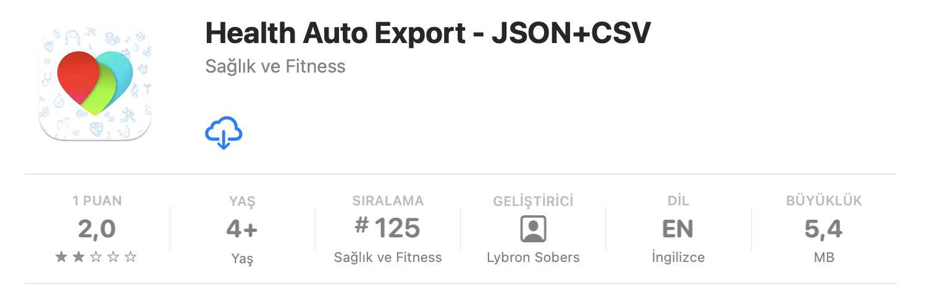
How I Obtained The Data ?
By the Help of Health Auto Export – JSON + CVS App pulled the active energy + step count
Screen Time Data are recorded in Apple both for Macbook and Iphone in separate and together. However, manually writing required and you can go only go 30 days past.
Manuelly signed the days of working and midterm exam days

Slide 6

Hypothesis - 1
Null Hypothesis : There are observable differences of PC screen time before midterms and general PC screen times
Alternative Hypothesis: There are no observable differences of PC screen time before midterms and general PC screen times

Slide 7
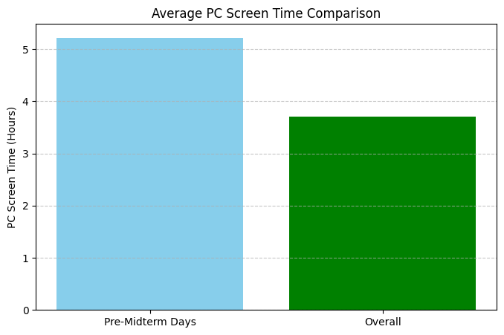
Is There Any Differences Between Overall and Pre-Midterm Days ?

Slide 8
How About P-Values
Because I had 4 midterms (4 samples) I used Mann-Whitney U Test
P-Value for Null Hypothesis was: 0.43296751931403044
Which is greater than 0.05
Thus, Null Hypothesis cannot be rejected
The graph also shows confident sample
We can say my average time spend on PC increases because, while I am studying for midterms, I feel comfortable with looking at lecture slides together with taking key notes to remember.

Slide 9
Hypothesis - 2
Null hypothesis: There is no difference of screen times between working and non-working days
Alternative hypothesis: There is difference of screen times between working and non-working days

Slide 10
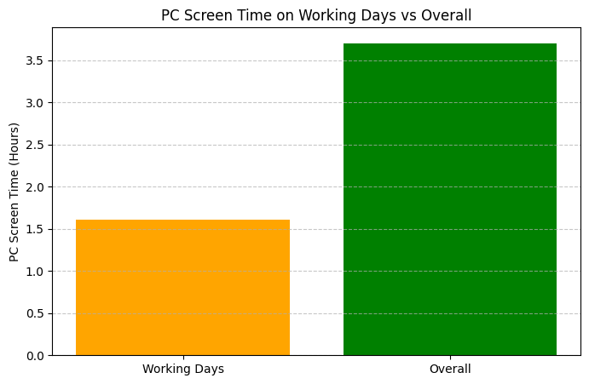
Is There Difference Between Working and Other Days in Terms of PC Screen Time?

Slide 11
About P-Values and Null Hypothesis
I continued to use Mann-Whitney U Test
P-Value: 3.0745018644748963e-09
P-Value < 0.05
This means we So, reject the null hypothesis
Also means there is difference of PC screen time between my working days and other days
That is because my job is not computer-based one and I nearly never use computer for my job. The working period is 8.30 in morning and 19.00 in evening. The transportation also wastes lots of time and the tiredness is in absolute levels during working so generally if there is nothing critical to work on I just prefer to skip anything appart from sleeping. So during working days my computer screen time should be lower than other days

Slide 12
Hypothesis - 3
Null Hypothesis: Talking base on working days; the Thursdays and rest of the days do not have a significant difference about PC screen time
Alternative Hypothesis: Talking base on working days; the Thursdays and rest of the days do have a significant difference about PC screen time

Slide 13
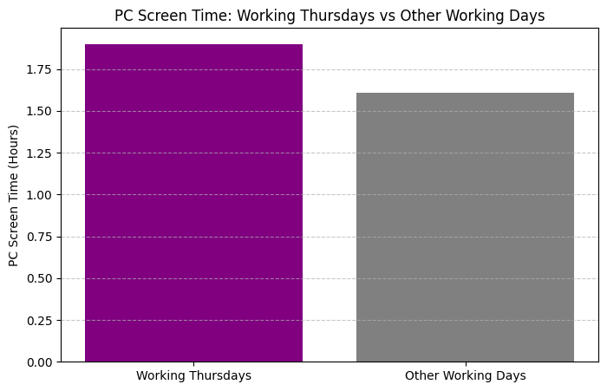
What About Means ?

Slide 14
What P-Value Says ?
I got the P-Value: 0.6343763152931656
Means Null Hypothesis did not rejected
But why do I compare the working Thursdays and other working days?
My course schedule is mainly integrated days of Monday, Tuesday, Friday. So, Wednesday, Thursday and Saturday are my free days during week. There were some days that I did not get to work due to my midterm schedule. Because I am 4th year student and working on graduation project (I already have taken and pass the CS412 Machine Learning course just could not take the CS210 new name DSA210 course because of my schedule availability) the project meetings are planned to Thursday and that why I have to bring my PC to work and attend to online zoom meeting during Thursdays + workdays. So, my Thursdays working PC screen times should be more than other working days.

Slide 15
Hypothesis - 4
What about my total screen time and step count ?
Null hypothesis: There is no negative correlation between step count and total screen time
Alternative hypothesis: There is a negative correlation between step count and total screen time.

Slide 16
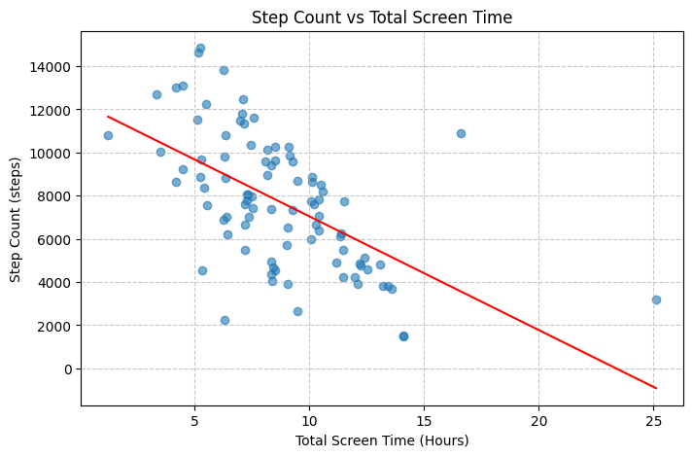
What is the Relation ?
As you can say there are some outliers which also disrupt the graph

Slide 17
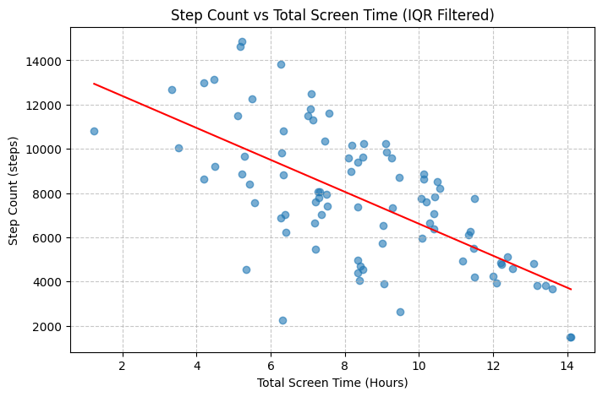
Cleaning the Data from Dirt
By IQR method, the data has been cleaned from outlier data points.

Slide 18
Spearman and P-Value
Why Spearmen and not Pearson ?
Although data looks like Pearson correlation would give perfect fit the step count and screen time relation would be more defined as monotonic relation. If we want to use Pearson the linearity will be the key aspect however in our case the monotonicity is the key that's why looking from spearman window would be much more accurate from my sight of views.
Spearman Correlation: -0.6068118114819537
P-value: 1.8209281134573636e-10

Slide 19
What we Obtain by Hypothesis – 4 ?
The step count and the total screen time should have negative correlation between them; because time spent on screen eventually decrease the person mobility in most of the cases.
Also, in the spearman correlation perspective the value is -0.607 which shows the trendy towards -1 and actually near. If we speak about spearman its values around -1 to +1 in which -1 tells us about total negative correlation while +1 vice-versa. Our result also shows negative correlation between screen time and step count..
Because the P-Value < than 0.05 we reject the no negative correlation appears hypothesis

Slide 20
Clustering Analysis
I tried to cluster the data point and gather the number of specific days to find their common point or points.

Slide 21
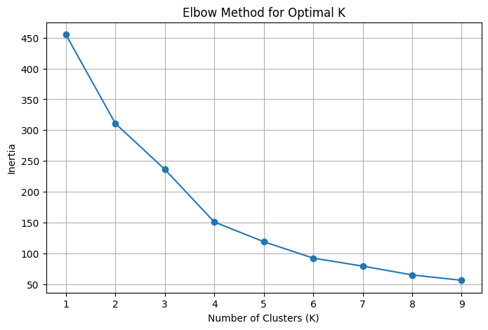
How to Find the Best K ?
By using elbow method, we can say that 4 is the optimal k in this table.

Slide 22
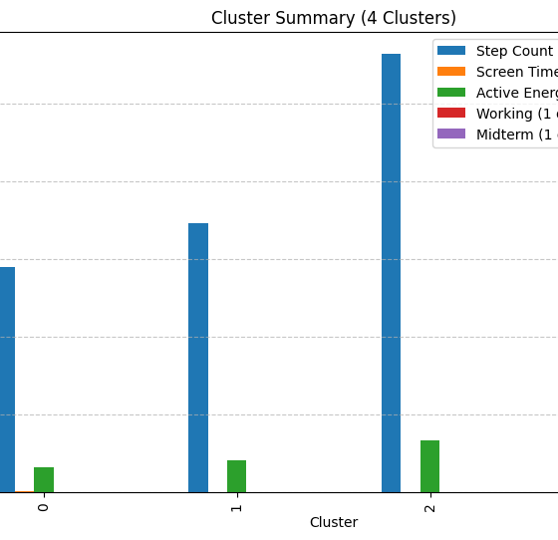
Is k = 4 correct or not ?
The elbow method says k = 4 is the optimal however visualization of the conditions are stating different.

Slide 23
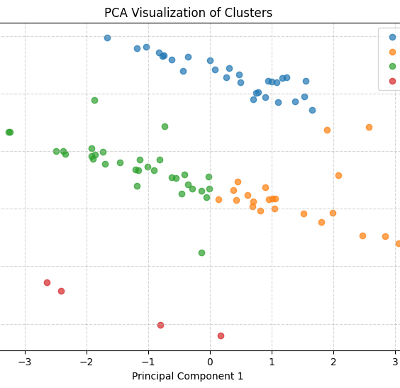
PCA Check for K = 4
The data spliced into 4 areas, which 1 area is containing only 4 days.

Slide 24
What are the Specs of the Clusters ?
Cluster 0: - Step Count (steps): 5800.09 - Screen Time (Total)(Hour,minute): 11.54 - Active Energy (kJ): 639.00 - Working (1 or 0): 0.00 - Midterm (1 or 0): 0.00
Cluster 1: - Step Count (steps): 6941.31 - Screen Time (Total)(Hour,minute): 6.97 - Active Energy (kJ): 817.21 - Working (1 or 0): 1.00 - Midterm (1 or 0): 0.00
Cluster 2: - Step Count (steps): 11297.84 - Screen Time (Total)(Hour,minute): 6.73 - Active Energy (kJ): 1340.77 - Working (1 or 0): 0.20 - Midterm (1 or 0): 0.00
Cluster 3: - Step Count (steps): 6651.00 - Screen Time (Total)(Hour,minute): 10.84 - Active Energy (kJ): 802.12 - Working (1 or 0): 0.00 - Midterm (1 or 0): 1.00

Slide 25
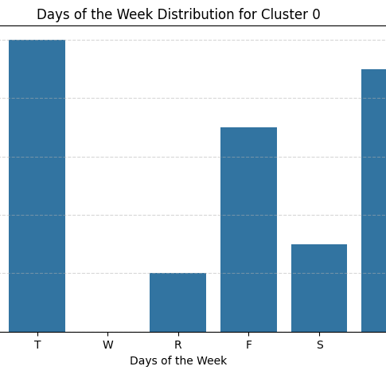
Cluster - 0
- Step Count 5800.09
- Screen Time : 11.54
Active Energy (kJ): 639.00
Working days (%): 0
Midterm days (%): 0
Cluster 0 is the general specs for non-working days.

Slide 26
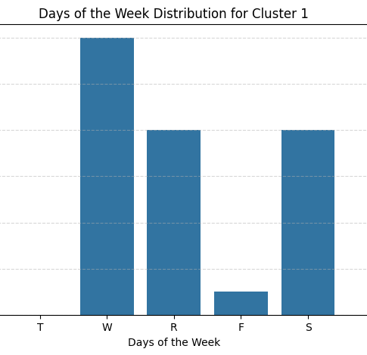
Cluster - 1
Step Count: 6941.31
Screen Time: 6.97
Active Energy (kJ): 817.21
Working days (%): 100
Midterm (%) : 0
Cluster 1 is specs for working day practice.

Slide 27
Comparison of Cluster 0 and 1
If you go back and fort in cluster 0 and 1 slides you may observe some changes.
First change is in step count, the step count increase in working days than non-working days. We can state that the energy consumption while working has higher rate than non-working days together with active energy data.
Also, huge decrease in screen time also

Slide 28
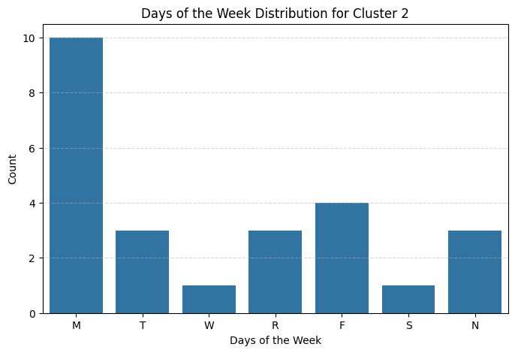
Cluster - 2
Step Count: 11297.84
Screen Time: 6.73
Active Energy (kJ): 1340.77
Working (%): 20
Midterm (%): 0
Cluster 2 is gathered most intense days in terms of active energy + step count. Maybe these are showing the extra workouts that I have been doing in my free times.

Slide 29
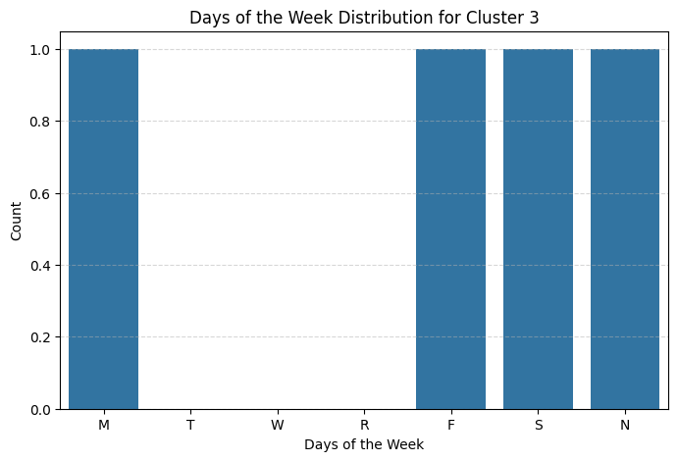
Cluster - 3
Step Count (steps): 6651.00
Screen Time: 10.84
Active Energy (kJ): 802.12
Working (%): 0
Midterm (%): 100
Cluster 3 gathers the midterm dates. A good view for days of exams going on.

Slide 30
Conclusion
By the data analysis techniques, the relations of the data shows significant outcomes together with understanding.
Creating relations and knowing the reasons of the why’s actually make people excited among new searches.
Data analysis is growing and growing fast in this world especially with growing number of data.
I tried to express all the reasoning and all the relation during the presentation and hopefully as a reader you can understand the most of it.
However, please feel free to ask any of your questions from: ruhibarkin@sabanciuniv.edu

