Slide 1

Vel Tech Rangarajan Dr. Sagunthala R&D Institute of Science and Technology
School of Computing
Department of Information Technology
10211IT224 / FULL STACK APPLICATION DEVELOPMENT (JAVA)
END SEMESTER PROJECT REVIEW
Date: 06-05-2026
Job Portal Management System
SDG: SDG No – SDG 10 – Reduced Inequalities
Presented By:
RUHINA NAAZ K – VTU26453 – 23UEIT0024
Courses Handling Faculty:
Dr. Visumathi J/ Professor/ IT

Slide 2
INTRODUCTION
1
The job market today is extremely competitive, with a large number of applicants competing for limited opportunities every day. Traditional methods of searching for jobs are often slow, inefficient, and lack clarity for both job seekers and employers. Therefore, a centralized digital solution is necessary to connect talent with opportunities effectively.
This project introduces a Job Portal Web Application developed using Spring Boot and Thymeleaf. It allows students and job seekers to explore and apply for job openings, while employers can post vacancies and manage applicants efficiently. Additionally, an Admin panel is included to supervise and control the platform. Role-based access ensures users can only access features relevant to their role, improving transparency, speed, and efficiency in the hiring process.
2
3
4
5
6
7
8
9

Slide 3
PROBLEM STATEMENT
1
2
In today’s job market, there is no single platform that efficiently connects job seekers, employers, and administrators in a secure environment. Job seekers face difficulty tracking their application progress, while employers lack effective tools to filter and shortlist candidates. Manual hiring methods are slow, prone to errors, and lack real-time interaction.
Many existing systems fail to provide role-specific dashboards, resume handling, and proper application tracking. Hence, there is a strong need for an automated, role-based full-stack job portal that simplifies the entire recruitment process—from job posting to candidate selection—while improving transparency and reducing time and effort.
3
4
5
6
7
8
9

Slide 4
OBJECTIVE(S)
1
2
To design and build a secure, role-based full-stack Job Portal Web Application using Spring Boot and Thymeleaf that allows students to search and apply for jobs, employers to manage job postings, and administrators to monitor the system.
To develop a complete application tracking system that includes real-time status updates (Applied, Shortlisted, Rejected), resume uploads, email notifications, and advanced job search filters based on location, skills, and experience—ensuring a smooth and transparent hiring process.
3
4
5
6
7
8
9

Slide 5
PROPOSED SYSTEM
1
The proposed system is a web-based Job Portal developed using Spring Boot (MVC, Security, JPA) and Thymeleaf as the frontend engine, running on localhost:8080.
It implements role-based access control with three roles: Student, Employer, and Admin, each having their own dashboard and restricted access.
Students can create profiles, upload resumes, search for jobs, apply, and monitor their application status.
Employers can post job openings, view applicants, and shortlist or reject candidates.
Admin manages users and job postings to maintain system integrity.
The platform includes dynamic job filtering based on location, skills, and experience using JavaScript and REST APIs. Email notifications are automatically sent during application submission and shortlisting. Passwords are secured using BCrypt, and all data is stored in a MySQL database.
2
3
4
5
6
7
8
9

Slide 6
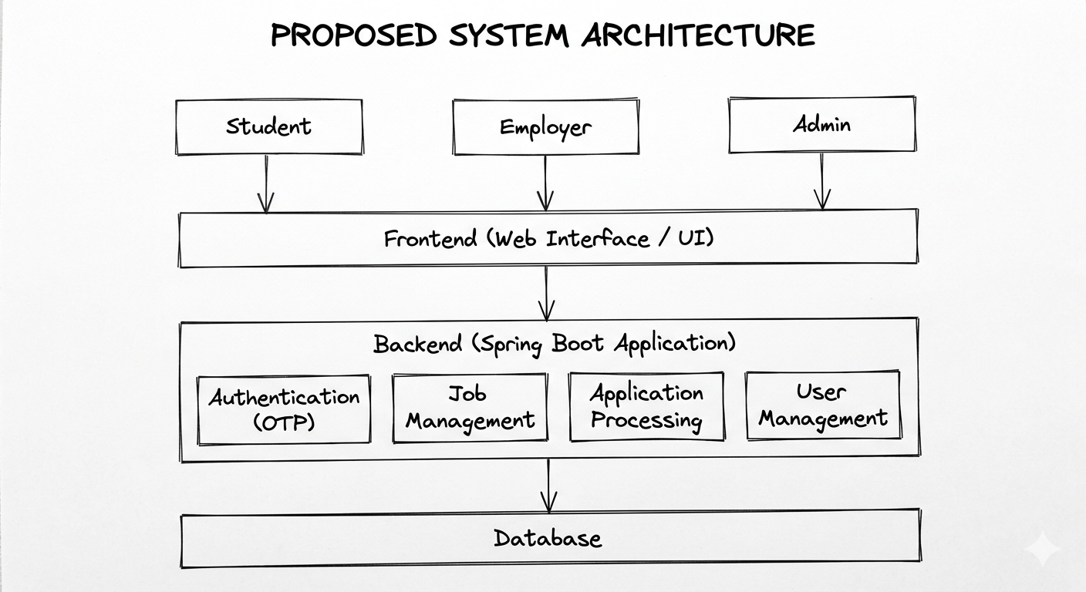
PROPOSED SYSTEM ARCHITECTURE
1
2
3
4
5
6
7
8
9

Slide 7
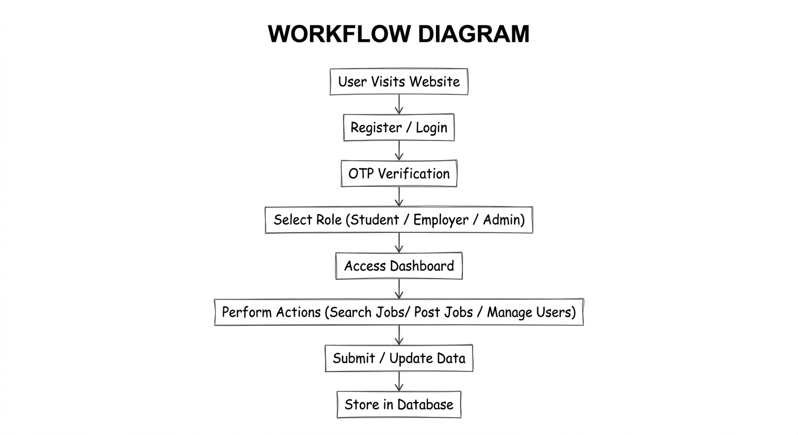
WORKFLOW
1
2
3
4
5
6
7
8
9

Slide 8
TECHNOLOGIES USED
Frontend: HTML5, CSS3, JavaScript (ES6), Thymeleaf, Responsive design (Flexbox/Grid) Backend: Java 17, Spring Boot, Spring MVC, Spring Data JPA, Spring Security, JavaMailSender, MultipartFile Database: MySQL 8.0+ Tools: Maven, Eclipse IDE, Postman, Git
System Requirements:
OS: Windows 10/11 or Linux
RAM: Minimum 8 GB
JDK: 17+
MySQL Server: 8.0+
Browser: Latest Chrome/Firefox
1
2
3
4
5
6
7
8
9

Slide 9
MODULE DESCRIPTION
Module 1: Authentication & Authorization Manages user registration and login for Students, Employers, and Admins. Spring Security ensures password encryption using BCrypt and controls access based on roles.
Module 2: Student Module Allows users to build profiles, upload resumes, browse jobs, apply, and track application status (Applied, Shortlisted, Rejected) through a personal dashboard.
Module 3: Employer Module Enables employers to post job details (title, description, skills, salary, location), view applicants, and take actions such as shortlisting or rejecting candidates, with email notifications triggered automatically.
Module 4: Admin & Analytics Module Provides full control to the Admin for managing users and job postings. It also includes analytics such as total jobs, applications, and shortlisted candidates displayed through dashboards.
1
2
3
4
5
6
7
8
9

Slide 10
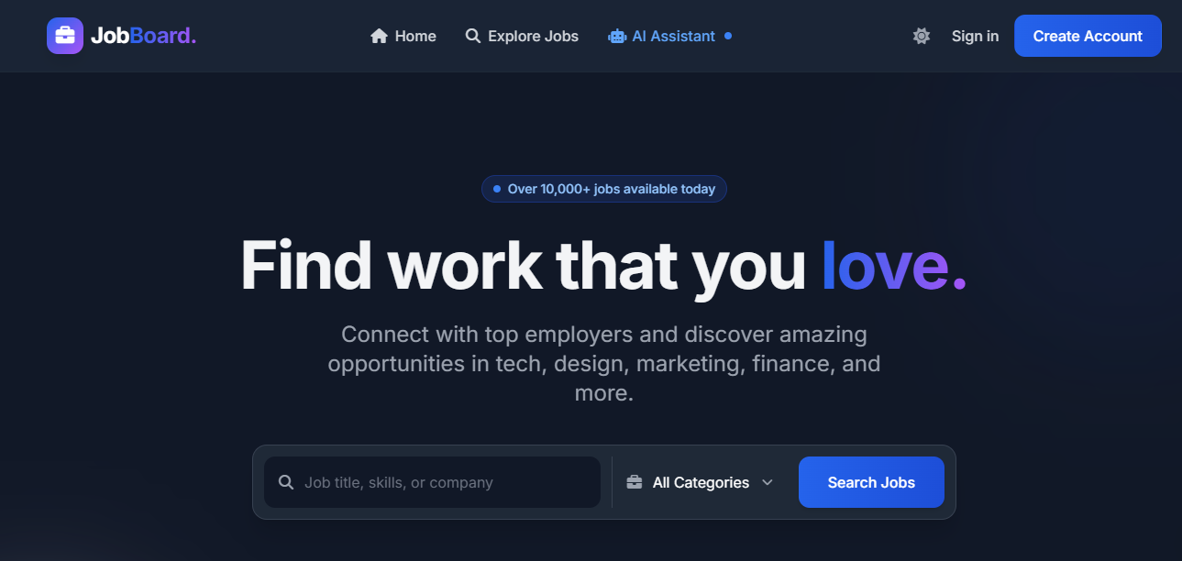
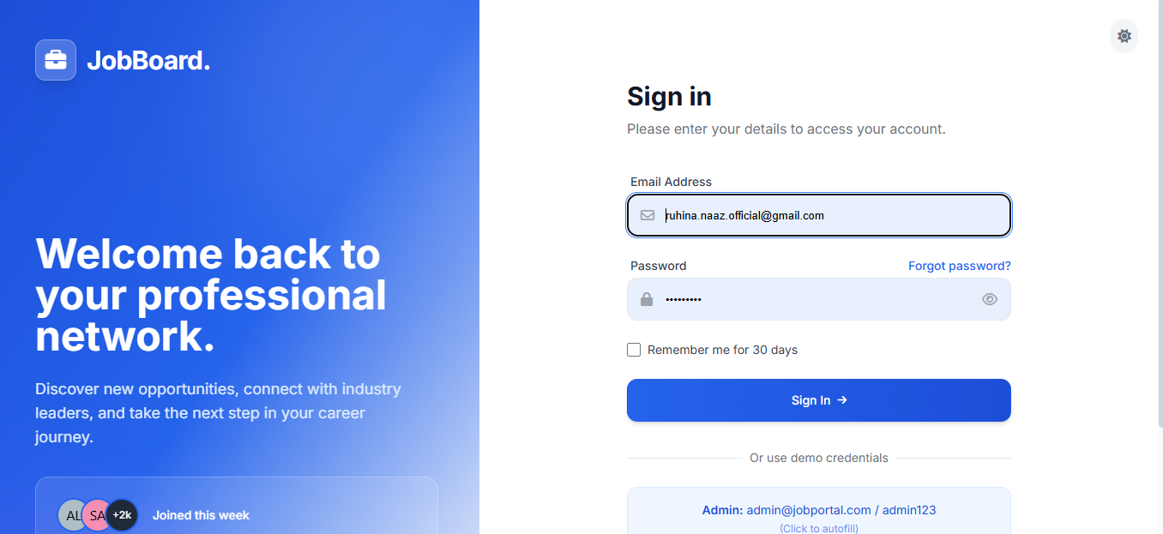
IMPLEMENTATION SCREENSHOTS
1
2
3
4
5
6
7
8
9
Homepage: Displays featured jobs, navigation options, and a welcome section.
LoginPage: Provides secure login with email and password.

Slide 11
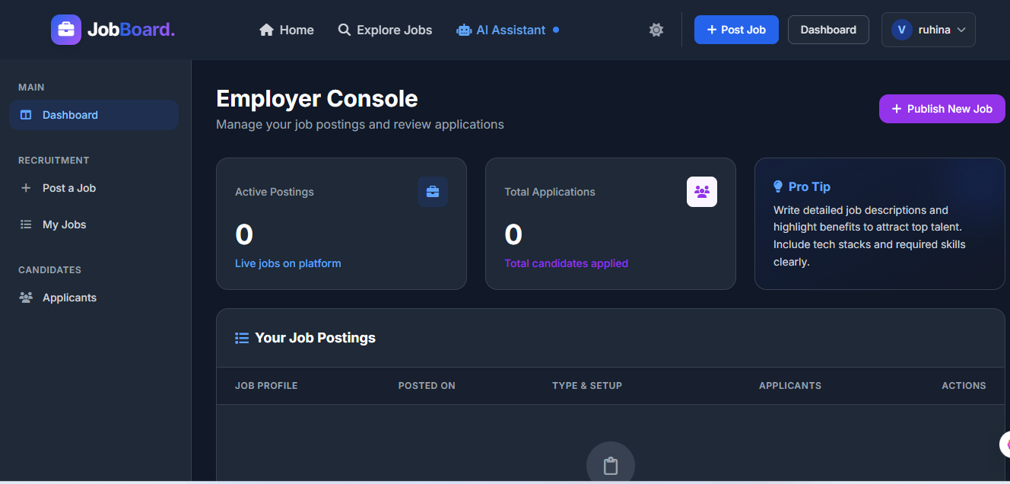
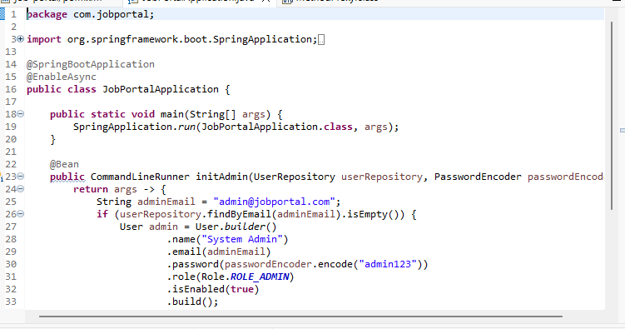
IMPLEMENTATION SCREENSHOTS
1
2
3
4
5
6
7
8(A)
9
OutputPage: Displays application tracking status for users.
MainModulePage: Shows job listings with details like title, salary, and skills..

Slide 12
ADVANTAGES & LIMITATIONS
1
2
Advantages:
Strong role-based security ensures proper access control.
Covers the complete hiring process from job posting to candidate selection.
Scalable architecture allows future expansion and integration.
Limitations:
No real-time chat feature between users.
Resumes are stored locally, which is not ideal for large-scale deployment.
No monetization features like paid job postings.
Runs on a single server without load balancing or distributed deployment.
3
4
5
6
7
8
9

Slide 13
Thank you

