Slide 1


Restaurants and COVID-19
Kim J. Ruhl, PhD
Mary Sue and Mike Shannon Chair in Economics
Associate Director, Center for Research on the Wisconsin Economy

Slide 2
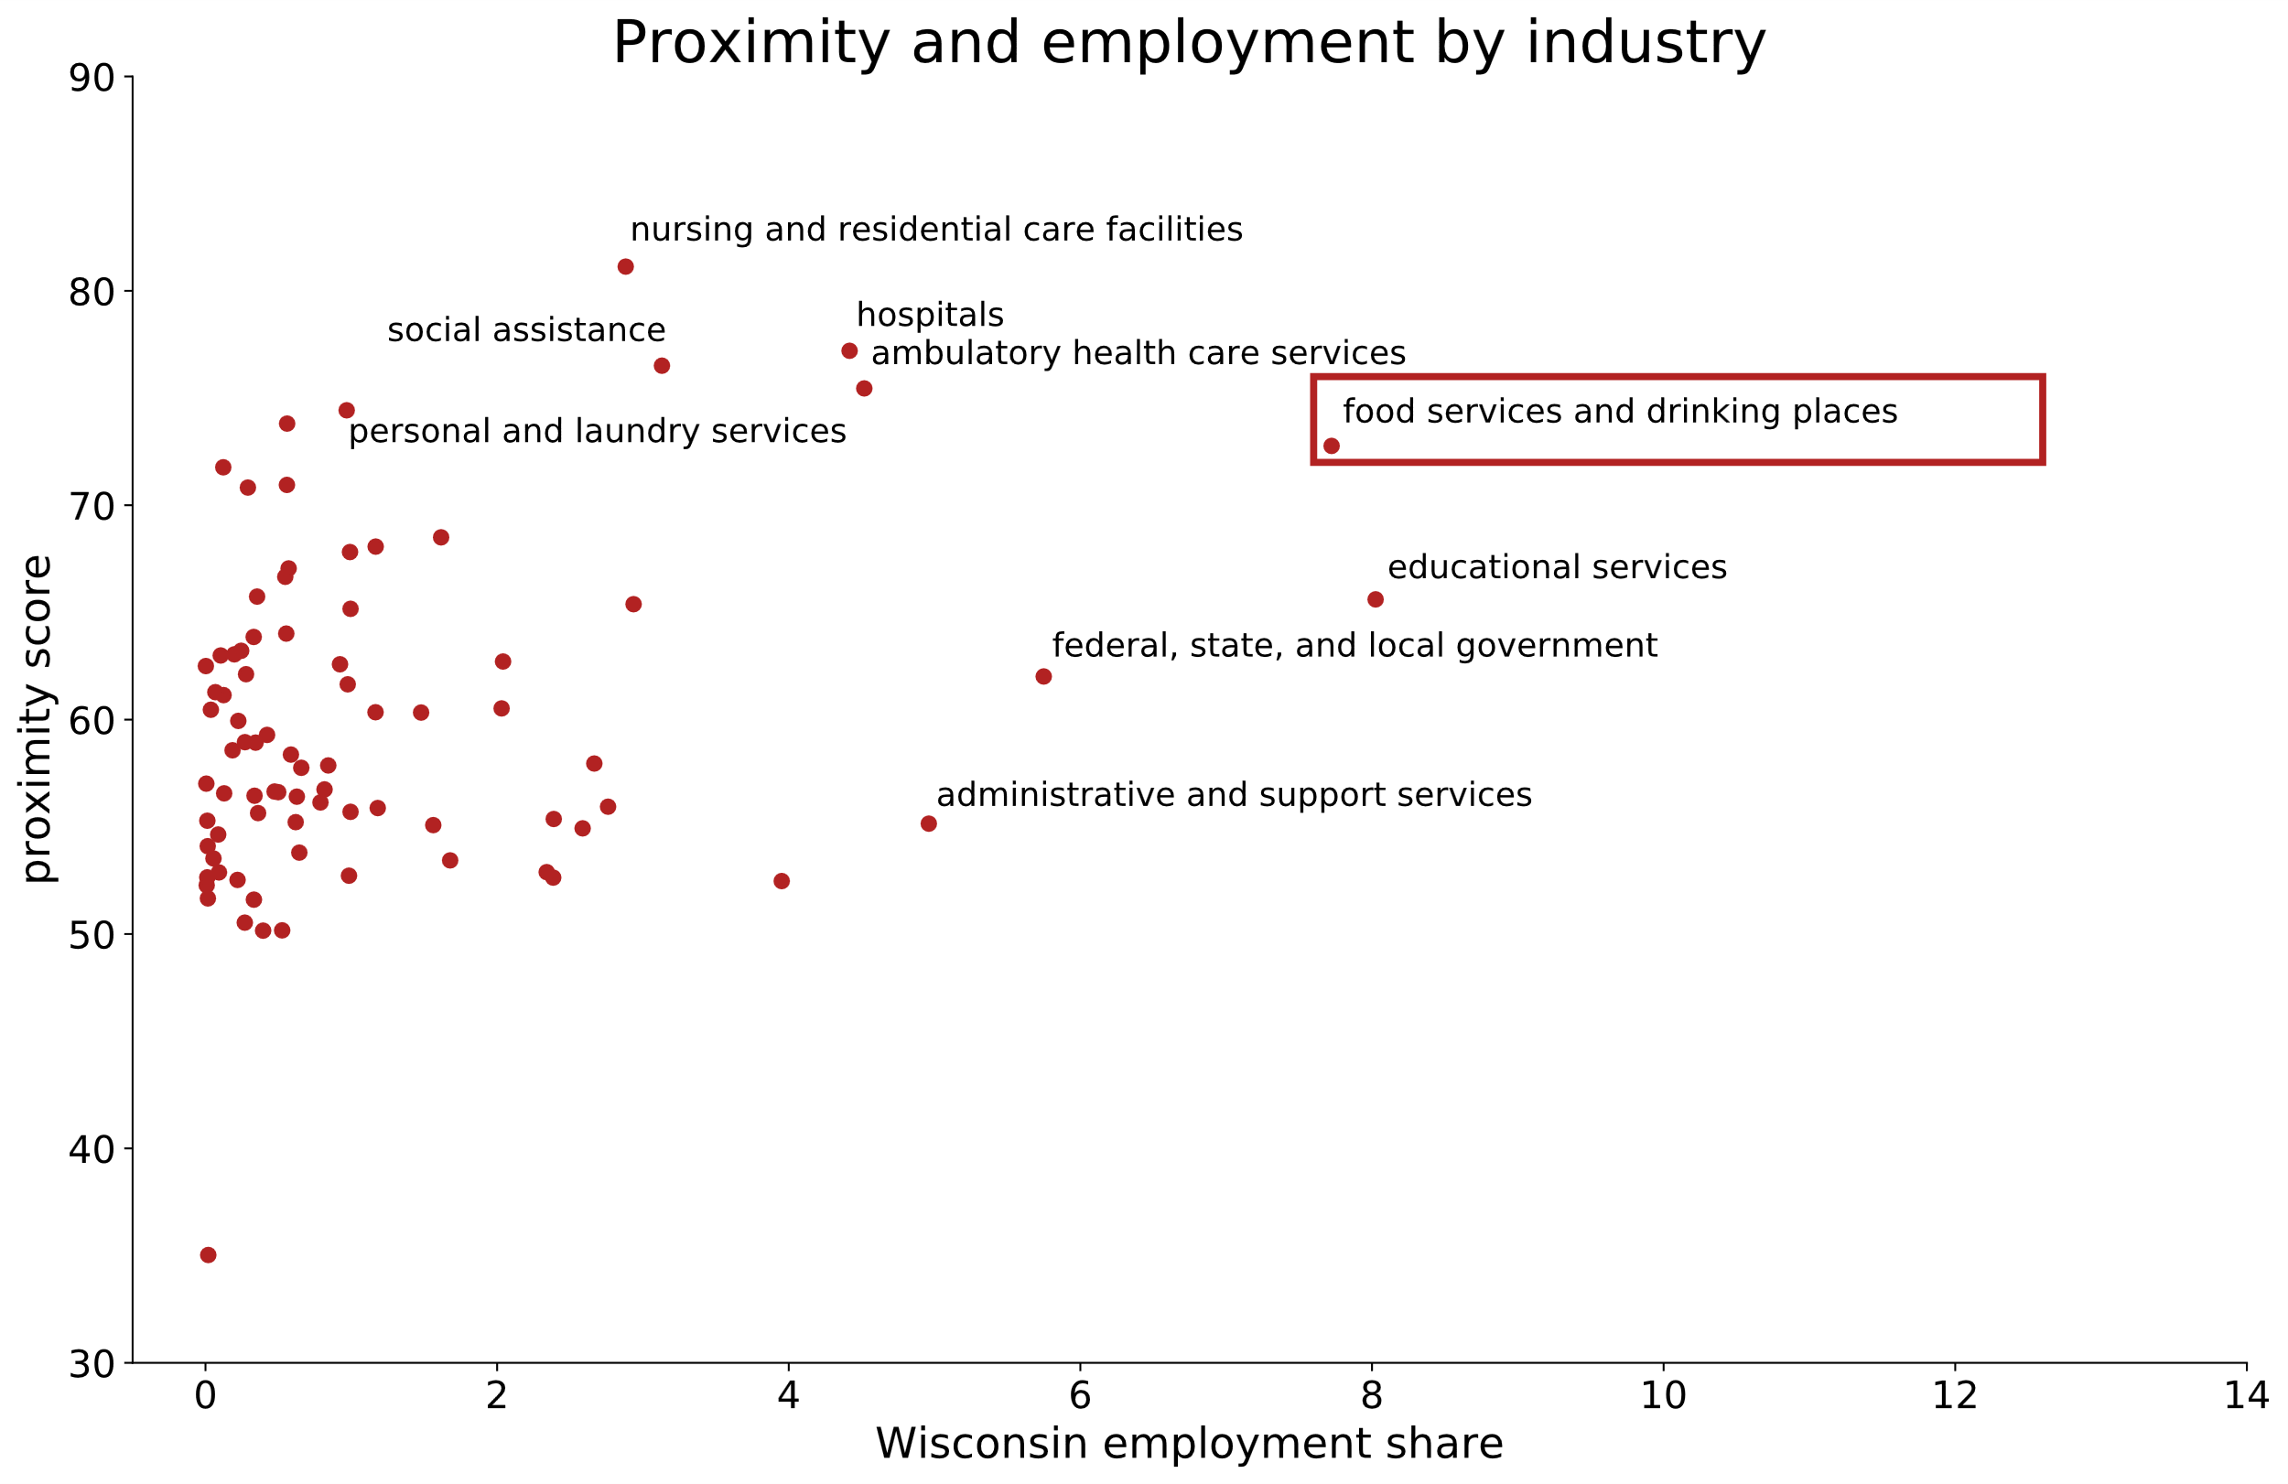

Slide 3
National trends
Shift from dining out to grocery
Employment in restaurants low compared to other sectors
Business creation similar to other sectors
Notes:
Content: headline, bullets

Slide 4
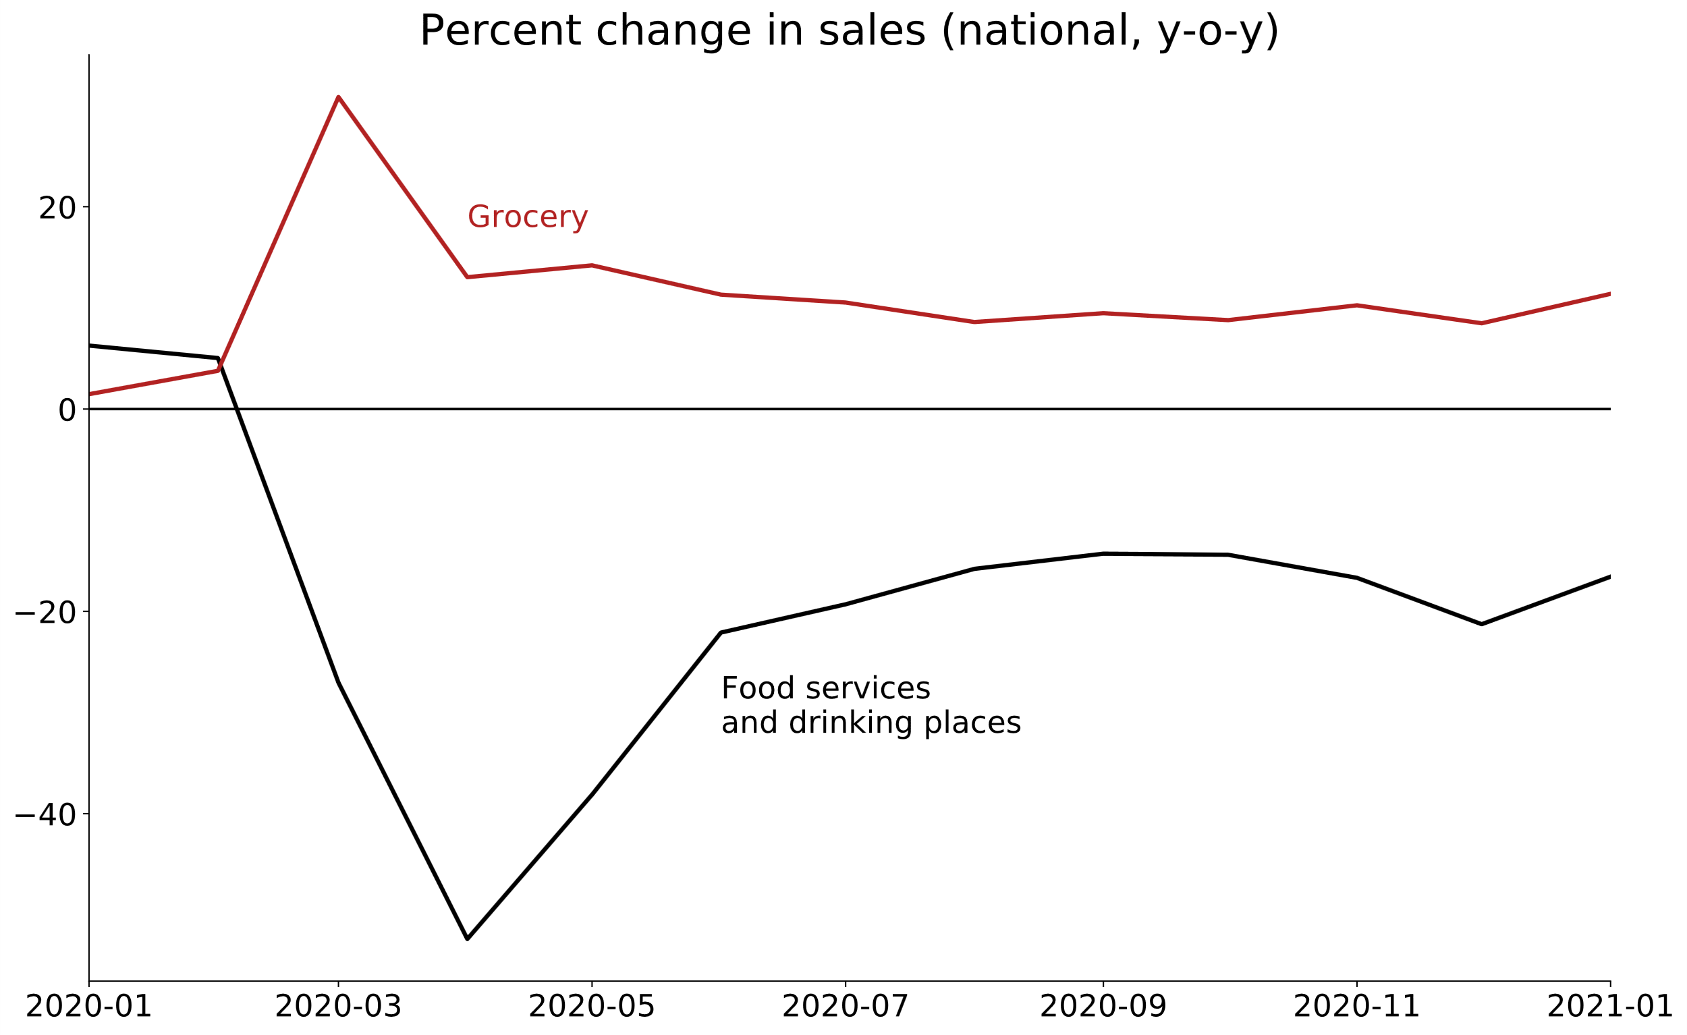

Slide 5
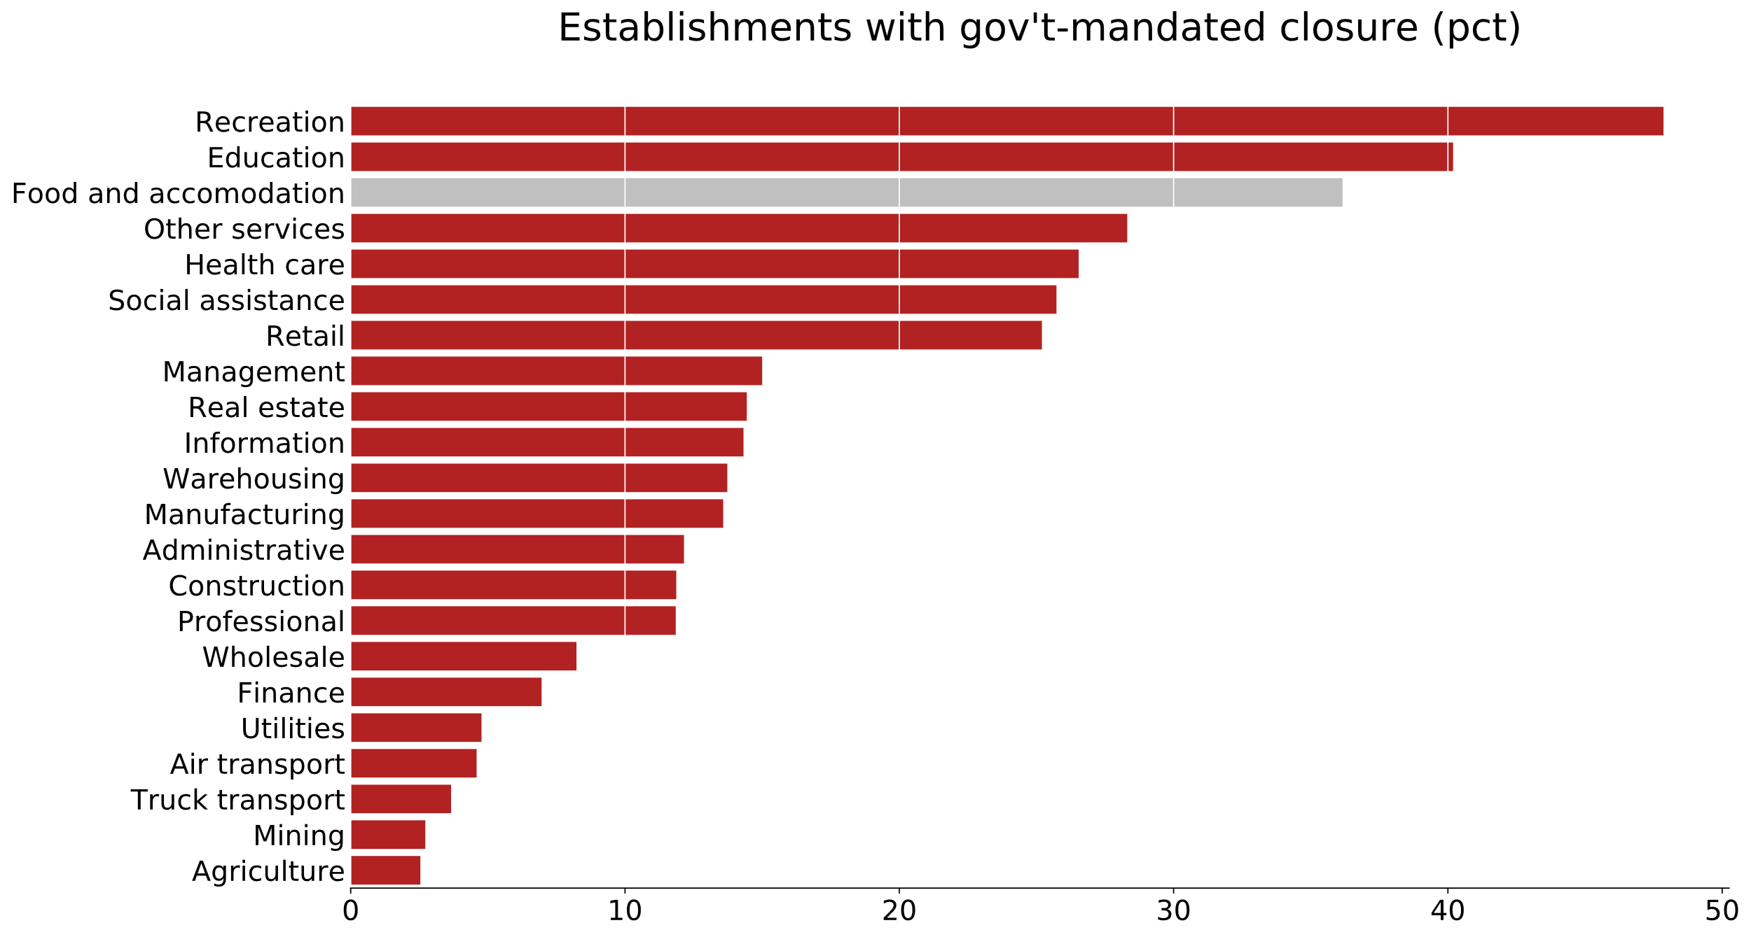

Slide 6
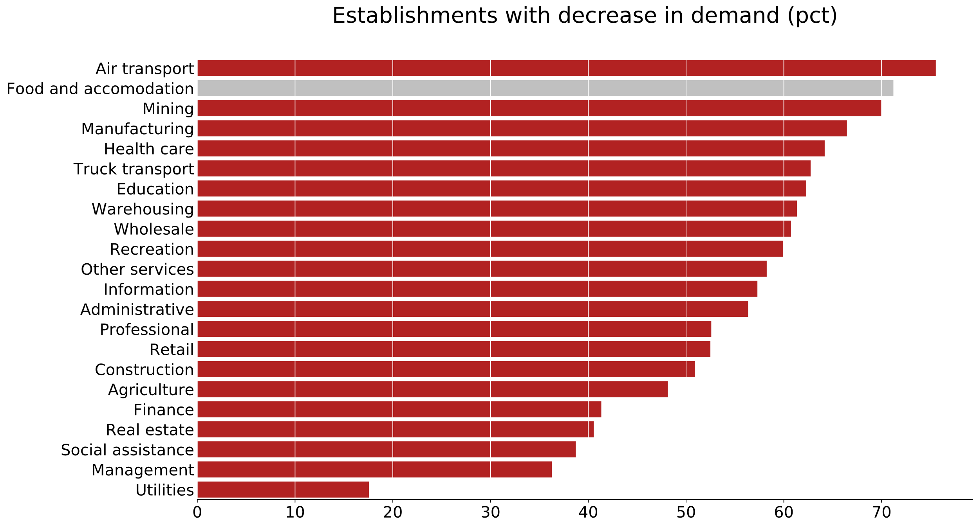

Slide 7
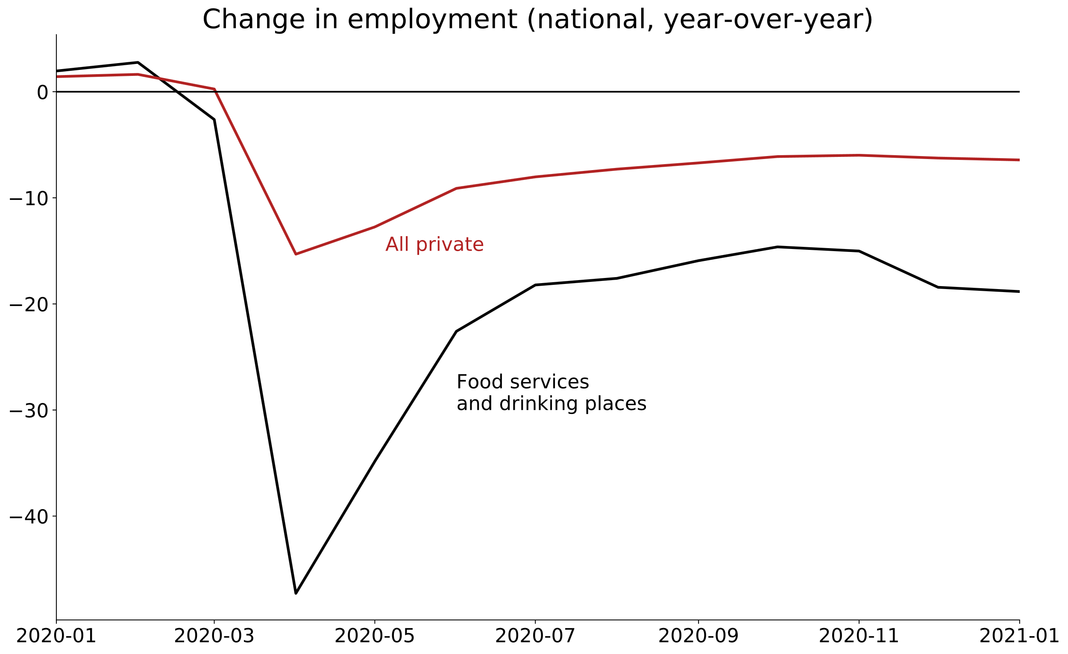

Slide 8
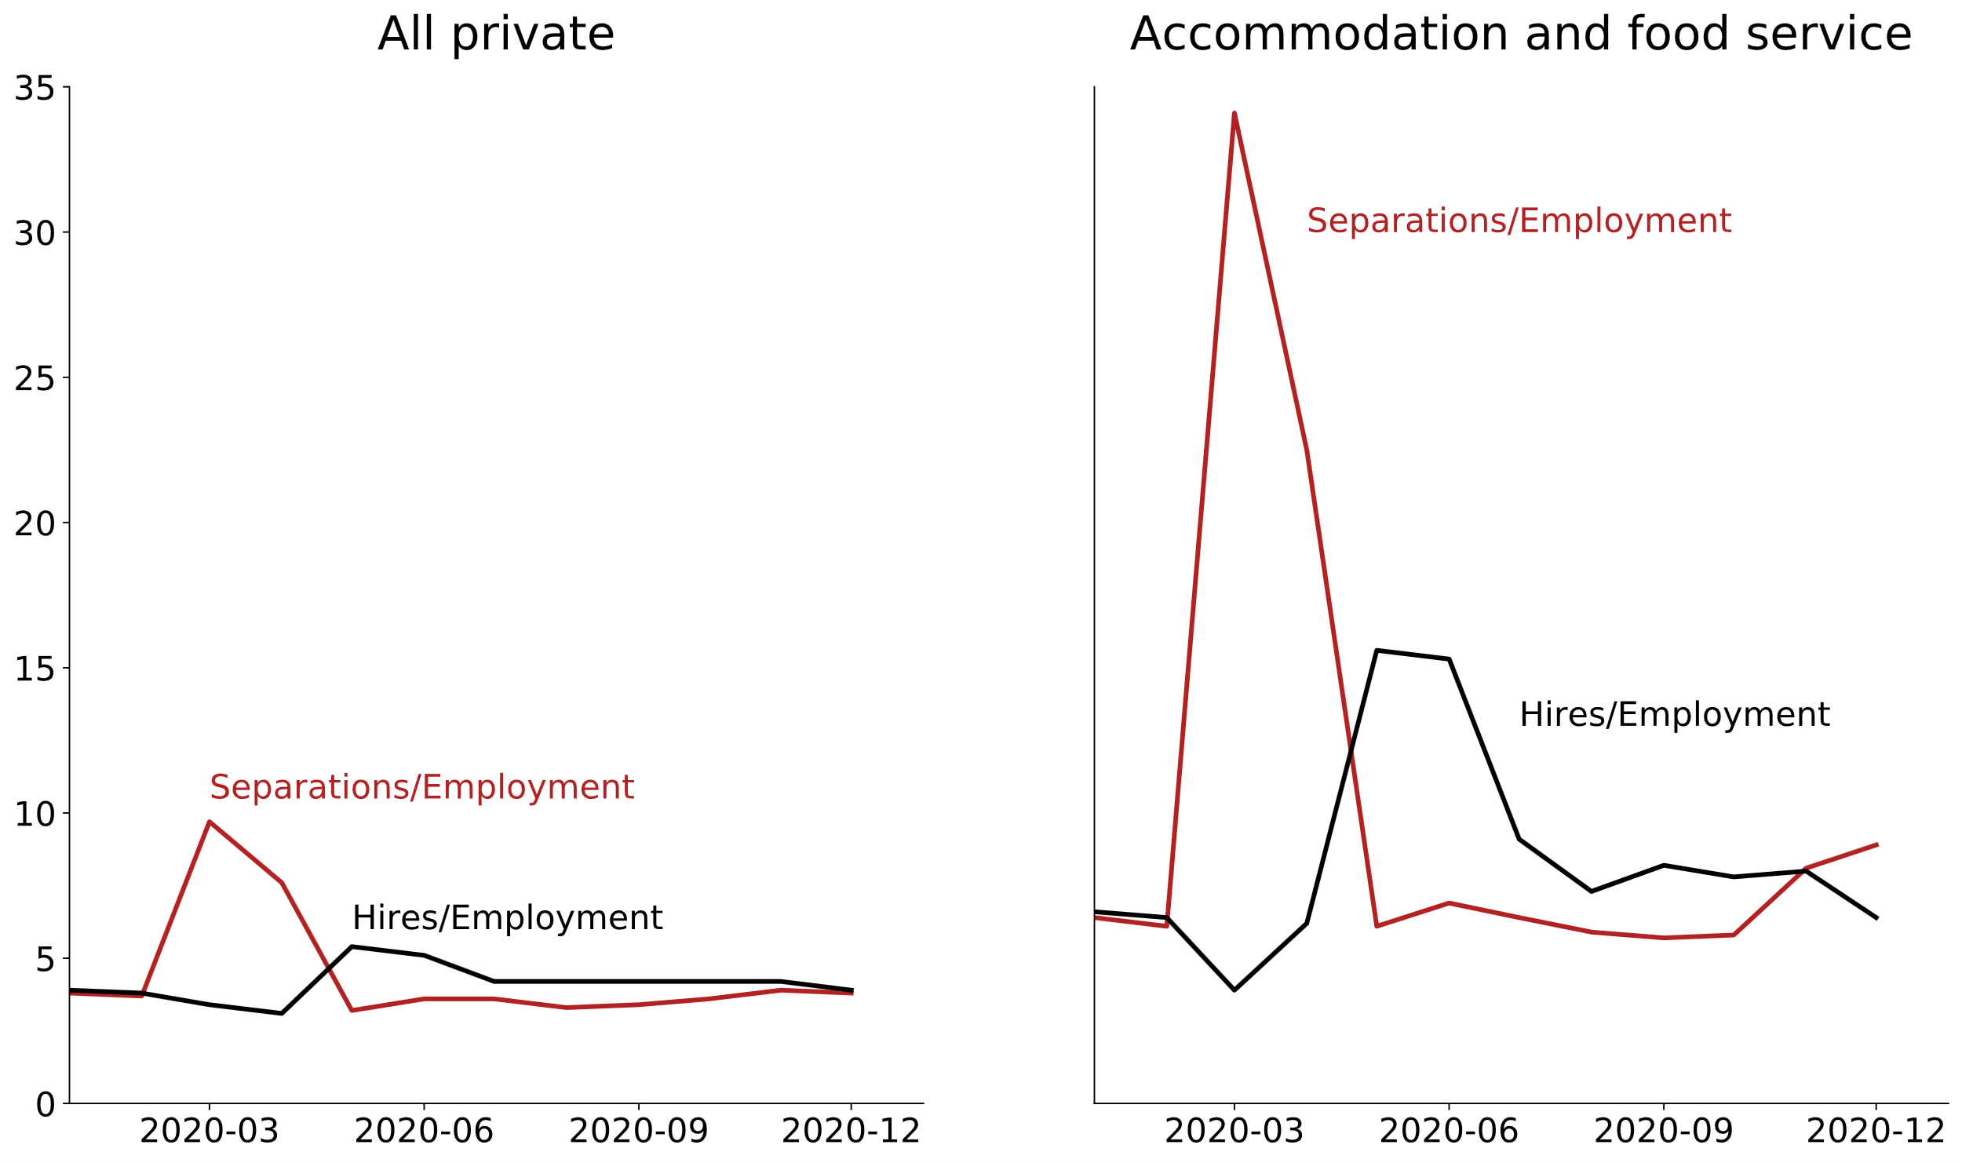

Slide 9
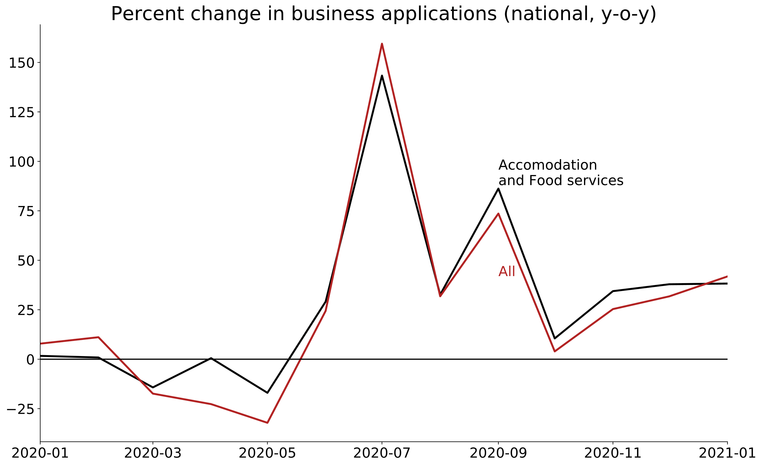

Slide 10
Wisconsin restaurants
Jan 2021 sales down 30% from Jan 2020 (national avg. -16%)
83% of operators report “below normal” staffing
29% of operators laid off or furloughed staff in Dec and Jan
Wisconsin Restaurant Assn.
National Restaurant Assn. Survey
Notes:
Content: headline, bullets

Slide 11
Long-term restaurant outlook
50% of operators expect sales to fall in Feb/Mar from Jan levels
33% of operators expect return to normal in 7-12 months
29% of operators expect return to normal in more than one year
12% of operators never expect a return to normal
Wisconsin Restaurant Assn.
National Restaurant Assn. Survey
Notes:
Content: headline, bullets

Slide 12
As of now, do you feel comfortable or uncomfortable eating inside a restaurant?
Comfortable | 52%
Uncomfortable | 47%
Marquette University Law School Poll
October 21-25, 2020
Notes:
Content: headline, bullets

Slide 13
Policy
Notes:
Quote

Slide 14
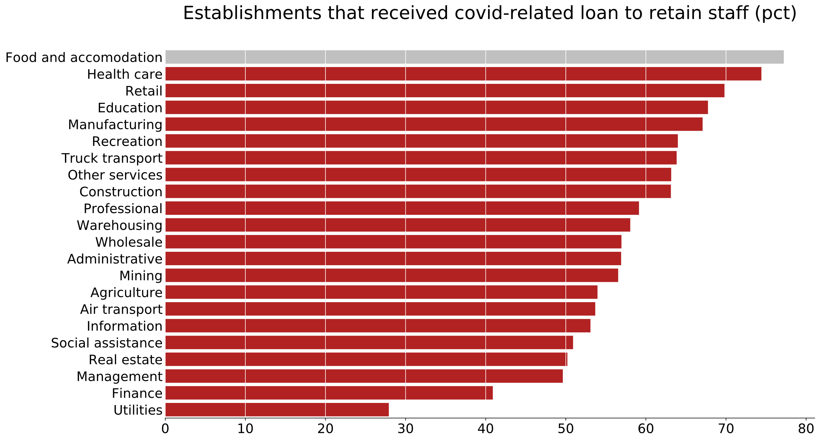

Slide 15
PPP loans (2/21/2021)
Industry | Share of total value (%) | Average loan value ($)
Construction | 13 | 126,223
Health care | 12 | 116,475
Professional services | 12 | 90,332
Manufacturing | 10 | 211,831
Accommodation and food services | 10 | 117,023
American Action Forum
Tracker: PPP loans
Notes:
Content: headline, bullets

Slide 16
Completed policy
COVID-19 business liability protections
In consideration
Cocktails to go
69% of operators: to-go sales < 30% of lost in-house sales (WRA)
$25 bil. for restaurants in American Rescue Plan
$15 federal minimum wage ($10.15 WI), removal of tipped min. wage
Notes:
Content: headline, bullets

