Slide 1


Inflation and Its Consequences
Kim J. Ruhl, PhD
Curt and Sue Culver Professor of Economics
Co-director, Center for Research on the Wisconsin Economy
Data and code available at https://github.com/ruhl0029/inflation-consequences

Slide 2
Roadmap
Why worry about inflation? Loss of purchasing power.
How do we measure inflation? The consumer price index (CPI).
Inflation data overview. Historically high.
The Federal Reserve’s response. Higher interest rates, potential recession.
Notes:
Content: headline, bullets

Slide 3
Inflation lowers purchasing power
$20/hr wage and $20 for lunch for two
Trade one hour of my labor for lunch for two
$20/hr wage and $22 for lunch for two (10% increase)
One hour of my labor only buys 90% of lunch for two
Notes:
Content: headline, bullets

Slide 4
Measuring inflation
Inflation is the increase in the general price level
The consumer price index is one measure of the price level
Construct an average basket of goods (surveys)
Price this basket each month
Change in the CPI in the inflation rate
Notes:
Content: headline, bullets

Slide 5
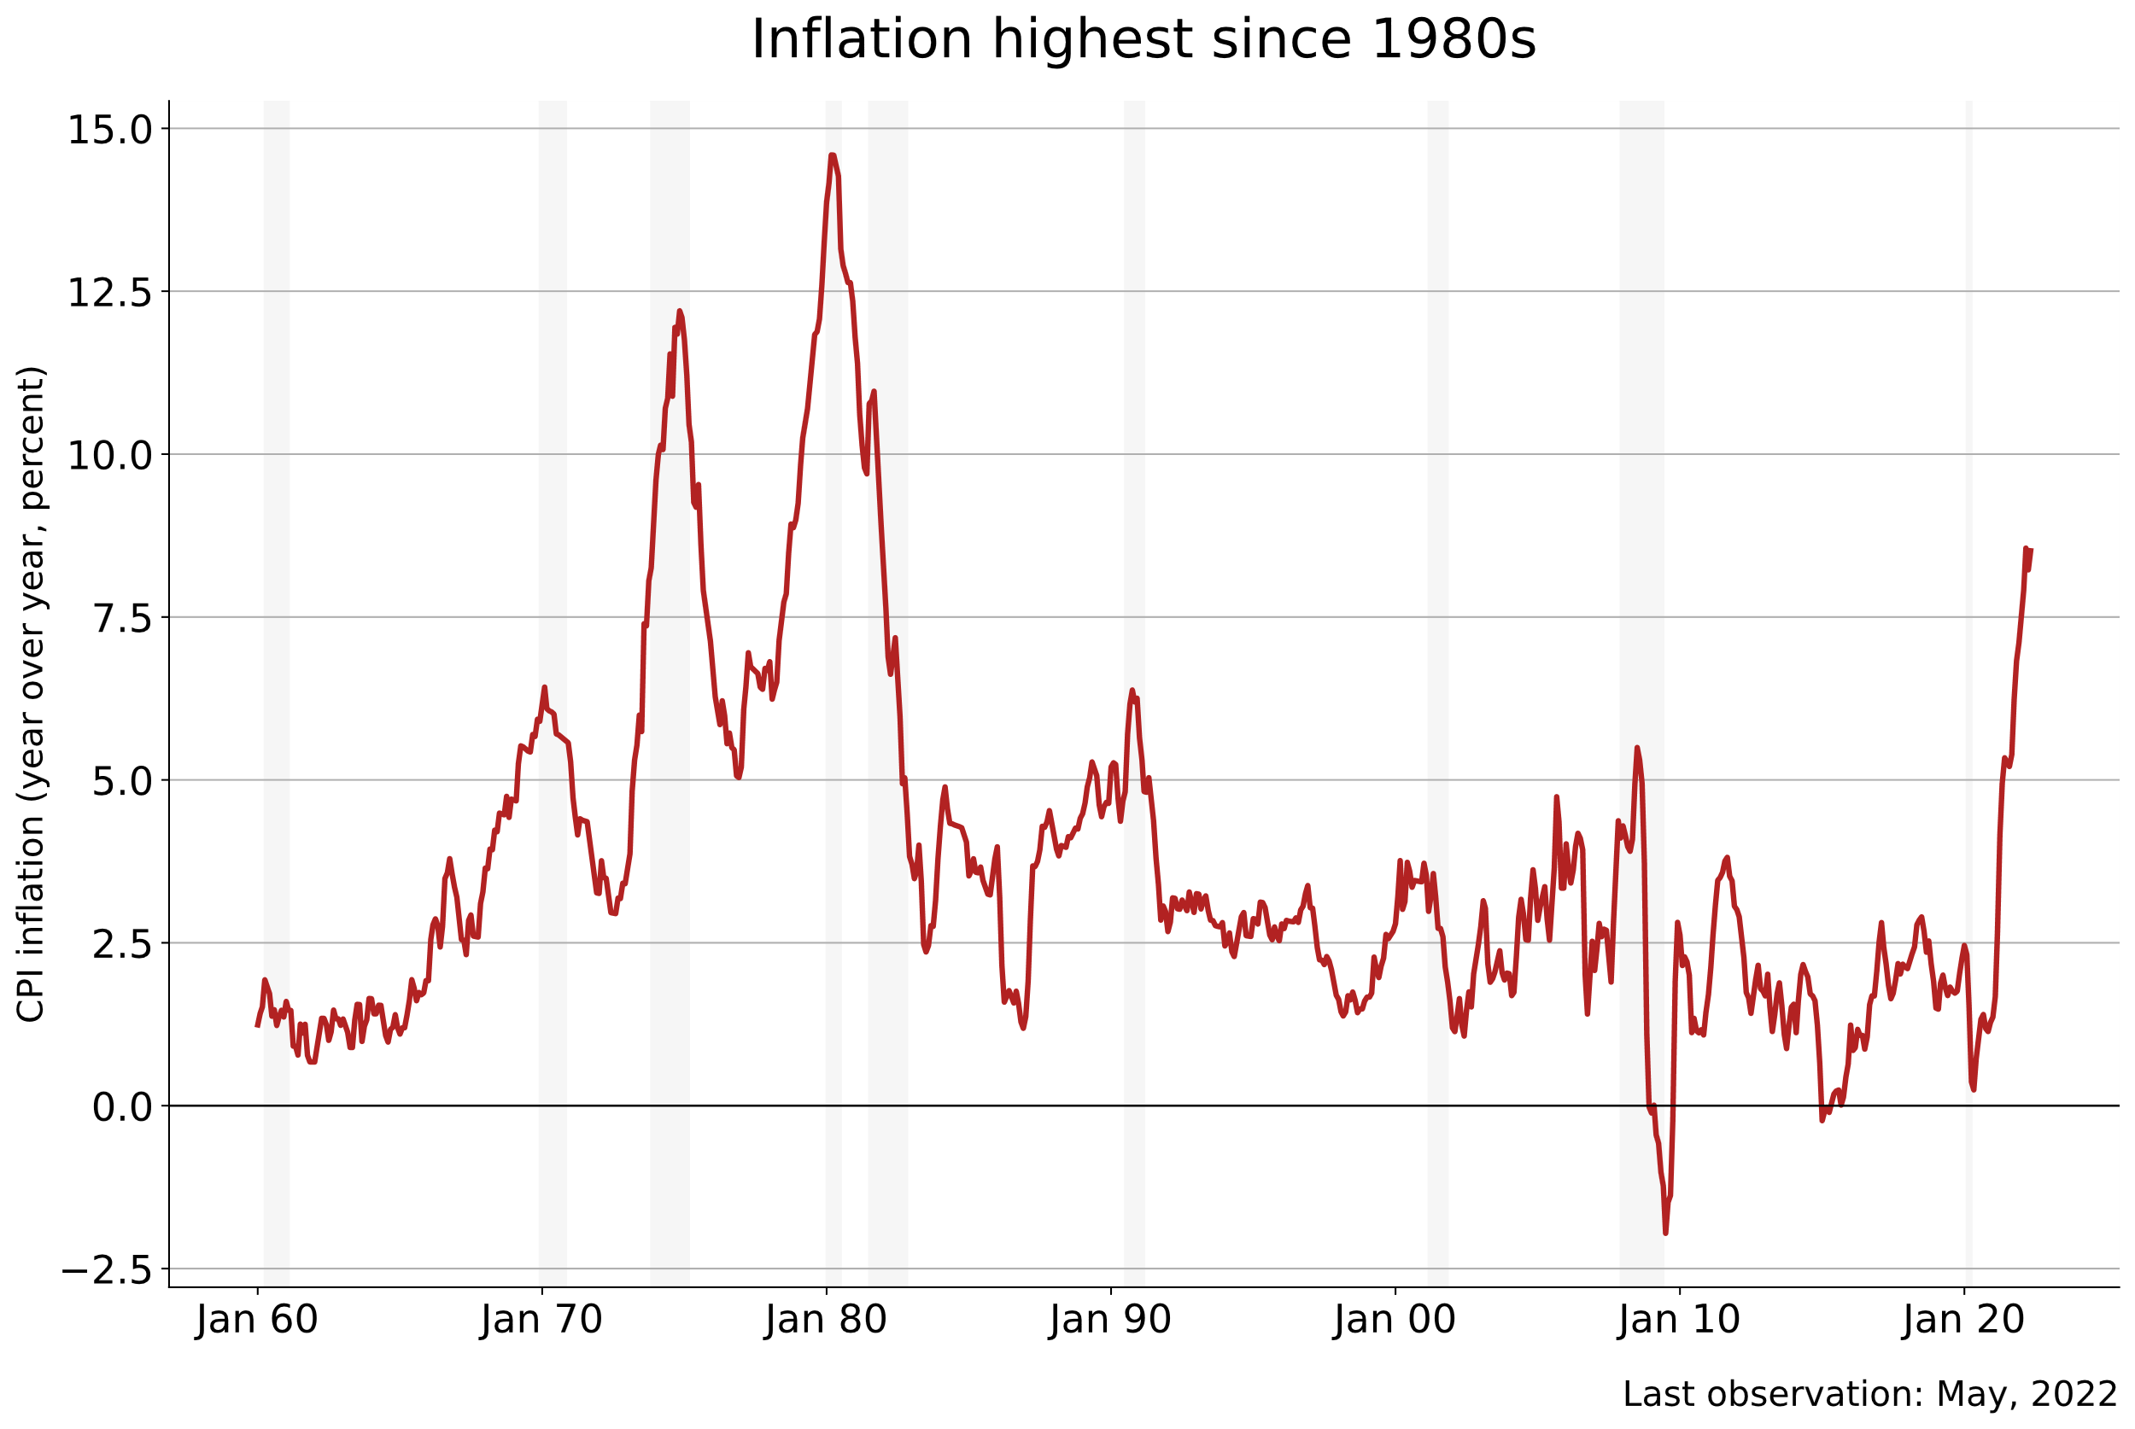

Slide 6
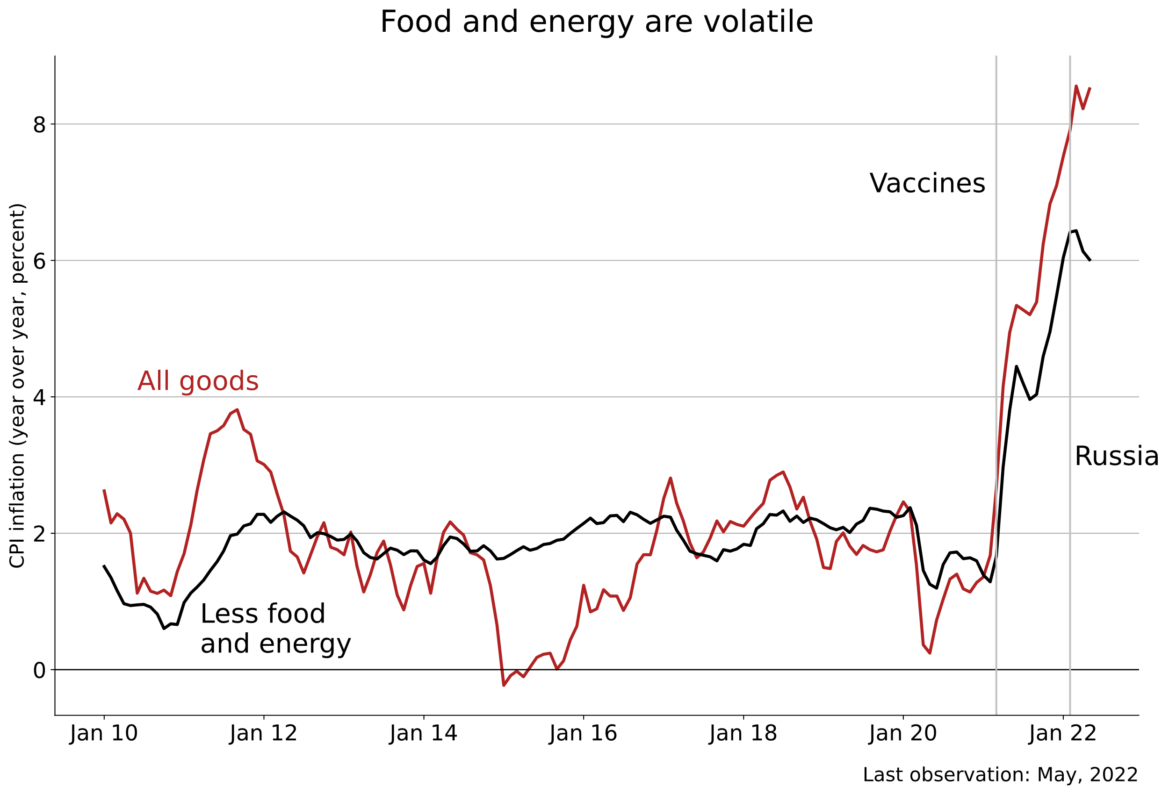

Slide 7
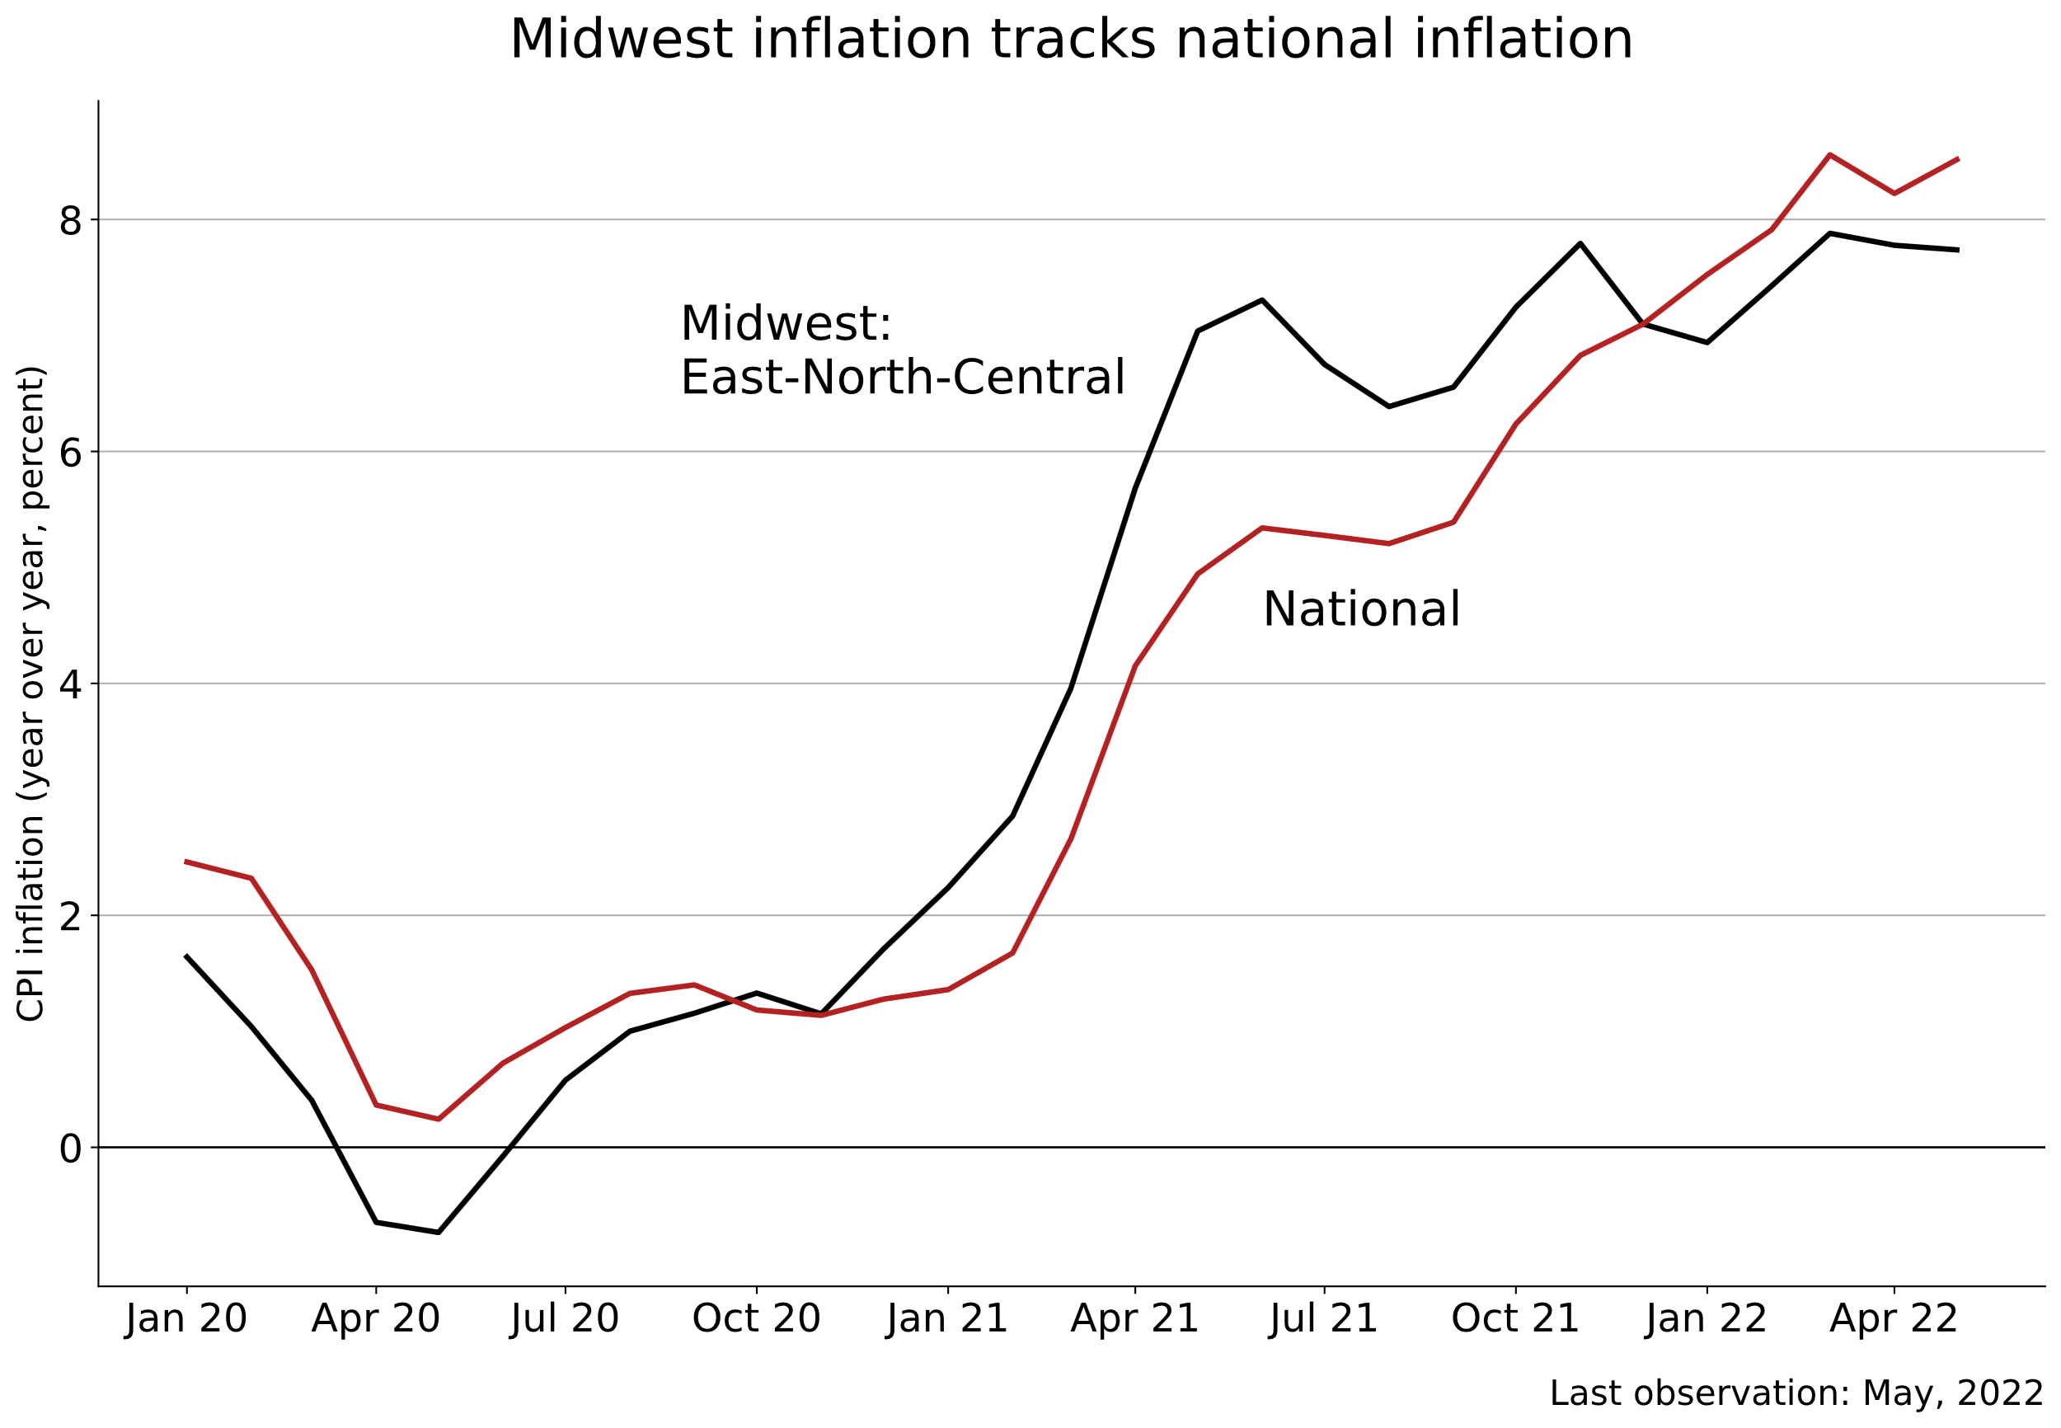

Slide 8
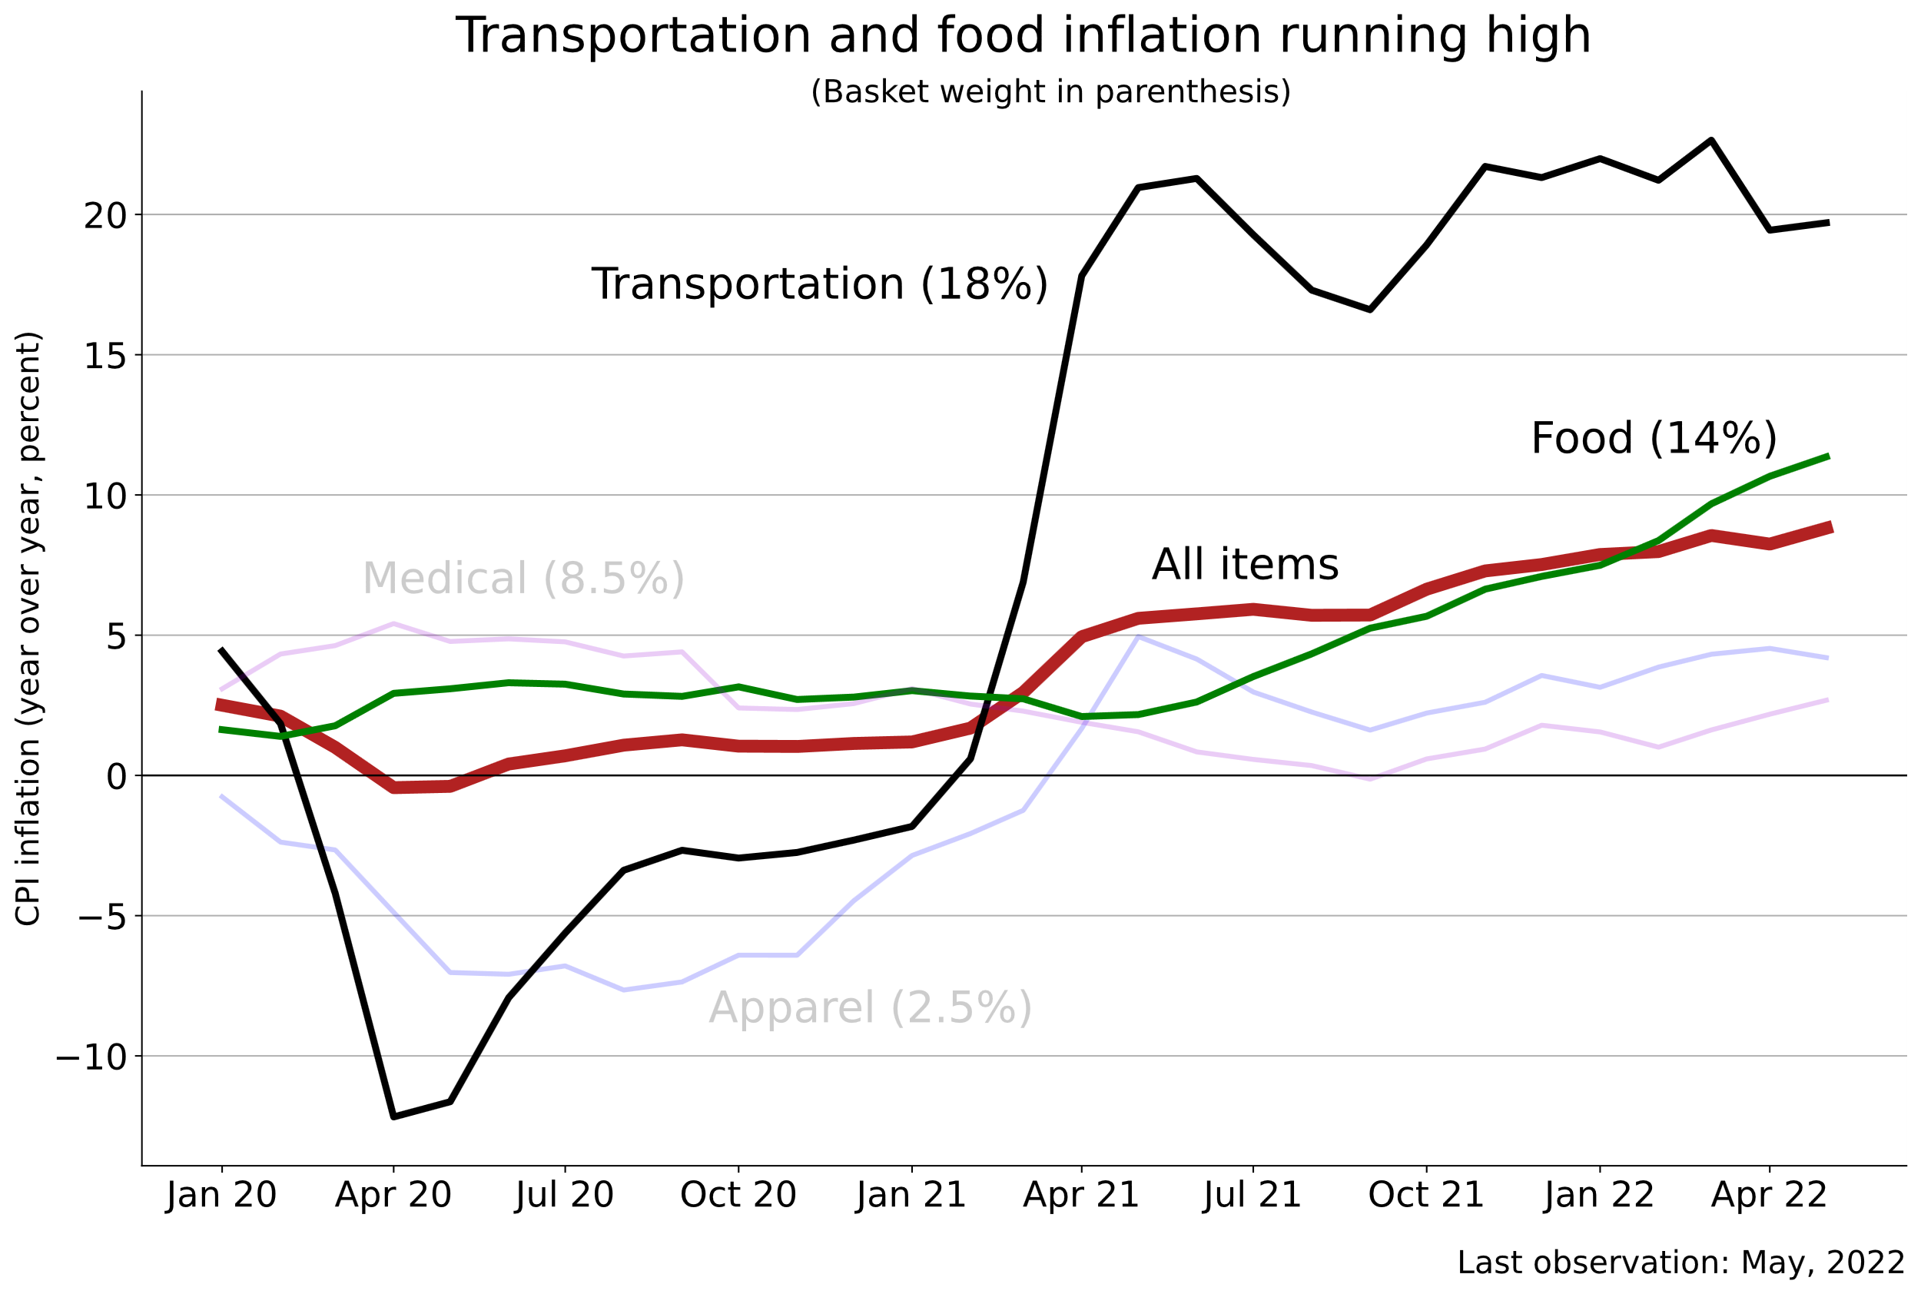

Slide 9
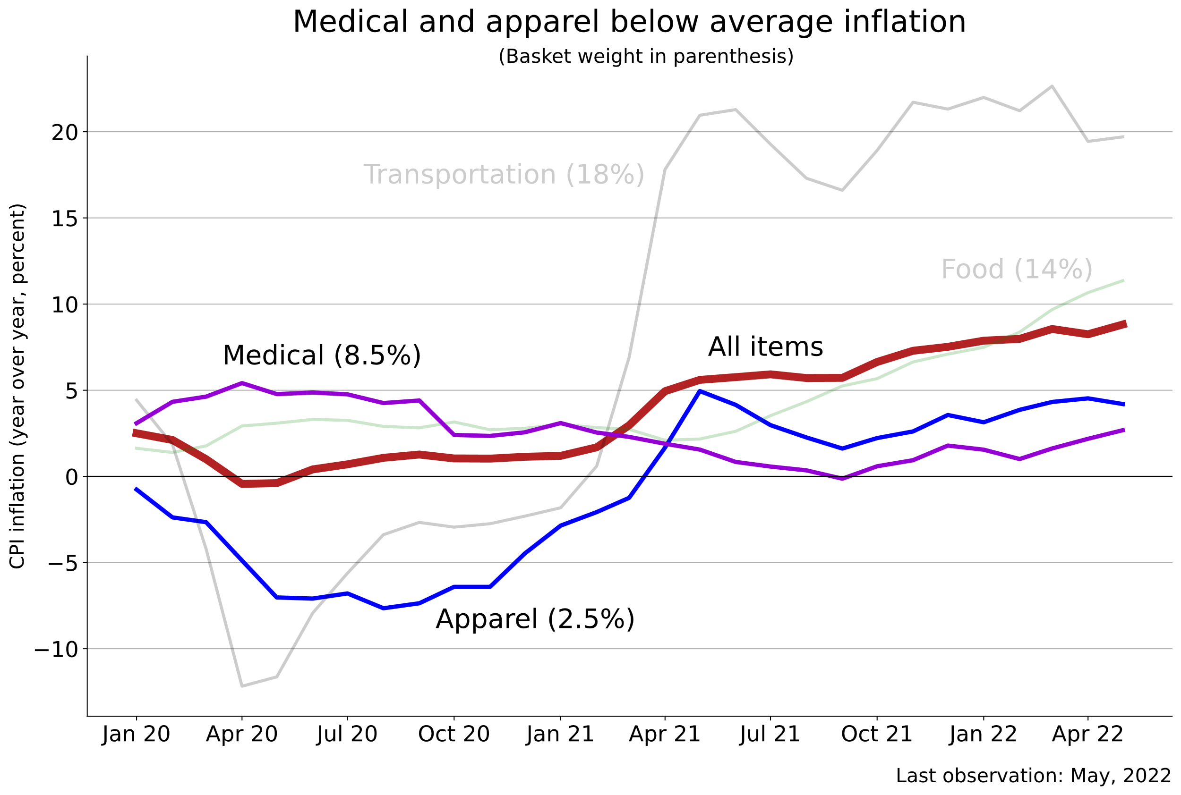

Slide 10
Inflation driven by high demand, low supply
Demand
Covid savings
Government stimulus
Supply
Tight labor markets
Supply chain disruptions
Russia/Ukraine
Fed cannot do much about supply. It can dampen demand…
Notes:
Content: headline, bullets

Slide 11
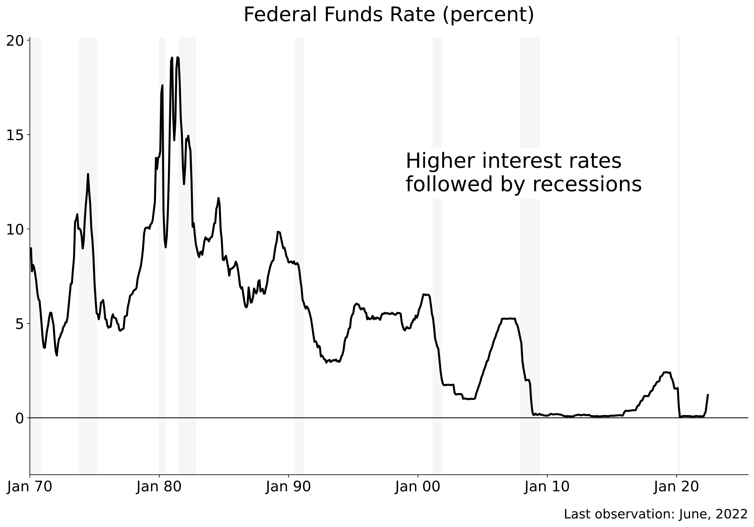

Slide 12
The future
Recession likely, if not already here
Duration will depend on inflation response
Will bring
Higher interest rates (+1.5% in 2022; +0.5% in 2023)
Lower demand, particularly for durable goods
Benefits
Could reset labor markets
Should help normalize supply chains
Notes:
Content: headline, bullets

