Slide 1


Labor and the recovery
Kim J. Ruhl, PhD
Mary Sue and Mike Shannon Chair in Economics
Associate Director, Center for Research on the Wisconsin Economy
Data and code available at https://github.com/ruhl0029/labor-recovery

Slide 2
Roadmap
How labor markets work in recoveries: Slow adjustment
Labor demand: An extra 2.1 million unfilled jobs
Labor supply: Are workers staying home? Why?
Wages: Wage pressure in low-skill industries for new hires
Notes:
Content: headline, bullets

Slide 3
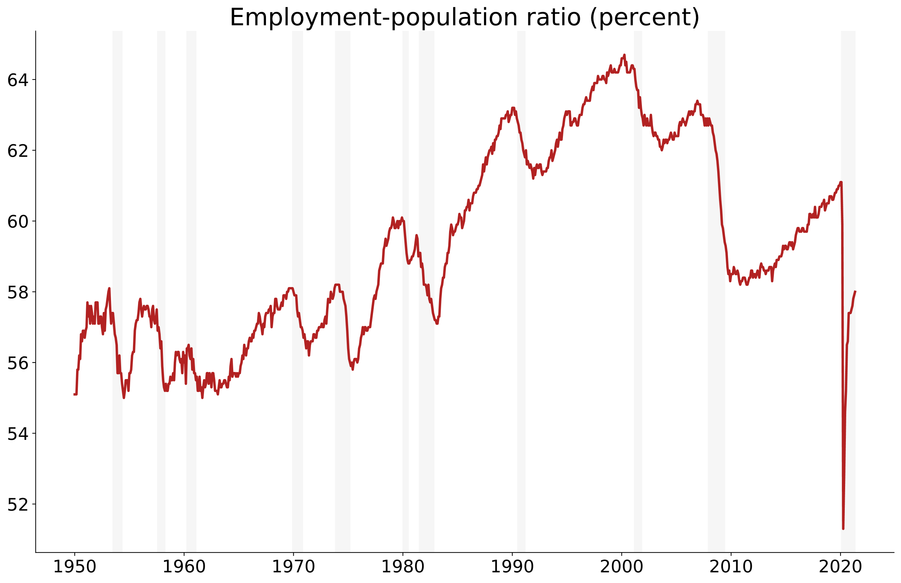

Slide 4
Labor markets as matching markets
Heterogeneous jobs + heterogenous workers
Similar to housing markets, dating, …
Employers and workers want a good “match”
It takes time and effort to find the right worker/firm
Labor adjustment is always slow — and this is a large adjustment
Notes:
Content: headline, bullets

Slide 5
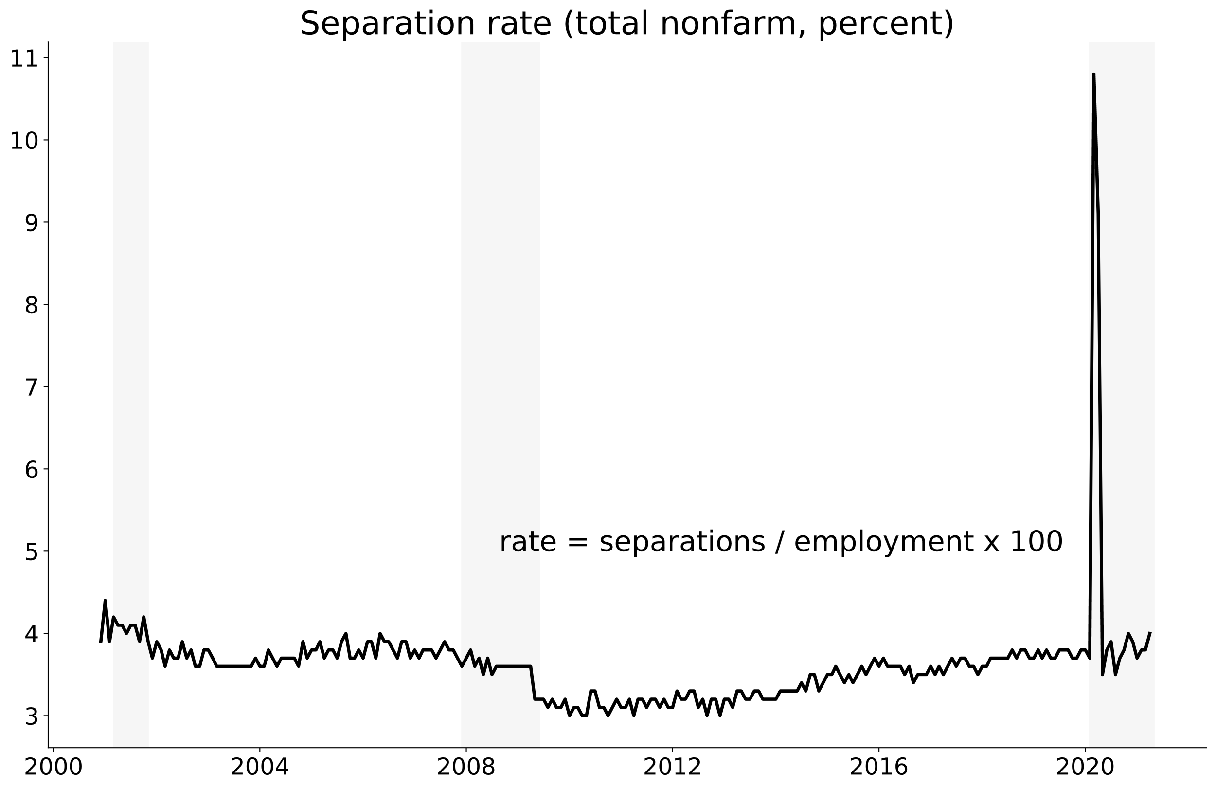

Slide 6
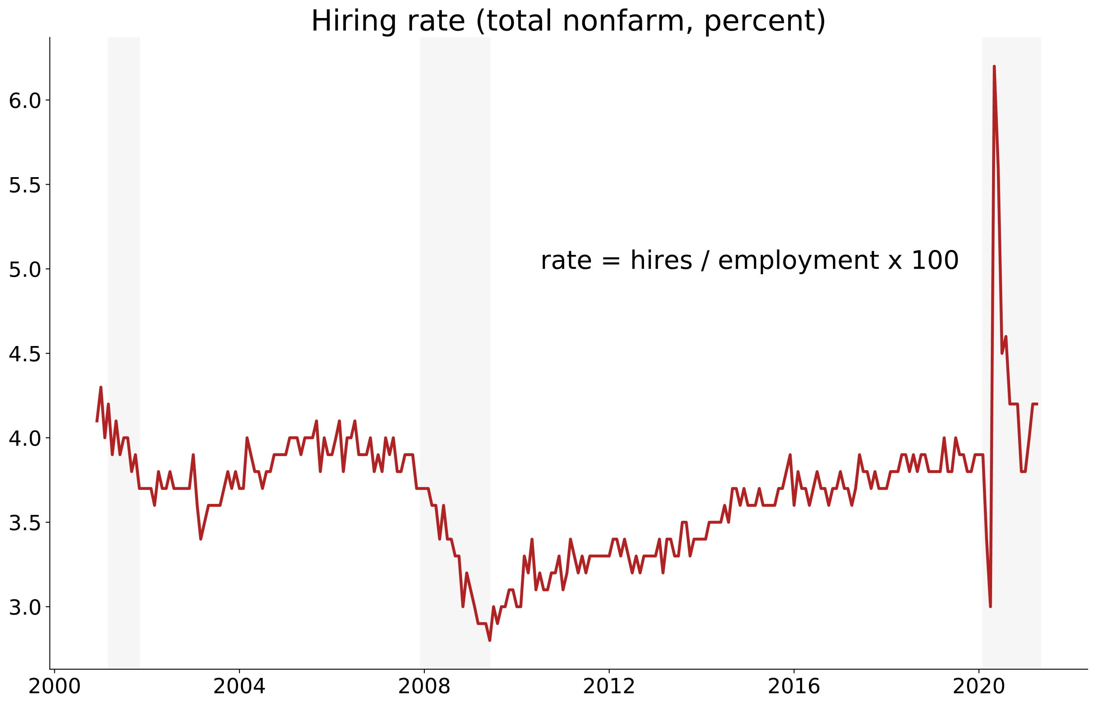

Slide 7
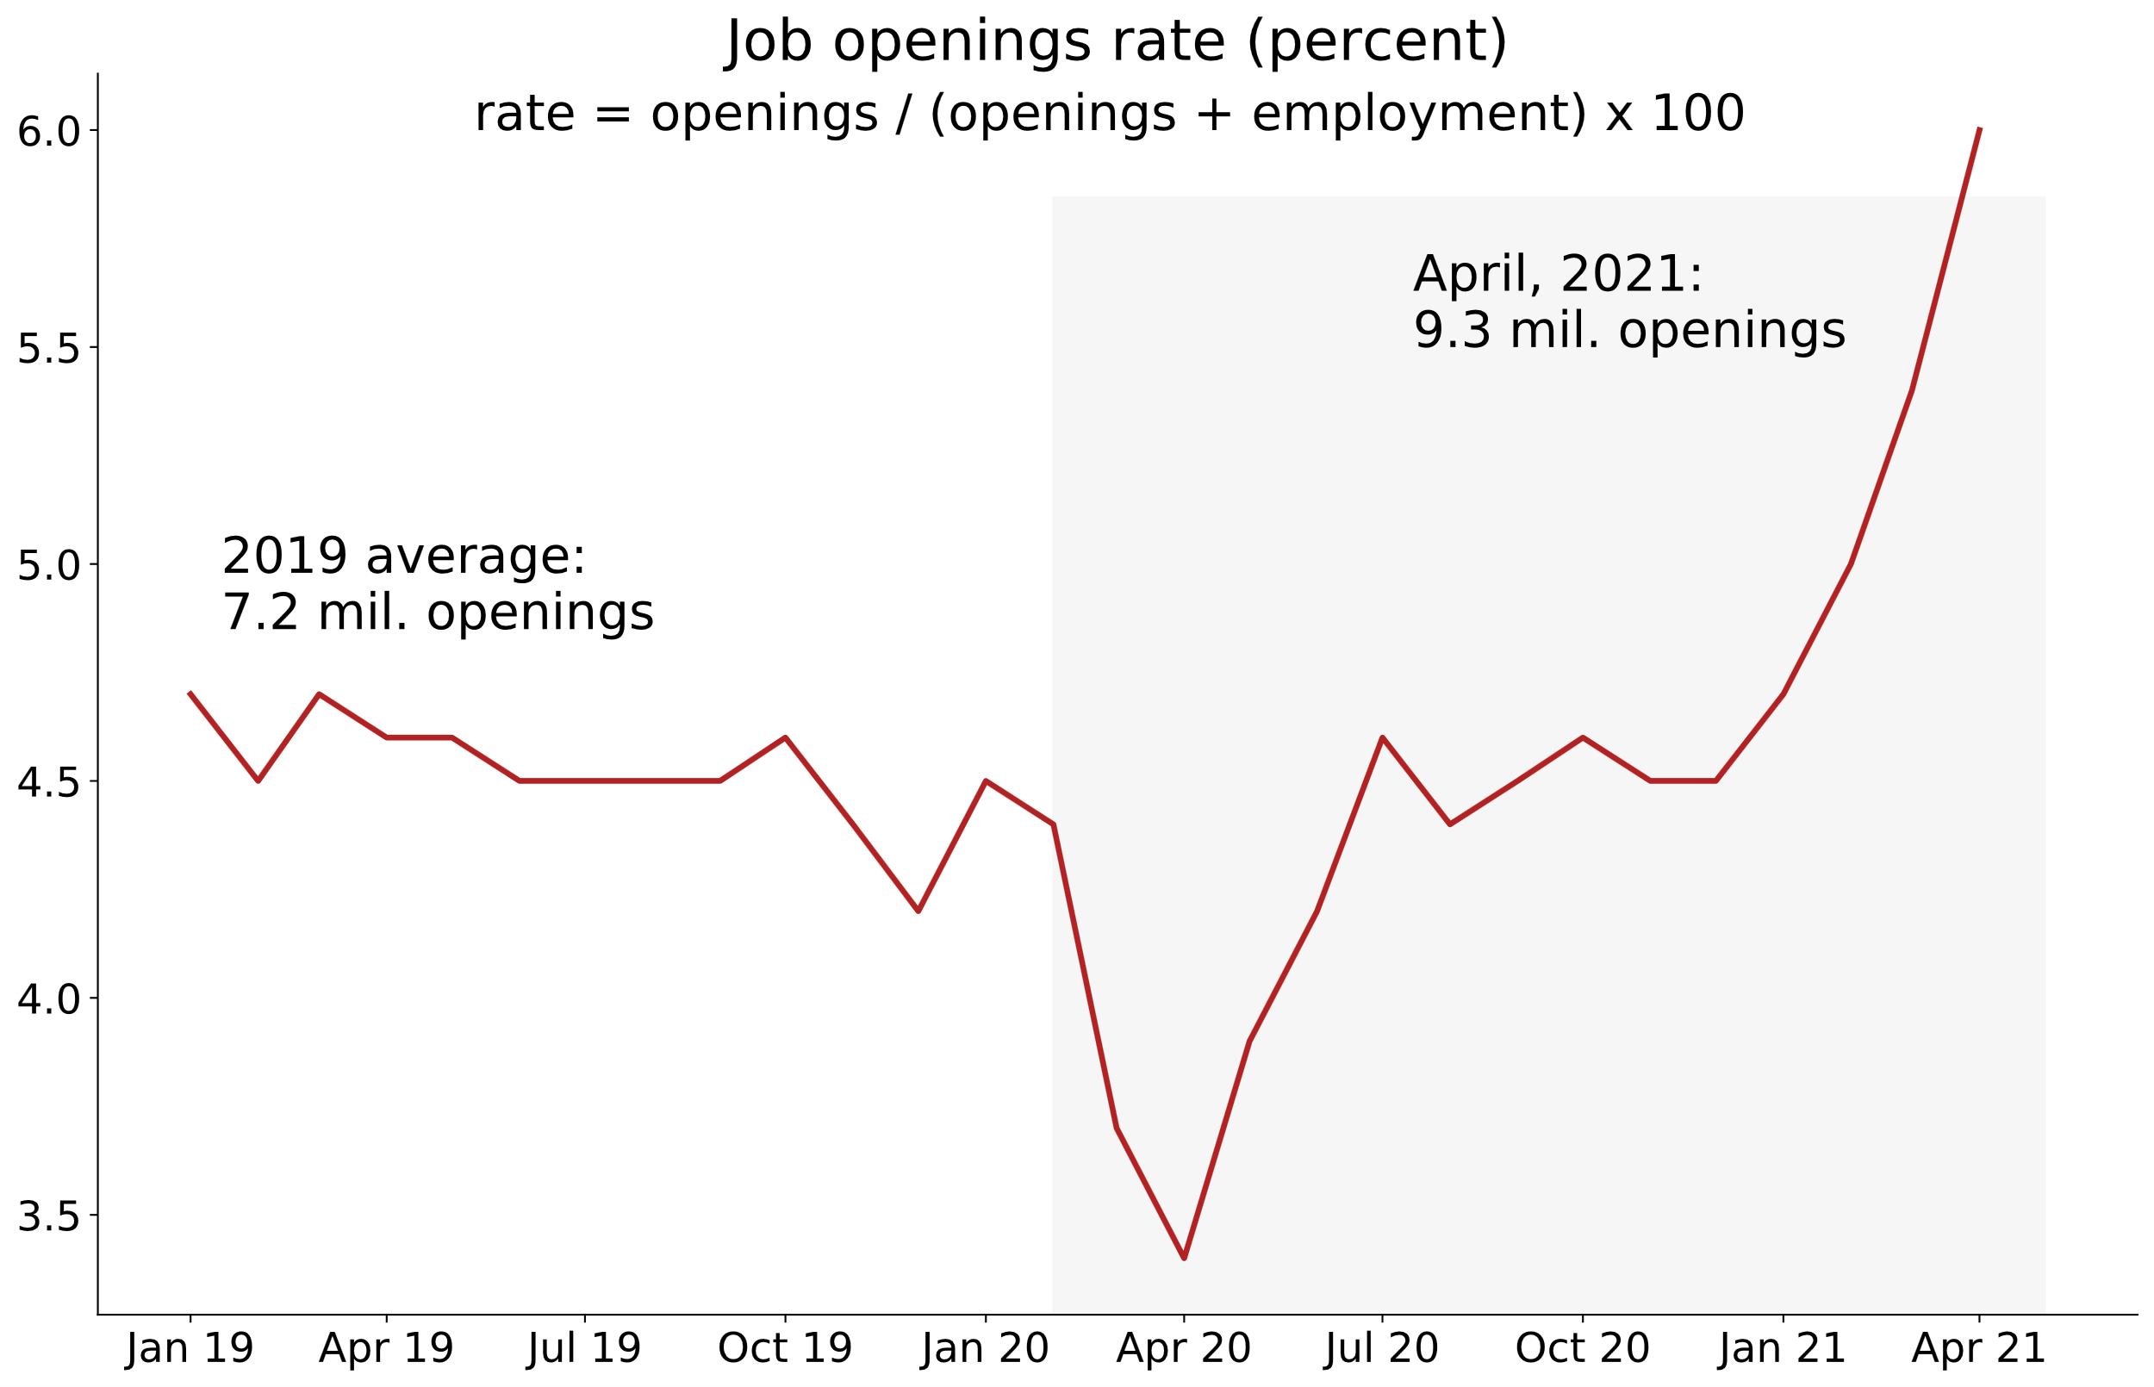

Slide 8
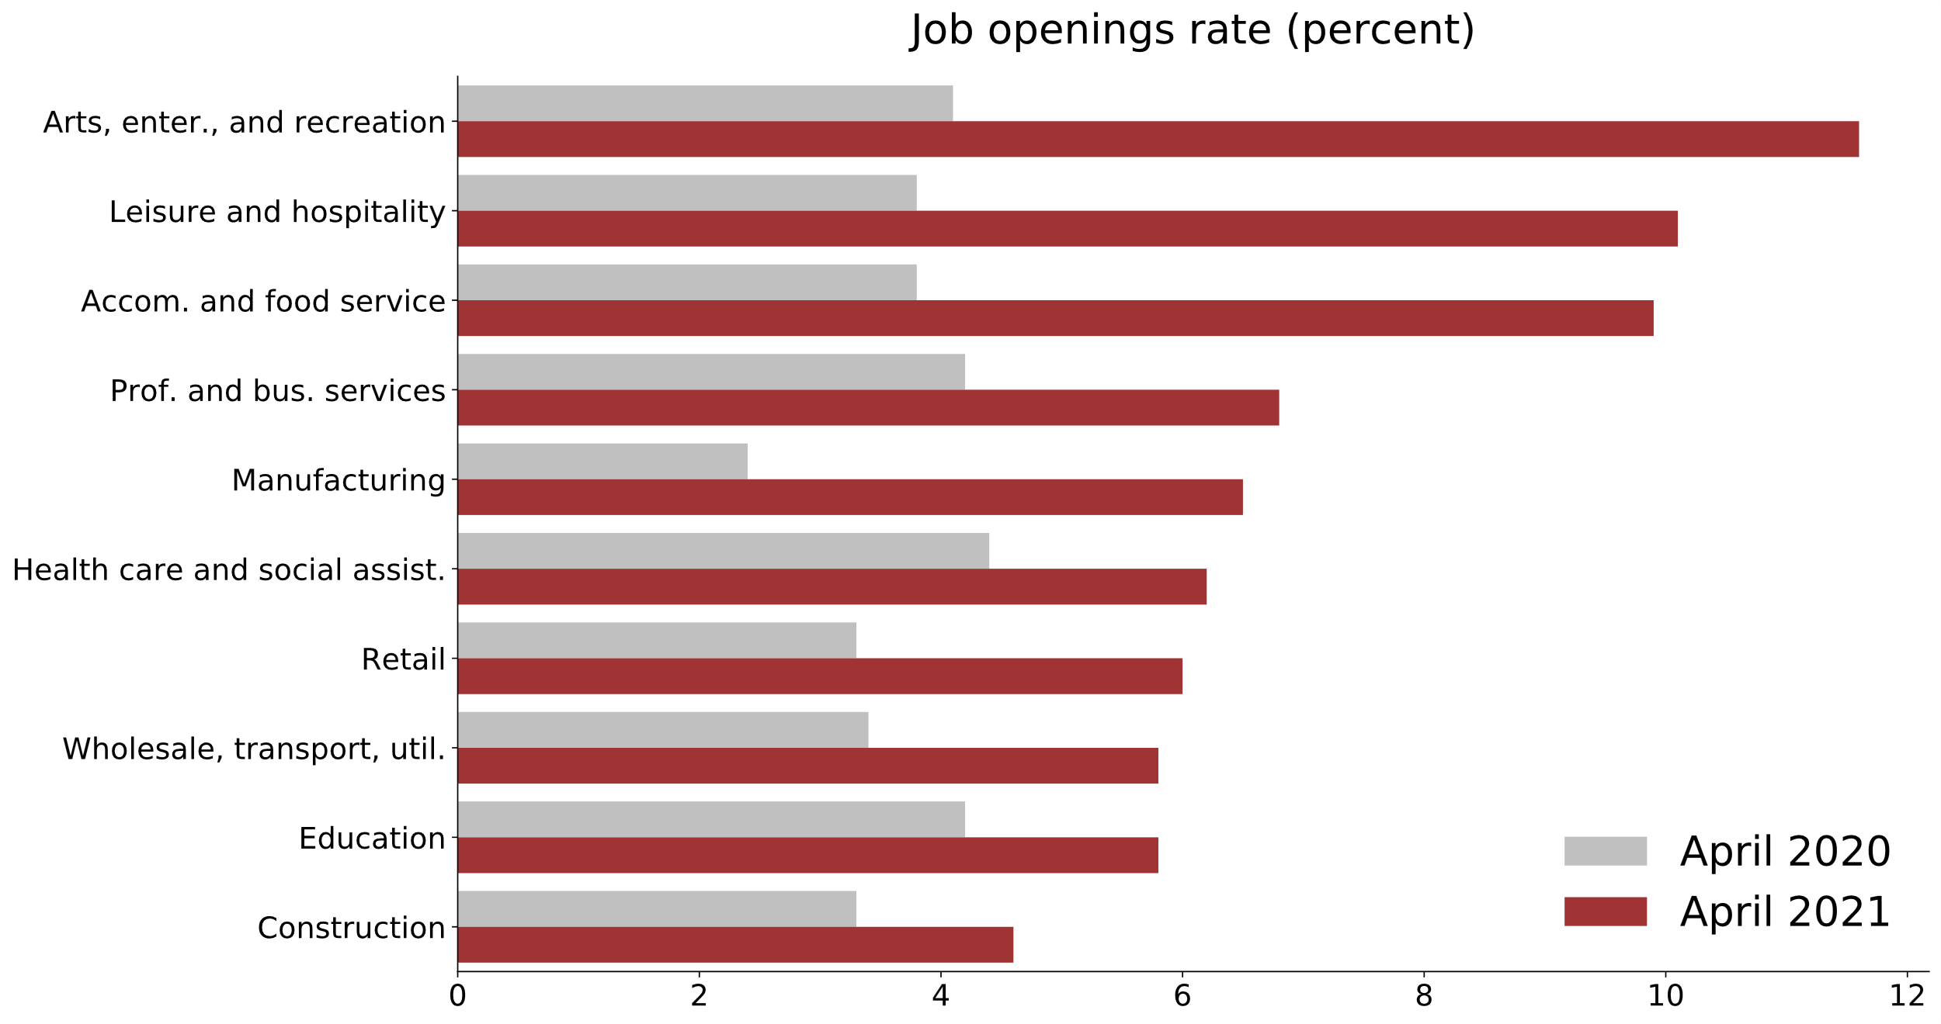

Slide 9
Labor supply forces
Extra unemployment benefits and savings (short term issue)
Encourages more job searching and slower matching
Initial UI claims down in AK, IA, MS, MO (CROWE report)
Laid-off workers changing industries
Concerns about COVID
Childcare (school and childcare closures)
Notes:
Content: headline, bullets

Slide 10
Supply + Demand
If:
Unmet demand for workers
Lower supply of workers
Then:
Market forces should create upward wage pressure
Do we see upward wage pressure?
Notes:
Content: headline, bullets

Slide 11
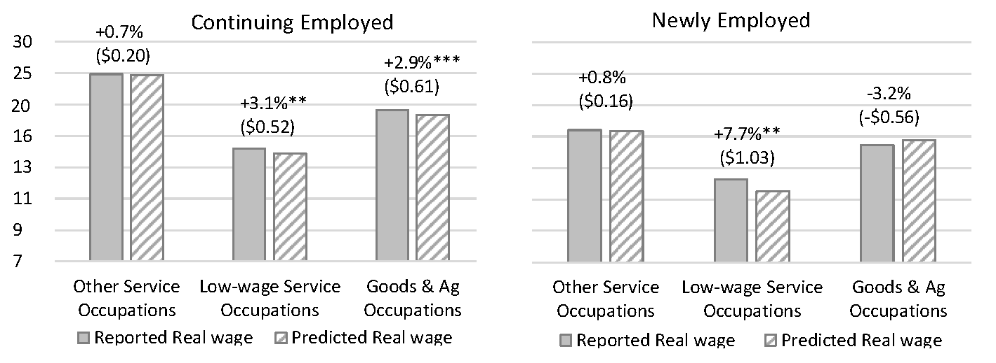
Wages
Predicted real wages based on January–March 2020
Reported real wages in March 2021
Source: Hotchkiss (2021)

Slide 12
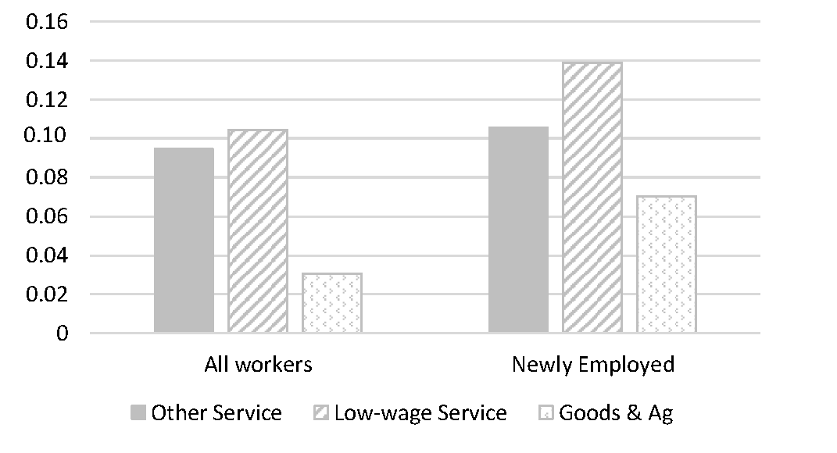
Share of workers who are women with a child < 12 years
Source: Hotchkiss (2021)

