Slide 1


Understanding the Labor Shortage
Kim J. Ruhl, PhD
Mary Sue and Mike Shannon Distinguished Chair in Economics
Associate Director, Center for Research on the Wisconsin Economy
Data and code available at https://github.com/ruhl0029/labor-shortage

Slide 2
Roadmap
How labor markets work in recoveries: Slow adjustment
Labor demand: An extra 3.2 million unfilled jobs
Labor supply: Are workers staying home? Why?
Are wages increasing?
Hard to see aggregate data
Some evidence in low-skill industries for new hires
Notes:
Content: headline, bullets

Slide 3
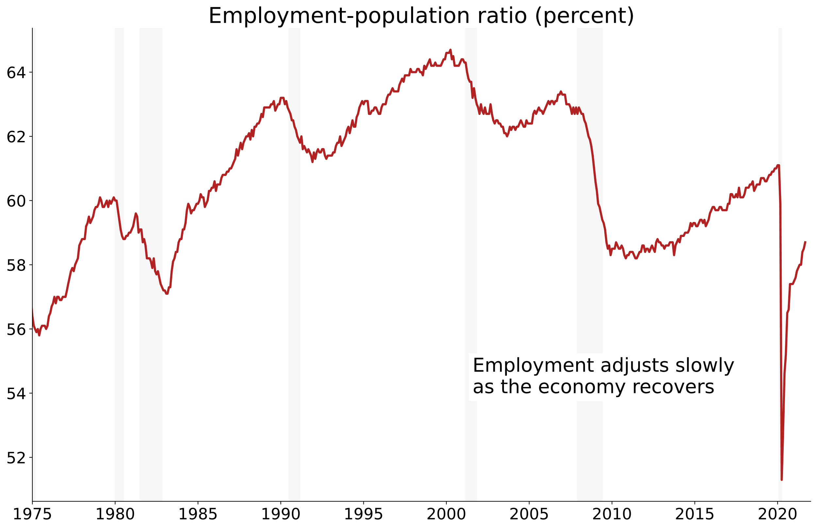

Slide 4
Labor markets as matching markets
Heterogeneous jobs + heterogenous workers
Similar to housing markets, dating, …
Employers and workers want a good “match”
It takes time and effort to find the right worker/firm
Labor adjustment is always slow — and this is a large adjustment
Notes:
Content: headline, bullets

Slide 5
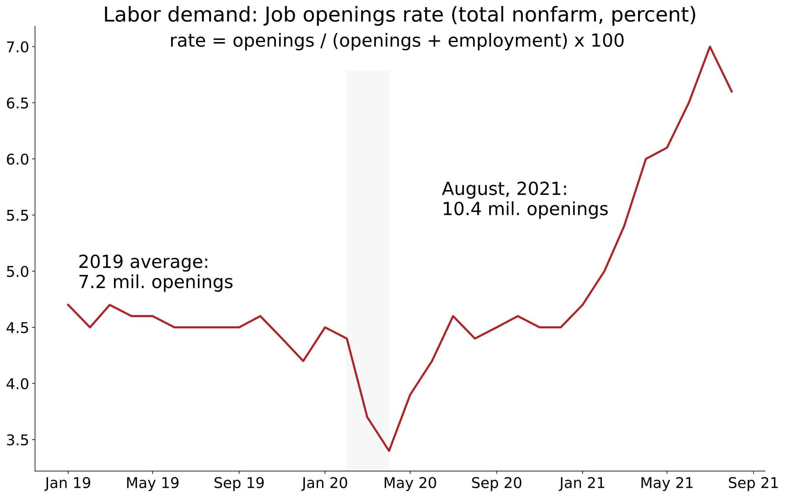

Slide 6
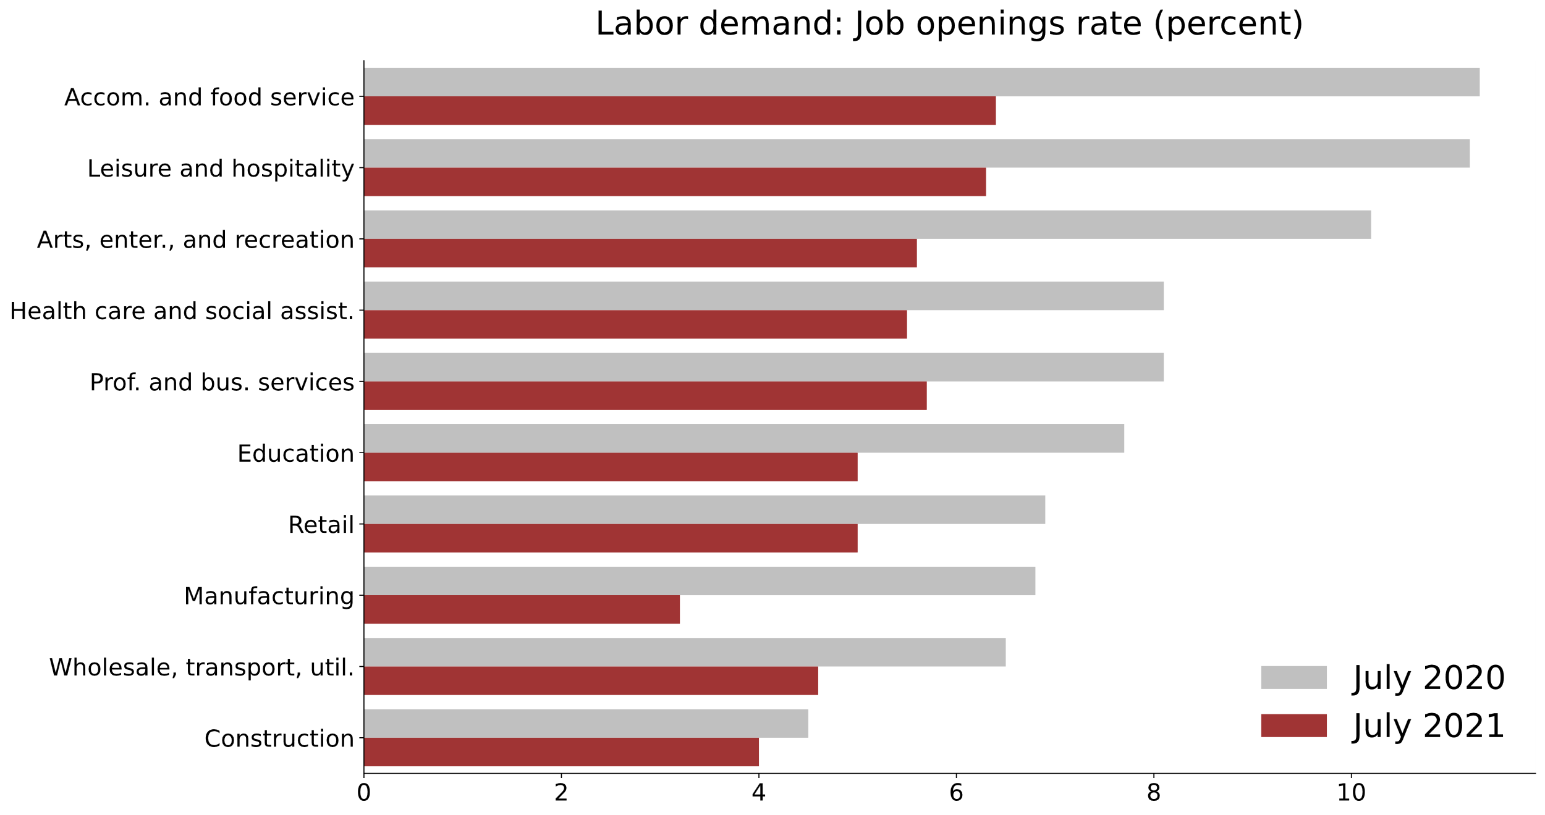

Slide 7
Labor supply forces
Extra unemployment benefits and savings (short term issue)
Encourages more job searching and slower matching
Laid-off workers changing industries
Concerns about COVID
Childcare (school and childcare closures)
Notes:
Content: headline, bullets

Slide 8
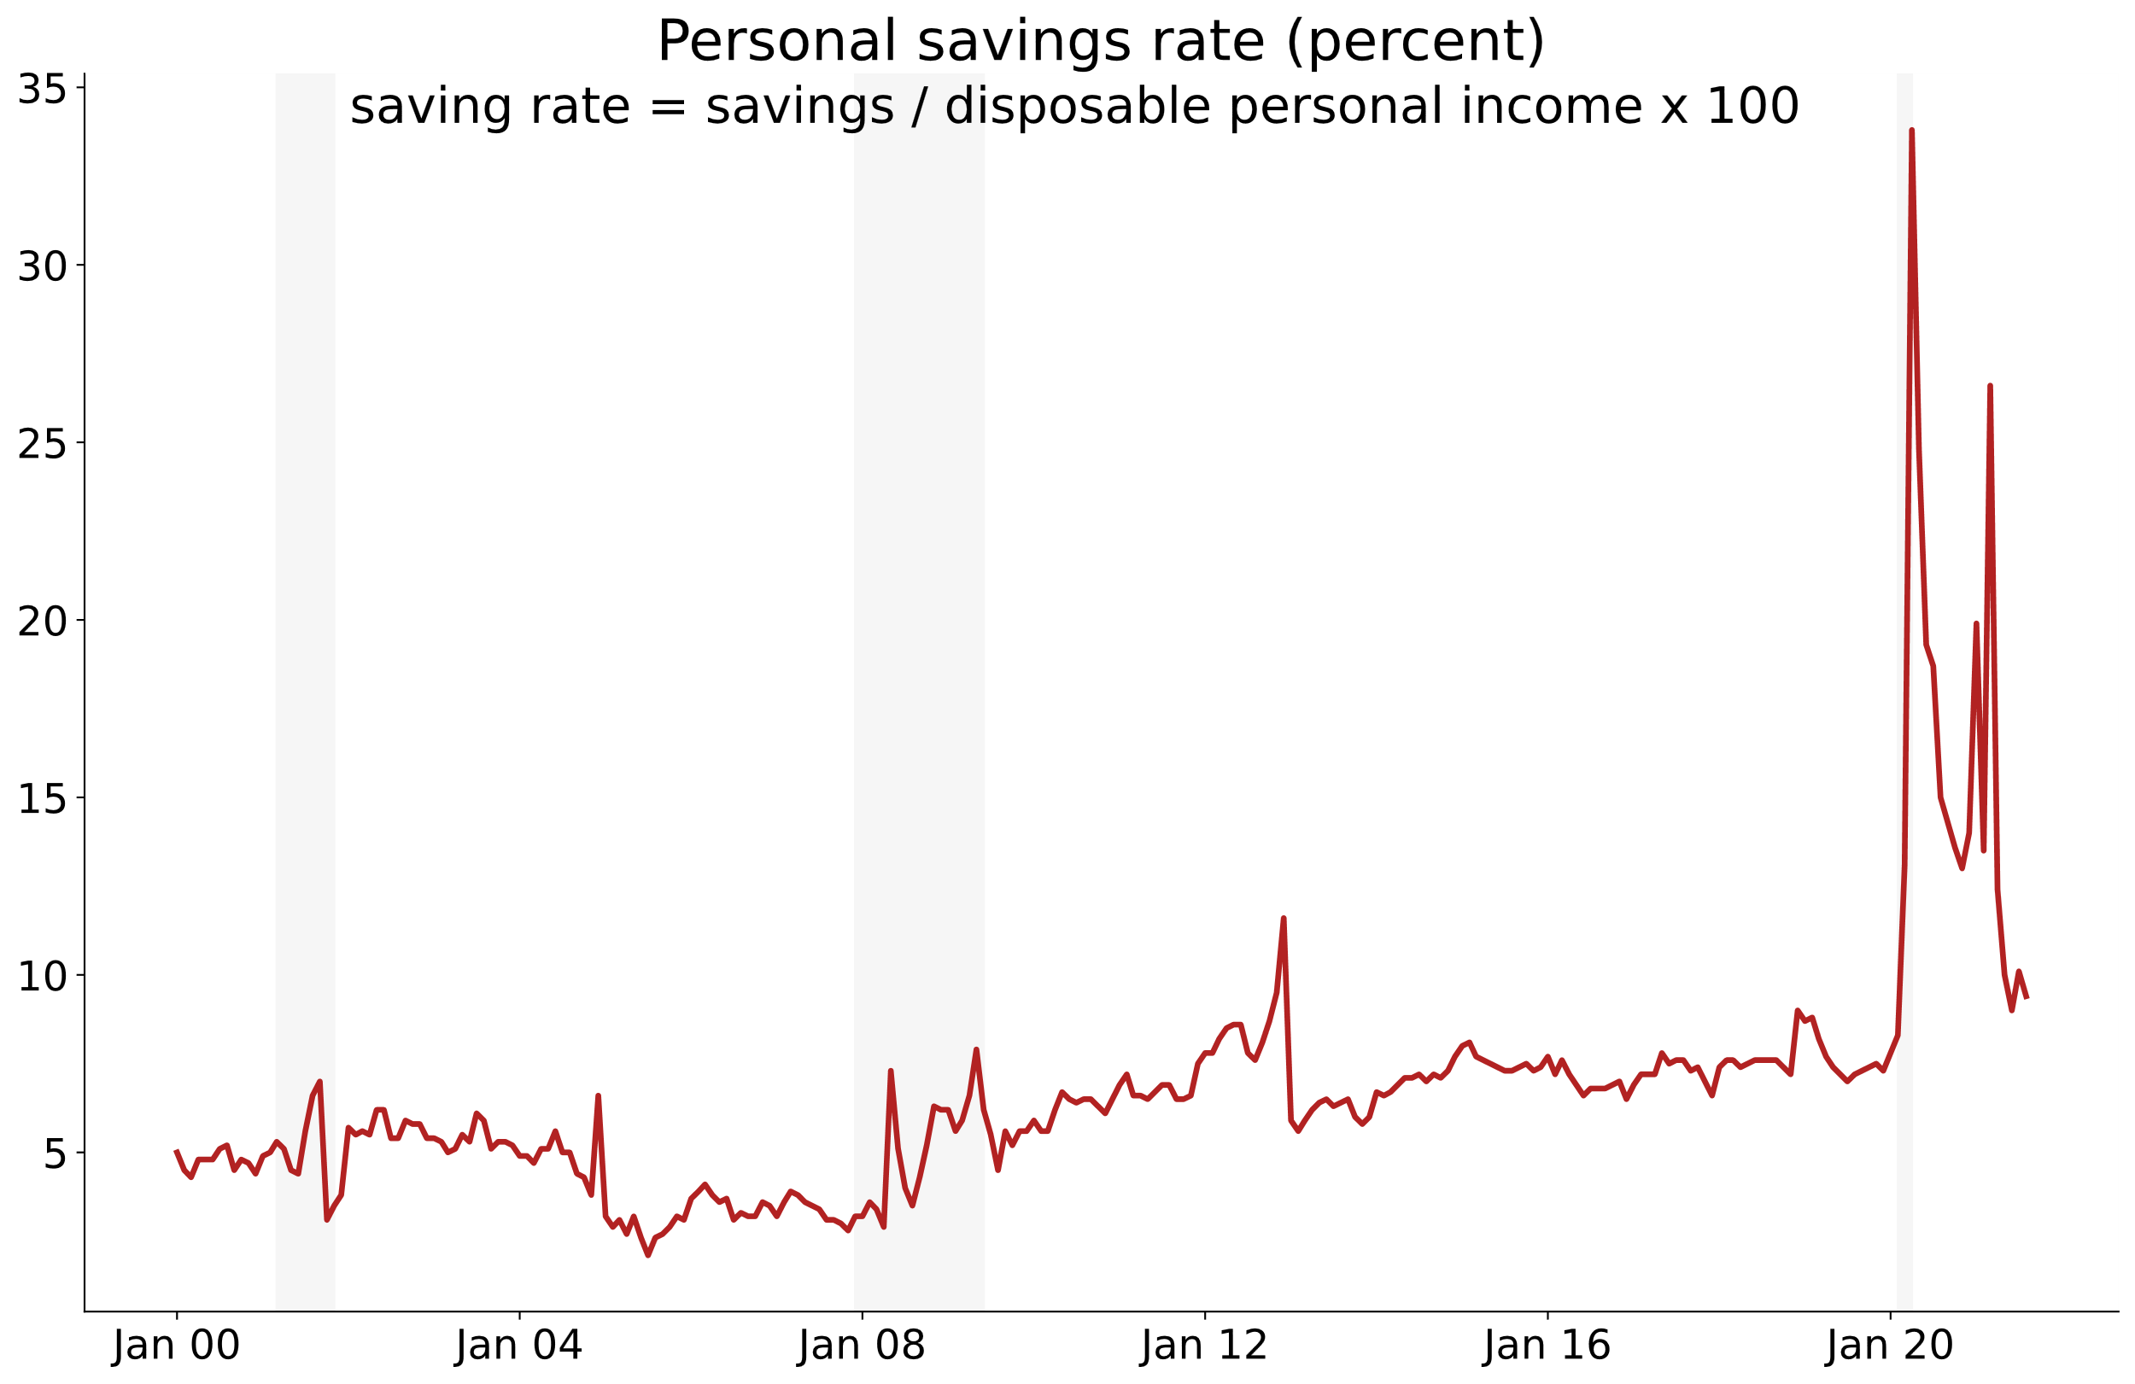

Slide 9
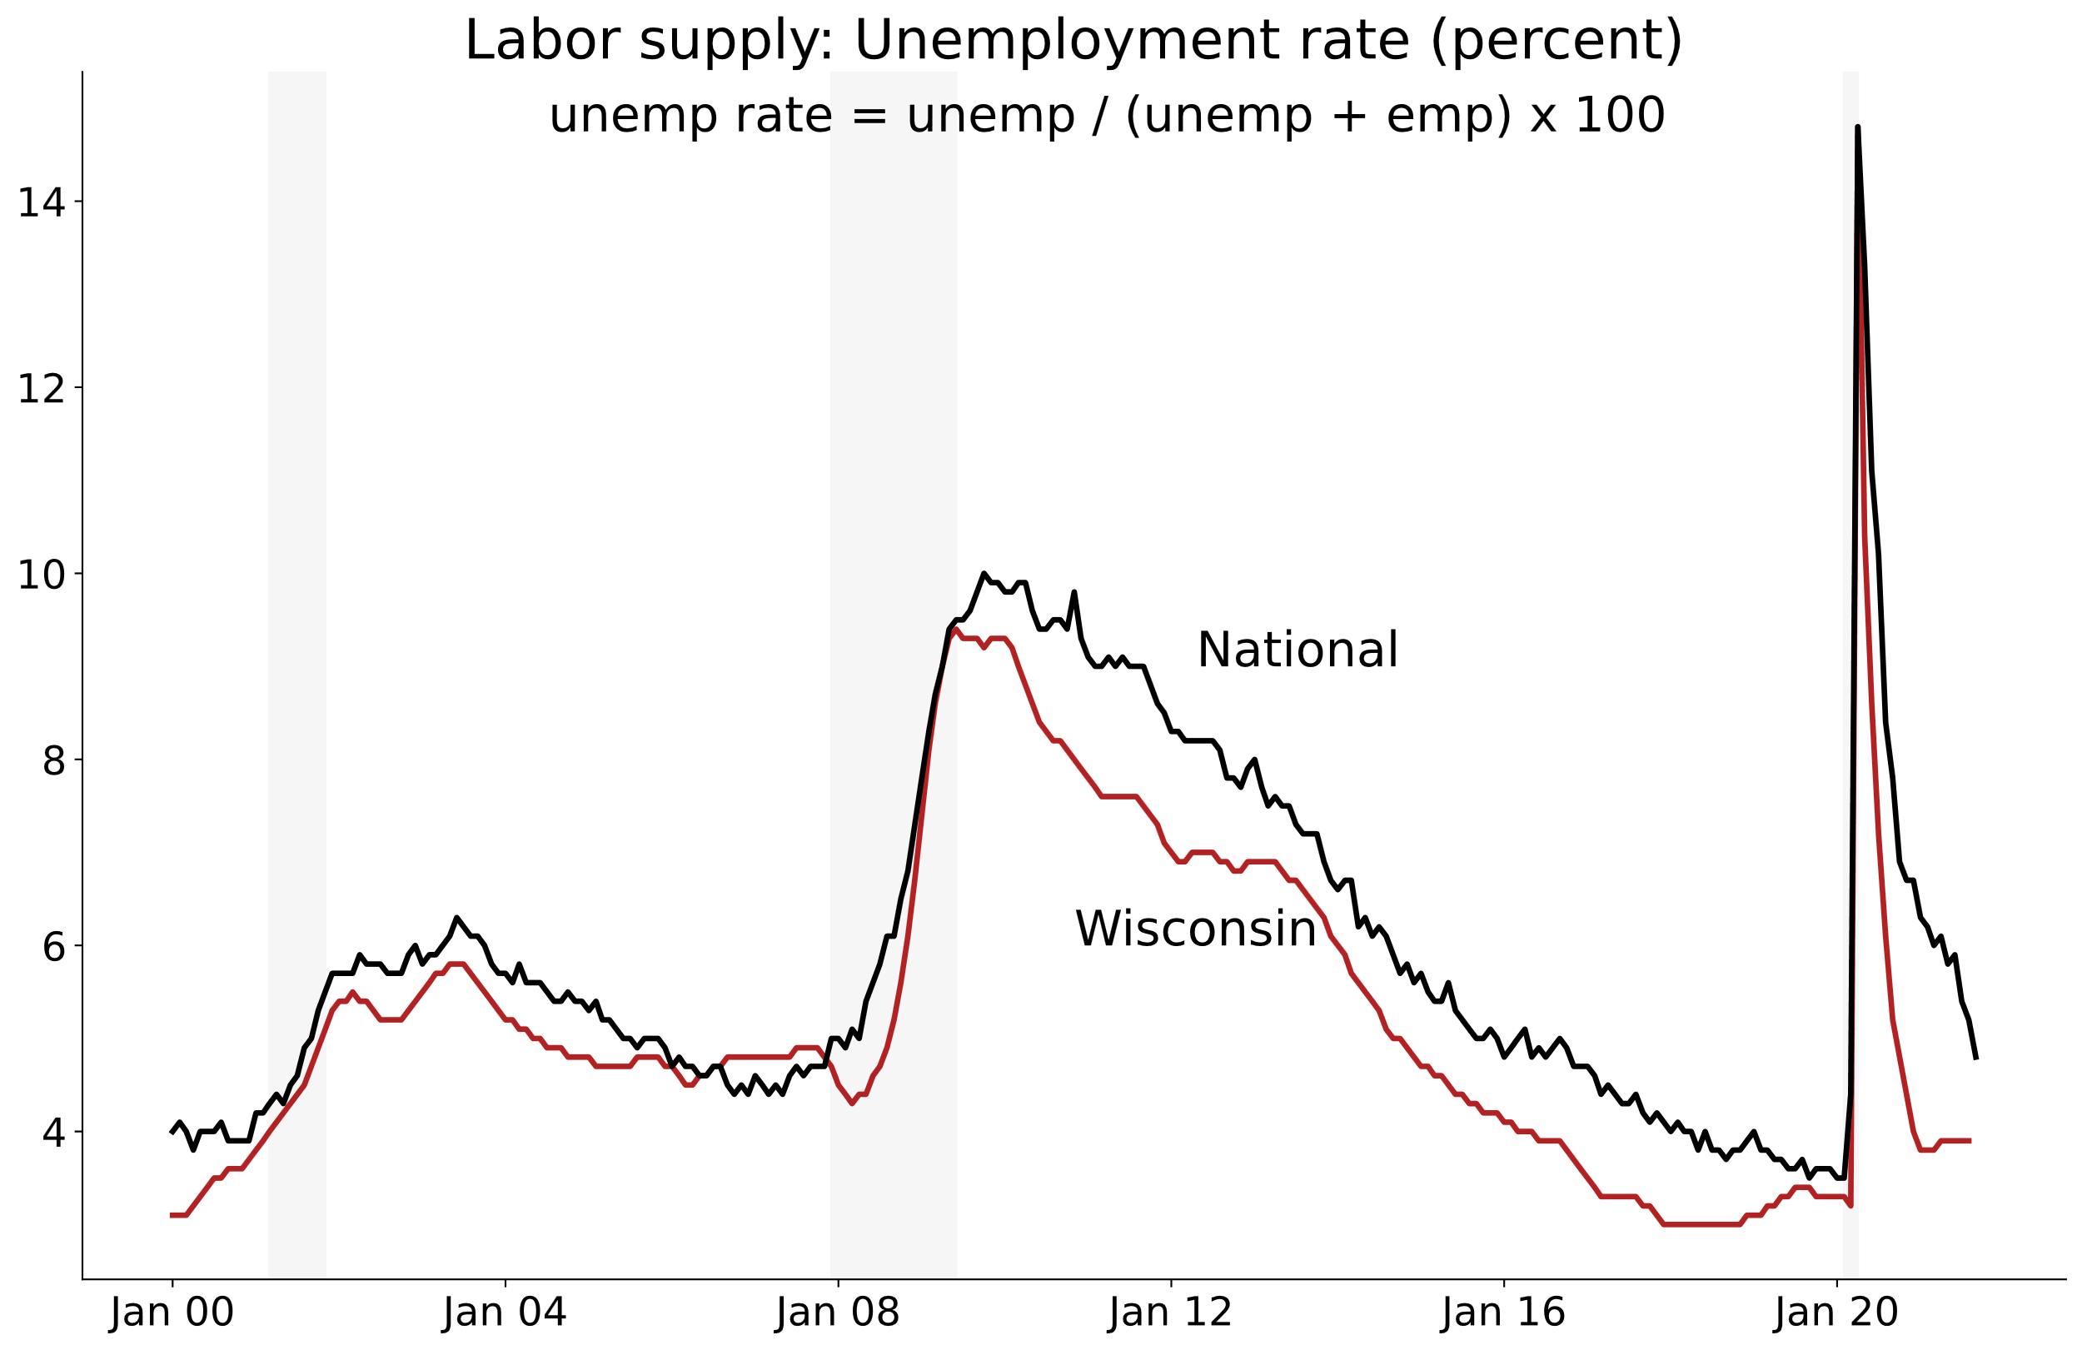

Slide 10
Supply + Demand
Labor market tightness
Unmet demand for workers
Lower supply of unemployed workers
Notes:
Content: headline, bullets

Slide 11
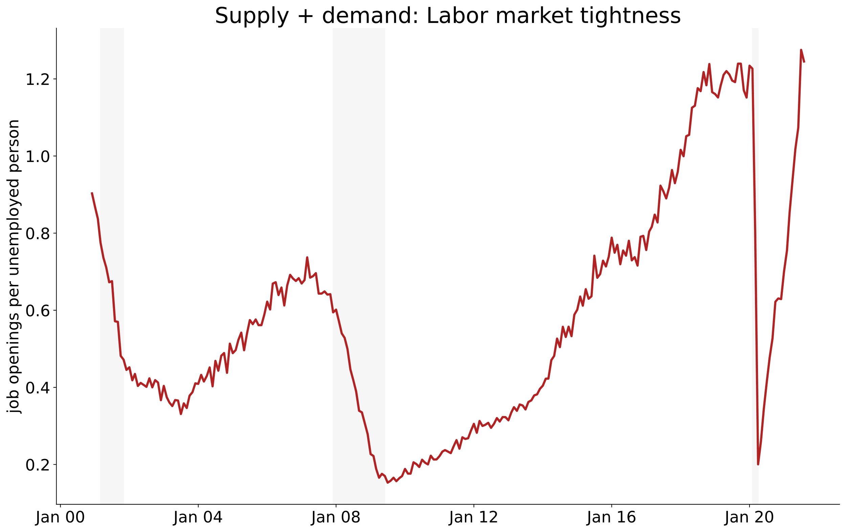

Slide 12
Supply + Demand
Labor market tightness
Unmet demand for workers
Lower supply of workers
Tight labor markets should create upward wage pressure
Do we see upward wage pressure?
Notes:
Content: headline, bullets

Slide 13
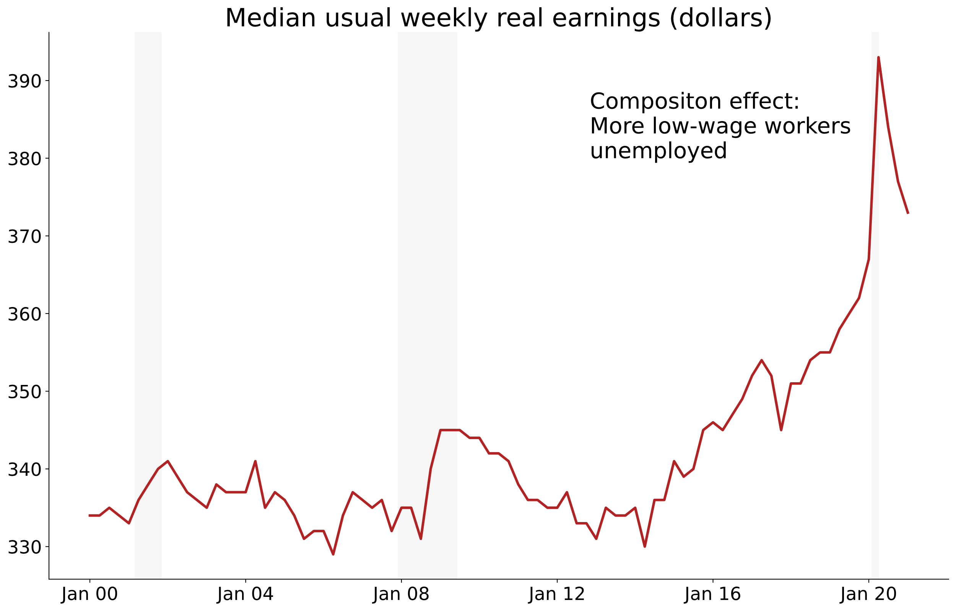

Slide 14
Supply + Demand
Labor market tightness
Unmet demand for workers
Lower supply of workers
Tight labor markets should create upward wage pressure
Do we see upward wage pressure?
Hard to see in the aggregate data
Some evidence of pressure in low-skill services (Hotchkiss, 2021)
Notes:
Content: headline, bullets

Slide 15
Anecdotal observations
indeed.com, “entry level”; “within 25 miles”
Company | Position | Hourly wage | Incentives
UPS | Package handler | up to $22 | No interview required
Sub-zero | Manufacturing pos. | $20.59-$25.75 | $1,500 sign-on bonus
Hy-Vee | Flex worker | from $16
UW-Madison | Catering leader | from $18.75 | $2000-$4000 hiring incentives
Divine package | Delivery associate | $18-$21 | No marijuana test
Chipotle | Crew member | $13.50-$15

