Slide 1
习题课
Notes:
一小节课5-6张，一共6次课讲完。

Slide 2
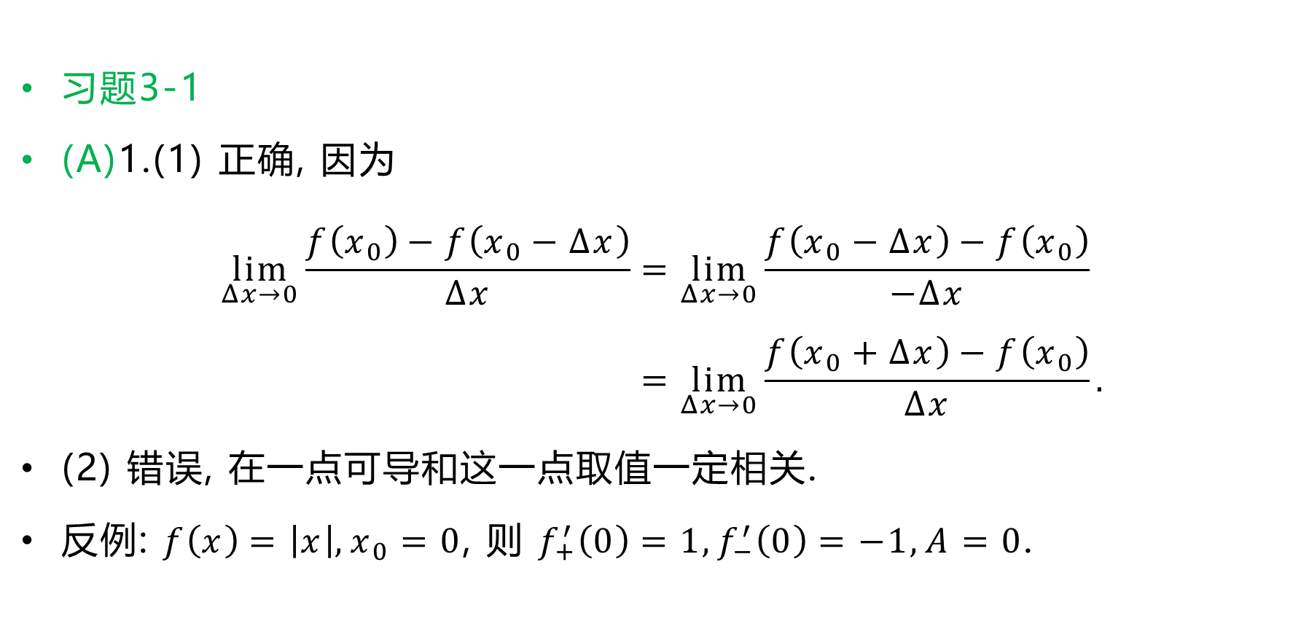
习题3-1
(A)1.(1) 正确, 因为
$$\lim_{Δx→0}{\frac{f\left(x_{0}\right)−f\left(x_{0}−Δx\right)}{Δx}}=\lim_{Δx→0}{\frac{f\left(x_{0}−Δx\right)−f\left(x_{0}\right)}{−Δx}} \\ =\lim_{Δx→0}{\frac{f\left(x_{0}+Δx\right)−f\left(x_{0}\right)}{Δx}}.$$
(2) 错误, 在一点可导和这一点取值一定相关.
反例: $f\left(x\right)=\left|x\right|,x_{0}=0$, 则 $f_{+}^{′}\left(0\right)=1,f_{−}^{′}\left(0\right)=−1,A=0$.

Slide 3

2. 由于
$$f^{′}\left(x_{0}\right)=\lim_{Δx→0}{\frac{f\left(x_{0}+Δx\right)−f\left(x_{0}\right)}{Δx}}=\lim_{Δx→0}{\frac{f\left(x_{0}+2Δx\right)−f\left(x_{0}\right)}{2Δx}} \\ =\lim_{Δx→0}{\frac{f\left(x_{0}−Δx\right)−f\left(x_{0}\right)}{−Δx}},$$
因此
$$\lim_{Δx→0}{\frac{f\left(x_{0}+2Δx\right)−f\left(x_{0}−Δx\right)}{2Δx}}=\lim_{Δx→0}\left[\frac{f\left(x_{0}+2Δx\right)−f\left(x_{0}\right)}{2Δx}+\frac{1}{2}⋅\frac{f\left(x_{0}−Δx\right)−f\left(x_{0}\right)}{−Δx}\right] \\ =f^{′}\left(x_{0}\right)+−\frac{1}{2}f^{′}\left(x_{0}\right)=\frac{3}{2}f^{′}\left(x_{0}\right).$$

Slide 4
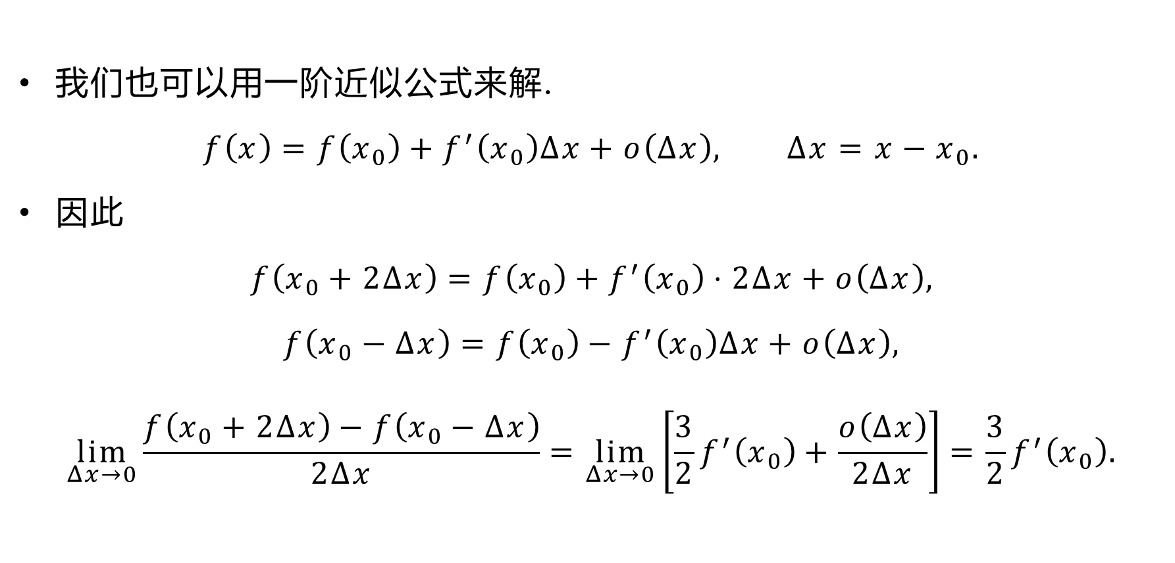
我们也可以用一阶近似公式来解.
$$f\left(x\right)=f\left(x_{0}\right)+f^{′}\left(x_{0}\right)Δx+o\left(Δx\right), Δx=x−x_{0}.$$
因此
$$f\left(x_{0}+2Δx\right)=f\left(x_{0}\right)+f^{′}\left(x_{0}\right)⋅2Δx+o\left(Δx\right),$$
$$f\left(x_{0}−Δx\right)=f\left(x_{0}\right)−f^{′}\left(x_{0}\right)Δx+o\left(Δx\right),$$
$$\lim_{Δx→0}{\frac{f\left(x_{0}+2Δx\right)−f\left(x_{0}−Δx\right)}{2Δx}}=\lim_{Δx→0}\left[\frac{3}{2}f^{′}\left(x_{0}\right)+\frac{o\left(Δx\right)}{2Δx}\right]=\frac{3}{2}f^{′}\left(x_{0}\right).$$

Slide 5
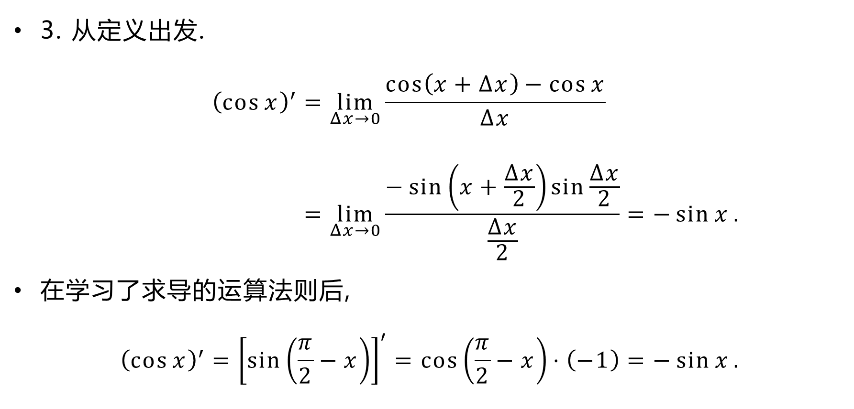
3. 从定义出发.
$${\left(\cos{x}\right)}^{′}=\lim_{Δx→0}{\frac{\cos\left(x+Δx\right)−\cos{x}}{Δx}} \\ =\lim_{Δx→0}{\frac{−\sin\left(x+\frac{Δx}{2}\right)\sin{\frac{Δx}{2}}}{\frac{Δx}{2}}}=−\sin{x}.$$
在学习了求导的运算法则后,
$${\left(\cos{x}\right)}^{′}={\left[\sin\left(\frac{π}{2}−x\right)\right]}^{′}=\cos\left(\frac{π}{2}−x\right)⋅\left(−1\right)=−\sin{x}.$$

Slide 6
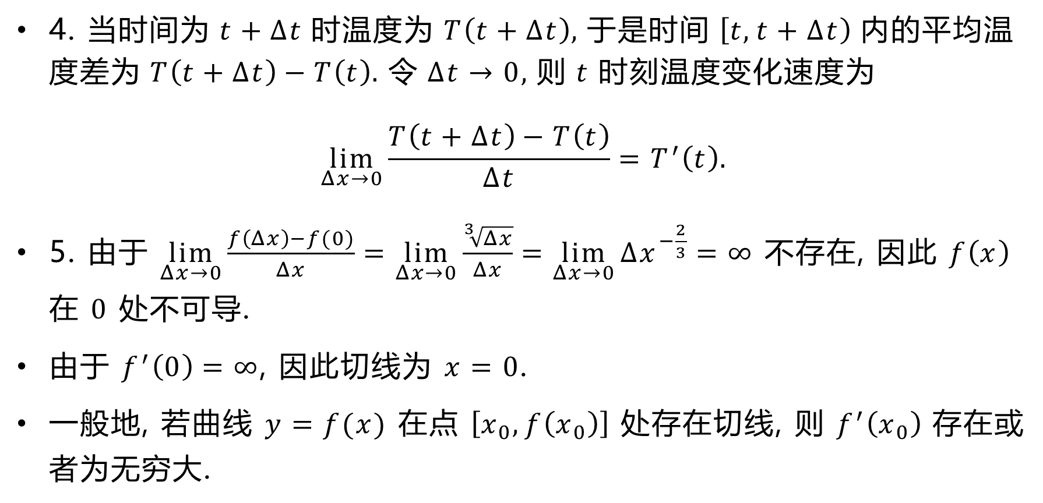
4. 当时间为 $t+Δt$ 时温度为 $T\left(t+Δt\right)$, 于是时间 $\left[t,t+Δt\right)$ 内的平均温度差为 $T\left(t+Δt\right)−T\left(t\right)$. 令 $Δt→0$, 则 $t$ 时刻温度变化速度为
$$\lim_{Δx→0}{\frac{T\left(t+Δt\right)−T\left(t\right)}{Δt}}=T^{′}\left(t\right).$$
5. 由于 $\lim_{Δx→0}{\frac{f\left(Δx\right)−f(0)}{Δx}}=\lim_{Δx→0}{\frac{\sqrt[3]{Δx}}{Δx}}=\lim_{Δx→0}{Δx^{−\frac{2}{3}}}=∞$ 不存在, 因此 $f\left(x\right)$ 在 $0$ 处不可导.
由于 $f^{′}\left(0\right)=∞$, 因此切线为 $x=0$.
一般地, 若曲线 $y=f(x)$ 在点 $\left[x_{0},f\left(x_{0}\right)\right]$ 处存在切线, 则 $f^{′}\left(x_{0}\right)$ 存在或者为无穷大.

Slide 7
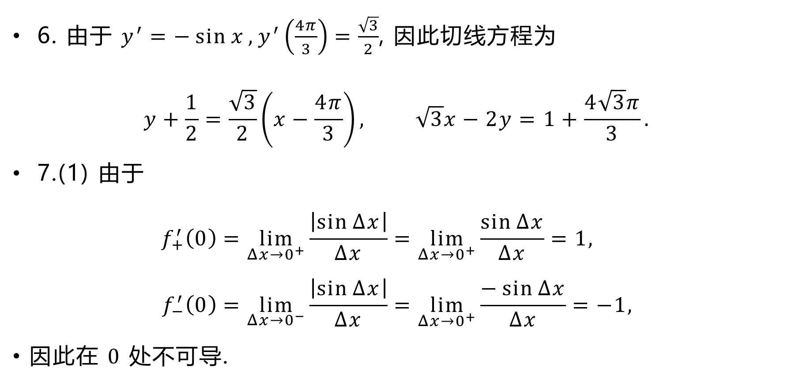
6. 由于 $y^{′}=−\sin{x},y^{′}\left(\frac{4π}{3}\right)=\frac{\sqrt{3}}{2}$, 因此切线方程为
$$y+\frac{1}{2}=\frac{\sqrt{3}}{2}\left(x−\frac{4π}{3}\right), \sqrt{3}x−2y=1+\frac{4\sqrt{3}π}{3}.$$
7.(1) 由于
$$f_{+}^{′}\left(0\right)=\lim_{Δx→0^{+}}{\frac{\left|\sin{Δx}\right|}{Δx}}=\lim_{Δx→0^{+}}{\frac{\sin{Δx}}{Δx}}=1, \\ f_{−}^{′}\left(0\right)=\lim_{Δx→0^{−}}{\frac{\left|\sin{Δx}\right|}{Δx}}=\lim_{Δx→0^{+}}{\frac{−\sin{Δx}}{Δx}}=−1,$$
因此在 $0$ 处不可导.

Slide 8
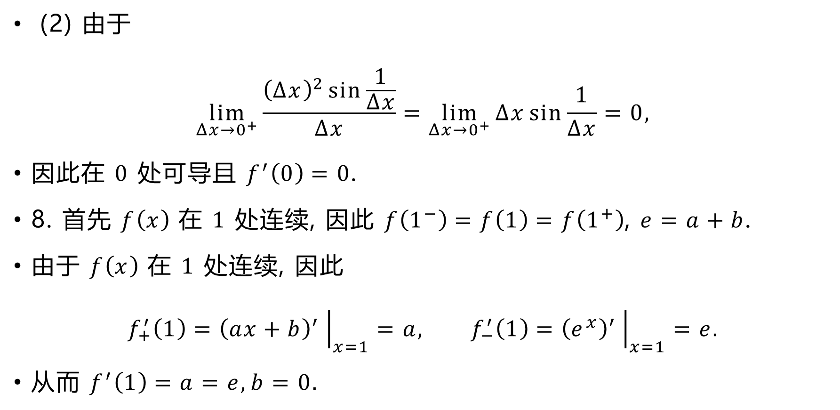
(2) 由于
$$\lim_{Δx→0^{+}}{\frac{{\left(Δx\right)}^{2}\sin{\frac{1}{Δx}}}{Δx}}=\lim_{Δx→0^{+}}{Δx\sin{\frac{1}{Δx}}}=0,$$
因此在 $0$ 处可导且 $f^{′}\left(0\right)=0$.
8. 首先 $f\left(x\right)$ 在 $1$ 处连续, 因此 $f\left(1^{−}\right)=f\left(1\right)=f\left(1^{+}\right)$, $e=a+b$.
由于 $f\left(x\right)$ 在 $1$ 处连续, 因此
$$f_{+}^{′}\left(1\right)={\left(ax+b\right)}^{′}{\left.​\right|}_{x=1}=a, f_{−}^{′}\left(1\right)={\left(e^{x}\right)}^{′}{\left.​\right|}_{x=1}=e.$$
从而 $f^{′}\left(1\right)=a=e,b=0.$

Slide 9
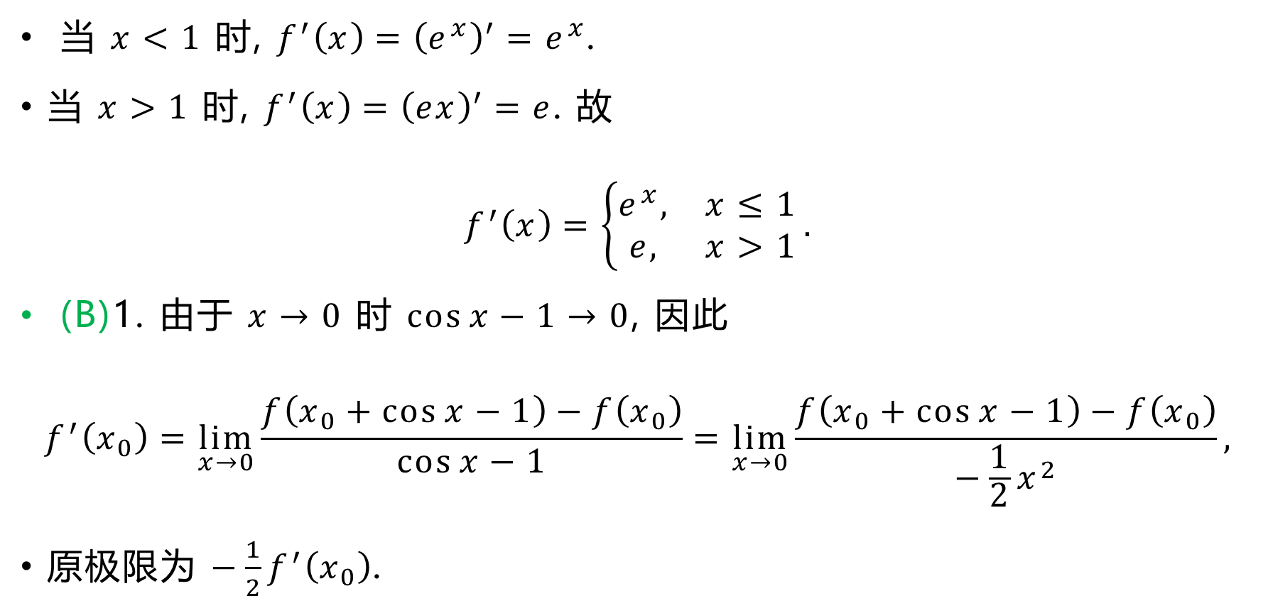
当 $x<1$ 时, $f^{′}\left(x\right)={\left(e^{x}\right)}^{′}=e^{x}$.
当 $x>1$ 时, $f^{′}\left(x\right)={\left(ex\right)}^{′}=e$. 故
$$f^{′}\left(x\right)=\left\{\begin{matrix}e^{x}, & x≤1 \\ e, & x>1\end{matrix}\right..$$
(B)1. 由于 $x→0$ 时 $\cos{x}−1→0$, 因此
$$f^{′}\left(x_{0}\right)=\lim_{x→0}{\frac{f\left(x_{0}+\cos{x}−1\right)−f\left(x_{0}\right)}{\cos{x}−1}}=\lim_{x→0}{\frac{f\left(x_{0}+\cos{x}−1\right)−f\left(x_{0}\right)}{−\frac{1}{2}x^{2}}},$$
原极限为 $−\frac{1}{2}f^{′}\left(x_{0}\right)$.

Slide 10
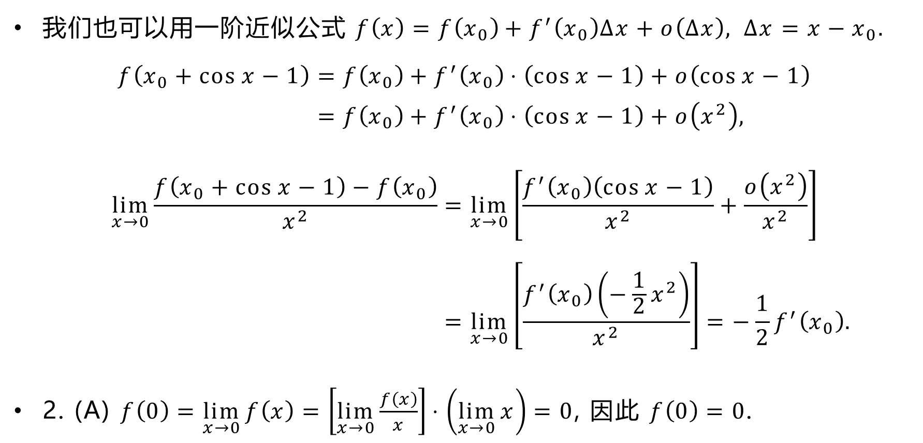
我们也可以用一阶近似公式 $f\left(x\right)=f\left(x_{0}\right)+f^{′}\left(x_{0}\right)Δx+o\left(Δx\right), Δx=x−x_{0}.$
$$f\left(x_{0}+\cos{x}−1\right)=f\left(x_{0}\right)+f^{′}\left(x_{0}\right)⋅\left(\cos{x}−1\right)+o\left(\cos{x}−1\right) \\ =f\left(x_{0}\right)+f^{′}\left(x_{0}\right)⋅\left(\cos{x}−1\right)+o\left(x^{2}\right),$$
$$\lim_{x→0}{\frac{f\left(x_{0}+\cos{x}−1\right)−f\left(x_{0}\right)}{x^{2}}}=\lim_{x→0}\left[\frac{f^{′}\left(x_{0}\right)\left(\cos{x}−1\right)}{x^{2}}+\frac{o\left(x^{2}\right)}{x^{2}}\right] \\ =\lim_{x→0}\left[\frac{f^{′}\left(x_{0}\right)\left(−\frac{1}{2}x^{2}\right)}{x^{2}}\right]=−\frac{1}{2}f^{′}\left(x_{0}\right).$$
2. (A) $f\left(0\right)=\lim_{x→0}{f\left(x\right)}=\left[\lim_{x→0}{\frac{f\left(x\right)}{x}}\right]⋅\left(\lim_{x→0}{x}\right)=0$, 因此 $f\left(0\right)=0$.

Slide 11
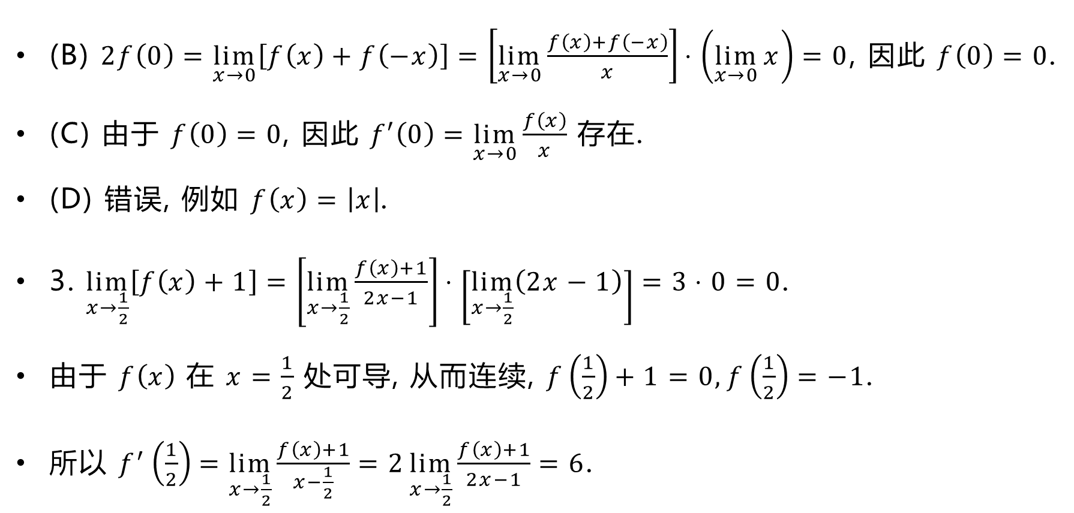
(B) $2f\left(0\right)=\lim_{x→0}\left[f\left(x\right)+f\left(−x\right)\right]=\left[\lim_{x→0}{\frac{f\left(x\right)+f\left(−x\right)}{x}}\right]⋅\left(\lim_{x→0}{x}\right)=0$, 因此 $f\left(0\right)=0$.
(C) 由于 $f\left(0\right)=0$, 因此 $f′\left(0\right)=\lim_{x→0}{\frac{f\left(x\right)}{x}}$ 存在.
(D) 错误, 例如 $f\left(x\right)=\left|x\right|$.
3. $\lim_{x→\frac{1}{2}}\left[f\left(x\right)+1\right]=\left[\lim_{x→\frac{1}{2}}{\frac{f\left(x\right)+1}{2x−1}}\right]⋅\left[\lim_{x→\frac{1}{2}}\left(2x−1\right)\right]=3⋅0=0$.
由于 $f\left(x\right)$ 在 $x=\frac{1}{2}$ 处可导, 从而连续, $f\left(\frac{1}{2}\right)+1=0,f\left(\frac{1}{2}\right)=−1$.
所以 $f^{′}\left(\frac{1}{2}\right)=\lim_{x→\frac{1}{2}}{\frac{f\left(x\right)+1}{x−\frac{1}{2}}}=2\lim_{x→\frac{1}{2}}{\frac{f\left(x\right)+1}{2x−1}}=6$.

Slide 12
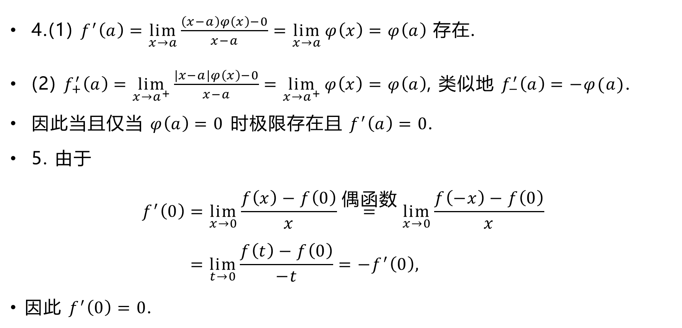
4.(1) $f^{′}\left(a\right)=\lim_{x→a}{\frac{\left(x−a\right)φ\left(x\right)−0}{x−a}}=\lim_{x→a}{φ\left(x\right)}=φ\left(a\right)$ 存在.
(2) $f_{+}^{′}\left(a\right)=\lim_{x→a^{+}}{\frac{\left|x−a\right|φ\left(x\right)−0}{x−a}}=\lim_{x→a^{+}}{φ\left(x\right)}=φ\left(a\right)$, 类似地 $f_{−}^{′}\left(a\right)=−φ(a)$.
因此当且仅当 $φ\left(a\right)=0$ 时极限存在且 $f^{′}\left(a\right)=0$.
5. 由于
$$f^{′}\left(0\right)=\lim_{x→0}{\frac{f\left(x\right)−f\left(0\right)}{x}}\overset{\text{偶函数}}{=}\lim_{x→0}{\frac{f\left(−x\right)−f\left(0\right)}{x}} \\ =\lim_{t→0}{\frac{f\left(t\right)−f\left(0\right)}{−t}}=−f^{′}\left(0\right),$$
因此 $f^{′}\left(0\right)=0$.

Slide 13
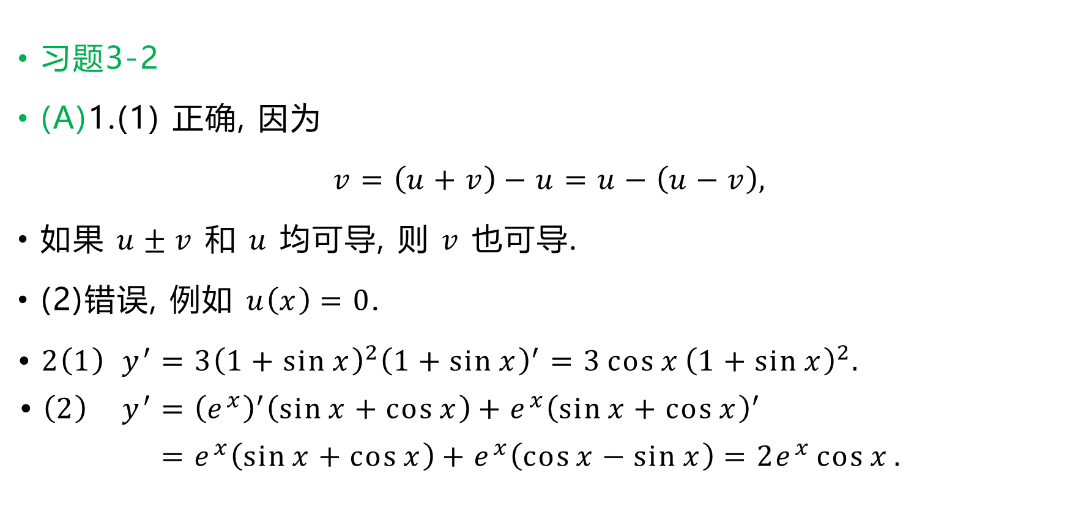
习题3-2
(A)1.(1) 正确, 因为
$$v=\left(u+v\right)−u=u−\left(u−v\right),$$
如果 $u±v$ 和 $u$ 均可导, 则 $v$ 也可导.
(2)错误, 例如 $u\left(x\right)=0$.
$$\text{•} 2\left(1\right) y^{′}=3{\left(1+\sin{x}\right)}^{2}{\left(1+\sin{x}\right)}^{′}=3\cos{x}{\left(1+\sin{x}\right)}^{2}. \\ \text{•} \left(2\right) y^{′}={\left(e^{x}\right)}^{′}\left(\sin{x}+\cos{x}\right)+e^{x}{\left(\sin{x}+\cos{x}\right)}^{′} \\ =e^{x}\left(\sin{x}+\cos{x}\right)+e^{x}\left(\cos{x}−\sin{x}\right)=2e^{x}\cos{x}.$$

Slide 14

$$\text{•} \left(3\right) y^{′}=\frac{{\left(\sec{x}+\tan{x}\right)}^{′}}{\sec{x}+\tan{x}}=\frac{\frac{\sin{x}}{\cos^{2}{x}}+\frac{1}{\cos^{2}{x}}}{\sec{x}+\tan{x}}=\frac{1}{\cos{x}}=\sec{x}.$$
$$\text{•} \left(4\right) y^{′}=\sqrt{a^{2}−x^{2}}+x⋅\frac{−2x}{2\sqrt{a^{2}−x^{2}}}+\frac{a^{2}}{\sqrt{1−\frac{x^{2}}{a^{2}}}}⋅\frac{1}{a} \\ =\frac{1}{\sqrt{a^{2}−x^{2}}}\left(a^{2}−x^{2}−x^{2}+a^{2}\right)=2\sqrt{a^{2}−x^{2}}.$$

Slide 15

$$\text{•} \left(5\right) y^{′}=\frac{1}{1+{\left(\frac{x+1}{x−1}\right)}^{2}}⋅{\left(\frac{x+1}{x−1}\right)}^{′}=\frac{{\left(x−1\right)}^{2}}{2x^{2}+2}⋅{\left(1+\frac{2}{x−1}\right)}^{′} \\ =\frac{{\left(x−1\right)}^{2}}{2x^{2}+2}⋅\frac{−2}{{\left(x−1\right)}^{2}}=−\frac{1}{1+x^{2}}.$$
$$\text{•} \left(6\right) y^{′}=n\sin^{n−1}{x}⋅\cos{x}⋅\cos{nx}+\sin^{n}{x}⋅\left(−n\sin{nx}\right) \\ =n\sin^{n−1}{x}\left(\cos{x}⋅\cos{nx}−\sin{x}⋅\sin{nx}\right) \\ =n\sin^{n−1}{x}\cos\left(n+1\right)x.$$

Slide 16
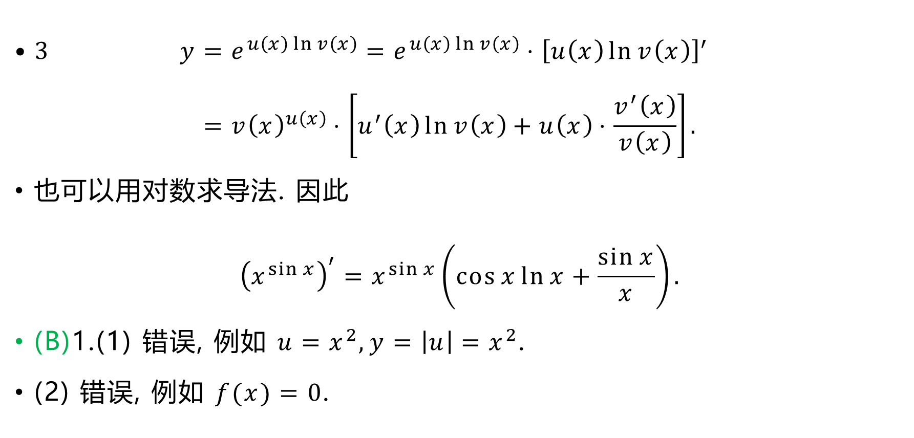
$$\text{•}\text{ 3} y=e^{u\left(x\right)\ln{v\left(x\right)}}=e^{u\left(x\right)\ln{v\left(x\right)}}⋅{\left[u\left(x\right)\ln{v\left(x\right)}\right]}^{′} \\ ={v\left(x\right)}^{u\left(x\right)}⋅\left[u^{′}\left(x\right)\ln{v\left(x\right)}+u\left(x\right)⋅\frac{v^{′}\left(x\right)}{v\left(x\right)}\right].$$
也可以用对数求导法. 因此
$${\left(x^{\sin{x}}\right)}^{′}=x^{\sin{x}}\left(\cos{x}\ln{x}+\frac{\sin{x}}{x}\right).$$
(B)1.(1) 错误, 例如 $u=x^{2},y=\left|u\right|=x^{2}$.
(2) 错误, 例如 $f(x)=0$.

Slide 17

$$\text{•}\text{ 2(1)} y^{′}=e^{\sin^{2}{\frac{1}{x}}}⋅2\sin{\frac{1}{x}}⋅\cos{\frac{1}{x}}⋅\left(−\frac{1}{x^{2}}\right)=−\frac{1}{x^{2}}\sin{\frac{2}{x}}e^{\sin^{2}{\frac{1}{x}}}.$$
$$\text{•}\text{ (2)} y=\ln\left(\sqrt{1+e^{x}}−1\right)−\ln\left(\sqrt{1+e^{x}}+1\right), \\ y^{′}=\left(\frac{1}{\sqrt{1+e^{x}}−1}−\frac{1}{\sqrt{1+e^{x}}+1}\right){\left(\sqrt{1+e^{x}}\right)}^{′} \\ =\frac{2}{e^{x}}⋅\frac{1}{2\sqrt{1+e^{x}}}⋅e^{x}=\frac{1}{\sqrt{1+e^{x}}}.$$

Slide 18

$$\text{• }\text{ (}\text{3)} y^{′}=\frac{{\left(x+\sqrt{x+\sqrt{x}}\right)}^{′}}{2\sqrt{x+\sqrt{x+\sqrt{x}}}}=\frac{1}{2\sqrt{x+\sqrt{x+\sqrt{x}}}}⋅\left[1+\frac{{\left(x+\sqrt{x}\right)}^{′}}{2\sqrt{x+\sqrt{x}}}\right] \\ =\frac{1}{2\sqrt{x+\sqrt{x+\sqrt{x}}}}⋅\left(1+\frac{1+\frac{1}{2\sqrt{x}}}{2\sqrt{x+\sqrt{x}}}\right) \\ =\frac{1+2\sqrt{x}+4\sqrt{x^{2}+x\sqrt{x}}}{8\sqrt{x^{2}+x\sqrt{x}}⋅\sqrt{x+\sqrt{x+\sqrt{x}}}}.$$

Slide 19
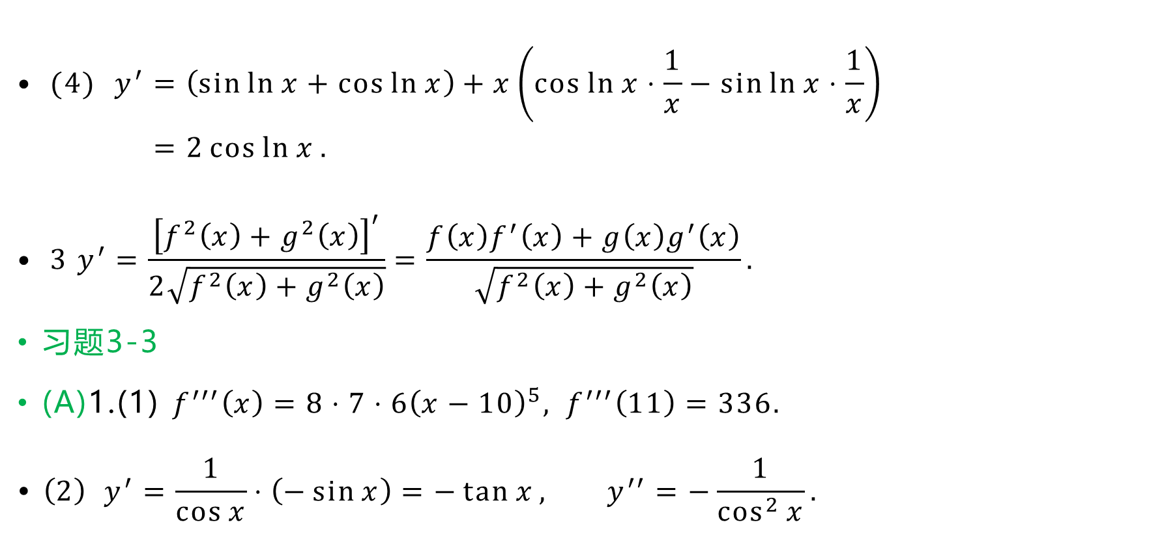
$$\text{• }\text{ (}\text{4)} y^{′}=\left(\sin{\ln{x}}+\cos{\ln{x}}\right)+x\left(\cos{\ln{x}}⋅\frac{1}{x}−\sin{\ln{x}}⋅\frac{1}{x}\right) \\ =2\cos{\ln{x}}.$$
$$\text{• }\text{ 3} y^{′}=\frac{{\left[f^{2}\left(x\right)+g^{2}\left(x\right)\right]}^{′}}{2\sqrt{f^{2}\left(x\right)+g^{2}\left(x\right)}}=\frac{f\left(x\right)f^{′}\left(x\right)+g\left(x\right)g^{′}\left(x\right)}{\sqrt{f^{2}\left(x\right)+g^{2}\left(x\right)}}.$$
习题3-3
(A)1.(1) $f^{′′′}\left(x\right)=8⋅7⋅6{\left(x−10\right)}^{5}, f^{′′′}\left(11\right)=336.$
$$\text{• }\left(2\right) y^{′}=\frac{1}{\cos{x}}⋅\left(−\sin{x}\right)=−\tan{x}, y^{′′}=−\frac{1}{\cos^{2}{x}}.$$

Slide 20
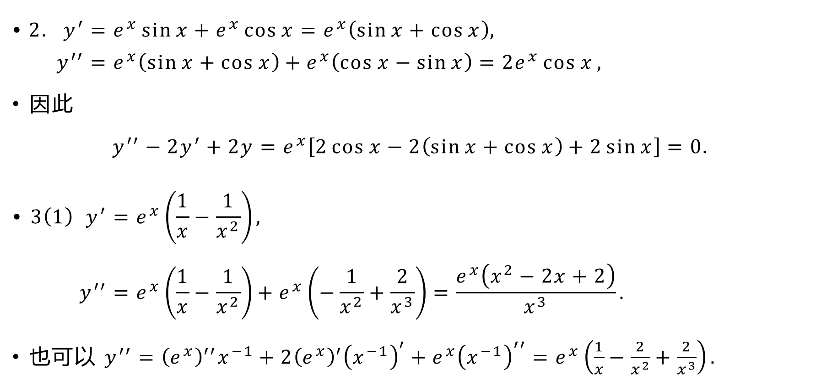
$$\text{•} 2. y^{′}=e^{x}\sin{x}+e^{x}\cos{x}=e^{x}\left(\sin{x}+\cos{x}\right), \\ y^{′′}=e^{x}\left(\sin{x}+\cos{x}\right)+e^{x}\left(\cos{x}−\sin{x}\right)=2e^{x}\cos{x},$$
因此
$$y^{′′}−2y^{′}+2y=e^{x}\left[2\cos{x}−2\left(\sin{x}+\cos{x}\right)+2\sin{x}\right]=0.$$
$$\text{•} 3\left(1\right) y^{′}=e^{x}\left(\frac{1}{x}−\frac{1}{x^{2}}\right), \\ y^{′′}=e^{x}\left(\frac{1}{x}−\frac{1}{x^{2}}\right)+e^{x}\left(−\frac{1}{x^{2}}+\frac{2}{x^{3}}\right)=\frac{e^{x}\left(x^{2}−2x+2\right)}{x^{3}}.$$
也可以 $y^{′′}={\left(e^{x}\right)}^{′′}x^{−1}+2{\left(e^{x}\right)}^{′}{\left(x^{−1}\right)}^{′}+e^{x}{\left(x^{−1}\right)}^{′′}=e^{x}\left(\frac{1}{x}−\frac{2}{x^{2}}+\frac{2}{x^{3}}\right).$

Slide 21
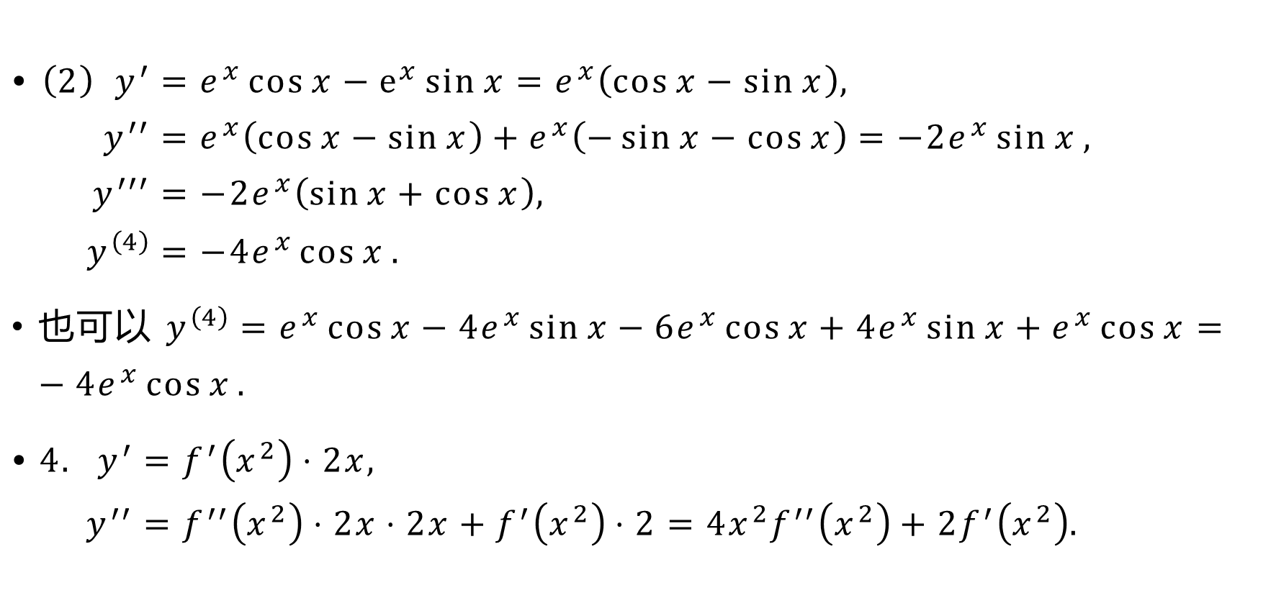
$$\text{• }\left(2\right) y^{′}=e^{x}\cos{x}−e^{x}\sin{x}=e^{x}\left(\cos{x}−\sin{x}\right), \\ y^{′′}=e^{x}\left(\cos{x}−\sin{x}\right)+e^{x}\left(−\sin{x}−\cos{x}\right)=−2e^{x}\sin{x}, \\ y^{′′′}=−2e^{x}\left(\sin{x}+\cos{x}\right), \\ y^{\left(4\right)}=−4e^{x}\cos{x}.$$
也可以 $y^{\left(4\right)}=e^{x}\cos{x}−4e^{x}\sin{x}−6e^{x}\cos{x}+4e^{x}\sin{x}+e^{x}\cos{x}=−4e^{x}\cos{x}.$
$$\text{•} 4. y^{′}=f^{′}\left(x^{2}\right)⋅2x, \\ y^{′′}=f^{′′}\left(x^{2}\right)⋅2x⋅2x+f^{′}\left(x^{2}\right)⋅2=4x^{2}f^{′′}\left(x^{2}\right)+2f^{′}\left(x^{2}\right).$$

Slide 22
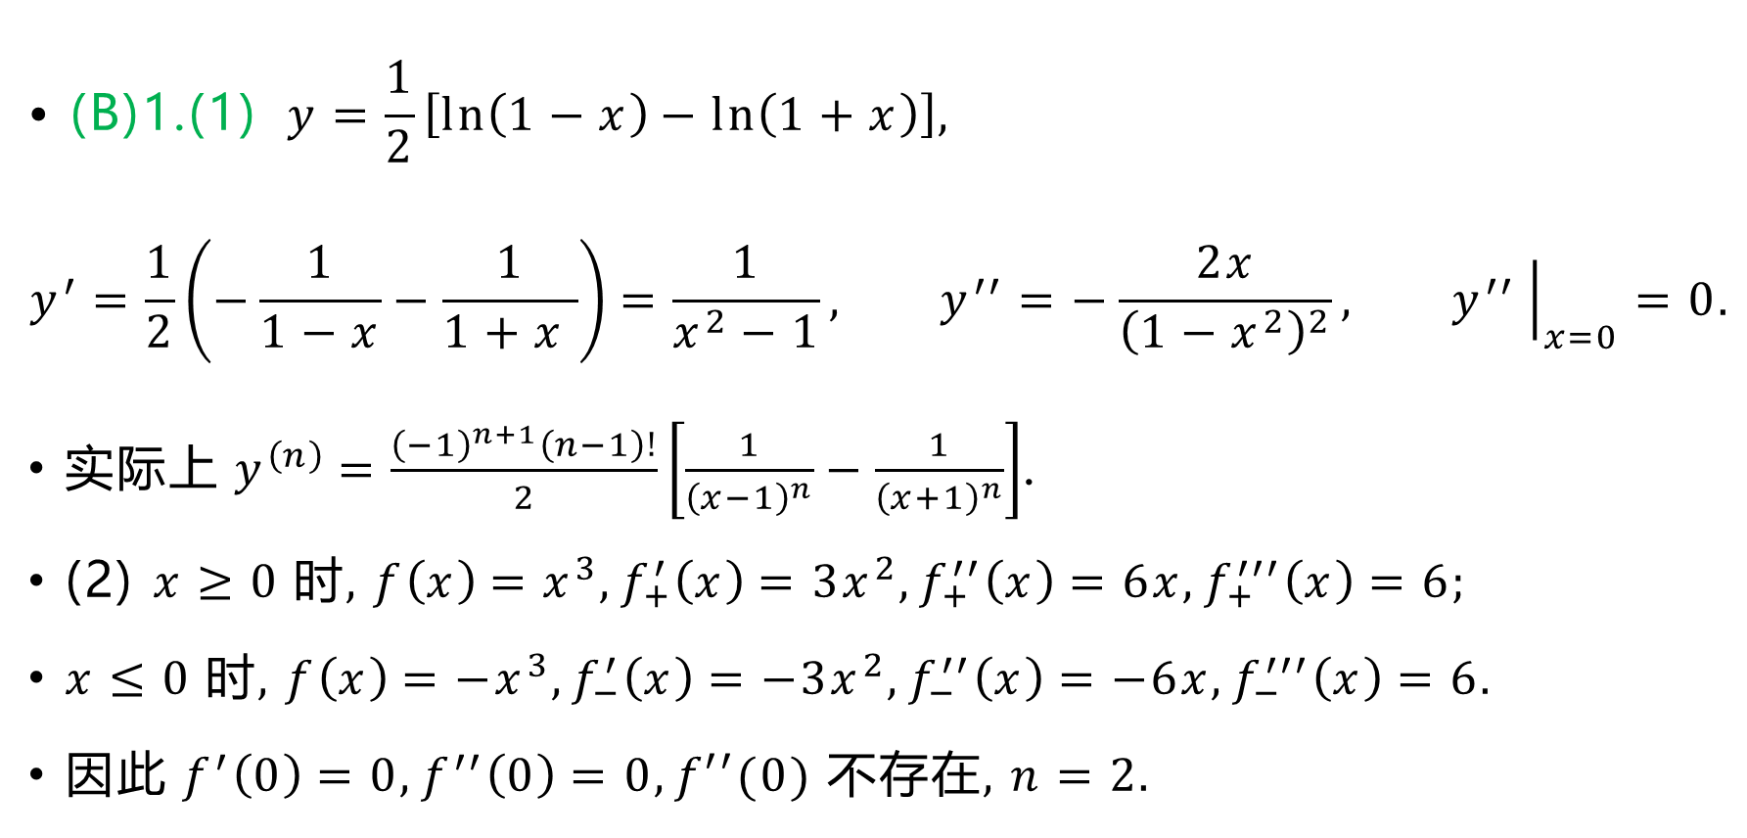
$$\text{•} \text{(}\text{B}\text{)1.(1)} y=\frac{1}{2}\left[\ln\left(1−x\right)−\ln\left(1+x\right)\right],$$
$$y^{′}=\frac{1}{2}\left(−\frac{1}{1−x}−\frac{1}{1+x }\right)=\frac{1}{x^{2}−1}, y^{′′}=−\frac{2x}{{\left(1−x^{2}\right)}^{2}}, y^{′′}{\left.​\right|}_{x=0}=0.$$
$实际上 y^{\left(n\right)}=\frac{{\left(−1\right)}^{n+1}\left(n−1\right)!}{2}\left[\frac{1}{{\left(x−1\right)}^{n}}−\frac{1}{{\left(x+1\right)}^{n}}\right]$.
(2) $x≥0$ 时, $f\left(x\right)=x^{3},f_{+}^{′}\left(x\right)=3x^{2},f_{+}^{′′}\left(x\right)=6x,f_{+}^{′′′}\left(x\right)=6$;
$x≤0$ 时, $f\left(x\right)=−x^{3},f_{−}^{′}\left(x\right)=−3x^{2},f_{−}^{′′}\left(x\right)=−6x,f_{−}^{′′′}\left(x\right)=6$.
因此 $f^{′}\left(0\right)=0,f^{′′}\left(0\right)=0,f′′(0)$ 不存在, $n=2$.

Slide 23
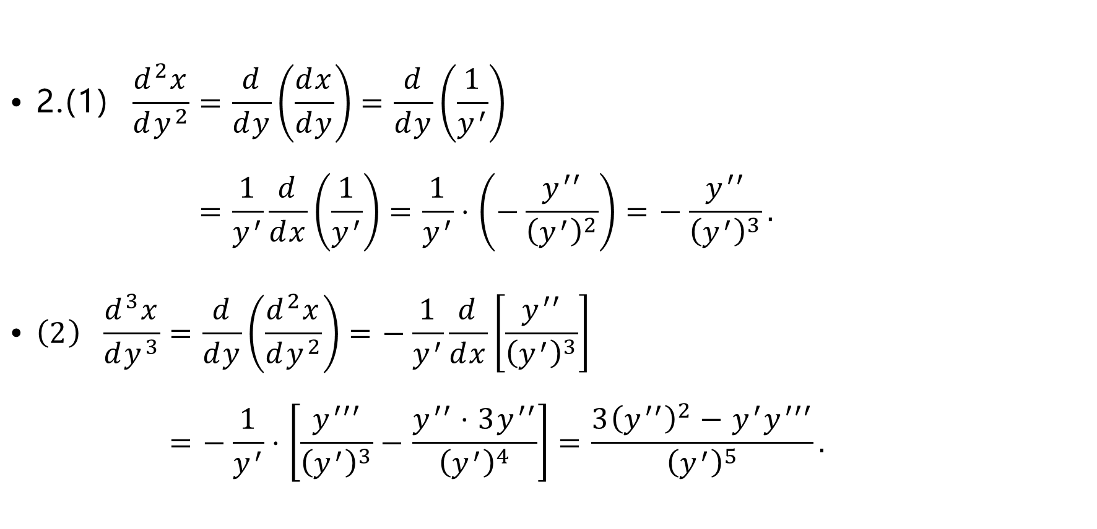
$$\text{•} \text{2.(1)} \frac{d^{2}x}{dy^{2}}=\frac{d}{dy}\left(\frac{dx}{dy}\right)=\frac{d}{dy}\left(\frac{1}{y^{′}}\right) \\ =\frac{1}{y^{′}}\frac{d}{dx}\left(\frac{1}{y^{′}}\right)=\frac{1}{y^{′}}⋅\left(−\frac{y^{′′}}{{\left(y^{′}\right)}^{2}}\right)=−\frac{y^{′′}}{{\left(y^{′}\right)}^{3}}.$$
$$\text{•} \left(2\right) \frac{d^{3}x}{dy^{3}}=\frac{d}{dy}\left(\frac{d^{2}x}{dy^{2}}\right)=−\frac{1}{y^{′}}\frac{d}{dx}\left[\frac{y^{′′}}{{\left(y^{′}\right)}^{3}}\right] \\ =−\frac{1}{y^{′}}⋅\left[\frac{y^{′′′}}{{\left(y^{′}\right)}^{3}}−\frac{y^{′′}⋅3y^{′′}}{{\left(y^{′}\right)}^{4}}\right]=\frac{3{\left(y^{′′}\right)}^{2}−{y^{′}y}^{′′′}}{{\left(y^{′}\right)}^{5}}.$$

Slide 24
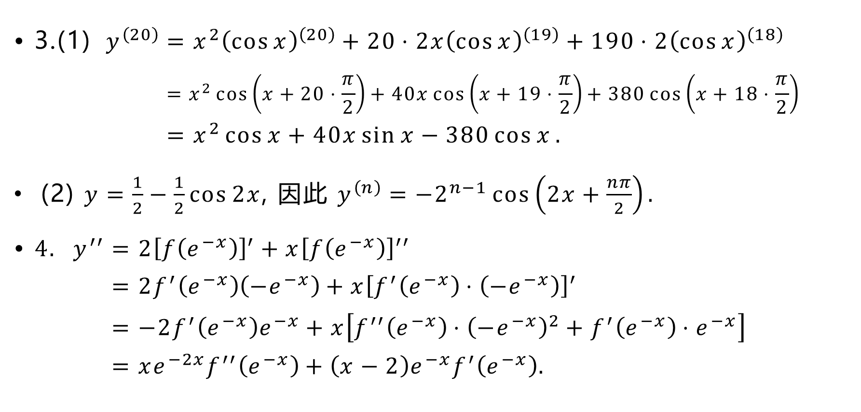
$$\text{•} \text{3.(1)} y^{\left(20\right)}=x^{2}{\left(\cos{x}\right)}^{\left(20\right)}+20⋅2x{\left(\cos{x}\right)}^{\left(19\right)}+190⋅2{\left(\cos{x}\right)}^{\left(18\right)} \\ =x^{2}\cos\left(x+20⋅\frac{π}{2}\right)+40x\cos\left(x+19⋅\frac{π}{2}\right)+380\cos\left(x+18⋅\frac{π}{2}\right) \\ =x^{2}\cos{x}+40x\sin{x}−380\cos{x}.$$
(2) $y=\frac{1}{2}−\frac{1}{2}\cos{2x}$, 因此 $y^{\left(n\right)}=−2^{n−1}\cos\left(2x+\frac{nπ}{2}\right).$
$$\text{•} 4. y^{′′}=2{\left[f\left(e^{−x}\right)\right]}^{′}+x{\left[f\left(e^{−x}\right)\right]}^{′′} \\ =2f^{′}\left(e^{−x}\right)\left(−e^{−x}\right)+x{\left[f^{′}\left(e^{−x}\right)⋅\left(−e^{−x}\right)\right]}^{′} \\ =−2f^{′}\left(e^{−x}\right)e^{−x}+x\left[f^{′′}\left(e^{−x}\right)⋅{\left(−e^{−x}\right)}^{2}+f^{′}\left(e^{−x}\right)⋅e^{−x}\right] \\ =xe^{−2x}f^{′′}\left(e^{−x}\right)+\left(x−2\right)e^{−x}f^{′}\left(e^{−x}\right).$$

Slide 25
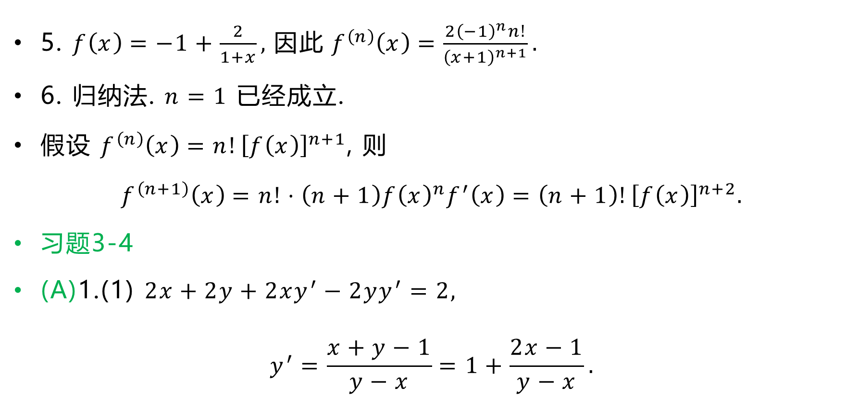
5. $f\left(x\right)=−1+\frac{2}{1+x},$ 因此 $f^{\left(n\right)}\left(x\right)=\frac{2{\left(−1\right)}^{n}n!}{{\left(x+1\right)}^{n+1}}.$
6. 归纳法. $n=1$ 已经成立.
假设 $f^{\left(n\right)}\left(x\right)=n!{\left[f\left(x\right)\right]}^{n+1}$, 则
$$f^{\left(n+1\right)}\left(x\right)=n!⋅\left(n+1\right)f{\left(x\right)}^{n}f^{′}\left(x\right)=\left(n+1\right)!{\left[f\left(x\right)\right]}^{n+2}.$$
习题3-4
(A)1.(1) $2x+2y+2xy^{′}−2yy^{′}=2,$
$$y^{′}=\frac{x+y−1}{y−x}=1+\frac{2x−1}{y−x}.$$

Slide 26
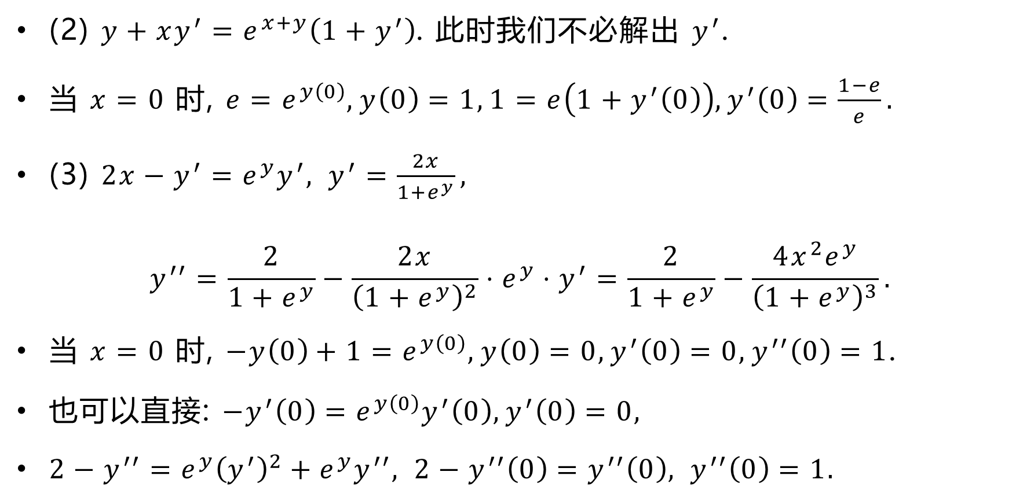
(2) $y+xy^{′}=e^{x+y}\left(1+y^{′}\right)$. 此时我们不必解出 $y^{′}$.
当 $x=0$ 时, $e=e^{y\left(0\right)},y\left(0\right)=1, 1=e\left(1+y^{′}\left(0\right)\right), y^{′}\left(0\right)=\frac{1−e}{e}.$
(3) $2x−y^{′}=e^{y}y^{′}, y^{′}=\frac{2x}{1+e^{y}},$
$$y^{′′}=\frac{2}{1+e^{y}}−\frac{2x}{{\left(1+e^{y}\right)}^{2}}⋅e^{y}⋅y^{′}=\frac{2}{1+e^{y}}−\frac{4x^{2}e^{y}}{{\left(1+e^{y}\right)}^{3}}.$$
当 $x=0$ 时, $−y\left(0\right)+1=e^{y\left(0\right)},y\left(0\right)=0,y^{′}\left(0\right)=0,y^{′′}\left(0\right)=1$.
也可以直接: $−y^{′}\left(0\right)=e^{y\left(0\right)}y^{′}\left(0\right),y^{′}\left(0\right)=0,$
$2−y^{′′}=e^{y}{\left(y^{′}\right)}^{2}+e^{y}y^{′′}, 2−y^{′′}\left(0\right)=y^{′′}\left(0\right), y^{′′}\left(0\right)=1.$

Slide 27
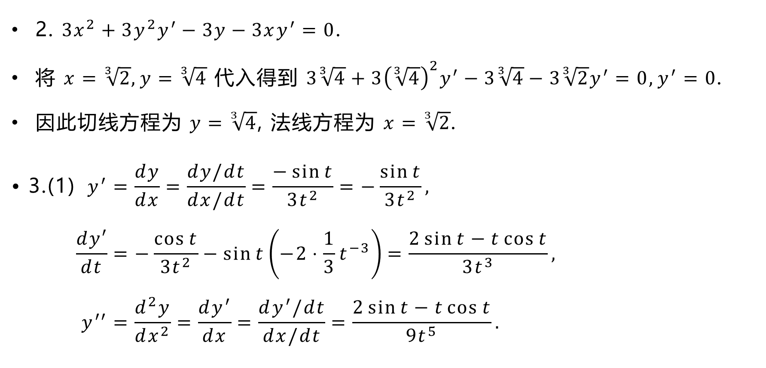
2. $3x^{2}+3y^{2}y^{′}−3y−3xy^{′}=0$.
将 $x=\sqrt[3]{2},y=\sqrt[3]{4}$ 代入得到 $3\sqrt[3]{4}+3{\left(\sqrt[3]{4}\right)}^{2}y^{′}−3\sqrt[3]{4}−3\sqrt[3]{2}y^{′}=0,y^{′}=0$.
因此切线方程为 $y=\sqrt[3]{4}$, 法线方程为 $x=\sqrt[3]{2}$.
$$\text{• 3.(1)} y^{′}=\frac{dy}{dx}=\frac{dy/dt}{dx/dt}=\frac{−\sin{t}}{3t^{2}}=−\frac{\sin{t}}{3t^{2}}, \\ \frac{dy′}{dt}=−\frac{\cos{t}}{3t^{2}}−\sin{t}\left(−2⋅\frac{1}{3}t^{−3}\right)=\frac{2\sin{t}−t\cos{t}}{3t^{3}}, \\ y^{′′}=\frac{d^{2}y}{dx^{2}}=\frac{dy^{′}}{dx}=\frac{dy^{′}/dt}{dx/dt}=\frac{2\sin{t}−t\cos{t}}{9t^{5}}.$$

Slide 28
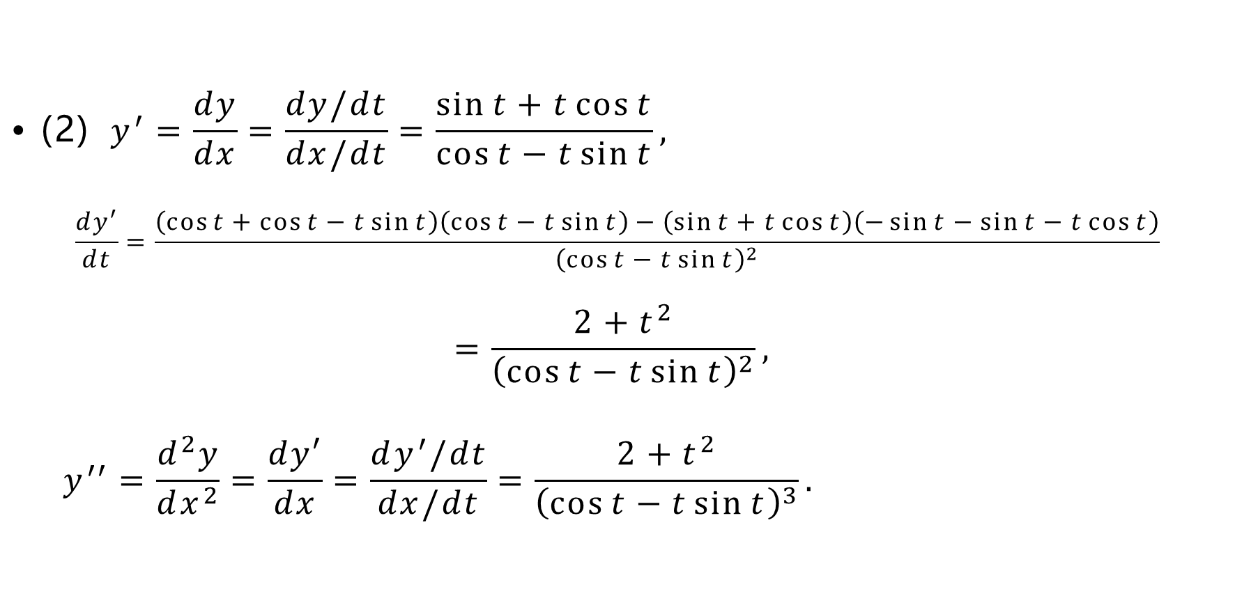
$$\text{•} \text{(2)} y^{′}=\frac{dy}{dx}=\frac{dy/dt}{dx/dt}=\frac{\sin{t}+t\cos{t}}{\cos{t}−t\sin{t}},$$
$$\frac{dy′}{dt}=\frac{\left(\cos{t}+\cos{t}−t\sin{t}\right)\left(\cos{t}−t\sin{t}\right)−\left(\sin{t}+t\cos{t}\right)\left(−\sin{t}−\sin{t}−t\cos{t}\right)}{{\left(\cos{t}−t\sin{t}\right)}^{2}} \\ =\frac{2+t^{2}}{{\left(\cos{t}−t\sin{t}\right)}^{2}},$$
$$y^{′′}=\frac{d^{2}y}{dx^{2}}=\frac{dy′}{dx}=\frac{dy^{′}/dt}{dx/dt}=\frac{2+t^{2}}{{\left(\cos{t}−t\sin{t}\right)}^{3}}.$$

Slide 29
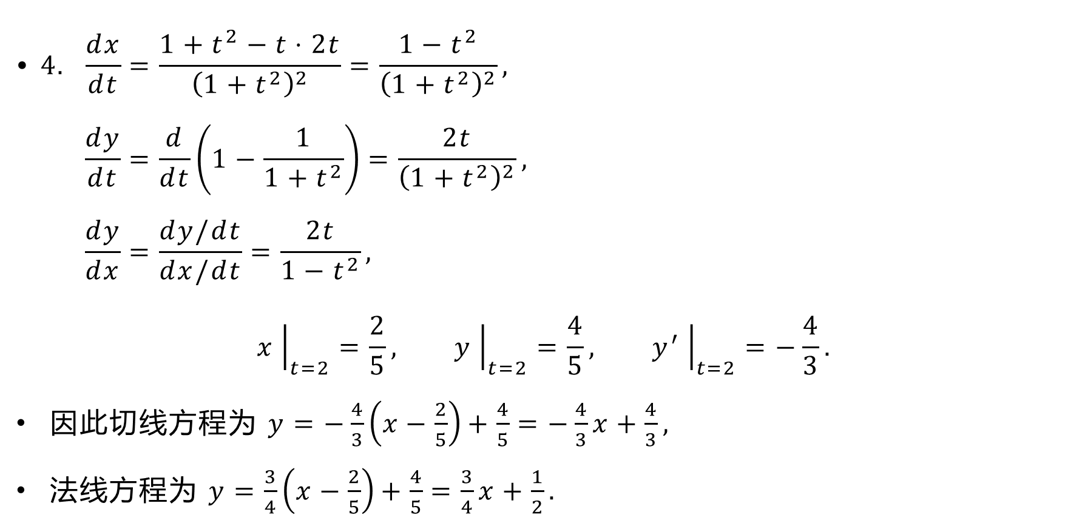
$$\text{• }4. \frac{dx}{dt}=\frac{1+t^{2}−t⋅2t}{{\left(1+t^{2}\right)}^{2}}=\frac{1−t^{2}}{{\left(1+t^{2}\right)}^{2}}, \\ \frac{dy}{dt}=\frac{d}{dt}\left(1−\frac{1}{1+t^{2}}\right)=\frac{2t}{{\left(1+t^{2}\right)}^{2}}, \\ \frac{dy}{dx}=\frac{dy/dt}{dx/dt}=\frac{2t}{{1−t}^{2}},$$
$$x{\left.​\right|}_{t=2}=\frac{2}{5}, y{\left.​\right|}_{t=2}=\frac{4}{5}, y^{′}{\left.​\right|}_{t=2}=−\frac{4}{3}.$$
因此切线方程为 $y=−\frac{4}{3}\left(x−\frac{2}{5}\right)+\frac{4}{5}=−\frac{4}{3}x+\frac{4}{3},$
法线方程为 $y=\frac{3}{4}\left(x−\frac{2}{5}\right)+\frac{4}{5}=\frac{3}{4}x+\frac{1}{2}.$

Slide 30

$$\text{•} \text{(}\text{B}\text{)1.(1) }\frac{1}{1+{\left(\frac{y}{x}\right)}^{2}}⋅\left(\frac{y^{′}}{x}−\frac{y}{x^{2}}\right)=\frac{1}{2}⋅\frac{1}{x^{2}+y^{2}}⋅\left(2x+2yy^{′}\right),$$
$$xy^{′}−y=x+yy^{′},y^{′}=\frac{x+y}{x−y}.$$
$$y^{′}+xy^{′′}−y^{′}=1+{\left(y^{′}\right)}^{2}+yy^{′′},$$
$$y^{′′}=\frac{1+{\left(y^{′}\right)}^{2}}{x−y}=\frac{2\left(x^{2}+y^{2}\right)}{{\left(x−y\right)}^{3}}.$$

Slide 31

$$\text{•} \left(2\right) y^{′}=e^{xy}+xe^{xy}\left(y+xy^{′}\right)=e^{xy}\left(1+xy+x^{2}y^{′}\right),$$
$$y^{′}=\frac{1+xy}{e^{−xy}−x^{2}}.$$
$$y\left(0\right)=1, y^{′}\left(0\right)=1.$$
$$y^{′′}=e^{xy}\left(y+xy^{′}\right)\left(1+xy+x^{2}y^{′}\right)+e^{xy}\left(y+xy^{′}+2xy^{′}+x^{2}y^{′′}\right),$$
$$y^{′′}\left(0\right)=1+1=2.$$

Slide 32
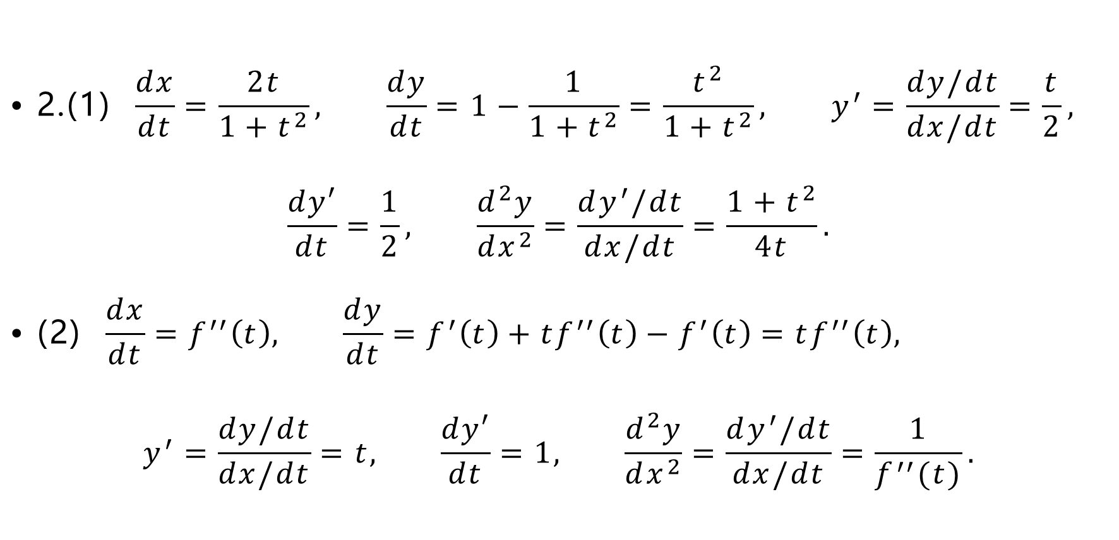
$$\text{•} \text{2.(1)} \frac{dx}{dt}=\frac{2t}{1+t^{2}}, \frac{dy}{dt}=1−\frac{1}{1+t^{2}}=\frac{t^{2}}{1+t^{2}}, y^{′}=\frac{dy/dt}{dx/dt}=\frac{t}{2},$$
$$\frac{dy′}{dt}=\frac{1}{2}, \frac{d^{2}y}{dx^{2}}=\frac{dy^{′}/dt}{dx/dt}=\frac{1+t^{2}}{4t}.$$
$$\text{•} \text{(2)} \frac{dx}{dt}=f^{′′}\left(t\right), \frac{dy}{dt}=f^{′}\left(t\right)+tf^{′′}\left(t\right)−f^{′}\left(t\right)=tf^{′′}\left(t\right),$$
$$y^{′}=\frac{dy/dt}{dx/dt}=t, \frac{dy′}{dt}=1, \frac{d^{2}y}{dx^{2}}=\frac{dy^{′}/dt}{dx/dt}=\frac{1}{f^{′′}(t)}.$$

Slide 33

3.(1) $x=e^{θ}\cos{θ},y=e^{θ}\sin{θ}$.
$$\frac{dx}{dθ}=e^{θ}\cos{θ}−e^{θ}\sin{θ}, \frac{dy}{dθ}=e^{θ}\sin{θ}+e^{θ}\cos{θ},$$
$$\frac{dy}{dx}=\frac{\sin{θ}+\cos{θ}}{\cos{θ}−\sin{θ}}, \frac{dy}{dx}{\left.​\right|}_{θ=π}=1,x_{0}=−e^{π},y_{0}=0.$$
切线方程为 $y=x+e^{π}$, 法线方程为 $y=−x−e^{π}$.

Slide 34

习题3-5
$$\text{•} \text{(}\text{A}\text{)1.(1) }Δy=y\left(1+Δx\right)−y\left(1\right) \\ ={\left(1+Δx\right)}^{2}+2\left(1+Δx\right)−3 \\ =4Δx+{\left(Δx\right)}^{2},$$
$$dy=4Δx,$$
$$\begin{aligned}Δy{\left.​\right|}_{Δx=1}&=5,&dy{\left.​\right|}_{Δx=1}=&4, \\ Δy{\left.​\right|}_{Δx=0.1}&=0.41,&dy{\left.​\right|}_{Δx=0.1}=&0.4, \\ Δy{\left.​\right|}_{Δx=0.01}&=0.0401, &dy{\left.​\right|}_{Δx=0.01}=&0.04.\end{aligned}$$

Slide 35

2.(1) $d\left(\frac{1}{2}x^{2}\right)=xdx$.
(2) $d\left(−\sin{x}\right)=\cos{x}dx$.
$\text{(3) }d\left(\ln\left|1+x\right|\right)=\frac{1}{1+x}dx.$
(4) $d\left(e^{−x}\right)=−e^{−x}dx, d\left(\cot{x}\right)=\csc^{2}xdx,$
$d\left(−e^{−x}−\cot{x}\right)=\left(e^{−x}−\csc^{2}x\right)dx.$
3.(1) $dy=\left(2x\sin{2x}+x^{2}\cos{2x}⋅2\right)dx=\left(2x\sin{2x}+2x^{2}\cos{2x}\right)dx.$

Slide 36
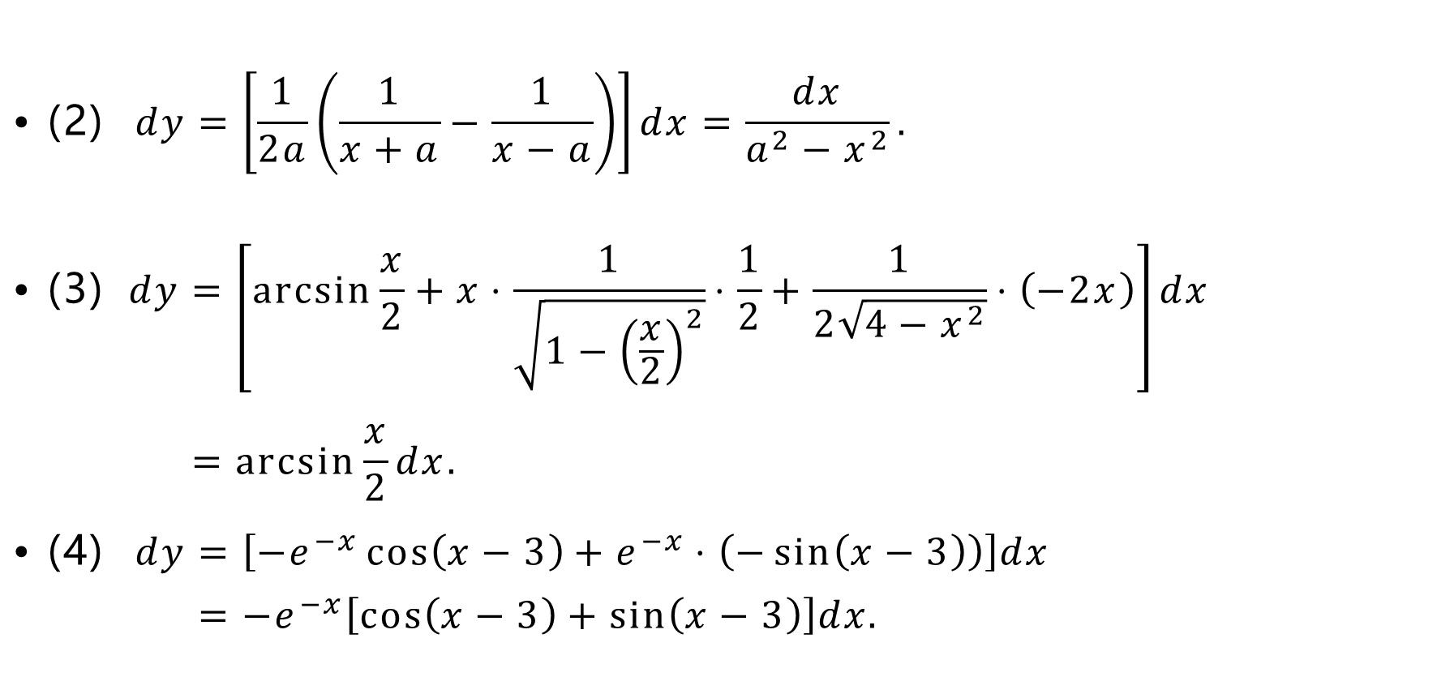
$$\text{•} \text{(}\text{2}\text{)} dy=\left[\frac{1}{2a}\left(\frac{1}{x+a}−\frac{1}{x−a}\right)\right]dx=\frac{dx}{a^{2}−x^{2}}.$$
$$\text{•} \text{(3)} dy=\left[\arcsin{\frac{x}{2}}+x⋅\frac{1}{\sqrt{1−{\left(\frac{x}{2}\right)}^{2}}}⋅\frac{1}{2}+\frac{1}{2\sqrt{4−x^{2}}}⋅\left(−2x\right)\right]dx \\ =\arcsin{\frac{x}{2}}dx.$$
$$\text{• (}\text{4}\text{)} dy=\left[−e^{−x}\cos\left(x−3\right)+e^{−x}⋅\left(−\sin\left(x−3\right)\right)\right]dx \\ =−e^{−x}\left[\cos\left(x−3\right)+\sin\left(x−3\right)\right]dx.$$

Slide 37
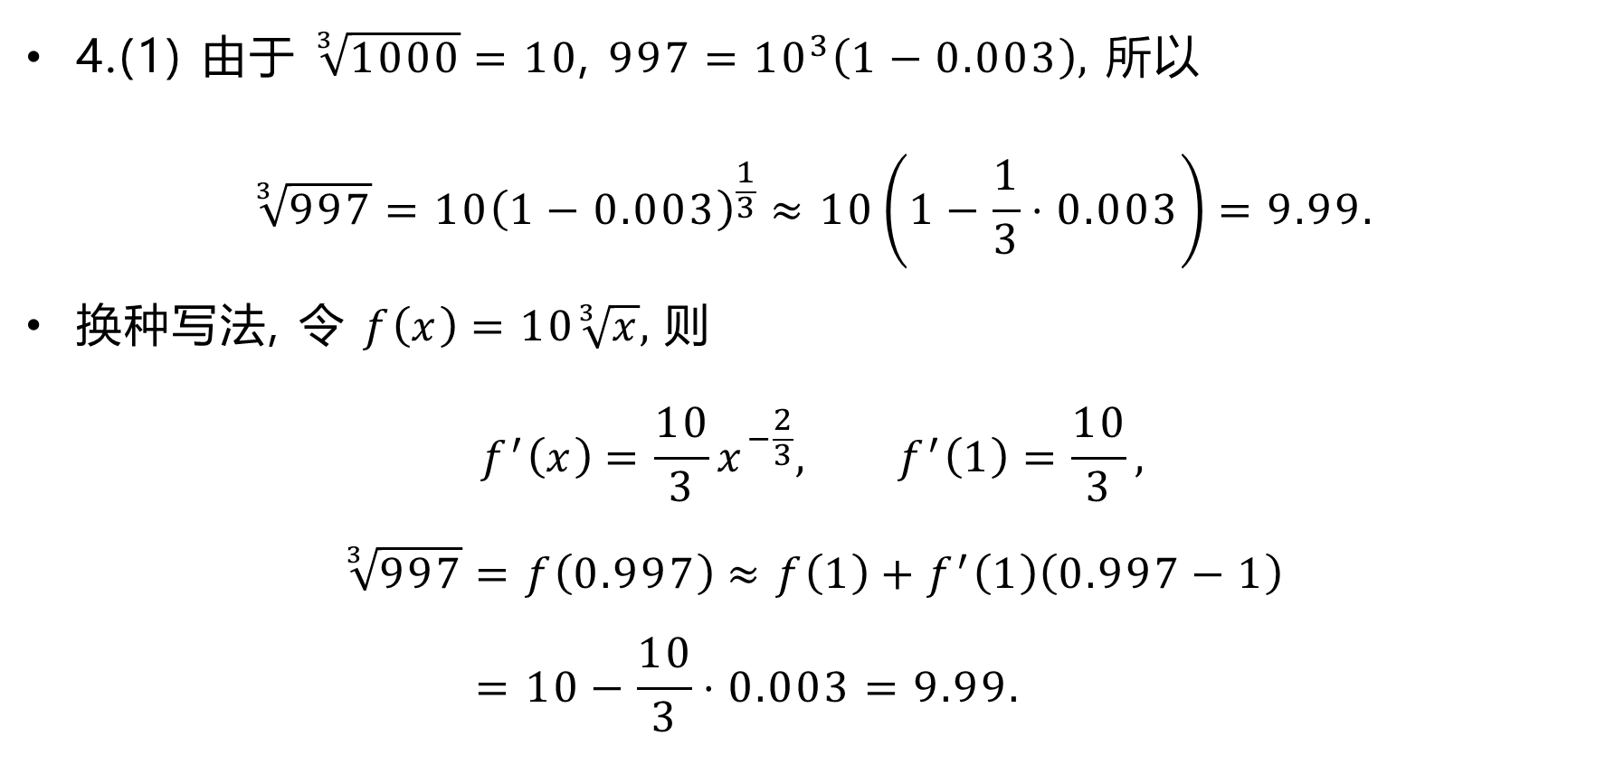
4.(1) 由于 $\sqrt[3]{1000}=10$, $997={10}^{3}\left(1−0.003\right),$ 所以
$$\sqrt[3]{997}=10{\left(1−0.003\right)}^{\frac{1}{3}}≈10\left(1−\frac{1}{3}⋅0.003\right)=9.99.$$
换种写法, 令 $f\left(x\right)=10\sqrt[3]{x}$, 则
$$f^{′}\left(x\right)=\frac{10}{3}x^{−\frac{2}{3}}, f^{′}\left(1\right)=\frac{10}{3},$$
$$\sqrt[3]{997}=f\left(0.997\right)≈f\left(1\right)+f^{′}\left(1\right)\left(0.997−1\right) \\ =10−\frac{10}{3}⋅0.003=9.99.$$

Slide 38
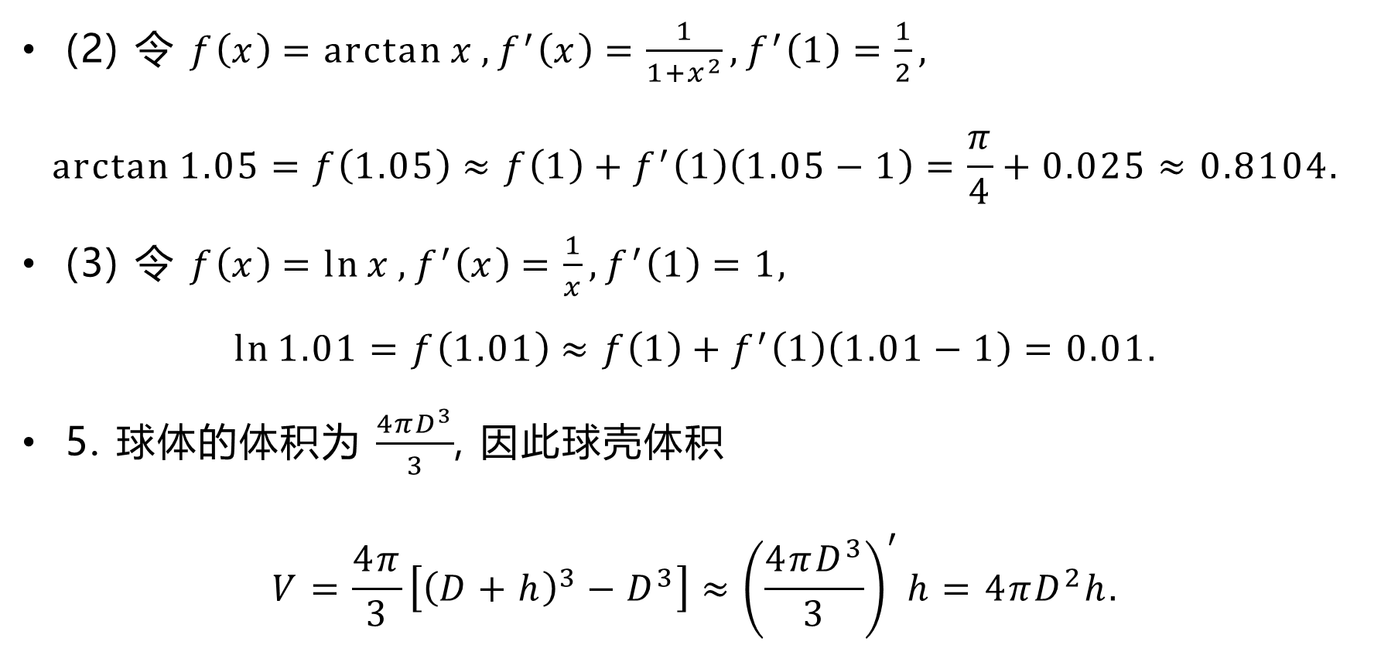
(2) 令 $f\left(x\right)=\arctan{x}, f^{′}\left(x\right)=\frac{1}{1+x^{2}},f^{′}\left(1\right)=\frac{1}{2},$
$$\arctan{1.05}=f\left(1.05\right)≈f\left(1\right)+f^{′}\left(1\right)\left(1.05−1\right)=\frac{π}{4}+0.025≈0.8104.$$
(3) 令 $f\left(x\right)=\ln{x}, f^{′}\left(x\right)=\frac{1}{x},f^{′}\left(1\right)=1,$
$$\ln{1.01}=f\left(1.01\right)≈f\left(1\right)+f^{′}\left(1\right)\left(1.01−1\right)=0.01.$$
5. 球体的体积为 $\frac{4πD^{3}}{3}$, 因此球壳体积
$$V=\frac{4π}{3}\left[{\left(D+h\right)}^{3}−D^{3}\right]≈{\left(\frac{4πD^{3}}{3}\right)}^{′}h=4πD^{2}h.$$

Slide 39
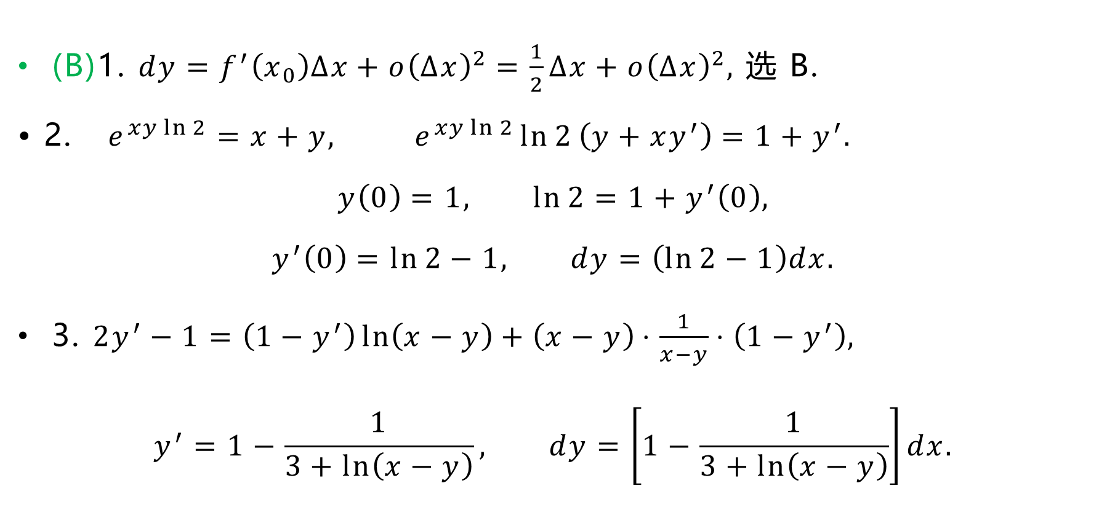
(B)1. $dy=f^{′}\left(x_{0}\right)Δx+o{\left(Δx\right)}^{2}=\frac{1}{2}Δx+o{\left(Δx\right)}^{2},$ 选 B.
$$\text{• 2.} e^{xy\ln{2}}=x+y, e^{xy\ln{2}}\ln{2}\left(y+xy^{′}\right)=1+y^{′}.$$
$$y\left(0\right)=1, \ln{2}=1+y^{′}\left(0\right),$$
$$y^{′}\left(0\right)=\ln{2}−1, dy=\left(\ln{2}−1\right)dx.$$
3. $2y^{′}−1=\left(1−y^{′}\right)\ln\left(x−y\right)+\left(x−y\right)⋅\frac{1}{x−y}⋅\left(1−y^{′}\right),$
$$y^{′}=1−\frac{1}{3+\ln\left(x−y\right)}, dy=\left[1−\frac{1}{3+\ln\left(x−y\right)}\right]dx.$$

Slide 40

$$\text{•} 4. y^{′}=f^{′}\left(\arcsin{x^{2}}\right)⋅\frac{1}{\sqrt{1−x^{4}}}⋅2x−\sin{f\left(x\right)}⋅f^{′}\left(x\right),$$
$$dy=\left[f^{′}\left(\arcsin{x^{2}}\right)⋅\frac{2x}{\sqrt{1−x^{4}}}−\sin{f\left(x\right)}⋅f^{′}\left(x\right)\right]dx.$$
总复习题三
$$\text{• 1.(1)} f\left(t\right)=\lim_{x→∞}{t{\left(\frac{x+t}{x−t}\right)}^{x}}=te^{\lim_{x→∞}\left(\frac{x+t}{x−t}−1\right)x}=te^{2t},$$
$$f^{′}\left(t\right)=e^{2t}+2te^{2t}=\left(2t+1\right)e^{2t}.$$

Slide 41

$$\text{•} \left(2\right) \cos{xy}⋅\left(y+xy^{′}\right)+\frac{1}{y−x}⋅\left(y^{′}−1\right)=1,$$
$$1+y^{′}\left(0\right)−1=1, y^{′}\left(0\right)=1,$$
切线方程为 $y=x+1$.
$$\text{•} \left(3\right) \frac{dx}{dt}=\cos{t}, \frac{dy}{dt}=\sin{t}+t\cos{t}−\sin{t}=t\cos{t},$$
$$y^{′}=\frac{dy/dt}{dx/dt}=t, \frac{dy′}{dt}=1, y^{′′}=\frac{dy^{′}/dt}{dx/dt}=\frac{1}{\cos{t}}, y^{′′}{\left.​\right|}_{t=\frac{π}{4}}=\sqrt{2}.$$

Slide 42
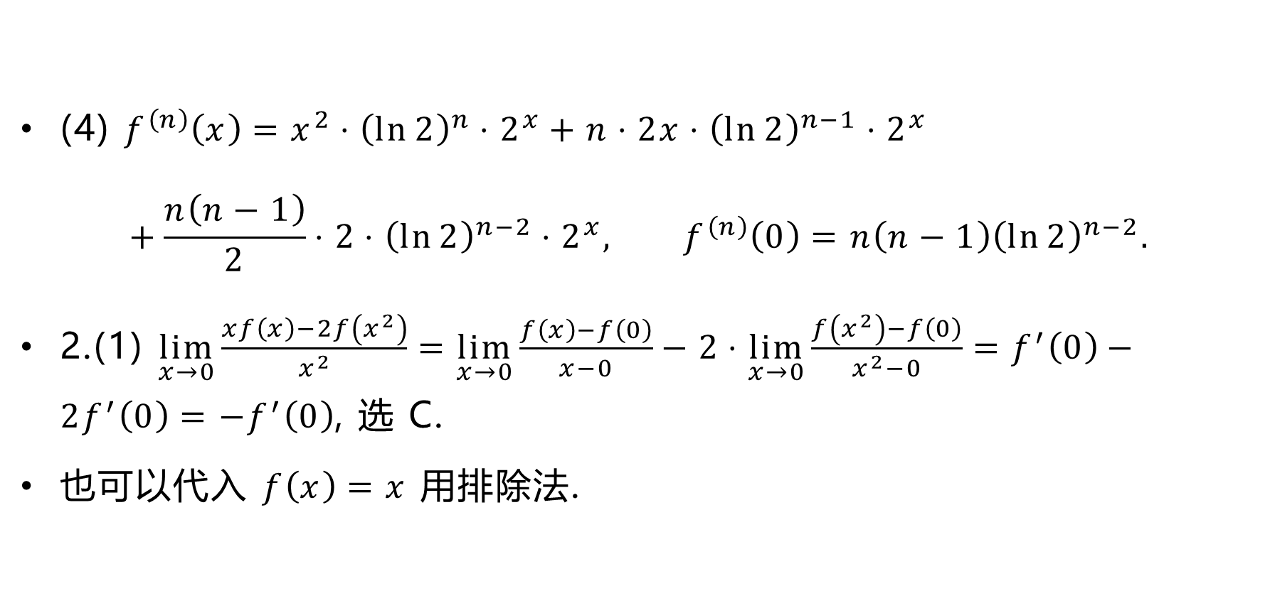
(4) $f^{\left(n\right)}\left(x\right)=x^{2}⋅{\left(\ln{2}\right)}^{n}⋅2^{x}+n⋅2x⋅{\left(\ln{2}\right)}^{n−1}⋅2^{x}$
$$+\frac{n\left(n−1\right)}{2}⋅2⋅{\left(\ln{2}\right)}^{n−2}⋅2^{x}, f^{\left(n\right)}\left(0\right)=n\left(n−1\right){\left(\ln{2}\right)}^{n−2}.$$
2.(1) $\lim_{x→0}{\frac{xf\left(x\right)−2f\left(x^{2}\right)}{x^{2}}}=\lim_{x→0}{\frac{f\left(x\right)−f\left(0\right)}{x−0}}−2⋅\lim_{x→0}{\frac{f\left(x^{2}\right)−f\left(0\right)}{x^{2}−0}}=f^{′}\left(0\right)−2f^{′}\left(0\right)=−f^{′}\left(0\right)$, 选 C.
也可以代入 $f\left(x\right)=x$ 用排除法.

Slide 43
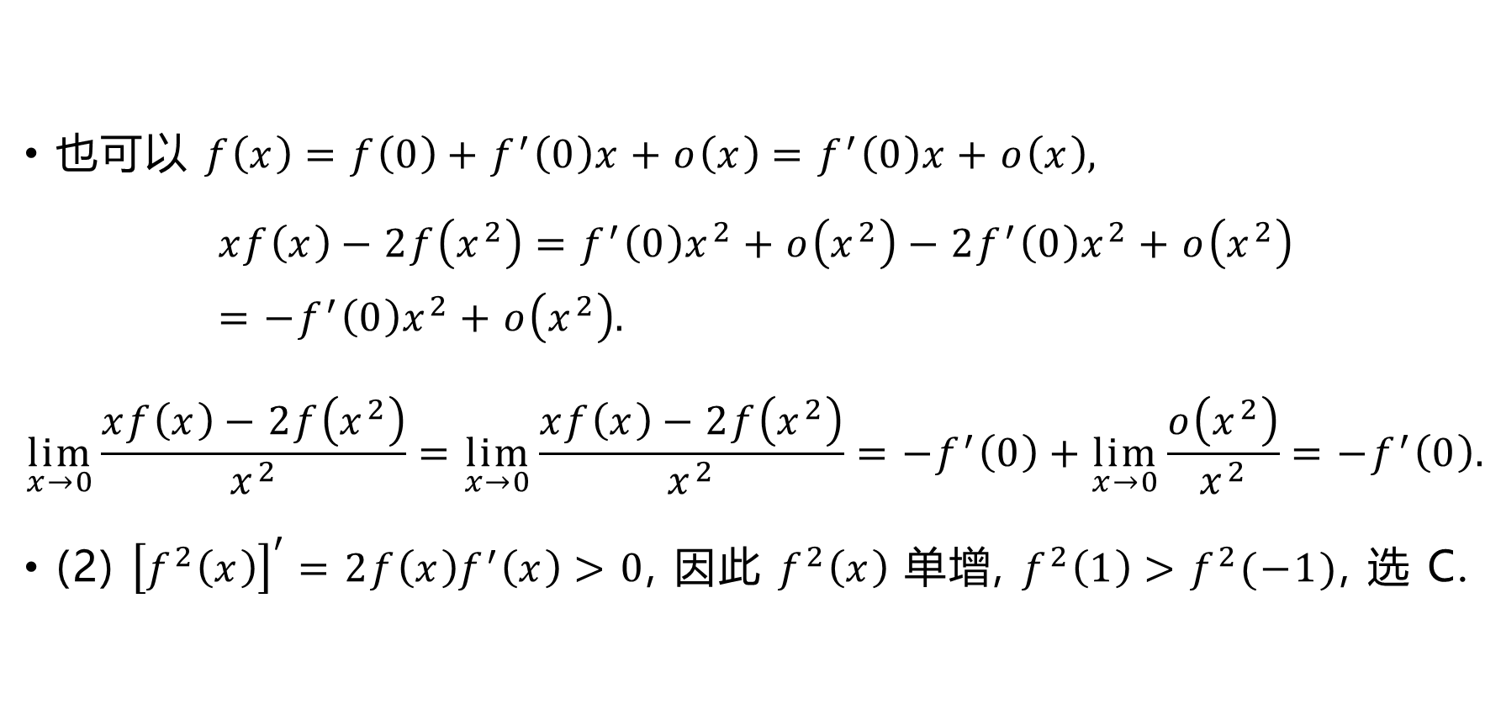
也可以 $f\left(x\right)=f\left(0\right)+f^{′}\left(0\right)x+o\left(x\right)=f^{′}\left(0\right)x+o\left(x\right),$
$$xf\left(x\right)−2f\left(x^{2}\right)=f^{′}\left(0\right)x^{2}+o\left(x^{2}\right)−2f^{′}\left(0\right)x^{2}+o\left(x^{2}\right)=−f^{′}\left(0\right)x^{2}+o\left(x^{2}\right).$$
$$\lim_{x→0}{\frac{xf\left(x\right)−2f\left(x^{2}\right)}{x^{2}}}=\lim_{x→0}{\frac{xf\left(x\right)−2f\left(x^{2}\right)}{x^{2}}}=−f^{′}\left(0\right)+\lim_{x→0}{\frac{o\left(x^{2}\right)}{x^{2}}}=−f^{′}\left(0\right).$$
(2) ${\left[f^{2}\left(x\right)\right]}^{′}=2f\left(x\right)f^{′}\left(x\right)>0$, 因此 $f^{2}\left(x\right)$ 单增, $f^{2}\left(1\right)>f^{2}(−1)$, 选 C.

Slide 44
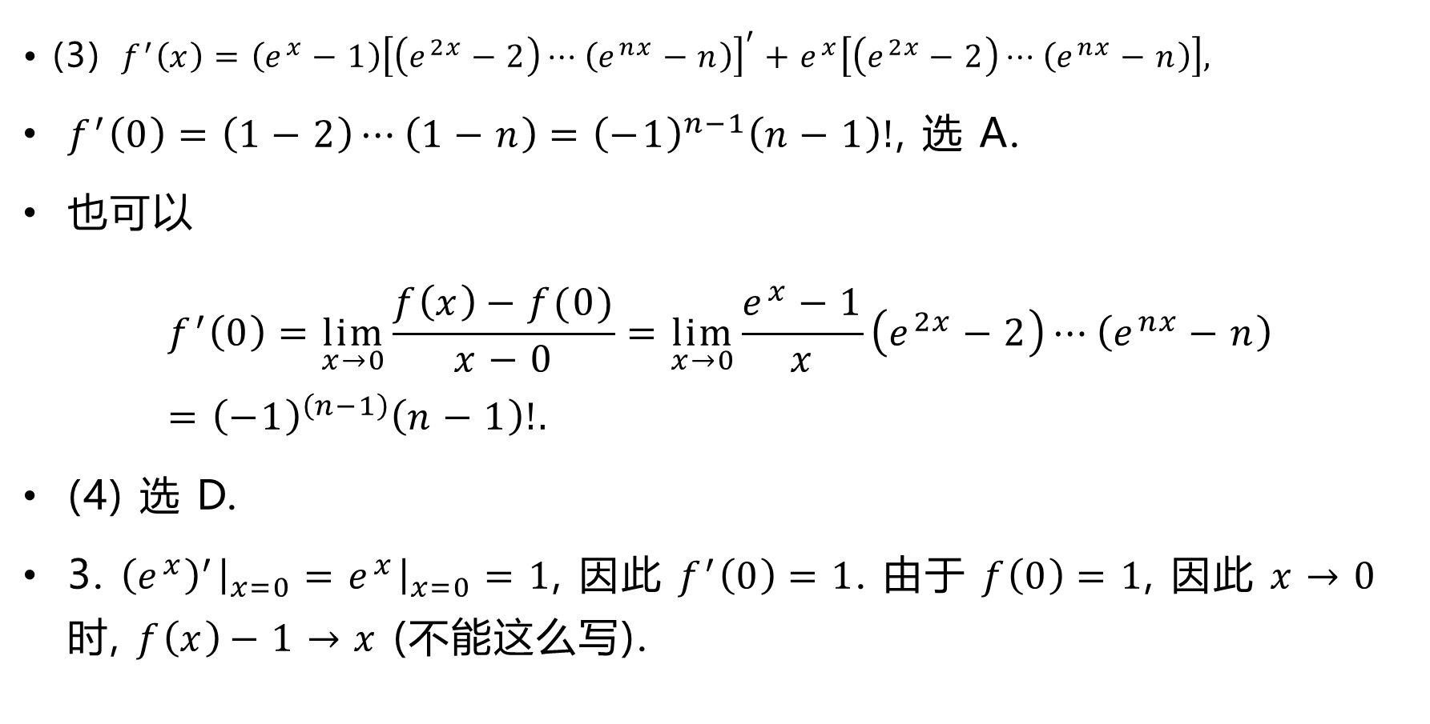
$$\text{•} \text{(3)} f^{′}\left(x\right)=\left(e^{x}−1\right){\left[\left(e^{2x}−2\right)⋯\left(e^{nx}−n\right)\right]}^{′}+e^{x}\left[\left(e^{2x}−2\right)⋯\left(e^{nx}−n\right)\right],$$
$f^{′}\left(0\right)=\left(1−2\right)⋯\left(1−n\right)={\left(−1\right)}^{n−1}\left(n−1\right)!$, 选 A.
也可以
$$f^{′}\left(0\right)=\lim_{x→0}{\frac{f\left(x\right)−f(0)}{x−0}}=\lim_{x→0}{\frac{e^{x}−1}{x}\left(e^{2x}−2\right)⋯\left(e^{nx}−n\right)}={\left(−1\right)}^{\left(n−1\right)}\left(n−1\right)!.$$
(4) 选 D.
3. ${\left(e^{x}\right)}^{′}{\left.​\right|}_{x=0}=e^{x}{\left.​\right|}_{x=0}=1$, 因此 $f^{′}\left(0\right)=1$. 由于 $f\left(0\right)=1$, 因此 $x→0$ 时, $f\left(x\right)−1→x$ (不能这么写).

Slide 45
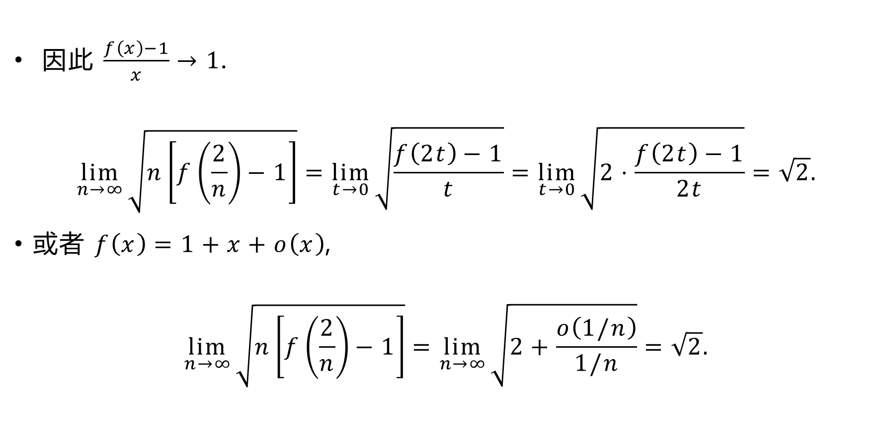
因此 $\frac{f\left(x\right)−1}{x}→1$.
$$\lim_{n→∞}{\sqrt{n\left[f\left(\frac{2}{n}\right)−1\right]}}=\lim_{t→0}{\sqrt{\frac{f\left(2t\right)−1}{t}}}=\lim_{t→0}{\sqrt{2⋅\frac{f\left(2t\right)−1}{2t}}}=\sqrt{2}.$$
或者 $f\left(x\right)=1+x+o\left(x\right)$,
$$\lim_{n→∞}{\sqrt{n\left[f\left(\frac{2}{n}\right)−1\right]}}=\lim_{n→∞}{\sqrt{2+\frac{o\left(1/n\right)}{1/n}}}=\sqrt{2}.$$

Slide 46
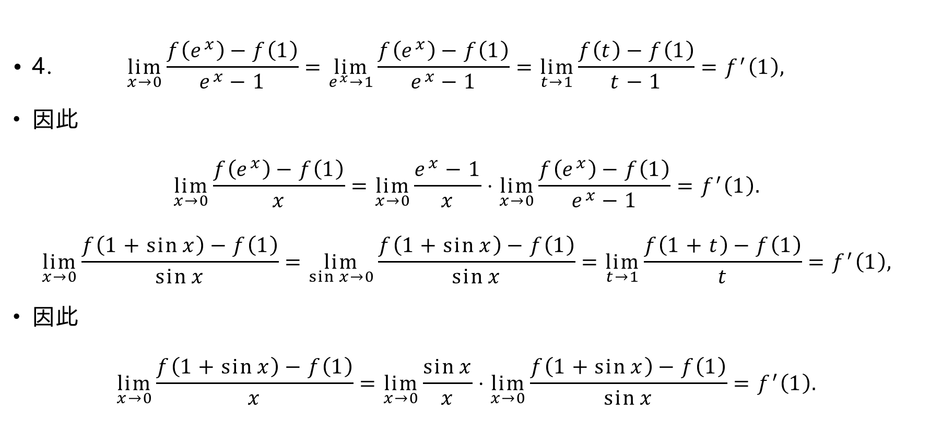
$$\text{•} \text{4.} \lim_{x→0}{\frac{f\left(e^{x}\right)−f\left(1\right)}{e^{x}−1}}=\lim_{e^{x}→1}{\frac{f\left(e^{x}\right)−f\left(1\right)}{e^{x}−1}}=\lim_{t→1}{\frac{f\left(t\right)−f\left(1\right)}{t−1}}=f^{′}\left(1\right),$$
因此
$$\lim_{x→0}{\frac{f\left(e^{x}\right)−f\left(1\right)}{x}}=\lim_{x→0}{\frac{e^{x}−1}{x}}⋅\lim_{x→0}{\frac{f\left(e^{x}\right)−f\left(1\right)}{e^{x}−1}}=f^{′}\left(1\right).$$
$$\lim_{x→0}{\frac{f\left(1+\sin{x}\right)−f\left(1\right)}{\sin{x}}}=\lim_{\sin{x}→0}{\frac{f\left(1+\sin{x}\right)−f\left(1\right)}{\sin{x}}}=\lim_{t→1}{\frac{f\left(1+t\right)−f\left(1\right)}{t}}=f^{′}\left(1\right),$$
$\text{因此}$
$$\lim_{x→0}{\frac{f\left(1+\sin{x}\right)−f\left(1\right)}{x}}=\lim_{x→0}{\frac{\sin{x}}{x}}⋅\lim_{x→0}{\frac{f\left(1+\sin{x}\right)−f\left(1\right)}{\sin{x}}}=f^{′}\left(1\right).$$

Slide 47
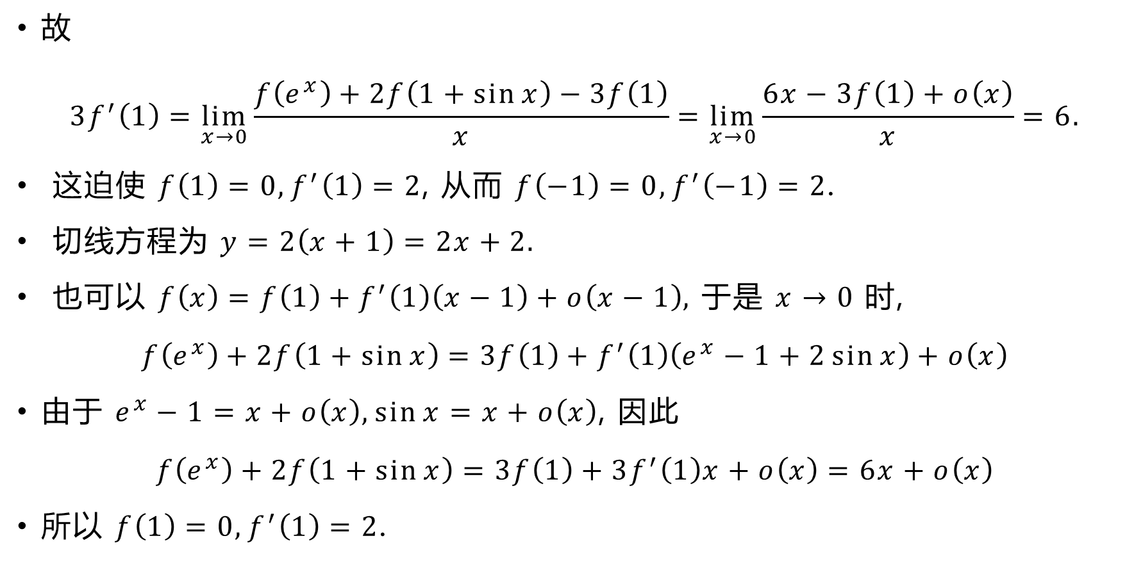
故
$$3f^{′}\left(1\right)=\lim_{x→0}{\frac{f\left(e^{x}\right)+2f\left(1+\sin{x}\right)−3f\left(1\right)}{x}}=\lim_{x→0}{\frac{6x−3f\left(1\right)+o\left(x\right)}{x}}=6.$$
这迫使 $f\left(1\right)=0,f^{′}\left(1\right)=2$, 从而 $f\left(−1\right)=0,f^{′}\left(−1\right)=2$.
切线方程为 $y=2\left(x+1\right)=2x+2.$
也可以 $f\left(x\right)=f\left(1\right)+f^{′}\left(1\right)\left(x−1\right)+o\left(x−1\right),$ 于是 $x→0$ 时,
$$f\left(e^{x}\right)+2f\left(1+\sin{x}\right)=3f\left(1\right)+f^{′}\left(1\right)\left(e^{x}−1+2\sin{x}\right)+o\left(x\right)$$
由于 $e^{x}−1=x+o\left(x\right),\sin{x}=x+o\left(x\right)$, 因此
$$f\left(e^{x}\right)+2f\left(1+\sin{x}\right)=3f\left(1\right)+3f^{′}\left(1\right)x+o\left(x\right)=6x+o\left(x\right)$$
所以 $f\left(1\right)=0,f^{′}\left(1\right)=2$.

Slide 48
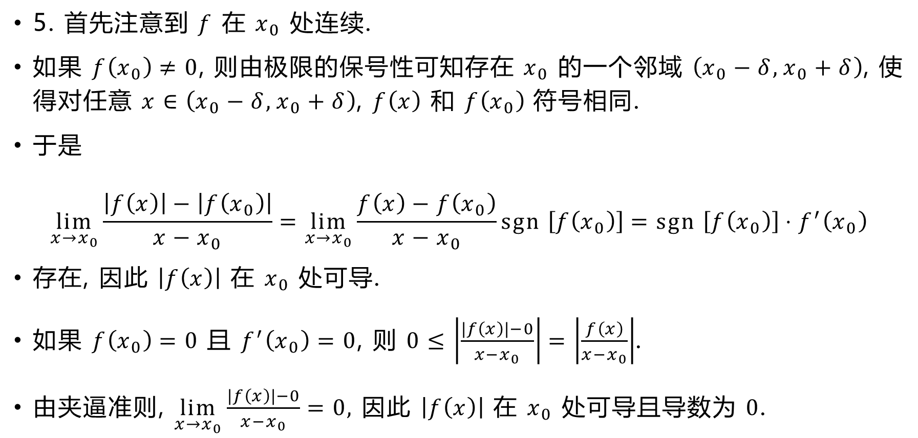
5. 首先注意到 $f$ 在 $x_{0}$ 处连续.
如果 $f\left(x_{0}\right)≠0$, 则由极限的保号性可知存在 $x_{0}$ 的一个邻域 $\left(x_{0}−δ,x_{0}+δ\right)$, 使得对任意 $x∈\left(x_{0}−δ,x_{0}+δ\right)$, $f\left(x\right)$ 和 $f\left(x_{0}\right)$ 符号相同.
于是
$$\lim_{x→x_{0}}{\frac{\left|f\left(x\right)\right|−\left|f\left(x_{0}\right)\right|}{x−x_{0}}}=\lim_{x→x_{0}}{\frac{f\left(x\right)−f\left(x_{0}\right)}{x−x_{0}}sgn \left[f\left(x_{0}\right)\right]}=sgn \left[f\left(x_{0}\right)\right]⋅f^{′}\left(x_{0}\right)$$
存在, 因此 $\left|f\left(x\right)\right|$ 在 $x_{0}$ 处可导.
如果 $f\left(x_{0}\right)=0$ 且 $f^{′}\left(x_{0}\right)=0$, 则 $0≤\left|\frac{\left|f\left(x\right)\right|−0}{x−x_{0}}\right|=\left|\frac{f\left(x\right)}{x−x_{0}}\right|$.
由夹逼准则, $\lim_{x→x_{0}}{\frac{\left|f\left(x\right)\right|−0}{x−x_{0}}}=0,$ 因此 $\left|f\left(x\right)\right|$ 在 $x_{0}$ 处可导且导数为 $0$.

Slide 49
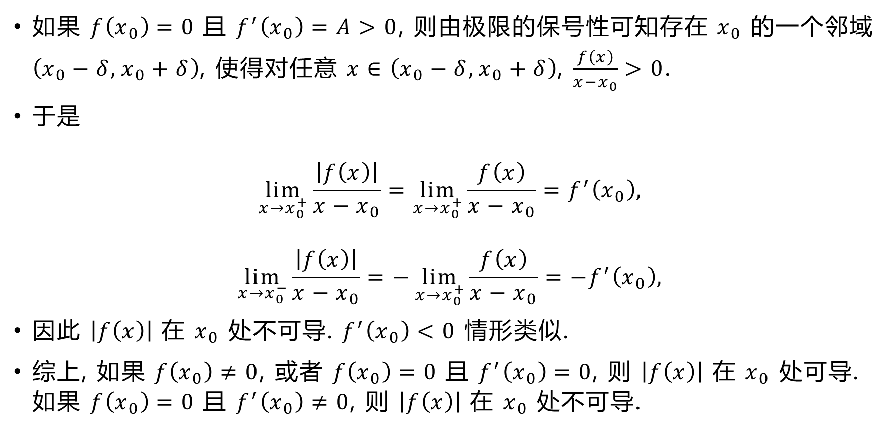
如果 $f\left(x_{0}\right)=0$ 且 $f^{′}\left(x_{0}\right)=A>0$, 则由极限的保号性可知存在 $x_{0}$ 的一个邻域 $\left(x_{0}−δ,x_{0}+δ\right)$, 使得对任意 $x∈\left(x_{0}−δ,x_{0}+δ\right)$, $\frac{f\left(x\right)}{x−x_{0}}>0$.
于是
$$\lim_{x→x_{0}^{+}}{\frac{\left|f\left(x\right)\right|}{x−x_{0}}}=\lim_{x→x_{0}^{+}}{\frac{f\left(x\right)}{x−x_{0}}}=f^{′}\left(x_{0}\right),$$
$$\lim_{x→x_{0}^{−}}{\frac{\left|f\left(x\right)\right|}{x−x_{0}}}=−\lim_{x→x_{0}^{+}}{\frac{f\left(x\right)}{x−x_{0}}}=−f^{′}\left(x_{0}\right),$$
因此 $\left|f\left(x\right)\right|$ 在 $x_{0}$ 处不可导. $f^{′}\left(x_{0}\right)<0$ 情形类似.
综上, 如果 $f\left(x_{0}\right)≠0$, 或者 $f\left(x_{0}\right)=0$ 且 $f^{′}\left(x_{0}\right)=0$, 则 $\left|f\left(x\right)\right|$ 在 $x_{0}$ 处可导. 如果 $f\left(x_{0}\right)=0$ 且 $f^{′}\left(x_{0}\right)≠0$, 则 $\left|f\left(x\right)\right|$ 在 $x_{0}$ 处不可导.

Slide 50
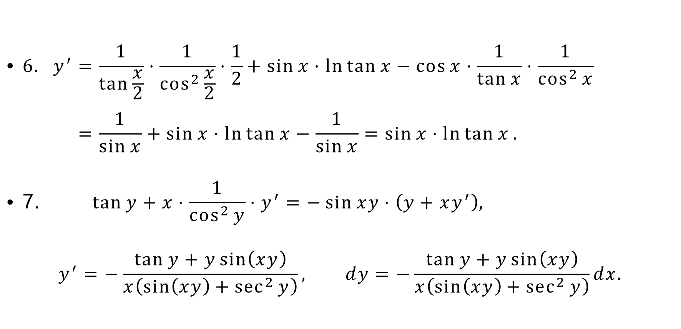
$$\text{•} 6. y^{′}=\frac{1}{\tan{\frac{x}{2}}}⋅\frac{1}{\cos^{2}{\frac{x}{2}}}⋅\frac{1}{2}+\sin{x}⋅\ln{\tan{x}}−\cos{x}⋅\frac{1}{\tan{x}}⋅\frac{1}{\cos^{2}{x}} \\ =\frac{1}{\sin{x}}+\sin{x}⋅\ln{\tan{x}}−\frac{1}{\sin{x}}=\sin{x}⋅\ln{\tan{x}}.$$
$$\text{• 7.} \tan{y}+x⋅\frac{1}{\cos^{2}{y}}⋅y^{′}=−\sin{xy}⋅\left(y+xy^{′}\right),$$
$$y^{′}=−\frac{\tan{y}+y\sin\left(xy\right)}{x\left(\sin\left(xy\right)+\sec^{2}{y}\right)}, dy=−\frac{\tan{y}+y\sin\left(xy\right)}{x\left(\sin\left(xy\right)+\sec^{2}{y}\right)}dx.$$

Slide 51
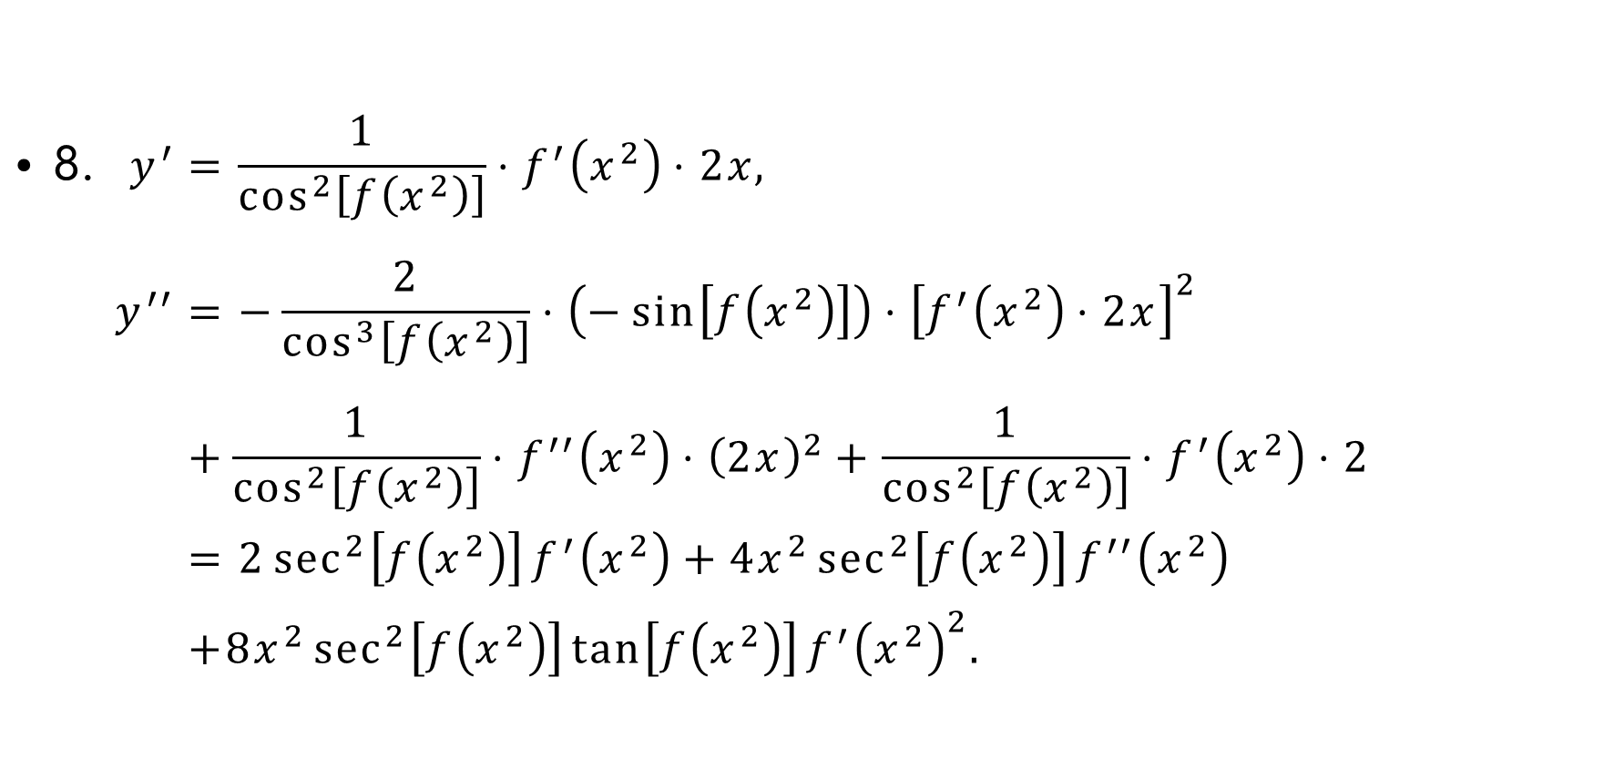
$$\text{• 8.} y^{′}=\frac{1}{\cos^{2}\left[f\left(x^{2}\right)\right]}⋅f^{′}\left(x^{2}\right)⋅2x, \\ y^{′′}=−\frac{2}{\cos^{3}\left[f\left(x^{2}\right)\right]}⋅\left(−\sin\left[f\left(x^{2}\right)\right]\right)⋅{\left[f^{′}\left(x^{2}\right)⋅2x\right]}^{2} \\ +\frac{1}{\cos^{2}\left[f\left(x^{2}\right)\right]}⋅f^{′′}\left(x^{2}\right)⋅{\left(2x\right)}^{2}+\frac{1}{\cos^{2}\left[f\left(x^{2}\right)\right]}⋅f^{′}\left(x^{2}\right)⋅2 \\ =2\sec^{2}\left[f\left(x^{2}\right)\right]f^{′}\left(x^{2}\right)+4x^{2}\sec^{2}\left[f\left(x^{2}\right)\right]f^{′′}\left(x^{2}\right) \\ +8x^{2}\sec^{2}\left[f\left(x^{2}\right)\right]\tan\left[f\left(x^{2}\right)\right]f^{′}{\left(x^{2}\right)}^{2}.$$

Slide 52

$$\text{• 9.} \ln{x}+f\left(y\right)=y, \frac{1}{x}+f^{′}\left(y\right)y^{′}=y^{′},$$
$$y^{′}=\frac{1}{x\left[1−f^{′}\left(y\right)\right]}, −\frac{1}{x^{2}}+f^{′′}\left(y\right){\left(y^{′}\right)}^{2}+f^{′}\left(y\right)y^{′′}=y^{′′},$$
$$y^{′′}=\frac{1}{1−f^{′}\left(y\right)}\left[f^{′′}\left(y\right){\left(y^{′}\right)}^{2}−\frac{1}{x^{2}}\right]=\frac{f^{′′}\left(y\right)−{\left[1−f^{′}\left(y\right)\right]}^{2}}{x^{2}{\left[1−f^{′}\left(y\right)\right]}^{3}}.$$

Slide 53

$$\text{• 10.} y{\left.​\right|}_{t=0}=1, \frac{dx}{dt}=6t+2, \frac{dx}{dt}{\left.​\right|}_{t=0}=2, e^{y}\frac{dy}{dt}\sin{t}+e^{y}\cos{t}−\frac{dy}{dt}=0,$$
$$\frac{dy}{dt}=\frac{\cos{t}}{e^{−y}−\sin{t}}, \frac{dy}{dt}{\left.​\right|}_{t=0}=e, y^{′}=\frac{dy}{dx}=\frac{\cos{t}}{\left(6t+2\right)\left(e^{−y}−\sin{t}\right)},$$
$$\frac{dy^{′}}{dt}=\frac{−\sin{t}}{\left(6t+2\right)\left(e^{−y}−\sin{t}\right)} \\ −\frac{\cos{t}}{{\left[\left(6t+2\right)\left(e^{−y}−\sin{t}\right)\right]}^{2}}\left[6\left(e^{−y}−\sin{t}\right)+\left(6t+2\right)\left(−e^{−y}\frac{dy}{dt}−\cos{t}\right)\right],$$
$$\frac{dy′}{dt}{\left.​\right|}_{t=0}=−\frac{1}{4e^{−2}}\left(6e^{−1}−4\right)=\frac{2e^{2}−3e}{2}, \frac{dy′}{dx}{\left.​\right|}_{t=0}=\frac{2e^{2}−3e}{4}.$$

Slide 54

$$\text{• 11.} y=x{\left(x+1\right)}^{−\frac{1}{2}}, \\ y^{′}={\left(x+1\right)}^{−\frac{1}{2}}−\frac{1}{2}x{\left(x+1\right)}^{−\frac{3}{2}}=\left(\frac{x}{2}+1\right){\left(x+1\right)}^{−\frac{3}{2}}, \\ y^{′′}=\frac{1}{2}{\left(x+1\right)}^{−\frac{3}{2}}−\frac{3}{2}\left(\frac{x}{2}+1\right){\left(x+1\right)}^{−\frac{5}{2}}=\left(−\frac{x}{4}−1\right){\left(x+1\right)}^{−\frac{5}{2}}, \\ y^{′′′}=−\frac{1}{4}{\left(x+1\right)}^{−\frac{5}{2}}−\frac{5}{2}\left(−\frac{x}{4}−1\right){\left(x+1\right)}^{−\frac{7}{2}}=\left(\frac{3x}{8}+\frac{9}{4}\right){\left(x+1\right)}^{−\frac{7}{2}}, \\ y^{\left(4\right)}=\frac{3}{8}{\left(x+1\right)}^{−\frac{7}{2}}−\frac{7}{2}\left(\frac{3x}{8}+\frac{9}{4}\right){\left(x+1\right)}^{−\frac{9}{2}} \\ =\left(−\frac{15}{16}x−\frac{15}{2}\right){\left(x+1\right)}^{−\frac{9}{2}}=−\frac{15\left(x+8\right)}{16{\left(x+1\right)}^{4}\sqrt{x+1}}.$$

Slide 55

另解 $y={\left(x+1\right)}^{\frac{1}{2}}−{\left(x+1\right)}^{−\frac{1}{2}},$
$y^{\left(4\right)}=\frac{1}{2}⋅\left(−\frac{1}{2}\right)⋅\left(−\frac{3}{2}\right)⋅\left(−\frac{5}{2}\right){\left(x+1\right)}^{−\frac{7}{2}}−\left(−\frac{1}{2}\right)⋅\left(−\frac{3}{2}\right)⋅\left(−\frac{5}{2}\right)⋅\left(−\frac{7}{2}\right){\left(x+1\right)}^{−\frac{9}{2}}=−\frac{15}{16}{\left(x+1\right)}^{−\frac{7}{2}}−\frac{105}{16}{\left(x+1\right)}^{−\frac{9}{2}}=−\frac{15\left(x+8\right)}{16{\left(x+1\right)}^{\frac{9}{2}}}.$
一般地, $y^{\left(n\right)}=\frac{{\left(−1\right)}^{n−1}\left(2n−2\right)!\left(x+2n\right)}{2^{2n−1}\left(n−1\right)!{\left(x+1\right)}^{n+\frac{1}{2}}}.$

Slide 56

12. $y+xy^{′}=0,y^{′}=−\frac{y}{x}$, 因此在 $\left(x_{0},y_{0}\right)$ 处的切线方程为
$$y=−\frac{y_{0}}{x_{0}}\left(x−x_{0}\right)+y_{0}.$$
它与横纵坐标轴的交点分别为 $\left(2x_{0},0\right),\left(0,2y_{0}\right)$, 因此面积为
$$\frac{1}{2}\left(2x_{0}\right)\left(2y_{0}\right)=2x_{0}y_{0}=2a^{2}.$$
13. $y^{′}=2ax={\left(\ln{x}\right)}^{′}=\frac{1}{x}$, 因此 $x=\frac{1}{\sqrt{2a}}$.
此时 $y=\frac{1}{2}=\ln{x}=−\frac{1}{2}\ln\left(2a\right)$, 因此 $a=\frac{1}{2e}$.

