Slide 1
Version Control System
NAME | ID
Md Ruhul Amin | 1512487042
Md Yeasir Arafat | 1631007042

Slide 2
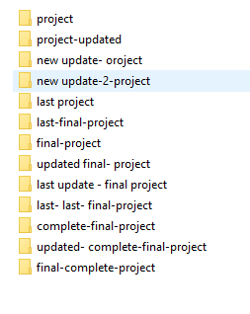
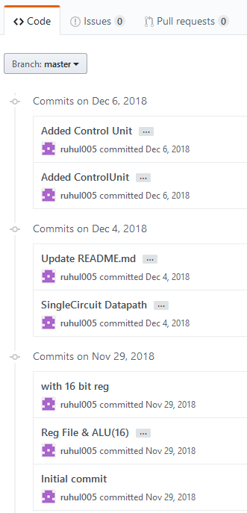
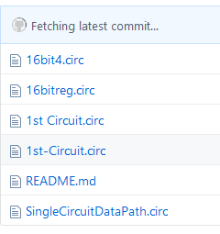
Why Version Control System
Without VCS
With VCS

Slide 3
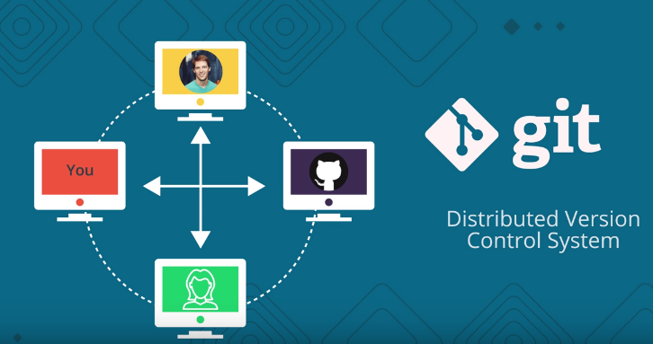
Version Control System
Manage changes to source code overtime
Keep tracks of every modification
Easily traceable
Control contribution

Slide 4
Benefits of version control systems
Developing software without using version control is risky
Helping prevent concurrent work from conflicting
Good version control software supports a developer's preferred workflow without imposing one particular way of working
Works in every platform
Branching and merging
Traceability

Slide 5
Systems that provide version control
GitHub
GitLab
Bit bucket
Beanstalk
Perforce
AWS Code Commit
CVS
SVN
Mercurial
Bazaar

Slide 6
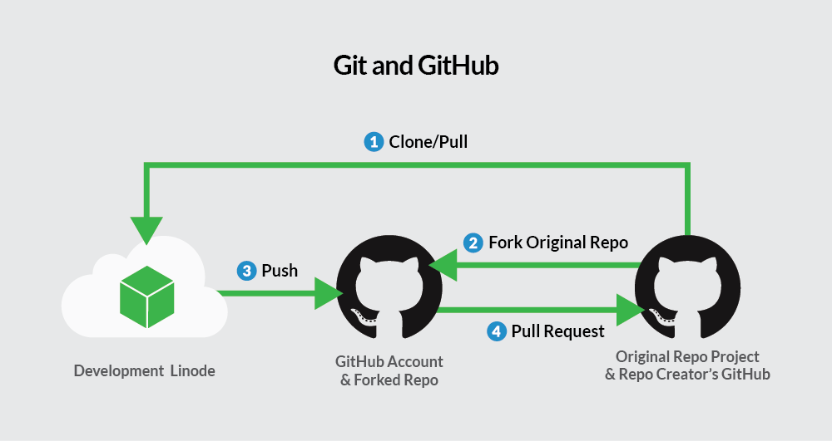
Git and GitHub
git- Version Control Tool
GitHub- Service that host git projects

Slide 7
git commands
git init – Create new repository
git clone – clone existing repository
git status – displays a lot of information about repo
touch – add new file
git add – add new repository
git commit – create record of changes
git branch – interreact with git branches
git merge – combine git branches

Slide 8
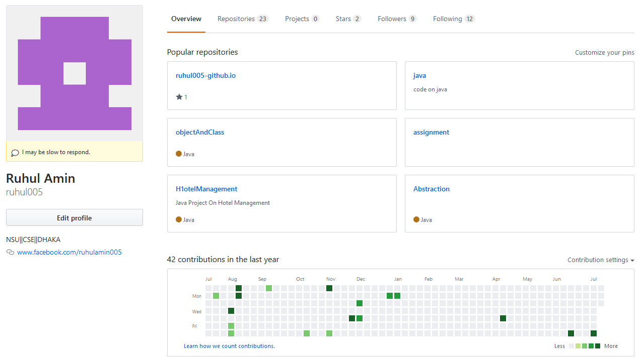
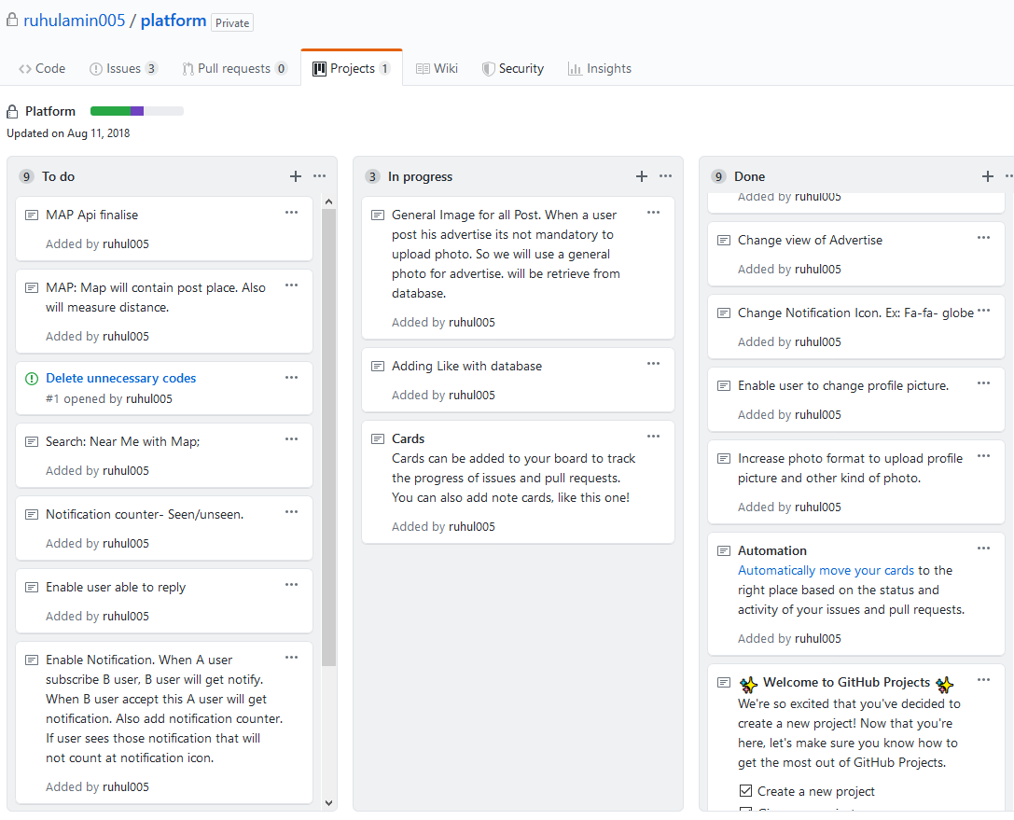
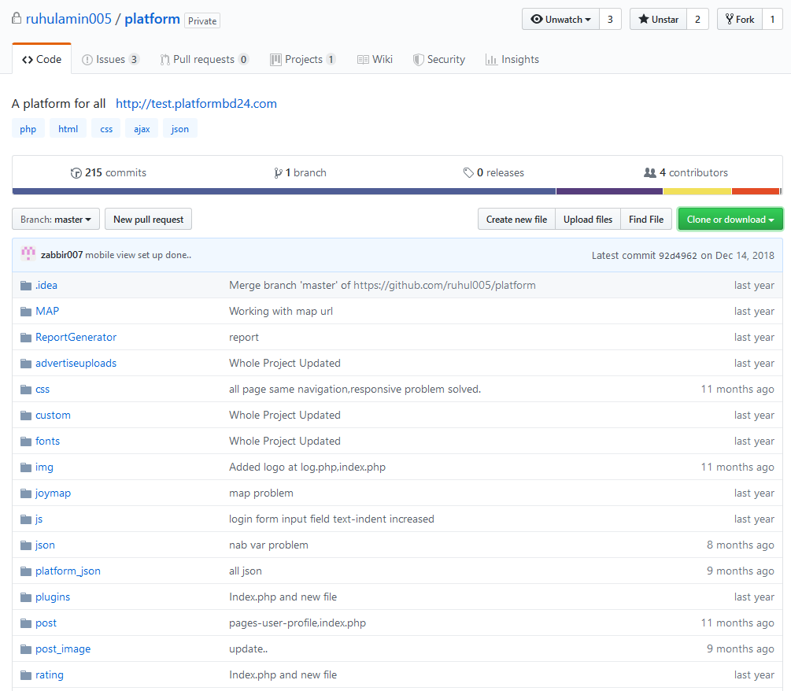
GitHub
A graphical interface and cloud of git
Easier to use
A great network for developers
Project Trace, to do, in progress
Learning platform
Can be used as CV

Slide 9
Git & Software Engineering
Helps to write manageable codes
Project manager use it to manage large projects
Can revert to any version using it
Helps to reuse codes
Can read others codes
Can get idea how other solved their problem
Offers a great network among developers

Slide 10
Thank You

