Slide 1
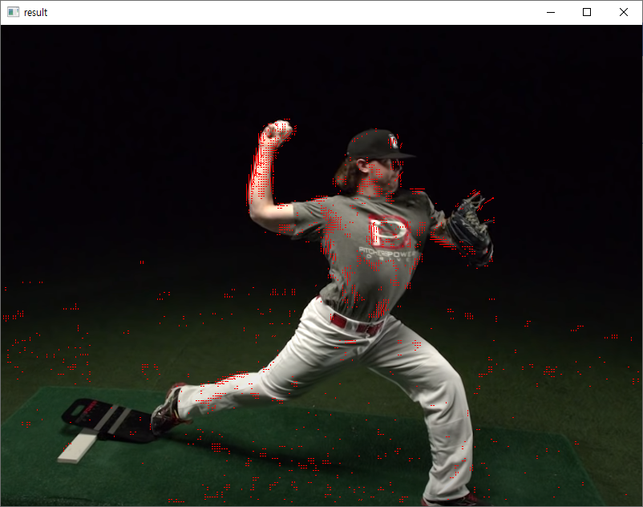
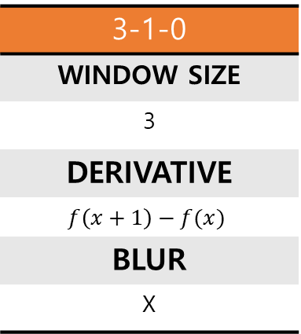
LUCAS
KANADE
PARAM
TEST
3-1-0
WINDOW SIZE
3
DERIVATIVE
$$f\left(x+1\right)−f(x)$$
BLUR
X

Slide 2
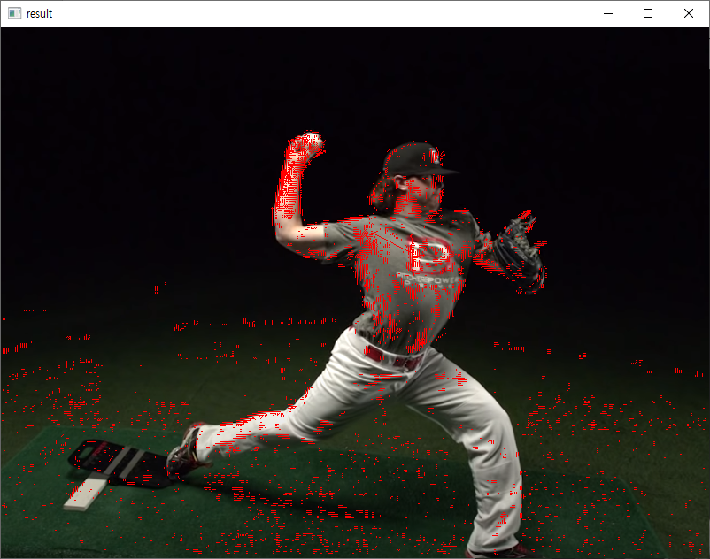

LUCAS
KANADE
PARAM
TEST
5-1-0
WINDOW SIZE
5
DERIVATIVE
$$f\left(x+1\right)−f(x)$$
BLUR
X

Slide 3

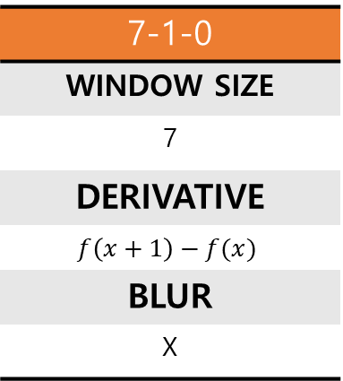
LUCAS
KANADE
PARAM
TEST
7-1-0
WINDOW SIZE
7
DERIVATIVE
$$f\left(x+1\right)−f(x)$$
BLUR
X

Slide 4
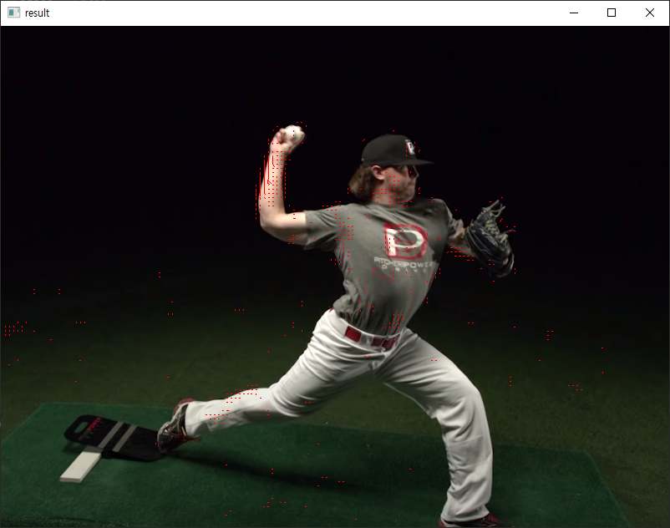

LUCAS
KANADE
PARAM
TEST
11-1-0
WINDOW SIZE
11
DERIVATIVE
$$f\left(x+1\right)−f(x)$$
BLUR
X

Slide 5
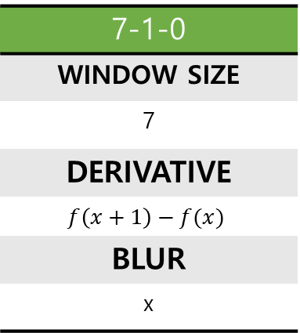
LUCAS
KANADE
PARAM
TEST
7-1-0
WINDOW SIZE
7
DERIVATIVE
$$f\left(x+1\right)−f(x)$$
BLUR
x

Slide 6
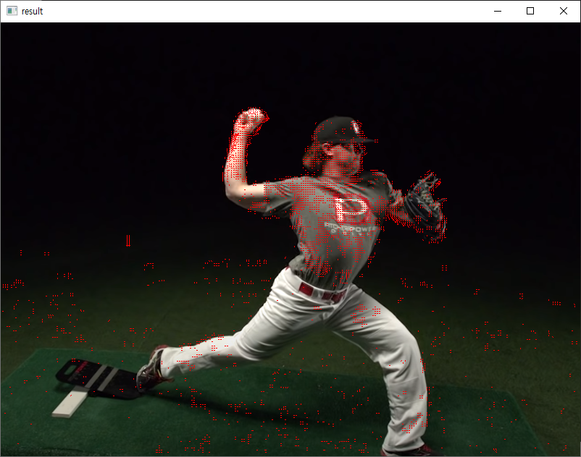
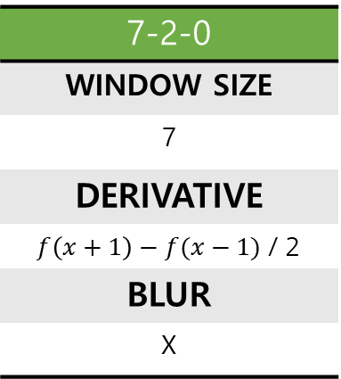
LUCAS
KANADE
PARAM
TEST
7-2-0
WINDOW SIZE
7
DERIVATIVE
$f\left(x+1\right)−f(x−1)$ / 2
BLUR
X

Slide 7

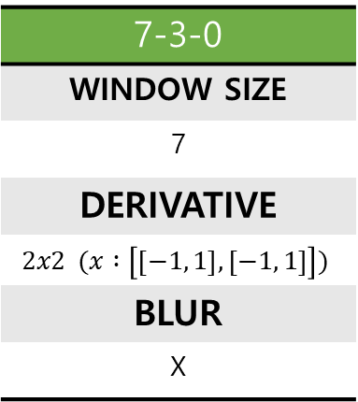
LUCAS
KANADE
PARAM
TEST
7-3-0
WINDOW SIZE
7
DERIVATIVE
$$2x2 (x :\left[\left[−1, 1\right],\left[−1, 1\right]\right])$$
BLUR
X

Slide 8

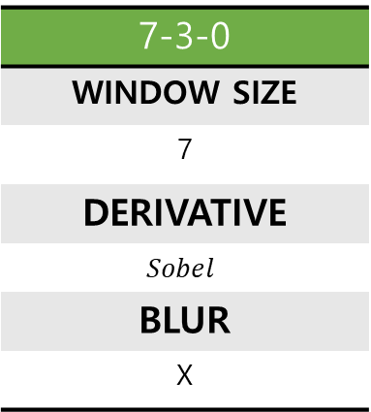
LUCAS
KANADE
PARAM
TEST
7-3-0
WINDOW SIZE
7
DERIVATIVE
$$Sobel$$
BLUR
X

Slide 9
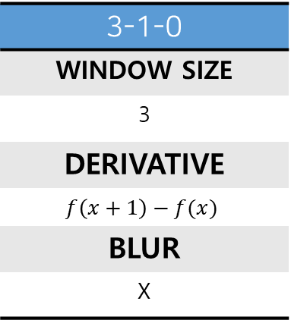
LUCAS
KANADE
PARAM
TEST
3-1-0
WINDOW SIZE
3
DERIVATIVE
$$f\left(x+1\right)−f(x)$$
BLUR
X

Slide 10
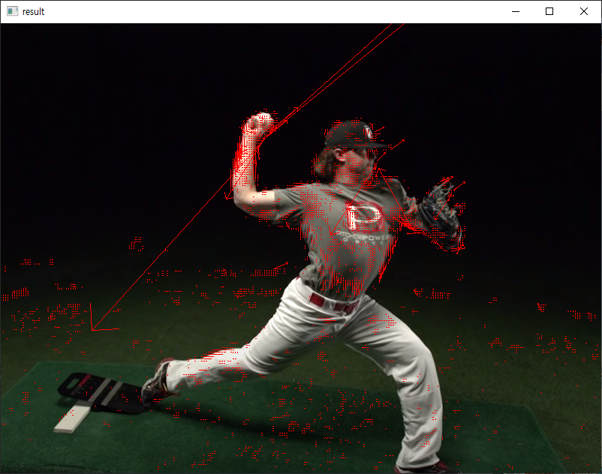
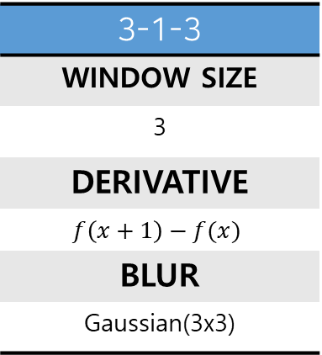
LUCAS
KANADE
PARAM
TEST
3-1-3
WINDOW SIZE
3
DERIVATIVE
$$f\left(x+1\right)−f(x)$$
BLUR
Gaussian(3x3)

Slide 11

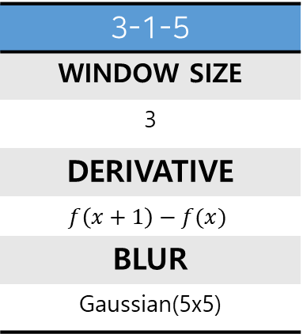
LUCAS
KANADE
PARAM
TEST
3-1-5
WINDOW SIZE
3
DERIVATIVE
$$f\left(x+1\right)−f(x)$$
BLUR
Gaussian(5x5)

Slide 12
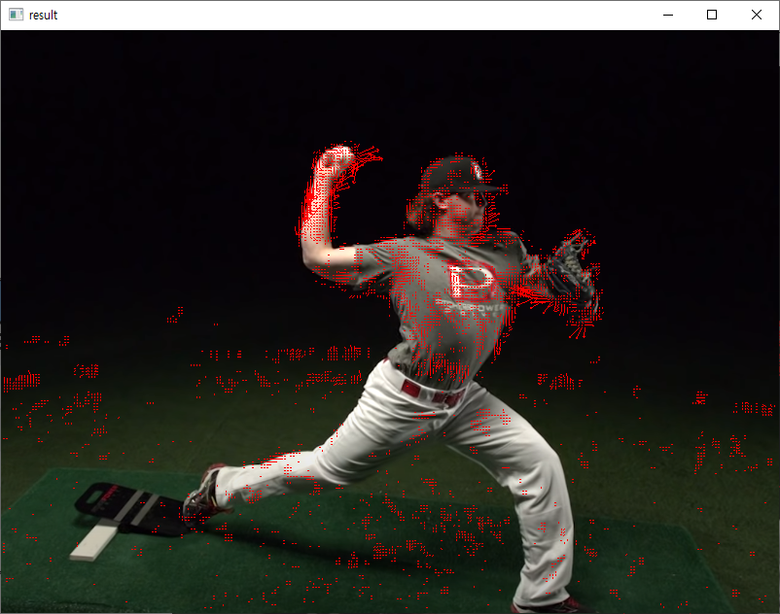

LUCAS
KANADE
PARAM
TEST
3-1-7
WINDOW SIZE
3
DERIVATIVE
$$f\left(x+1\right)−f(x)$$
BLUR
Gaussian(7x7)

Slide 13

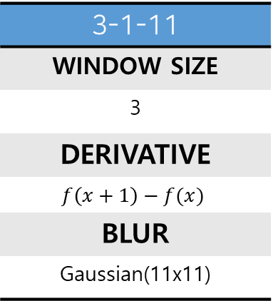
LUCAS
KANADE
PARAM
TEST
3-1-11
WINDOW SIZE
3
DERIVATIVE
$$f\left(x+1\right)−f(x)$$
BLUR
Gaussian(11x11)

